Slide 1
WRAP 2014 Regional Modeling
WRF MPE Summary
Jeremiah Johnson
jjohnson@ramboll.com
Jan 31, 2019

Slide 2
EPA vs WAQS WRF Configuration
WRF Option | 2014/2015 EPA | 2014 WAQS
Domains run | 12-km | 36/12/4-km
Microphysics | Morrison 2 | Thompson
LW Radiation | RRTMG | RRTMG
SW Radiation | RRTMG | RRTMG
Sfc Layer Physics | MM5 similarity | MM5 similarity
LSM | Pleim-Xiu | Noah
PBL scheme | ACM2 | YSU
Cumulus | Kain-Fritsch | 36/12-km Multi-scale Kain Fritsch
BC, IC Analysis Nudging Source | 12-km NAM | 12-km NAM
Analysis Nudging Grids | 12-km | 36/12-km
Obs Nudging | None | 4-km
Sea Sfc Temp | FNMOC | FNMOC

Slide 3
EPA vs WAQS WRF Domains
EPA 12US1
WAQS 36/12/4 km

Slide 4
EPA vs WAQS WRF MPE Approach
Evaluate EPA 12US1 and WAQS 12WUS2
For 12US1, include observation sites within WAQS 12 km only
Quantitative Evaluation
METSTAT – model/obs pairing, bias/error statistics against NCAR ds3505 observations
Soccer plots – monthly stats
Time series – hourly and daily
Plots for whole domain (12WUS2), all sites in a given state, and each individual site within each state
Qualitative Evaluation
PRISM precipitation spatial maps
Monthly and daily

Slide 5
WRF Statistical Benchmarks
Meteorological Variable | Simple Conditions |  | Complex Conditions
 | Bias | Error | Bias | Error
Temperature | < ±0.5 °C | < 2.0 °C | < ±2.0 °C | < 2.5 °C
Wind Speed | < ±0.5 m/s | < 2.0 m/s (RMSE) | < ±1.5 m/s | < 2.5 m/s (RMSE)
Wind Direction | < ±10 degrees | < 30 degrees | < ±10 degrees | < 50 degrees
Humidity | < ±0.8 g/kg | < 2.0 g/kg | < ±1.0 g/kg | < 2.0 g/kg

Slide 6
Soccer Plots – Wind Speed
EPA 12 km
WAQS 12 km
Most months within simple conditions goal for both runs
EPA run has slight overprediction bias for most months; WAQS slight underprediction

Slide 7
Soccer Plots – Wind Direction
EPA 12 km
WAQS 12 km
WAQS outperforms EPA with overall lower bias; error is similar

Slide 8
Soccer Plots – Temperature
EPA 12 km
WAQS 12 km
EPA run outperforms WAQS
WAQS temperature poorest for Jan-Apr with cold bias

Slide 9
Soccer Plots – Humidity
EPA 12 km
WAQS 12 km
WAQS run outperforms EPA; both runs have positive (wet) bias for all months
EPA performance poorest for May-Oct: overactive convection?

Slide 10
Soccer Plots – Humidity for all AZ sites
EPA 12 km
WAQS 12 km
WAQS run outperforms EPA; both runs have wet bias in Jul-Aug monsoon period

Slide 11
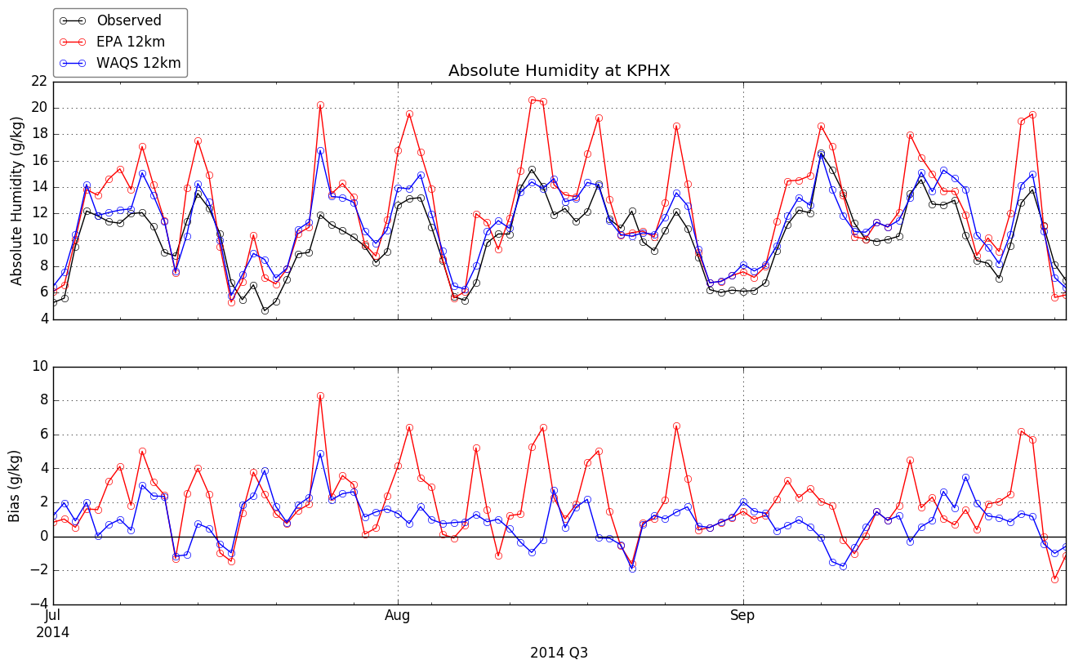
Time Series – 2014 Q3 Humidity at KPHX
Aug 2

Slide 12
Daily Precipitation Plots – Aug 3, 2014 (end 5 AM MST)
PRISM Obs
EPA 12 km
WAQS 12 km

Slide 13
Monthly Precipitation Plots – Aug 2014
PRISM Obs
EPA 12 km
WAQS 12 km

Slide 14
Monthly Precipitation Plots – Jan 2014
PRISM Obs
EPA 12 km
WAQS 12 km

Slide 15
Daily Precipitation Plots – Jan 31, 2014
PRISM Obs
EPA 12 km
WAQS 12 km
Excellent agreement in spatial extent for both runs
Slight overestimation in magnitude for both runs, WAQS a bit better

Slide 16
Summary and Conclusions
WRF performance reasonable for both simulations
No obvious/egregious errors that would prevent use of either WRF simulation for AQ modeling
Not possible to know which WRF simulation will perform better in CAMx/CMAQ
Relative performance varies across parameters/seasons/locations
Best (or worst) performing WRF days may have small (or large) influence on AQ concentrations
Other meteorological variables (vertical diffusion, PBL heights, etc.) may be more important than the ones we can easily evaluate (T, Q, winds, precip)
However, general performance tendencies
EPA – wet bias in summer months associated with overactive summer convection; WAQS smaller wet bias
WAQS – cold bias in Jan-Apr
EPA and WAQS – good precipitation performance outside of summer months
All products (soccer plots, time series, precip maps) available for transfer to IWDW

