Slide 1
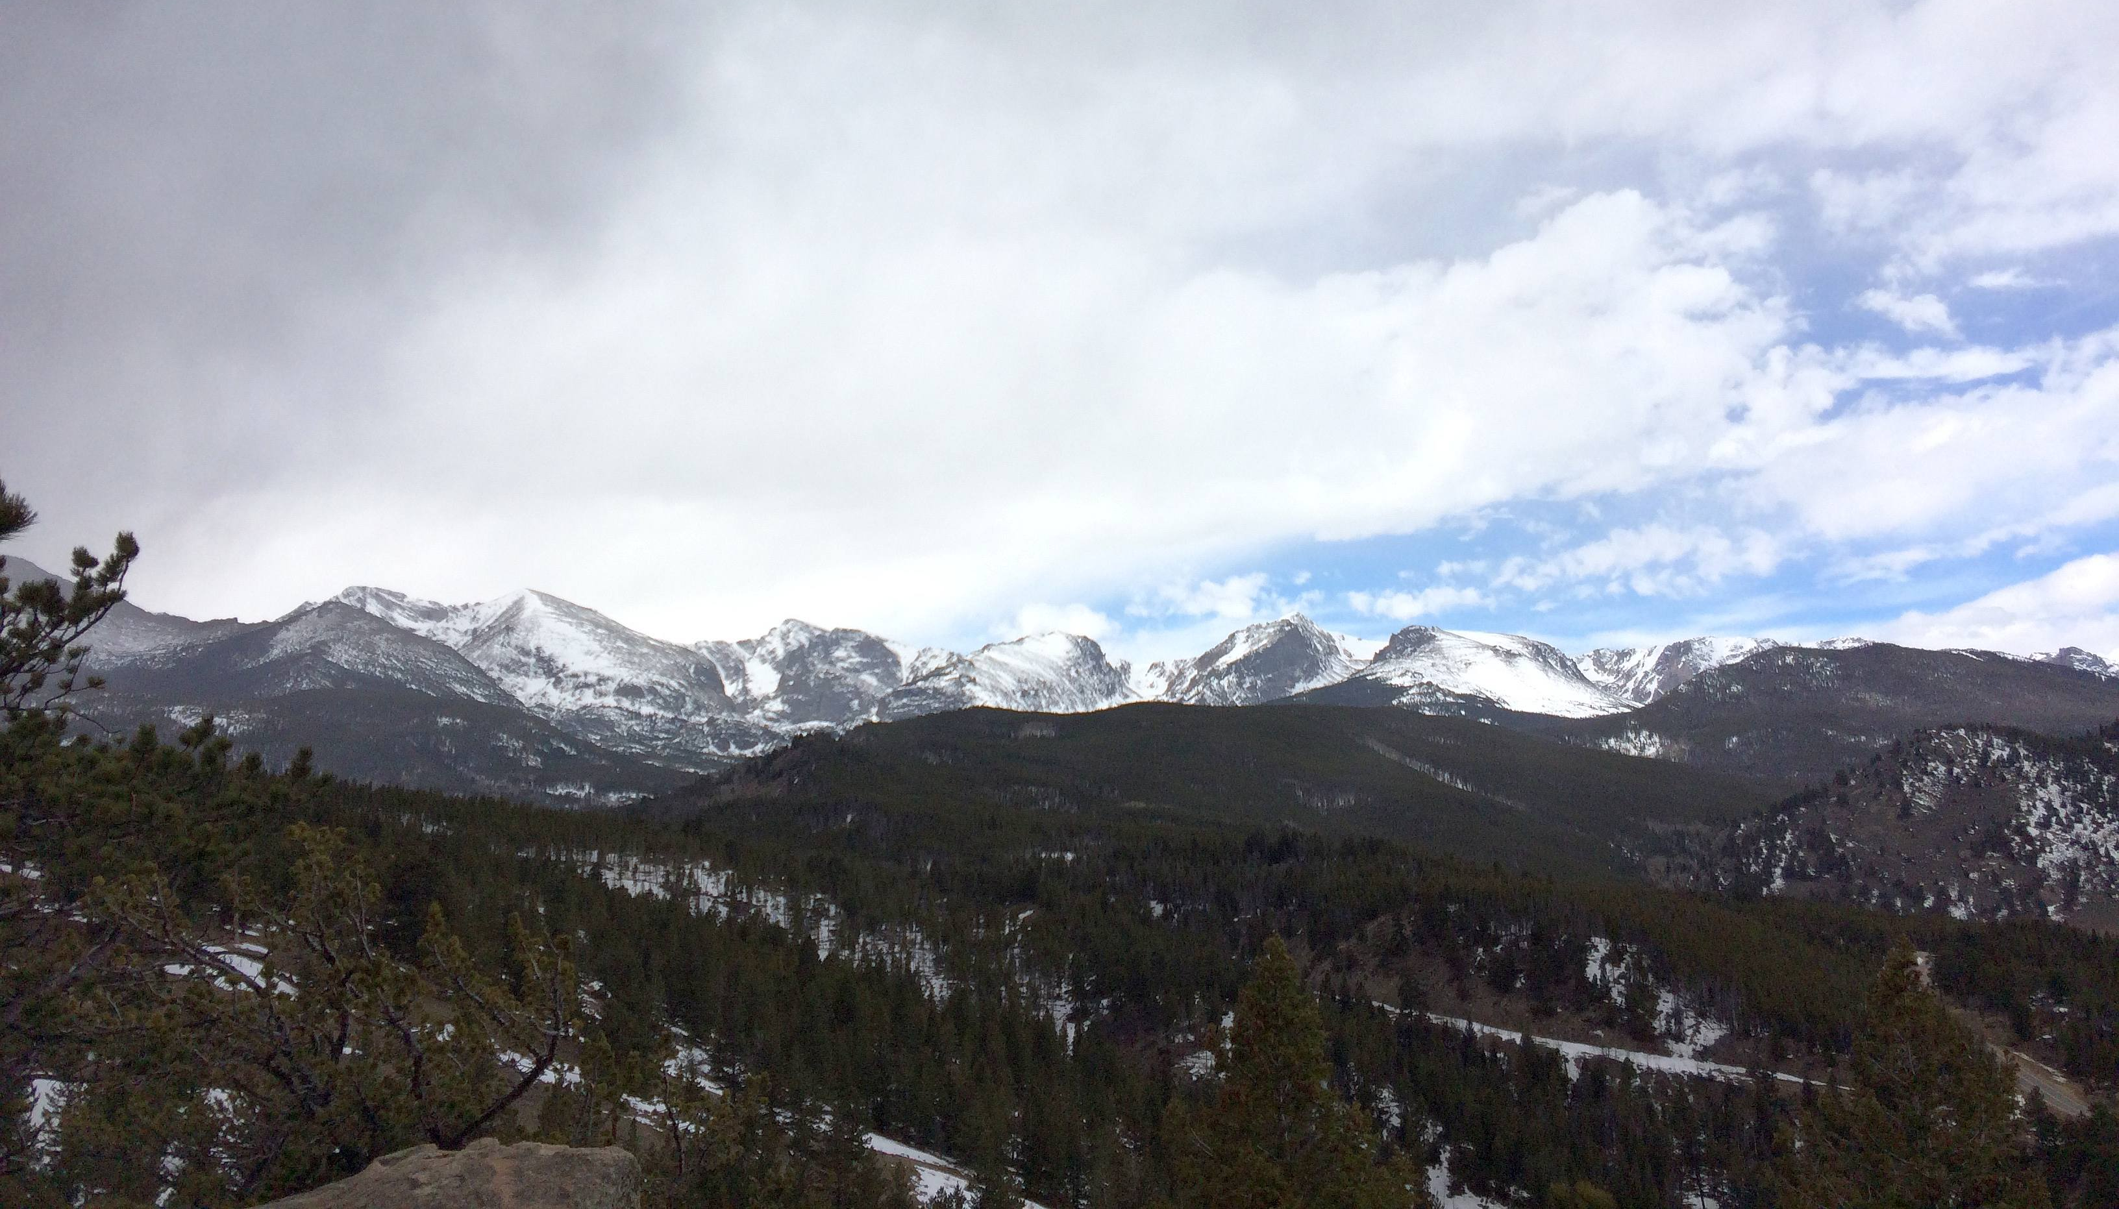
Western Regional Modeling and Analysis Platform
Update on 2014v2 Modeling
Ralph Morris, Pradeepa Vennam, Tejas Shah Marco Rodriguez and Chao-Jung Chien
  Modeling Team
John Grant, Tejas Shah, Yesica Alvarez and Amnon Bar-Ilan
  Emissions Team
RHPWG – Emissions Inventory & Modeling Protocol Subcommittee
December 5, 2019

Slide 2
Todays Content (Dec 5, 2019)
On-Going WRAP 2014 Phase III Modeling
  Task 1.6: 2014v2 36/12-km CAMx Annual Modeling and Model Performance Evaluation (Dec 2019)
  Task 2.2: RepBase SMOKE Emissions Modeling (Dec 2019)
  Task 2.3: RepBase CAMx 36/12-km Modeling (Dec 2019)
  Task 1.7: 2014 GEOS-Chem/RepBase CAMx NAT and (ZROW) Modeling (Dec-Jan 2020)
  Task 1.8: CAMx RepBase ANT/NAT Source Apportionment Modeling (Dec-Jan 2019)
2028 Mobile Source Emissions Development for 12WUS2 Domain
  On-road Mobile Sources
  Non-Road Mobile Sources (Off-Road Equipment, Rail, Marine, Aircraft)
New WRAP 2014 Phase IV Modeling
  Task 3: Dynamic Evaluation (2002 Modeling)
  Task 4: 2028 SMOKE Emissions and CAMx Photochemical Modeling
  Task 6: IWDW Verification, Data Transfer and Tool Development
  Task 6.2: WEP/AOI Analysis

Slide 3
2014v1 vs. 2014v2 Final model configuration
(Major Changes in Red)
Option | CAMx |  | CMAQ (Postponed)
 | 2014v1 | 2014v2 | 2014v1 | 2014v2
Model | CAMx v6.5 | CAMx v7.0 | CMAQ v5.2.1 | CMAQ V5.3
Nesting | One-Way | Two-Way | One-Way | One-Way
# Levels | 25 | 25 | 25 | 35
BCs | EPA GC | WRAP GC | EPA GC | WRAP GC
Anthro. | 2014v1 | 2014v2 | 2014v1 | 2014v2
Biogenic | BEIS | BEIS | BEIS | BEIS
Fires | Bluesky | WRAP | Bluesky | Bluesky
NH3 BiDi | No | Yes | No | No
Elements | No | Yes | Yes | Yes
SOAALK | No | Yes | Yes | Yes

Slide 4
Sources of RepBase and 2028OTBa Emissions
Source Sector | Representative Baseline | 2028 OTBa
California 12WUS2 | CARB-2014v2 | CARB-2028
WRAP Fossil EGU w/ CEM | WRAP-RB-EGU | WRAP-2028-EGU
WRAP Fossil EGU w/o CEM | WRAP-RB-EGU | WRAP-2028-EGU
WRAP Non-Fossil EGU | EPA-2016v1 | EPA-2028v1
Non-WRAP EGU | EPA-2016v1 | EPA-2028v1
O&G WRAP O&G States | WRAP-RB-O&G | WRAP-2028-O&G
O&G WRAP Other States | EPA-2016v1 | EPA-2028v1
O&G non-WRAP States | EPA-2016v1 | EPA-2028v1
WRAP Non-EGU Point² | WRAP-2014v2 | EPA-2028v1
Non-WRAP non-EGU Point | EPA-2016v1 | EPA-2028v1
On-Road Mobile 12WUS2 | WRAP-2014v2 | WRAP-2028-Mobile
On-Road Mobile 36US | EPA-2016v1 | EPA-2028v1
Non-Road 12WUS2 | EPA-2016v1 | WRAP-2028-Mobile
Non-Road non-WRAP 36US | EPA-2016v1 | EPA-2028v1
Other (Non-Point) 12WUS2 | EPA-2016v1 | EPA-2028v1
Can/Mex/Offs 12WUS2 | EPA-2016v1 | EPA-2028v1
Fires (WF, Rx, Ag) | WRAP-RB-Fires | WRAP-RB-Fires
Natural (Bio, etc.) | WRAP-2014v2 | WRAP-2014v2
Boundary Conditions (BCs) | WRAP-2014-GEOS⁵ | WRAP-2014-GEOS⁵

Slide 5
WRAP PHASE III – BUILDING BLOCKS FOR REGIONAL HAZE SIPs
2014v2 CAMx actual base case and model performance evaluation (MPE)
  MPE essential component of any PGM application
CAMx Representative Baseline (RepBase) Modeling
  Represents 2014-2018 five-year planning period for projecting to 2028
Representative Baseline Anthro/Natural Source Apportionment Modeling
  Breakdowns RepBase visibility by: U.S. Anthropogenic; International Anthropogenic; Fires; and Natural
  Calculate modeled Most Impaired Days (MID) and International Anthro Contribution
Natural (NAT) and International Anthropogenic Emissions (ZROW) Simulations
  Coupled 2014 GEOS-Chem and CAMx RepBase zero-out modeling
  Modeled estimate of Natural conditions and International Anthro Contribution

Slide 6
2028 Mobile Sources Project Update: On-road
October:
  Held teleconference on October 17 summarizing on-road methodology and asking for agency input on activity forecasts
  Received input from several states: AZ, CO, UT
November:
  Integrated data received from states into SMOKE-MOVES inputs and began SMOKE-MOVES runs for 2028
December:
  Complete SMOKE-MOVES runs, summarize and QA results
January:
  Present final WRAP-region 2028 mobile source emission inventory

Slide 7
Mobile Sources Project Update: OFF-road
October:
  Reviewed EPA 2016v1 modeling platform methods and emissions
November to early-December:
  Presented summary of EPA 2016v1 modeling platform methods, emissions, and requested agency input to improve off-road emissions in the WRAP region
  Agency input due by Dec. 5th. Have already received input from UTDAQ, CDPHE.
December:
  Ramboll will revise WRAP region emission inventory based on agency provided inputs by mid-December
January:
  Present final WRAP-region 2028 mobile source emission inventory

Slide 8
WRAP PHASE IV – Task 3: Dynamic Evaluation
Backcast 2014v2 U.S. anthropogenic emissions to 2002
CAMx 2002 simulation using 2002 U.S. anthropogenic and RepBase other emissions and BCs
Several products from Dynamic Evaluation
  U.S. anthropogenic emissions contribution to visibility impairment for 2002, RepBase (2014-2018) and 2028 (eventually)
  Evaluate Most Impaired Days (MID) projection technique by comparing observed IMPROVE MID visibility between 2000-2005 Baseline and 2014-2018 5-year planning period with modeled changes in MID visibility between 2002 and RepBase
    Can evaluate for total MID visibility impairment and by species (AmmSO4, AmmNO3, etc.)

Slide 9
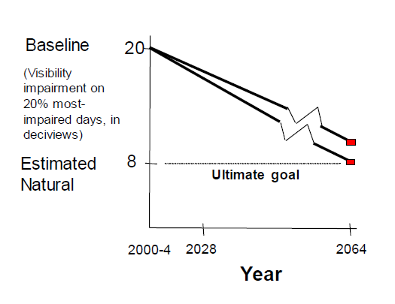
WRAP PHASE IV – Task 4: 2028 Modeling
2028 SMOKE emissions modeling of anthropogenic sources
  Hold natural emissions and Boundary Conditions (2014 GEOS-Chem) constant at 2014v2 levels
Two 2028 On-the-Book/On-the-Way CAMx simulations:
  2028OTBa: Use RepBase fire emissions
  2028OTBb: Use 2014v2 actual fire emissions
2028 Visibility Projections using RRFS:
  CAMx 2014v2 & 2028OTBb w/ 2012-2016 IMPROVE MID
  CAMx RepBase & 2028OTBa w/ 2014-2018 IMPROVE MID
    Use Alternative RRF Approaches
Account for Effects of International Emissions in URP Glideslopes
  GEOS-Chem & RepBase CAMx ZROW Modeling
  RepBase ANT/NAT/FIRE and USA/non-USA PM Source Apportionment Modeling

Slide 10
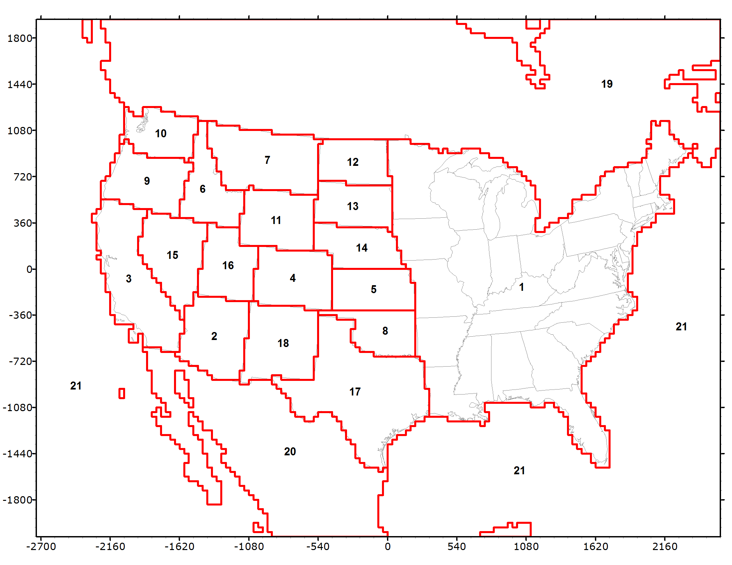
WRAP PHASE IV – Task 4.6 2028 State-Specific Source Apportionment Modeling
CAMx 2028OTBa PM Source Apportionment
  SO4, NO3, NH4, EC, POA, Soil, CM
    No SOA (do have SOAA and SOAB)
Straw Person Starting Point
  Geographic Regions:
    17 western states, EUSA, Can, Mex, Off-shore
  Source Sectors:
    Natural, WF, Rx+Ag, O&G, EGU Point, Non-EGU Point, On-Road, Non-Road, Remainder Anthro
  Boundary Conditions (GCBC):
    Natural, U.S. Anthro, Intl Anthro
Task Products:
  2028 Vis Impairment at CIAs by State and Sector
  Contributions of International Anthro emissions

Slide 11
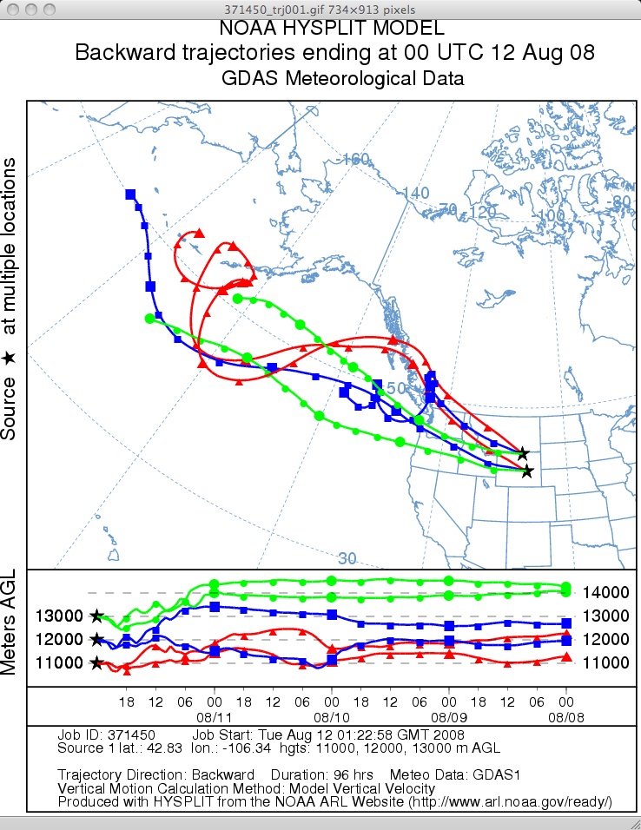
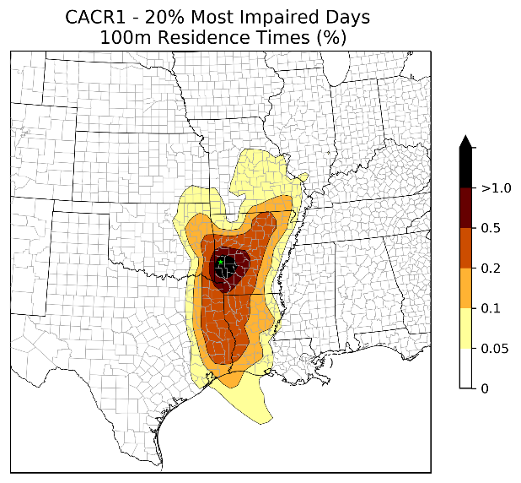
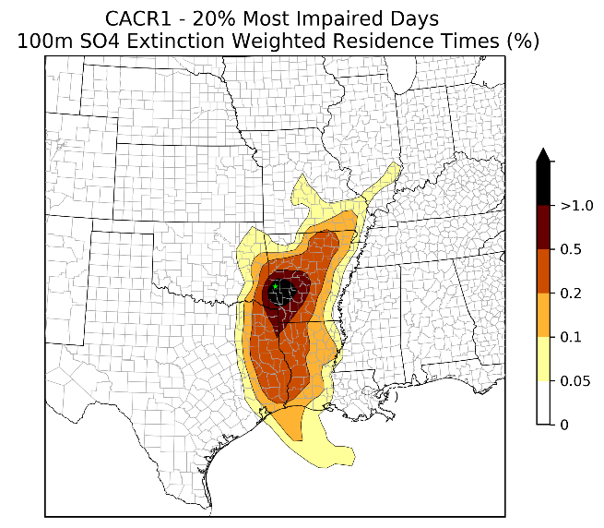
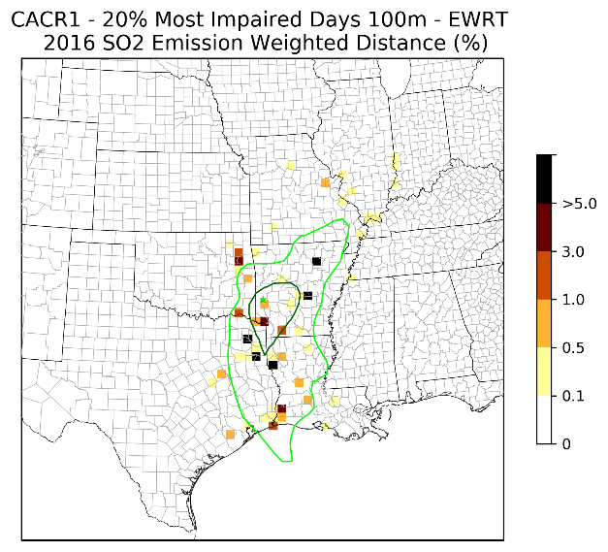
WRAP PHASE IV: Task 6: IWDW Support
2014v2, RepBase and 2028OTB CAMx verification runs on IWDW
Assist IWDW in implementing modeling results on IWDW
  Technical Support System (TSS) and WRAP 2014 modeling webpage
  Interactive tools for MPE, URP Glideslope, Source Apportionment
Weighted Emissions Potential (WEP)/ Area of Influence (AOI)

Slide 12
WRAP 2014 PHASE IV MODELING SCHEDULE

