Slide 1






Three-State Air Quality Study (3SAQS)
Three-State Data Warehouse (3SDW)
Summary of 2008 Modeling Results and Plan Forward
University of North Carolina (UNC-IE)
Cooperative Institute for Research in the Atmosphere (CIRA)
ENVIRON International Corporation (ENVIRON)
October 31, 2013

Slide 2
Outline
WestJumpAQMS ozone and PM modeling and source apportionment results for the 3-state region
WestJumpAQMS CAMx-CMAQ comparison
VOC reactivity analysis results
Plan and timeline for 2008 3SAQS emissions modeling and air quality modeling base case
3SAQS study domain
3SAQS working groups
2008 emissions projections
Status of 2011 NEI release

Slide 3
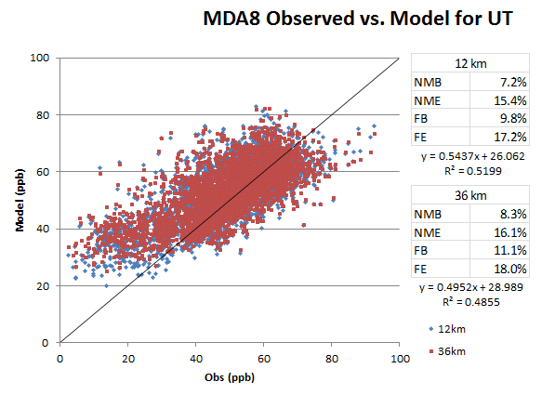
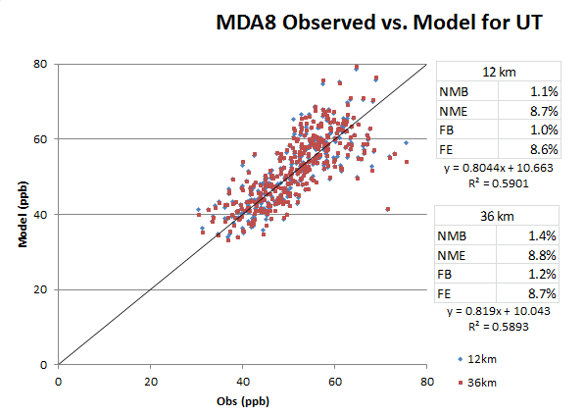
WestJumpAQMS Results for 3S Region
UT
Bias
7-11% AQS
1% CNet
Error
15-18% AQS
9% Cnet
CO
Bias
9-13% AQS
8-9% CNet
Error
16-18% AQS
14% CNet

Slide 4
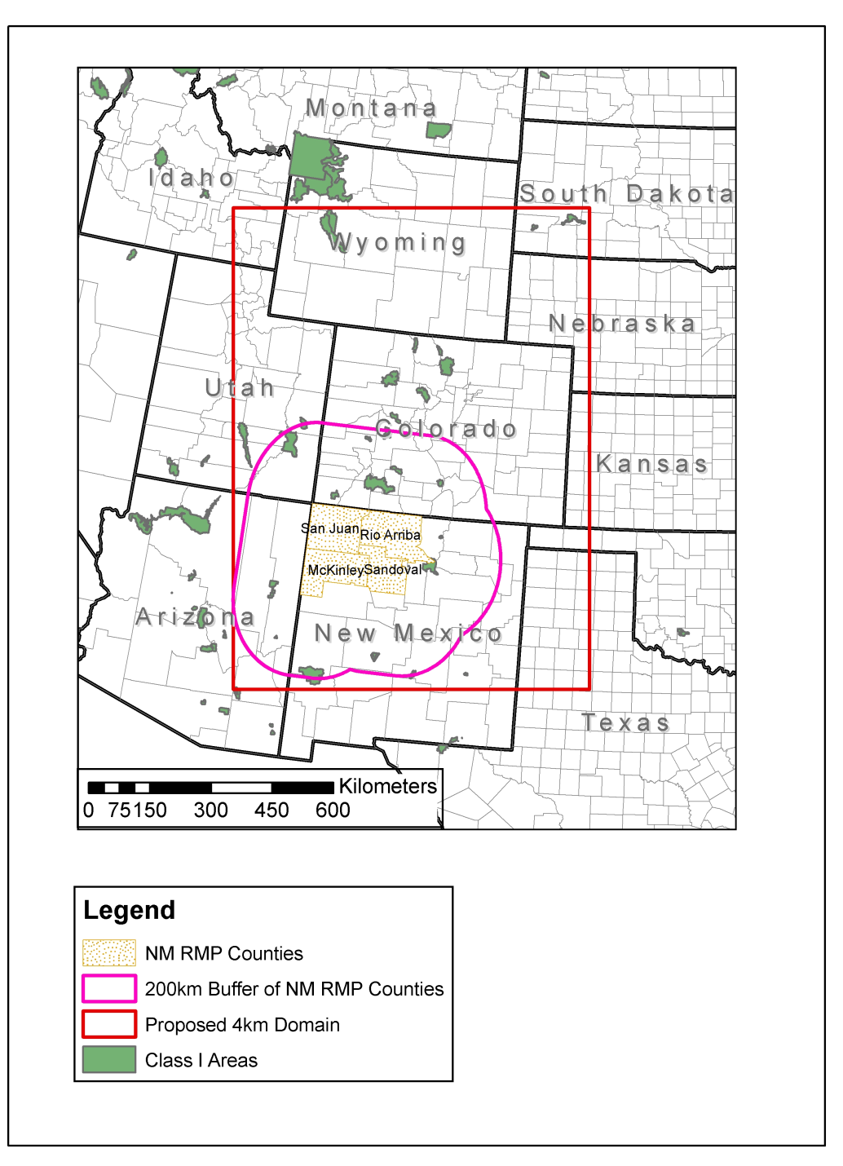
CARMMS Domain Evaluation
WestJumpAQMS did separate model performance evaluation for BLM Colorado Air Resource Management Modeling Study (CARMMS) 4 km domain

Slide 5
CAMx Daily Max 8-Hr Ozone MPE in 4 km CARMMS Domain
CASTNet
AQS

Slide 6
Total PM_{2.5} Mass MPE
FRM
CSN
IMPROVE

Slide 7
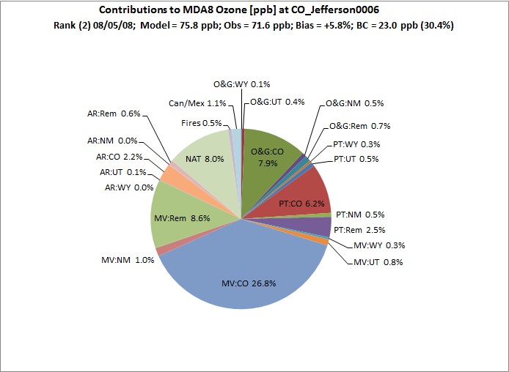
Ozone Contributions on Aug 5, 2008 at RFNO, CO monitoring site

Slide 8
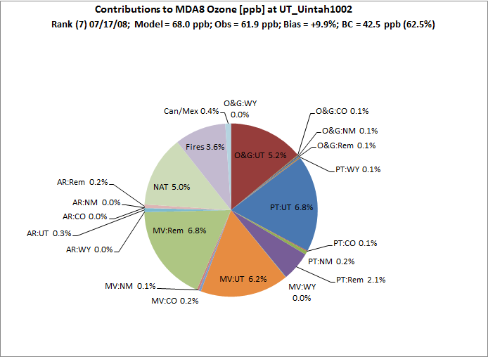
Ozone Contributions on Jul 17, 2008 at Uintah_1002, UT monitoring site

Slide 9
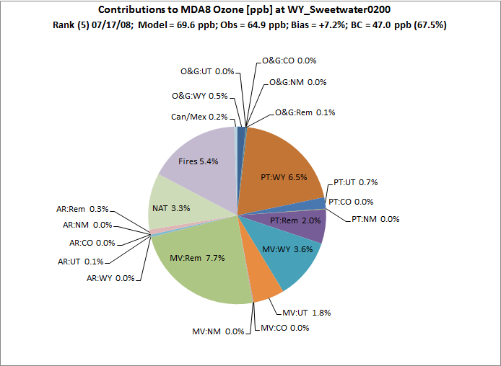
Ozone Contributions on Jul 17, 2008 at Sweetwater_0200, WY monitoring site

Slide 10
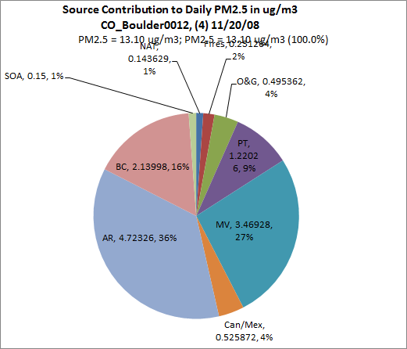
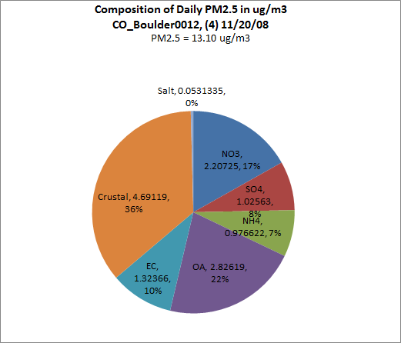
Source and Species PM2.5 Contributions at Boulder_0012 11/20/08

Slide 11
Summary 2008 4 km CARMMS Domain MPE
Ozone good performance with low bias that meets Performance Goals by wide margin
PM2.5 mass usually meets PM Performance Criteria and sometimes meets performance goal
SO4 underestimation bias that may be due in part to insufficient chemical conversion of So2
NO3 underestimation in summer may be due to insufficient ammonia availability
EC performance good
OA underestimated and OPM2.5 overestimated
  Measurement /Modeled incommensurability
  Likely related

Slide 12
WestJumpAQMS Results for the 3-state region
Data
  Carrying forward the WJAQMS 2008 modeling platform to the 3SAQS
  WJAQMS 2008 results used to test 3SAQS modeling and 3-State Data Warehouse prototype
Modeling results
  Targeting improvements to the modeling/data based on evaluation and experience from WJAQMS
Lessons learned
  Incremental improvements to the data, modeling, and evaluation based on experience from 3SAQS

Slide 13
WestJumpAQMS CAMx-CMAQ comparison
WestJumpAQMS CAMx inputs converted to CMAQ format and run through CMAQv5.0.1 at 36 and 12-km. Analysis on 12-km domain.
Targeted performance evaluation and comparison in the 3-states
Are there particular performance areas that one model does better or worse than the other?

Slide 14
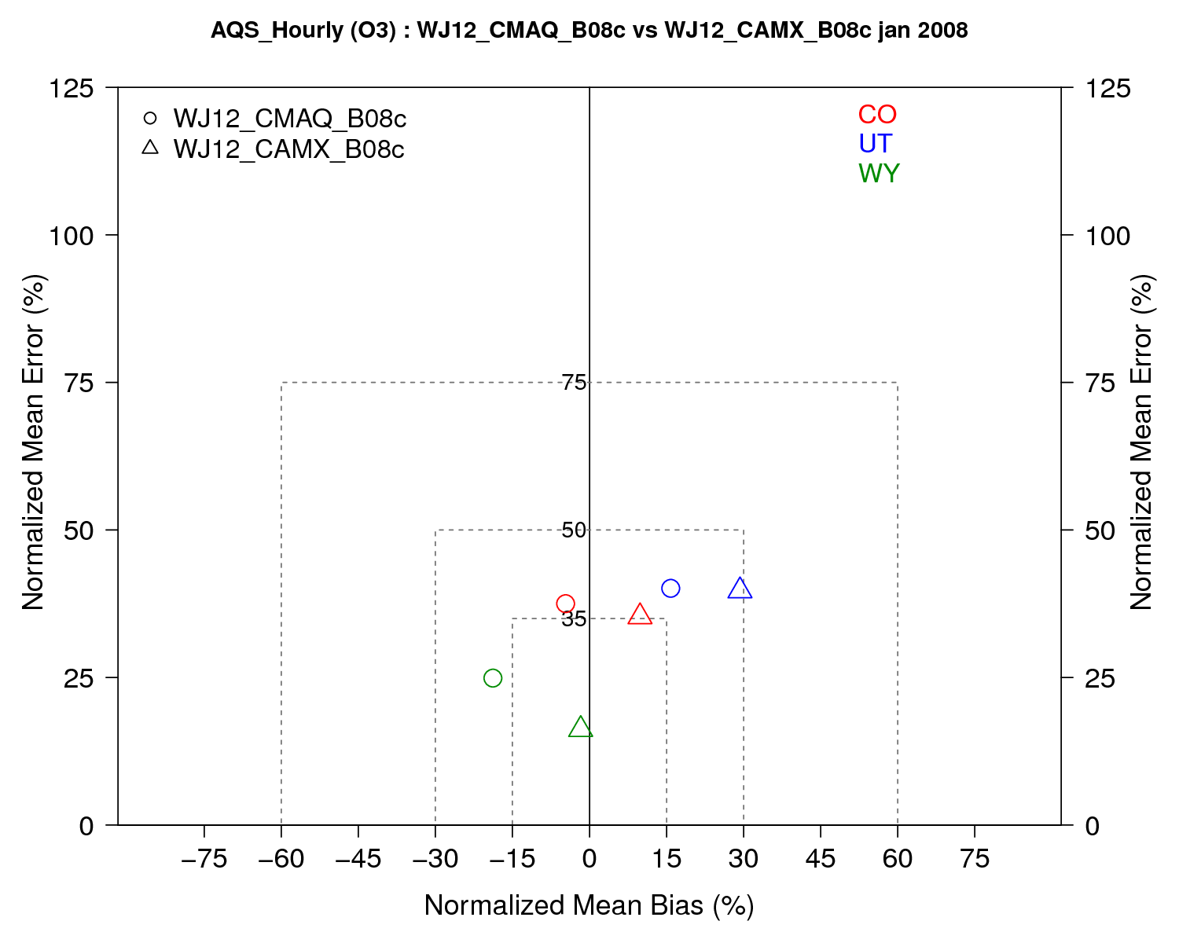
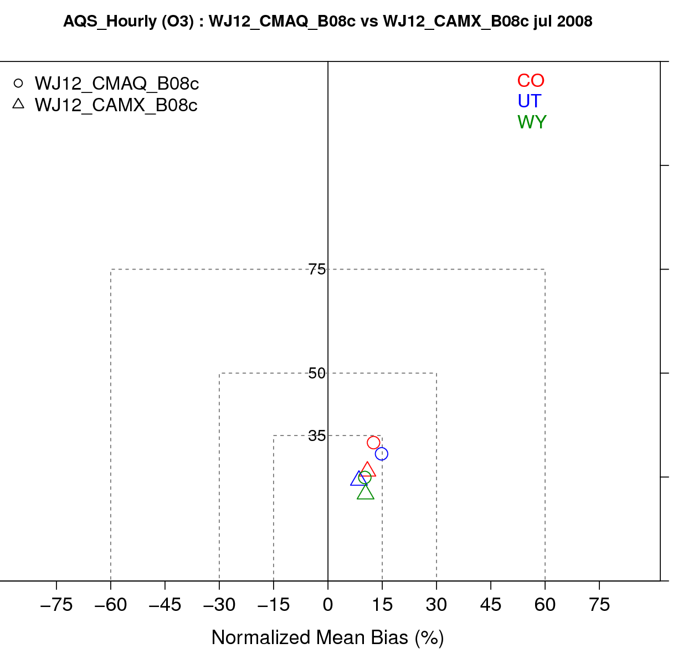
CO, UT, WY January and July 2008 AQS O3
January
July

Slide 15
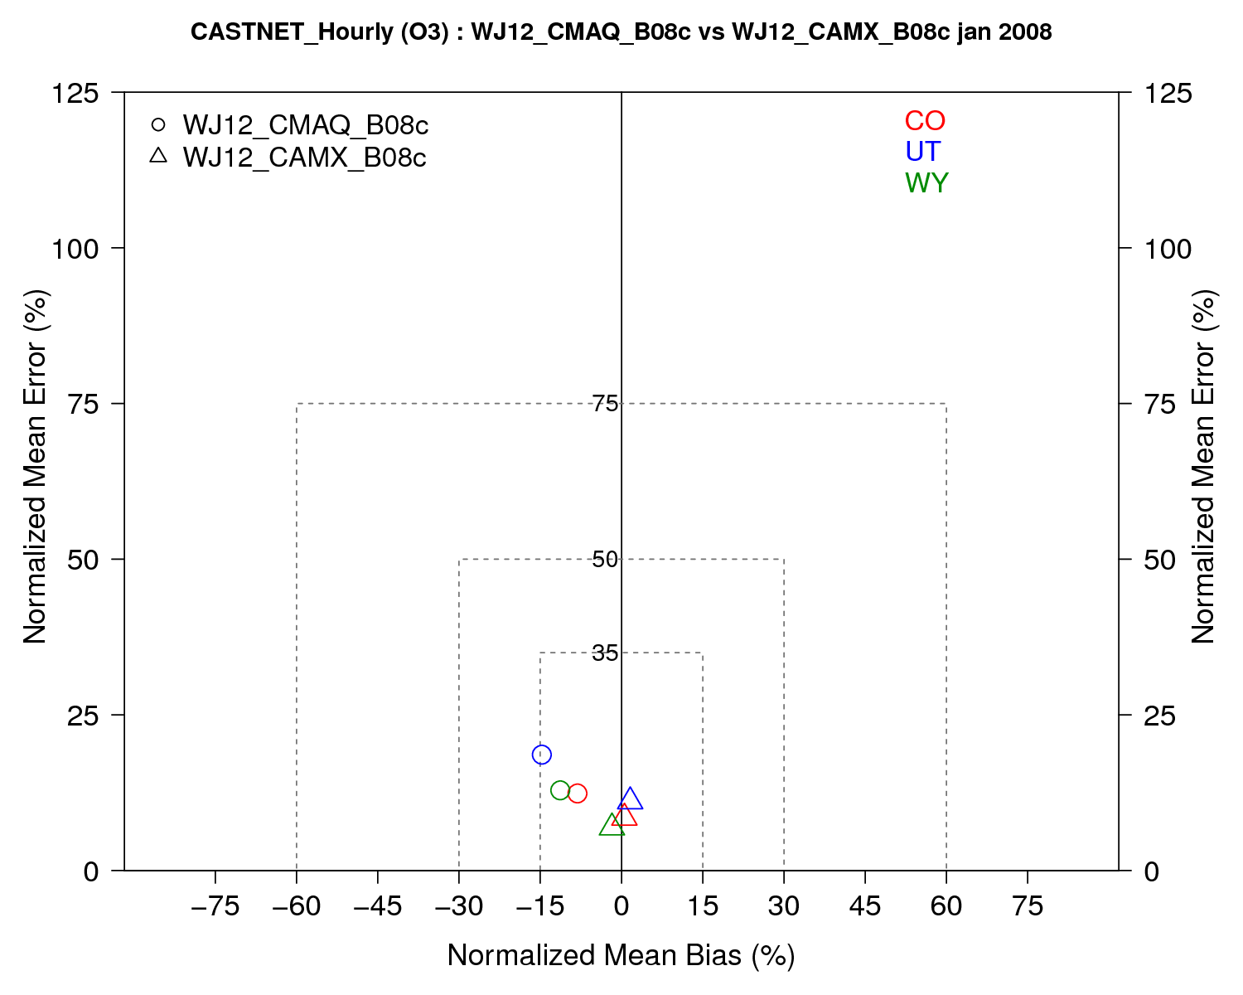
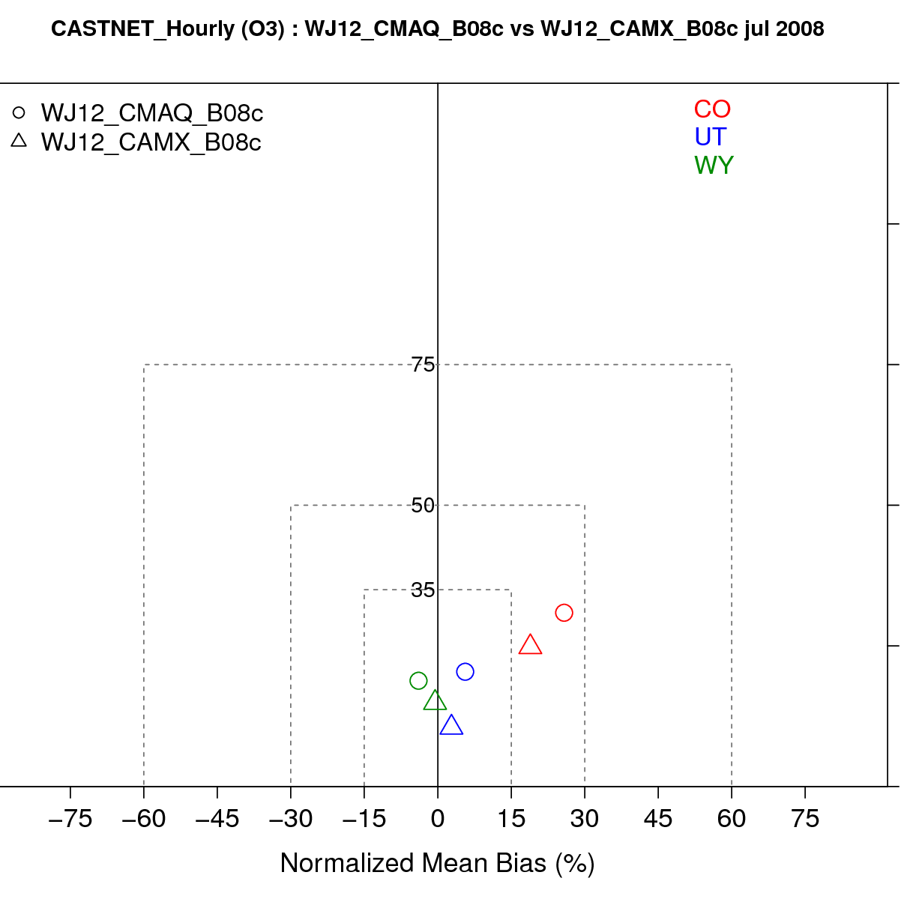
CO, UT, WY January and July 2008 CASTnet O3
January
July

Slide 16
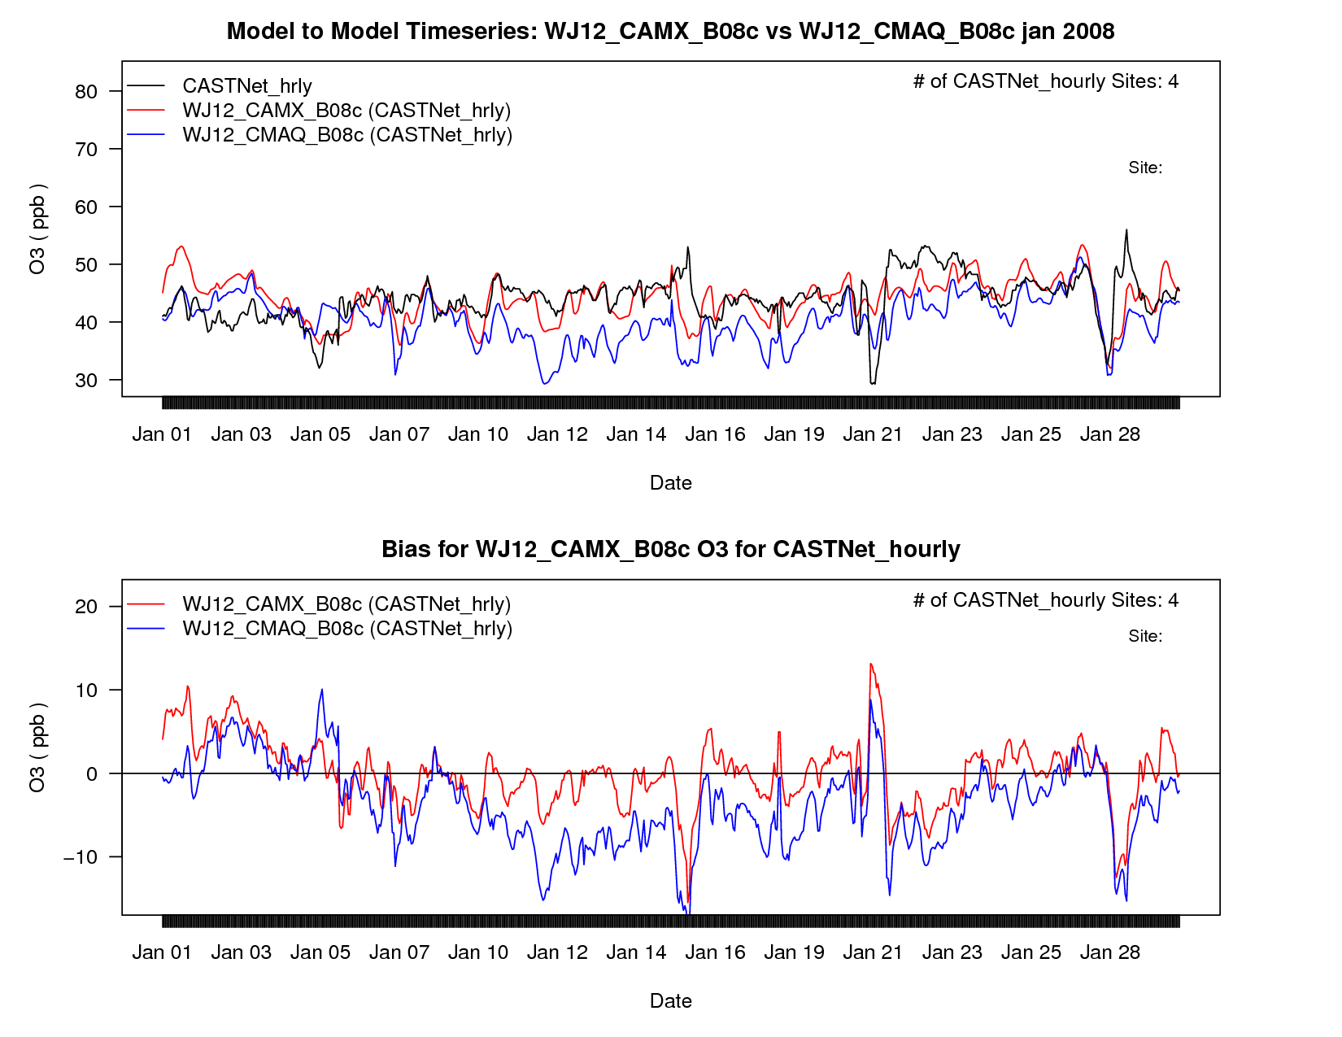
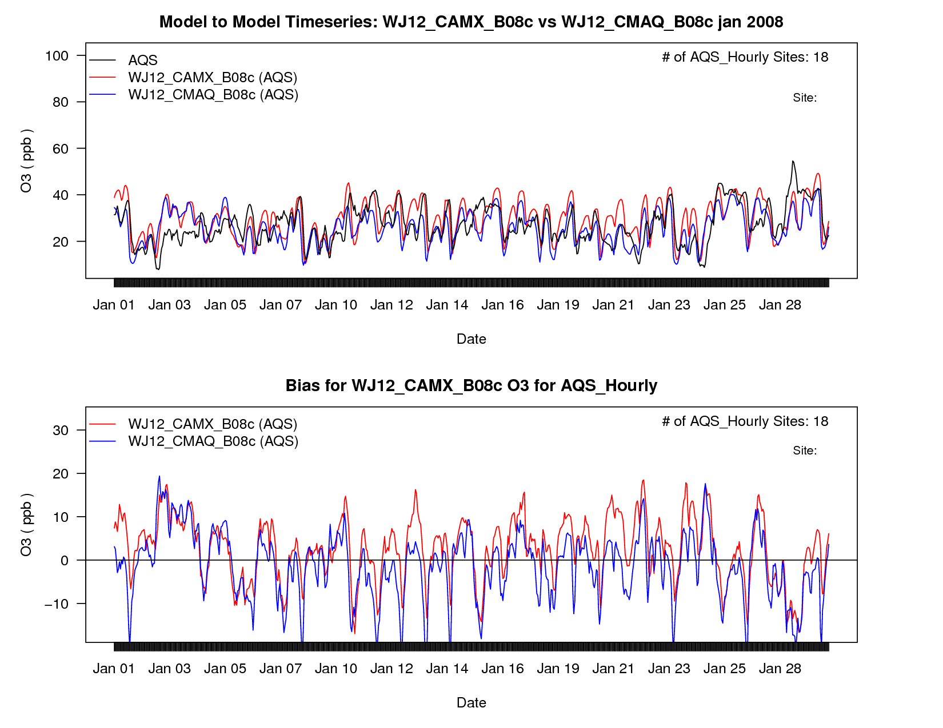
Colorado January O3
CASTNet
AQS

Slide 17
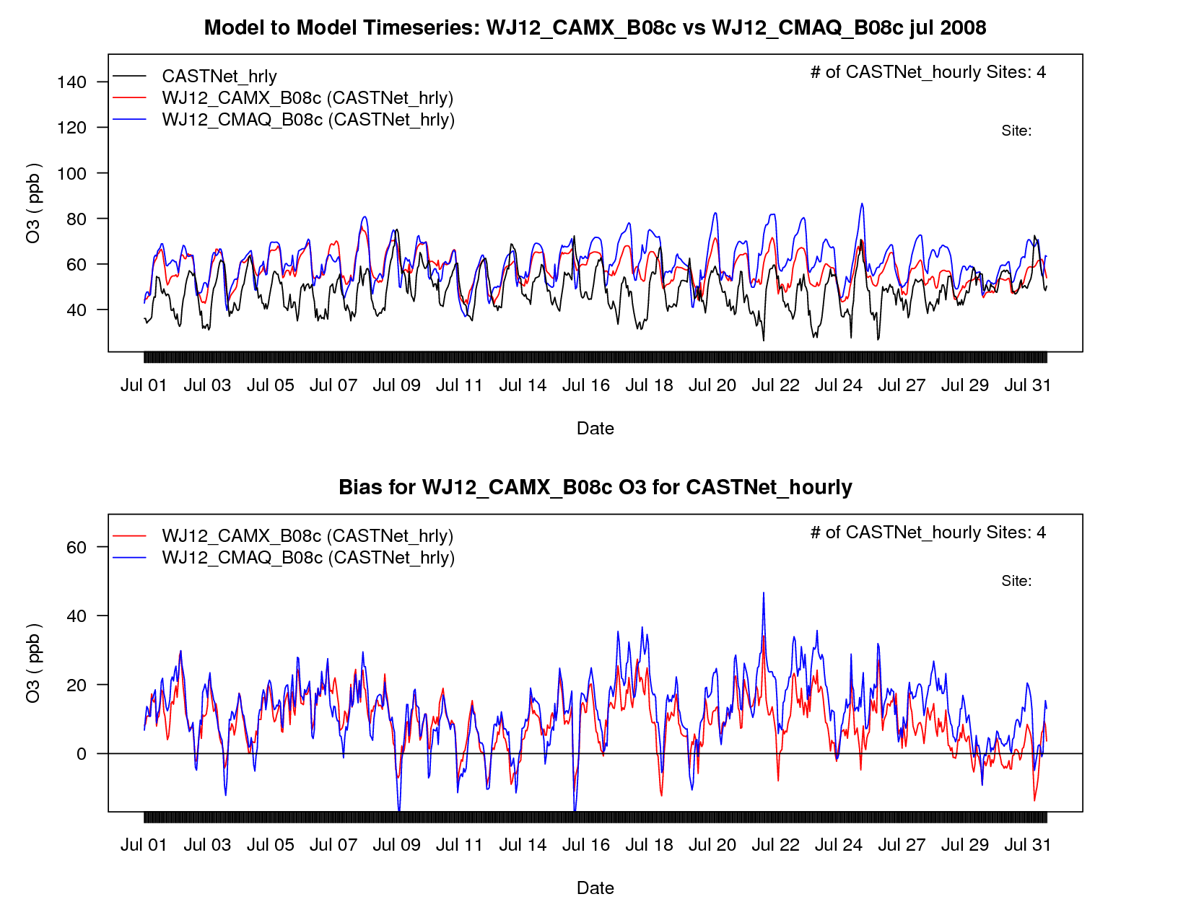
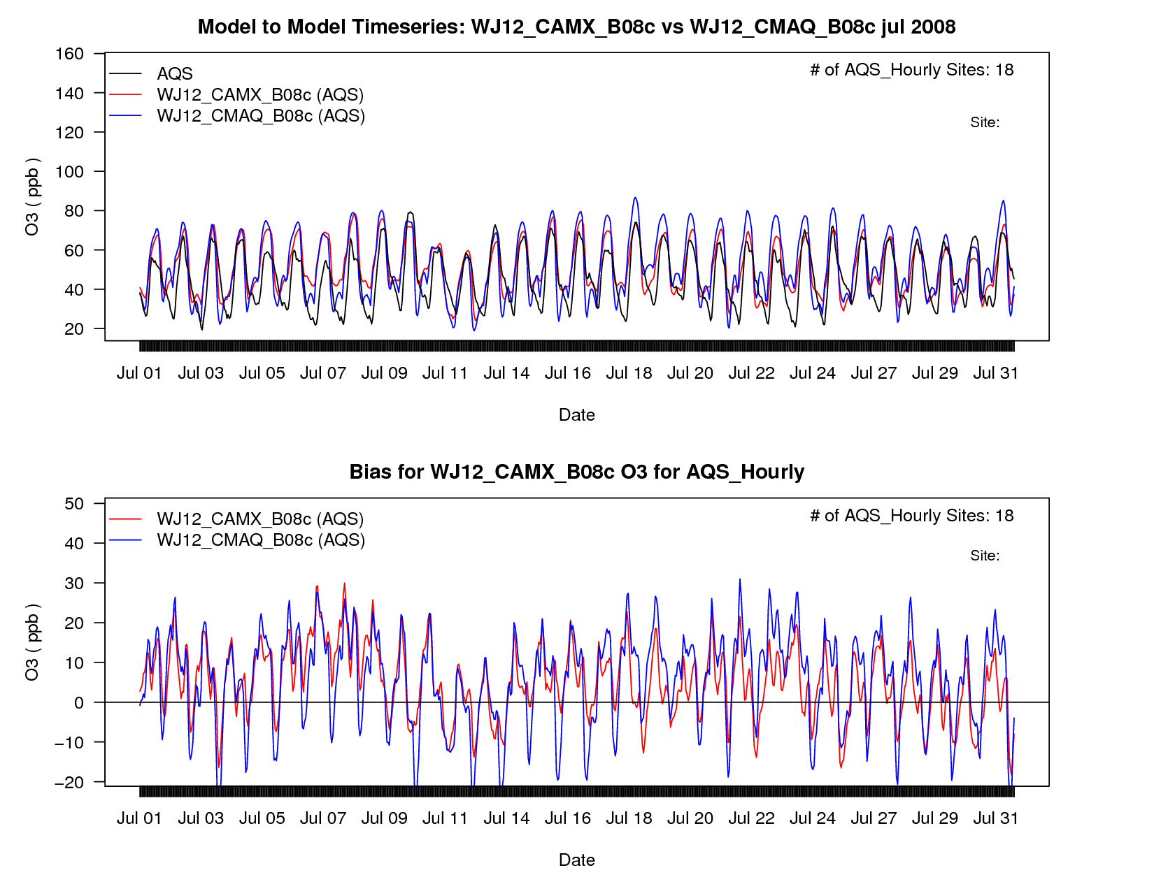
Colorado July O3
CASTNet
AQS

Slide 18
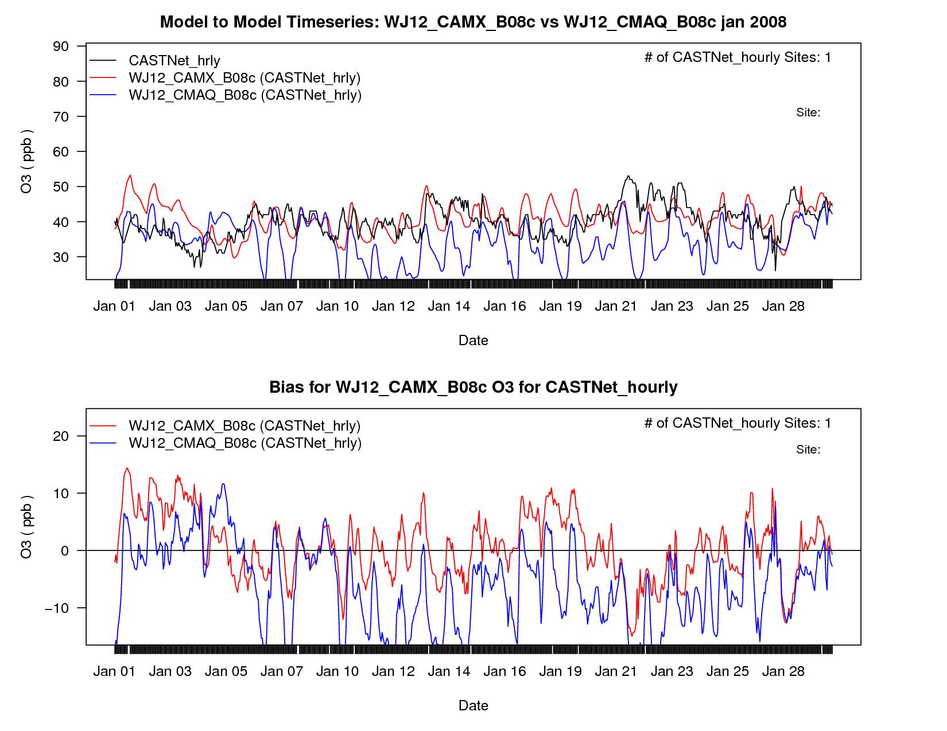
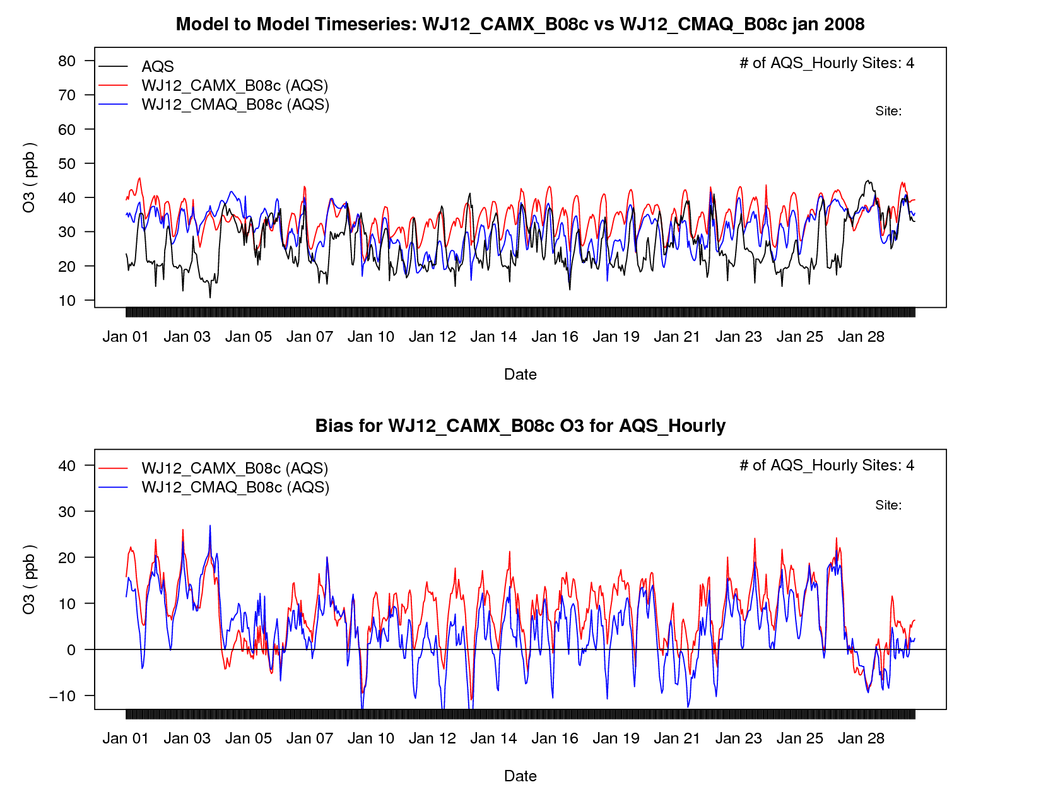
Utah January O3
CASTNet
AQS

Slide 19
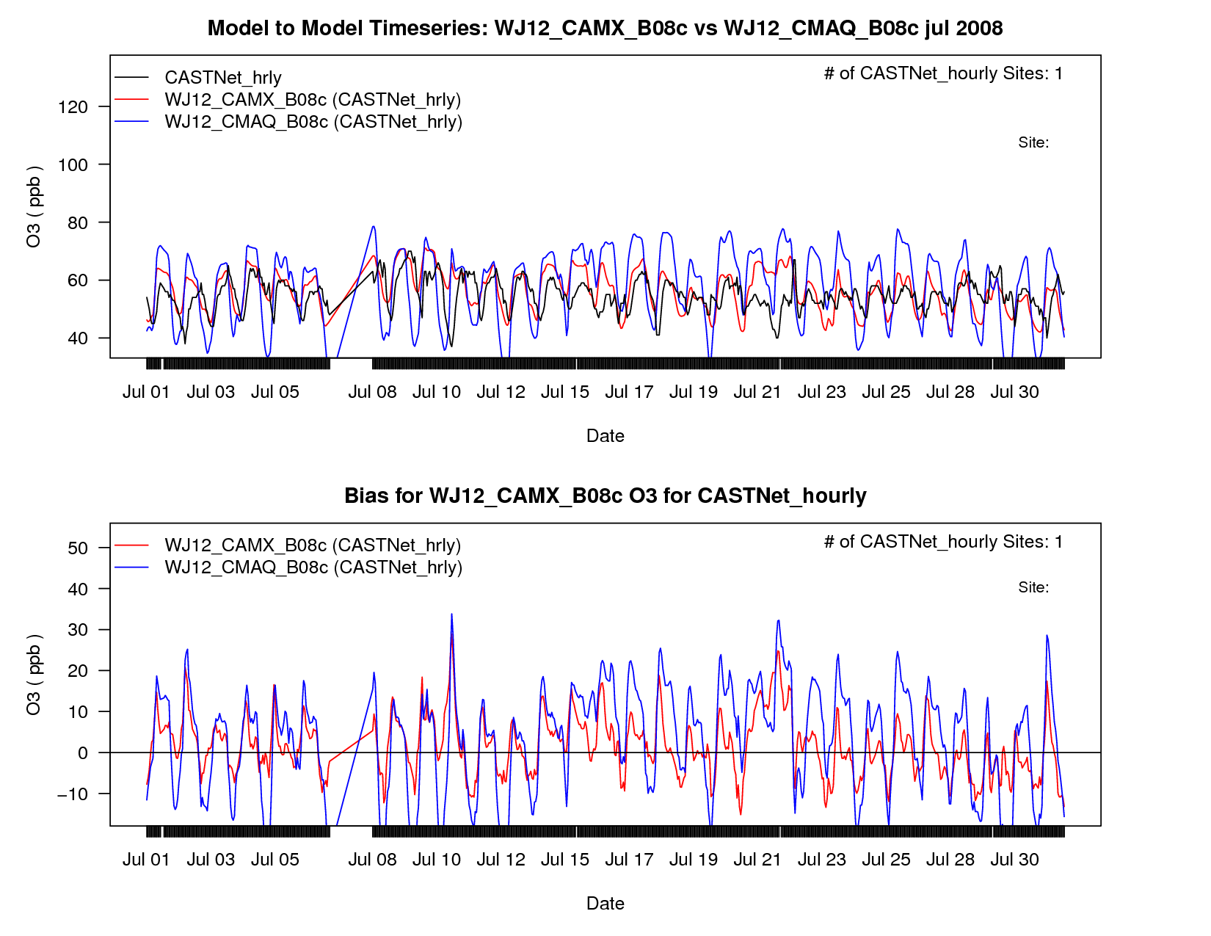
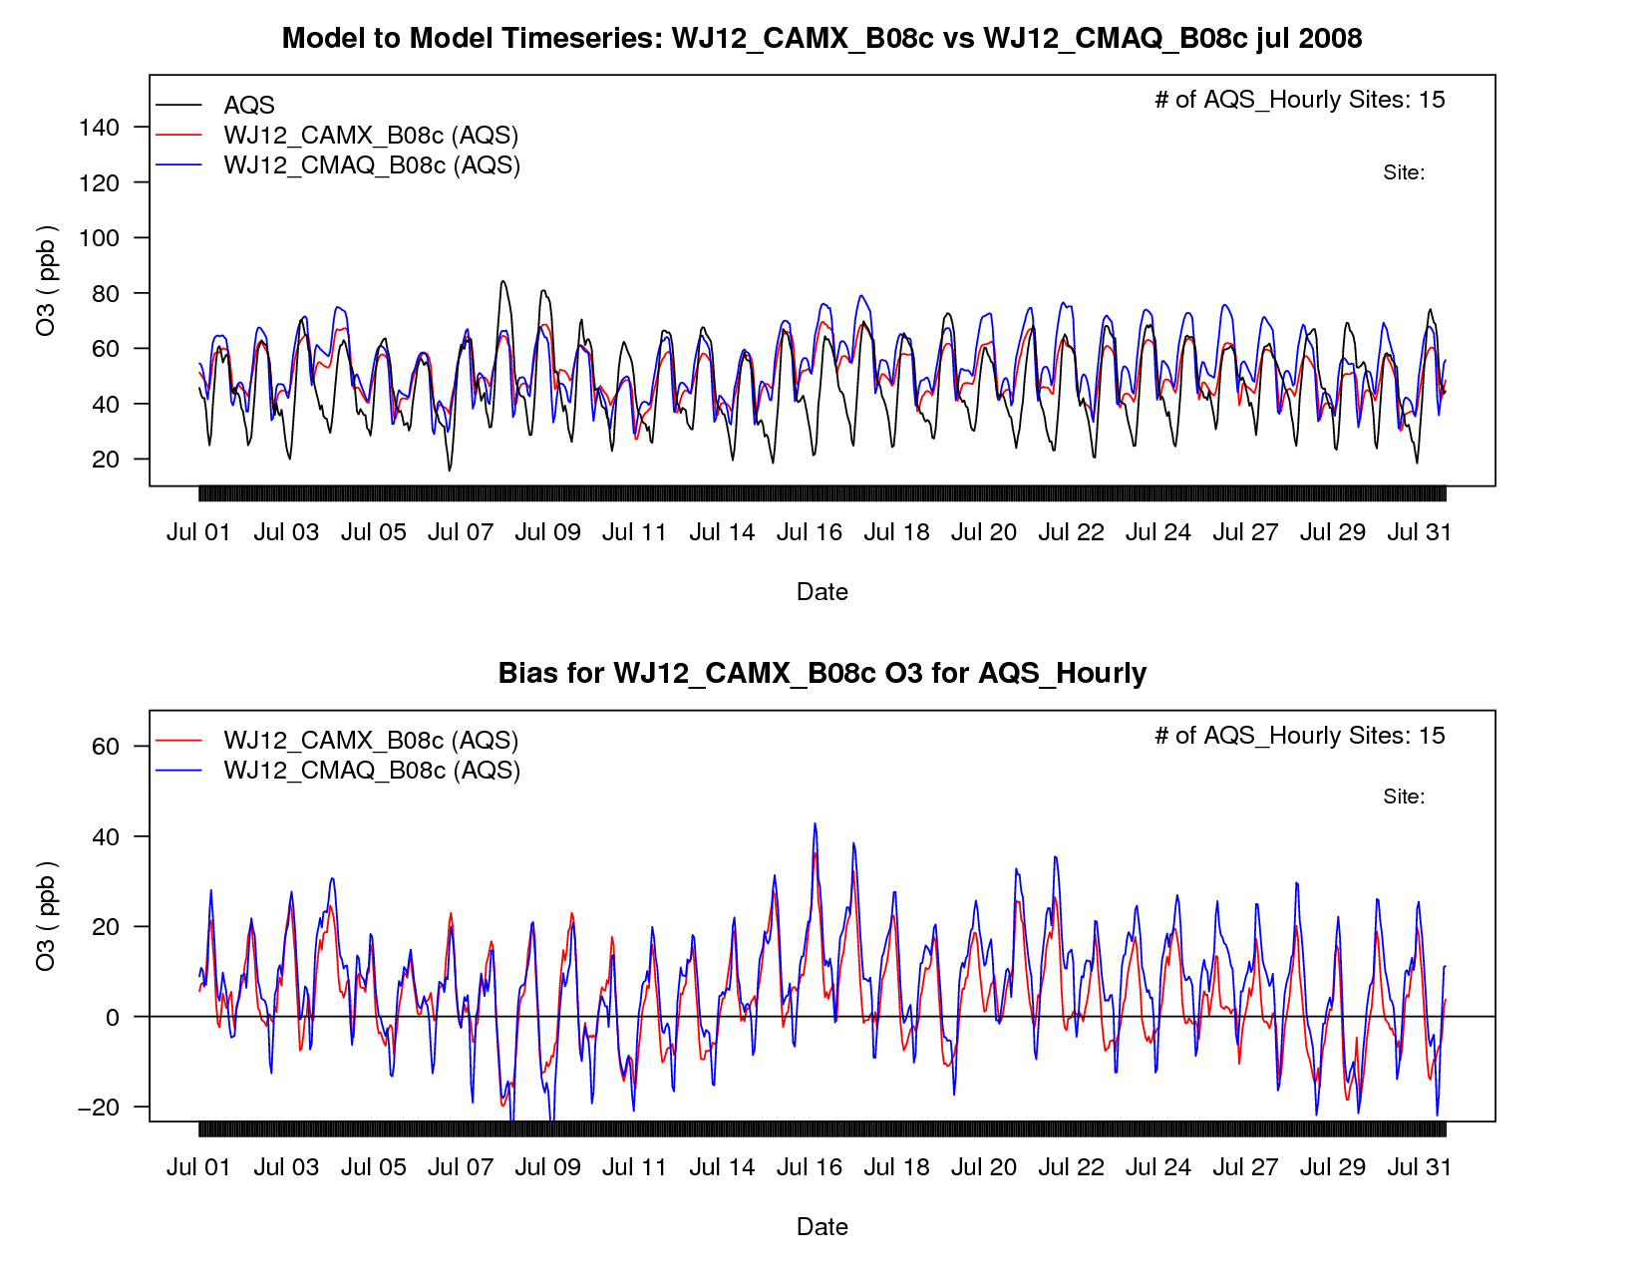
Utah July O3
CASTNet
AQS

Slide 20
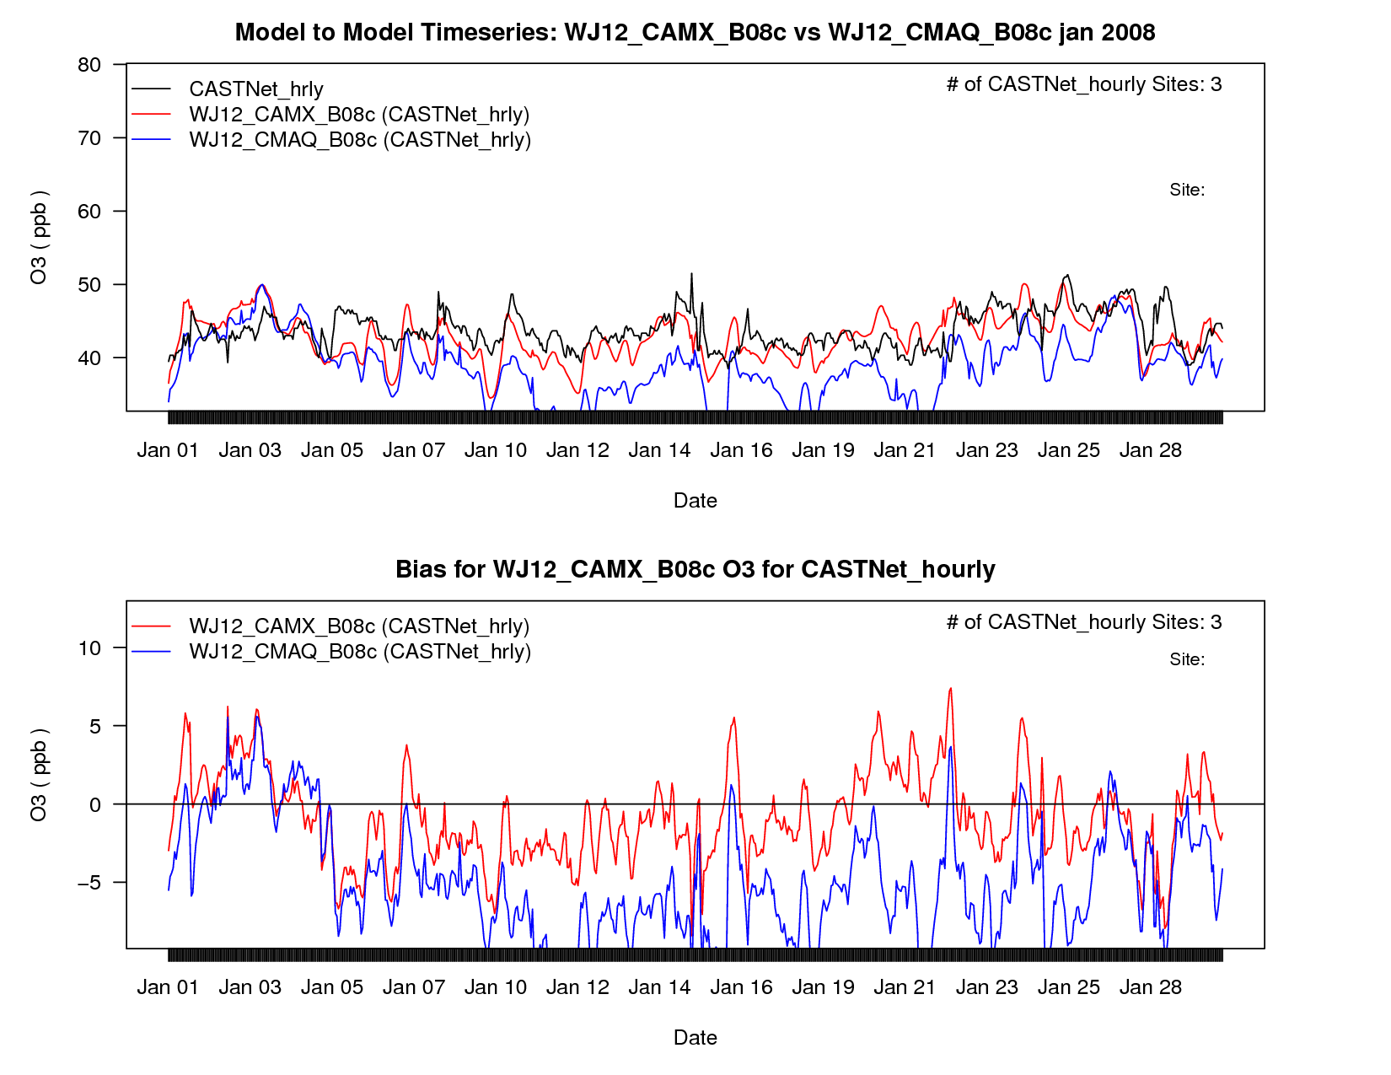
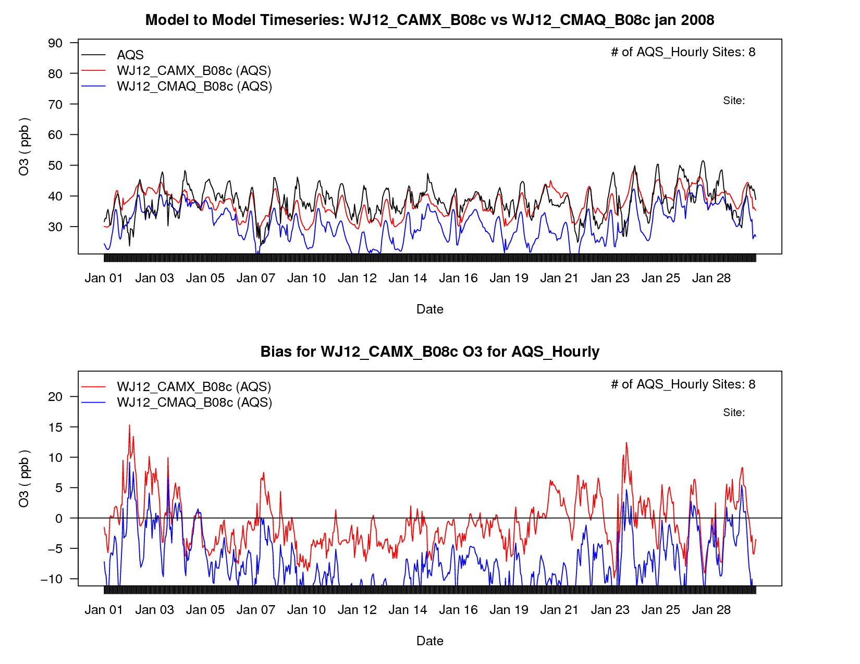
Wyoming January O3
CASTNet
AQS

Slide 21
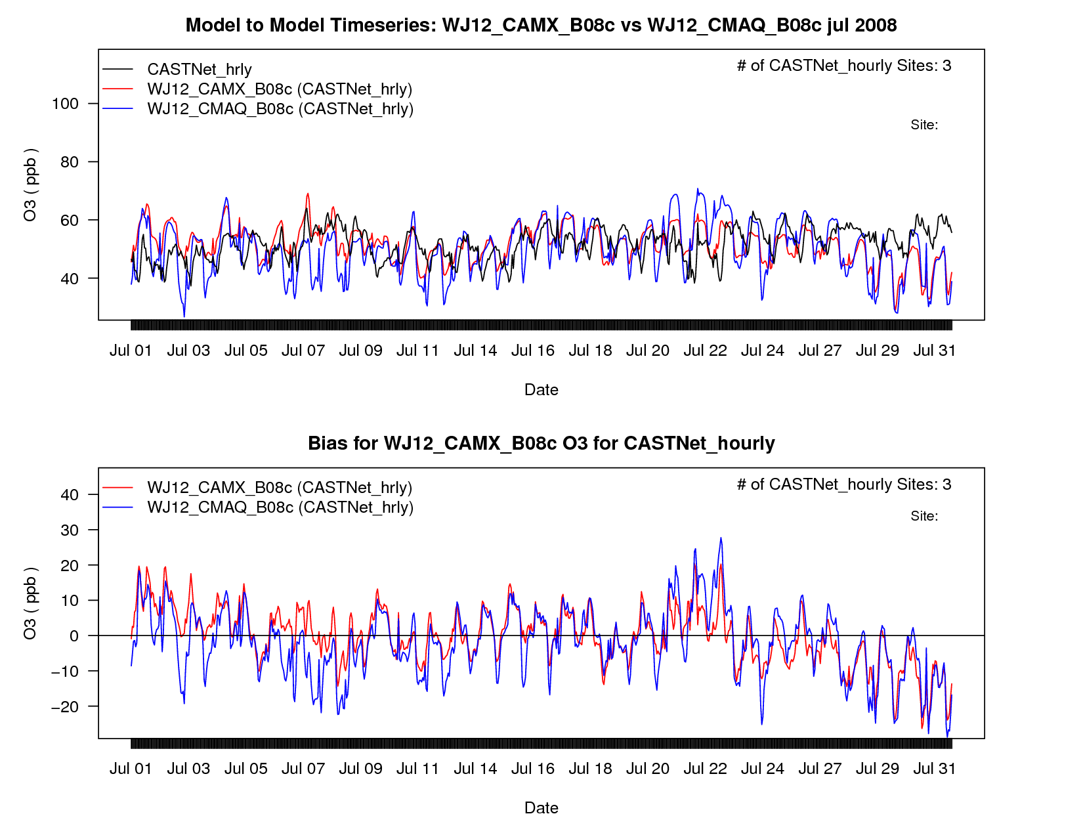
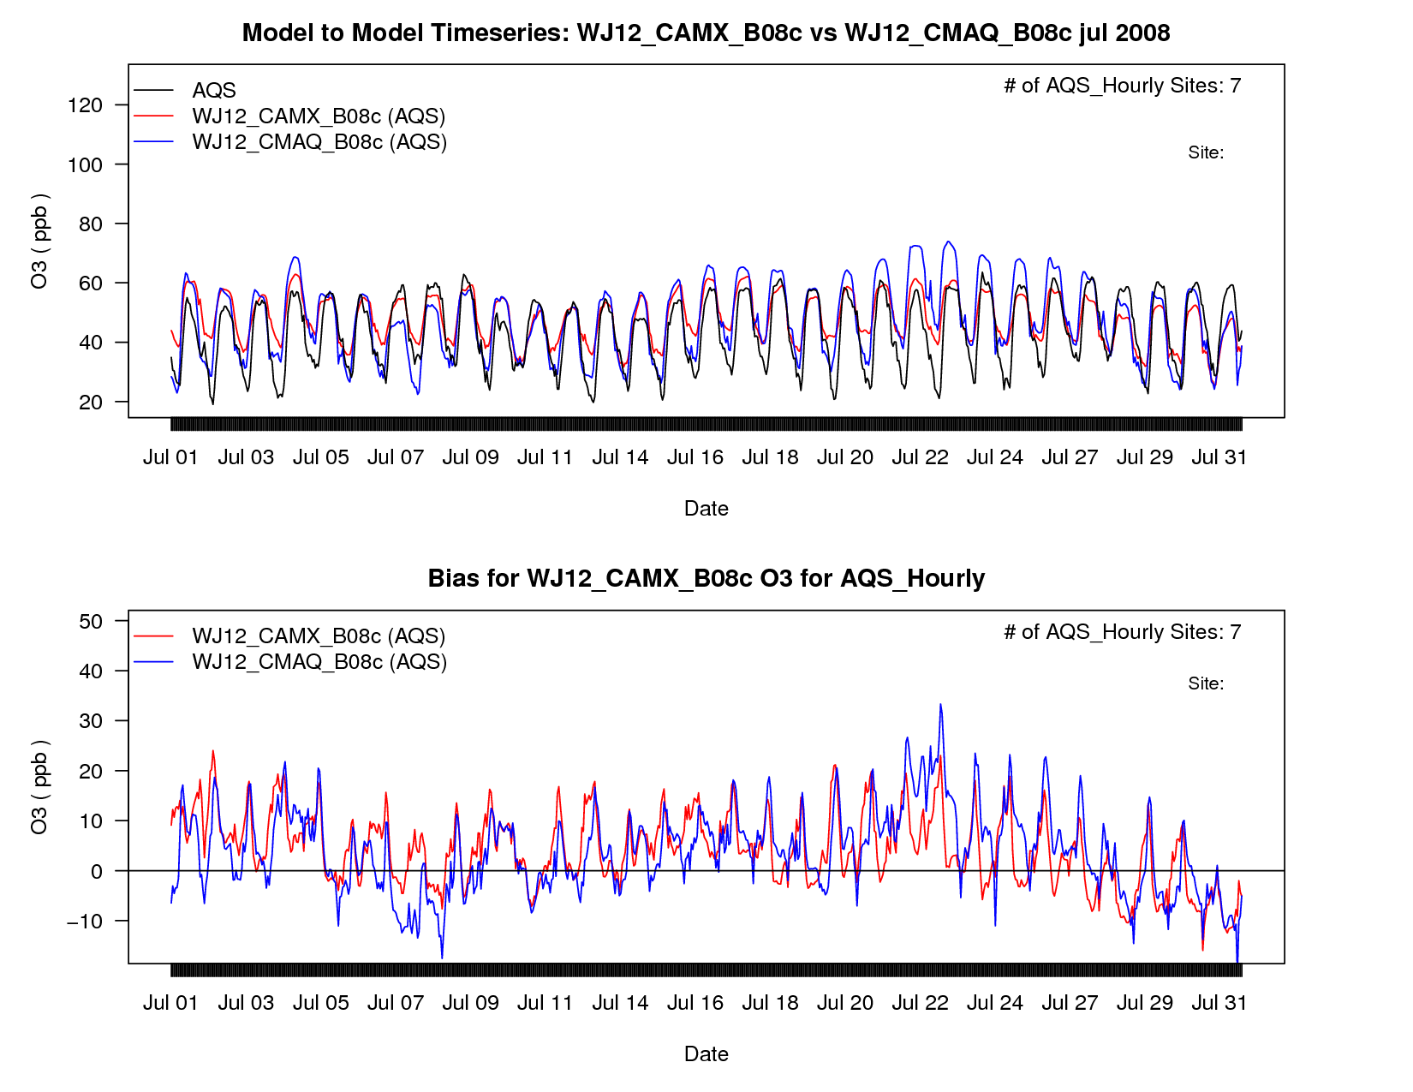
Wyoming July O3
CASTNet
AQS

Slide 22
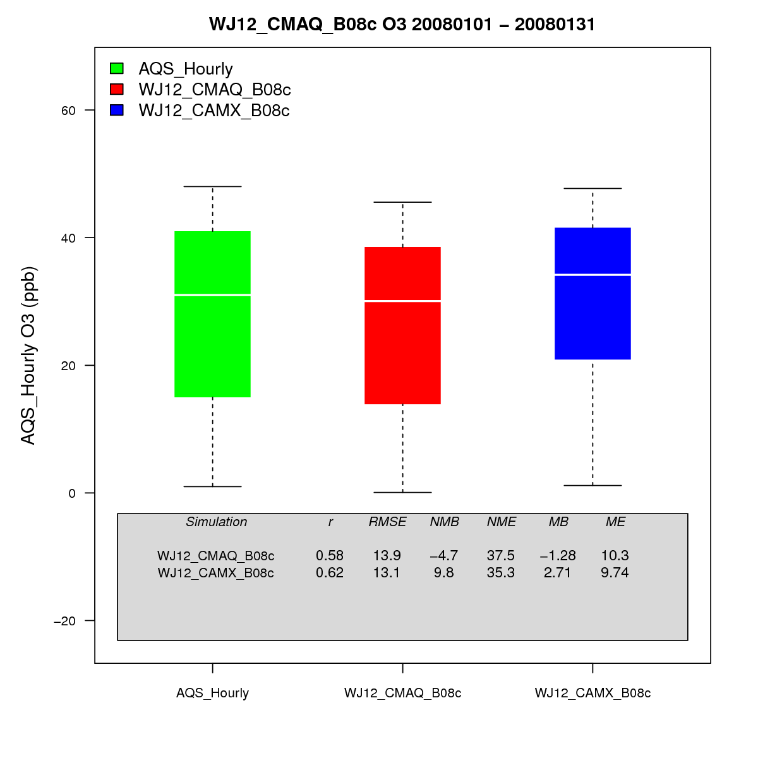
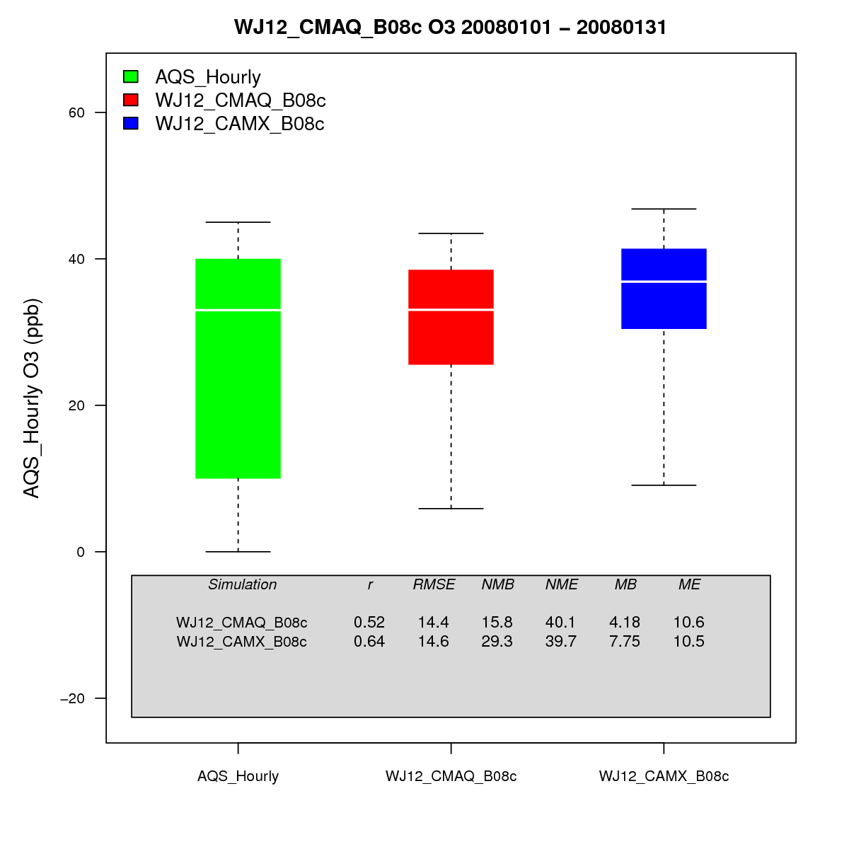
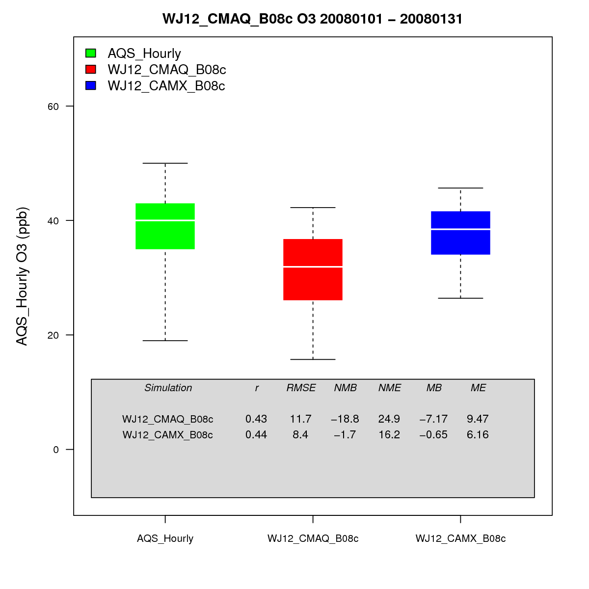
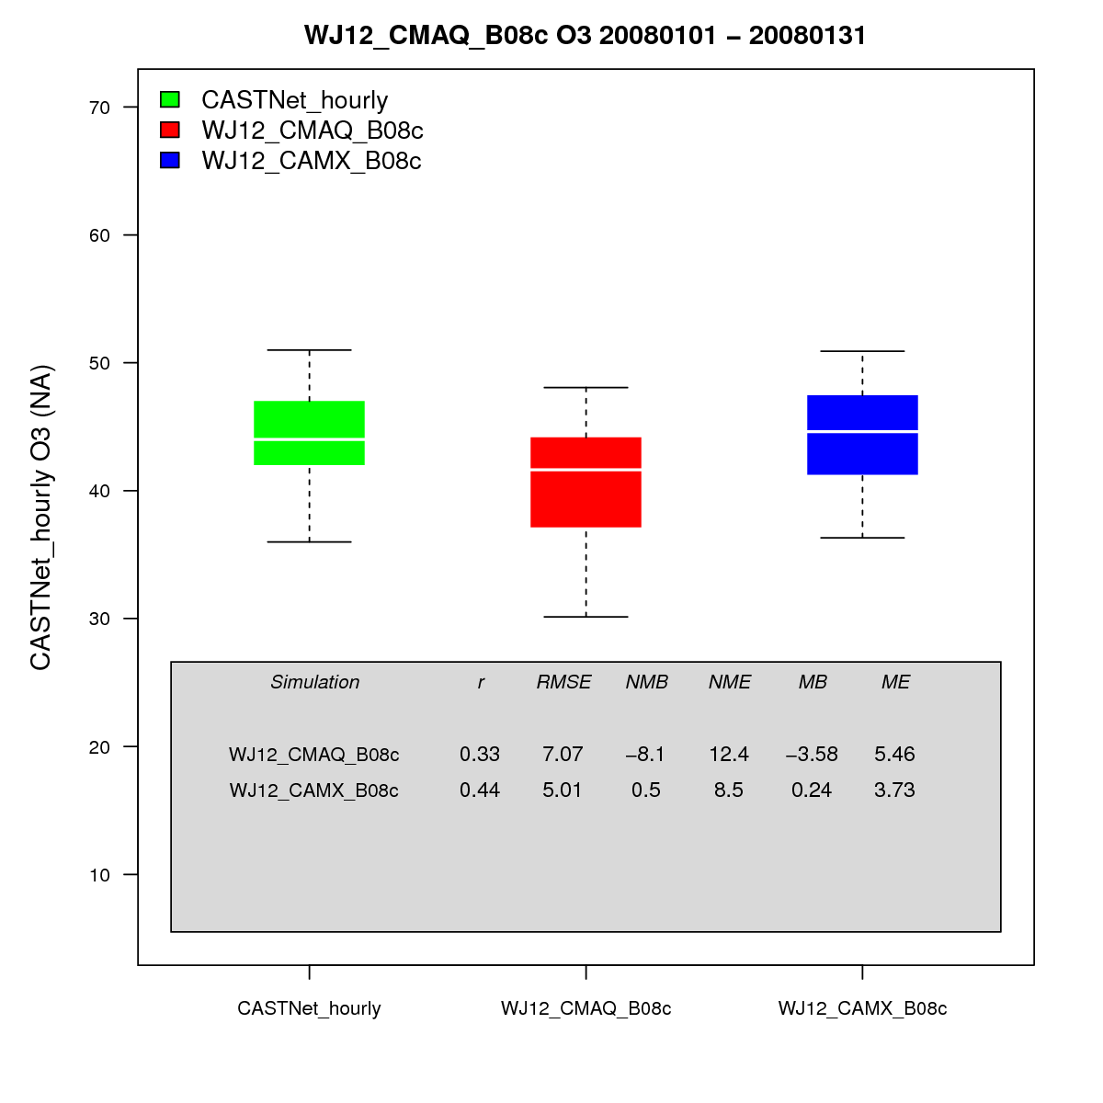
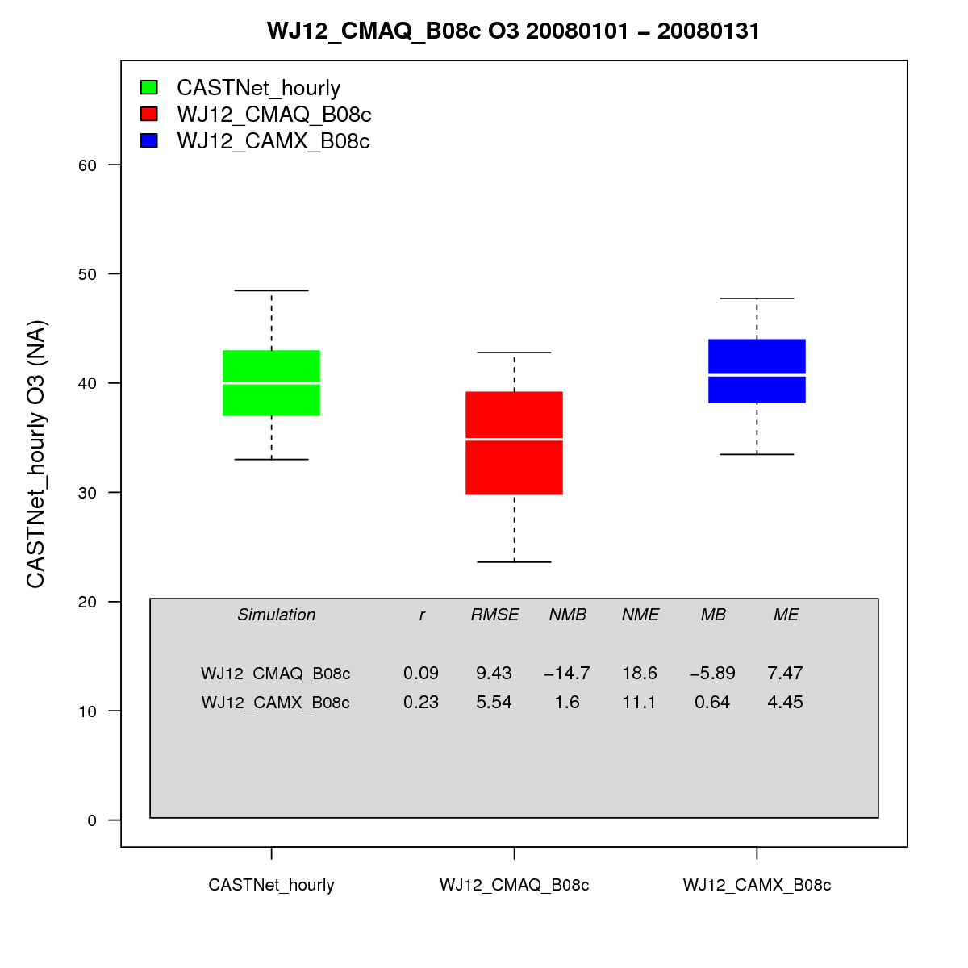
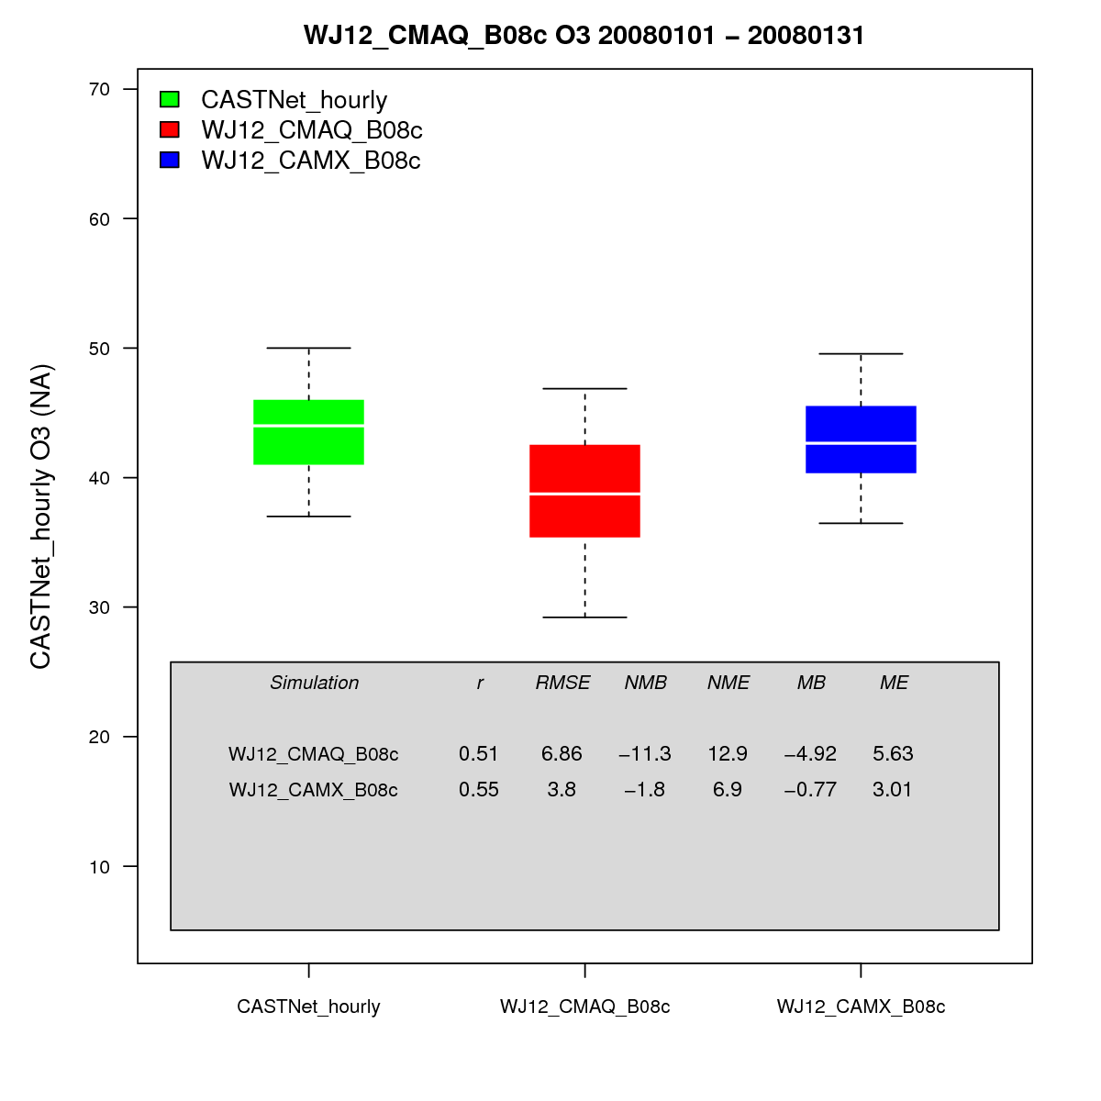
CO AQS Jan
UT AQS Jan
WY AQS Jan
CO CNET Jan
UT CNET Jan
WY CNET Jan

Slide 23
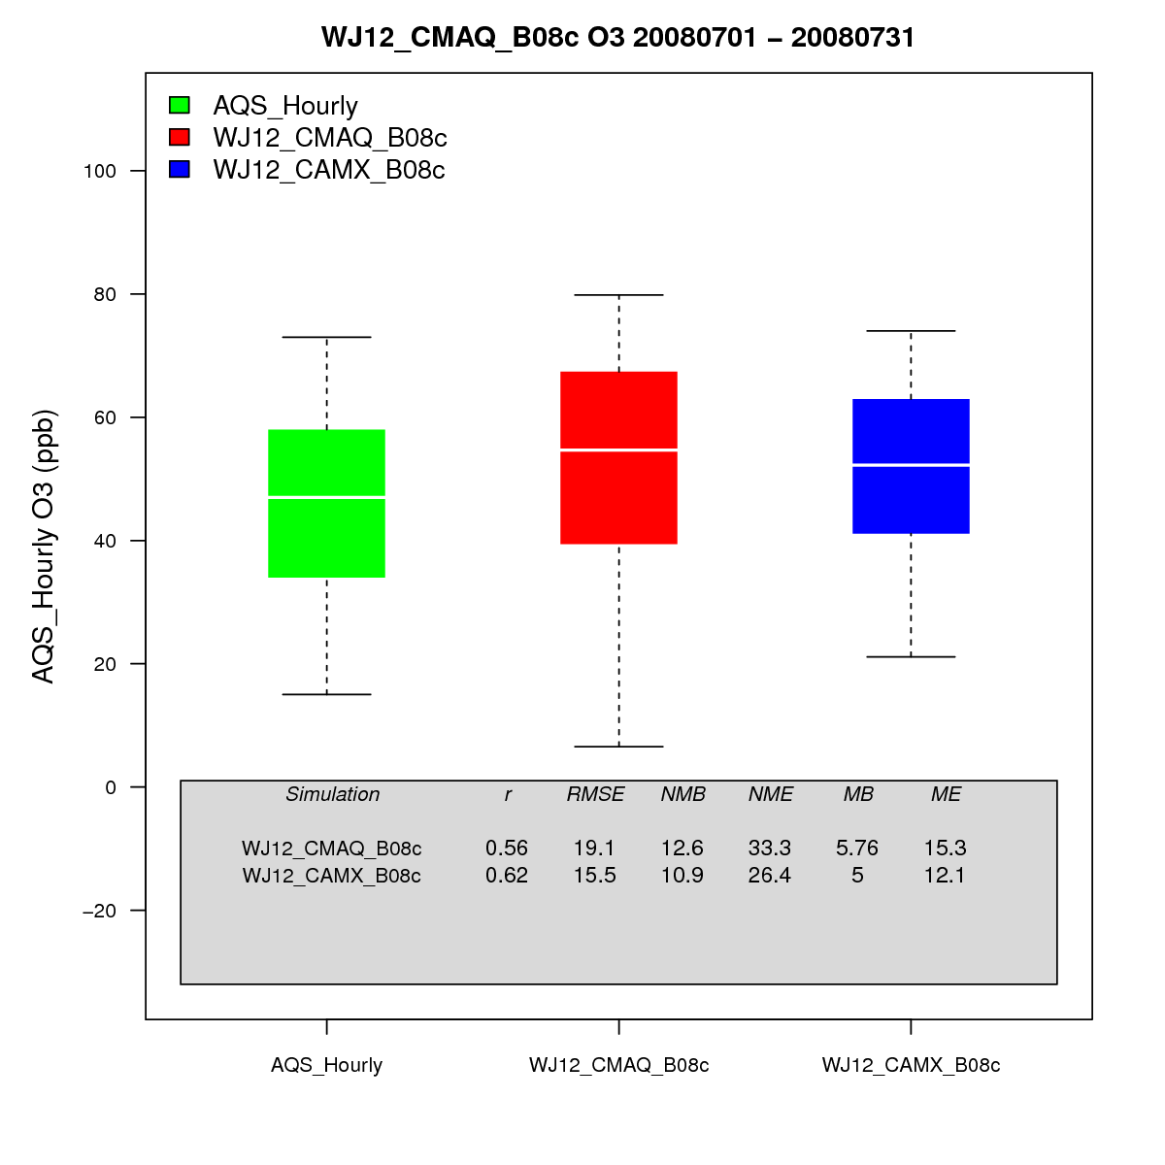
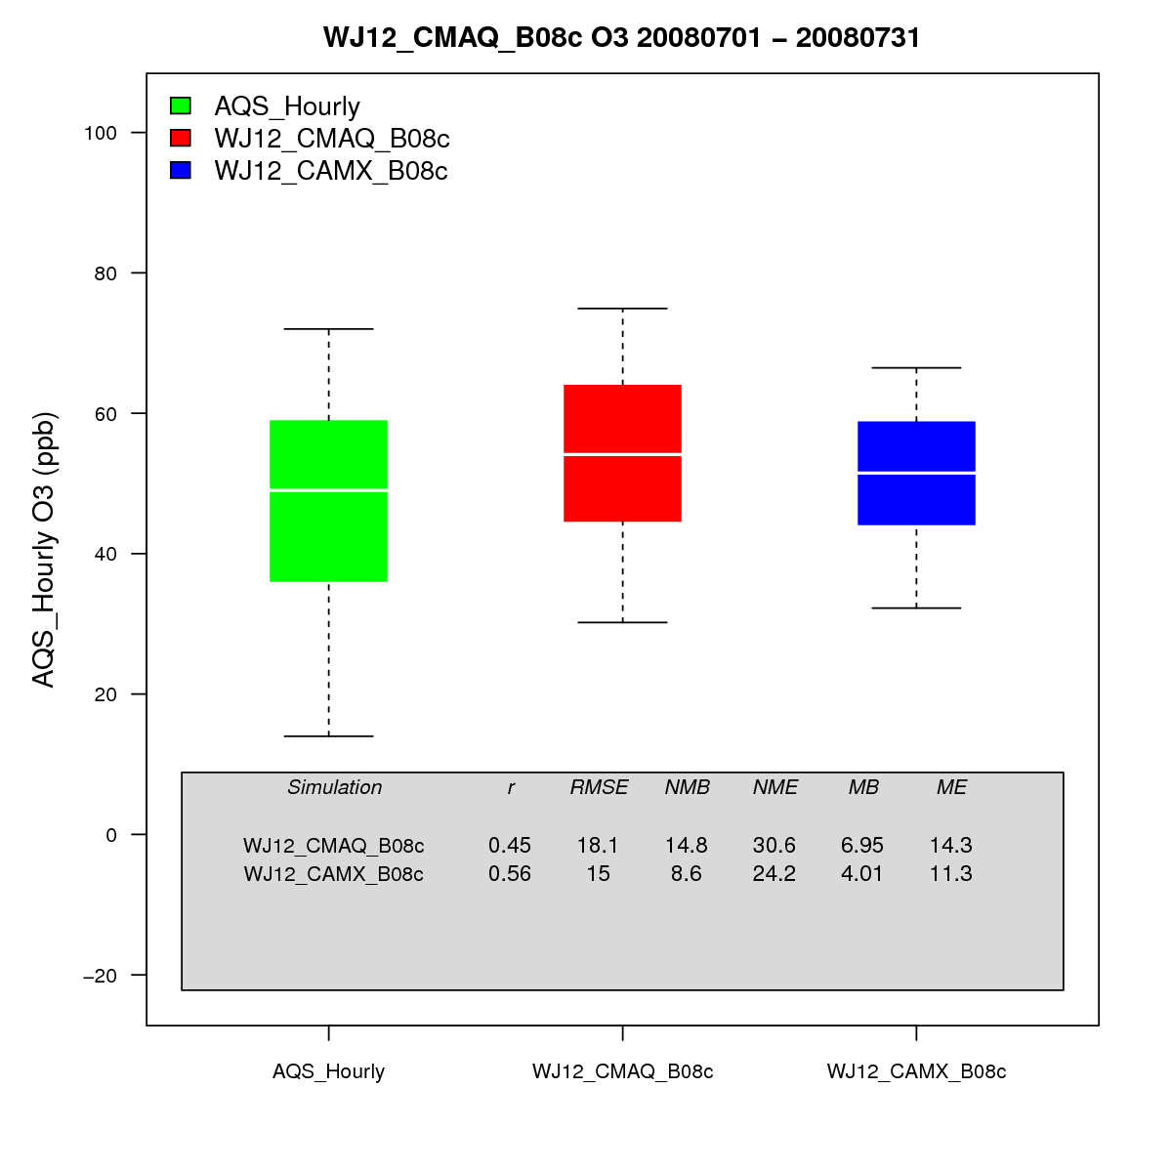
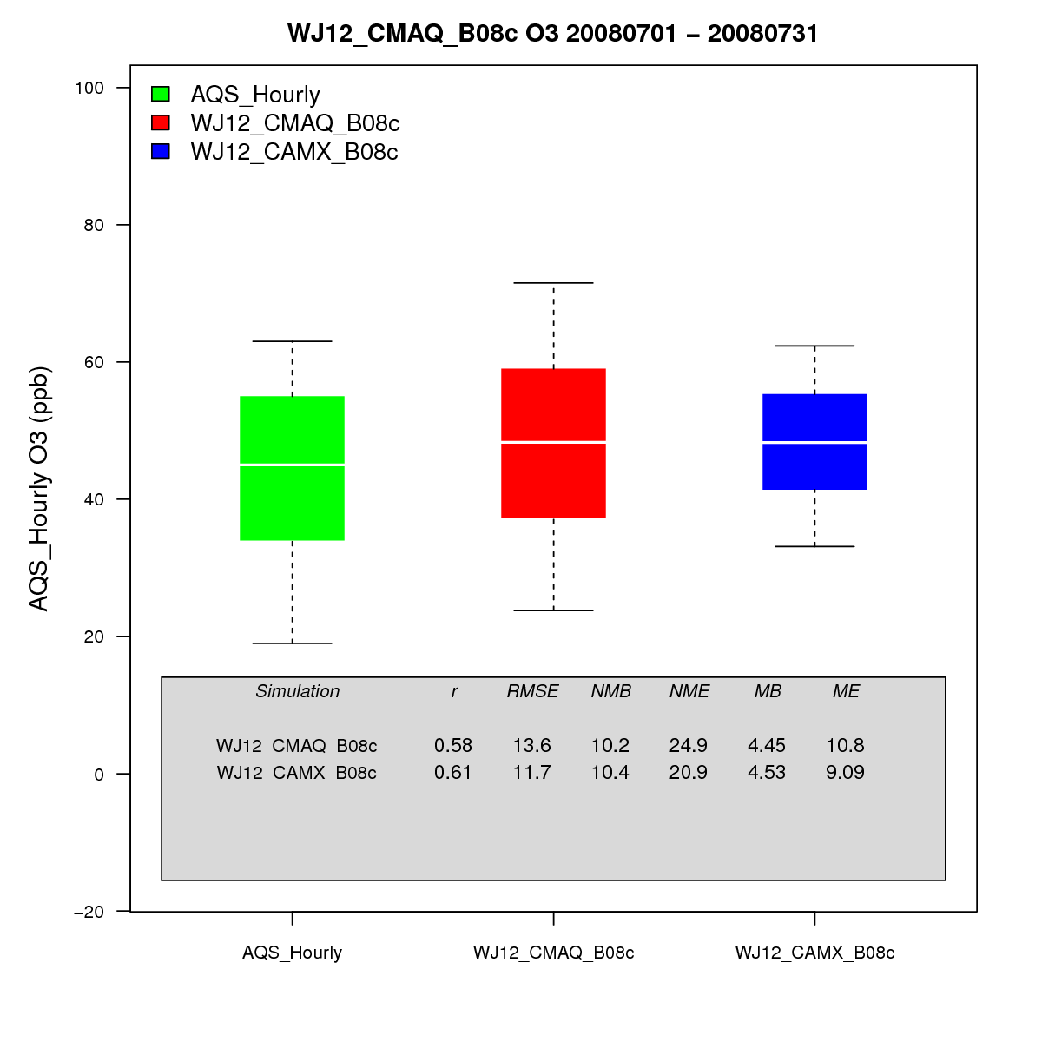
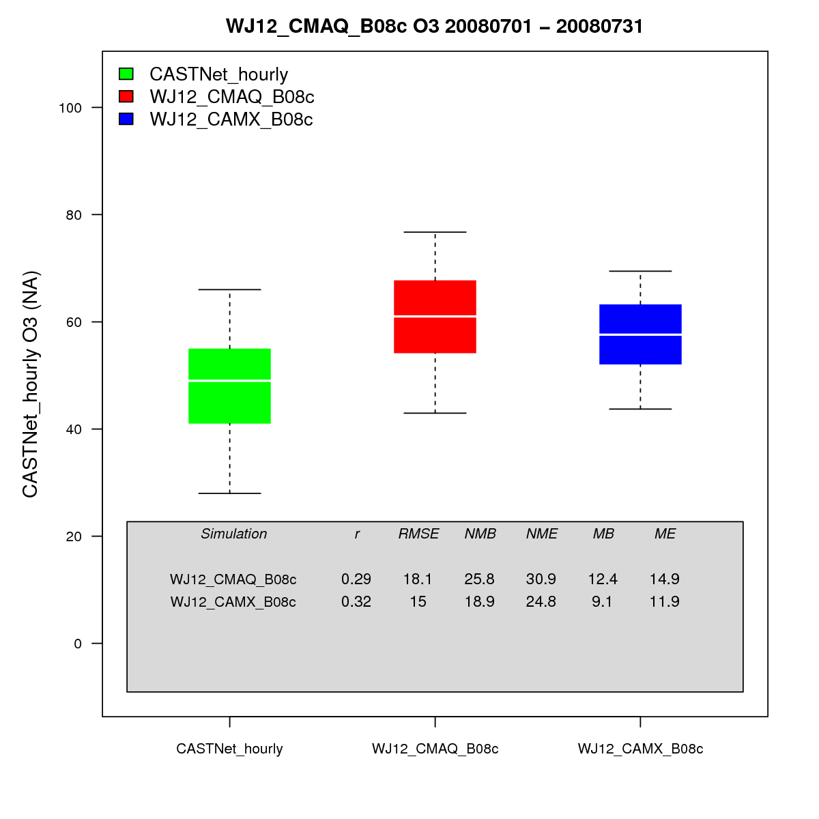
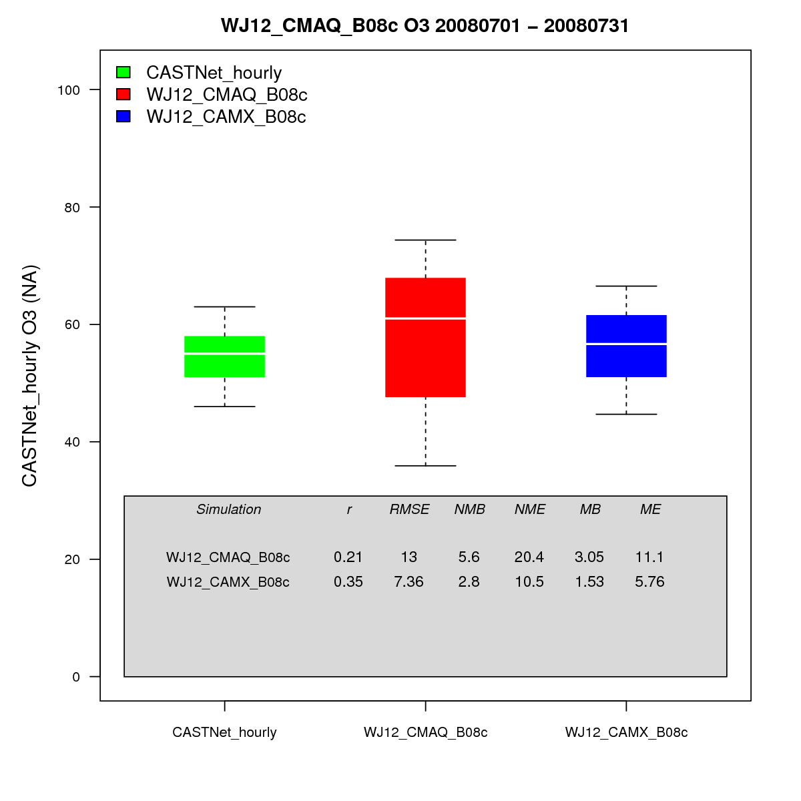
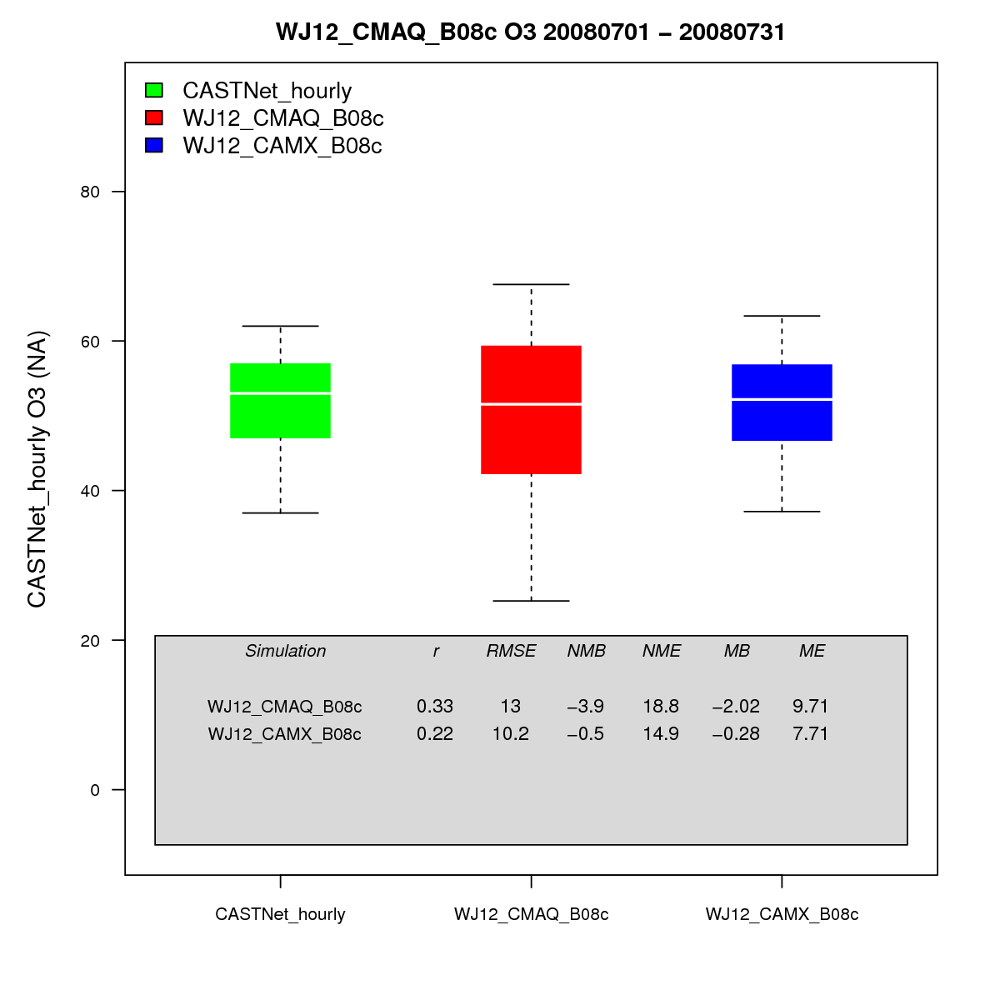
CO AQS Jul
UT AQS Jul
WY AQS Jul
CO CNET Jul
UT CNET Jul
WY CNET Jul

Slide 24
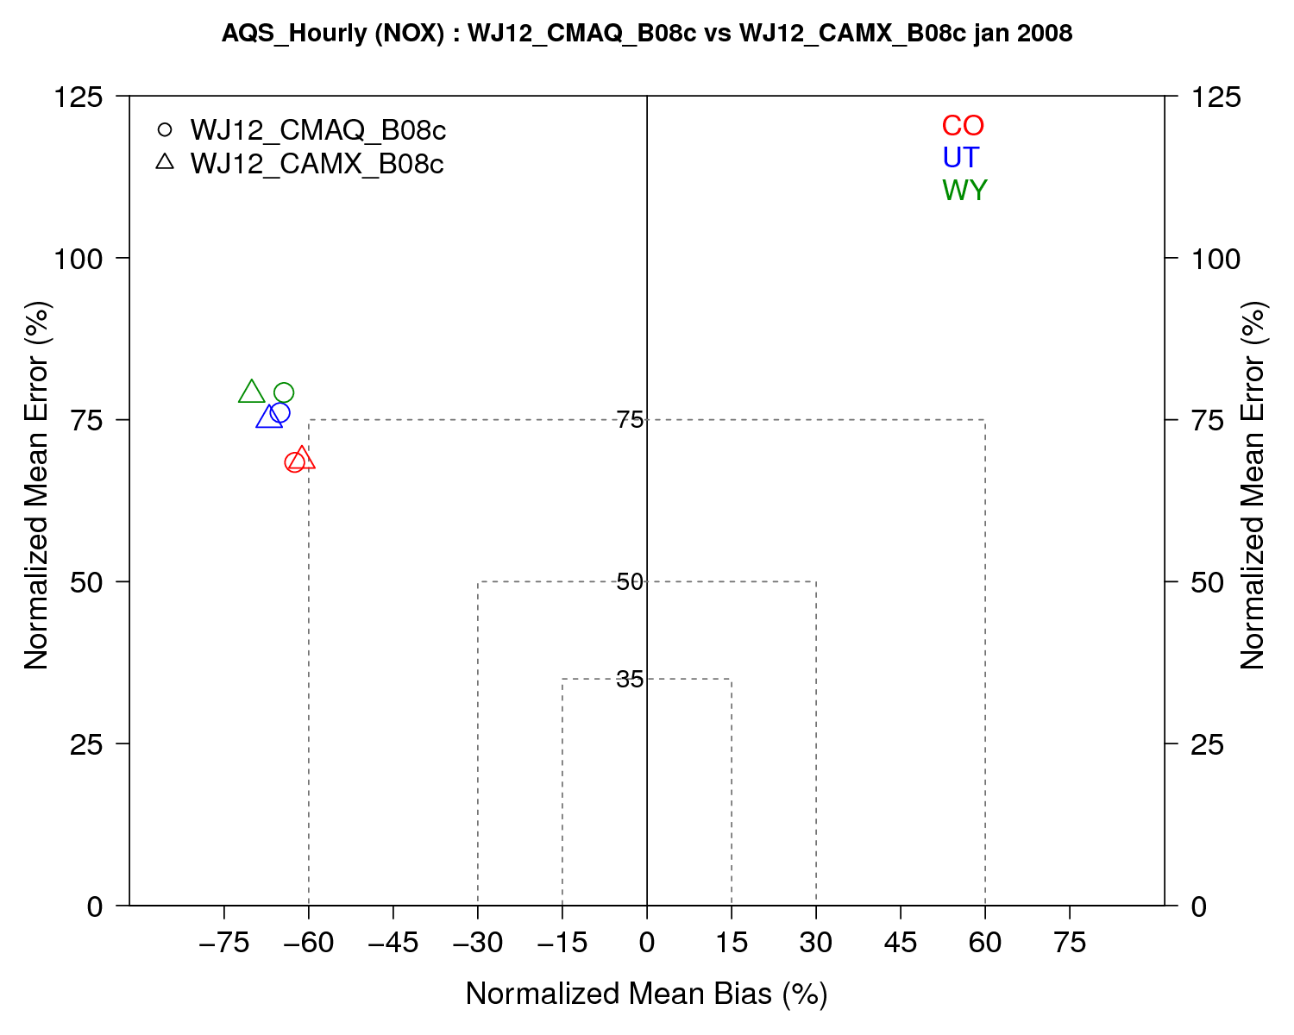
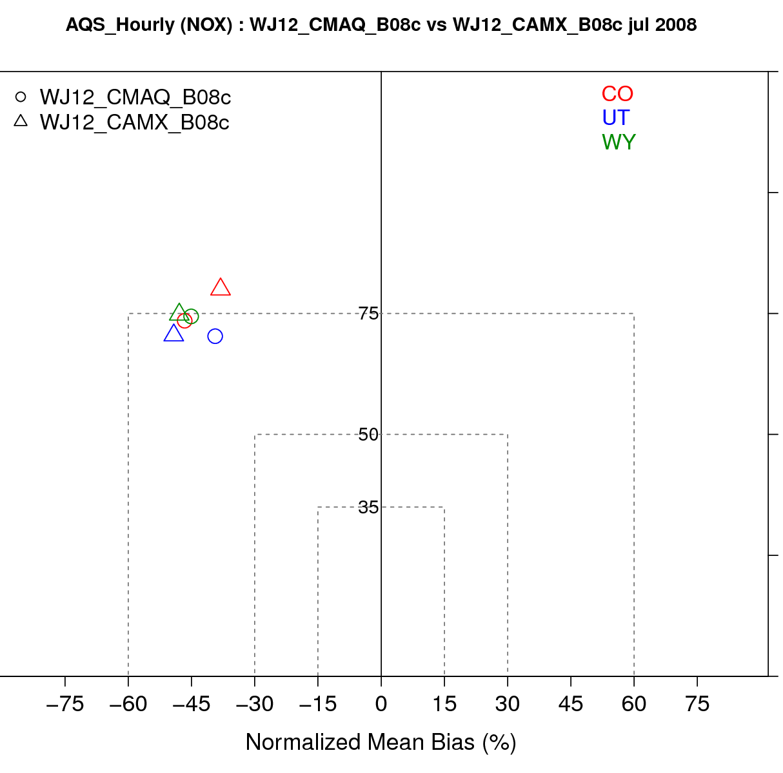
CO, UT, WY January and July 2008 AQS NOx
January
July

Slide 25
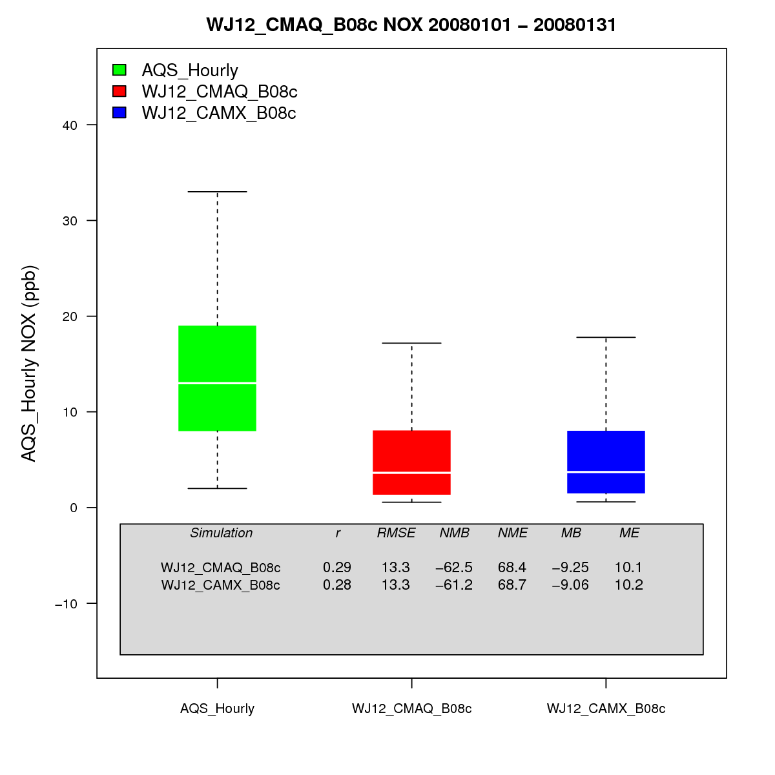
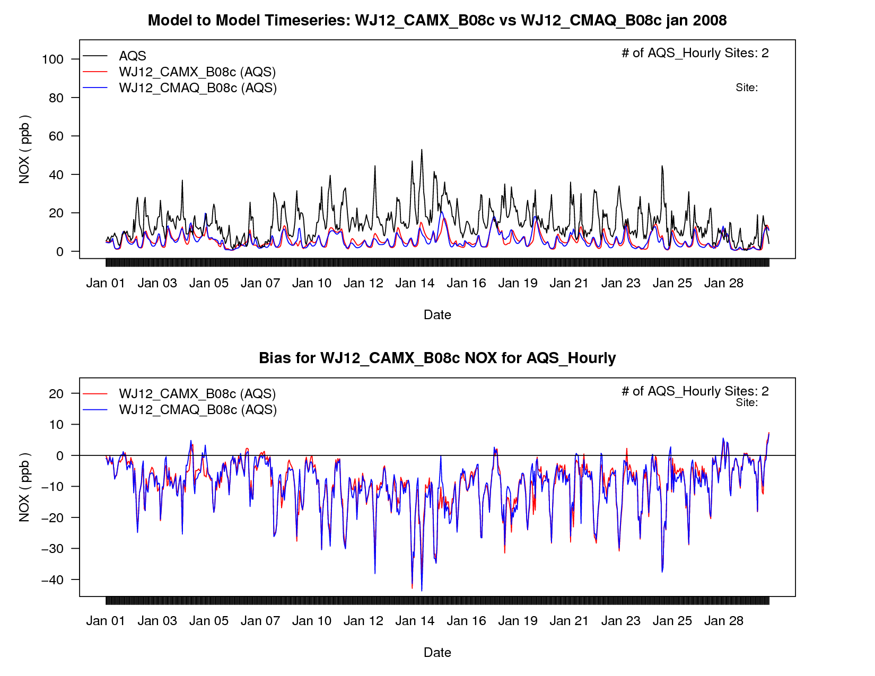
Colorado January AQS NOx

Slide 26
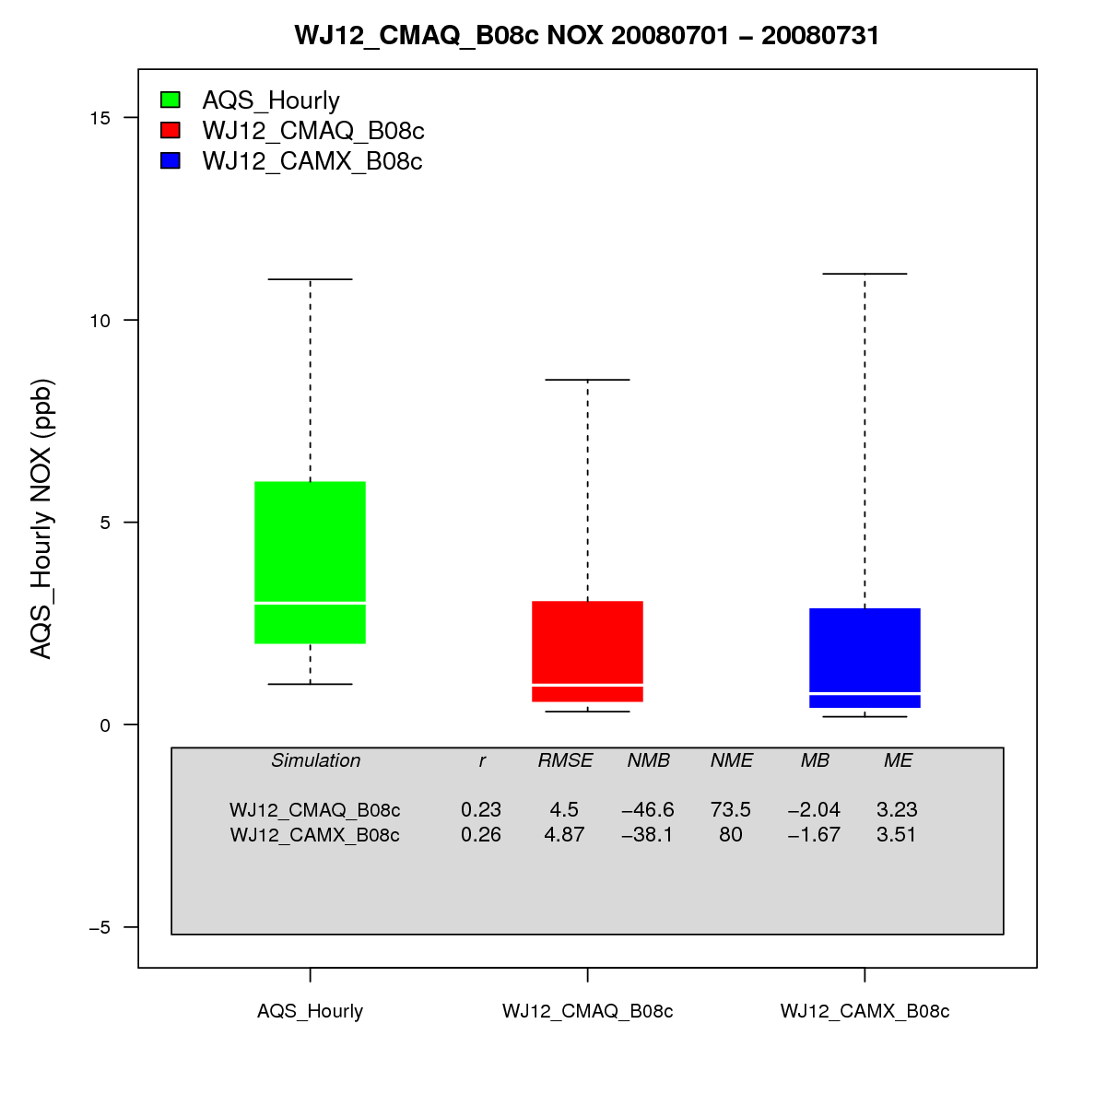
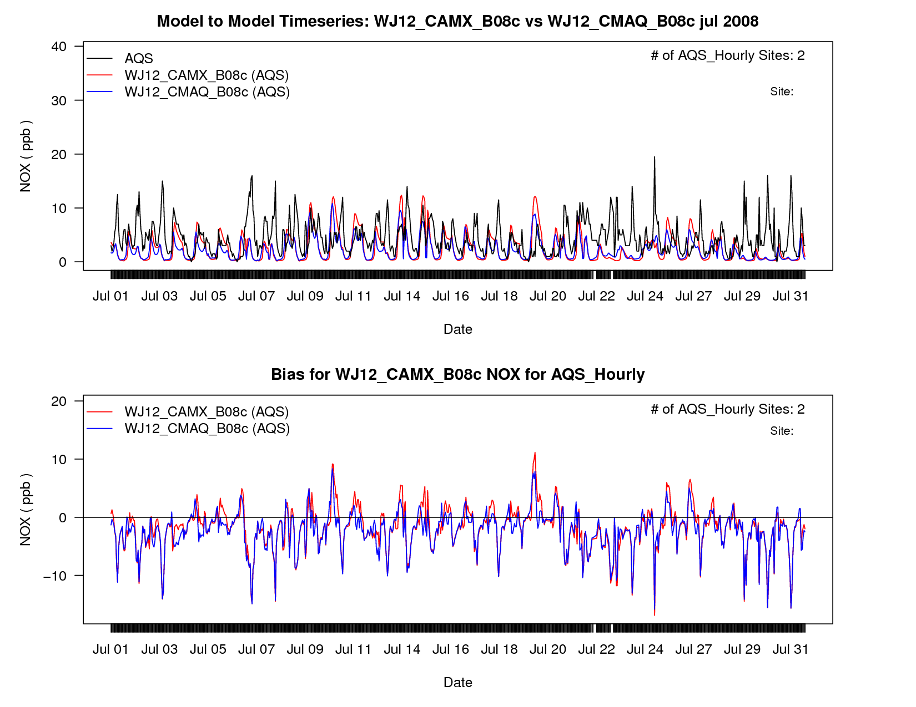
Colorado July AQS NOx

Slide 27
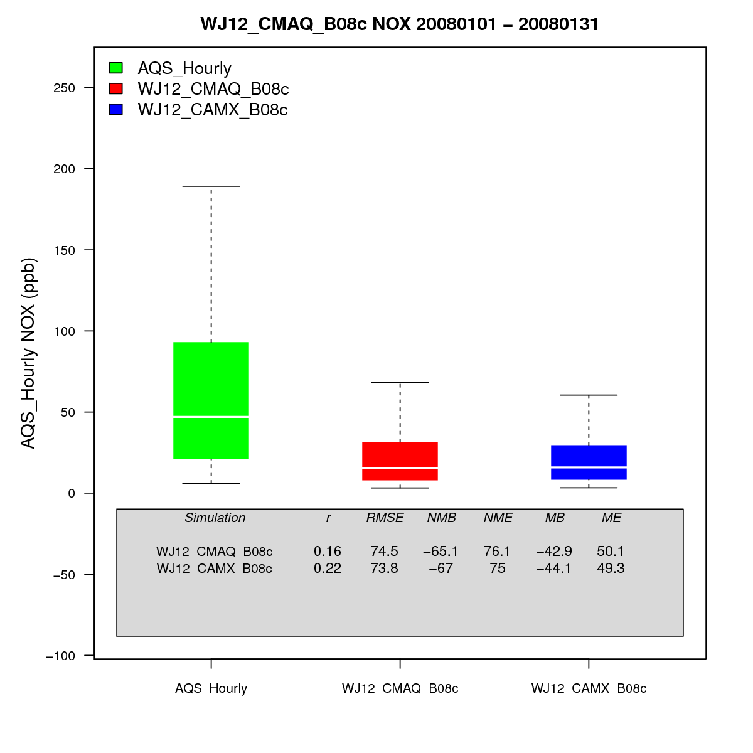
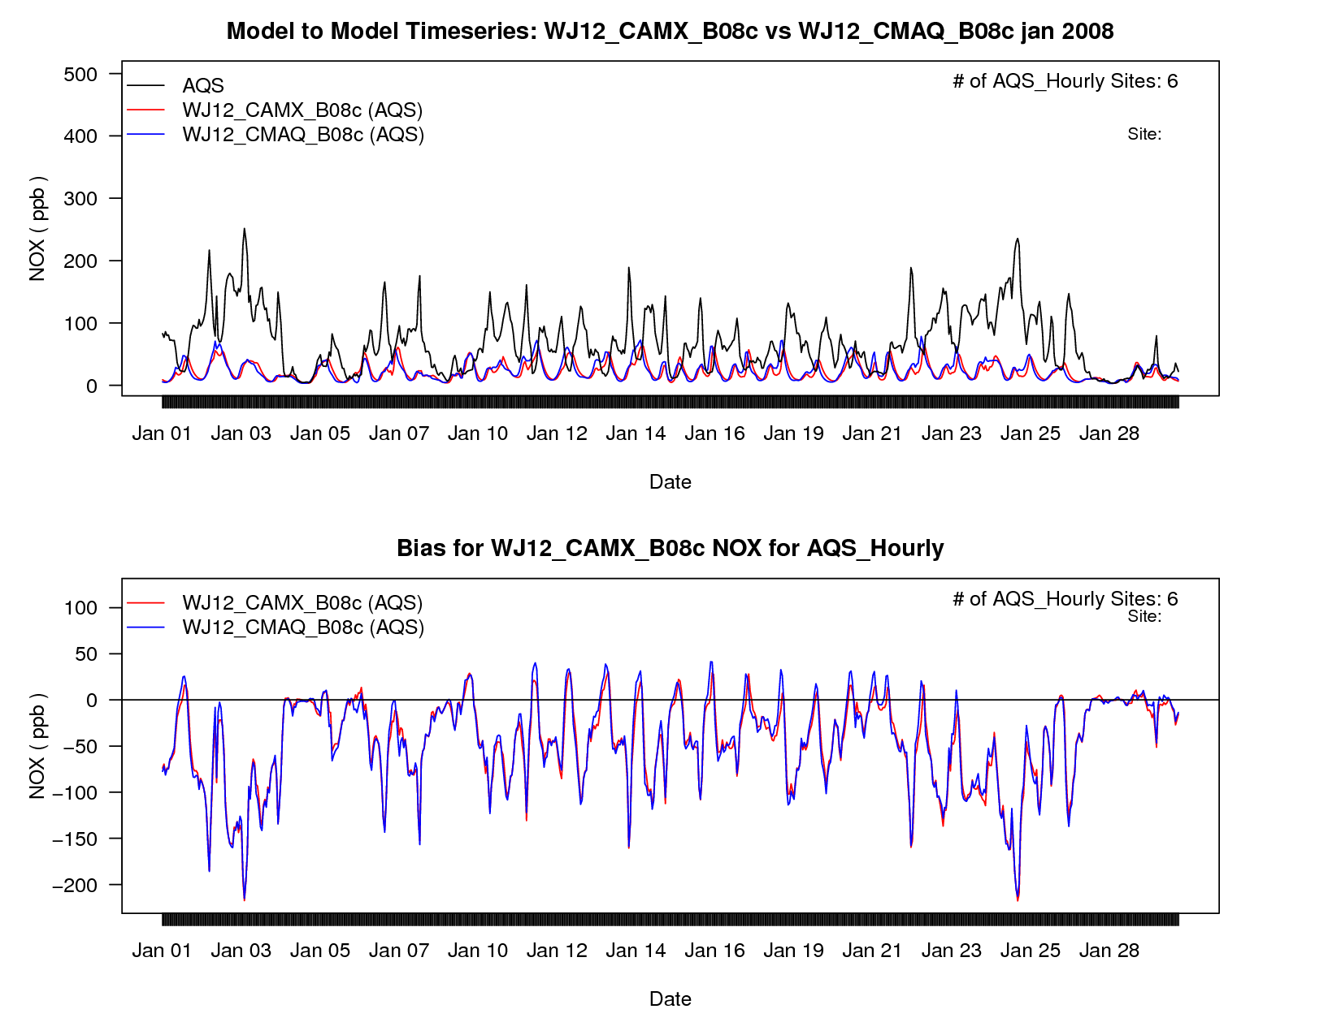
Utah January AQS NOx

Slide 28
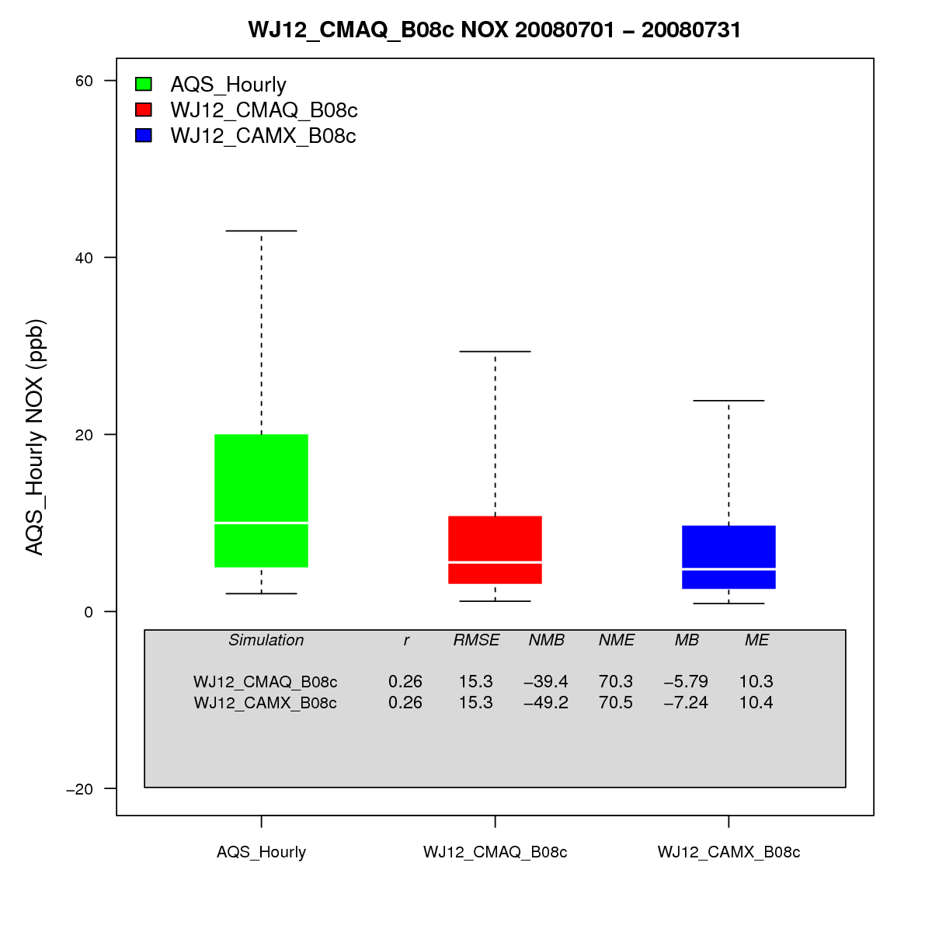
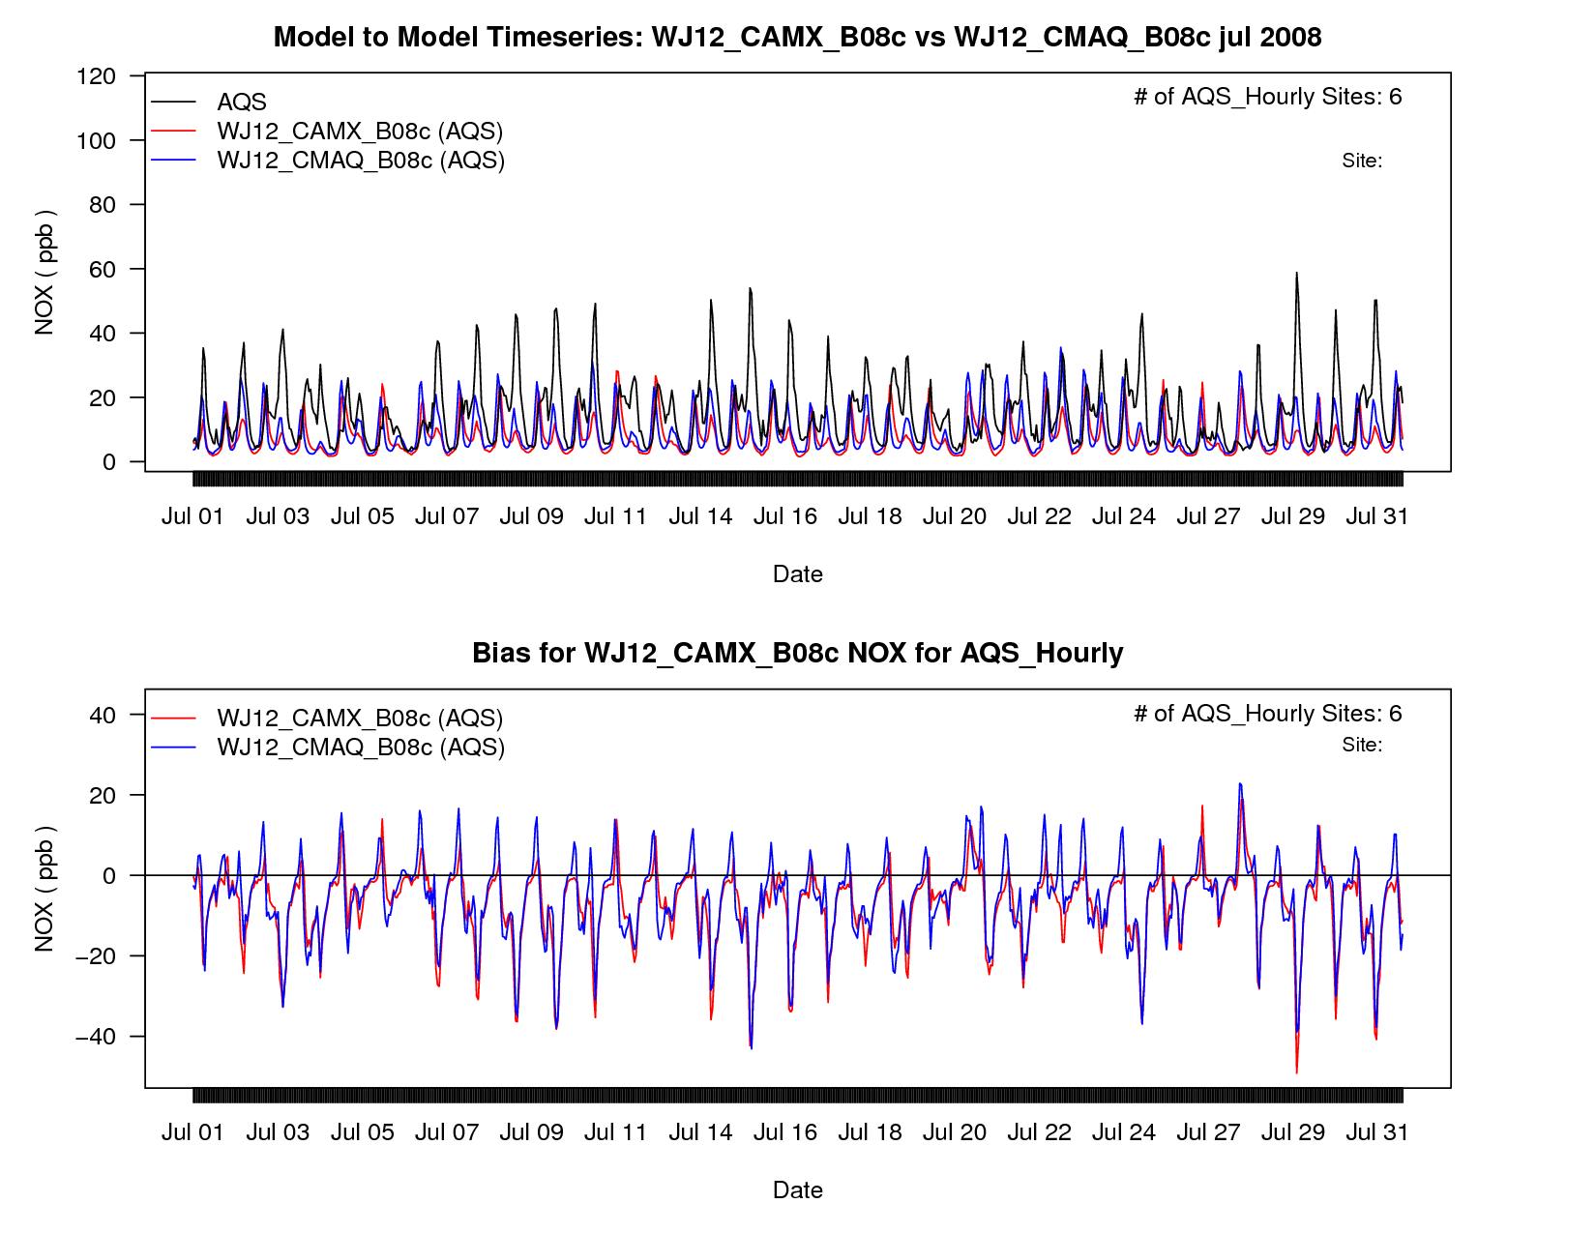
Utah July AQS NOx

Slide 29
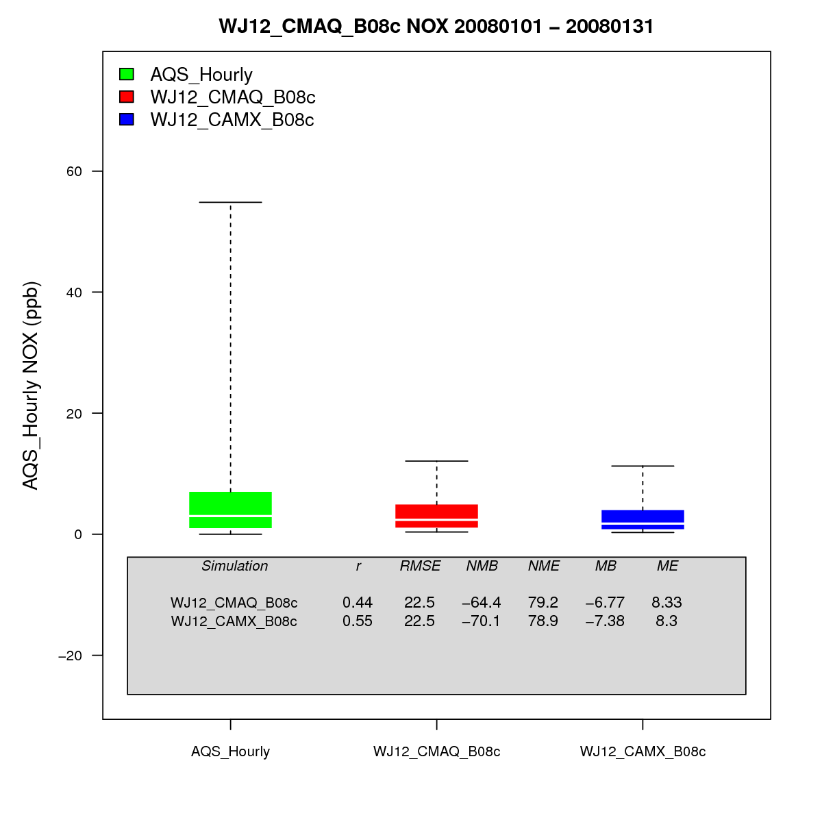
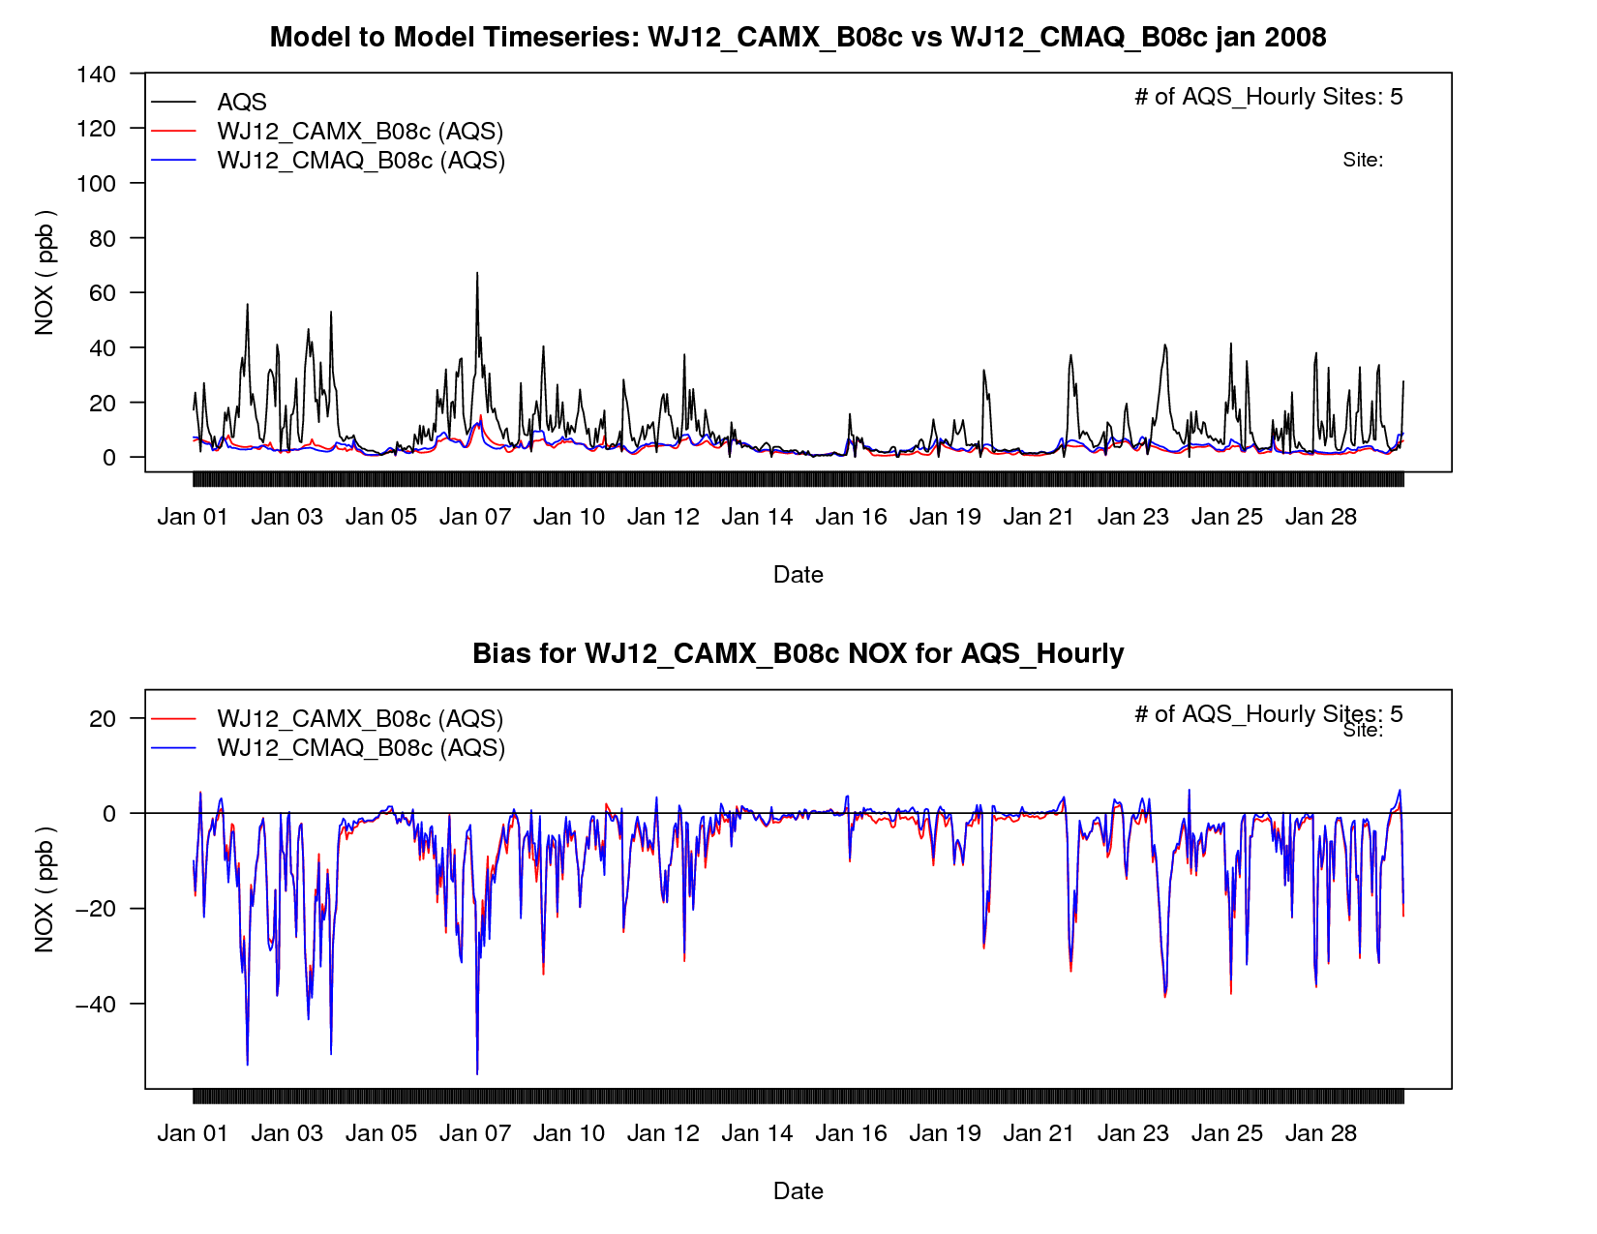
Wyoming January AQS NOx

Slide 30
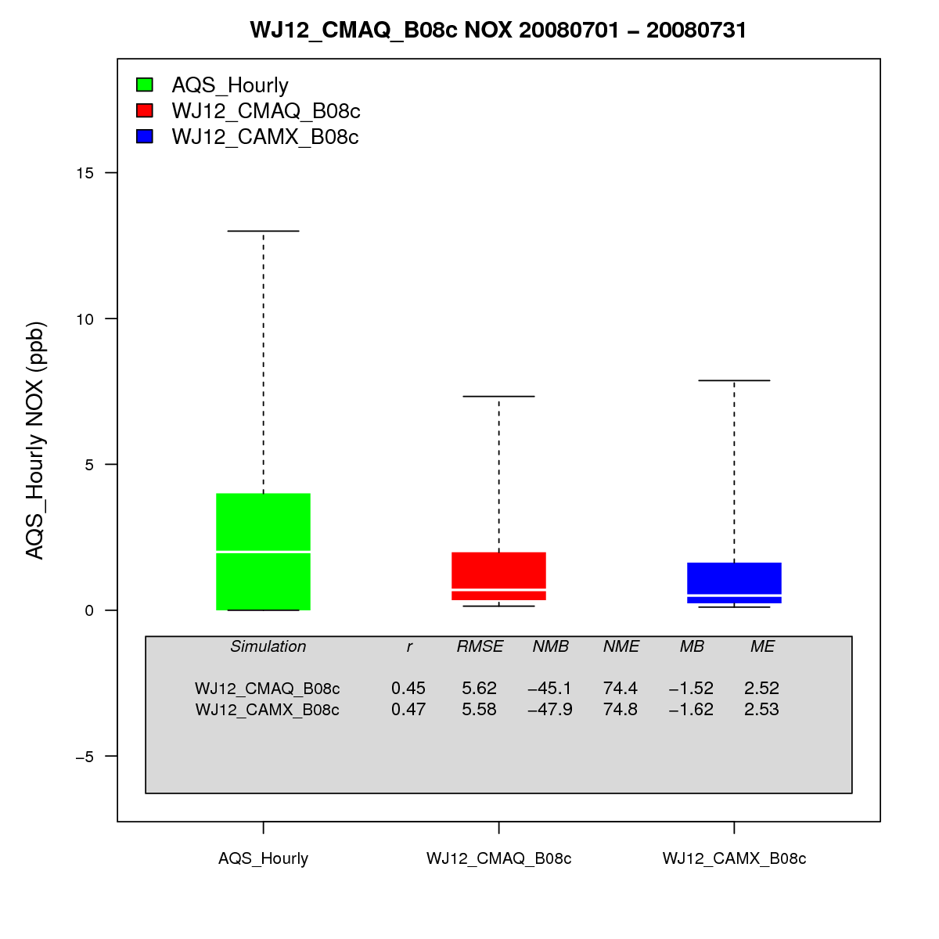
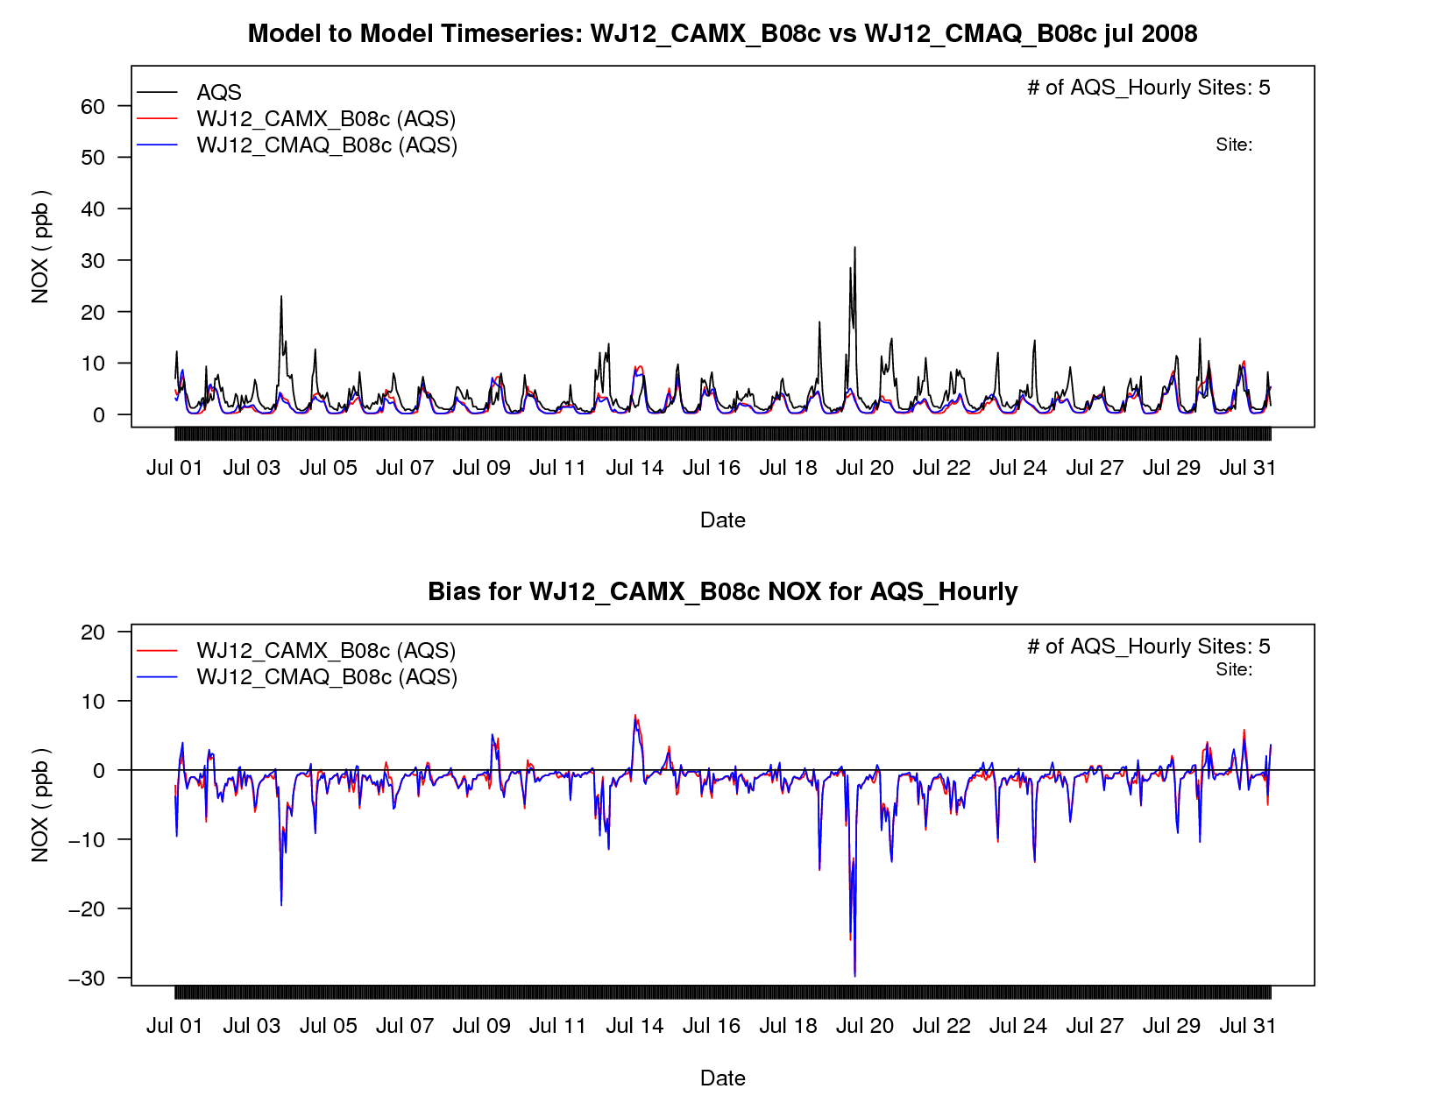
Wyoming July AQS NOx

Slide 31
WestJumpAQMS CAMx-CMAQ Comparison Plots
Project page at UNC-IE:
www.ie.unc.edu/cempd/project/data_viewer/results.cfm?project=WRAP West-wide Jump Start Air Quality Modeling Study
“View the results from a single simulation”
or
“Compare the results from two simulations side-by-side”
then
AQ → WJ12_CMAQ_B08c-WJ12_CAMX_B08c
AQ → WJ12_CAMx_B08c
AQ → WJ12_CMAQ_B08c

Slide 32





3SAQS VOC Emissions Reactivity Analysis
Volatile organic compounds (VOCs) react at different rates and via different mechanisms to form ozone
Look at 3-state VOC inventories in terms of reactivity instead of mass

Slide 33
VOC Emissions Reactivity
Profile Total MIR Example
  Profile 7: Natural Gas Turbine
  70% methane, MIR_{CH4} = 0.014 gO₃/gCH₄
  30% formaldehyde, MIR_{FORM} = 9.46 gO₃/gH₂CO
  Total MIR = 0.7MIR_{CH4} + 0.3MIR_{FORM}
  = 2.85 gO₃/gVOC
SPECIATE database reactivity now completed
  Carter estimated MIR, MOIR, EBIR, for all 1700+ compounds in the database, including complex mixtures

Slide 34


VOC Emissions Reactivity
RTOG = TOG * Profile Total MIR
RTOG/TOG = Relative emission reactivity

Slide 35



VOC Emissions Reactivity
RTOG = TOG * Profile Total MIR
RTOG/TOG = Relative emission reactivity

Slide 36

RTOG
RTOG /TOG
Reactivity analysis is important for the 3SAQS because it puts the impacts of O&G VOC on O3 formation in context
Lends to the goal of understanding and improving the inputs used for NEPA studies

Slide 37




3SAQS 2008 Base Modeling and MPE
3SAQS 2008 emissions processing is done
July Onroad Mobile NOx
July Area
O&G CH4
July Point
O&G CH4

Slide 38
3SAQS 2008 Base Modeling Schedule
Protocols
  Final meteorology modeling protocol adopted from WestJumpAQMS
  Draft emissions modeling protocol ready for review
  Air quality modeling protocol in progress
Starting 36 and 12-km CAMx runs now
Target end of November to finish runs and post initial evaluation plots for review
December 15 for draft model performance evaluation report

Slide 39


3SAQS Study Region
Focused domain on the locations of the 3-state monitors
Expanded domain that brings in all three states in their entirety

Slide 40
3SAQS Working Group Questions
Strengths/weaknesses in WestJumpAQMS modeling; what should the foci be for improving the 3SAQS 2011 modeling?
What are the outstanding emissions issues in the region?
Beyond base case modeling, what types of modeling runs are needed to support the 3SAQS stakeholders
What data/analysis products are needed from the stakeholders?

Slide 41
Possible 3SAQS Working Groups
Emissions data and modeling
Winter ozone
Regional meteorology improvements
Air quality modeling and evaluation
Background air quality and boundary conditions for 2011
Air quality impacts of oil and gas
Identifying and quantifying sources of uncertainty in the model inputs/outputs

Slide 42
Possible 3SAQS Working Groups
Emissions data and modeling
Winter ozone
Regional meteorology improvements
Air quality modeling and evaluation
Background air quality and boundary conditions for 2011
Air quality impacts of oil and gas
Identifying and quantifying sources of uncertainty in the model inputs/outputs

Slide 43
Three-State Air Quality Study (3SAQS)
Three-State Data Warehouse (3SDW)
3SAQS Emissions Projections
for 2008-based Air Quality Modeling
Zac Adelman, UNC-IE
Ralph Morris, Amnon Bar-Ilan, John Grant, ENVIRON

Slide 44
3-State Air Quality Study
2008 Emissions Modeling Platform
2008 inventory and ancillary emissions data
  Derived from the final WestJumpAQMS 2008 emissions data
  NEI2008v2 for all non-O&G anthropogenic emissions
  MOVESv2010a monthly 2008 typical weekday/weekend
  WRAP 2006 Phase III O&G inventory projected to 2008
  2008 Permian Basin inventory
  DEASCO3 point-source fires
  MEGAN version 2.10 biogenics
  WRAP Windblown Dust Model
  Targeted improvements to spatial surrogates, temporal profiles, and VOC speciation for major sources in the 3-state study area

Slide 45
3-State Air Quality Study
Non-O&G 2020 Emissions Projections
3SAQS 2008 → 2020 projection approach
EPA NEI2007v5 modeling platform for anthropogenic sources
  Case 2020re_v5_07c
  Supported the 2012 PM NAAQS RIA
  Represents 2020 emissions with all Federal and State controls promulgated or under reconsideration as of July 2012
  Projection methodologies vary by sector*
Natural emissions will be held constant at 2008 levels
  Fires, biogenic, seasalt, lightning NOx
*http://epa.gov/ttn/chief/emch/2007v5/2007v5_2020base_EmisMod_TSD_13dec2012.pdf

Slide 46
3-State Air Quality Study
Non-O&G 2020 Emissions Projections
NEI 2020re_v5_07c sector summary
  IPM point – IPMv4.10 with CSAPR and final MATS; update with state information
  Non-IPM point – projections reflect CSAPR comments and emissions reductions due to national rules, control programs, plant closures, consent decrees; projections for corn ethanol and biodiesel production and upstream impacts; changes in aircraft landing/takeoff activity
  Livestock - population projections based on 2005 Dept. of Ag data
  Fertilizer - application projections include impacts of Energy Independence and Security Act of 2007
  Nonpoint – projections reflect CSAPR comments and reductions due to control programs; res. wood combustion projections reflect phase-in of low emitting stoves
Notes:
Pull 2020 IPM sources for 3-states and distribute to 3SAQS group
Remove area and point O&G sources from inventories that are not covered by ENVIRON’s inventories

Slide 47
3-State Air Quality Study
Non-O&G 2020 Emissions Projections
NEI 2020re_v5_07c sector summary (con’t)
  Nonroad mobile – NMIM/NONROAD2008a using future year equipment population estimates and control programs to the year 2020; CA-specific data provided by CARB
  Locomotive and C1/C2 marine – projections reflect final locomotive-marine and small spark ignition OTAQ rules; CA-specific data provided by CARB
  C3 marine – incorporates controls based on Emissions Control Area (ECA) and International Marine Organization (IMO) global NOx and SO2 controls
  Onroad mobile – MOVES2010b emissions factors for year 2020; CA-specific data provided by CARB
Notes:
Create analysis of onroad showing difference between NEI2008v2 and WestJump MOVES results; compare to Denver CONCEPT results
Use NEI2008v2 MOVES results for 3SAQS instead of WestJump

Slide 48
3-State Air Quality Study
O&G Projections – Phase 1
2008 WestJump inventories will be projected forward to 2011
  If 2011 inventories or permitted sources data already exist those will be used (i.e. Wyoming, Colorado APENs data, Utah permit data)
  Regulatory requirements will be factored in to the 2011 inventories (state/federal regs)
  Arrive at new 2011 baseline inventory for all WestJump basins in the three states
  Add Big Horn, Paradox, Raton basins
    Big Horn – data will come directly from Wyoming DEQ detailed operator surveys and permit database for all sources
    Raton – data will come from CDPHE APENs database for all sources
    Paradox – use any major and minor source permit data in Utah

Slide 49
3-State Air Quality Study
O&G Projections – Phase 1
2011 inventories will then be projected forward to 2020
Inventory projection will be based on:
  Activity growth/decline (scaling factors)
  Controls analysis (control factors)
Generate 2020 inventories with the same level of detail as for the baseline 2011 inventories

Slide 50
3-State Air Quality Study
O&G Projections – Phase 1
Activity projections:
  IHS database tool will be used to develop historic trends through most current complete year of data (2012)
  Well counts, spud counts, production by type (gas, condensate, oil)
  Trend lines will be projected forward to 2020
    Decline: continue decline trend but do not allow to drop to zero
    Maintain: if historic data show relatively flat trends, continue them
    Increase: continue increasing trend but literature research on whether a reasonable cap on increases could occur (reservoir analysis, well spacing, number of operating rigs, etc.)
  Develop scaling factors as ratio of 2020 activity to 2011 activity
  Similar approach to that used in the 2012/2015 projections in Phase III

Slide 51
3-State Air Quality Study
O&G Projections – Phase 1
Controls analysis
  For each of the basins in the three states, apply controls based on state/federal regulatory requirements
  Review which are more stringent (federal vs. state by year and by source category)
  Some require a step-wise approach (year-by-year controls analysis) while others can just be applied to expected controls in 2020
  Includes all area source categories subject to control based on “on-the-books” regulations at this time
  No turnover assumption – need to discuss this with technical committee
    Previous Phase III projections assume that existing equipment on the ground was unlikely to turn over in the time frame of the projections, subject only to regulations at the time of installation (unless otherwise required to comply)
    How to handle this for a 2020 projection? Is this still a reasonable assumption?
  Point sources – controls analysis is generally not possible if there is insufficient data on the current level of control (beyond the scope/resources of Phase 1)

Slide 52
3-State Air Quality Study
O&G Projections – Phase 2
Will start with 2011 data reported by states and EPA
Supplemental, targeted surveys for important sources with greatest uncertainties
Projections to multiple future years from 2011
Account more explicitly for planned development
To be outlined in more detail at Oct. 31/Nov. 1 Tech Comm workshop
Work to then be done Winter 2013 through Spring 2014

Slide 53
2008-Based Projection Inventory Schedule
Non-oil & gas inventories are available now and we will begin preparing these for CAMx in November
Phase I oil & gas inventory for 2008 -> 2020 will be completed in ???
Phase II oil and gas work to then be done Winter 2013 through Spring 2014

Slide 54
Three-State Air Quality Study (3SAQS)
Three-State Data Warehouse (3SDW)
NEI 2011 Release Status
Zac Adelman, UNC-IE

Slide 55
NEI 2011 Availability
The following two slides taken directly from Eyth, Mason, and Zubrow (2013) presentation at the 12th Annual CMAS Conference:
http://www.cmascenter.org/conference/2013/slides/eyth_development_status_2013.pptx

Slide 56
2011 Emissions Modeling Platform Development: Steps and Timing
Item | Timeframe
Preliminary 2011 Runs | May-August, 2013
Finalize 2011 Base Year Platform | September, 2013
Develop Future Year Projections | October-November, 2013
Provide 2011 Modeling Platform | November, 2013
2011 National Air Toxics Assessment | Began August, 2013
Transport Rule Proposal Modeling | Began October, 2013
Provide 2018 Projection from 2011 | December, 2013
Ozone NAAQA RIA Proposal | TBD
Comments on 2011 and 2018 Data | Winter (2011), Spring (2018)

Slide 57

Changes from 2008 to 2011 NEI

Slide 58
Three-State Air Quality Study (3SAQS)
Three-State Data Warehouse (3SDW)
Transient Methane CMAQ Simulation
Zac Adelman, UNC-IE
Gail Tonnesen, US EPA

Slide 59


January CH4 and ΔO3

