Slide 1
3SAQS Network Assessment Final Recommendations
DRAFT
19 Feb 2014
Prepared by:
Till Stoeckenius, ENVIRON and
Tom Moore, WRAP/WESTAR
On Behalf of:
Three-State Air Quality Working Group
27 February 2014

Slide 2
3SAQS Monitoring Network Objectives
Provide adequate spatial coverage of study area
Monitor locations with O₃ close to or above NAAQS
Monitor locations downwind of existing or planned future development areas
Monitor Class I and sensitive Class II AQRV impacts
Characterize background O₃
Provide data for model performance evaluation (O₃, PM and precursors)

Slide 3
Network Assessment Objectives
Network adequacy wrt network objectives
Determine optimal network configuration
Provide recommendations for how best to:
utilize available 3SAQS monitoring budget
optimize collaborative operational efforts among 3-State cooperating agencies; and
implement 3-State agencies’ individual commitments to monitoring operations

Slide 4
3SAQS Network Assessment Working Group
Colorado Dept. of Health and Environment (CDPHE) | Gordon Pierce Greg Harshfield Kevin Briggs
U.S. Environmental Protection Agency (EPA) | Gail Tonnesen Rebecca Matichuk Vanessa Hinkle
National Park Service (NPS) | Mike George Barkley Sive Mike Barna
Colorado Bureau of Land Management (CO BLM) | Chad Meister
Wyoming Bureau of Land Management (WY BLM) | Charis Tuers
Utah Bureau of Land Management (UT BLM) | Leonard Herr Collin Schwartz
Utah Division of Air Quality (UDAQ) | Patrick Barickman Bo Call
Wyoming Dept. of Environmental Quality (WYDEQ) | Cara Keslar
U.S. Forest Service (USFS) | Debbie Miller John Korfmacher

Slide 5
Approach
Data Gathering
Existing network: locations, owners & operators, characteristic high O₃ values, etc.
Background geographic information (terrain, population, Class I areas, tribal lands)
Emissions
Future oil and gas developments
Mean transport winds
Observed air quality and inter-site correlations
Model predictions
Analysis
Area served analysis (geographic coverage)
Emissions source assessment (current and potential future source impacts; background AQ)
Air quality representativeness analysis (hotspots, highly correlated sites)
Population served analysis (monitoring of population centers)

Slide 6
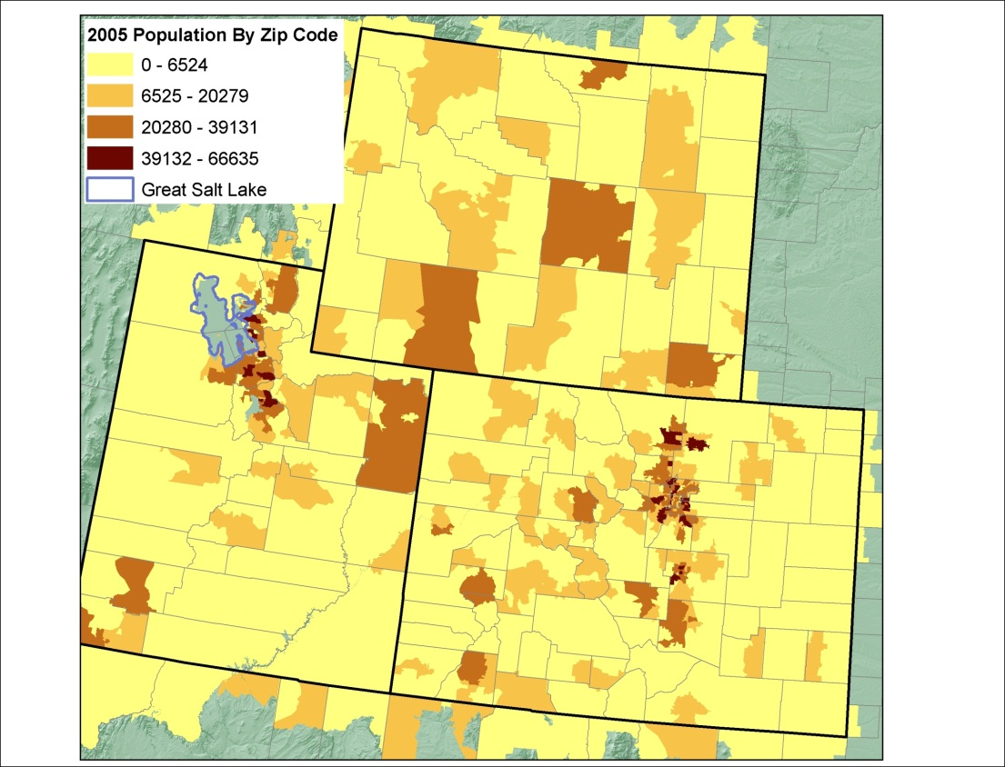
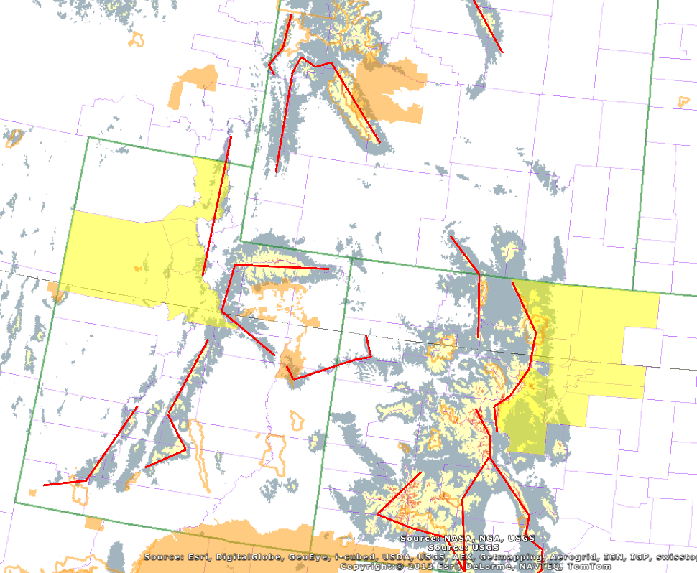
Geography

Slide 7
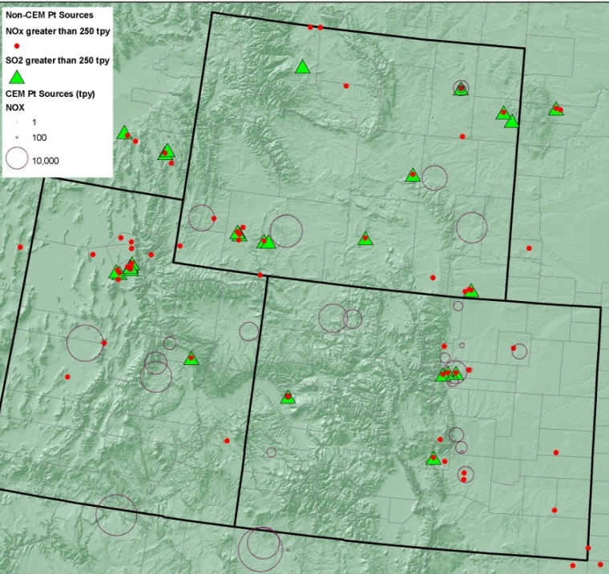
Emissions:
Point Sources

Slide 8
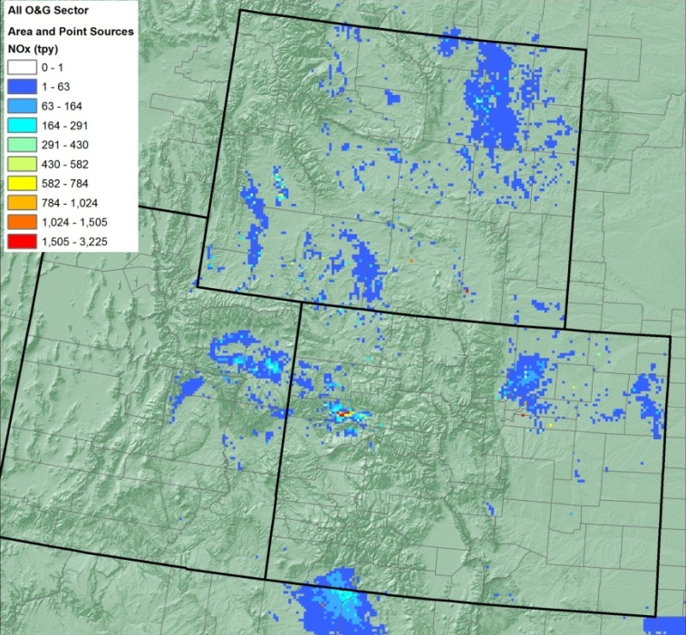
Emissions:
O&G NOx

Slide 9
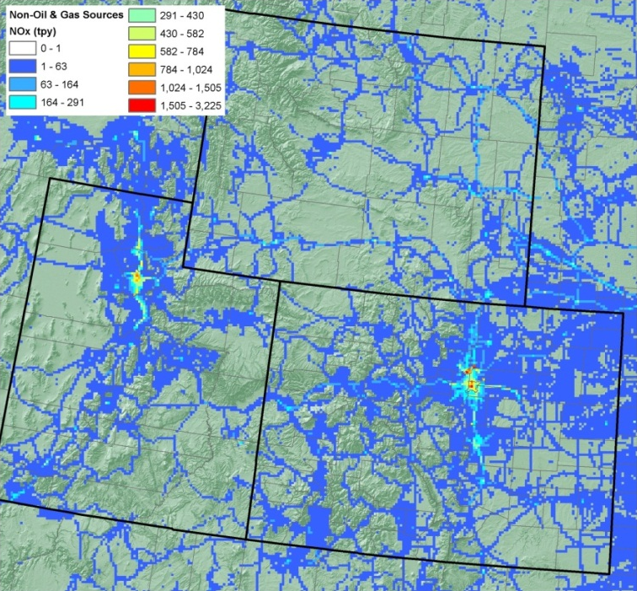
Emissions:
Non-O&G Area NOx

Slide 10
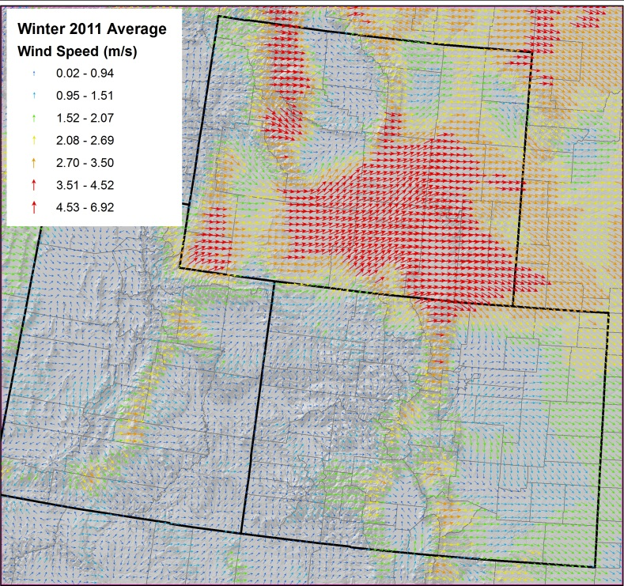
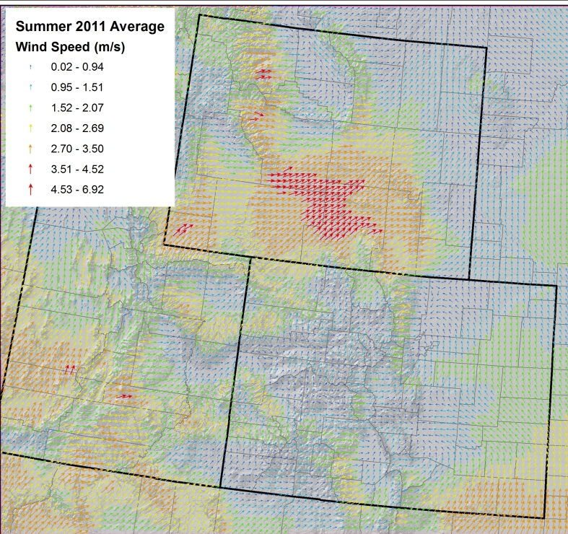
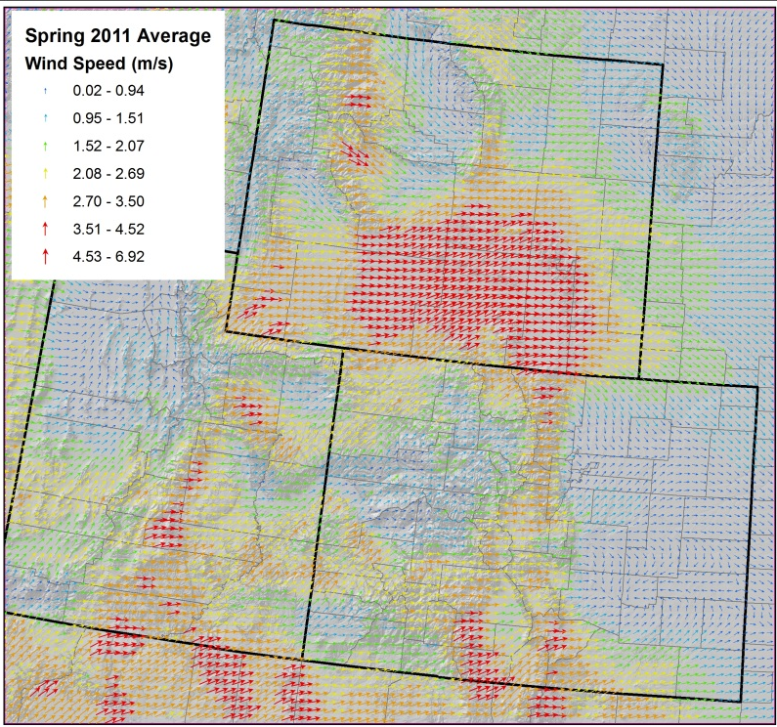
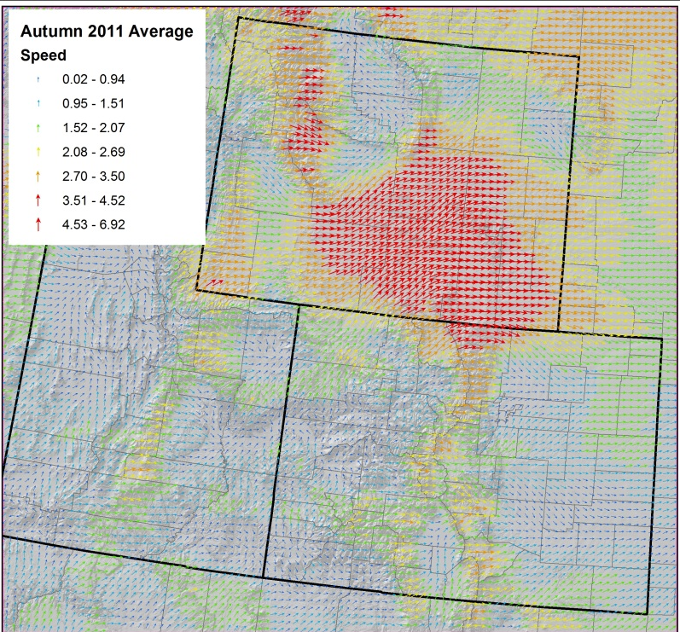
Mean Boundary Layer Winds (2011)
Winter (DJF)
Summer (JJA)
Spring (MAM)
Fall (SON)

Slide 11
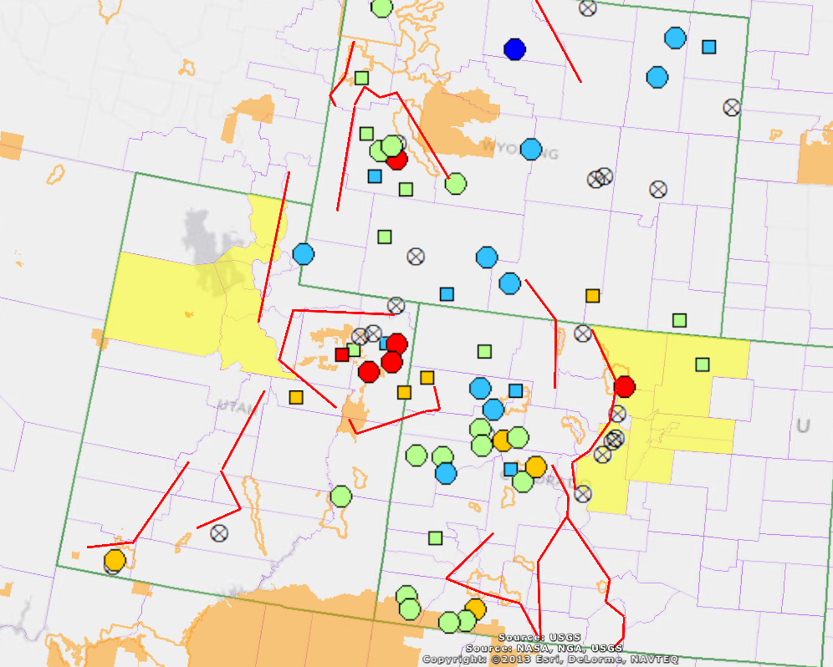
O3 (ppm)
Little or no Data Available
Value Based on Full 3-Year Avg.
Value Based on Incomplete Data
Ozone:
Avg. 4th Highest 8-Hr Daily Max.

Slide 12
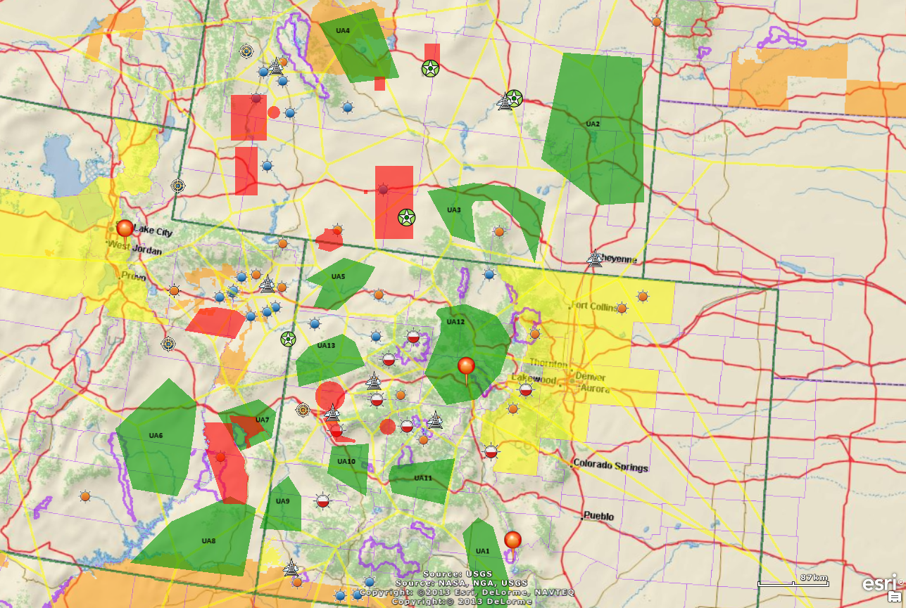
Evaluation of Potentially Underserved Areas (UAs)
13 UAs identified on map
List pros and cons for each UA
Rank order UAs

Slide 13
Potentially Underserved Areas

Slide 14
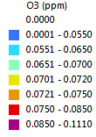
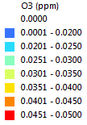
Predicted 4th Highest Daily Max 8-hr O3: Apr-Aug 2008 (no fires)
Predicted 4th Highest Daily Max 8-hr O3: Apr-Aug 2008 (no fires; no BC/IC)

Slide 15
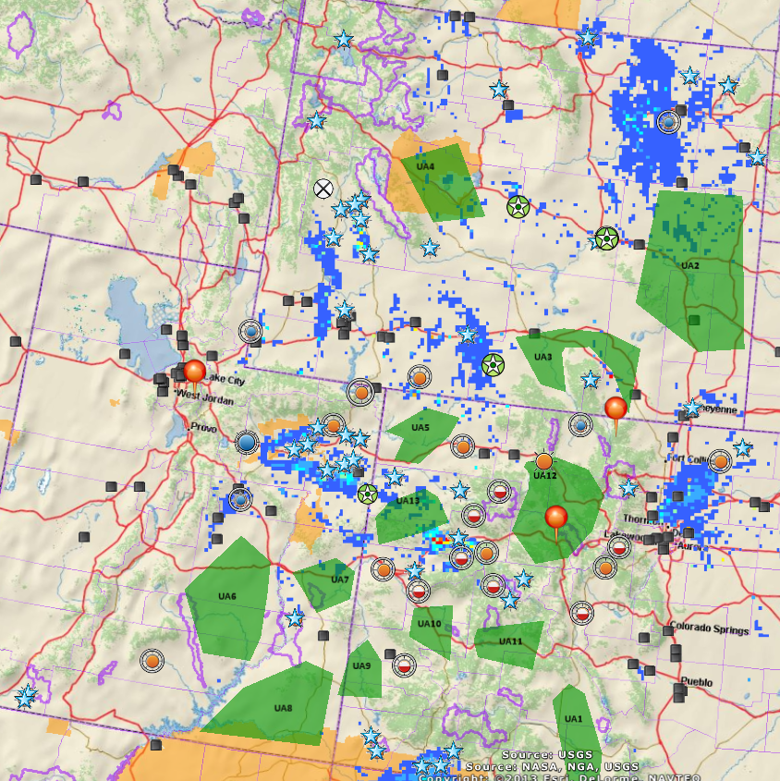
“Permanent” Site
Wyoming Range (Closed)
“Non-Permanent” Site
Industry Site
New Snowbird O3 Monitor
New Deadman Pass Site
New Storm Peak (DRI)
USFS Holy Cross (potential replacement for Wilson)
Old Great Sand Dunes O3 Monitor (1988-1991)

Slide 16
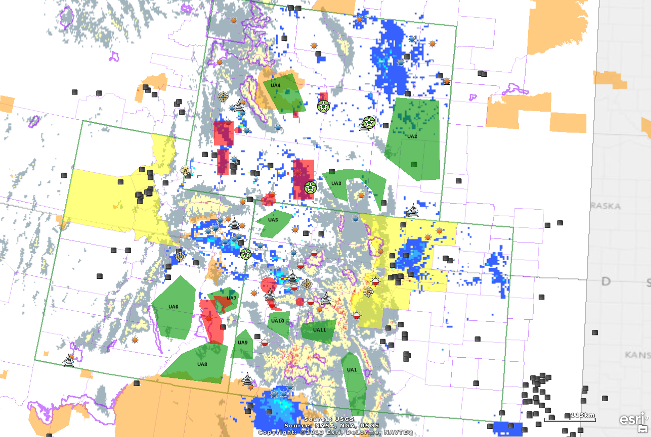
Potentially Underserved Areas
 |  |  | Price | Escalante | Canyonlands
 |  | Site ID: | _490071003 | _490170004 | _490370101
 |  | Elevation (m asl): | 1722 | 1789 | 1814
Series | Correlation Type | Ozone DV (ppm): | 0.07 | incomplete | 0.068
Anomaly | Pearson | Price | 1 | 0.598 | 0.633
Anomaly | Pearson | Escalante | 0.598 | 1 | 0.752
Anomaly | Pearson | Canyonlands | 0.633 | 0.752 | 1
Absolute | Pearson | Price | 1 | 0.853 | 0.883
Absolute | Pearson | Escalante | 0.853 | 1 | 0.905
Absolute | Pearson | Canyonlands | 0.883 | 0.905 | 1
8-Hr Daily Max O₃
2007-2012
UA6
Pros | Cons
Upwind boundary | No significant sources or population centers
Near Capitol Reef Class I area | High absolute correlations between surrounding sites

Slide 17
Potentially Underserved Areas
UA5
Pros | Cons
Downwind of Uintah Basin | No significant sources or population centers
Cross-border transport
Hiawatha RFD on northern edge
High values at Rangely and Dinosaur (Lay Peak at much higher elevation)

Slide 18
UA Evaluation
Potentially Underserved Area | Pros | Cons | Add’l Comments | Rank*
UA1: Saguache-Monte Vista-Alamosa | Great Sand Dunes NM on eastern boundary (but at higher elevation) Far from any existing monitoring sites Some areas of elevated non-fire O3 impacts predicted, including areas below 8,000’ (WestJump modeling) | Isolated; No significant existing sources or major population centers in immediate vicinity Far from any emissions sources Generally low O3 contribution from anthropogenic sources predicted (WestJump modeling) | J. Korfmacher (1/13/14): Not a priority for a number of reasons, but a very interesting area topographically: big, broad valley that may be subject to the inversions and snow cover in the winter that characterize Pinedale and Vernal. A valley-floor monitor for a season or two might be very useful. D.Miller (1/16/14): Believe this is a low priority. | L
UA2: East-Central WY | Downwind of PSD major point sources (Dave Johnston and Laramie River Station) Anticipated future increase in O&G development | Minimal current O&G development Low NOx emissions density Low non-biogenic O3 impacts predicted (WestJump modeling) | J. Korfmacher (1/13/14): On and around Thunder Basin NG. Probably not much happening out there--very few sources upwind and very well-mixed. Maybe MedBow or R2 have an interest in monitoring around the Thunder Basin. D.Miller (1/16/14): Suggest low priority. WY DEQ (1/17/14): Considered High priority for WY AQD due to anticipated future development; two temporary O3 monitors have already been deployed in this area. | H
UA3: Medicine Bow – Saratoga | Downwind of CDC development area (some downwind impacts from CDC are predicted in this area) Not well represented by higher elevation Centennial monitor | Minimal O&G development No PSD major sources Generally low anthropogenic O3 impacts predicted (WestJump modeling) | D. Miller(1/16/14): Modeling suggests this is downwind of very large oil and gas projects—suggest medium or high priority J. Korfmacher (1/13/14): Not too far from my Snowy Range field site, so it wouldn't be too big of a deal to manage/maintain. Some potential O&G upwind precursor sources. WY DEQ (1/17/14): Considered low priority for WY AQD given high average winds and lack of anticipated O3 impacts. | M
UA4: Central West WY | Includes population center (Riverton, Lander) Current Fremont County Monitoring Stations (South Pass and Spring Creek) may not be accurate representations of the County air quality as a whole due to elevation and nearby development. | Minimal O&G development No PSD major sources Land jurisdiction in this area is uncertain thus complicating monitor siting Low anthropogenic O3 impact predicted (WestJump modeling) | J. Korfmacher (1/13/14): Agree that this is a low-priority site. D.Miller (1/16/14): Project development is occurring at the southern end of this area; suggest medium priority. WY DEQ (1/17/14): Considered medium priority for WY AQD | L

Slide 19
Area | Assessment Summary | Recommended Rank [DRAFT]
UA13: Roan Plateau | Downwind of O&G developments and far from Rangely; USFS suggests Douglas Pass site | 3
UA5: Dinosaur East Side | Of interest for several reasons and commentators have suggested high priority but USFS may have difficulty servicing this remote location | 3
UA12: Kremmling Area | Mostly high elevation; downwind of White River O&G development; low elevation areas not well represented by current network; potential USFS Holy Cross site in southern end and DRI Storm Peak in northern end | 2-3
UA3: Medicine Bow – Saratoga | Potentially downwind of large O&G development but WestJump predicts low anthropogenic impact; may be manageable by USFS | 2
UA9: Dove Creek North Side | May be reasonably well represented by existing sites but there is potential for future development in the area (Mancos and Paradox) | 2
UA2: East-Central WY | Considered high priority by WY DEQ due to future development plans; considered low priority by other agencies; mobile monitors in place 2013 – 2014 and likely to continue | 3 (based on WY DEQ analysis)
UA4: Central West WY | Some on-going development to the south but otherwise of lower interest; considered medium priority by WY DEQ | 1-2
UA6(Caineville-Hanksville), UA7(Green River-Westwater), UA8(Blanding Area) | Long way from any existing assets; UDAQ suggests existing sites are reasonably representative of UA6, UA7 and UA8 | 1
UA10(Delta-Montrose), UA11(Black Canyon of the Gunnison) | Minimal evidence of ozone greater than background; Near otherwise unmonitored Class I areas (Black Canyon of the Gunnison and West Elk); Easy access via US-50 | 1
UA1: Saguache-Monte Vista-Alamosa | Low priority based on ENVIRON analysis and other comments received; | 1

Slide 20
Existing Site Classification
Site classification method
Step 1: List of “permanent” and “non-permanent” sites
Step 2: Non-Permanent Class A vs Class B sites
Review Class B sites and potentially underserved areas (UAs)
Monitoring Site Classification
Potential 3SAQS Sites
Starting Network
Step 1:
Permanent Site?
Yes
Permanent Sites
No
Non-Permanent Sites
Monitoring Network Objectives
Step 2 :
High value location?
Yes
Retain
(Class A Site)
No
Consider Moving
(Class B Site)

Slide 21
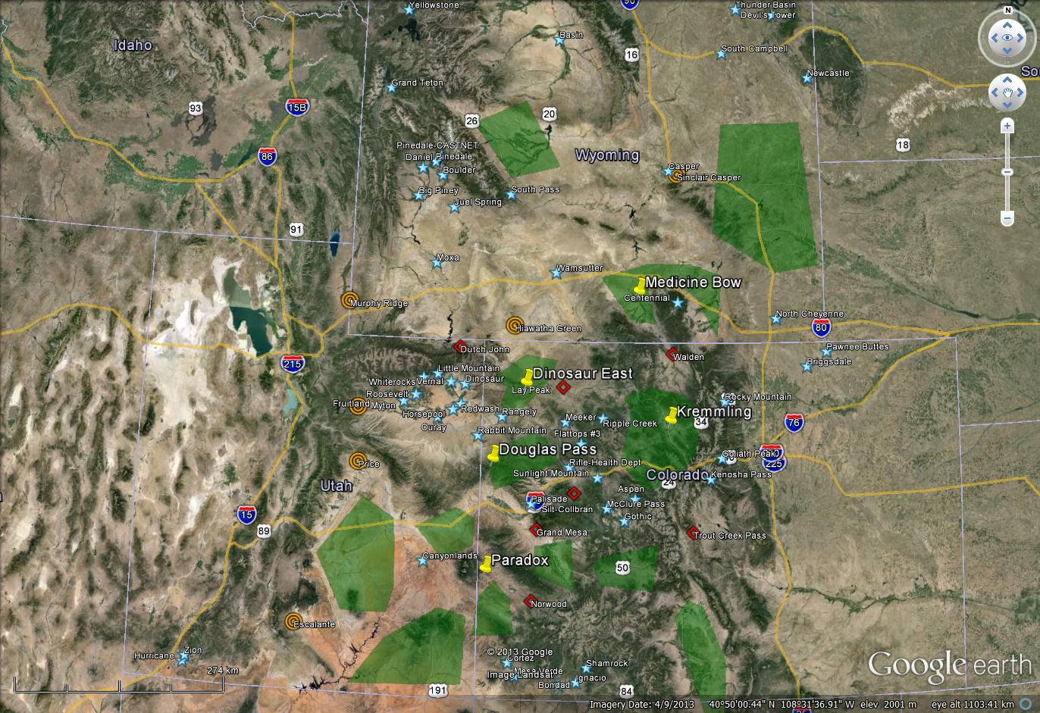
Sites to Keep (no 3SAQS funding)
Sites Considered for Closure
Existing Sites Requiring Funding
Potential New Sites
Locations are Rough Approximations

Slide 22
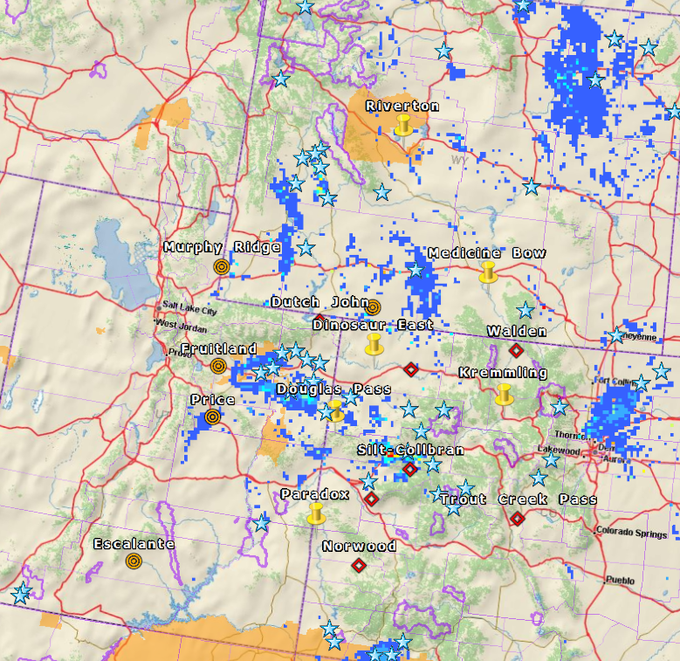
Site Reference Map with O&G NOx Emissions

Slide 23
Construction of Future Network Configuration Scenarios
Start with existing network as base case
Identify potential network changes
Open a new site using new or existing equipment
Close existing site
Estimate costs associated with each action
Available in-kind contributions
3SAQS funding
Combine actions into configuration scenarios
Potential 2014 configuration scenarios
Potential 2015 - 2017 configuration scenarios
Estimate 3SAQS funding needed for each scenario

Slide 24
Factors to Consider
Maintain existing sites through end of 2014 whenever possible
Include at least basic meteorological monitoring at all new sites (to the extent possible)
States don’t have to make monitors at sites permanent, can be Special Purpose indefinitely
State can decide to close or move sites during the ’14-’17 timeframe, but consult with 3SAQS cooperators first

Slide 25
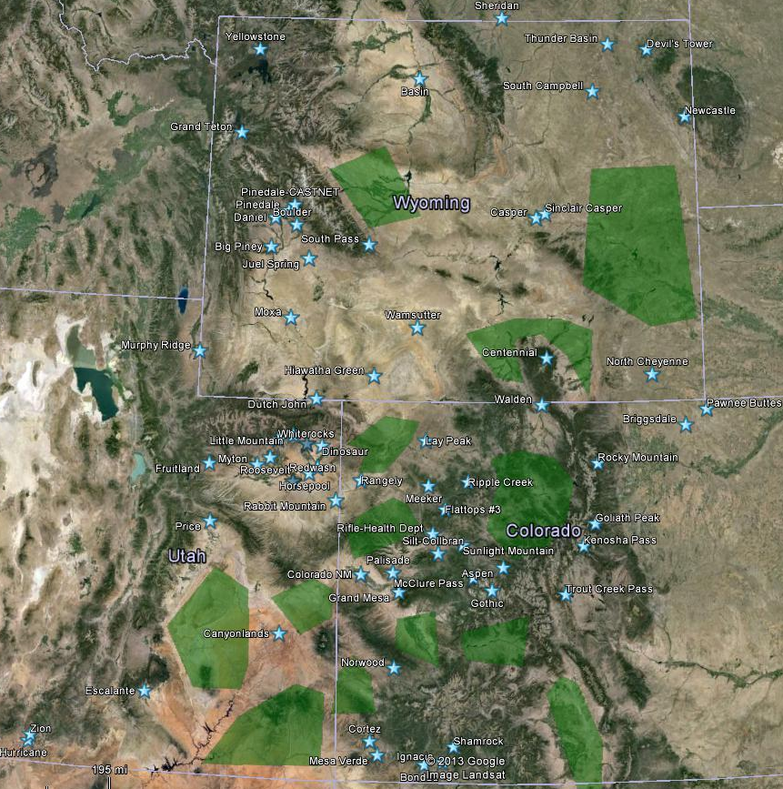
Existing Network

Slide 26
Potential Closures
3SAQS Pilot Study Sites (need continued funding)
Colorado | Utah | Wyoming
Lay Peak | Fruitland | Wamsutter VOC
Walden | Price
 | Escalante
Sites Considered for Potential Closure
Colorado | Utah | Wyoming
Lay Peak (CDPHE) | Dutch John (USFS) | Murphy Ridge (CDPHE)
Walden (USFS) |  | Hiawatha (CDPHE)
Norwood (USFS)
Silt-Collbran (USFS)
Grand Mesa (USFS)
Trout Creek Pass (USFS)

Slide 27
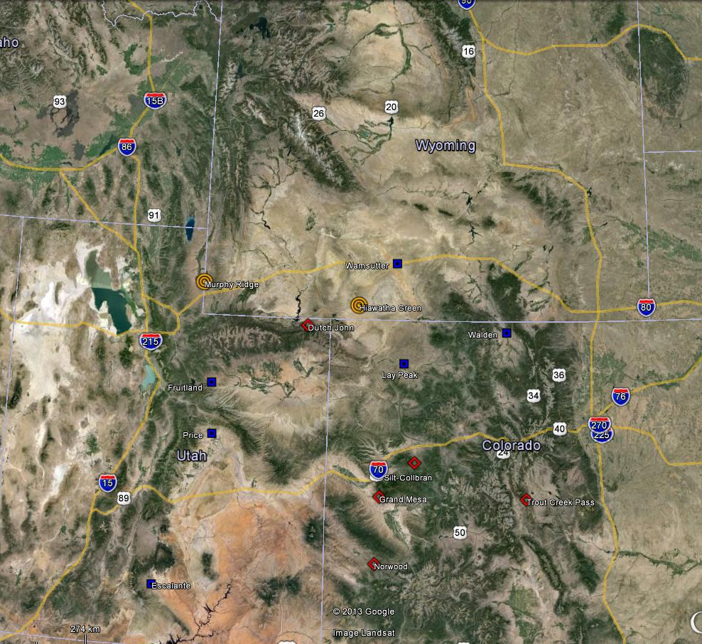
Potential
Closures

Slide 28
Recommended Network Changes Impacting 3SAQS Monitoring Budget
Potential Action | Primary Supported Objective(s) | Available Cost Offsets
Establish new site at Douglas Pass (USFS) | UA13-Roan Plateau (source impact monitoring; cross-border transport) | Close one or more designated USFS sites
Establish new site at East Dinosaur early 2014 (CDPHE) | UA5-Dinosaur East (source impact monitoring; cross-border transport) | Close (CDPHE) Lay Peak in late 2014
Establish new site near Kremmling (USFS) | UA12-Kremmling Area (C1 area monitoring and MPE) | Close one or more designated USFS sites
Establish new site near Paradox (CDPHE/USFS) | UA9-Dove Creek North (potential new development; MPE) | Close Norwood (USFS); Close Walden (CDPHE)
Establish new seasonal site near Medicine Bow NF (USFS) | UA3-Medicine Bow – Saratoga (CDC new development impact; MPE) | Close one or more designated USFS sites
Maintain Fruitland site | Background monitoring | BLM take over from CDPHE and apply in-kind resources
Maintain Price site | Source impact monitoring and MPE | CDPHE maintain
Maintain Escalante site | Background monitoring | Reduced level of effort through ARS contract
Maintain Walden unless funding is needed to maintain Hiawatha | Source impact monitoring | Hiawatha currently funded through 30 June 2014; continued WDEQ funding to be decided in March 2014. Walden funded through October 2014.
2015 - 2017
2014 - 2017
7/14 - 2017
MPE = Model Performance Evaluation

Slide 29
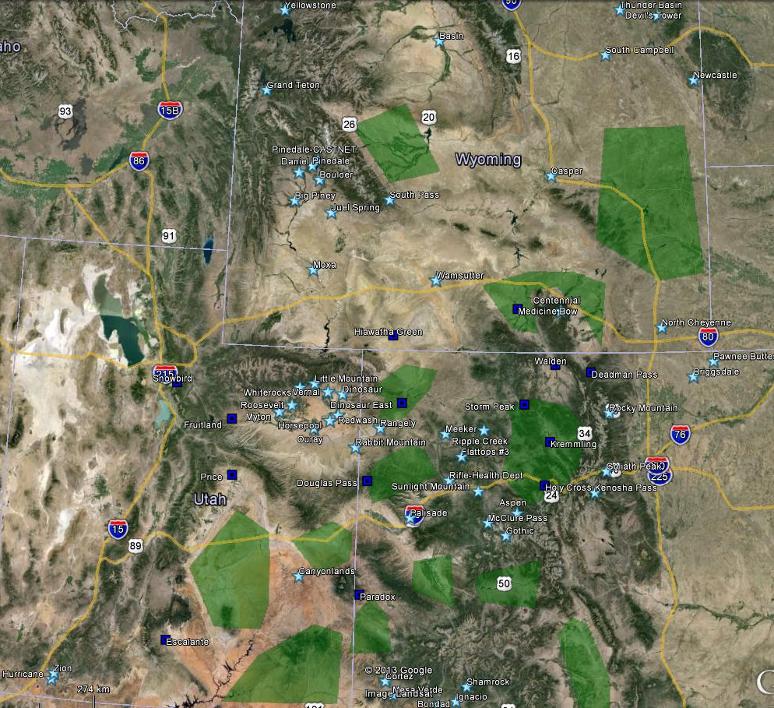
Reconfigured Network as Recommended

Slide 30
Cost Estimates

Slide 31
Monitoring Cost Elements
 | Item | $
Establish Site | Decommissioning of existing site | $ per site
 | Equipment acquisition | $ per site
 | New site installation (including site scouting trip, equipment delivery, setup and testing) | $ per site
Site Operations | Rent, Utilities, Data Link | $ per year
 | Monthly Site Visits | $ per year
 | Data Retrieval, Processing, QA | $ per year
 | Data Upload to AQS | $ per year
 | Equipment maintenance and repair | $ per year
 | Site audits | $ per year

Slide 32
New USFS Sites
Site: | Douglas Pass (USFS POM) |  |  |  | Kremmling |  |  |  | Medicine Bow
 | Responsible Agency | Unit | Unit Cost | Expected 3SAQS Contribution | Responsible Agency | Unit | Unit Cost | Expected 3SAQS Contribution | Responsible Agency | Unit | Unit Cost | Expected 3SAQS Contribution
Overall Site Lead | USFS |  |  |  | USFS |  |  |  | USFS
Decommission Old Site | USFS | 1 |  | $ - | USFS | 1 |  | $ - | USFS | 1 |  | $ -
New equipment buy/rent | N/A |  |  |  | N/A |  |  |  | N/A
New Site Setup | USFS | 1 | $ 500 | $ 500 | USFS | 1 | $ 500 | $ 500 | 500 | 1 | $ 500 | $ 500
Rent, utilities and data link | USFS |  |  | $ - | USFS |  |  | $ - | USFS |  |  | $ -
Data Owner | USFS |  |  |  | USFS |  |  |  | USFS
Monthly Site Visits/calibrations | USFS |  |  | $ - | USFS |  |  | $ - | USFS |  |  | $ -
Data retrieval, processing and QA | USFS |  |  | $ - | USFS |  |  | $ - | USFS |  |  | $ -
Data upload to AQS | USFS |  |  |  | USFS |  |  |  | USFS
Equipment maintenance and repair | USFS |  |  | $ - | USFS |  |  | $ - | USFS |  |  | $ -
Site audits | USFS |  |  | $ - | USFS |  |  | $ - | USFS |  |  | $ -
TOTAL COST: |  |  | $ 500 | $ 500 |  |  | $ 500 | $ 500 |  |  | $ 500 | $ 500
Up-Front Cost: |  |  | $ 500 | $ 500 |  |  | $ 500 | $ 500 |  |  | $ 500 | $ 500
Annual Cost:

Slide 33
Colorado
 | Site: | Dinosaur E./Lay Peak |  |  |  | Paradox (FRM) |  |  |  |  | Walden
 |  | Responsible Agency | Unit | Unit Cost | Expected 3SAQS Contribution | Responsible Agency | Unit |  | Unit Cost | Expected 3SAQS Contribution | Responsible Agency | Unit | Unit Cost | Expected 3SAQS Contribution
 | Overall Site Lead | CDPHE |  |  |  | CDPHE or USFS |  |  |  |  | USFS
Establish Site | Decommission Old Site | CDPHE | 1 | $ 15,000 | $ 10,000 | N/A |  |  |  |  | N/A
 | New equipment buy/rent | N/A |  |  |  | CDPHE |  | 1 | $ 70,000 | $ 70,000 | N/A
 | New Site Setup | CDPHE | 1 | $ 10,000 | $ 10,000 | CDPHE |  | 1 | $ 10,000 | $ 5,000 | N/A
 | Rent, utilities and data link | CDPHE | 3 |  | $ - | CDPHE |  |  |  | $ - | CDPHE |  |  | $ -
 | Data Owner | CDPHE |  |  |  | CDPHE or USFS |  |  |  |  | USFS
Operate Site | Monthly Site Visits/calibrations | ARS Cont. | 3 | $ 11,000 | $ 11,000 | ARS Cont. |  | 3 | $ 11,000 | $ 11,000 | ARS Cont. | 3 | $ 40,000 | $ 40,000
 | Data retrieval, processing and QA | CDPHE | 3 |  | $ - | CDPHE |  | 3 |  |  | ARS Cont. | 3
 | Data upload to AQS | CDPHE | 3 |  | $ - | CDPHE |  | 3 |  |  | ARS Cont. | 3
 | Equipment maintenance and repair | ARS Cont. | 3 | $ 11,000 | $ 11,000 | ARS Cont. |  | 3 | $ 11,000 | $ 11,000 | ARS Cont. | 3
 | Site audits | CDPHE | 3 |  | $ - | CDPHE |  | 3 |  | $ - | ARS Cont. | 3
 | TOTAL COST: | $ - |  | $ 91,000 | $ 86,000 |  |  |  | $ 146,000 | $ 141,000 |  |  | $ 120,000 | $ 120,000
 | Up-Front Cost: |  |  | $ 25,000 | $ 20,000 |  |  |  | $ 80,000 | $ 75,000 |  |  | $ - | $ -
 | Annual Cost: |  | 3 | $ 22,000 | $ 22,000 |  |  | 3 | $ 22,000 | $ 22,000 |  | 3 | $ 40,000 | $ 40,000

Slide 34
Utah
 | Site: | Fruitland |  |  |  | Price |  |  |  | Escalante
 |  | Responsible Agency | Unit | Unit Cost | Expected 3SAQS Contribution | Responsible Agency | Unit | Unit Cost | Expected 3SAQS Contribution | Responsible Agency | Unit | Unit Cost | Expected 3SAQS Contribution
 | Overall Site Lead | BLM |  |  |  | UDAQ |  |  |  | NPS
Establish Site | Decommission Old Site | N/A |  |  |  | N/A |  |  |  | N/A |  |  | $ -
 | New equipment buy/rent | N/A |  |  |  | N/A |  |  |  | N/A |  |  | $ -
 | New Site Setup | N/A |  |  |  | N/A |  |  |  | N/A |  |  | $ -
 | Rent, utilities and data link | UDAQ | 4 | $ 3,000 | $ - | UDAQ | 4 | $ 3,000 | $ - | ARS Cont. | 4 | $ 3,000 | $ 3,000
 | Data Owner | BLM |  |  |  | UDAQ |  |  |  | NPS
Operate Site | Monthly Site Visits/calibrations | BLM | 4 |  |  | UDAQ | 4 | $ 11,849 | $ 11,849 | BLM | 4 |  | $ -
 | Data retrieval, processing and QA | BLM | 4 |  |  | UDAQ | 4 | $ 6,313 | $ 6,313 | ARS Cont. | 4 | $ 5,000 | $ 5,000
 | Data upload to AQS | BLM | 4 |  |  | UDAQ | 4 | $ - | $ - | ARS Cont. | 4
 | Equipment maintenance and repair | BLM | 4 |  |  | UDAQ | 4 | $ 6,046 | $ 6,046 | ARS Cont. | 4 | $ 4,000 | $ 4,000
 | Site audits | UDAQ | 4 | $ 4,474 | $ 4,474 | UDAQ | 4 | $ 4,474 | $ 4,474 | UDAQ | 4 | $ 4,474 | $ 4,474
 | TOTAL COST: |  |  | $ 29,895 | $ 17,895 |  |  | $ 126,724 | $ 114,724 |  |  | $ 65,895 | $ 65,896
 | Up-Front Cost: |  |  | $ - | $ - |  |  | $ - | $ - |  |  | $ - | $ -
 | Annual Cost: |  | 4 | $ 7,474 | $ 4,474 |  | 4 | $ 31,681 | $ 28,681 |  | 4 | $ 16,474 | $ 16,474

Slide 35
Wyoming
 | Site: | Hiawatha
 |  | Responsible Agency | Unit | Unit Cost | Expected 3SAQS Contribution
 | Overall Site Lead | WDEQ
Establish Site | Decommission Old Site | N/A |  |  | $ -
 | New equipment buy/rent | N/A |  |  | $ -
 | New Site Setup | N/A |  |  | $ -
 | Rent, utilities and data link | WDEQ |  |  | $ -
 | Data Owner | WDEQ
Operate Site | Monthly Site Visits/calibrations | ARS Cont. | 3.5 | $ 47,000 | $ 47,000
 | Data retrieval, processing and QA | ARS Cont. | 3.5
 | Data upload to AQS | ARS Cont. | 3.5
 | Equipment maintenance and repair | ARS Cont. | 3.5
 | Site audits | WDEQ |  |  | $ -
 | TOTAL COST: |  |  | $ 164,500 | $ 164,500
 | Up-Front Cost: |  |  | $ - | $ -
 | Annual Cost: |  | 3.5 | $ 47,000 | $ 47,000

Slide 36
Totals
 |  |  |  | 3SAQS Contribution
 | Open | Close | Keep | Up-Front | Annual | 2014-2017 Total
USFS | Douglas Pass, Kremmling, Medicine Bow, Holy Cross, Deadman Pass, Pawnee Buttes | Dutch John, Norwood (and potentially one or more of Trout Creek Pass, Silt-Collbran, Grand Mesa) | Briggsdale, Goliath Peak, Flattops, Ripple Creek, Sunlight Mountain, McClure Pass, Kenosha Pass, Weminuche (Shamrock), Little Mountain | $ 1,500 | $ - | $ 1,500
Colorado DPHE | Dinosaur East | Lay Peak | All Others | $ 20,000 | $ 22,000 | $ 86,000
USFS/CDPHE | Paradox 2B | Walden | All Others | $ 1,500 | $ 18,000 | $ 55,500
UDAQ/BLM |  |  | All including Fruitland, Price, Escalante | $ - | $ 49,629 | $ 198,515
USFS or WDEQ |  |  | Walden or Hiawatha | $ - | $ 43,500 | $ 142,250
 |  |  |  | $ 23,000 | $ 133,129 | $ 483,765 | TOTAL

Slide 37
NOx, VOC and PM Monitoring
WDEQ will continue VOC monitoring at Wamsutter through March 2015
Year-round stations in shelters to include NOx monitoring to the extent possible (see map of current NOx monitors next slide)
Maintain current PM network (see map following)

Slide 38
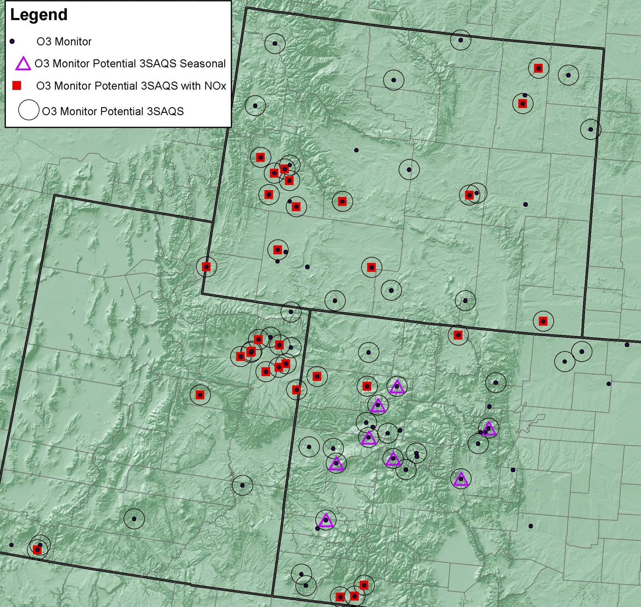
Ozone Monitors with NOx

Slide 39
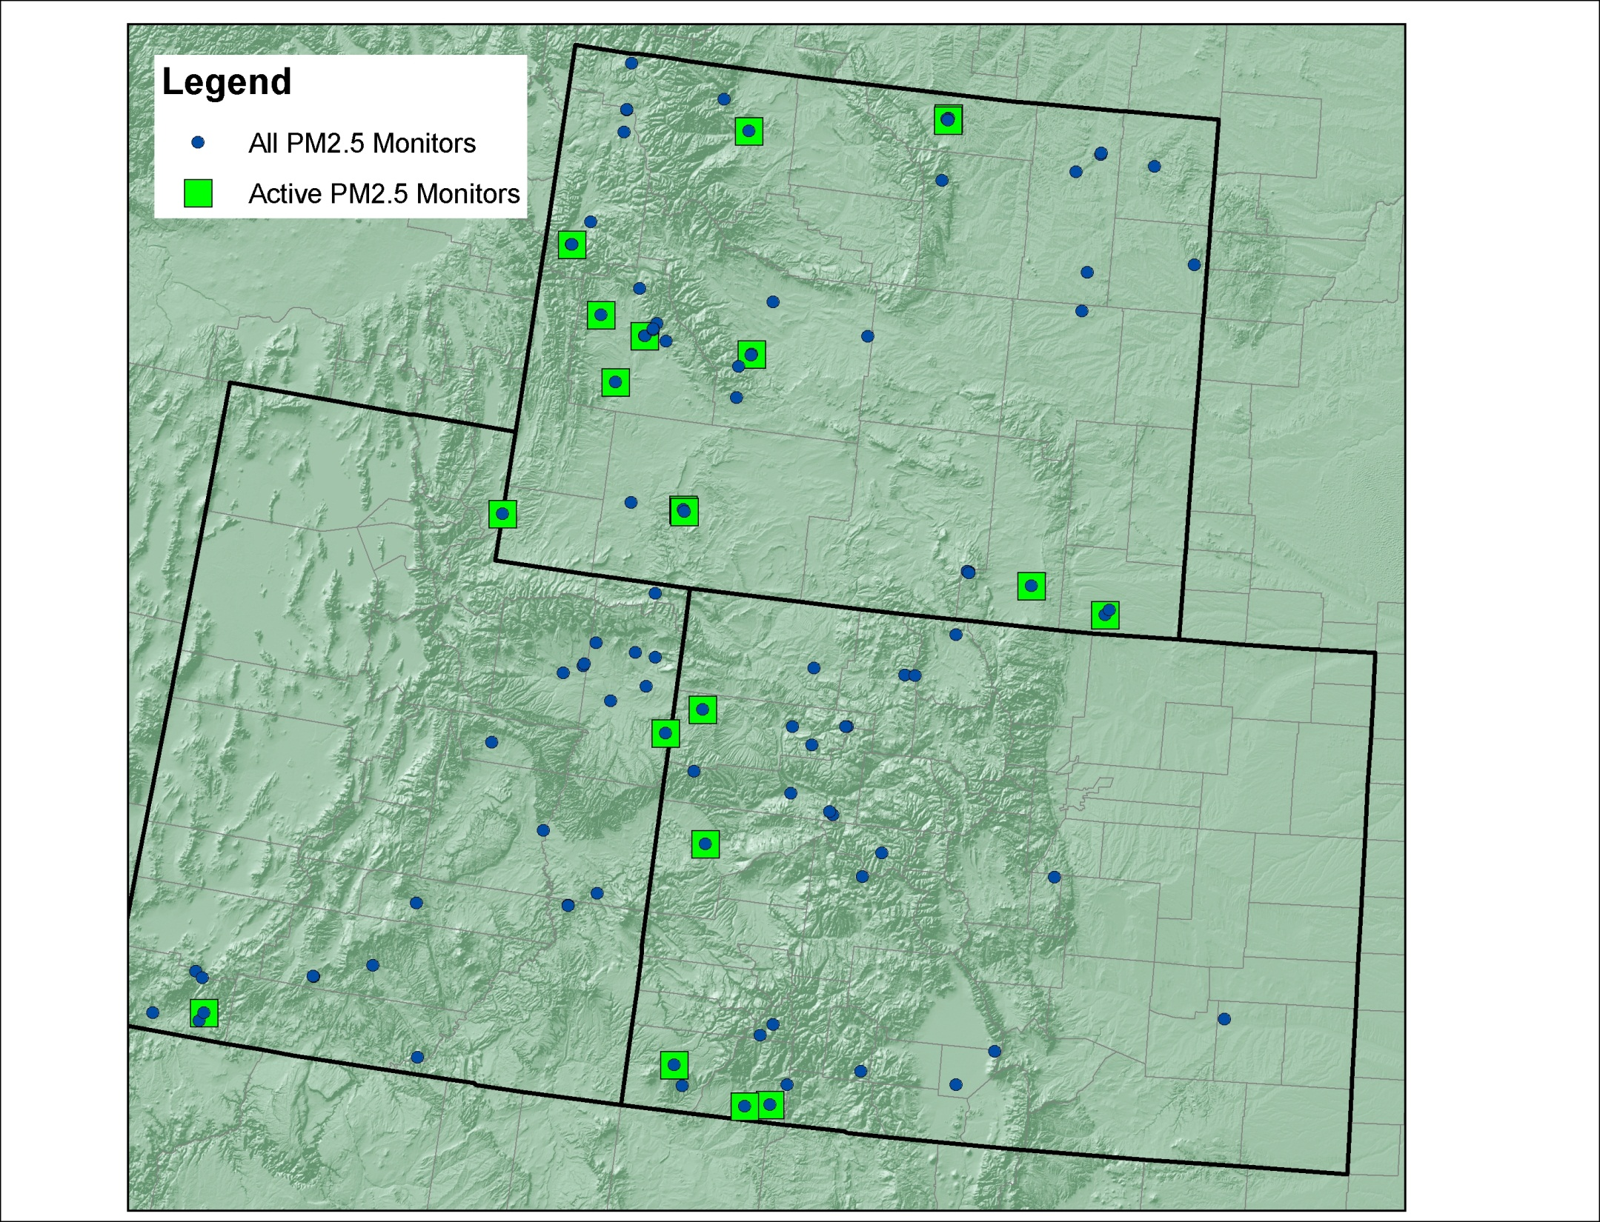
PM2.5 Monitors

Slide 40
Outline of Final Memo
Introduction
Scope and objectives
Process
Analysis
Data
Identification and evaluation of UAs
Classification of existing sites
Cost analysis
Recommendations
Review of current network configuration and funding sources
Recommended reconfigurations
Cost estimates
Appendices
Electronic Appendices
Map files (shapefiles, layers, kml files)
Monitoring site spreadsheet
Costing spredsheet

Slide 42
UA Evaluation
Potentially Underserved Area | Pros | Cons | Add’l Comments | Rank*
UA1: Saguache-Monte Vista-Alamosa | Great Sand Dunes NM on eastern boundary (but at higher elevation) Far from any existing monitoring sites Some areas of elevated non-fire O3 impacts predicted, including areas below 8,000’ (WestJump modeling) | Isolated; No significant existing sources or major population centers in immediate vicinity Far from any emissions sources Generally low O3 contribution from anthropogenic sources predicted (WestJump modeling) | J. Korfmacher (1/13/14): Not a priority for a number of reasons, but a very interesting area topographically: big, broad valley that may be subject to the inversions and snow cover in the winter that characterize Pinedale and Vernal. A valley-floor monitor for a season or two might be very useful. D.Miller (1/16/14): Believe this is a low priority. | L
UA2: East-Central WY | Downwind of PSD major point sources (Dave Johnston and Laramie River Station) Anticipated future increase in O&G development | Minimal current O&G development Low NOx emissions density Low non-biogenic O3 impacts predicted (WestJump modeling) | J. Korfmacher (1/13/14): On and around Thunder Basin NG. Probably not much happening out there--very few sources upwind and very well-mixed. Maybe MedBow or R2 have an interest in monitoring around the Thunder Basin. D.Miller (1/16/14): Suggest low priority. WY DEQ (1/17/14): Considered High priority for WY AQD due to anticipated future development; two temporary O3 monitors have already been deployed in this area. | H
UA3: Medicine Bow – Saratoga | Downwind of CDC development area (some downwind impacts from CDC are predicted in this area) Not well represented by higher elevation Centennial monitor | Minimal O&G development No PSD major sources Generally low anthropogenic O3 impacts predicted (WestJump modeling) | D. Miller(1/16/14): Modeling suggests this is downwind of very large oil and gas projects—suggest medium or high priority J. Korfmacher (1/13/14): Not too far from my Snowy Range field site, so it wouldn't be too big of a deal to manage/maintain. Some potential O&G upwind precursor sources. WY DEQ (1/17/14): Considered low priority for WY AQD given high average winds and lack of anticipated O3 impacts. | M
UA4: Central West WY | Includes population center (Riverton, Lander) Current Fremont County Monitoring Stations (South Pass and Spring Creek) may not be accurate representations of the County air quality as a whole due to elevation and nearby development. | Minimal O&G development No PSD major sources Land jurisdiction in this area is uncertain thus complicating monitor siting Low anthropogenic O3 impact predicted (WestJump modeling) | J. Korfmacher (1/13/14): Agree that this is a low-priority site. D.Miller (1/16/14): Project development is occurring at the southern end of this area; suggest medium priority. WY DEQ (1/17/14): Considered medium priority for WY AQD | L

Slide 43
Potentially Underserved Area | Pros | Cons | Add’l Comments | Rank*
UA5: Dinosaur East Side | Downwind of Uintah Basin Cross-border transport Hiawatha RFD on northern edge High values at Rangely and Dinosaur (Lay Peak at much higher elevation) Moderate anthropogenic O3 impacts predicted (WestJump modeling) | No significant sources or population centers | NPS and USFS have expressed interest. J. Korfmacher (1/13/14): A loooong way from any other sites--would be a pretty substantial commitment to establish a site out there. Would be very useful though. G. Pierce (1/16/14): Recommend highest priority area | H
UA6: Caineville-Hanksville | Upwind boundary Near Capitol Reef Class I area | No significant sources or population centers High absolute correlations between surrounding sites Low anthropogenic O3 impact predicted (WestJump modeling) | J. Korfmacher (1/13/14): UA6/UA7/UA8 (East/Central Utah): A couple years ago I had thought about trying to get some assets deployed out that way. Very difficult to say what is happening in those areas as there are so few assets anywhere nearby. Would require a significant commitment of resources unless there are skilled on-site operators. P. Barickman (Utah 1/16/14) See UA7 | L
UA7: Green River-Westwater | Near Arches Class I area and Moab Potential new O&G development (Moab Master Leasing Plan) Only moderate correlations between nearby sites (Canyonlands and Colorado NM) Moderate anthropogenic O3 contributions and moderate non-fire O3 contributions predicted (WestJump modeling) | No significant existing sources or major population centers in immediate vicinity | J. Korfmacher (1/13/14): [see UA6 above] P. Barickman (Utah 1/16/14). I would rank all 3 Utah underserved areas as a low priority for new monitors. Based on trend data analysis of CASTNET monitors we did 6+ years ago, a good bit of the 4 Corners area is affected by regional conditions. Monitors at Canyonlands, M Verde, GC, Zion, Escalante (seasonal) and Price probably cover SE/East central Utah well. | M
UA8: Blanding Area | Contains Natural Bridges and Hovenweep NMs Moderate anthropogenic O3 impacts predicted (WestJump modeling) | No significant sources or population centers High absolute correlations between surrounding sites | J. Korfmacher (1/13/14): [see UA6 above] P. Barickman (Utah 1/16/14) See comment above. | L

Slide 44
Potentially Underserved Area | Pros | Cons | Add’l Comments | Rank*
UA9: Dove Creek North Side | Surrounding monitors with annual 4th Max 8-Hour O3 values approaching NAAQS (65-70 ppb) Downwind of future Paradox and Mancos development? | No significant sources or population centers Cortez and Norwood monitors well correlated Moderate anthropogenic O3 contributions and moderate non-fire O3 contributions predicted towards Cortez but lower values predicted further north (WestJump modeling) | J. Korfmacher (1/13/14): Not much going on at Norwood monitor, also a very long way from Norwood (which is also a long way from other sites). G. Pierce (1/16/14): Recommend fourth highest priority area | M
UA10: Delta-Montrose | Near Black Canyon of the Gunnison NM Class I area Potential new O&G development (Moab Master Leasing Plan) Some areas of elevated ozone predicted, including areas below 8,000’ | No significant existing sources or major population centers in immediate vicinity Not far from Grand Mesa USFS seasonal site but Grand Mesa is at higher elevation (3040 m) Generally low O3 contribution from anthropogenic sources predicted (WestJump modeling) | J. Korfmacher (1/13/14): UA10-UA11: Low priority, but monitors along US Hwy 50 would be fairly easy to access and maintain. I don't think either of these areas would have much O3 loading. | L
UA11: Black Canyon of the Gunnison | Near Black Canyon and West Elk Class I areas | No significant existing sources or major population centers in immediate vicinity More remote than UA10 Generally low O3 contribution from anthropogenic sources predicted (WestJump modeling) | J. Korfmacher (1/13/14): [see UA10 above] D.Miller (1/16/14): Appears to be far from monitors; might be useful for filling in coverage gaps | L

Slide 45
Potentially Underserved Area | Pros | Cons | Add’l Comments | Rank*
UA12: Kremmling Area | Downwind of Piceance Basin O&G development (Garfield Co.) Includes Eagle’s Nest Class I area | Higher elevation locations may be adequately represented by DRI’s Storm Peak monitor Sites to west (Flattops, Ripple Creek Pass, Meeker) show low values Low non-biogenic O3 impacts predicted (WestJump modeling) | J. Korfmacher (1/13/14): Not sure why there are so few assets in Summit/Grand Counties. Buffalo Pass, Walden and Mines Peak will all be on the periphery of this area, but a low-elevation site in Granby, White Sulphur or Kremmling is probably necessary to complete the data picture. Kremmling would be the site we could support most easily as it's on the way to Ripple Creek. Potentially a year-round site. D.Miller (1/16/14): Downwind of potential White River development, might be useful to monitor G. Pierce (1/16/14): Recommend third highest priority area | M
UA13: Roan Plateau | Downwind of Uintah Basin and O&G development in NE Grand Co., UT Cross-border transport Black Hills RFD to the south suggests further potential development Monitors to NW show (Rabbit Mt., Rangely) show high winter values Moderate anthropogenic O3 impacts predicted (WestJump modeling) | Minimal O&G emissions at this time Adequately represented by Rangely? | J. Korfmacher (1/13/14): Douglas Pass seems to me to be the most obvious site--there are radio comm shacks and cellphone facilities already there, so it seems like we could coordinate the use of one of those. I don't think the Rangely site adequately assesses conditions in that area. Douglas Pass is >60 miles from Rangely and about an equal distance from the state site in Grand Jct. and our site at Grand Mesa. D.Miller (1/16/14): Agree this is a high priority area G. Pierce (1/16/14): Recommend second highest priority area | H

