Slide 1
3SDW Non-NEPA Request Form
Dustin Schmidt
11/6/2014

Slide 2
Terminology
File System Item
A File or Directory on the warehouse file system
Category
A collection of File System Items
A collection of other Categories
Relevant Meta Data
Currently only description
Add: Responsible Person, Links to documentation, others?
Manifest
The data being requested (Shopping Cart)
Specific to request
Add/Remove File System Items, Categories, and Packages

Slide 3
Use Cases
Pre-defined Package
Data grouped for a specific use
NEPA Analysis
Full Modeling Platform
Pre-defined Package Supplement
Package was insufficient and supplemental data is needed
Marco Rodriguez – AECOM – Converse County
Pre-defined Package Subset
Some package elements are not needed
Ralph Morris – Environ – Hiawatha & Navajo Generating Station
Rebecca Matichuk – EPA – SMOKE files
Gail Tonnesen – EPA –2008b Plot request for QA
Tim Lane – Battelle – 2008 WRF
Uncategorized (File System)
Data is not packaged. User is familiar with file system. Edge case.
Tammy Thompson – NPS – NPS/ARD files (?)

Slide 4
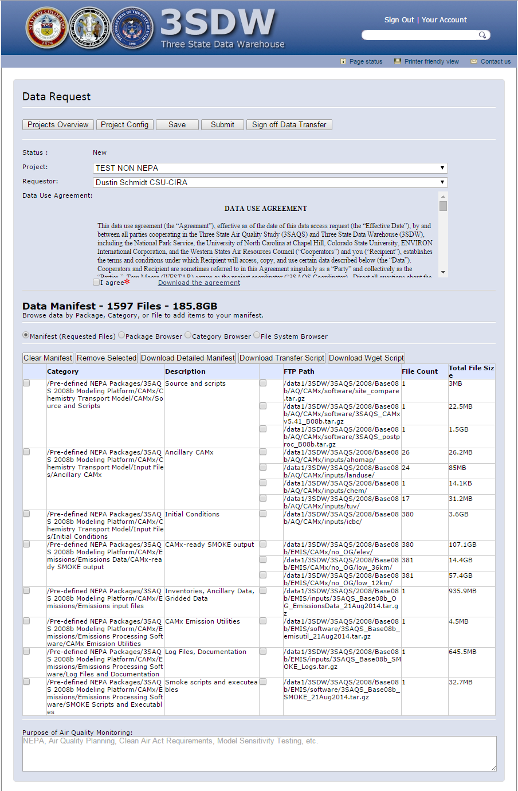
Request Manifest

Slide 5
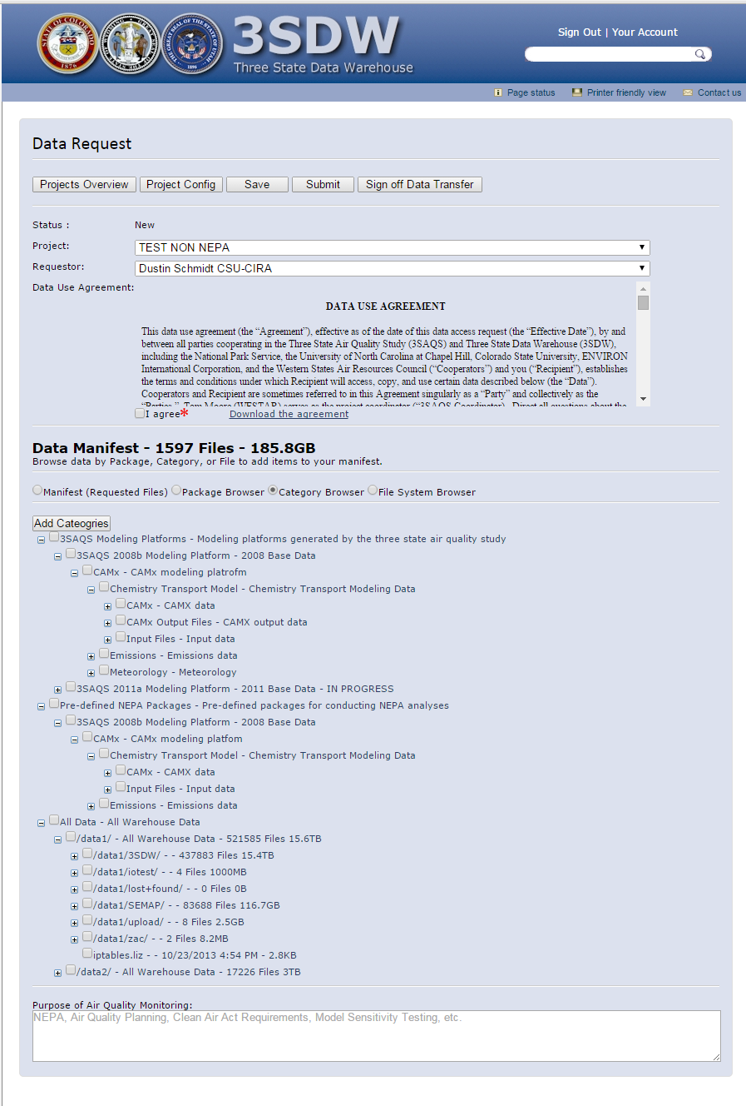
Category Browser

