Slide 1
Intermountain West Data Warehouse
Information Technology Update
IWDW Oversight Committee Meeting
March 3, 2021 2:30 p.m. (Mountain)
(Remote meeting via webinar)

Slide 2
Presentation Outline
IWDW refresher – from the bottom up
Hardware framework
Networking framework
Software framework
System ecosystem
IWDW update
Website overview
Website traffic summary
Data request process
Modeling platform data requests
Organizational composition of website traffic
Cooperator composition of website traffic
Summary of recent activities

Slide 3
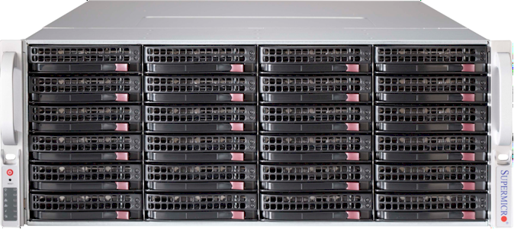
IWDW Hardware Update – Data Distribution Servers
SuperMicro dual 6-core CPU file servers (current quantity: 3)
Front view
Back view
1 or 2 bays reserved for in-chassis data transfers
Redundant power supplies
Redundant network ports
Hardware features:
36 drive bays
Dual power supplies
Dual Ethernet ports
Rack-mounted
Storage Capacity:
VIKING: | 250 | Terabytes
VALKYR: | 400 | Terabytes
VISIGOTH: | 400 | Terabytes
 | 1.05 | Petabytes

Slide 4
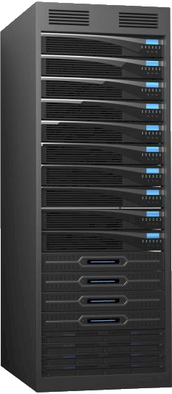
IWDW Hardware Update – Web, Database, and Support Servers
Tower chassis production servers (current quantity: 8-10)
Web
Web
Database
Database
Backup
Backup
Backup
Web servers:
Production IWDW website
Local web services
FTP/SFTP data distribution
Support websites (GIS, images)
Database servers:
Monitoring, modeled, emissions
Import and staging databases
User membership and auth.
Spatial databases
Backup servers:
Automatic backups
Development and testing
Auxiliary data storage
Data copy and transfer

Slide 5
IWDW Network Ecosystem
The Internet
Front Range Gigapop and the Internet2
Fiber optic networking to Atmos Hill
The CIRA subnetwork was phased out in 2017
CIRA subnetwork
100 Gigabit Ethernet within CIRA
IWDW Servers
Remote Desktop
Remote Desktop
Some servers have static public IPs
Some servers have static private IPs
Developer Workstation
Developer Workstation

Slide 6
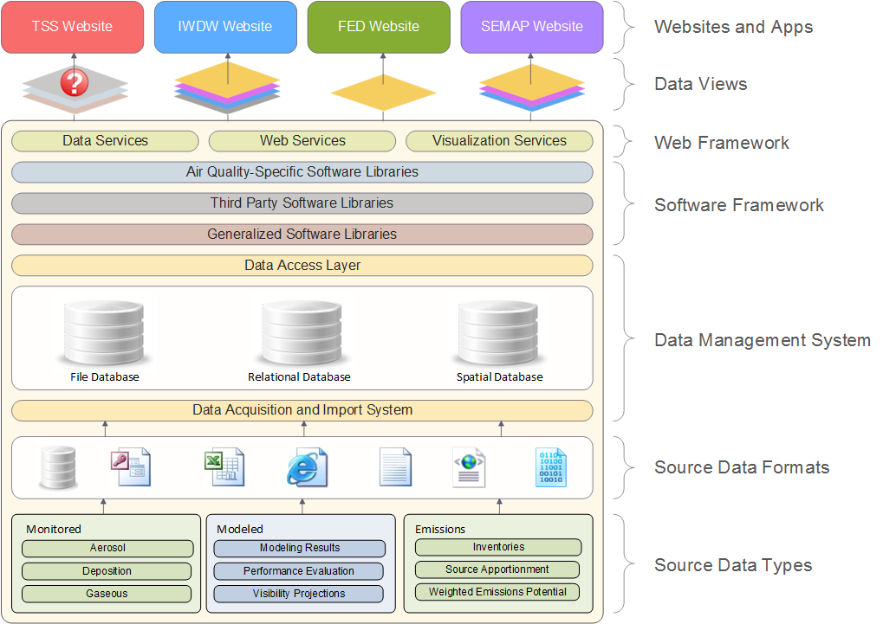
CIRA
Air Data Management System
Architecture

Slide 7
CIRA Air Data Management System Ecosystem
Intermountain West Data Warehouse
(IWDW)
Partners: NPS, BLM, USFS, EPA, States
WRAP Technical Support System
(TSS)
Partners: NPS, USFS
Databases
Websites
Software
Hardware
Currently funded
Currently funded
OGEC Repository
Partners: EPA, States
NASA ROSES
Partners: NASA / NPS
CIRA Air Data Management System
VIEWS
Partners: EPA / States
NASA NAAPS
Partners: NASA / NPS
FLM Environmental
Database
(FED)
Partners: NPS, USFS
Southeastern
Modeling, Analysis, and Planning
(SEMAP)
Partners: EPA, Southeastern States
Currently funded

Slide 8
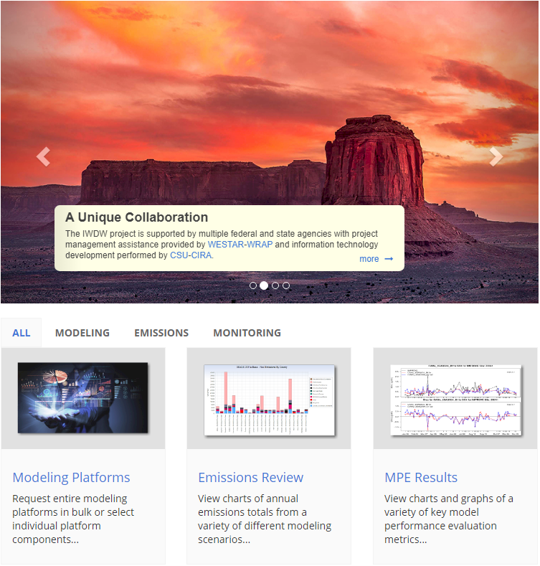
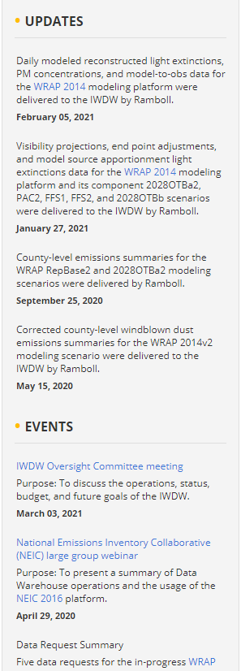
Updated IWDW Website

Slide 9
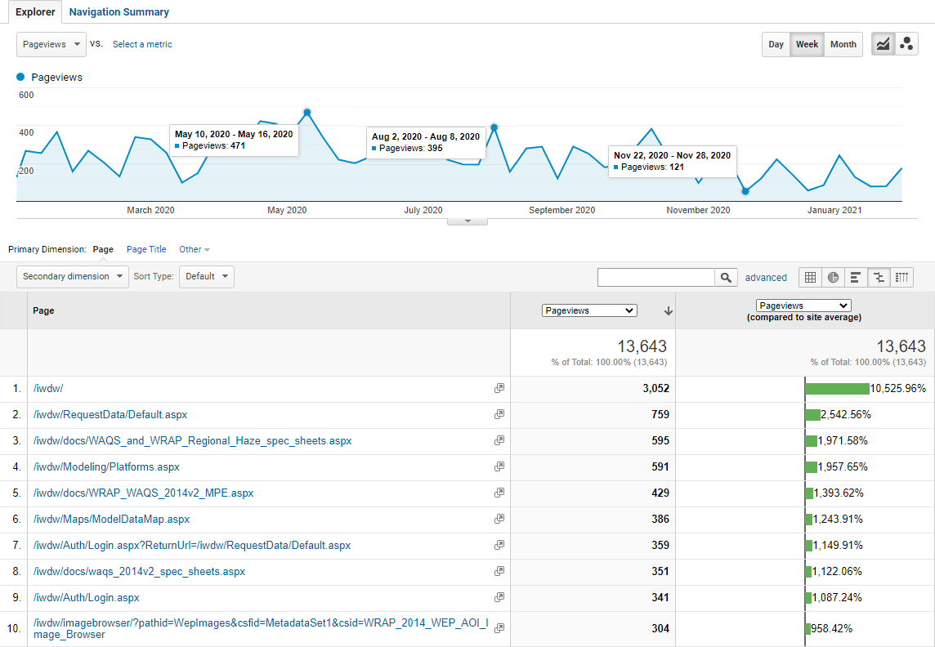
IWDW Website Traffic Summary – Past Year (Weekly View)
Apr – May 2020: First large infusion of WRAP 2014 modeling results
Additional WRAP 2014 modeling results become available
Final components of NEIC 2016v1 platform become available
Lowest traffic of past year: 121 unique page views in a week

Slide 10
IWDW Website Traffic Summary – (Past 3+ years monthly view overlaid)
Past 3+ years inset: Since the start of Analytics tracking (monthly view)
Lowest monthly pageviews (Feb 2018): 230
Highest monthly pageviews (Oct 2019): 2,106

Slide 11
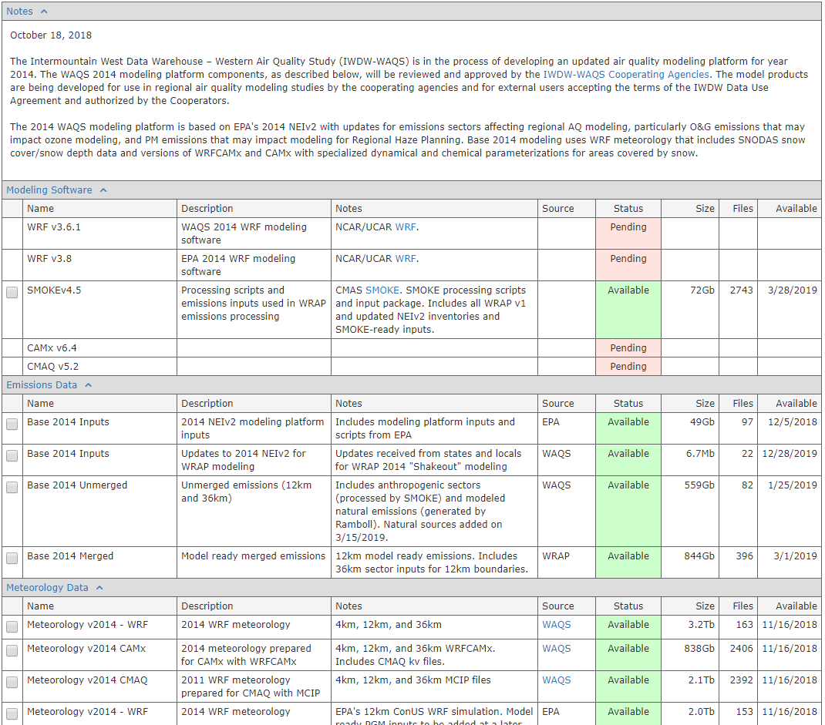
Modeling Platform Data Request Form
Purpose:
To facilitate the browsing, selection, and download of entire modeling platforms or individual modeling platform components, and to illustrate the expected roadmap for creating and distributing modeling platforms and individual platform scenarios. Platform components can be accessed and downloaded via SFTP, HTTP, and Globus, and extremely large-volume data requests can be delivered on physical hard drives via regular mail service.
Shows the status of the component
Shows the estimated size of the component
Shows the total number of files
Shows the expected availability date

Slide 12
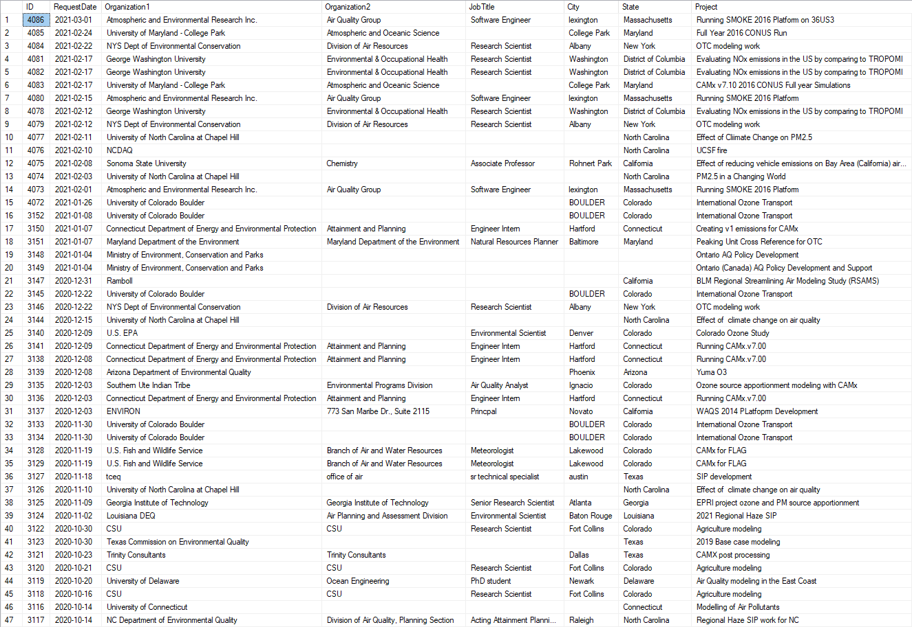
Data Request Tracking and Servicing

Slide 13
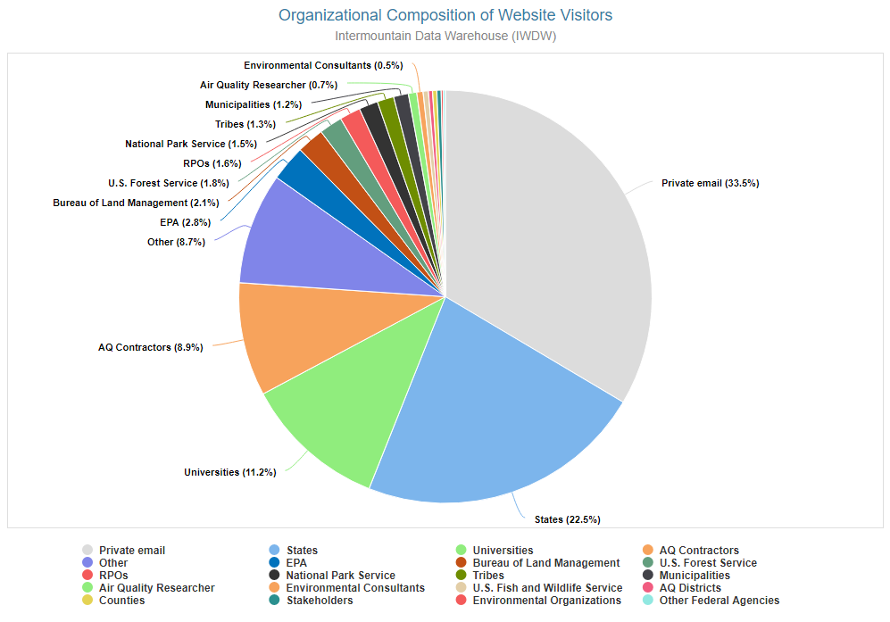
IWDW Website Traffic Summary – Organizational Composition (all)
Users who did not provide an organization name and also used a non-organizational email address (e.g. gmail, hotmail, aol, etc.)
Users belonging to an organization not covered by any of the other categories

Slide 14
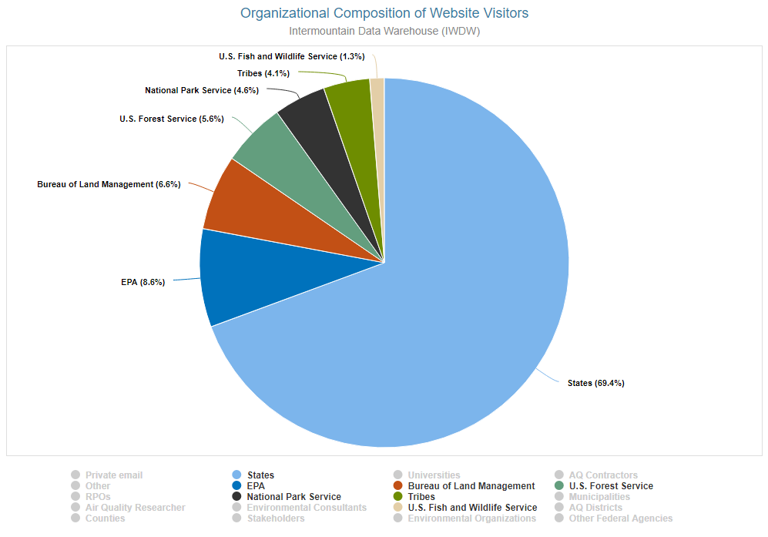
IWDW Website Traffic Summary – Filtered to Cooperator Traffic

Slide 15
Recent Activities
157 data requests serviced and fulfilled (2020 – 2021)
2021 Q1: 20
2020 Q1: 44
2020 Q2: 37
2020 Q3: 22
2020 Q4: 34
Daily modeled reconstructed light extinctions, PM concentrations, and model-to-obs data for the WRAP 2014 modeling platform were delivered to the IWDW by Ramboll.
Visibility projections, end point adjustments, and model source apportionment light extinctions data for the WRAP 2014 modeling platform and its component 2028OTBa2, PAC2, FFS1, FFS2, and 2028OTBb scenarios were delivered to the IWDW by Ramboll.
County-level emissions summaries for the WRAP RepBase2 and 2028OTBa2 modeling scenarios were delivered by Ramboll.
Corrected county-level windblown dust emissions summaries for the WRAP 2014v2 modeling scenario were delivered to the IWDW by Ramboll.
A summary of Data Warehouse operations and the usage of the NEIC 2016 platform was given to the National Emissions Inventory Collaborative (NEIC) on their annual webinar.
County-level fire emissions summaries and corrected fugitive dust data for the WRAP 2014v2 modeling scenario were delivered to the IWDW by Ramboll.
Updated county-level emissions summaries for the RepBase modeling scenario and intitial county-level emissions summaries for the 2028OTB and Natural modeling scenarios were delivered to the IWDW by Ramboll.
An initial collection of county-level emissions summaries and site-specific modeling results (concentrations and Bext) for the WRAP 2014v2 and the RepBase modeling scenarios were delivered to the IWDW by Ramboll.
A summary of Data Warehouse operations and the usage of the NEIC 2016 platform was given to the National Emissions Inventory Collaborative (NEIC) on their annual webinar.

Slide 16
Intermountain West Data Warehouse
The End
Thanks and Happy 2021!
https://views.cira.colostate.edu/iwdw

