Slide 1
Air Quality Data and Decision Support Systems
At
CSU/CIRA
ITEP Webinar
December 4th, 2019 10:30 a.m. (PDT)
Shawn McClure, CSU-CIRA

Slide 2
Presentation Outline
Overview of the CIRA Air Data Management System (~10 minutes)
Database framework
Web framework
Software framework
Hardware framework
Architectural Details
Web ecosystem (websites that leverage the CIRA ADMS)
Tour of selected web tools (~25 minutes)
Federal Land Manager Environmental Database (FED)
WRAP Technical Support System (TSS)
Intermountain West Data Warehouse (IWDW)
Summary (~10 minutes)
Short term roadmap
Registered users
Website traffic
Links and contacts
Questions

Slide 3
Overview of the CIRA Air Data Management System
Database
Web
Software
Hardware
CIRA Air Data Management System

Slide 4
Relational Database:
Over 1 billion records
62 air quality monitoring networks
5 dozen water quality projects
24 modeling and satellite datasets
15 emissions inventories
Database
Web
Software
Hardware
Database
Import/Update
Management
Administration
Dissemination
Data Warehouse:
250+ TB of online files
120+ TB of offline files
400+ TB downloaded/transferred
500 TB current storage capacity
12 modeling platforms/scenarios
CIRA Air Data Management System
Monitoring Datasets:
IMPROVE (and special studies)
IMPROVE RHR and Impairment
AQS (Most of the available datasets)
CASTNET (Dry deposition, O₃)
NADP (NTN, AIRMoN, MDN, Derived)
USFS Water Quality
more…

Slide 5
Websites:
IWDW
WRAP TSS
FED
IMPROVE
SEMAP
NASA ROSES
VIEWS
Web
Visualization tools
Analysis tools
Mapping tools
Query & retrieval tools
Web services
Software
Hardware
Web
Database
Service Consumers:
FETS
DataFed
UNC
Ramboll
ESIP
NPS
CIRA Air Data Management System

Slide 6
Database
Web
Hardware
Software
Code base:
Microsoft .NET Framework
Custom query management framework
Custom data visualization framework
Custom air quality analysis libraries
Optimized graphics generation library
Parameterized chart customization API
CIRA Air Data Management System
Software
Data access libraries
Data transformation tools
Web delivery framework
Data analysis tools
Specialized Tools:
ESRI ArcGIS
Interactive Data Language (IDL)
Statistical Analysis System (SAS)
MATLAB
Mathematica
ENVI

Slide 7
Database
Web
Software
Hardware
CIRA Air Data Management System
Hardware
Server configuration
Server maintenance
Networking
Troubleshooting & repair
Physical Infrastructure:
Fifteen Windows servers
Three 8U Linux file servers
Onsite sys-admin and service
99.9% Internet up-time
University-sized fiber optic Internet “pipe”
Internal data throughput of +1000 GB/s

Slide 8
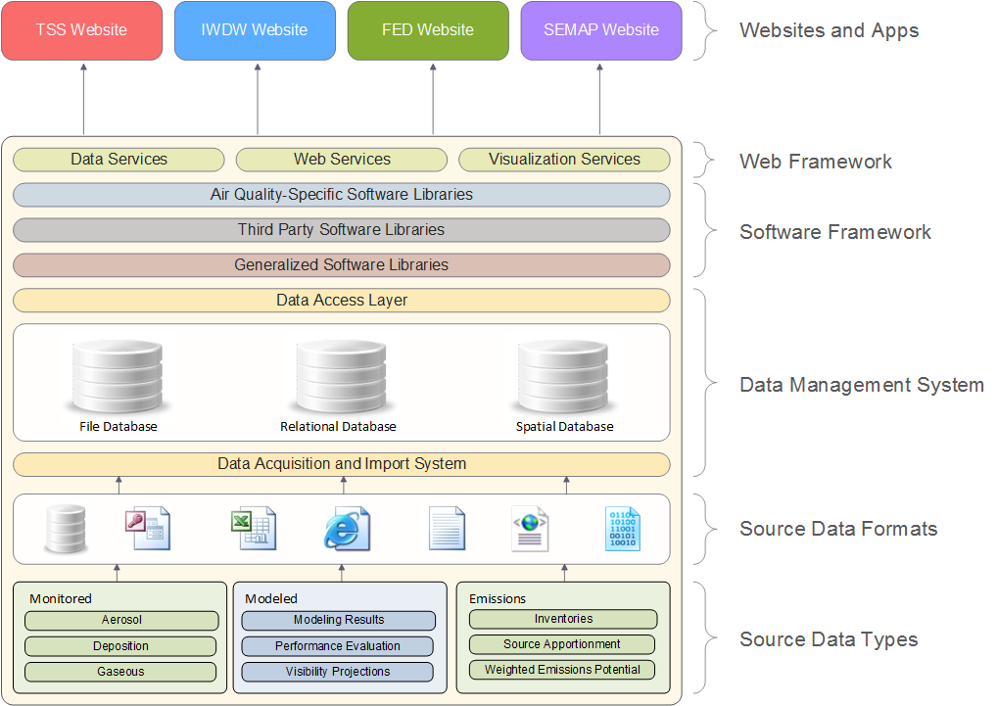
CIRA Air Data Management System Details
Everything in this box is generally invisible to most end users
General direction of data flow

Slide 9
Everything in this layer is visible to end users

Slide 10
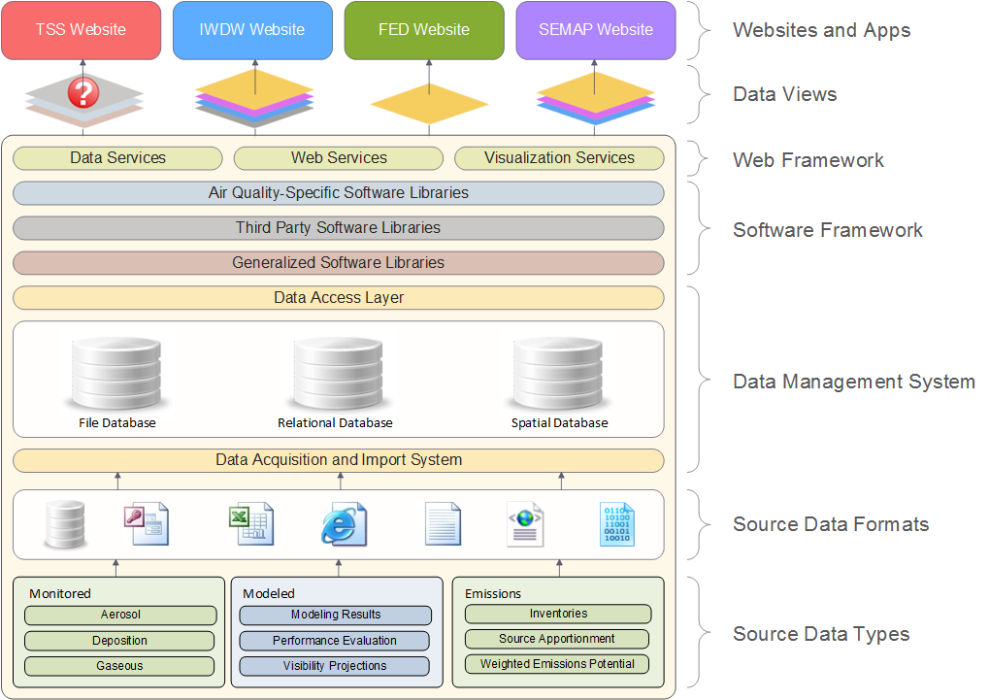
Filters and site-specific UI choices

Slide 11
CIRA Air Data Management System Ecosystem
Intermountain West Data Warehouse
(IWDW)
Partners: NPS, BLM, USFS, EPA, States
WRAP Technical Support System
(TSS)
Partners: NPS, USFS
Databases
Websites
Software
Hardware
Currently funded
Currently funded
OGEC Repository
Partners: EPA, States
NASA ROSES
Partners: NASA / NPS
CIRA Air Data Management System
VIEWS
Partners: EPA / States
NASA NAAPS
Partners: NASA / NPS
FLM Environmental
Database
(FED)
Partners: NPS, USFS
Southeastern
Modeling, Analysis, and Planning
(SEMAP)
Partners: EPA, Southeastern States
Currently funded

Slide 12
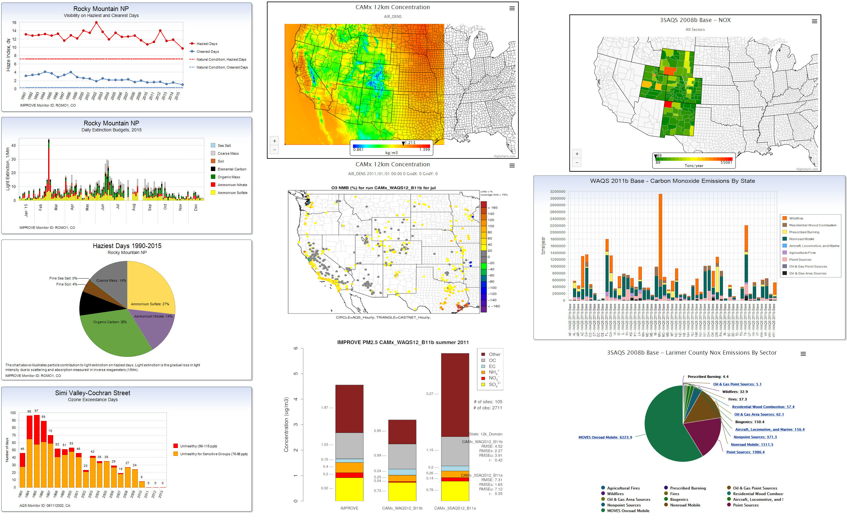
ADMS Tool and Product Categories
Monitored
Modeled
Emissions

Slide 13
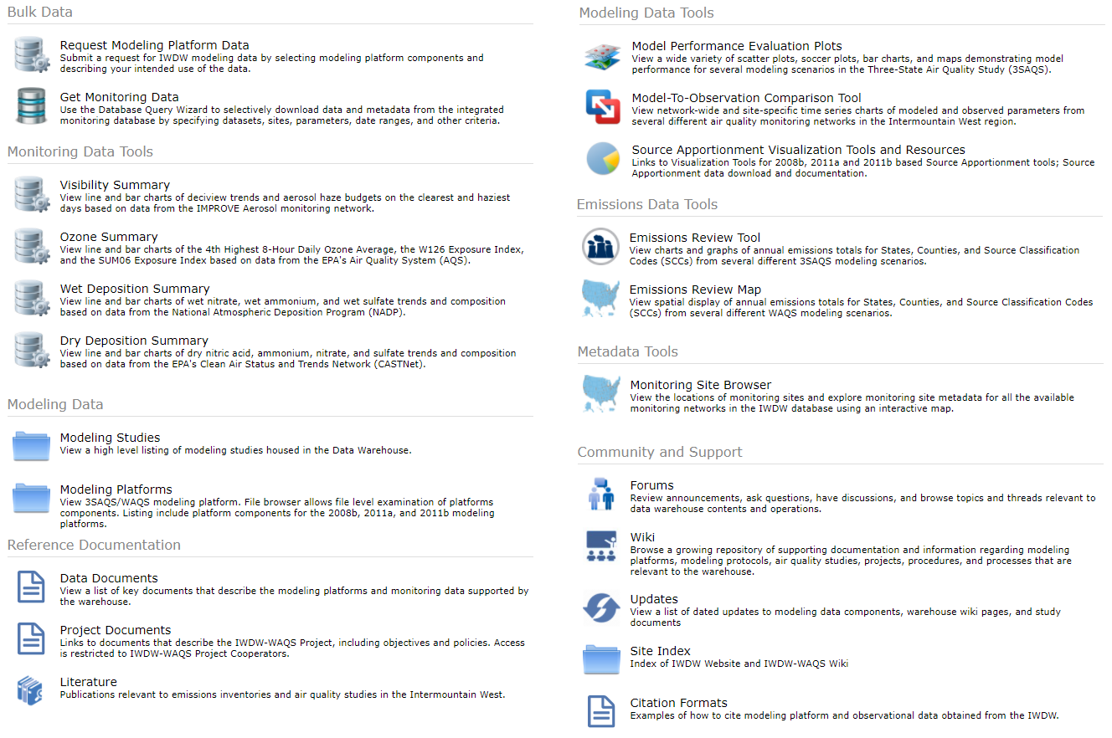
Summary of Data, Tools, and Other Resources

Slide 14
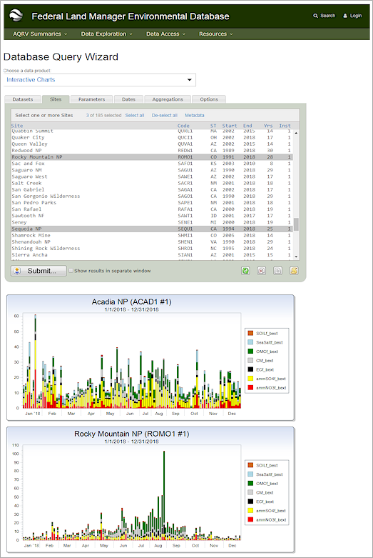
Federal Land Manager Environmental Database (FED)
Provides:
All raw air quality monitoring datasets
All IMPROVE special studies
Derived IMPROVE datasets (RHR, Imp.)
NPS-specific ozone metrics
All USFS water quality data
Unrestricted geographical area
Low-level analysis tools
Collaborators:
National Park Service (NPS)
U.S. Forest Service (FED)

Slide 15
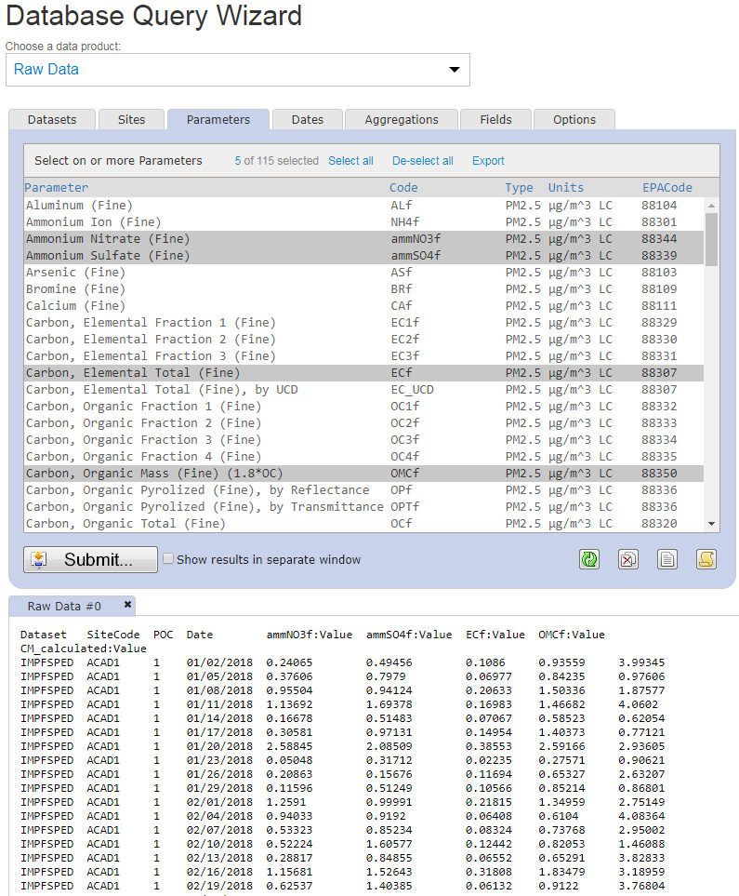
Raw Data Query and Download
Select a data product
Select dates
Select aggregations
Set output options
Select datasets
Select sites
Select data fields
Purpose:
To enable the fine-grained selection and download of raw air quality data by allowing the user to select sites, parameters, dates, aggregations, data fields, and output options. Data can be output to a variety of file formats, including CSV, Microsoft Excel, and HTML.
This tool is also available on the IWDW and TSS.
Click column names to sort by that column
Select parameters
Tab-delimited ASCII text file
Example:
In this example the user has selected the IMPROVE Aerosol dataset, the IMPROVE monitoring site at Acadia National Park, several pollutants, the year 2018, and some basic data fields, and has specified that the results be output to a tab-delimited ASCII text file.

Slide 16
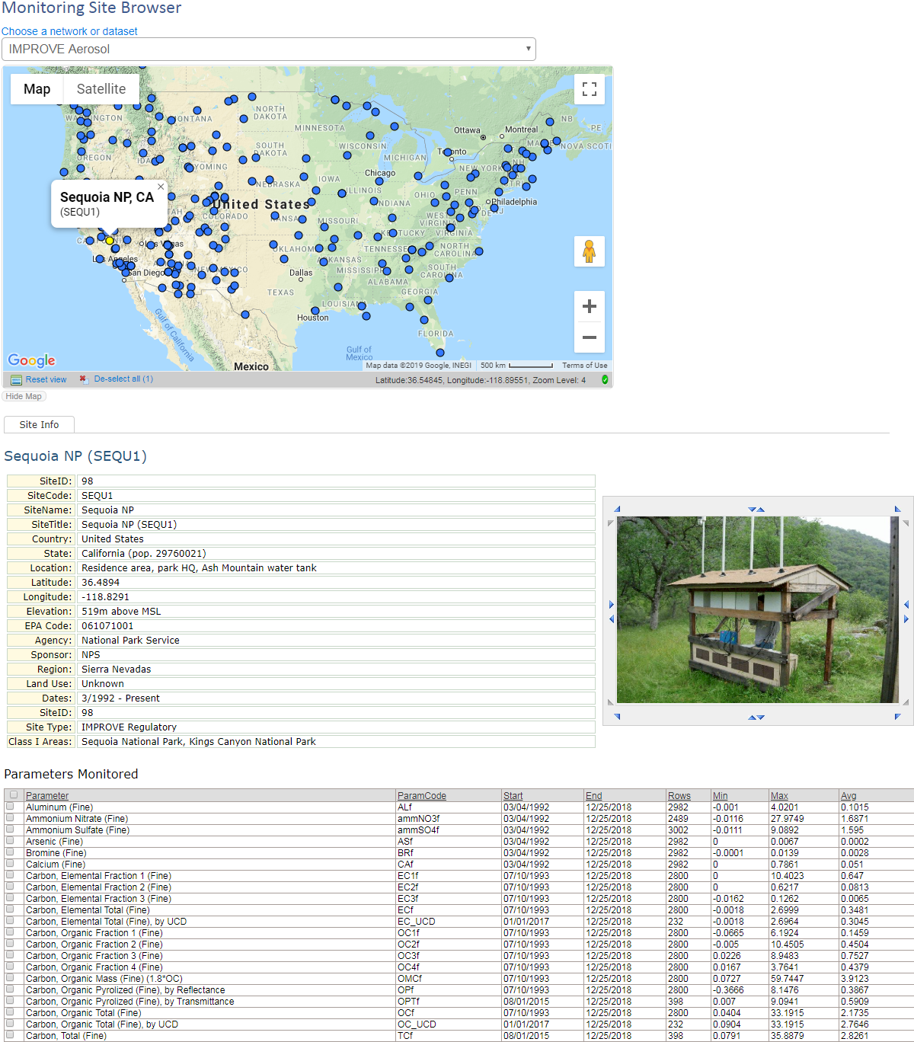
Monitoring Site Metadata
Select a monitoring network
The specific website that this example was taken from
Purpose:
To provide a quick and easy way to browse monitoring sites by air quality monitoring network or dataset. Site details like latitude, longitude, and elevation are displayed, as well as any site photographs that may be available. A high-level summary of the statistics for each parameter measured at the site is also displayed.
Click on map markers to select sites
Monitoring site details
Monitoring site photos
Monitoring site data statistics and summaries

Slide 17
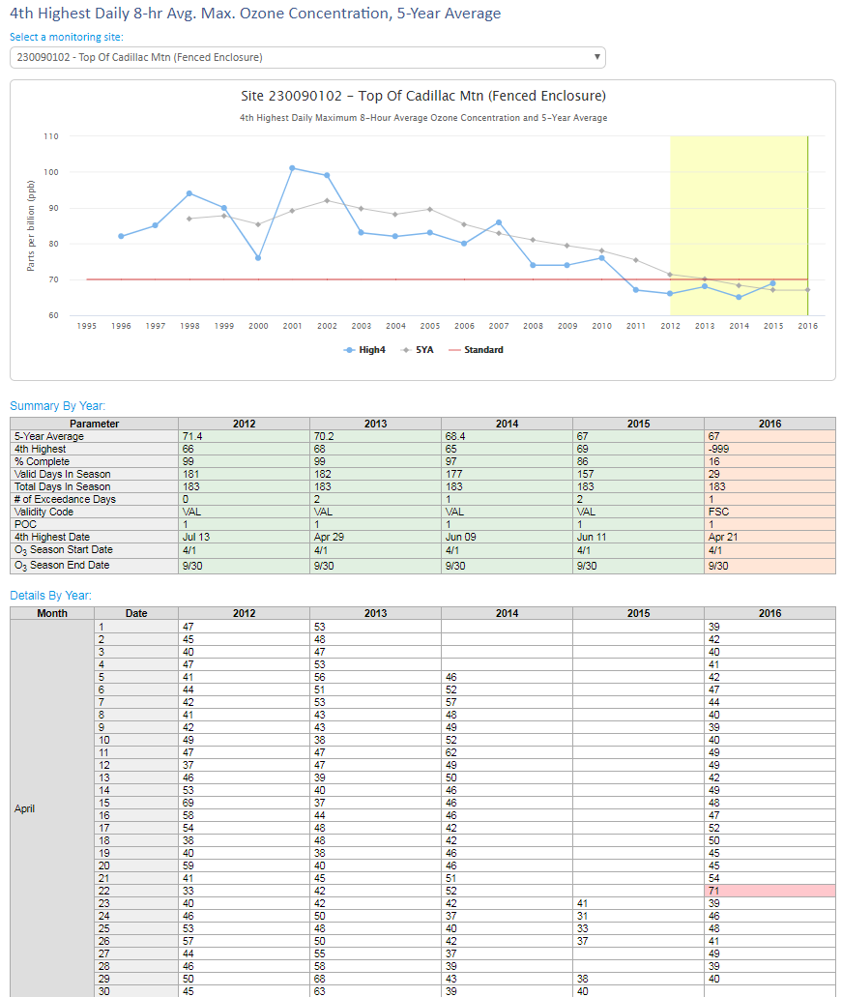
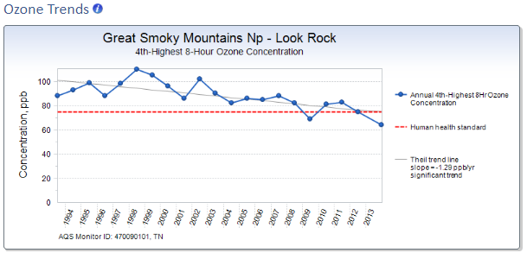
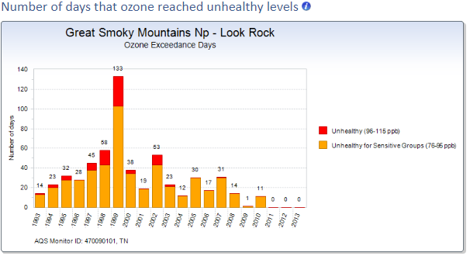
Ozone Data and Statistics
Highlights:
4th Highest Daily 8-Hr Avg. Max. Ozone
W126 Ozone Exposure Index for Vegetation
Human Health Standard Reference
Ozone Exceedance Days
5-year average period
4th Highest Daily 8-Hr Avg. Max. Ozone
Trendline
Click on “info” icons to get more details or help
Human health standard for O3 – 70 ppb
Detailed ozone statistics
Daily 4th Highest values
Exceedance day

Slide 18
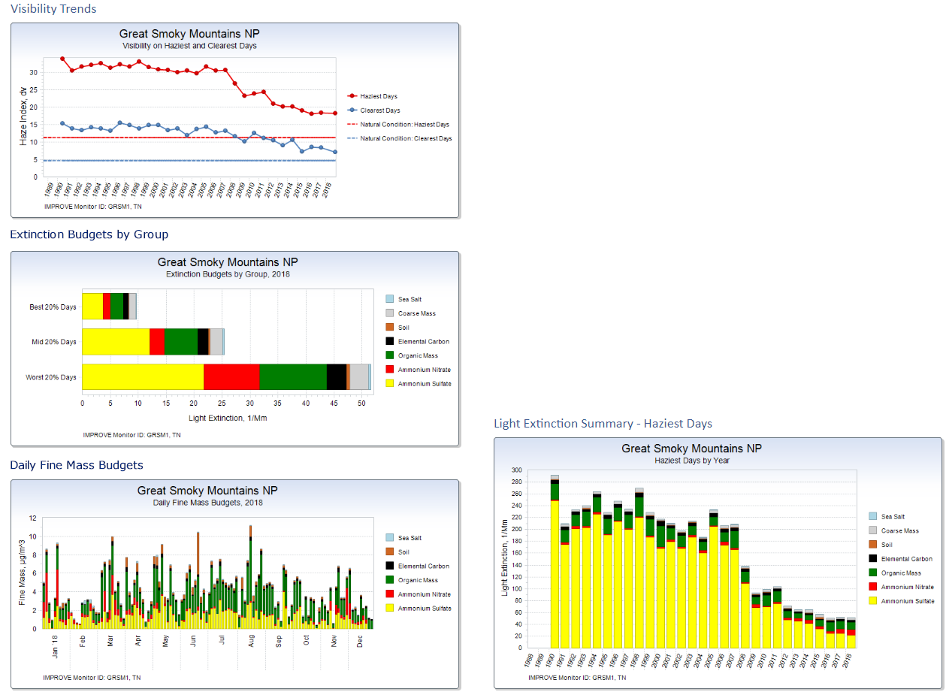
Visibility Data and Statistics
Highlights:
Visibility on the haziest, clearest, and M.I.D.
Daily and yearly extinction budgets by group
Daily and yearly fine and total mass budgets
Haziest, clearest, and M.I.D. by year
Raw Regional Haze Rule (RHR) data
Raw Impairment data

Slide 19
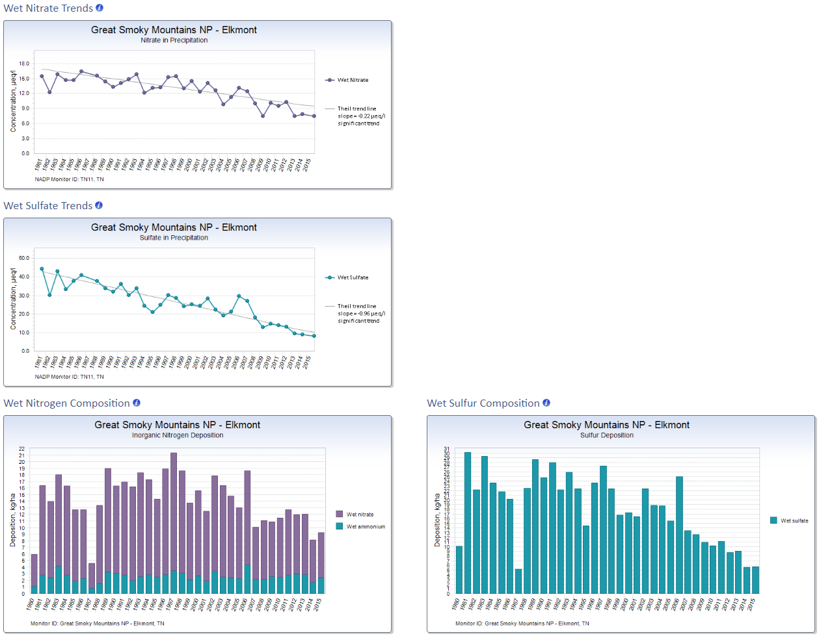
Wet Deposition Data and Statistics
Highlights:
Long-term wet Nitrate trends (NO₃, AmmNO₃)
Long-term wet Sulfate trends (SO₄, AmmSO₄)
Wet nitrogen composition (daily, annual, total)
Wet sulfur composition (daily, annual, total)

Slide 20
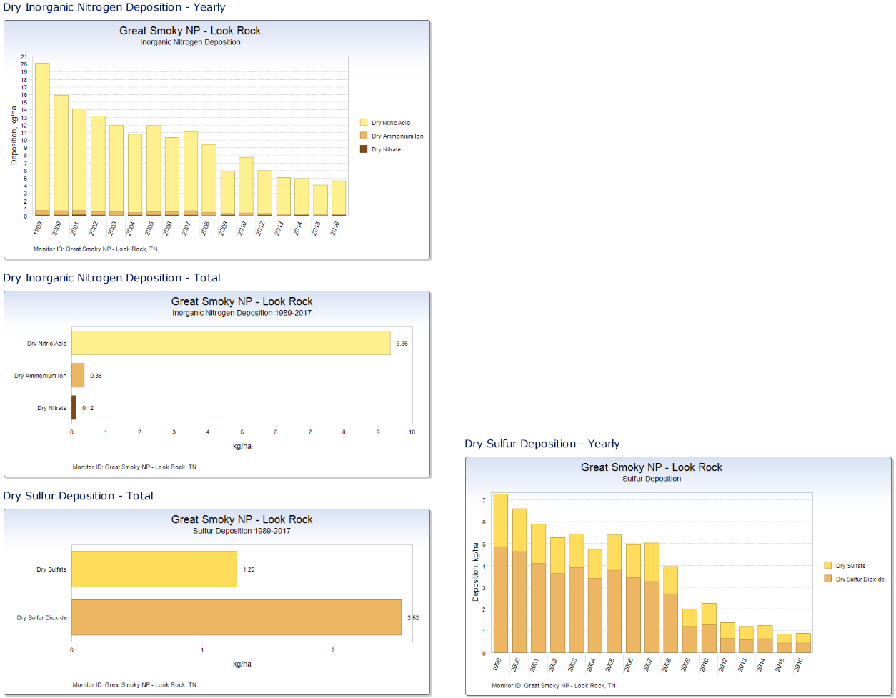
Dry Deposition Data and Statistics
Highlights:
Dry inorganic Nitrogen composition – yearly
Dry inorganic Nitrogen composition – total
Dry Sulfur deposition – yearly
Dry Sulfur deposition - total

Slide 21
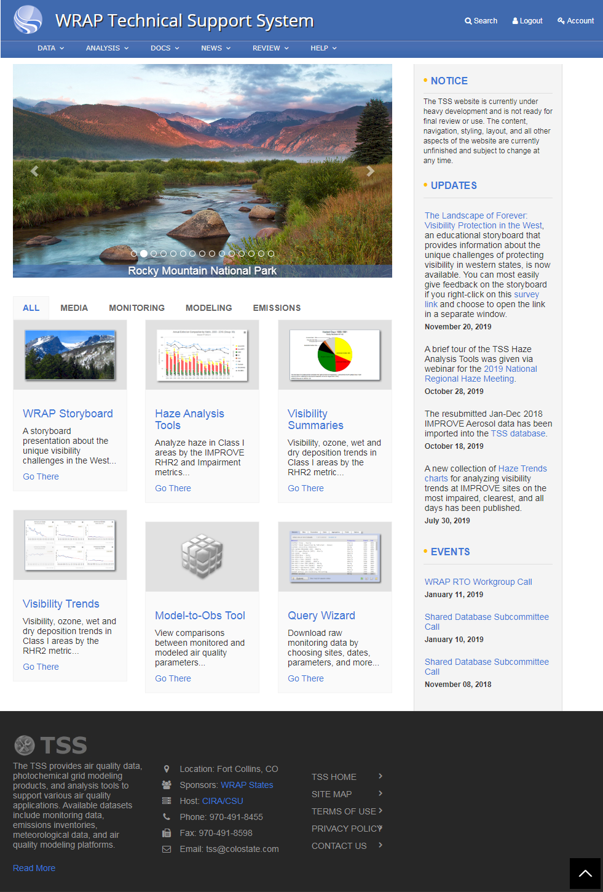
WRAP Technical Support System (TSS v.2)
Provides:
Regional haze planning support
Visibility progress tracking support
Support for State Implementation Plans (SIPs)
Support for Tribal Implementation Plans (TIPs)
Haze analysis tools
Visibility summaries
Collaborators:
15 Western States: Alaska, Arizona, California, Colorado, Hawaii, Idaho, Montana, Nevada, New Mexico, North Dakota, Oregon, South Dakota, Utah, Washington, Wyoming
WESTAR/WRAP

Slide 22
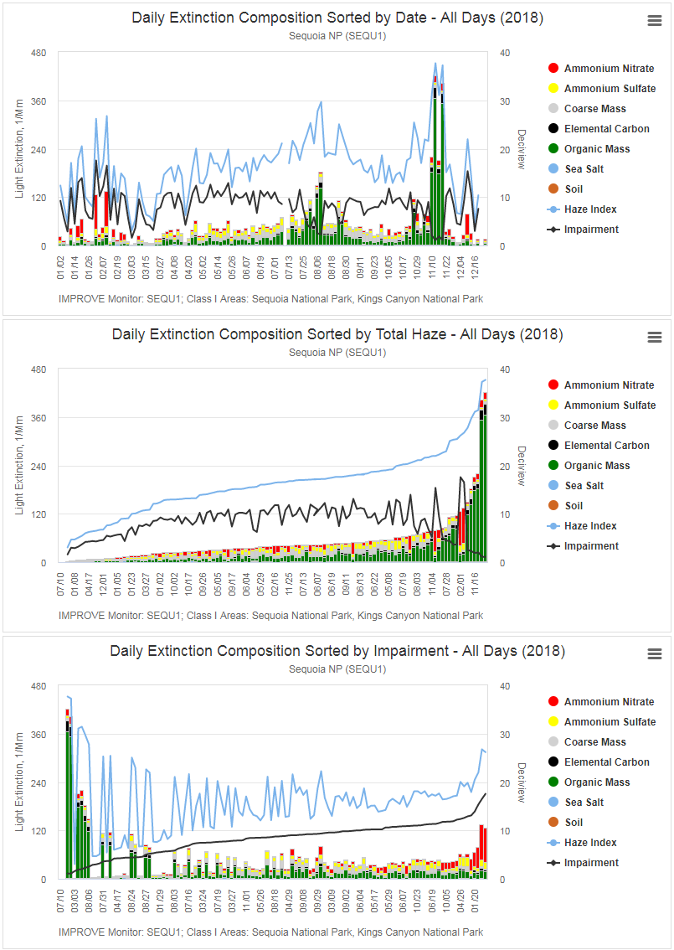
Comparison of Daily Extinction Composition, Sorted by Metric
Purpose:
To illustrate the difference between the days selected as the “haziest days” under the previous guidance versus the days selected as the “most impaired days” under the current guidance by sorting the days from a single year in three different ways – chronologically by date, by total haze (previous guidance), and total impairment, shown top to bottom here.
Features:
You can set the year for the report across the entire available record of IMPROVE data, and you can selectively choose the extinction parameters to show on the charts. You can also quickly show and hide individual parameters by clicking the legend items, and you can easily download the raw data used to create each chart in a variety of tabular formats, including CSV and Microsoft Excel.

Slide 23
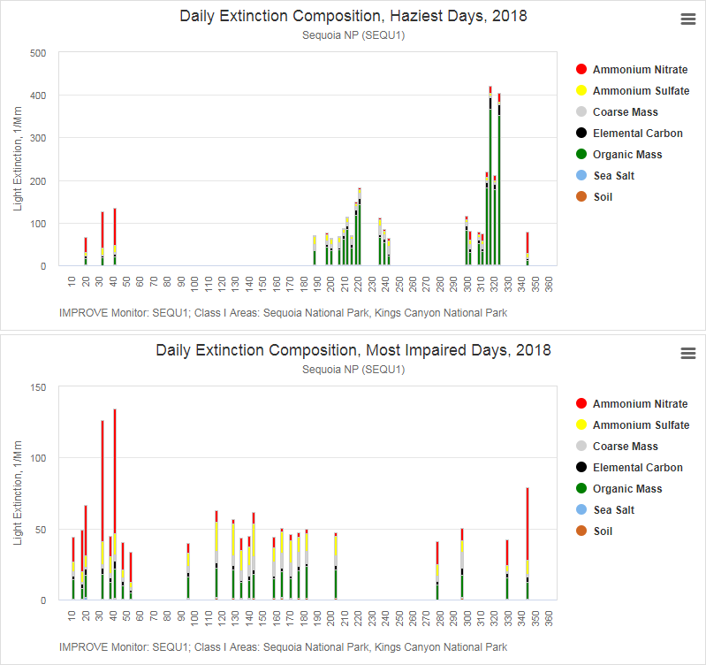
Comparison of Daily Extinction Composition on the Haziest Days and M.I.D.
Purpose:
To illustrate the difference between the days selected as the “haziest days” under the previous guidance versus the days selected as the “most impaired days” under the current guidance by showing only those two sets of days – one set on each chart – while excluding all other days.

Slide 24
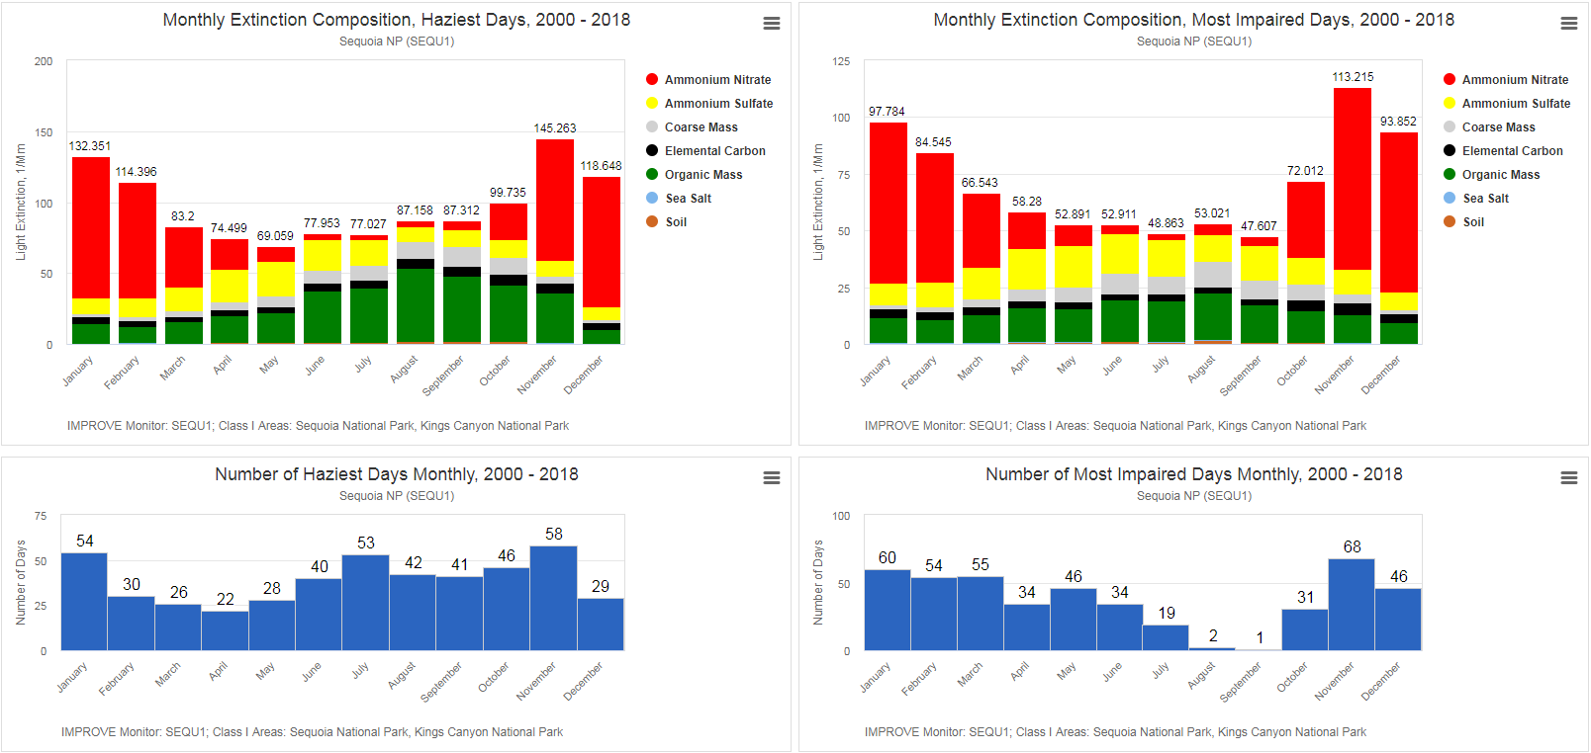
Comparison of Monthly Extinction Composition on the Haziest Days and M.I.D.
Purpose:
To illustrate the effect on monthly extinction composition by the choice of guidance metric applied. The charts in the left column above show monthly extinction composition on the haziest days (top) and the total number of haziest days per month (bottom). The charts in the right column show monthly extinction composition on the most impaired days (top) and the total number of most impaired days per month (bottom).

Slide 25
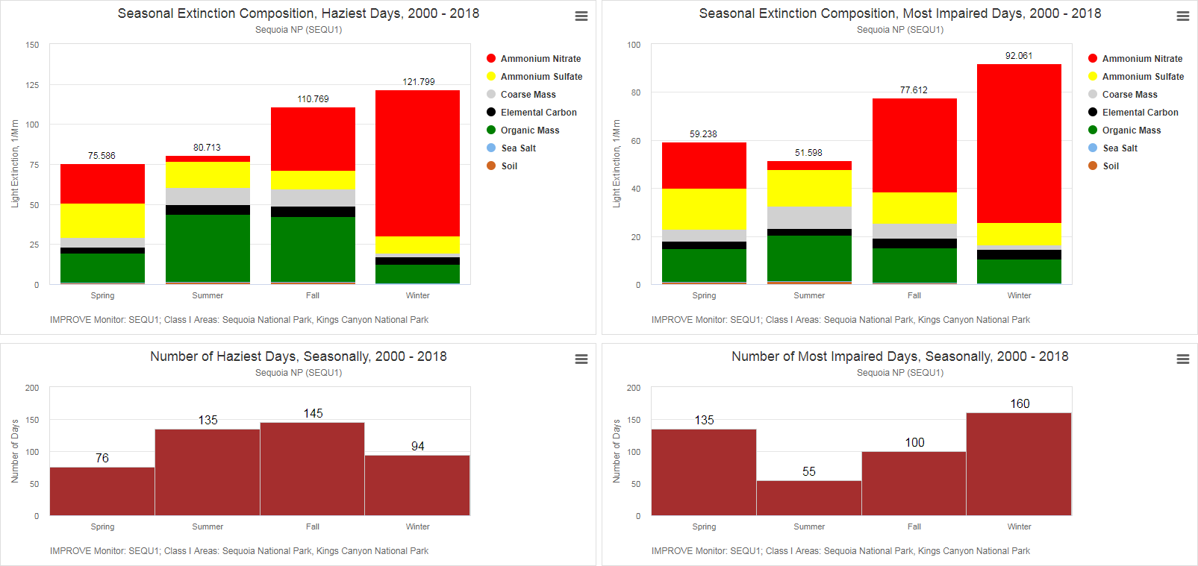
Comparison of Seasonal Extinction Composition on the Haziest Days and M.I.D.
Purpose:
To illustrate the effect on seasonal extinction composition by the choice of guidance metric applied. The charts in the left column above show seasonal extinction composition on the haziest days (top) and the total number of haziest days per season (bottom). The charts in the right column show seasonal extinction composition on the most impaired days (top) and the total number of most impaired days per season (bottom).

Slide 26
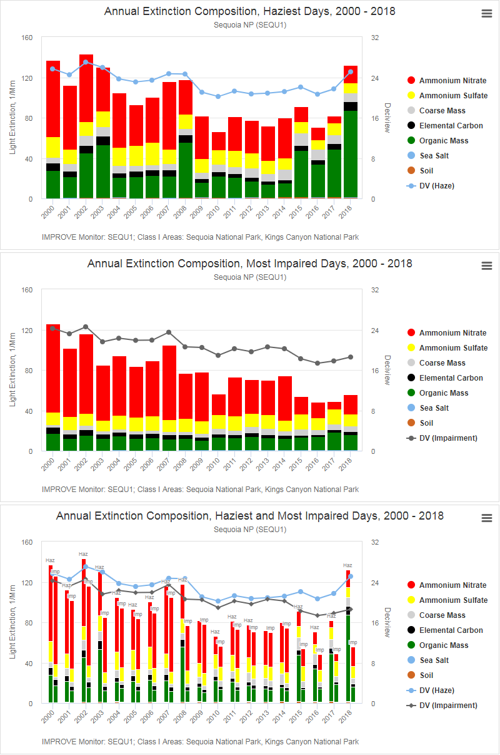
Comparison of Annual Extinction Composition on the Haziest and M.I.D.
Purpose:
To illustrate the effect on annual average extinction composition by the choice of guidance metric. The top chart shows annual average extinction composition on the haziest days with total haze overlaid as a time series, the middle chart shows annual average extinction composition on the most impaired days with total impairment shown as a time series, and the bottom chart shows the two views combined, with the haziest and most impaired bars arranged side-by-side.

Slide 27
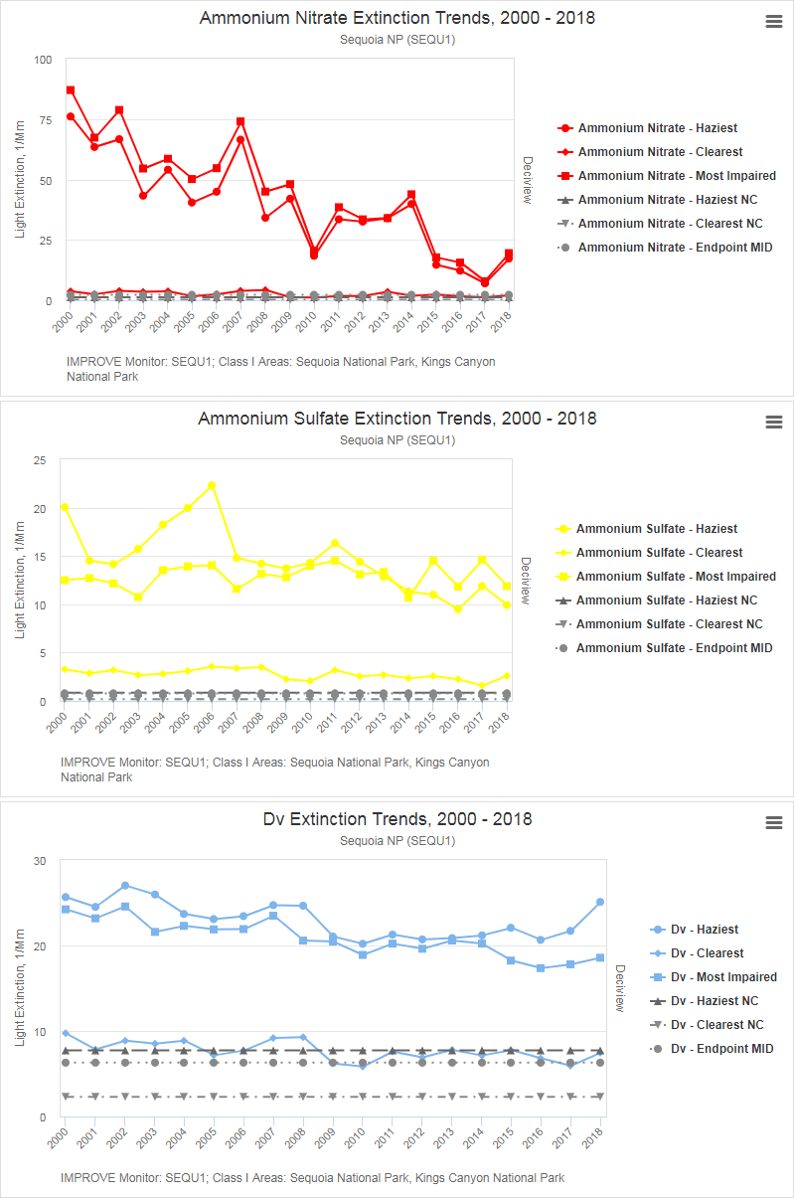
Comparison of Long Term Extinction Trends on the Haziest and M.I.D.
Purpose:
To illustrate long term trends in annual average extinction composition on the haziest and most impaired days, together with reference lines for natural conditions on the haziest and clearest days, as well as a reference line for the “endpoint” estimate of the current guidance. All seven of the primary extinction parameters can be selected, but only ammonium nitrate, ammonium sulfate, and deciview are shown in this example.
Feature Note:
To simplify any chart for viewing, you can click on a given entry in the legend in order to temporarily remove the corresponding series from the chart.

Slide 28
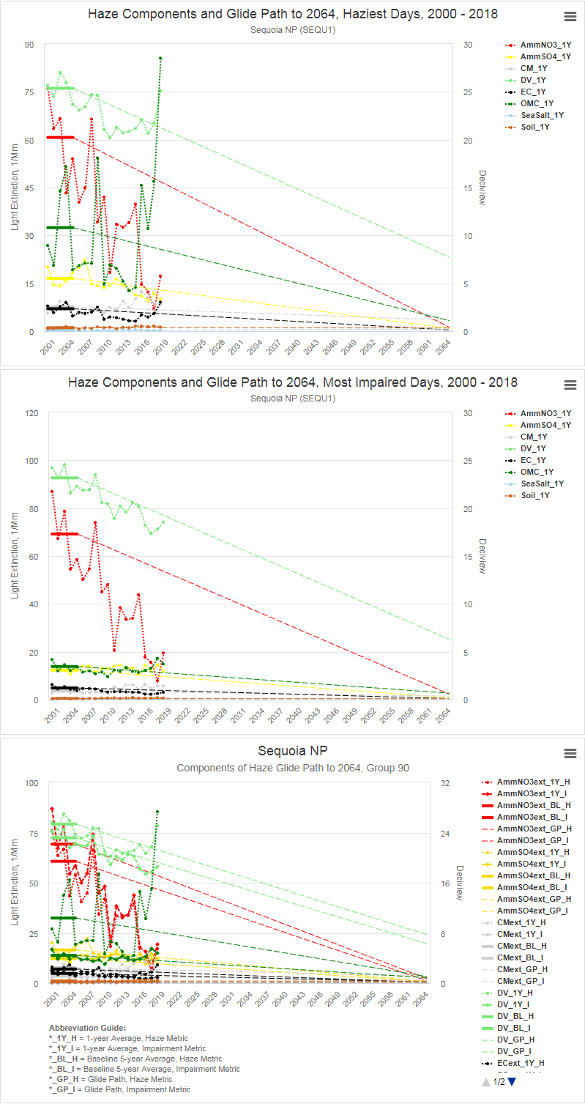
Uniform Rate of Progress Glide Paths on the Haziest and M.I.D.
Purpose:
To illustrate the “glide path” or “uniform rate of progress (URP)” line from the first and second baseline periods (2000-2004 and 2005-2009) to natural conditions and/or the “endpoint” for the primary extinction parameters. Annual average extinction is also shown as a time series for each selected parameter for the period of record. The top chart shows the URP glidepath for species extinction on the haziest days, the middle chart shows the same thing for the most impaired days, and the bottom chart combines the two views so that you can more easily compare the haziest and M.I.D. glide paths.
Feature Note:
While the all-parameter view of this report is visually “busy”, you can easily simplify each chart by clicking on a given entry in the legend in order to temporarily remove the corresponding series from the chart.

Slide 29
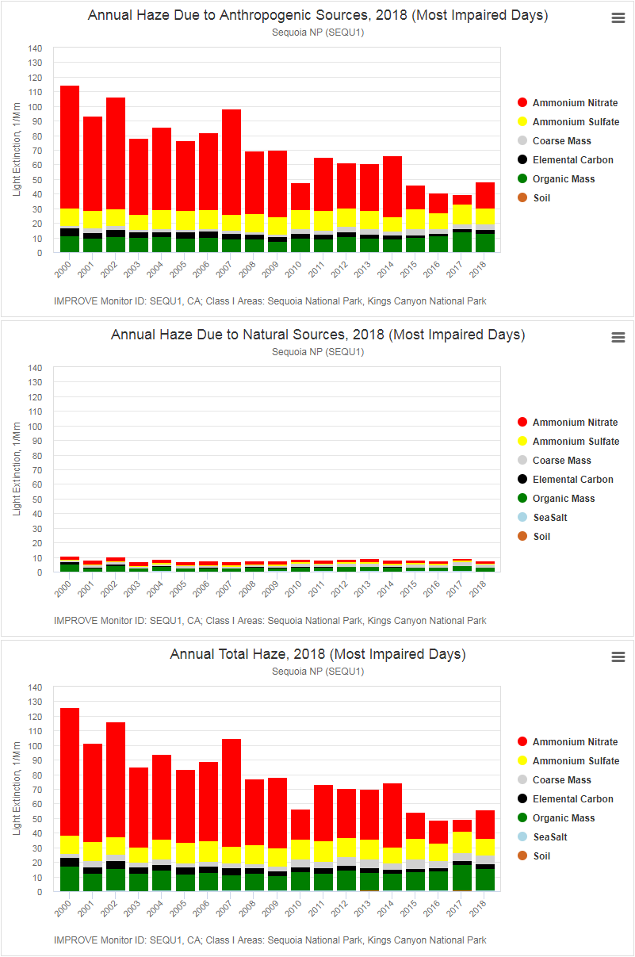
Annual Anthropogenic vs. Natural vs. Total Extinction on the M.I.D.
Purpose:
To illustrate and compare annual haze due to anthropogenic sources versus natural sources on the most impaired days. The top chart shows annual average haze for the primary extinction parameters due to anthropogenic sources, the middle chart shows annual average haze for the primary extinction parameters due to natural sources, and the bottom chart shows total annual average extinction (i.e. extinction due to all sources).
Feature Note:
At the bottom of each chart, the Class I Areas for which the selected monitoring site is considered “representative” are shown. Most sites are associated with a single Class I Area, but quite a few sites are considered representative for multiple Class I Areas.

Slide 30
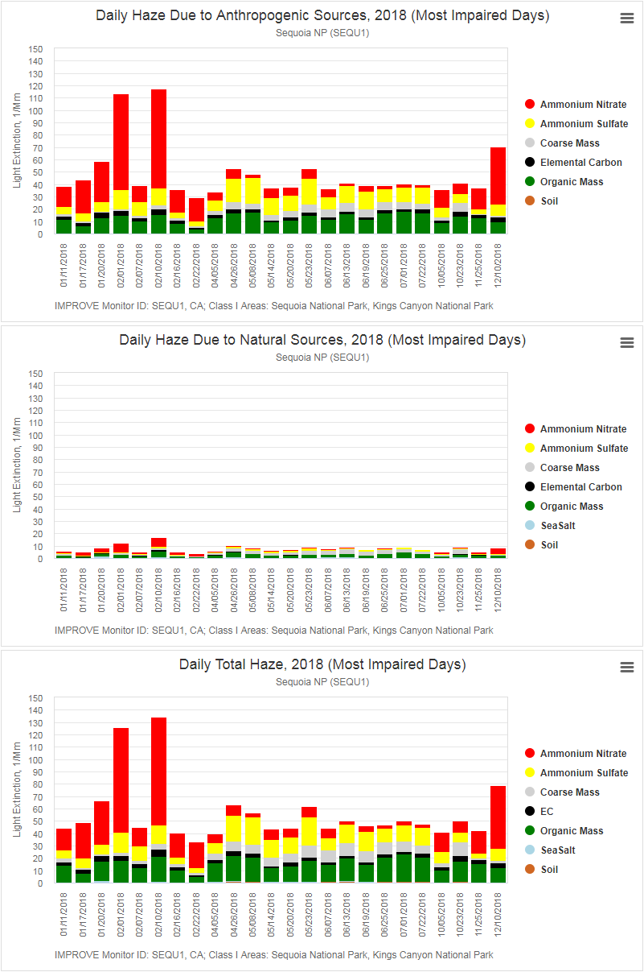
Daily Anthropogenic vs. Natural vs. Total Extinction on the M.I.D.
Purpose:
To illustrate and compare daily haze due to anthropogenic sources versus natural sources on the most impaired days. The top chart shows daily average haze for the primary extinction parameters due to anthropogenic sources, the middle chart shows daily average haze for the primary extinction parameters due to natural sources, and the bottom chart shows total annual average extinction (i.e. extinction due to all sources).

Slide 31
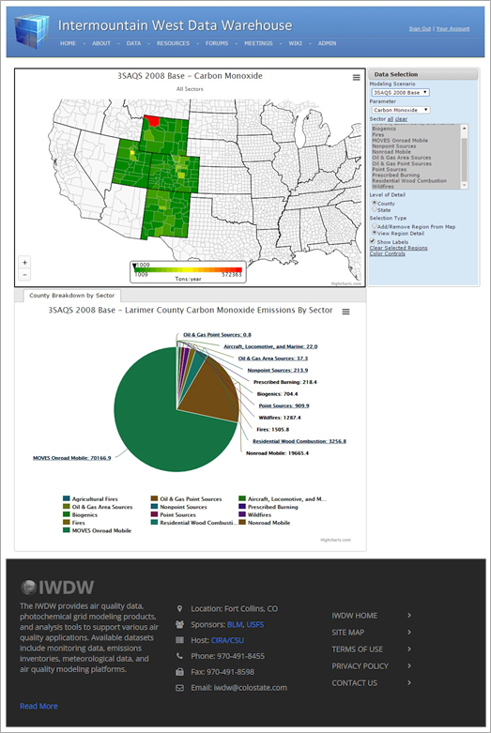
Intermountain West Data Warehouse (IWDW)
Provides:
Complete air quality modeling platforms
Individual modeling platform components
Modeling input data (met, emissions)
Boundary and initial conditions
Modeling software and configuration files
Air quality modeling results
Model performance evaluation tools
Model-to-obs comparison tools
Emissions review tools
Collaborators:
National Park Service (NPS)
U.S. Forest Service (USFS)
Bureau of Land Management (BLM)
States: Colorado, Wyoming, Utah, New Mexico
U.S. Environmental Protection Agency (EPA)
WESTAR/WRAP

Slide 32
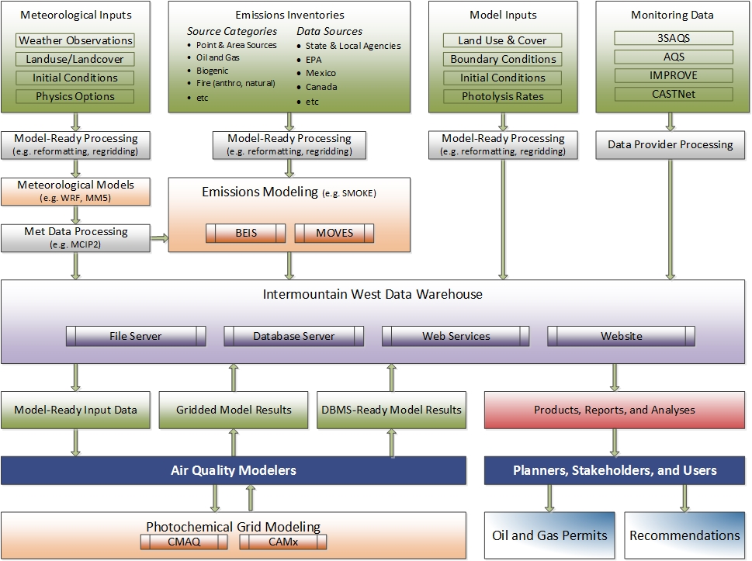
Data Warehouse Dataflow Diagram

Slide 33
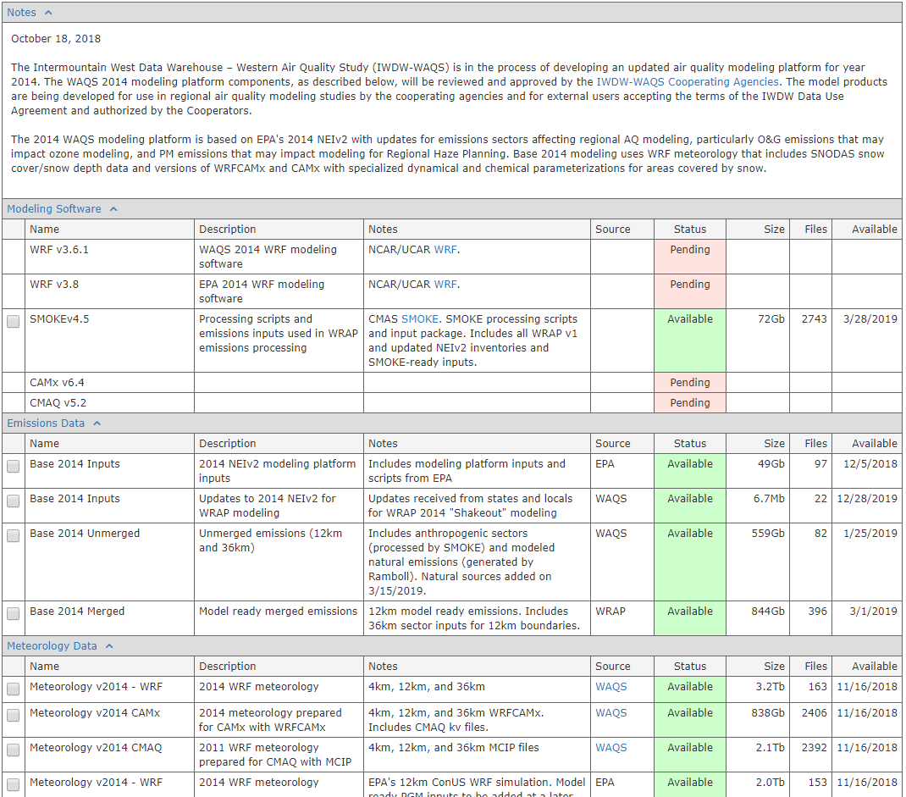
Modeling Platform Data Request Form
Purpose:
To facilitate the browsing, selection, and download of entire modeling platforms or individual modeling platform components, and to illustrate the expected roadmap for creating and distributing modeling platforms and individual platform scenarios. Platform components can be accessed and downloaded via SFTP, HTTP, and Globus, and extremely large-volume data requests can be delivered on physical hard drives via regular mail service.
Shows the status of the component
Shows the estimated size of the component
Shows the total number of files
Shows the expected availability date

Slide 34
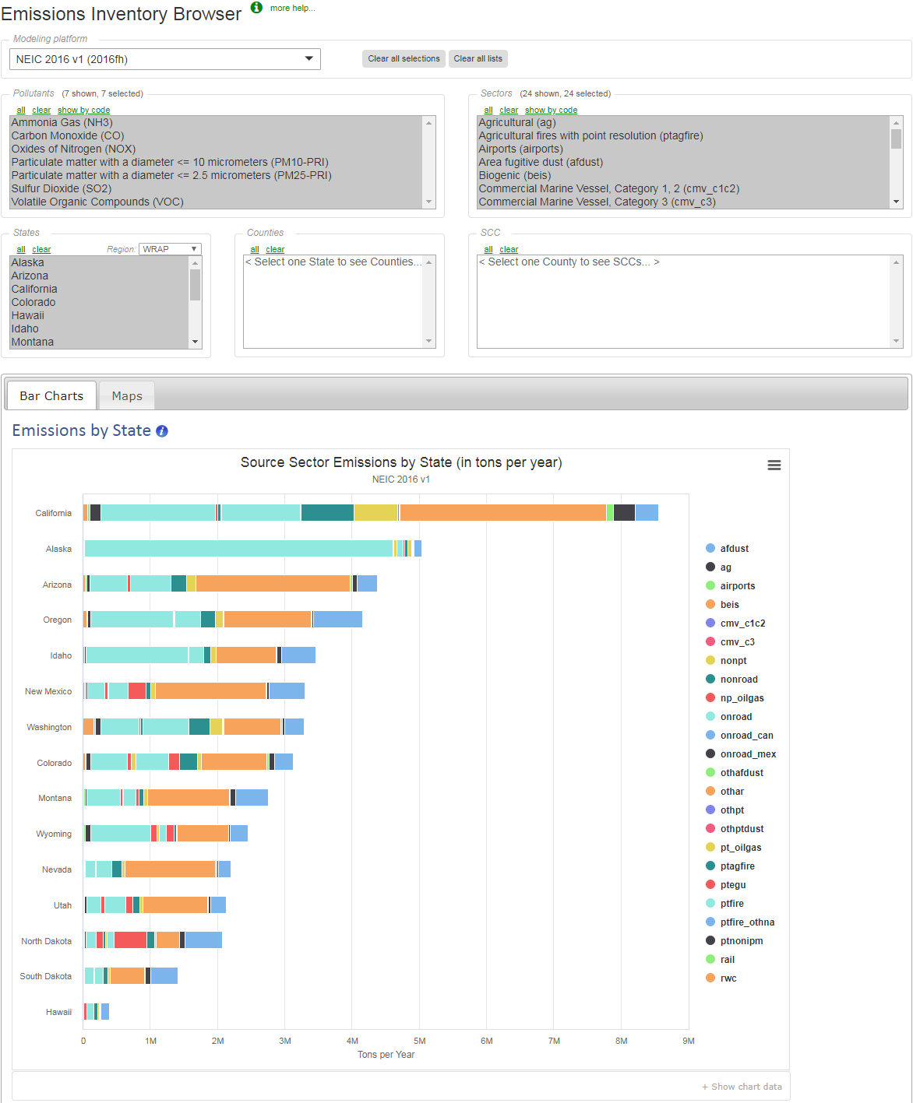
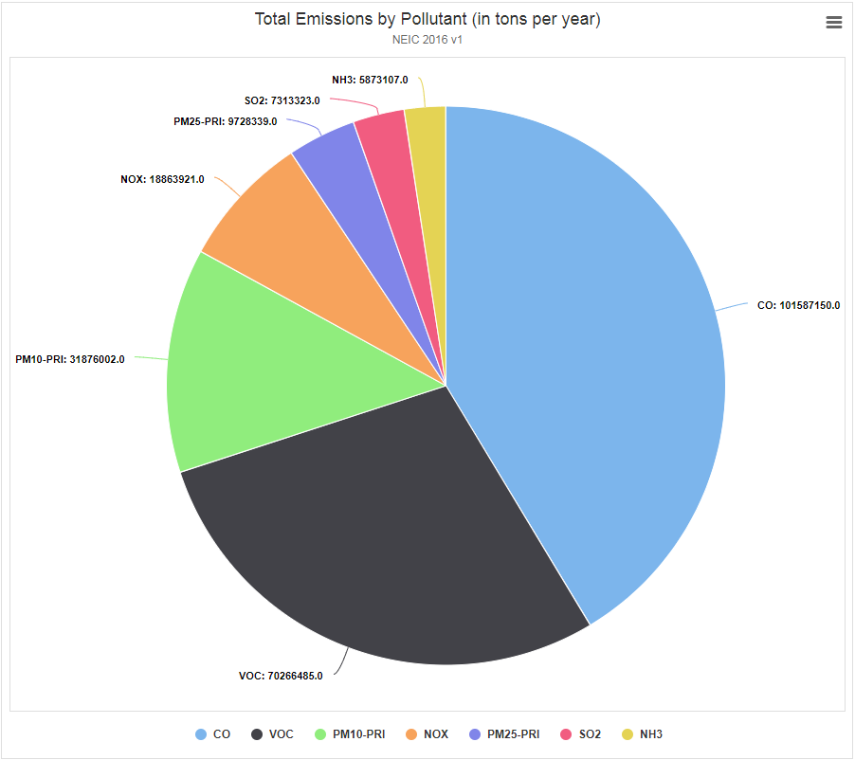
Emissions Review Tool
Select a modeling platform
Select pollutants
Select source categories
Purpose:
Provides a detailed summary of annual emissions totals by state, county, and source category via a variety of interactive maps and charts. The emissions inventory data used for ten different modeling scenarios is available, and emissions totals from multiple scenarios can be selected and visualized at the same time with multiple side-by-side charts or multiple side-by-side stacked bars on the same chart.
Select states
Select counties
Select SCCs

Slide 35
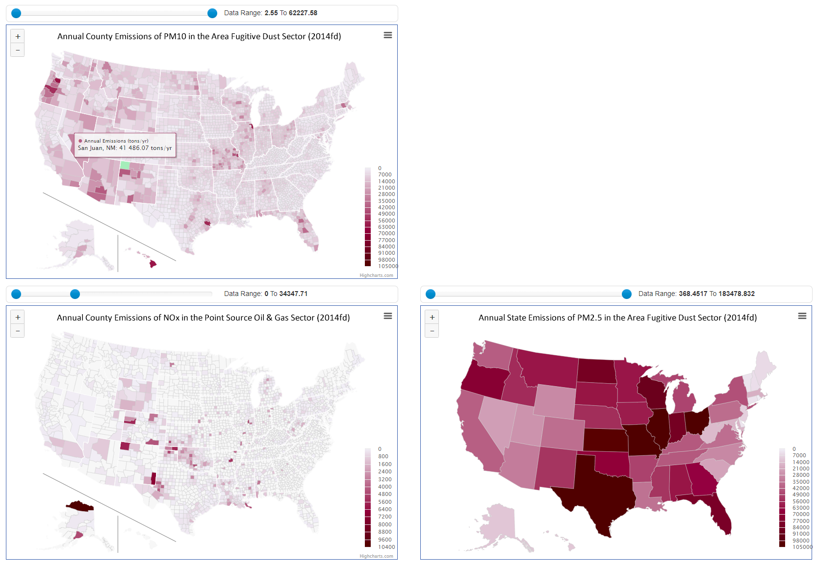
State and County Emissions Maps
Purpose:
To display state- and county-level annual emissions totals for the selected states, pollutants, and source sectors. You can mouse-over individual states and counties to display more detail, and you can use the “Data Range” slider bars to specify a range of total emissions in tons per year in order to filter out large numbers of low and/or high values and thus change the visual contrast and separation of the map colors.
Mouse-over counties and states to see details

Slide 36
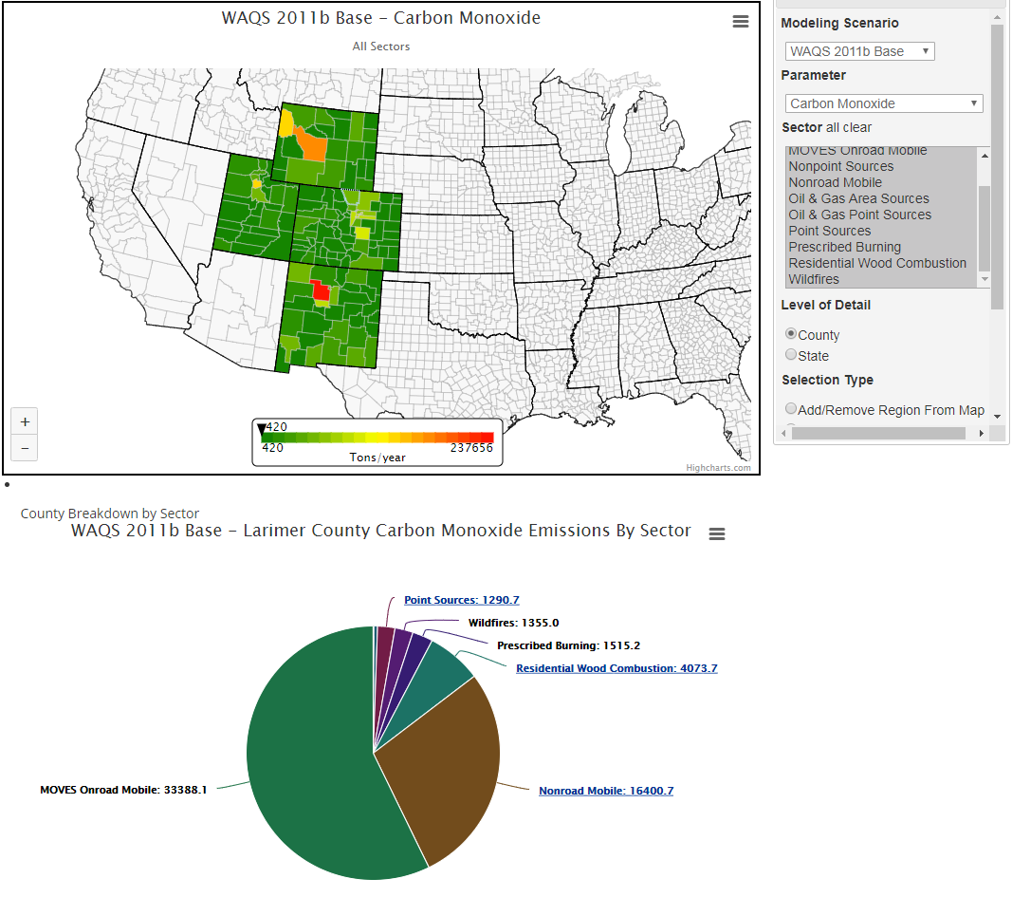
Emissions Exploration Map
Purpose:
Provides a detailed breakdown of annual emissions totals by state, county, and source category via a variety of interactive maps and charts.

Slide 37
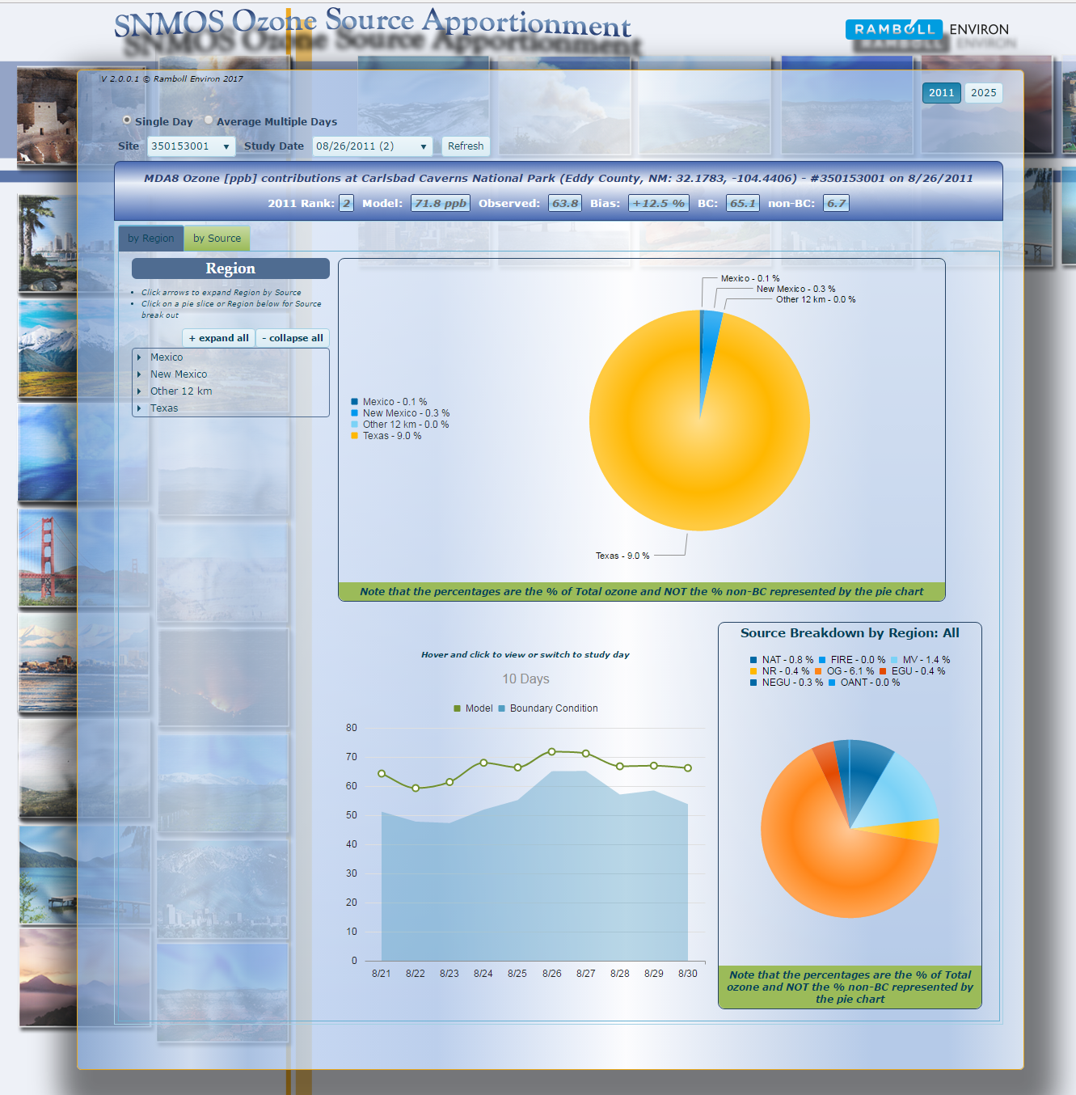
Source Apportionment Tools
Purpose:
Provides a variety of charts and graphs for analyzing source attribution for modeled parameters on specific days and/or for specific time periods.

Slide 38
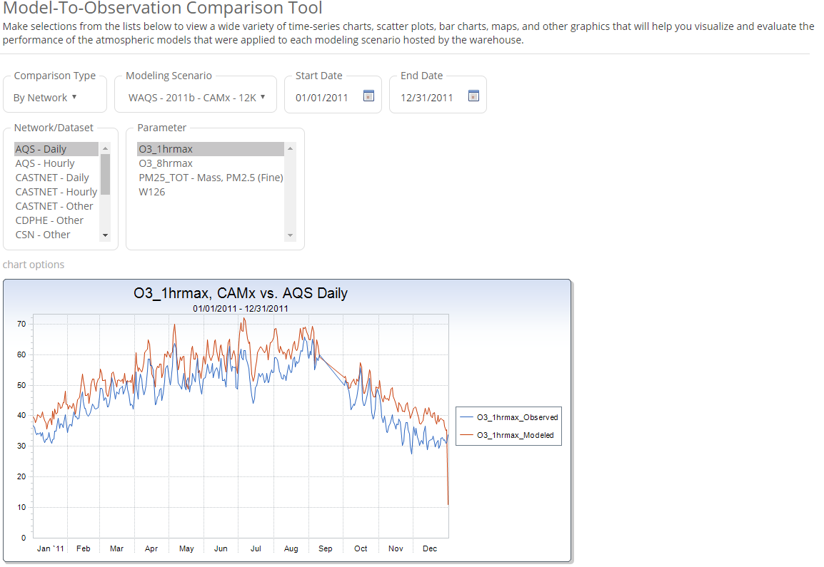
Model-to-Observation Comparison Tool
Purpose:
Provides a variety of site-specific plots of modeled vs. observed values in order to help evaluate model performance.

Slide 39
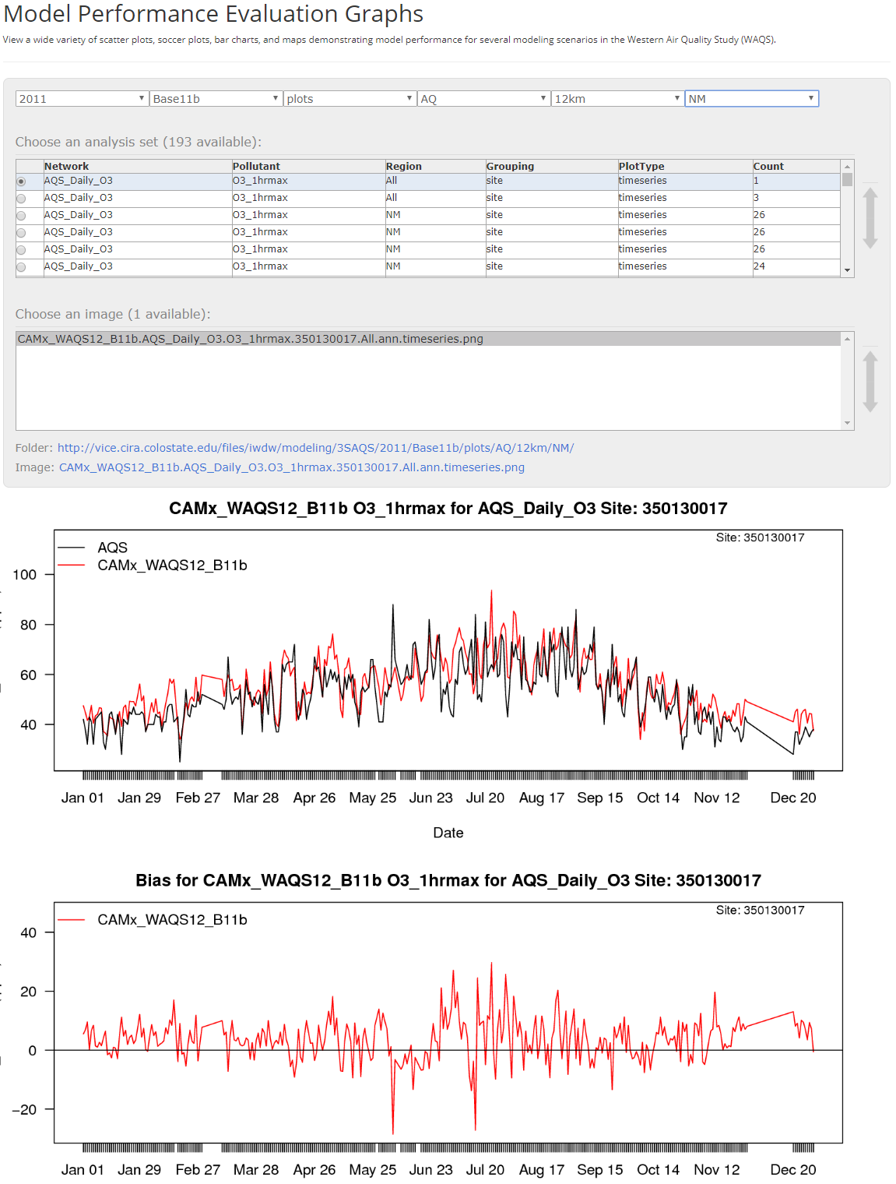
Model Performance Evaluation Plot Browser
Purpose:
Provides a simple interface for browsing and viewing the static plots generated by external model evaluation tools like AMET.

Slide 40
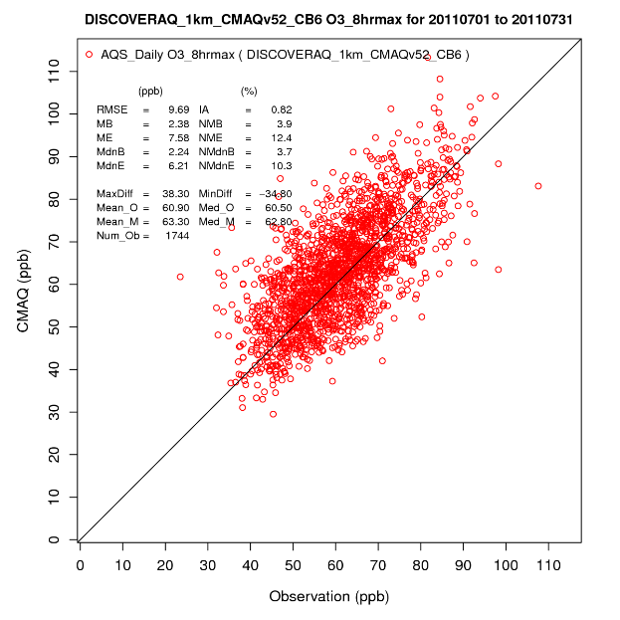
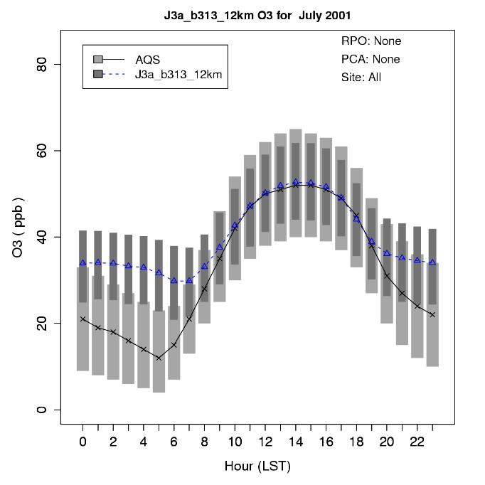
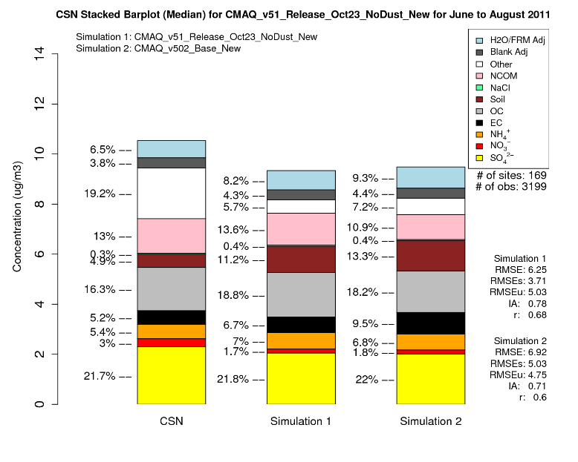
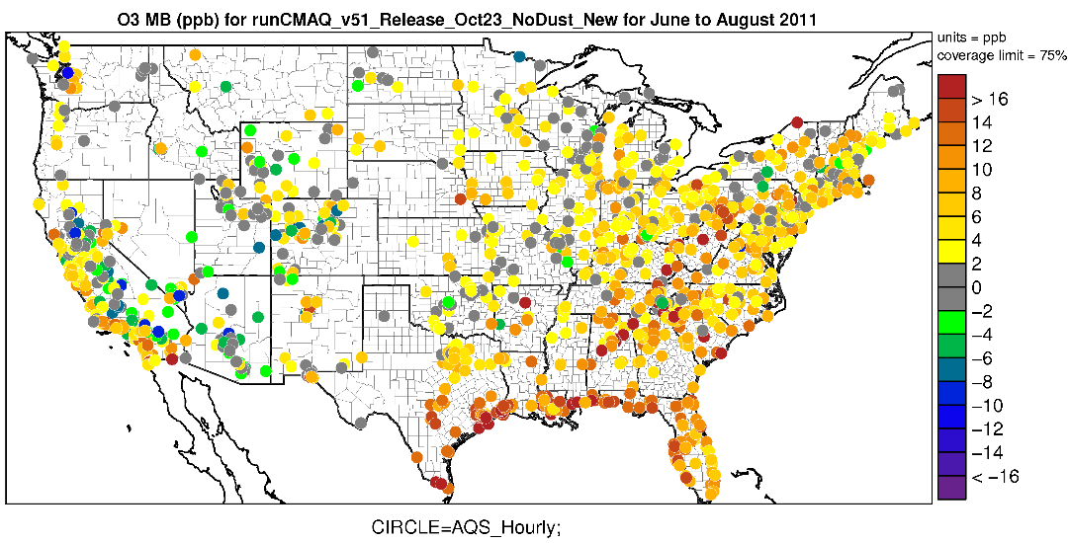
Model Performance Evaluation Plot Browser (continued)
40

Slide 41
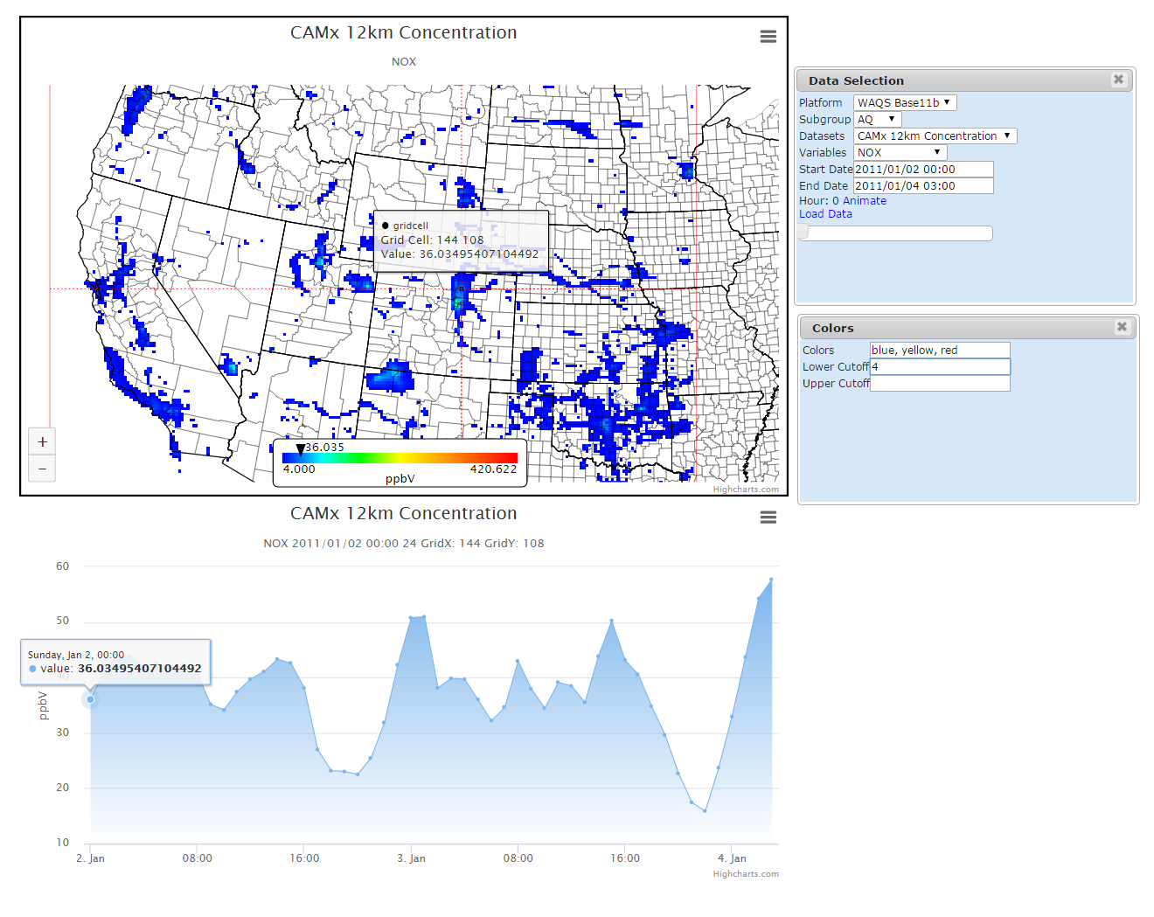
Model Data Browser
Purpose:
Provides an interactive display of gridded modeling data and detailed drill-down to the individual modeling grid cell level.

Slide 42
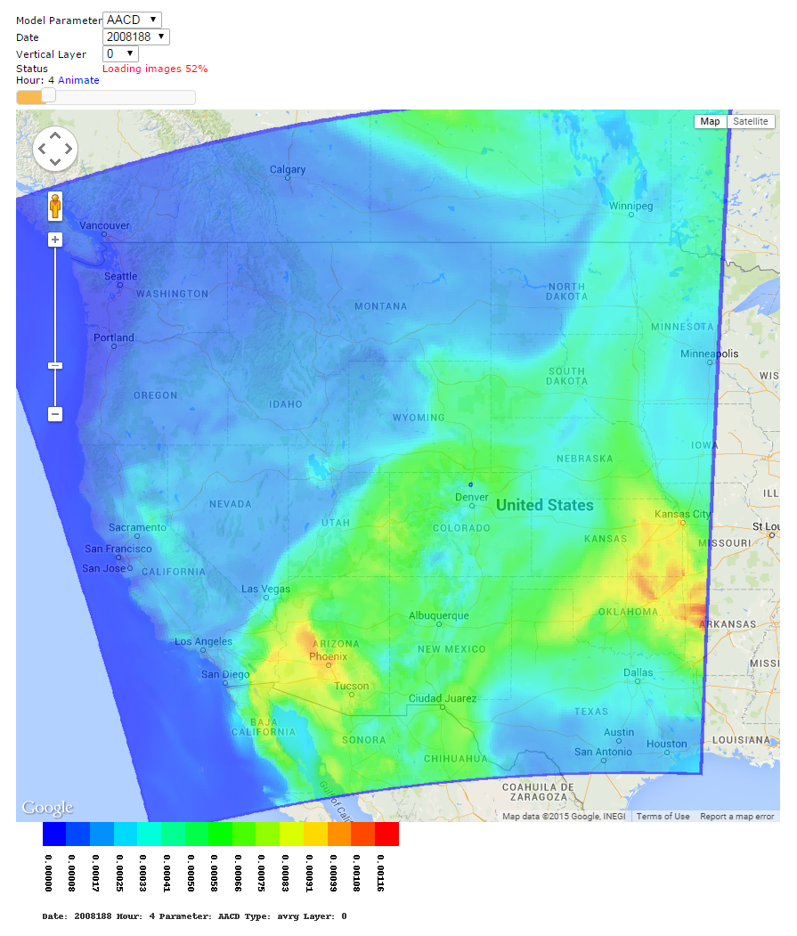
Gridded Data Visualization Tool
Purpose:
Provides an interactive map of gridded data down to the level of individual model days. A series of maps can be animated over a selected time period.

Slide 43
Short-Term Roadmap
Finalize the WAQS 2014 modeling platform
Emissions summary tables (2002, 2014v2 and RepBase)
Dynamic evaluation visibility results at Class I Areas
Gridded 2028 OTB a&b emissions
Gridded 2028 OTB a&b annual/seasonal concentrations
Gridded residence time fields for all Class I Areas
Gridded WEP & emissions and point sources
Finalize the USEPA 2016 modeling platform
More SIP and TIP development tools and products
Add future year model projections to glide path products
Create simplified versions of existing tools specific to current guidance
Add high-level emissions and modeling results summaries
Further streamline the modeling platform data request pipeline
Develop additional gridded data display tools
Integrate proscribed fire data and associated tools
Incorporate satellite data
Create full failover hardware and data redundancy
Update and renew the various project agreements
Notes:
This is an excerpt from the table of registered IWDW users (with names, usernames, and full email addresses omitted for privacy) showing the information that was supplied by each user when they registered (and/or when they updated their profile information).

Slide 44
Website Traffic Data (past example)
Notes:
This is an excerpt from the table of “unique visits” to the IWDW website by registered users. Note that the visit date and the user’s IP address are the only fields recorded. The only field not shown here is the “browser string” field, which is a long text string containing information about the browser (or device) being used during each visit. For additional details about the information that is collected by the website software when a user visits the website, you can refer to the IWDW’s Privacy Policy (http://views.cira.colostate.edu/iwdw/Privacy.aspx).

Slide 45
Registered Users (small excerpt)
Notes:
This is an excerpt from the table of registered IWDW users (with names, usernames, and full email addresses omitted for privacy) showing the information that was supplied by each user when they registered (and/or when they updated their profile information).

Slide 46
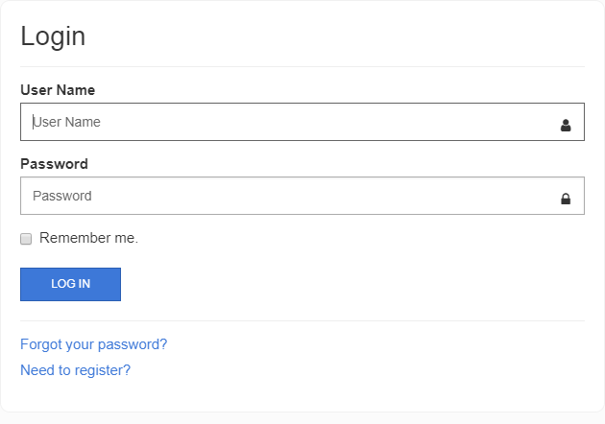
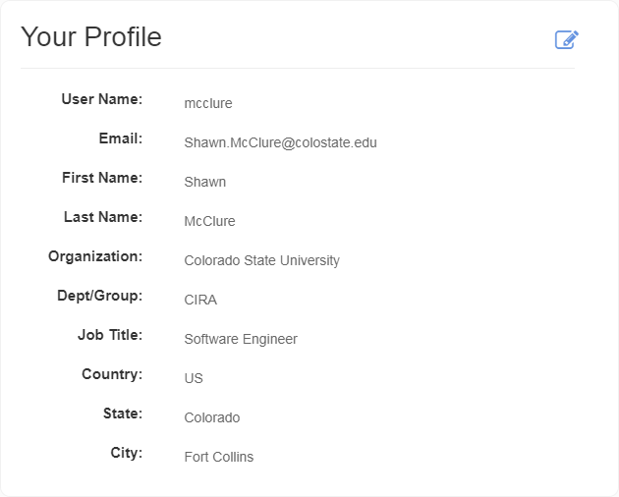
We Encourage You To Register!
Login form
User account/profile form

Slide 47
Links and Contacts
Website Links:
Intermountain West Data Warehouse (IWDW):
https://views.cira.colostate.edu/iwdw
WRAP Technical Support System (TSS):
https://views.cira.colostate.edu/tssv2
Federal Land Manager Environmental Database (FED):
https://views.cira.colostate.edu/fed
Contacts:
Shawn McClure, CIRA-CSU: Shawn.McClure@colostate.edu
Ted Friesner, CIRA-CSU: Ted.Friesner@colostate.edu

