Slide 1
WRF 2017 Modeling
Task Summary
Jeremiah Johnson, Chris Emery
December 14, 2021

Slide 2
Background
In late 2020, WESTAR setting up for 2017 WAQS and needed meteorological inputs for CAMx
WAQS 36/12 km model configuration similar to previous applications with good performance
Annual 2014 WAQS
Summer 2014 NMED OAI
Final report delivered May 18

Slide 3
2017 WAQS WRF CONFIGURATION
WRF Option | 2017 WAQS | 2014 WAQS
WRF Version | 4.2 | 3.6.1
Vertical Coordinate | hybrid sigma-pressure | sigma
Domains run | 36/12-km | 36/12/4-km
Microphysics | Thompson | Thompson
LW Radiation | RRTMG | RRTMG
SW Radiation | RRTMG | RRTMG
LSM | Noah | Noah
PBL scheme | YSU | YSU
Sfc Layer Physics | MM5 similarity | MM5 similarity
Cumulus | 36/12-km Multi-scale Kain Fritsch | 36/12-km Multi-scale Kain Fritsch
BC, IC Analysis Nudging Source | 12-km NAM | 12-km NAM
Analysis Nudging Grids | 36/12-km | 36/12-km
Obs Nudging | None | 4-km
Sea Sfc Temp | FNMOC | FNMOC
WWLN/NLDN lightning assimilation procedure tied to WRF v3.8
Hybrid vertical coordinate not implemented until v3.9
Notes:
2017 WRF configuration identical to Summer 2014 NMED OAI configuration for NAM. Found precip underprediction with ERA over WRAP 12 km domain, so using NAM for 2017.

Slide 4
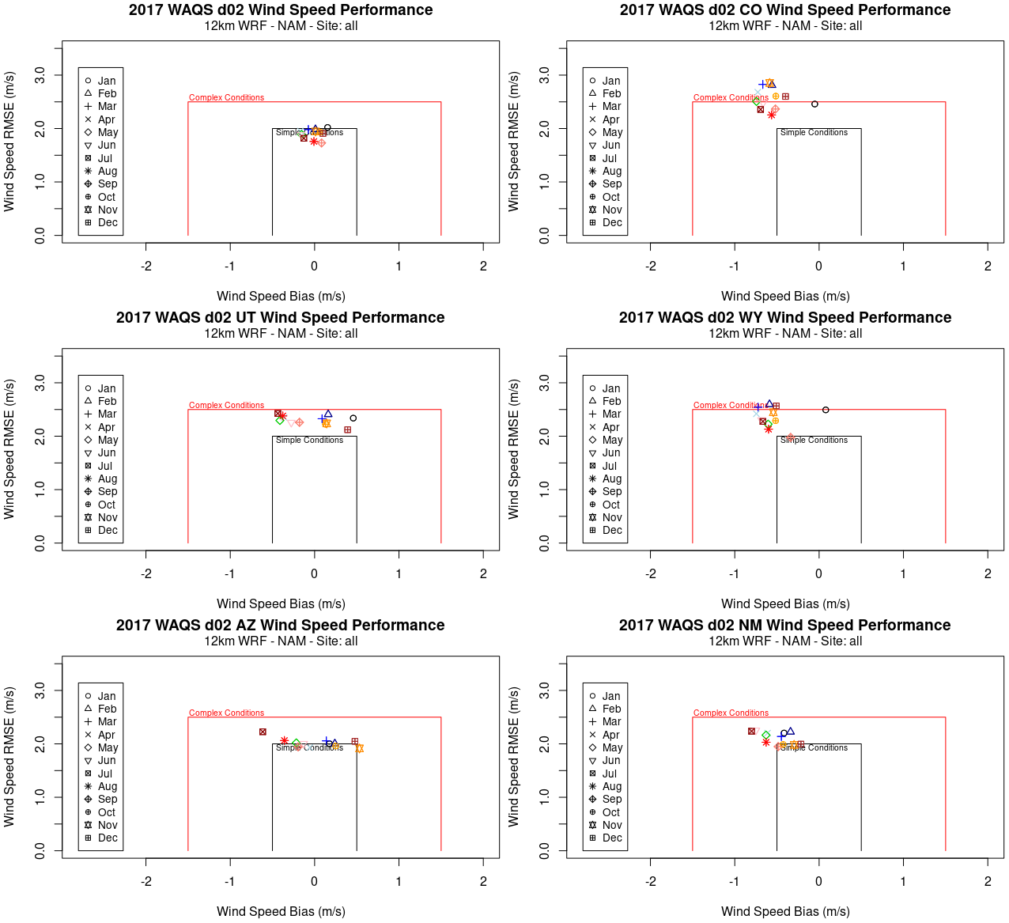
2017 WAQS 12 km WIND SPEED performance (STATES)
ALL
CO
# sites: 1376
# sites: 56
All stats within simple benchmark goal for all 12 km sites
UT
WY
# sites: 19
# sites: 25
Performance more varied at state level
Most months within complex benchmarks; persistent underestimations in CO, WY, NM
AZ
NM
# sites: 35
# sites: 31
Notes:
Bias may be artificially low for ALL simply from averaging over large number of sites in 12 km domain

Slide 5
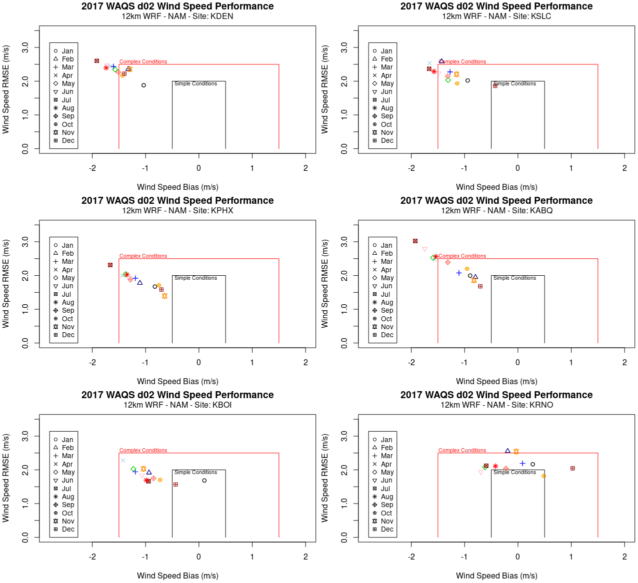
2017 WAQS 12 km WIND SPEED performance (SITES)
DEN
SLC
Performance comparable to 2014 WRAP-WAQS
PHX
ABQ
Both simulations include persistent negative wind speed biases
BOI
RNO
Notes:
Wind speed performance is best at Boise and Reno, where all months lie within or very close to the complex benchmark goal. Denver, Salt Lake City, Phoenix, and Albuquerque all have at least one month outside of the complex benchmark and all show
negative wind speed biases (WRF winds too slow) across all months.

Slide 6
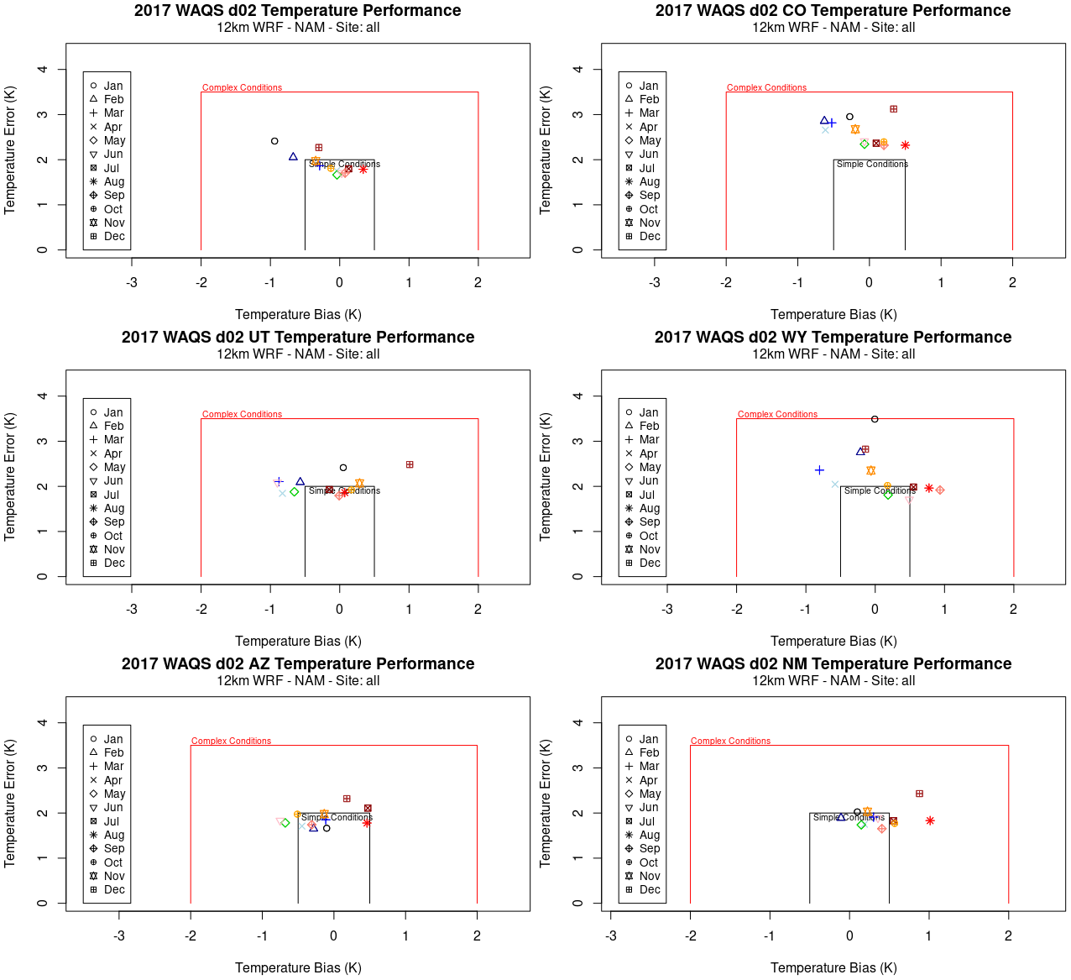
2017 WAQS 12 km TEMPERATURE performance (STATES)
ALL
CO
# sites: 1376
# sites: 56
All stats within complex benchmark goal for all states
UT
WY
# sites: 19
# sites: 25
Bias centered on zero for all states except NM (warm bias)
AZ
NM
# sites: 35
# sites: 31

Slide 7
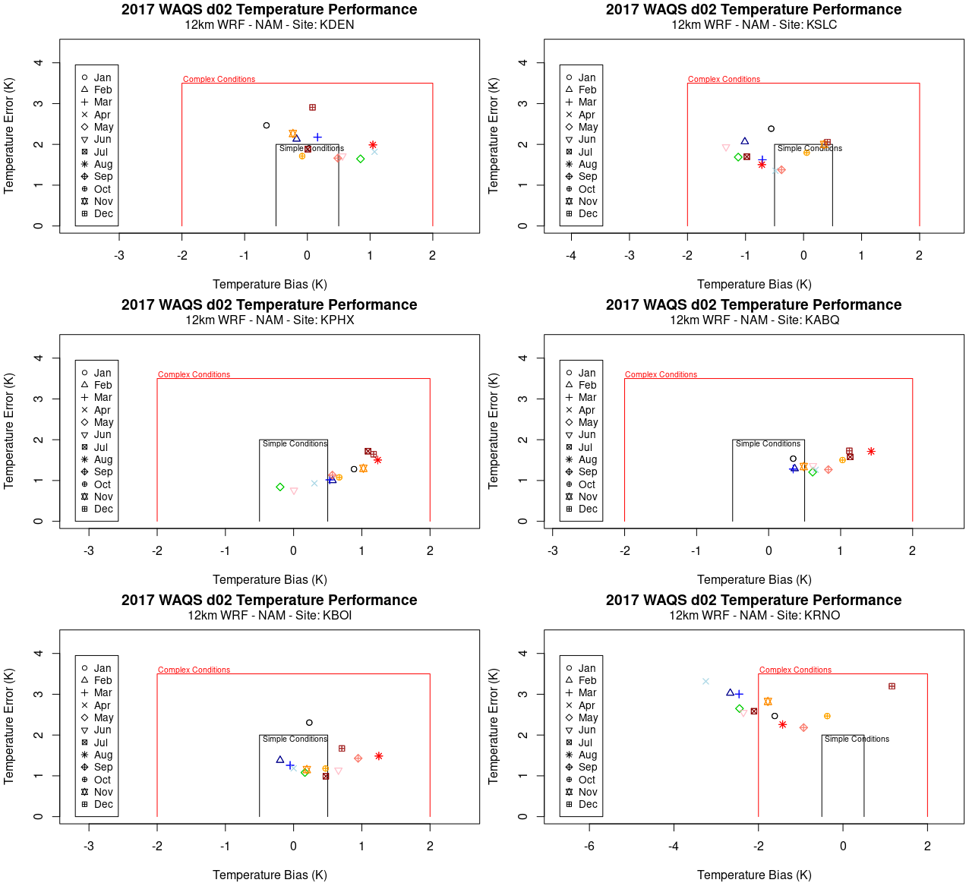
2017 WAQS 12 km TEMPERATURE performance (SITES)
DEN
SLC
Performance more varied at site level
PHX
ABQ
2017 WAQS shows slightly better temperature performance compared to 2014 WRAP-WAQS
BOI
RNO

Slide 8
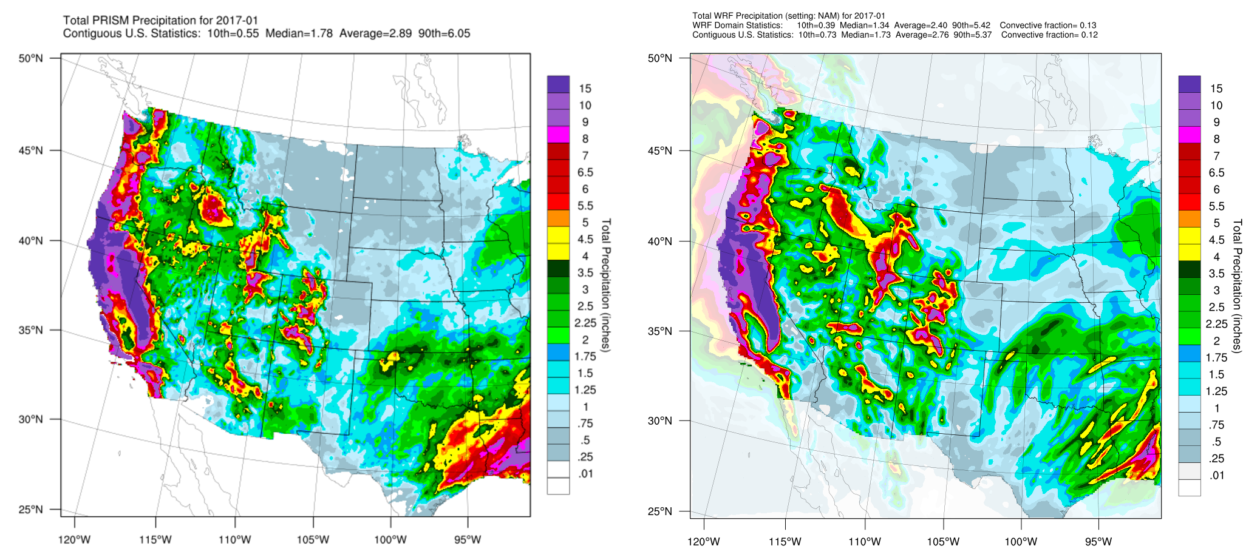
January 2017 PRECIP performance for WRAP 12 km
PRISM
WRF
Notes:
--Nov-Mar WRF precip performance quite good
--2017 ended California’s 5-year drought
(https://water.ca.gov/-/media/DWR-Website/Web-Pages/Programs/Groundwater-Management/Data-and-Tools/Files/Statewide-Reports/Water-Year-2017---What-a-Difference-a-Year-Makes_ay_19.pdf)

Slide 9
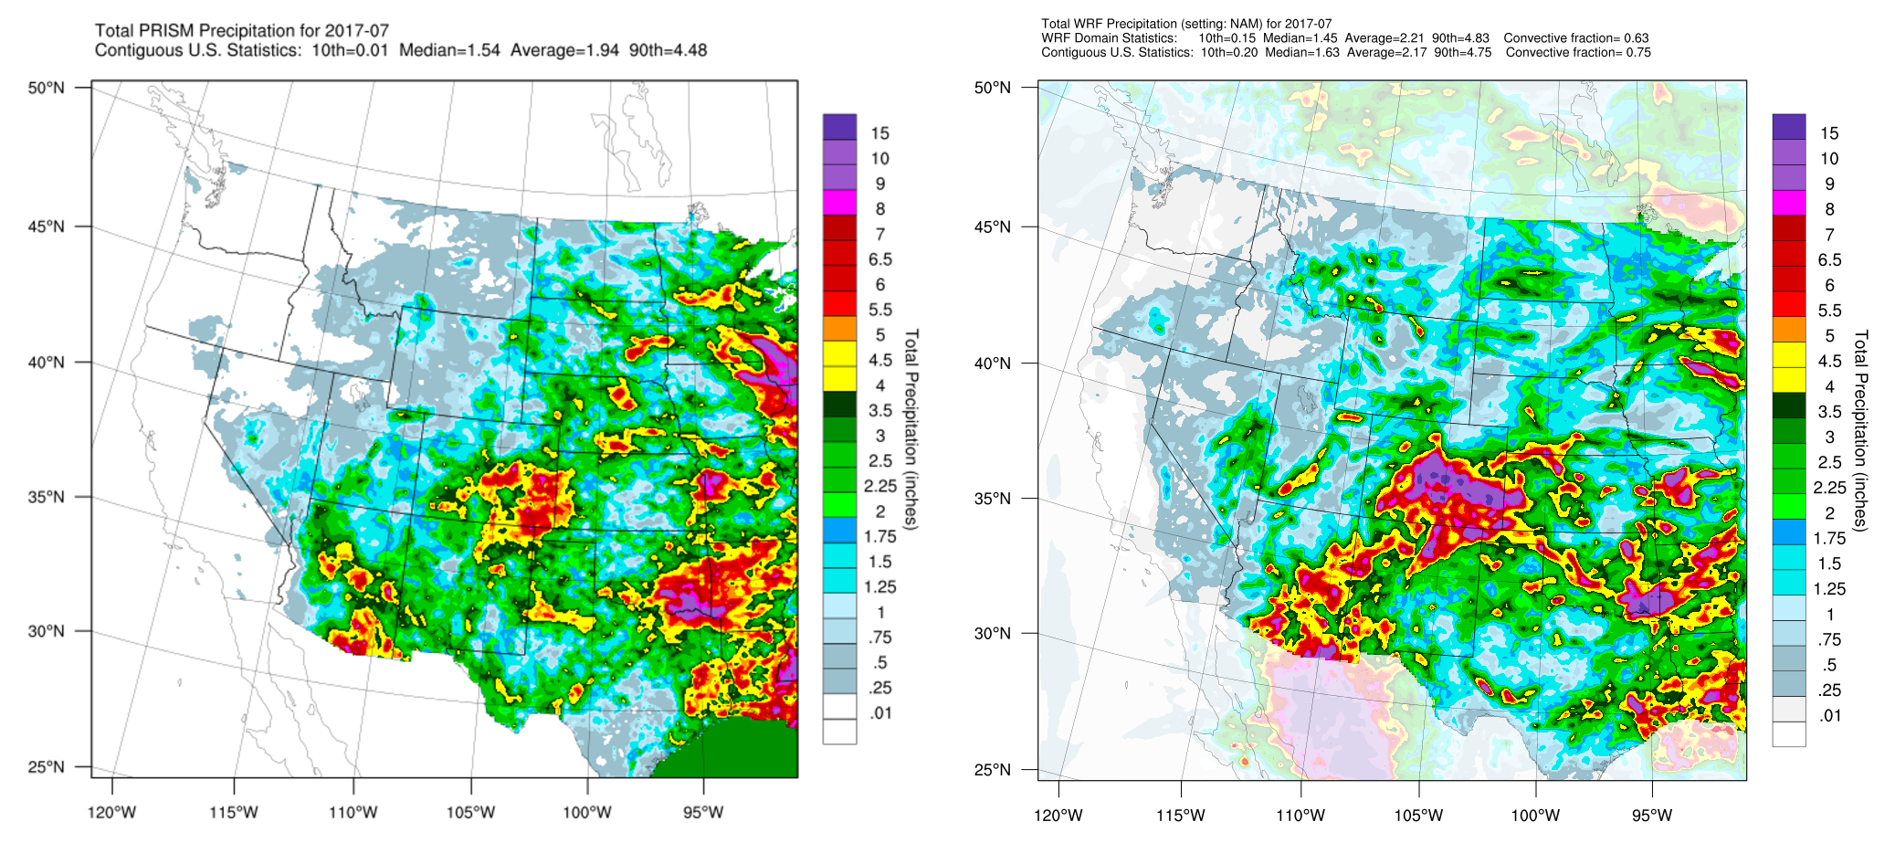
JULy 2017 PRECIP performance for WRAP 12 km
PRISM
WRF
Notes:
Precip overestimated in CO/NM/KS

Slide 10
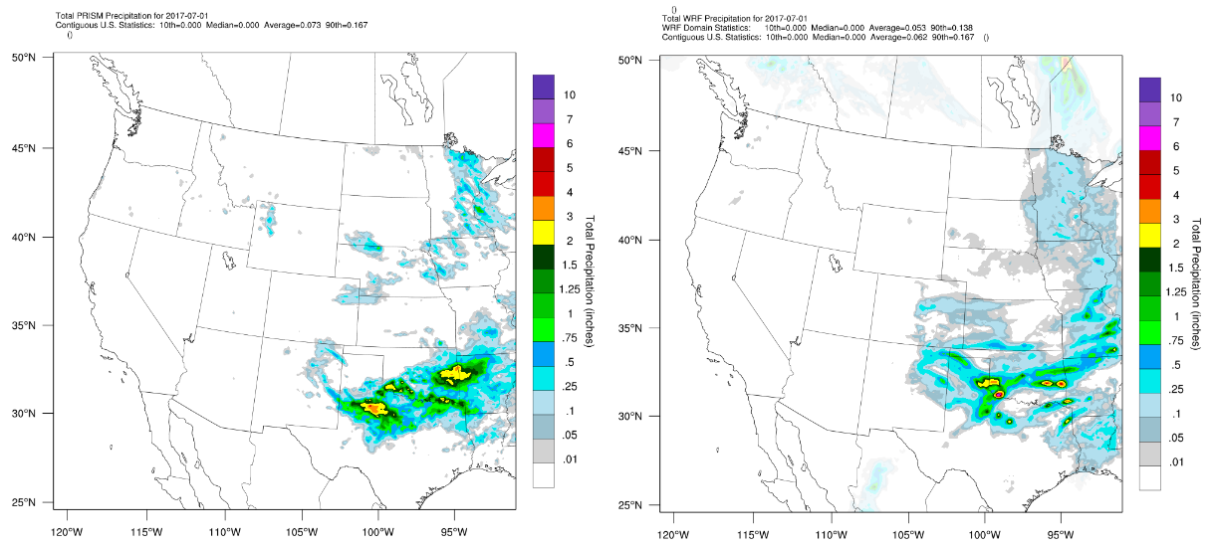
JULy 1, 2017 DAILY PRECIP performance for WRAP 12 km
PRISM
WRF
Example: zero/light precip day
Notes:
July 1: zero/light precip day

Slide 11
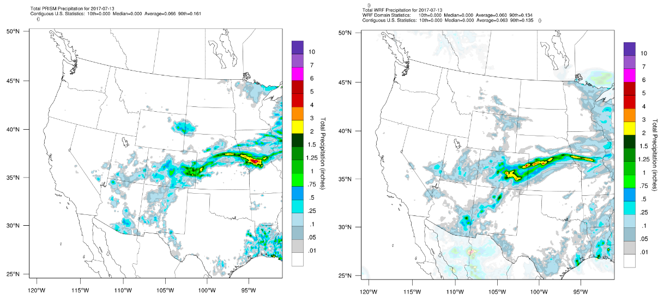
JULy 13, 2017 DAILY PRECIP performance for WRAP 12 km
PRISM
WRF
Example: well-performing day
Notes:
July 13: well-performing day

Slide 12
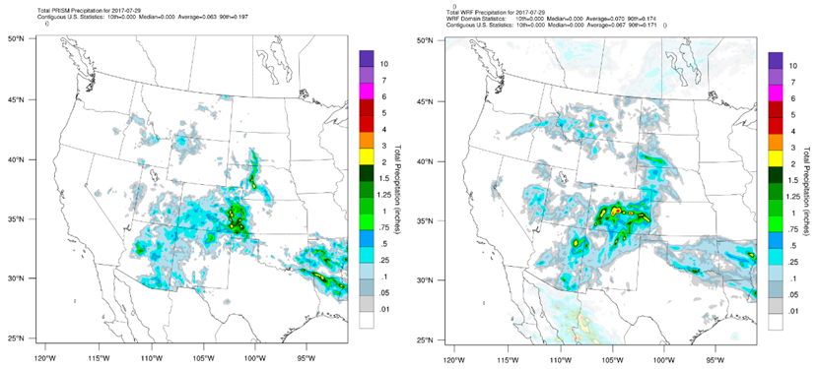
JULy 29, 2017 DAILY PRECIP performance for WRAP 12 km
PRISM
WRF
Example: overpredicted day
Notes:
July 29: overpredicted precip
Overall: WRF adequately simulates 16 days in July when zero or light sporadic precipitation was observed in the four-state intermountain west region. On 15 days with observed widespread and/or heavy rainfall patterns, WRF tends to generate too much convective activity both in spatial extent and intensity

Slide 13
SUMMARY/CONCLUSIONS
WRF configuration similar to 2014 WRAP-WAQS configuration
Biggest difference: hybrid vertical coordinate system
WRF performance comparable to 2014 WRAP-WAQS; suitable for WAQS CAMx modeling
WRFCAMx configuration closely matches the 2014 WRAP-WAQS configuration
Also allows for CAMx sensitivity testing with different mixing parameters and processing of natural emissions
All WRF inputs/outputs, WRFCAMx outputs and MPE products to be delivered to IWDW
Notes:
hybrid vertical coordinate -- designed to reduce numerical errors in the model

Slide 14
RECOMMENDATIONS
To assess sensitivity and identify potential performance improvements for precipitation coverage and rainfall intensities
Test an alternative multi-scale cumulus parameterization such as Grell-Freitas
Ingest an alternative source of large-scale analyses such as ERA5 (as was done for NMED OAI study);
Apply lightning data assimilation if this capability is brought forward to recent WRF versions that support the hybrid coordinate system
Investigate performance impacts from use of the hybrid vertical coordinate relative to the original eta/sigma coordinate;
Implement a 4-km resolution grid to better resolve complex topography in the Intermountain West

Slide 15
End

