Slide 1
GEOS-Chem 2017 Modeling
Task Summary
Ou Nopmongcol, Jean Guo, Yuge Shi, Chris Emery
December 14, 2021

Slide 2
Background
UDAQ is modeling 2017 for SIPs and needed boundary conditions for CAMx
WESTAR was also planning for 2017 WAQS
Two GEOS-Chem simulations
  2017 Base Case
  2017 Scenario with non-US anthropogenic emissions set to zero (Zero Rest of World run; ZROW)

Slide 3
Project Schedule
Task | Anticipated Completion | Note
Simulations completed | End of Feb | Completed
GEOS-Chem output to UDAQ | March 4 | Completed
Model Performance Evaluation | March 26 | Completed
Final Report | April 9 | Completed
Notes:
Did UDAQ have any issue with BC extraction?

Slide 4
Emission inputs

Slide 5
Global Modeling
Global anthropogenic emissions based on latest global and regional inventories available for GEOS-Chem
  Region-specific :
    US NEI 2011
    Canada CAC 2014
    China MEIC 2017
  Global:
    Anthropogenic: Community Emission Data System (CEDS)
    Biomass burning: Global Fire Emissions Dataset (GFED)
    Natural sources driven by 2017 meteorology (biogenic/soil, oceanic, dust, LNOx)
Notes:
soil NOx, sea-salt, oceanic DMS, biogenic VOC, WBD, short-lived bromo-carbon

Slide 6
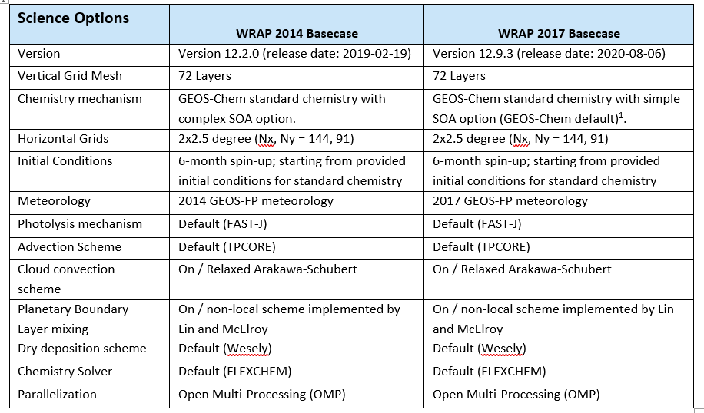
GEOS-Chem Configuration Comparison

Slide 7
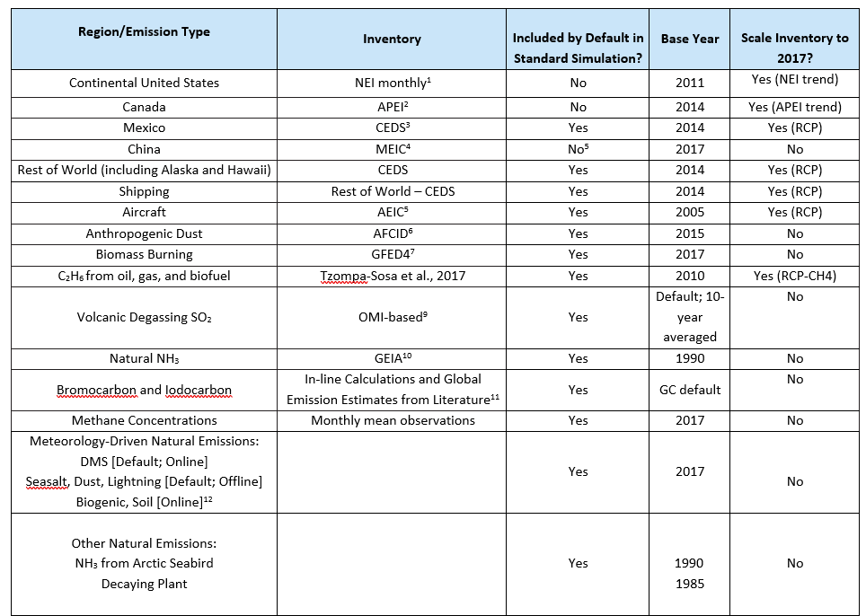
Emissions used in the 2017 GEOS-Chem

Slide 8
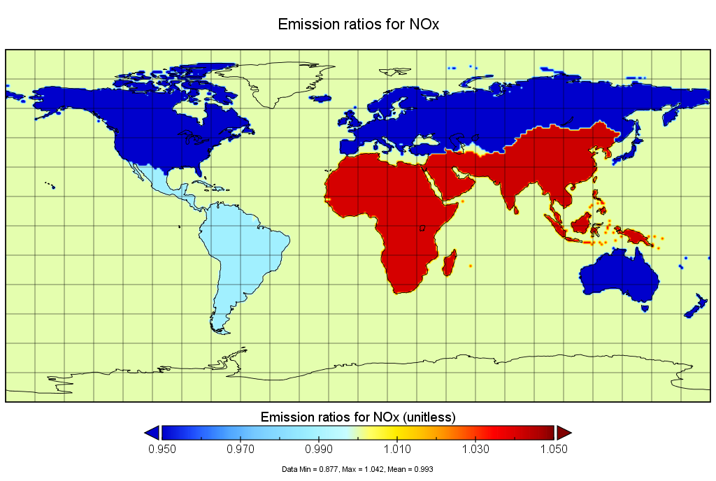
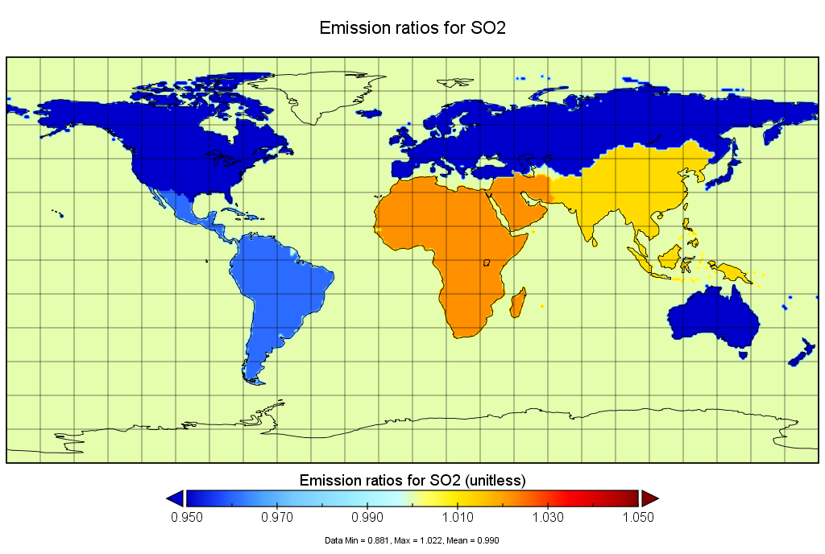
Emission Scalers
CEDS 2014->2017 scalers range 0.88-1.06

Slide 9
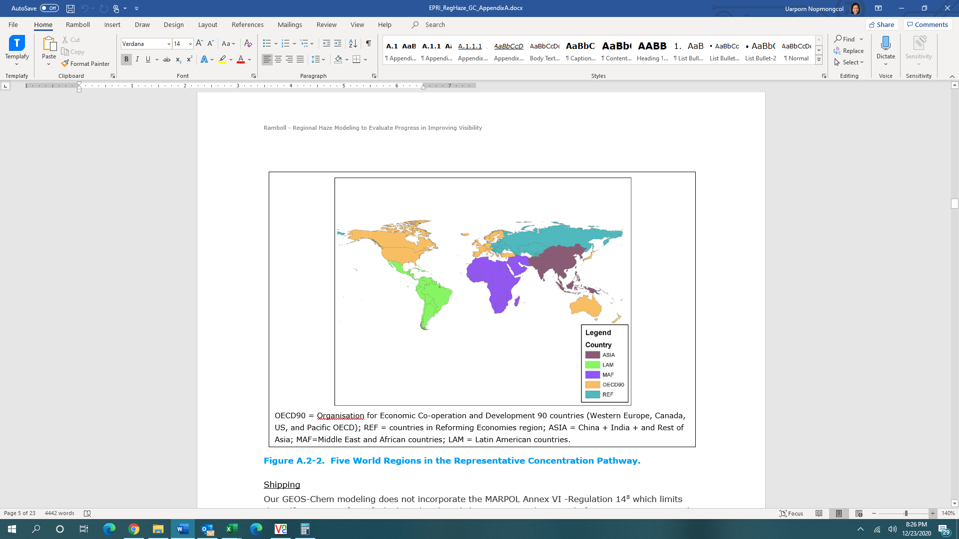
Emission Scalers
Notes:
C2H6 from oil and gas and biofuel

Slide 10
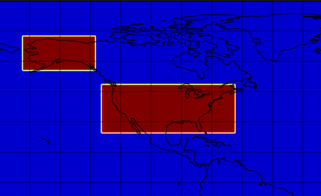
ZROW Simulation
Mask applied to global EIs
Notes:
Global methane is important in the ZROW scenario. GEOS-Chem specifies methane by interpolating global measurements rather than computing methane from emissions and chemistry (as for VOC). Any change we make to the measurements will be somewhat arbitrary. We propose that the effects of methane be addressed as weight-of-evidence. For example, Butler et al., 2020 suggests 1 ppb ozone decreases in northern hemisphere average surface ozone when methane is reduced by ~20%.

Slide 11
Post-processing
Spatial Plots of quarterly average concentrations across North America
CAMx boundary conditions
  New output species to be mapped to CAMx model species
  CAMx meteorological files from UDAQ for testing and QA
Model Performance Evaluation
  Ozone (CASTNET) and PM_{2.5} (IMPROVE)
    Spatial maps of NMB/NME, Summary table
  Ozonesonde at Trinidad Head (CA) and Boulder (CO)

Slide 12
Quarterly spatial plots

Slide 13
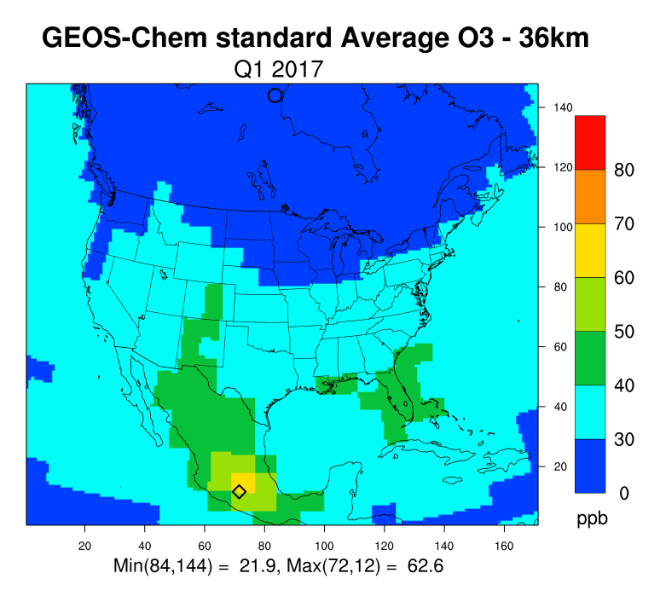
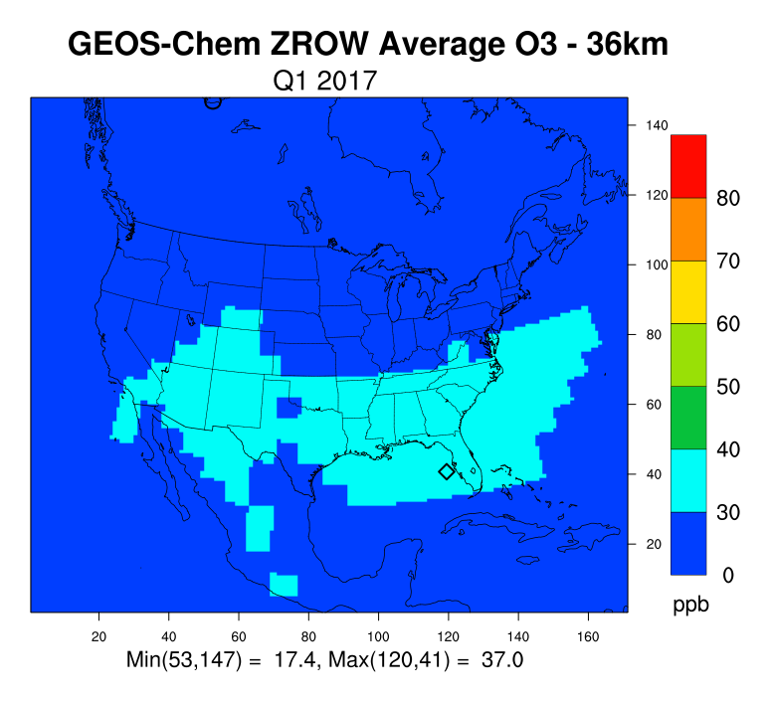
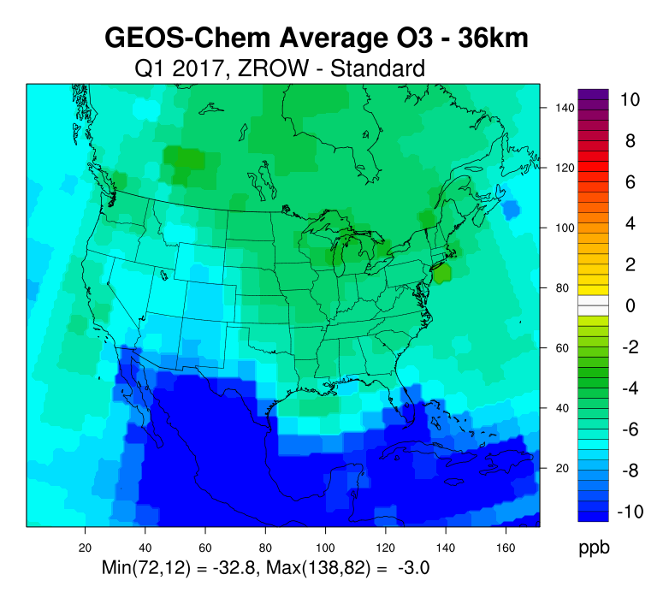
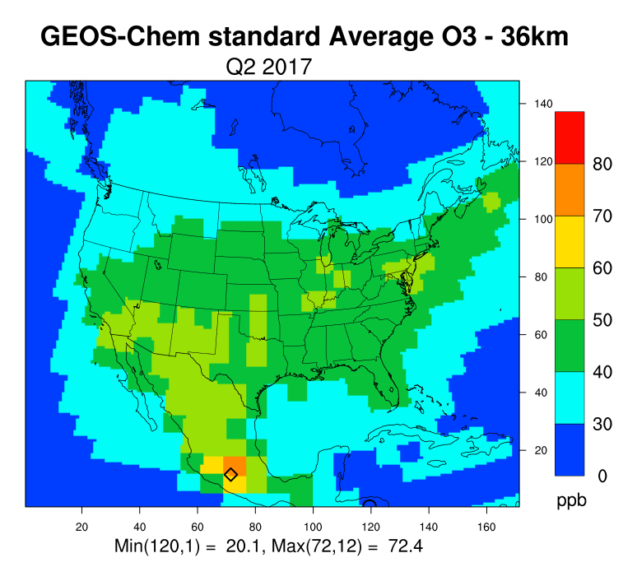
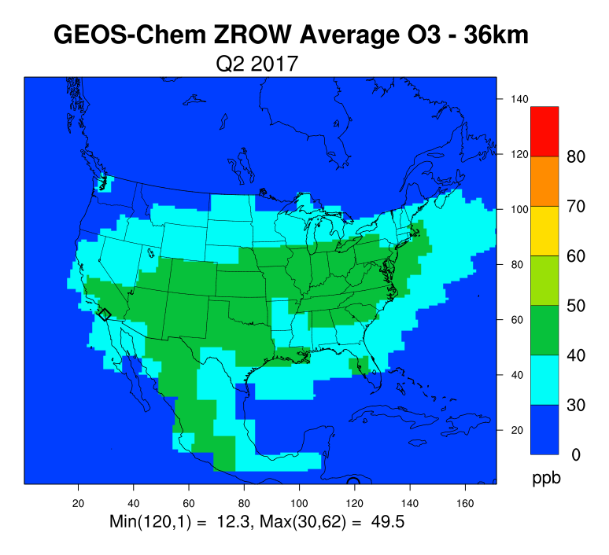
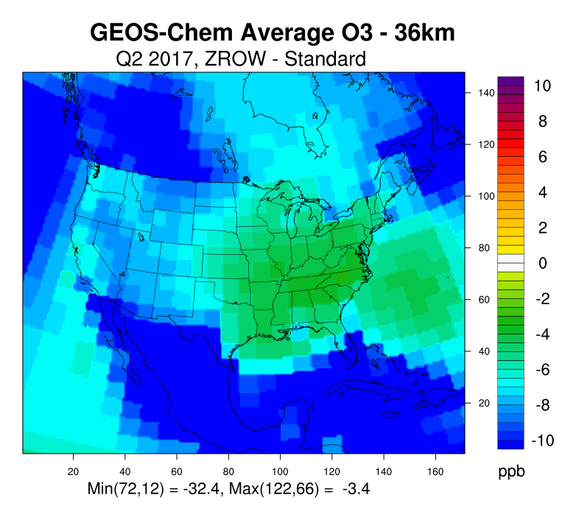
MDA8 Ozone
Base
ZROW
ZROW - Base
Q1
Base
ZROW
ZROW - Base
Q2

Slide 14
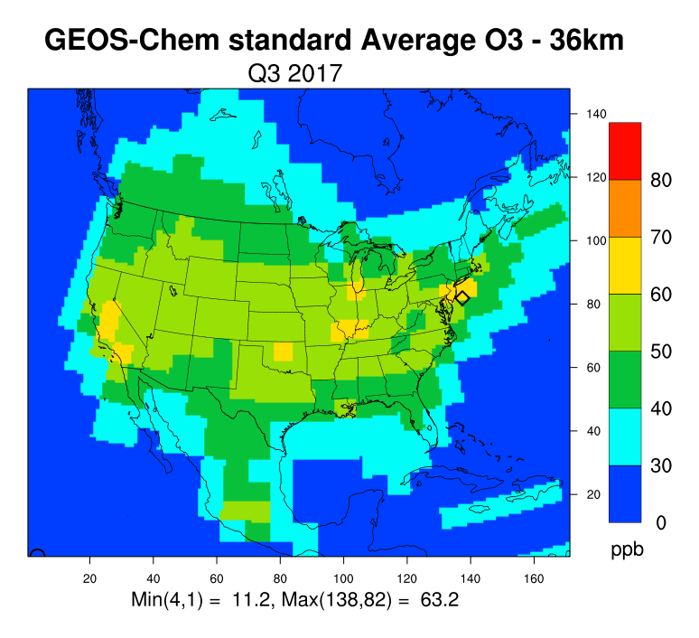
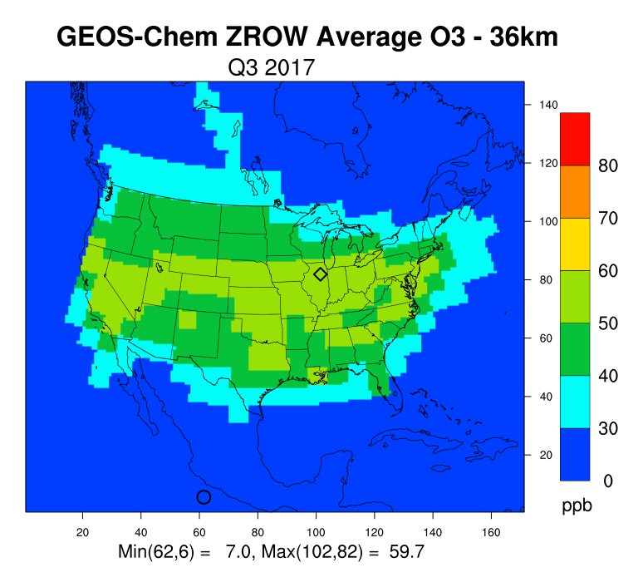
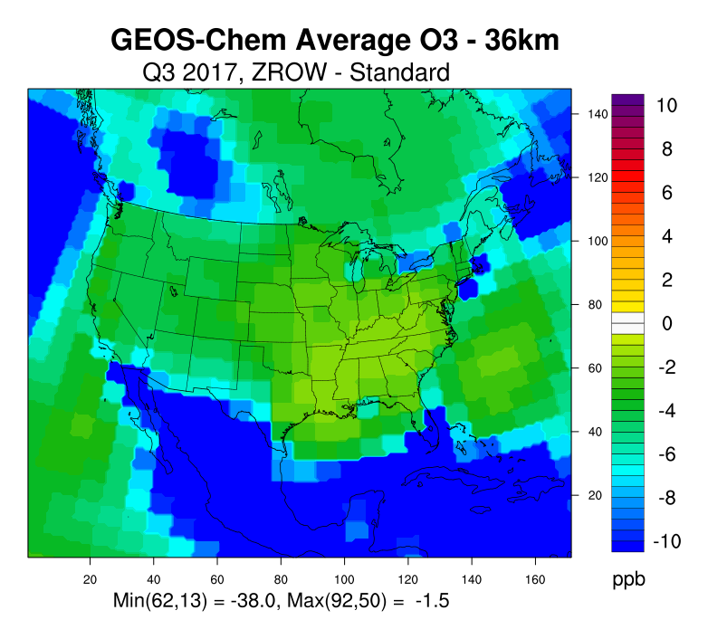
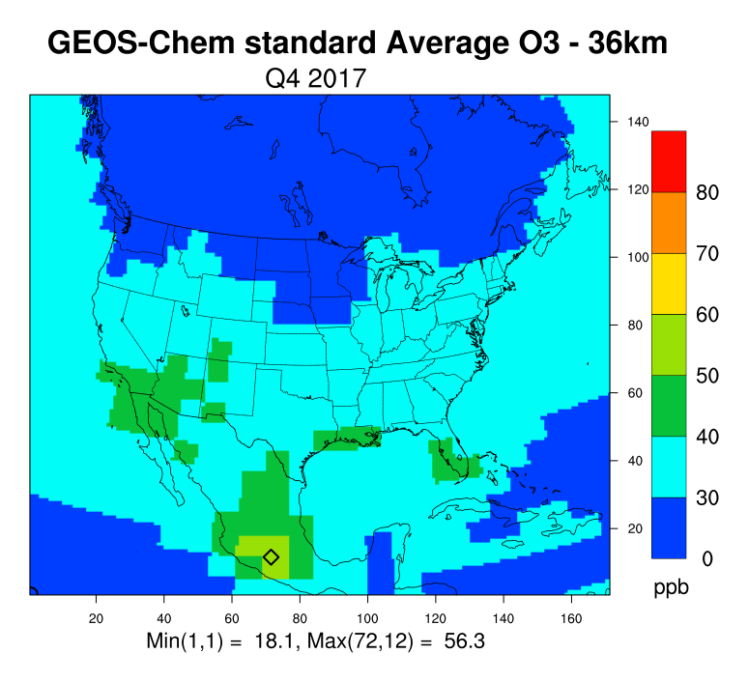
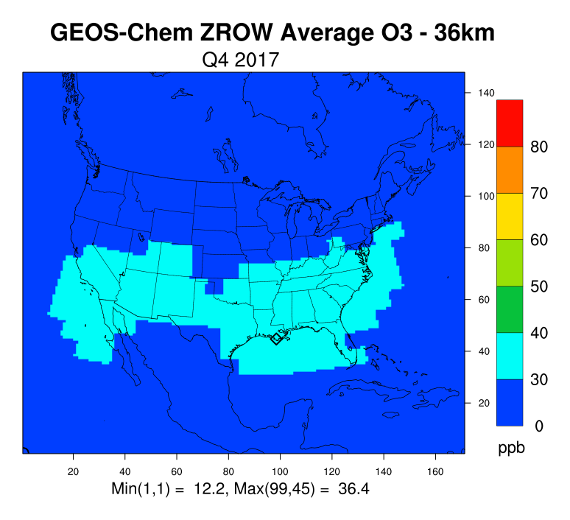
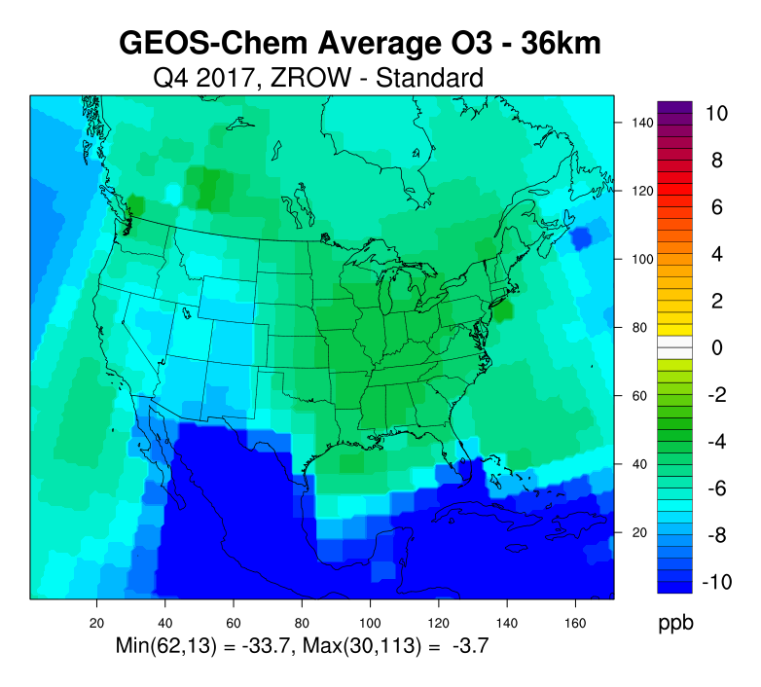
MDA8 Ozone
Base
ZROW
ZROW - Base
Q3
Base
ZROW
ZROW - Base
Q4

Slide 15
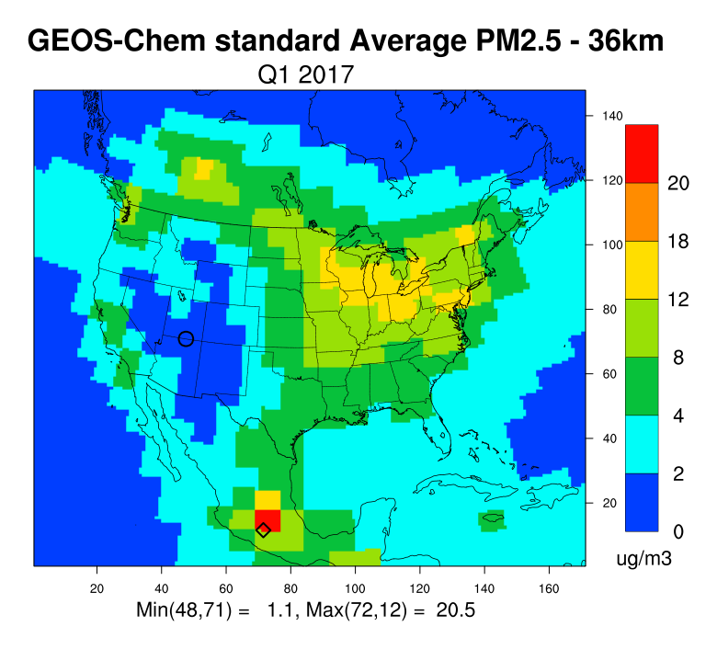
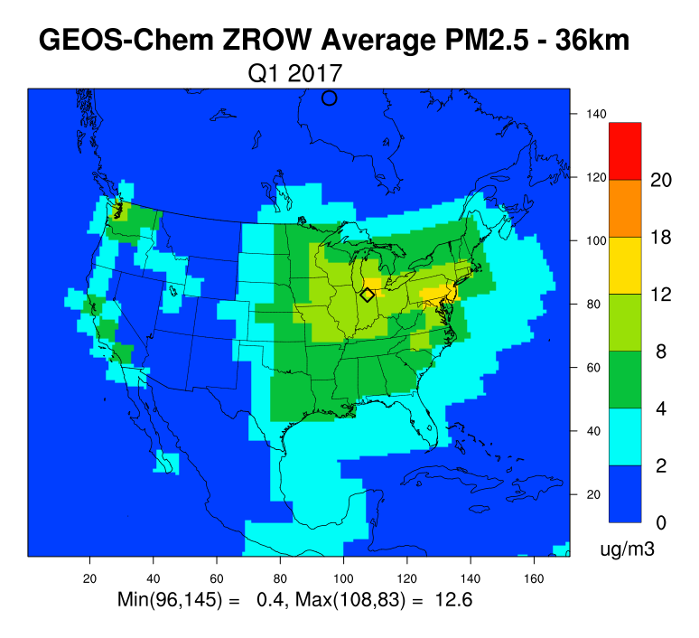
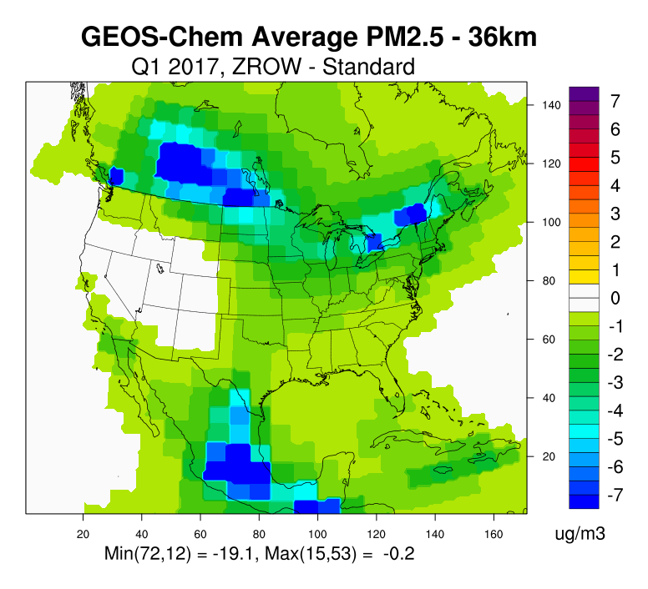
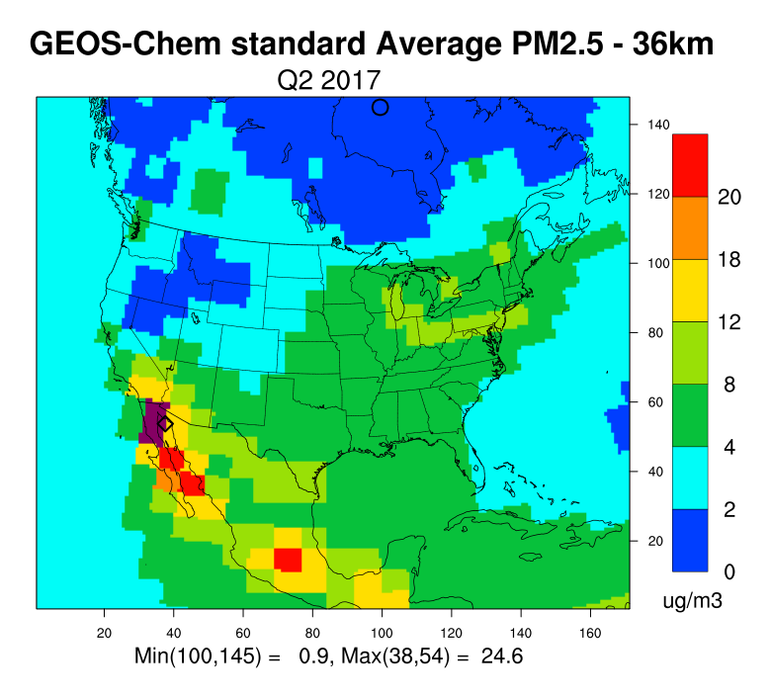
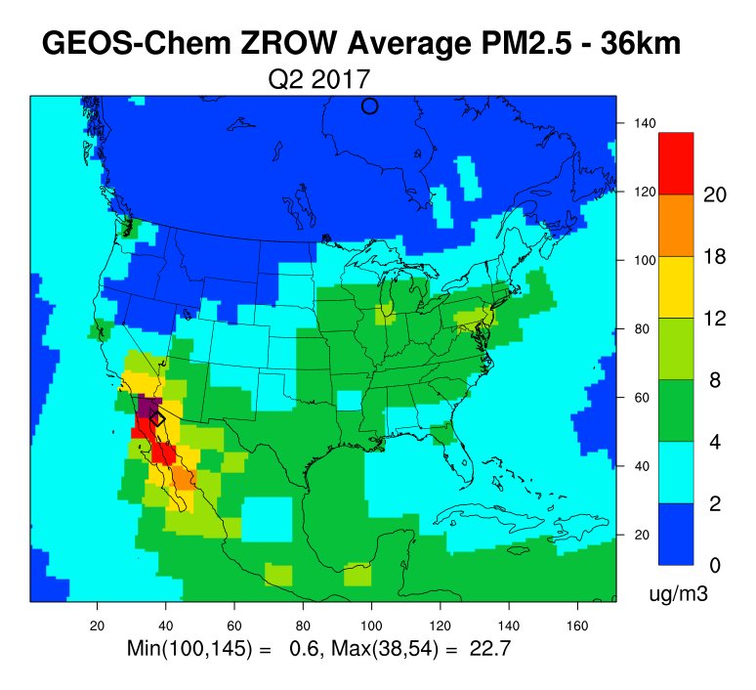
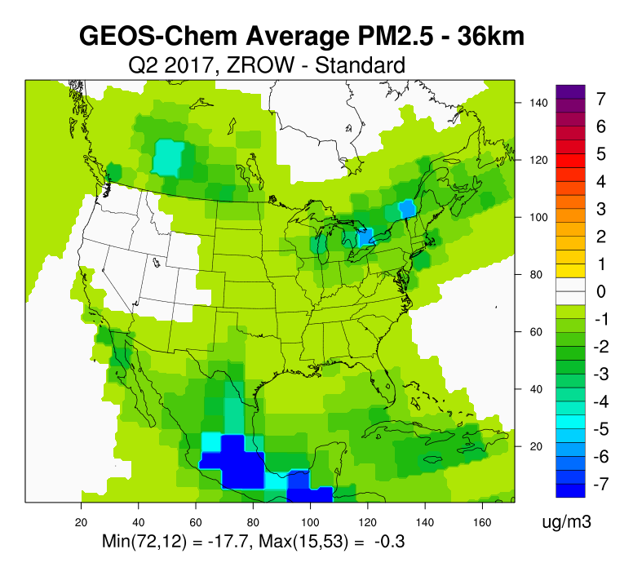
Average PM_{2.5}
Base
ZROW
ZROW - Base
Q1
Base
ZROW
ZROW - Base
Q2

Slide 16
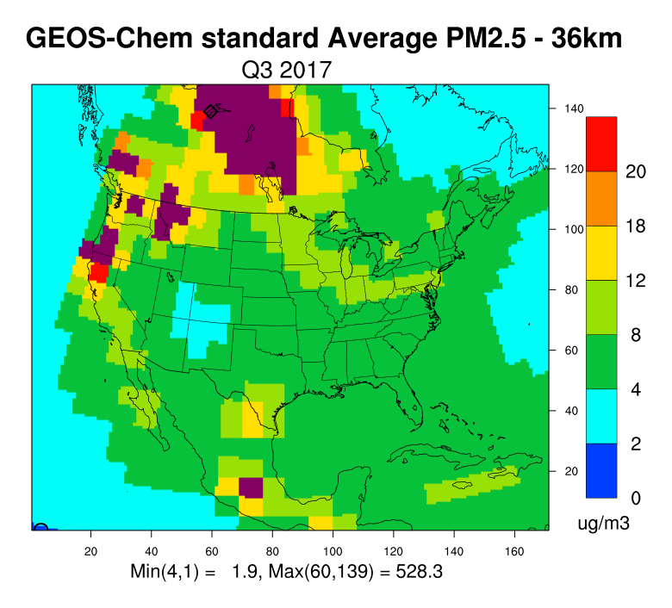
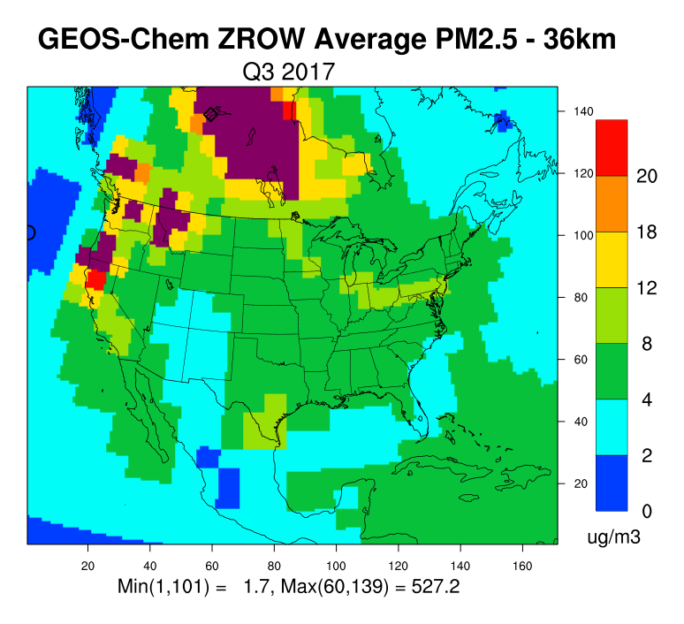
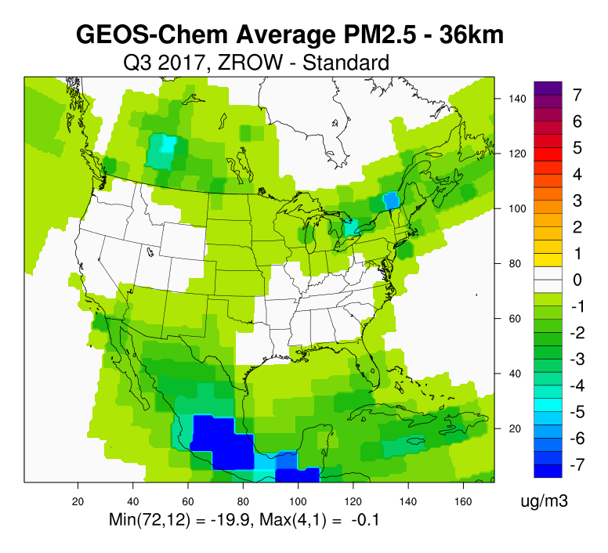
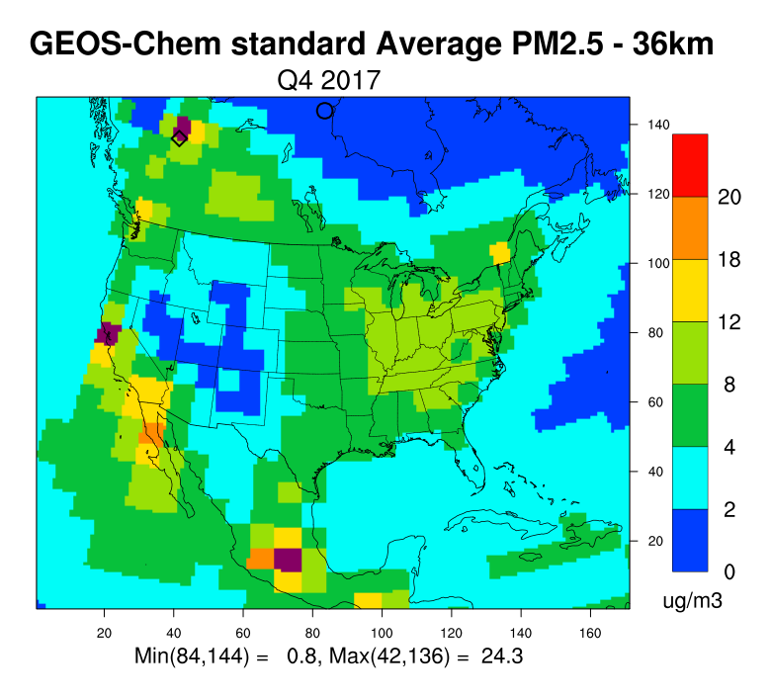
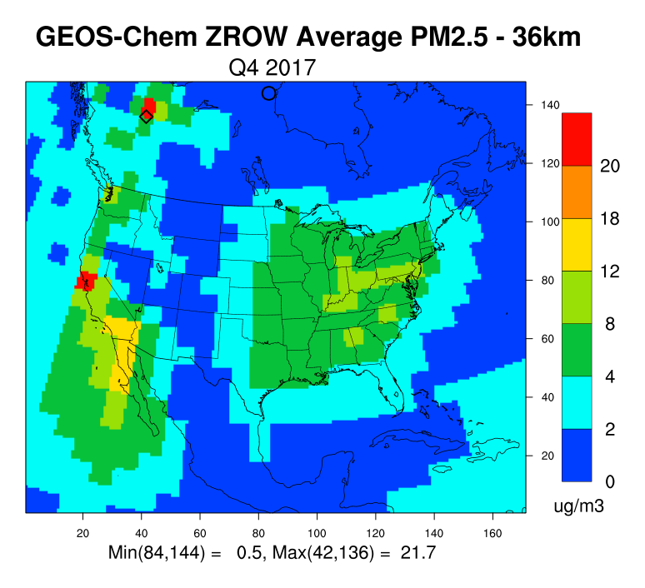
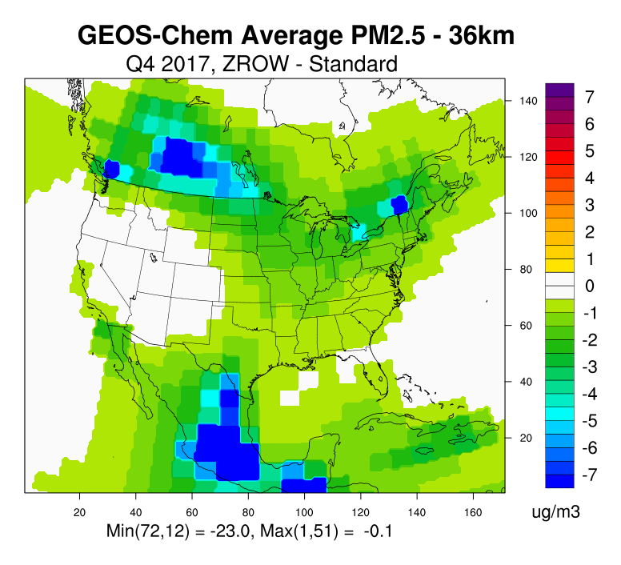
Average PM_{2.5}
Base
ZROW
ZROW - Base
Q3
Base
ZROW
ZROW - Base
Q4
Notes:
Typical hot spots as seen in 2014 as well. Fire impacts in Canada seem high, although they are localized.
Overall, similar spatial patterns but lower magnitude compared to the 2014 results

Slide 17
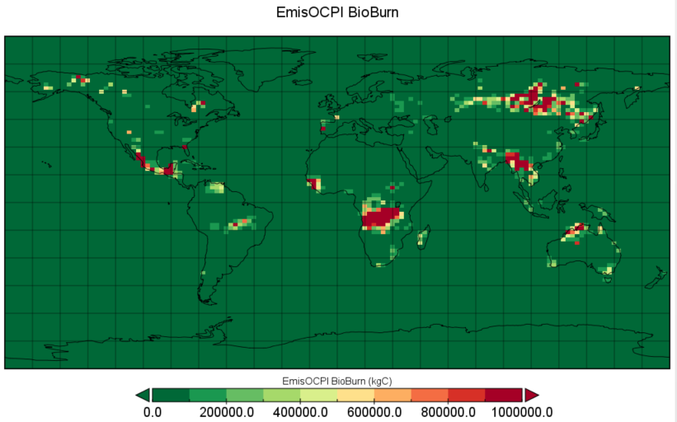
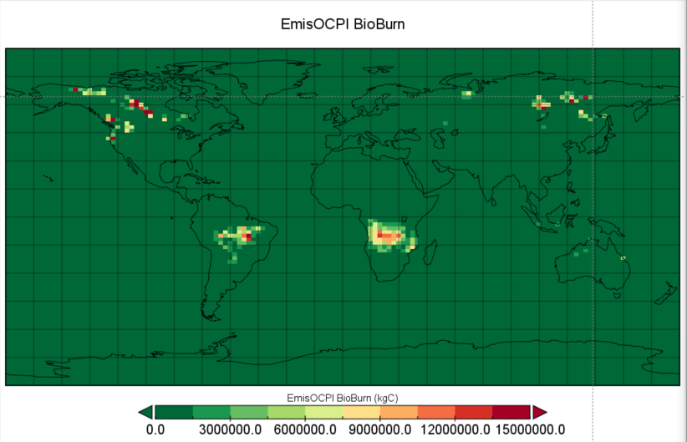
Fire-driven PM_{2.5} peaks
Mexico in Q2
Canada in Q3
Notes:
OCPI = Hydrophilic organic carbon aerosol
OCPO = Hydrophobic organic carbon aerosol

Slide 18
Model Performance Evaluation

Slide 19
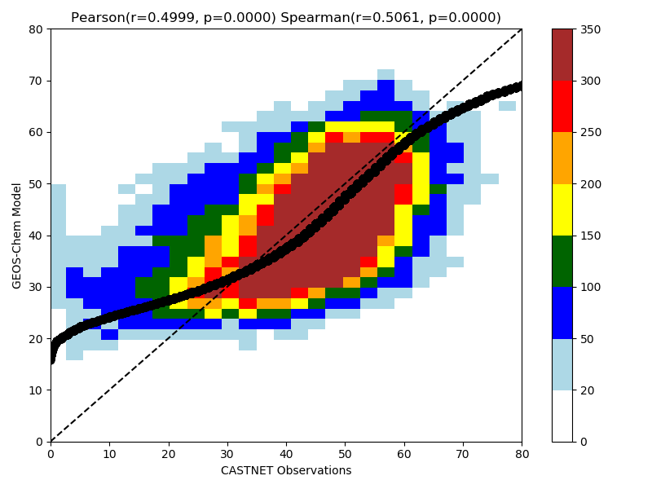
Ozone
CASTNET Summer, All Western Sites
MDA8 Ozone
Biases below <±15% criteria except in May
Slight tendency to underestimate
Correlation of 0.56 – 0.68
Hourly ozone Q-Q plot
Period | NMB (%) | NME (%) | Correlation (r)
May | -19.3 | 19.6 | 0.68
June | -11.5 | 14.3 | 0.67
July | -1.1 | 12.1 | 0.49
August | 4.1 | 10.6 | 0.56
Performance Criteria: Bias <±15%, Error < 25%, r > 0.5
Notes:
Model performance evaluation focusing rural sites
Bias = Normalized Mean Bias
Error = Normalized Mean Error

Slide 20
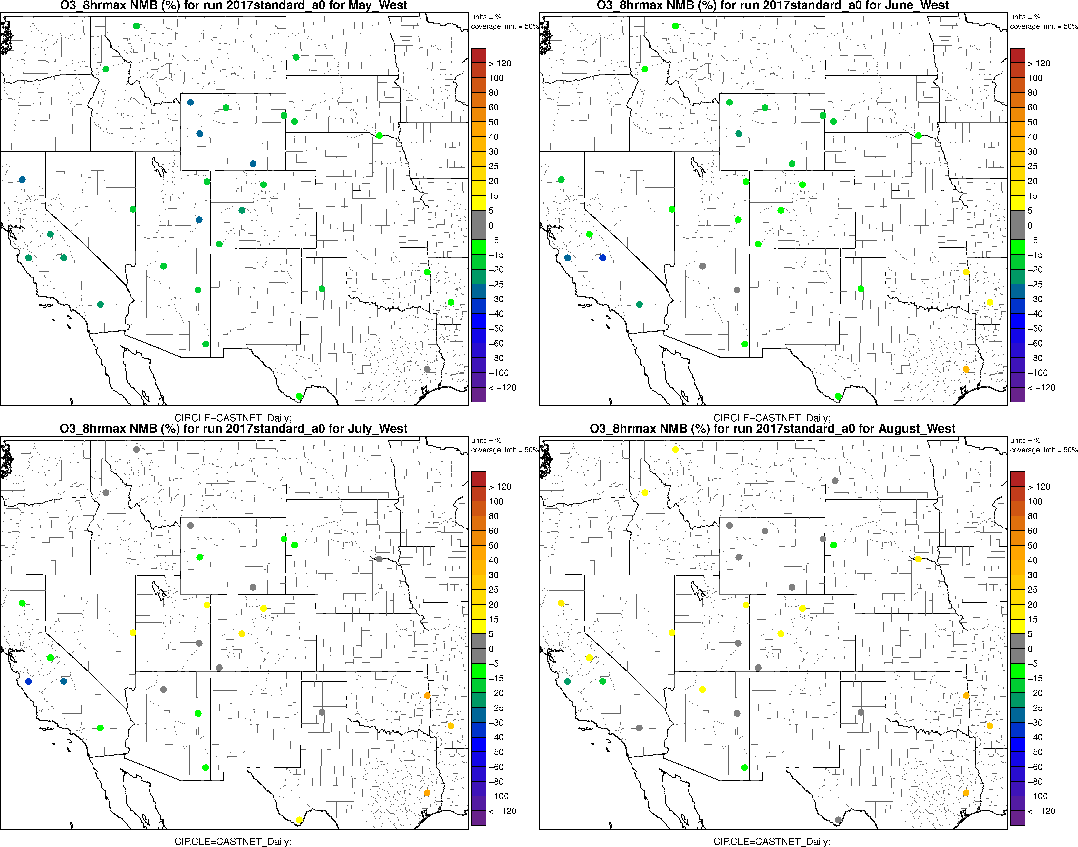
Ozone
NMB (%)
May
Jun
Tends to underestimate ozone
Largest biases in California in over all four months (Pinnacle and Sequoia) and the Rocky Mountain states in May
Jul
Aug

Slide 21
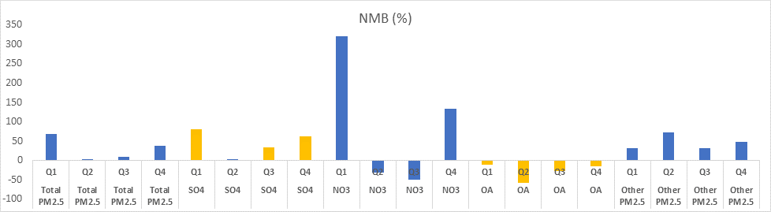
PM_{2.5}
IMPROVE 4 Quarters, All Western Sites
24-hr avg PM_{2.5}
Period | NMB (%) | NME (%) | Correlation (r)
Q1 | 68 | 104 | 0.21
Q2 | 3.8 | 48 | 0.25
Q3 | 8.8 | 51 | 0.49
Q4 | 38 | 91 | 0.24
Better performance in Q2/Q4 than Q1/Q3
Over prediction of NO₃ in colder months
Tendency to over-estimate in the southwest due to overstated dust
Performance Criteria: Bias <±30%, Error < 50%, r > 0.4
Notes:
Consistent over prediction of sulfate, nitrate drives poor performance in Q1 and Q4
Consistent under prediction of organics
Other PM_{2.5} high throughout the year with highest biases in Q2 in the southwestern US attributable to overstated dust emissions

Slide 22
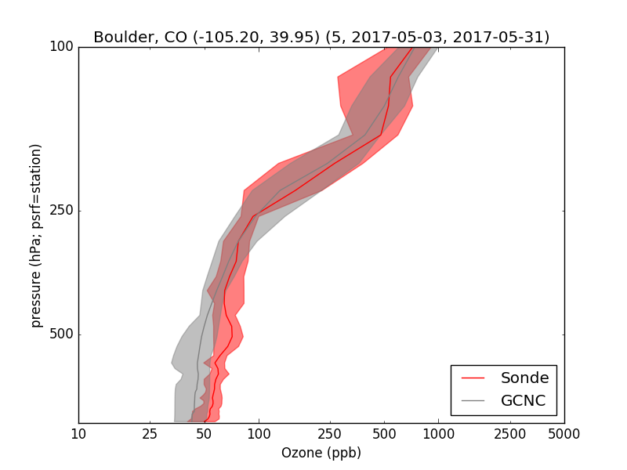
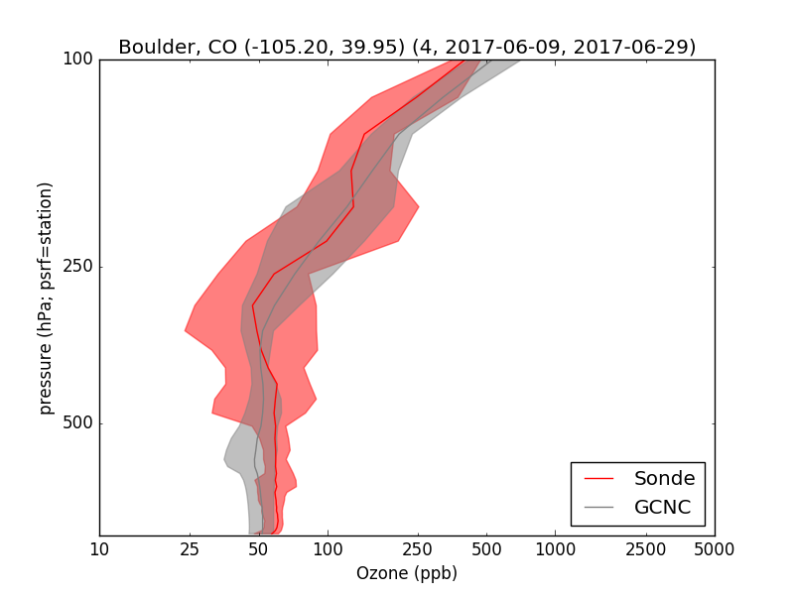
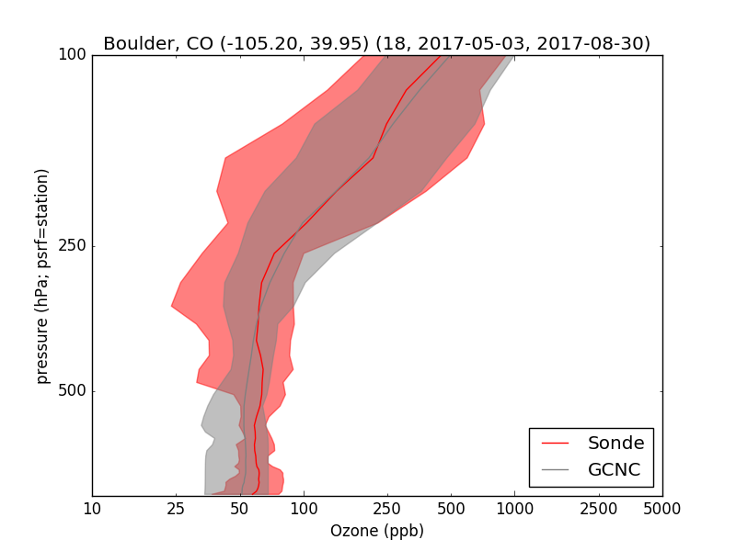
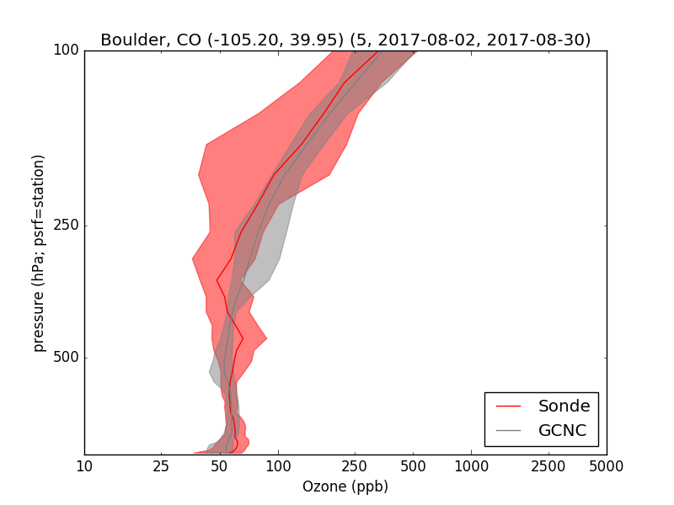
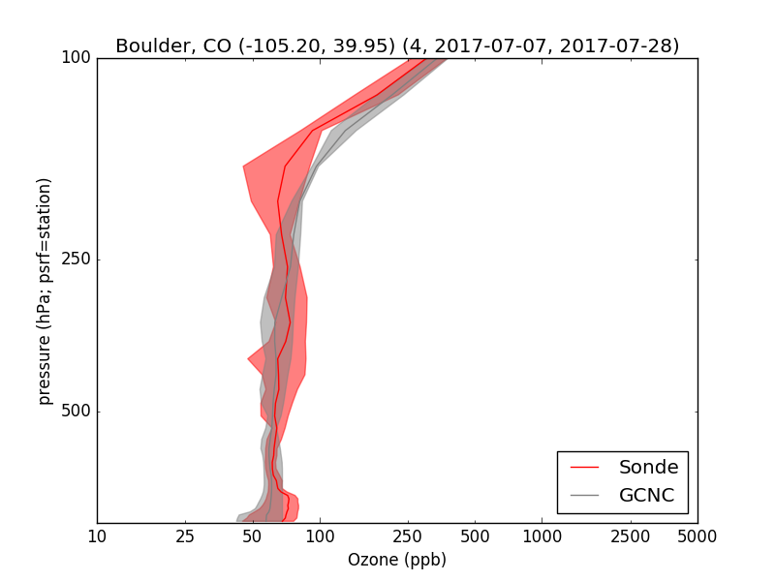
Ozone sonde comparison: Boulder
May June
July August
Tendency to underestimate below 5 km in May and June
Good performance aloft in all months
May-Aug

Slide 23
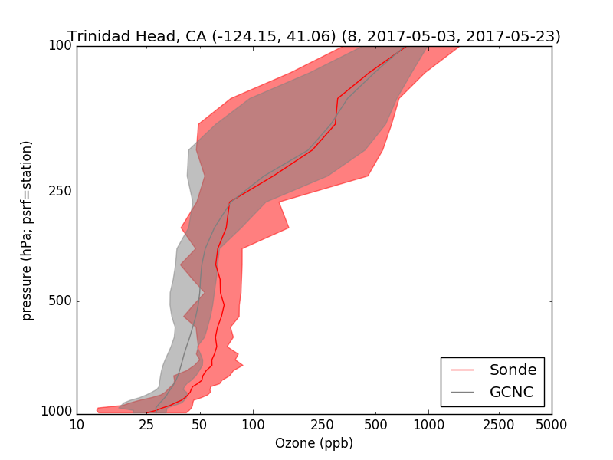
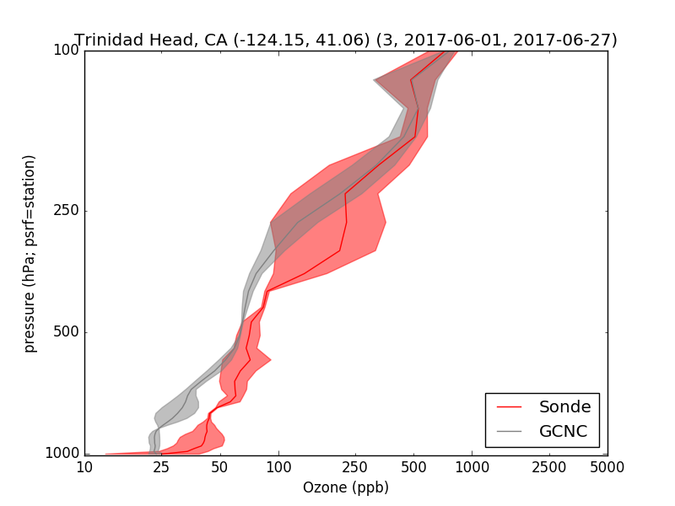
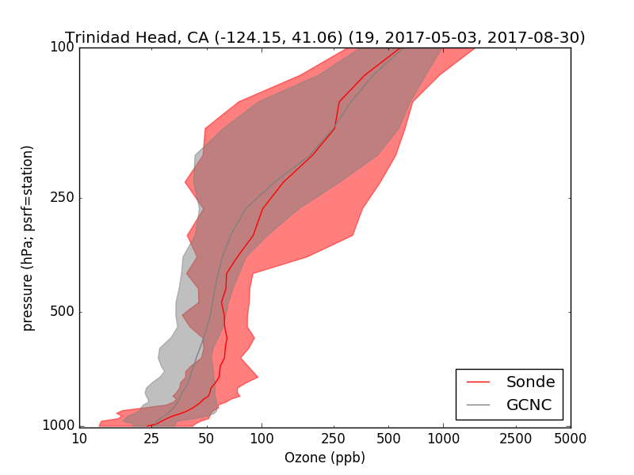
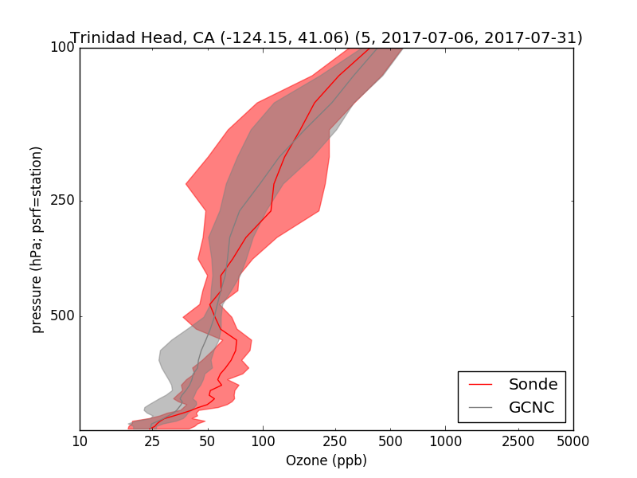
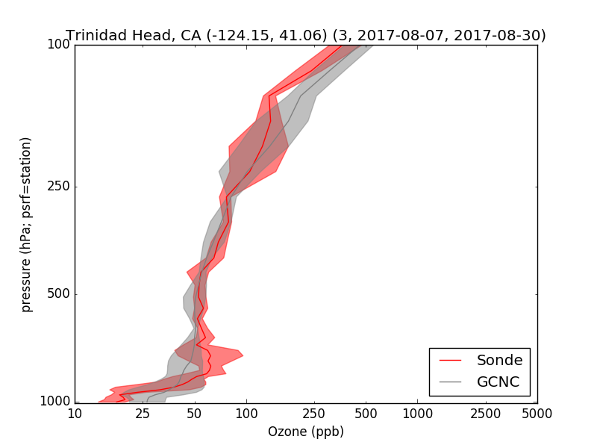
Ozone sonde comparison: Trinidad Head
May June
July August
Tendency to underestimate below 10 km in May and June
Generally good performance aloft
  Slight overestimation in August
May-Aug
Notes:
Trinidad Head
May – 6 days
June – 3 days
July – 5 days
Aug – 3 days

Slide 24
Testing CAMx BC extraction

Slide 25
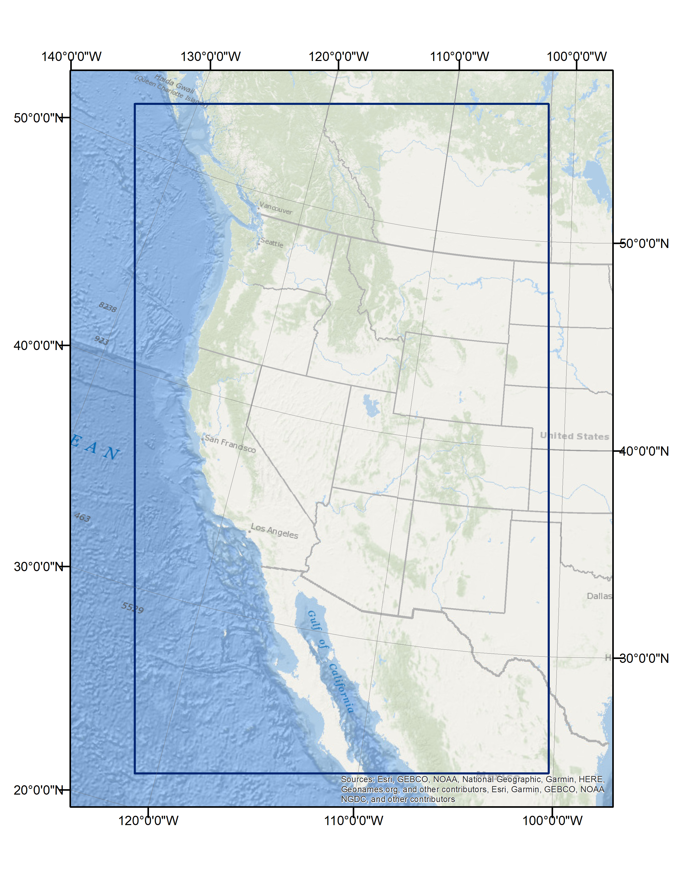
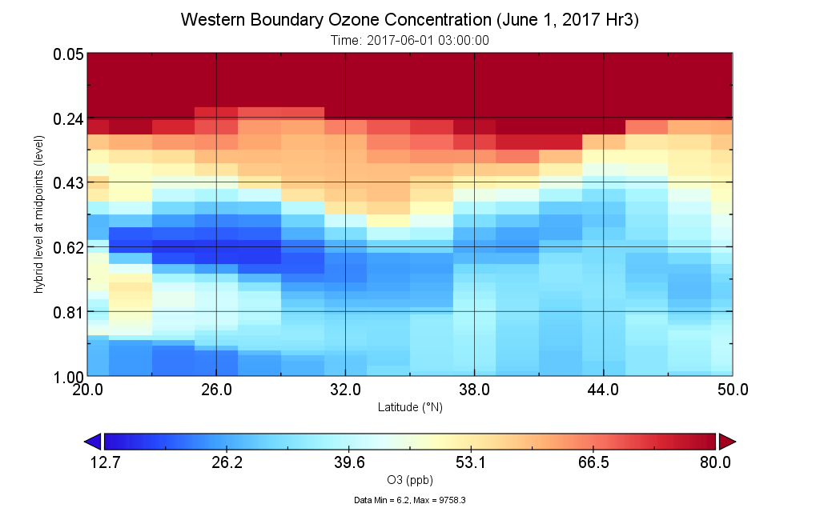
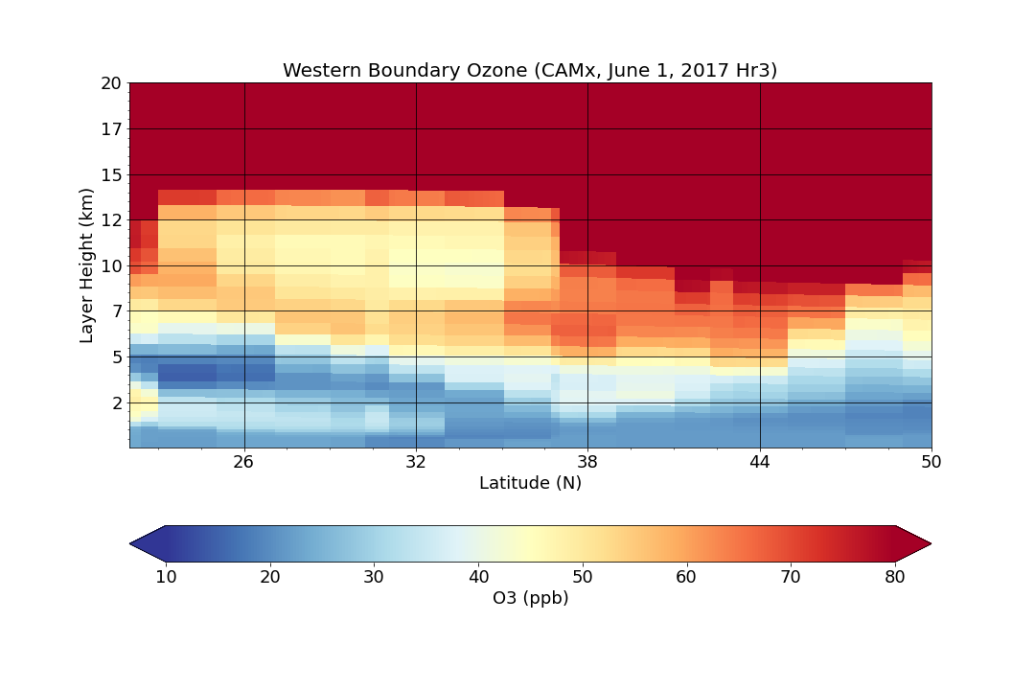
Test Case
Using UDAQ’s CAMx 12km meteorological file for June 1
Qualitative evaluation for QA
General agreement in patterns suggests a proper spatial extraction
GEOS-Chem output
CAMx BCs
Notes:
Curtain plot of the Western BCs
GEOS-Chem and CAMx employ different vertical and horizontal coordinate systems, so the visual comparison suggests differences by the way they are plotted

Slide 26
Summary
GEOS-Chem 2017 modeling setup seems reasonable
  Base case shows reasonable ozone performance
  PM_{2.5} performance not as good, particularly in colder seasons
    Much less likely driven by global transport than by local processes
Recommend that the effects of methane (not assessed in the ZROW simulation) be addressed as weight-of-evidence in the 179B demonstration
Developed 2017 CAMx IC/BC for WAQS
Notes:
Effects of methane were not assessed in the ZROW simulation due to the limitation of how global methane is treated in the GEOS-Chem model. We recommend that the effects of methane be addressed as weight-of-evidence in the 179B demonstration

Slide 27
Questions? cemery@ramboll.com
Chris Emery
Senior Managing Consultant

