Slide 1
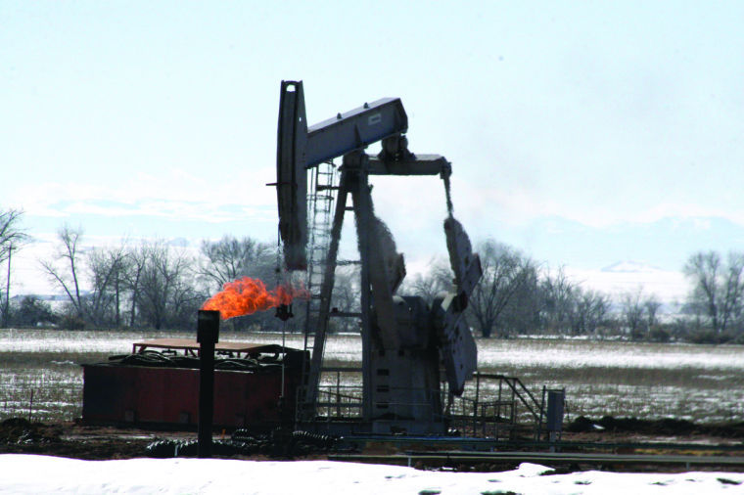
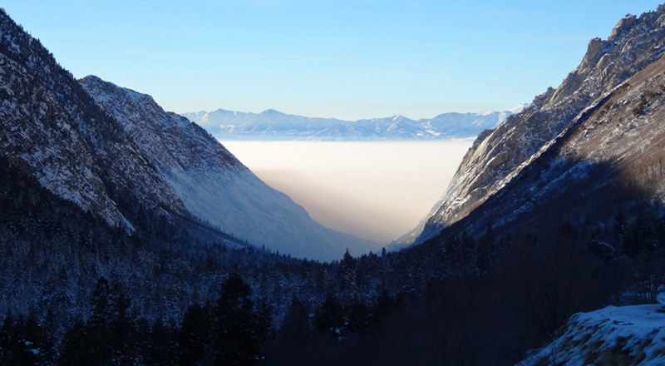
WRF Winter Modeling
Towards Improving Cold Air Pools
Jared Bowden
Kevin Talgo
UNC Chapel Hill
Institute for the Environment
Feb. 25, 2015

Slide 2
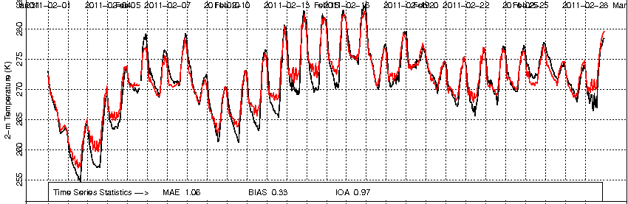
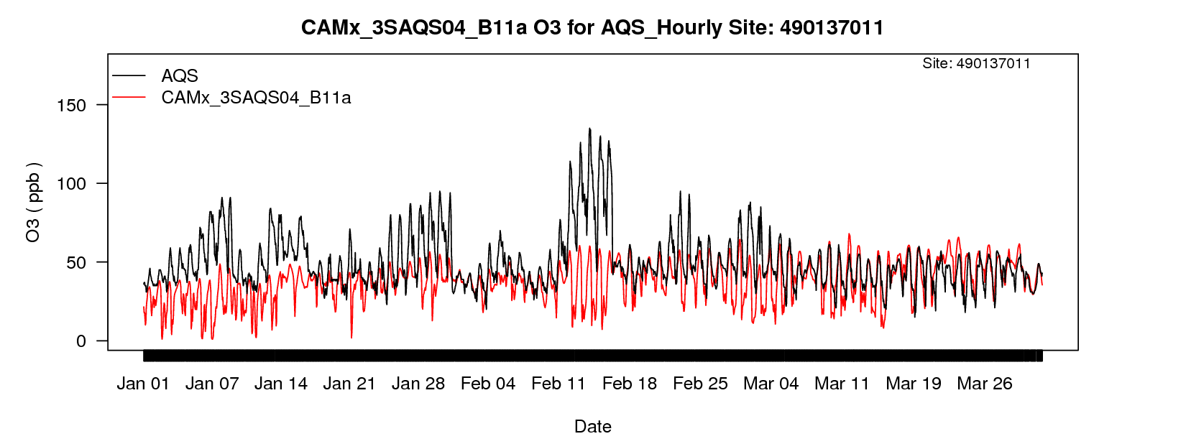
Motivation
Strong and persistent low-level atmosphere temperature inversions create favorable conditions for high ozone concentrations.
Previously, 2011 MPE identified rural oil and gas development areas with poor model performance during the winter.
2-m Temperature Utah
Model
Obs.
O3 Duchesne - Utah
O3 Event
> 90ppb

Slide 3
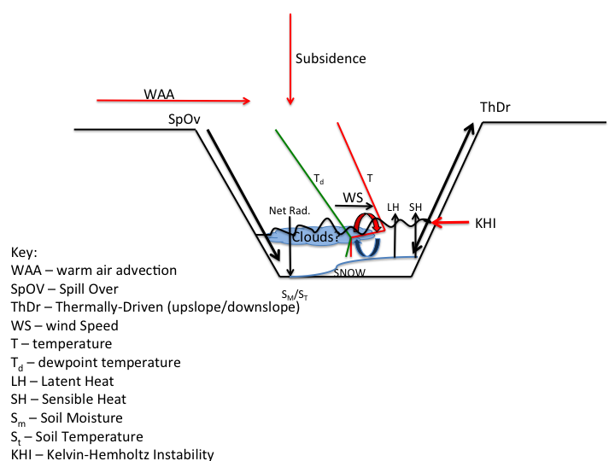
Cold Air Pool (CAP) Meteorology
Temperature inversion :
Surface Cooling,
Warming Aloft,
Both
Persistence :
- Surviving more than
one diurnal cycle
- High Pressure
CAP erosion :
- Strong troughs w
cold air advection
- Weaker trough-CAP
break-up (mesoscale /
microscale processes)
Lareau and Horel 2014

Slide 4
Modeling CAP meteorology
Neeman et al. 2015 discuss the importance of spatiotemporal variability of snow depth and albedo on CAP evolution and ozone concentrations.
Increase in snow cover can
Increase boundary layer stability via
enhanced surface albedo, reducing solar insolation,
and lowering near-surface temperatures.
Specifically for ozone
Increase in snow cover leads to
increased photolysis rates.

Slide 5
Objective
To improve the spatiotemporal variability of snow in WRF using data from the Snow Data Assimilation System (SNODAS).
Does incorporating SNODAS improve the model error? Specifically, process evaluation of the CAP meteorology with field campaign data from the
  Persistent Cold Air Pool Study (PCAPS)
  Uintah Basin Winter Ozone Studies (UBWOS)
  Upper Green River Winter Ozone Study (UGWOS)

Slide 6
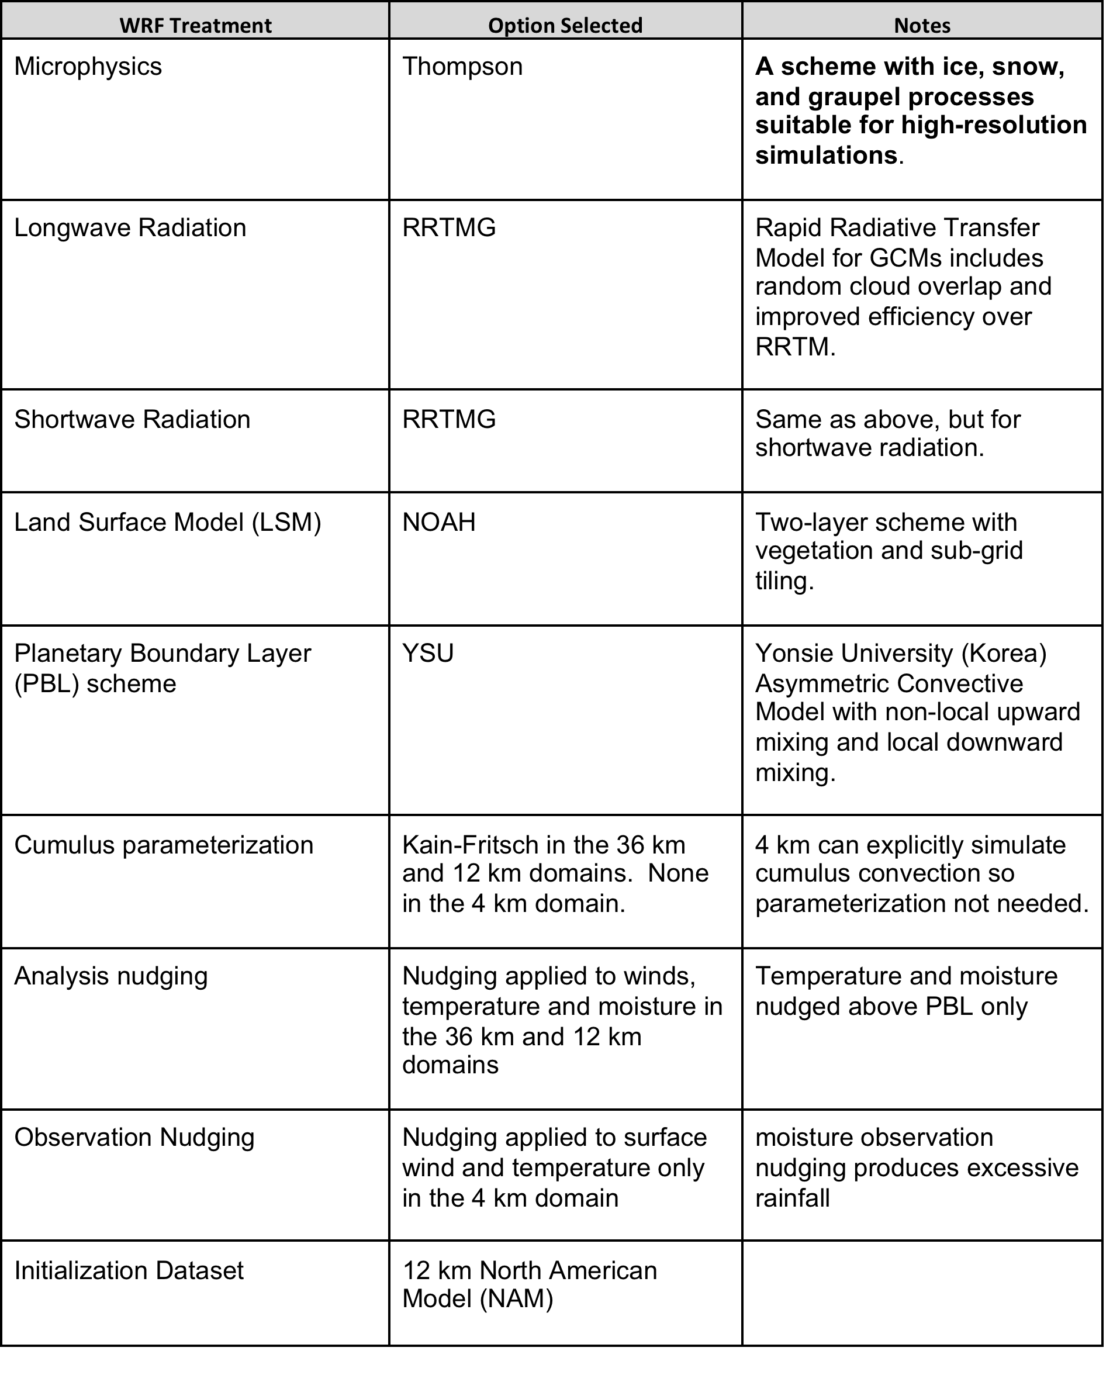
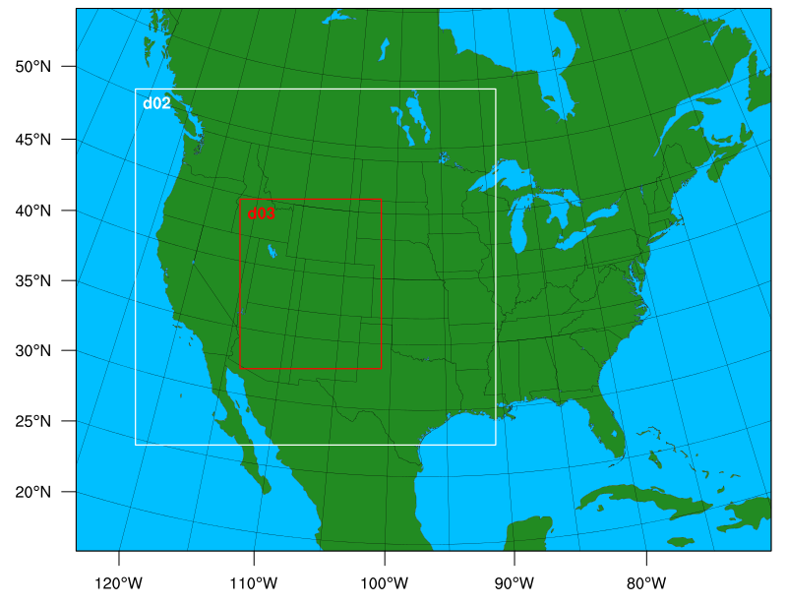
WRF Default (BASE) Configuration
WRFv3.6.1
37 Layers – approx. 17 layers in lowest 200m
USGS LULC
NCEP RTG SST (Salt Lake)
NAM Snow
5.5 reinitialization
Dec. 2010 – March 2011
Dec. 2012 – March 2013

Slide 7
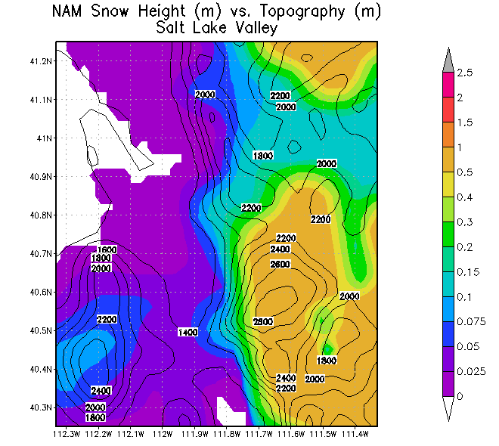
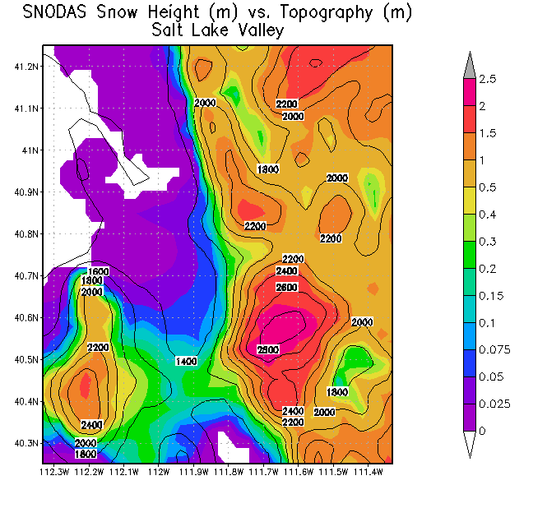
WRF (SNODAS) Experiments
SNODAS – same as BASE but substitute NAM snow depth and snow water equivalent with SNODAS.
SNODAS_ALBEDO – same as SNODAS but with albedo adjustment based on land use type.
Feb. 8, 2011 – NAM Initial Condition
Feb. 8, 2011 – SNODAS Initial Condition

Slide 8
WRF PX Experiment
What is the sensitivity of using a different land surface model? Noah vs. PX?
  Note PX will directly use the SNODAS to compute the surface heat capacity that is weighted according to the fraction of the surface that is covered by snow.
  ADVANTAGE: NO NEED TO REINITIALIZE TO SNODAS.

Slide 9
WRF PX Experiment #2
Iterative nudging
PX LSM uses 2-m Temp. and RH for indirect soil moisture and deep soil temperature nudging. Recycle 4-km WRF output to create an improved analysis for soil nudging.
Increase in
Error
Decrease in
Error
62%
Reduction in
Error
T2m RMSE
∆ RMSE
Increase in
Error
Courtesy Rob Gilliam – US EPA

Slide 10
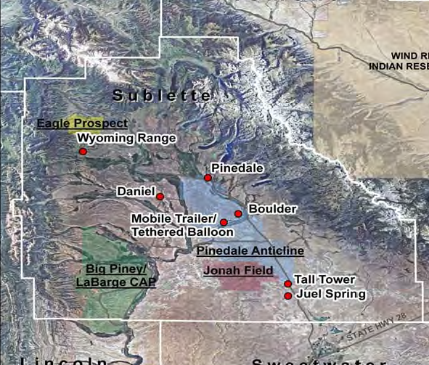
Preliminary Model Evaluation:
2011 UGWOS Study
Upper Green River Winter Ozone Study (UGWOS)
  Purpose is to study the formation of wintertime ozone in the Upper Green River Basin of Wyoming
Air quality and meteorological data collected from a number of monitoring sites (shown at right)
  Permanent AQ/MET sites
  Tethered balloon/mobile trailer
  SODAR
  Tall tower
Study period: Jan 15 – Mar 31 2011
We will focus in on individual episodes of elevated ozone
2011 UGWOS Monitoring Sites

Slide 11
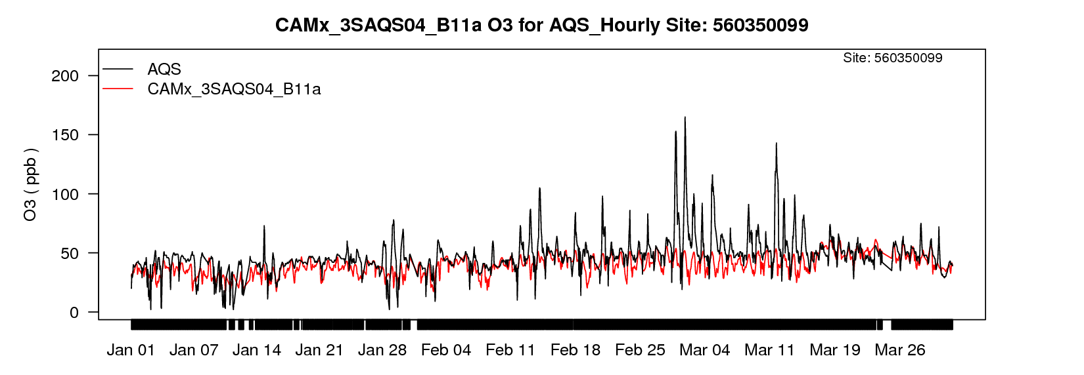
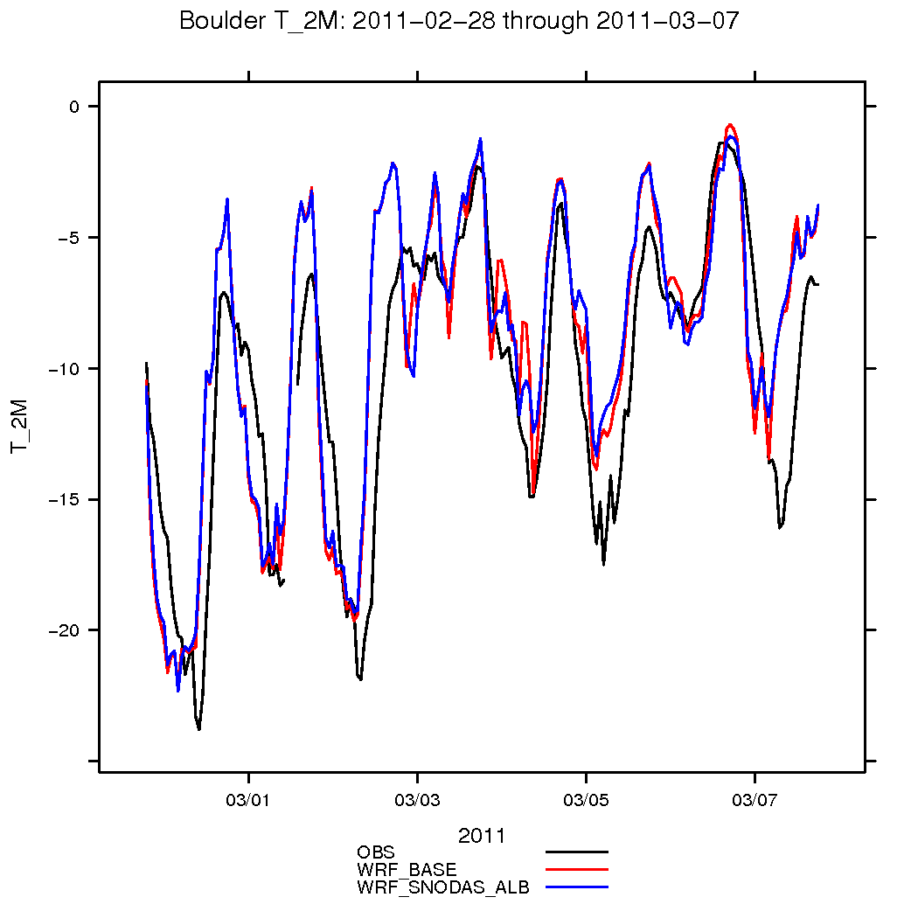
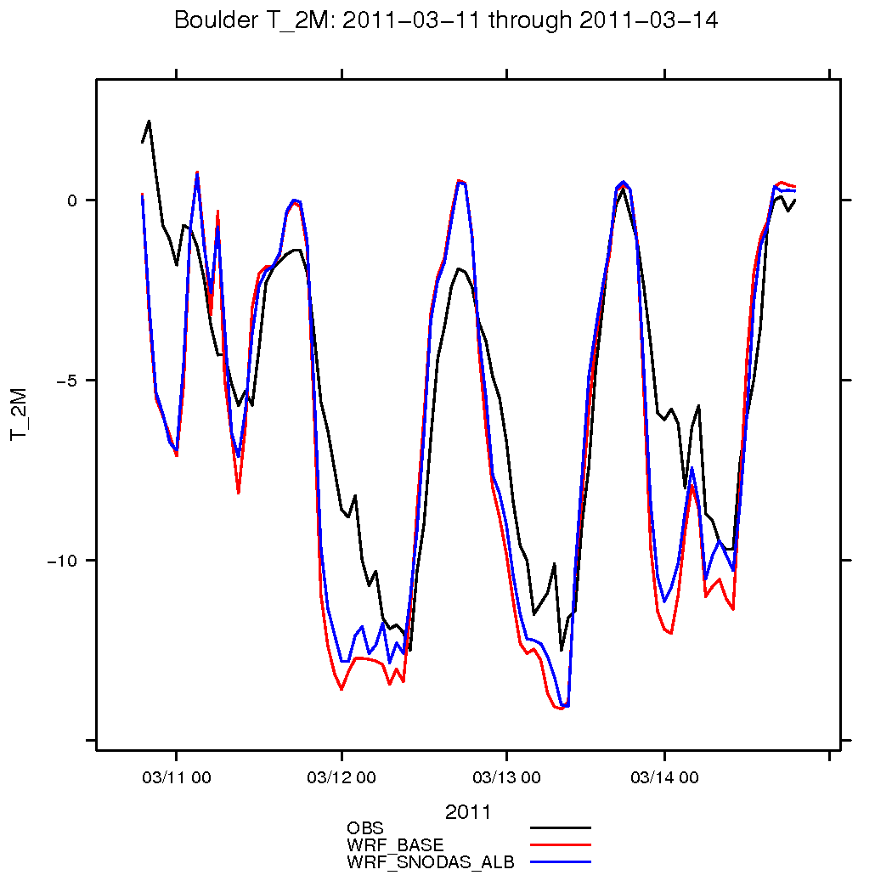
Boulder, WY Monitoring Site
Observed
vs
Modeled
O3
Jan – Mar 2011
‘
Observed
vs
Modeled
2-meter
Temperature
2/28-3/7/11
Observed
vs
Modeled
2-meter
Temperature
3/11-3/14/11

Slide 12
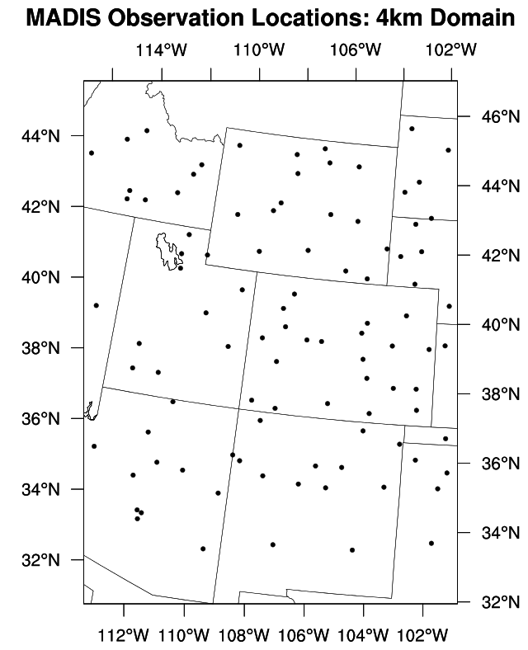
Model Evaluation: AMET
Atmospheric Model Evaluation Tool (AMET) used to evaluate WRF against NOAA’s Meteorological Assimilation Data Ingest System (MADIS) data
Period evaluated: Dec 2010 – Mar 2011
Qualitative and quantitative statistical analysis of all sites in 4km domain as well as individual 3SAQS states
Upper-air and surface obs

Slide 13
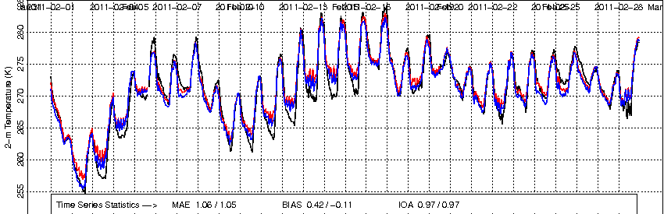
Timeseries: Utah, Feb 2011
Elevated O3
WRF SNODAS
WRF Base
Obs
2-meter temperature timeseries of all Utah stations in Feb 2011
SNODAS is correcting some of the warm bias at night during this elevated O3 episode, but still work to be done

Slide 14
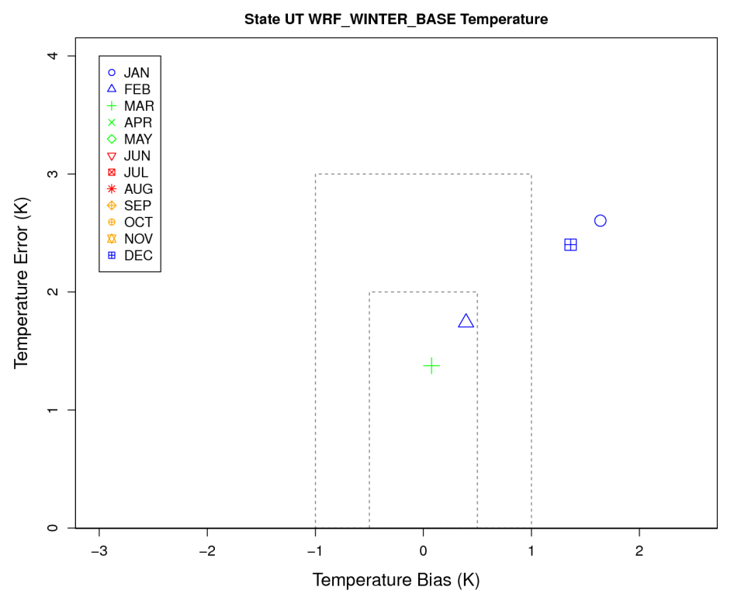
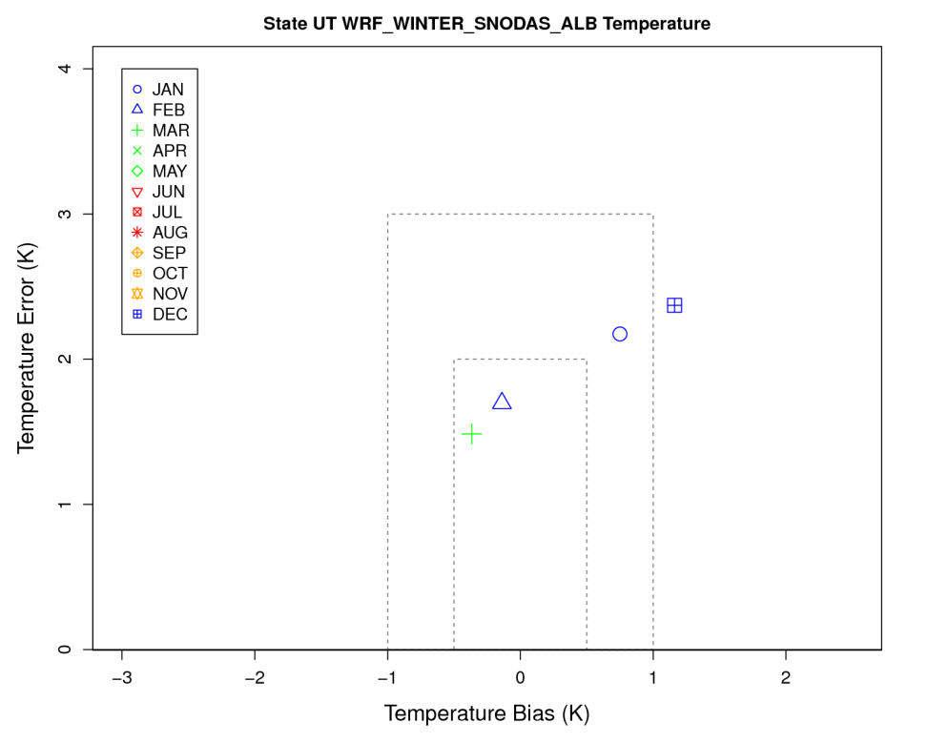
Bias/Error Soccerplot – All Utah Sites
WRF Base Simulation
WRF SNODAS Sensitivity
SNODAS is generally reducing the overall bias and mean absolute error across Utah stations in Winter 2010-2011

Slide 15
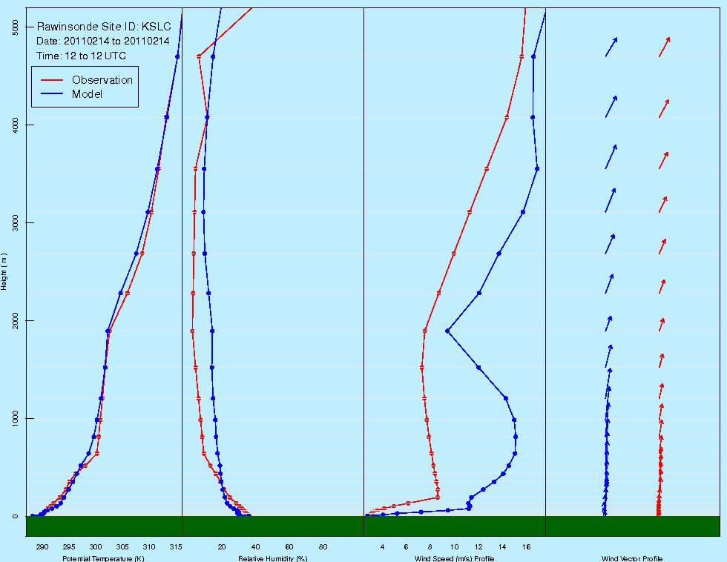
Upper-Air Sounding
Salt Lake City, UT 2/14/2011@12Z
Upper-air RAOB soundings are useful in diagnosing model performance during cold air pool episodes

Slide 16
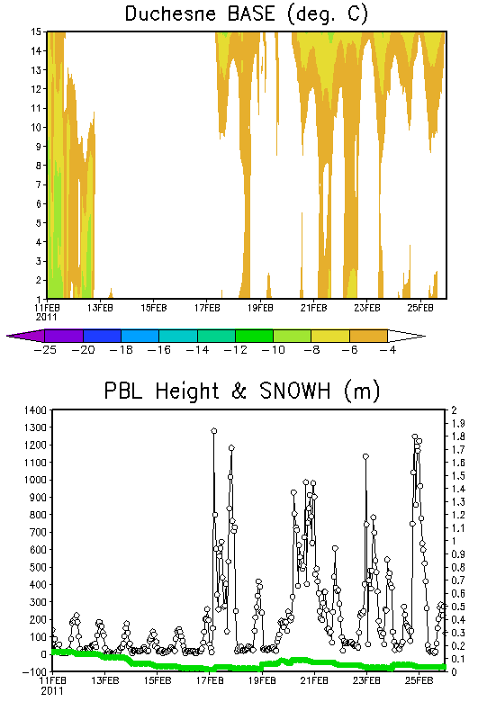
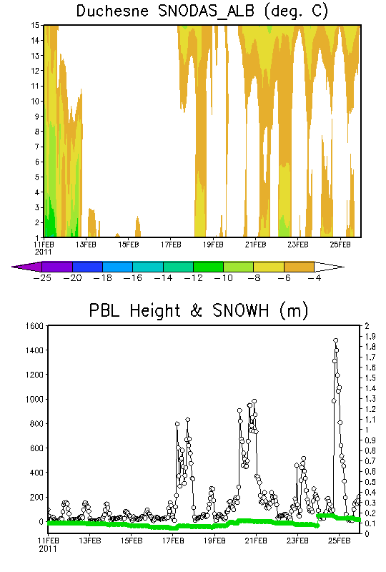
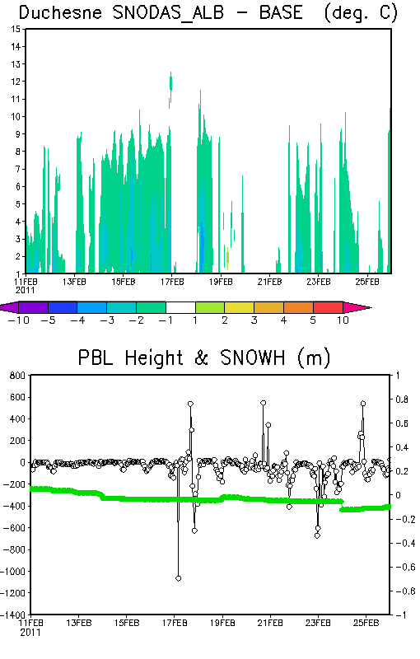
Sensitivity Analysis

Slide 17
Additional Ongoing Evaluation
Evaluating upper levels to compliment near-surface evaluation already performed at UGWOS monitoring locations
  Tall tower meteorology (temperature & winds at several heights above ground level)
Gridded time-height observations of temperature and winds from PCAPS study (Utah)
Meteorological observations from UBWOS field campaign - Uintah basin, UT

Slide 18
Special Thanks
Zac Adelman - UNC
Erik Crossman – University of Utah
Lance Avey – Utah DEQ
Rob Gilliam – US EPA
Ralph Morris - ENVIRON
Bart Brashers – ENVIRON

