Slide 1
Intermountain West Data Warehouse
3SAQS Technical Workshop
February 25th, 2015
Data Warehouse
Cataloging and Request Developments

Slide 2
Cataloging and Request Developments
Overview
Reception & Cataloging
Requests & Projects
Delivery
Model Data Visualization Prototype

Slide 3
Reception & Cataloging
Developments
Information links in data browser
Archive Checksum Tool

Slide 4
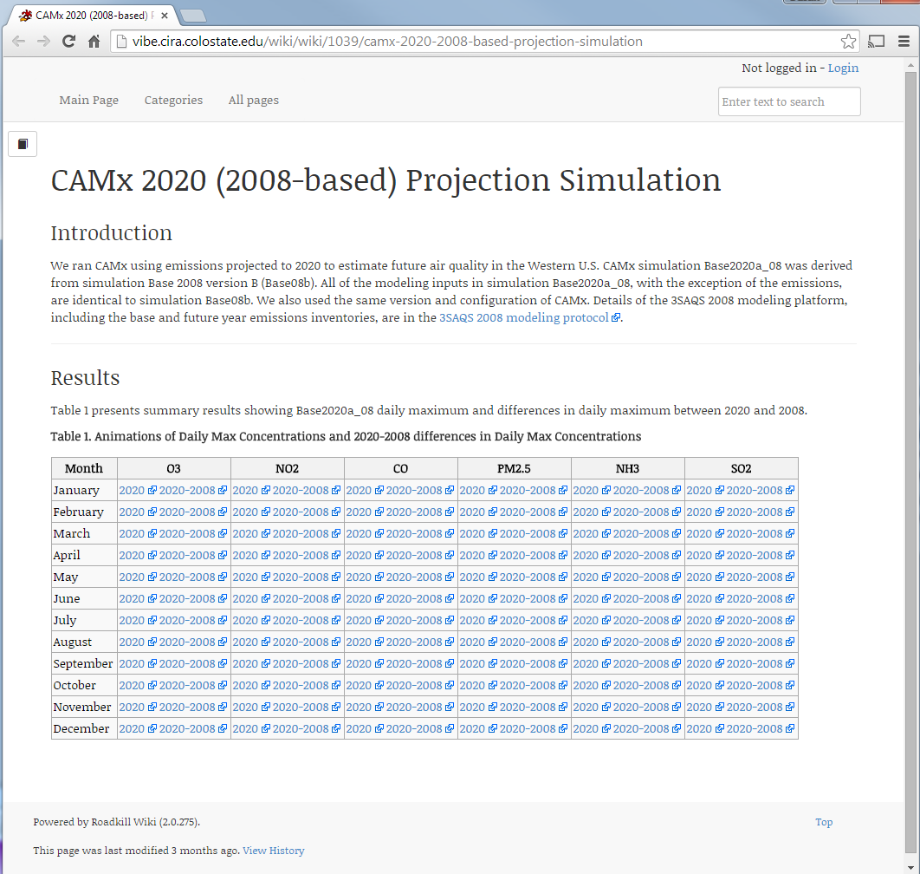
Information Links in Data Browser
Data categories can include web links to relevant information
Provide details and context for users while browsing data

Slide 5
Archive Checksum Tool
Generates MD5 sums for archive (tar.gz) contents using in-memory deompression
Ensures data integrity
Enables cataloging compressed files
Spares the effort and disc space of extracting compressed files.

Slide 6
Reception & Cataloging
Developments
Information links in data browser
Archive Checksum Tool
Future work
Data Status / Formalized Release Procedure
Possible data statuses
In delivery
Delivered
Pending review
Released
Integrated with data requests
Users can see but not necessarily request data based on its status
Searchable file metadata
Cataloging user interface
Automated checksum computation and database storage

Slide 7
Requests & Projects
Developments
Non Project Requests
Request lifecycle & Notifications
Data selection User Interface
Usage oriented parameter collection
File Attachments

Slide 8
Non-Project Requests
Background
Projects are containers for related requests
Previously a Project was required before a request could be created.
Non-Project Requests
Remove Project Configuration requirement for general users
Requests belong to a generic project titled “Unspecified”
Screening mechanism for Projects
Requesters provide information and browse available data
Warehouse team
Screens requests
Spawns a project
User/Warehouse Team/Cooperators assign a Cooperator Sponsor to approve requests and supervise data use.
One unified request form
http://views.cira.colostate.edu/TSDW/DataRequest/Default.aspx

Slide 9
Request Lifecycle
Requests move through a lifecycle – status sequence
Actions
Affect the status of a request
Taken by users with various roles
Dependent on current status and the role of the user
Trigger notifications to users depending on their role
Implemented to allow easy modification

Slide 10
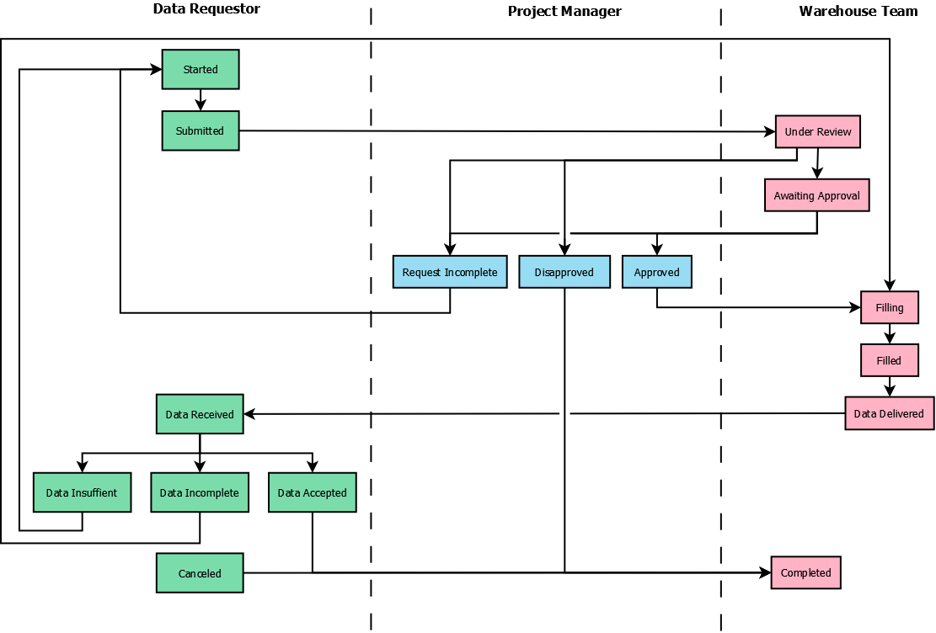
Request Lifecycle

Slide 11
Request Lifecycle
Available actions shown at the top of the request form
Informed by:
User Role
Current Status

Slide 12
Request Lifecycle
Available actions shown at the top of the request form.
Informed by:
User Role
Current Status

Slide 13
Request Lifecycle
Available actions shown at the top of the request form.
Informed by:
User Role
Current Status
Actions trigger email notifications to relevant people
User
Admins
Project Manager
New statuses/actions can easily be created

Slide 14
Data Selection User Interface
Left side shows data available for selection by Category
Right side shows summary of selected data
Total Data Volume shown at bottom
File level listing retrieved by using Download Detailed Manifest Button

Slide 15
Usage Oriented Parameter Collection
Users select any number of explicit intended uses
Data use agreement could reflect these uses
Detailed usage parameters are related to selection of intended uses.
Data Driven: Can be easily modified without any updates to the page.
Current uses and parameters need discussion and approval

Slide 16
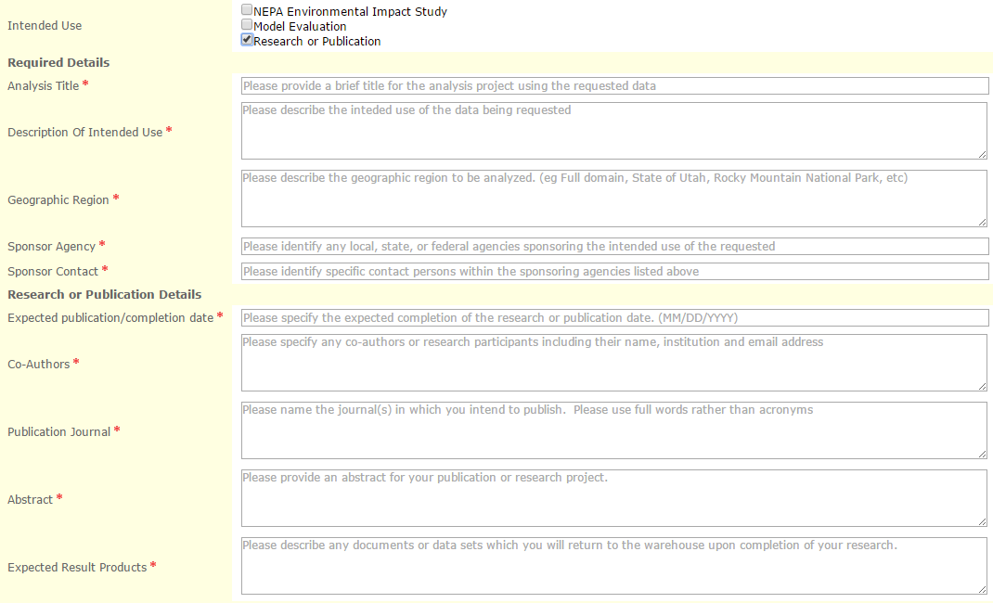
Usage Oriented Parameter Collection
Example for demonstration purposes

Slide 17
File Attachments
Requesters may attach relevant documents or graphics
Requests will be screened to disallow usage details which only say “See Document X.”

Slide 18
Requests & Projects
Developments
Non Project Requests
Request lifecycle & Notifications
Data selection User Interface
Usage oriented parameter collection
File Attachments
Future work
Formalization of request approval criteria
Possibly specified by data use agreement
Expansion of intended uses
GIS oriented specification of geographic region
Shape file, map selection, etc.
Obtaining cooperator approval for requests
Integrate Data Status into request lifecycle

Slide 19
Delivery
Developments
Automation of ftp account creation
Testing custom tools for online transfer

Slide 20
Automation of FTP account Creation
Facilitates FTP access to requested data
Read-only access limited to requested data
Requires
Request approval
Explicit action by warehouse admin

Slide 21
Delivery
Developments
Automation of ftp account creation
Testing custom tools for online transfer
Future work
Improve data transfer rates
More exploration of custom tools for online transfer

Slide 22
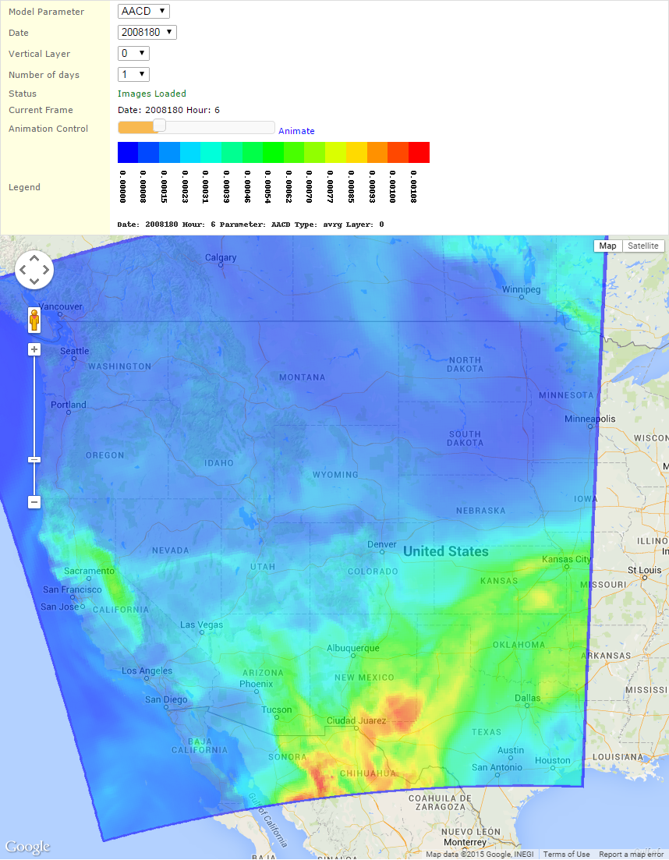
Model Data Visualization Prototype
http://views.cira.colostate.edu/demo2/Maps/ModelDataMap2.aspx
Projected overlays rendered from model output files and displayed on an interactive map
Parameterized by
Model Parameter
Date
Vertical Layer
Hourly animation over multiple days
Images cached for performance
Limitations
Projection information absent model output files
Color scale changes hourly
Future work
User specified colors
Colors scaled to selected time span
Observed data overlay

