Slide 1
3SAQS Network Assessment
Till Stoeckenius, ENVIRON
Three-State Air Quality Working Group
Conference Call
17 January 2014

Slide 2
What’s New
Reclassified Escalante as “permanent” based on assumed continued BLM funding
Examined CD-C modeling results
Obtained monitoring cost estimates from NPS and UT DAQ (needs refinement)
Developed draft future network configuration scenarios

Slide 3
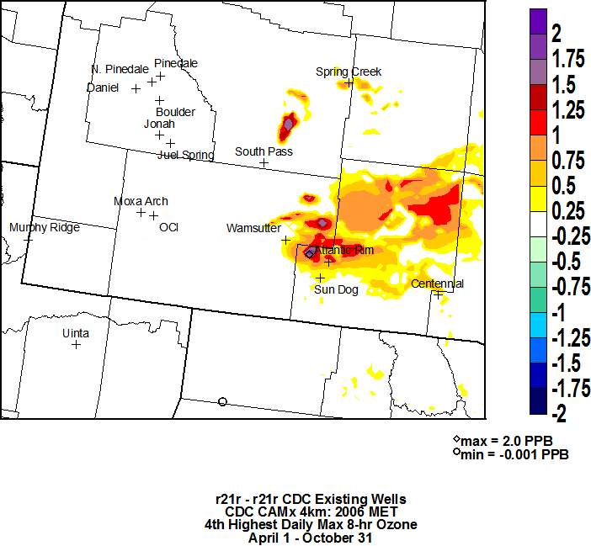
CDC Project Impacts on O3 DV (APCA analysis)
Source: CD-C Draft EIS, Fig. 4-40, Nov. 2012 (http://www.blm.gov/pgdata/etc/medialib/blm/wy/information/NEPA/rfodocs/cd_creston.Par.83471.File.dat/AQ-Ch4-FarFieldModel.pdf)

Slide 4
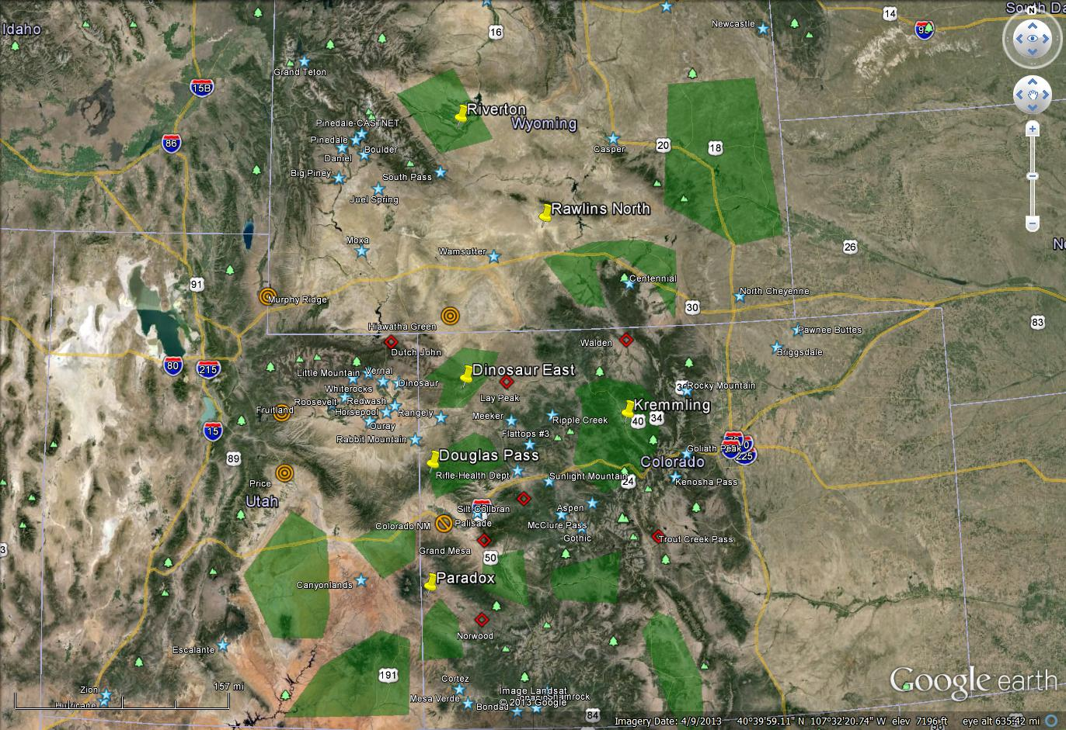

Sites to Keep | Sites Available to Close | Other Existing Sites | Potential New Sites
(see map) | Walden (end of 2014) Lay Peak (end of 2014) Silt-Collbran Grand Mesa Norwood Trout Creek Pass Dutch John | Hiawatha (potentially closing) Murphy Ridge (potentially closing) Fruitland (potentially closing) Price (potentially closing) Wamsutter VOC (potentially closing) Colorado NM (closing) Sinclair Casper (industry) | Douglas Pass Kremmling Rawlins North Riverton Paradox
Can assume all these sites are expected to continue operating thru 2017 without any additional 3SAQS funding?

Slide 5
Site Reference Map with UAs

Slide 6
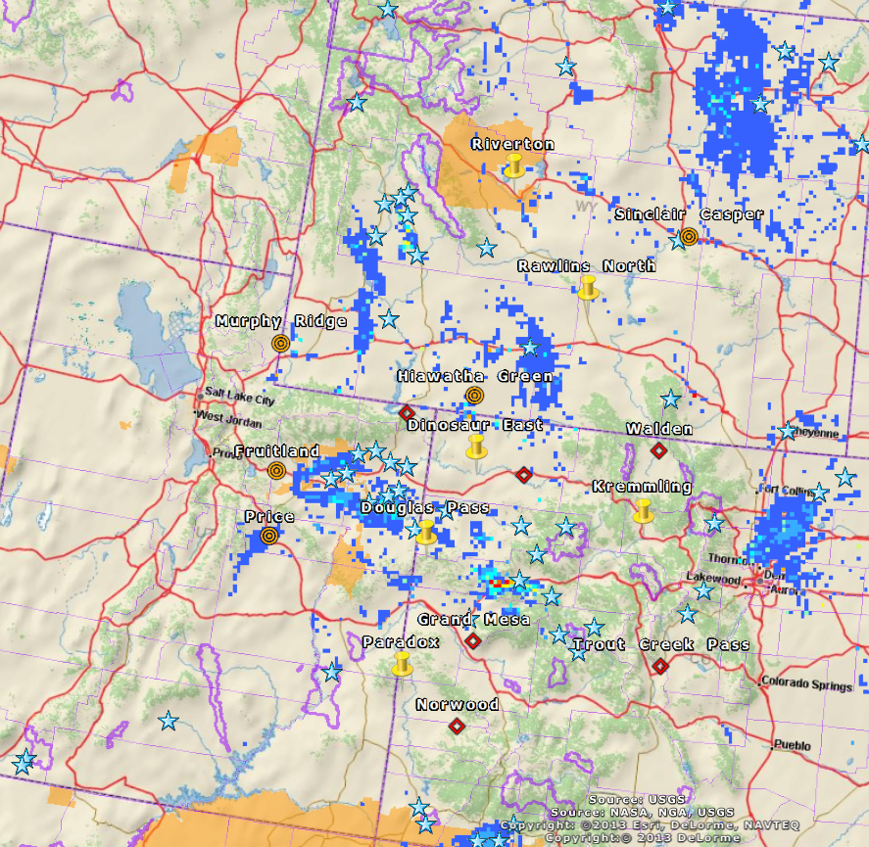
Site Reference Map with O&G NOx Emissions

Slide 7
Construction of Future Network Configuration Scenarios
Start with existing network as base case
List potential network changes
  Open a new site (no associated site closure)
  Move existing site to new location
  Close existing site
Identify alternative 2014 - 2017 configuration scenarios
  Each scenario consists of one or more site changes (new, move, and/or close)
  Rank order scenarios based on degree to which objectives achieved
  Estimate project funding needed for each scenario

Slide 8
Base Case Network Configuration
Site | Proposed 2014-17 Status | Base Case Assumptions
Six Sites funded (directly/indirectly) by 3-State Pilot Study (2011/12 through mid-2014) :
Wamsutter VOC | close or keep in some form? | ??
Lay Peak | keep through 2014, then move to Dinosaur East | Fund site move and 2015-2017 operation
Walden | Keep | Continued funding by??
Escalante | Keep | Continued BLM funding (sufficient?)
Fruitland | Keep | Fund UT DAQ operations via 3SAQS
Price | Keep | Fund UT DAQ operations via 3SAQS
All other sites not scheduled to close:
(see map; note that Murphy Ridge and/or Hiawatha may close in 2014) | Keep | Funded and operated through existing arrangements (not part of 3SAQS budget)
Which of these sites will the states/agencies not be able to operate 2014-2017 without additional 3SAQS funding?

Slide 9
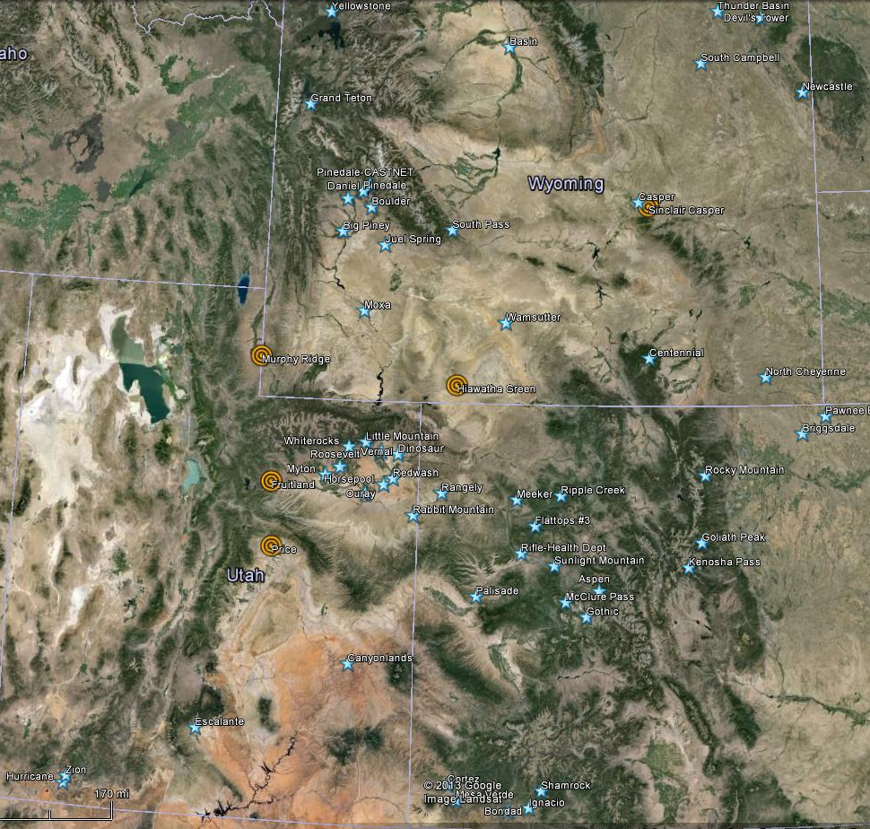
Base Case Network
(Note: Murphy Ridge and/or Hiawatha may close in 2014)
Which sites will the states/agencies not be able to fund 2014-2017 without additional project funds?

Slide 10
Potential Actions Beyond Base Case
Potential Action | Primary Supported Objective(s) | Available Cost Offsets | Priority /ID | Cost Impact w/ Offset
Establish new site at Douglas Pass (USFS) | UA13-Roan Plateau (source impact monitoring; cross-border transport) | Close (USFS) Silt-Collbran | H1 | Site move
Establish new site at East Dinosaur early 2014 (CDPHE) | UA5-Dinosaur East (source impact monitoring; cross-border transport) | Close (CDPHE) Lay Peak in late 2014 | H2 | Site move Operating E. Dinosaur for 1 year
Establish new site near Kremmling (USFS) | UA12-Kremmling Area (C1 area monitoring and MPE) | Close (USFS) Trout Creek Pass | H3 | Site move
Maintain Fruitland site | Background monitoring |  | H4 | Operate existing site
Maintain Price site | Source impact monitoring and MPE |  | H5 | Operate existing site
Maintain Hiawatha site | Source impact monitoring |  | H6 | Potential contribution to operation of existing site
Establish fixed site at end of mobile trailer monitoring period | Continued source impact monitoring in UA2 East-Central WY |  | H7 | None if WY can fund
Establish new USFS Rawlins North site | UA3-Medicine Bow – Saratoga (CDC new development impact; MPE) | Close Grand Mesa or Dutch John (or both?) | H8 | Site move
Establish new WYDEQ site near Riverton | UA4-Central West WY (MPE) |  | M1 | New site
Establish new USFS site near Paradox | UA9-Dove Creek North (potential new development; MPE) | Close Norwood (USFS) | M2 | Site move
MPE = Model Performance Evaluation

Slide 11
Flexibility
States don’t have make monitors at sites permanent, can be Special Purpose indefinitely
State can decide to close or move sites during the 14-17 timeframe, but consult with 3SAQS cooperators first

Slide 12
Monitoring Cost Elements
Item | $ | Comments
Equipment acquisition (including shelter) | $ per site | Can existing equipment be used?
Equipment depreciation | $ per site | Will this get charged to 3SAQS project?
New site installation (including site scouting trip, equipment delivery, setup and testing) | $ per site | Every site is different and costs will vary depending on state/agency; just need generic estimates for now
On-Site operations (land lease, data link, other utilities, site visits, QC ops, audits) | $ per year
Off-Site operations (data handling, QA and reporting) | $ per year
Site decommissioning | $ per site | Do not include in 3SAQS budget discussions?

Slide 13
Cost Allocation
Which cost elements will require 3SAQS funding?
  Varies depending on specific network change being considered
Who has capacity, how much can do without needing more resources? What additional $$ is needed?

Slide 14
Preliminary Cost and Budget Estimates
There is currently a placeholder in the budget for FY2015-2017 monitoring operations of $450k.
Operations
  NPS: Average per site cost per year of paying a contractor to poll, QA, and report the data it is approximately $28,580 - $37,000 ($85.7 – $111k for 3 years) Is this just for off-site operations?
  UT DAQ: Cost for on and off site operations is $25k - $30k per site-year (specific to Fruitland and Price)
NPS: One site move to new location costs $20k - $50k absent any in-kind contribution by participating agency

Slide 15
Recommended Network Configuration Scenarios
(2014 – 2017) (DRAFT)
Scenario (Potential Actions) | New Sites | Maintain Sites (plus all “permanent” sites) | Project Costs and Required Offsets and In-Kind Contributions
S0 (Base Case) (lowest cost) | Replace Lay Peak with Dinosaur E. end of 2014 | All operating sites including Fruitland, Price, Escalante, Walden, Lay Peak (thru 2014), Wamsutter VOC?? | -Support for UT DAQ operation of Fruitland and Price -Establish and operate Dinosaur E. starting 2015 as replacement for Lay Peak -All other sites as currently funded
S1 (H4, H5, H6, H1) (medium cost) | Douglas Pass (USFS) Dinosaur E. (replaces Lay Peaak end of 2014) | As in Base Case plus Hiawatha (assuming WYDEQ needs funding) | -3SAQS funds Fruitland, Price, Hiawatha -Closure of Silt-Collbran; -USFS operates new Douglas Pass site
S2 (H4, H5, H1, H2, H3) (medium cost) | Douglas Pass (USFS) Dinosaur East Kremmling | As in Base Case | -Closure of Silt-Collbran, Trout Creek Pass and (at end of 2014) Lay Peak; -USFS operates new Douglas Pass and and Kremmling sites (no net change in operating costs) -Dinosaur East site 2015-2017 operation costs offset by Lay Peak closure -WYDEQ maintains Hiawatha
S3 (H4, H5, H1, H2, H3, H8) (highest cost) | Douglas Pass Dinosaur East Kremmling Rawlins North | As in Base Case | -Closure of Silt-Collbran and Trout Creek Pass -Closure of Lay Peak (end of 2014) -USFS operates new Douglas Pass and Kremmling sites (no net change in operating cost) -Dinosaur East site 2015-2017 operation costs offset by Lay Peak closure -WYDEQ maintains Hiawatha

Slide 16
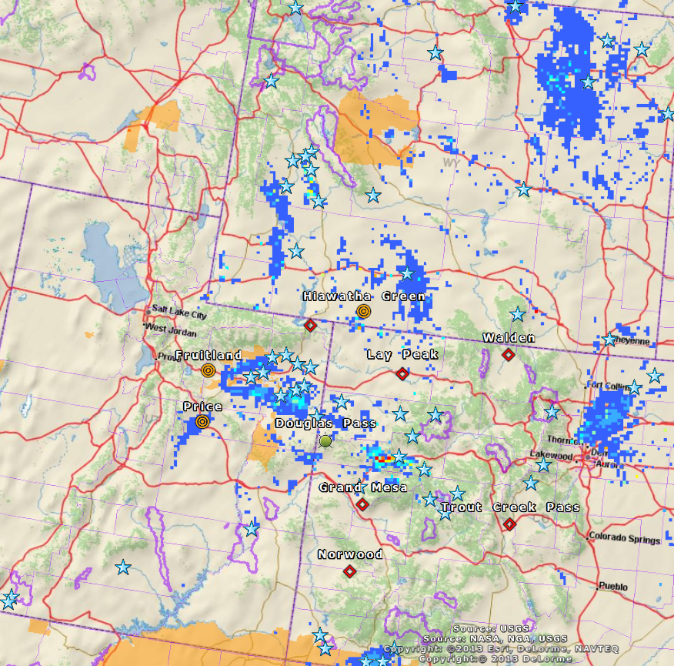
Scenario 1
Additional Assumptions:
-Murphy Ridge closes

Slide 17
Next Steps – Jan. 24th through mid-Feb.
Step | Deadline
Obtain additional input :
Call for Assessment WG to reach consensus on draft recommendations | TODAY!!
States/agencies provide additional information on: Monitoring cost element estimates Available in-kind contributions | 24 – 31 January
Additional calls as needed for Assessment WG to reach consensus | Possible calls on 28 and/or 29 January, or morning of 31 January
Complete recommendations presentation for distribution to Steering Committee | before or on 6 February
Review of recommendations by Steering Committee, including input on site operations commitments by each funding agency | by 14 February
Finalize recommendations including data files, map layers, data sources and processing procedures | 21 February

