Slide 1
3SAQS Network Assessment
Till Stoeckenius, ENVIRON
Three-State Air Quality Working Group
Conference Call
10 January 2014

Slide 2
Recent Work
Additional refinement of ozone site database
Additional state and FLM input
Correction to potential closure list for USFS sites
Fix error in location of Fruitland site
Formulating recommendations: the site classification system

Slide 3
Monitoring Site Classification
Potential 3SAQS Sites
Starting Network
Step 1:
Permanent Site?
Yes
Permanent Sites
No
Non-Permanent Sites
Monitoring Network Objectives
Step 2 :
High value location?
Yes
Retain
(Class A Site)
No
Consider Moving
(Class B Site)

Slide 4
Site Classification: Step 1
Focus on “potential 3SAQS sites”
Scheduled to remain operational
Potential closure due to budget issues
Ignore sites that are not currently operating or are definitely closing in 2014
Industry and tribal sites might or might not be available for use in 3SAQS
Identify existing sites that are “permanent” in that they are unlikely to be closed/moved
Regulatory sites (e.g., Rangely)
Long-term sites (e.g., Yellowstone)
Agency review required!

Slide 5
Potential 3SAQS Sites: “Permanent” Sites (draft)
Rifle | Dinosaur | Casper
Gothic | Vernal | Boulder
Shamrock | Redwash | Daniel
Ignacio | Ouray | Pinedale
Bondad | Rabbit Mountain | Big Piney
Rocky Mountain | Whiterocks | Juel Spring
Cortez | Hurricane | Pinedale-CASTNET
Mesa Verde | Zion | Hiawatha Green
Meeker | Centennial | Wamsutter
Rangely | Basin | Moxa
Dutch John | Thunder Basin | Grand Teton
Roosevelt | South Campbell Co. | Yellowstone
Myton | Devil's Tower
 | South Pass | Pawnee Buttes
Canyonlands | N. Cheyenne | Horsepool

Slide 6
Potential 3SAQS Sites: “Non-Permanent” Sites (draft)
Trout Creek Pass | Briggsdale
Goliath Peak | Price [Official 3SAQS site]
Flattops | Fruitland [Official 3SAQS site]
Ripple Creek | Little Mountain
Sunlight Mountain | Sinclair Casper
McClure Pass | Sheridan
Walden [Official 3SAQS site] | Wyoming Range
Palisade | Newcastle
Grand Mesa | Escalante [Official 3SAQS site]
Silt-Collbran | Murphy Ridge
Colorado NM
Lay Peak [Official 3SAQS site]
Kenosha Pass
Aspen
Norwood

Slide 7
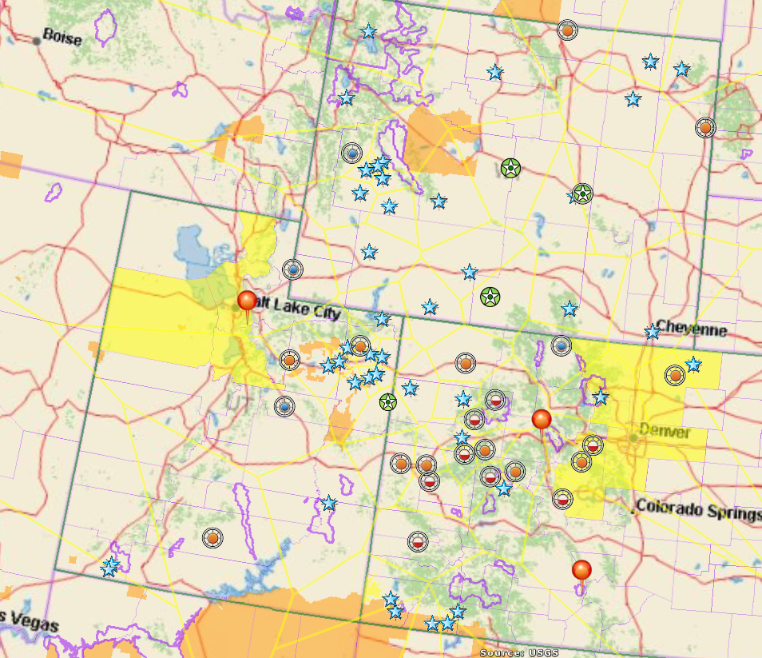
“Non-Permanent” Site
Industry Site
New Snowbird O3 Monitor
“Permanent” Site
USFS Holy Cross (potential replacement for Wilson)
Old Great Sand Dunes O3 Monitor (1988-1991)

Slide 8
3SAQS Monitoring Network Objectives
Provide adequate spatial coverage of study area
Monitor locations with O₃ close to or above NAAQS
Monitor locations downwind of existing or planned future development areas
Monitor Class I and sensitive Class II AQRV impacts
Characterize background O₃
Provide data for model performance evaluation (O₃, PM and precursors)

Slide 9
Site Classification: Step 2
Classify Non-Permanent sites (i.e., remaining potential 3SAQS sites that are not considered “permanent”)
Definitely keep in place: site considered critical for achieving 3SAQS monitoring objectives (see prior slide)
Consider moving: resources might be better spent monitoring elsewhere

Slide 10
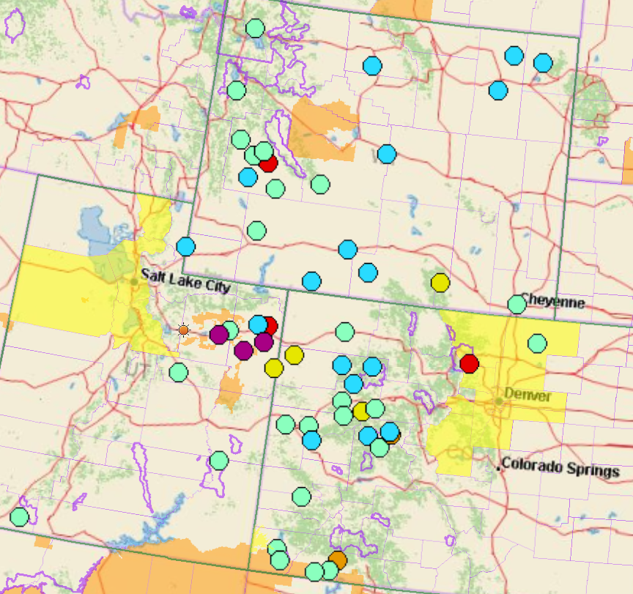
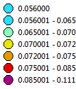
Annual 4th Highest 8-Hour Ozone (ppm)

Slide 11
Monitoring Site Database
Review revised file: ThreeStateOzoneMonitors_6Dec2013.xlsx
Tab: 3 State Ozone Monitors contains all site information
Tab: Site Ratings used to define site classifications

Slide 12
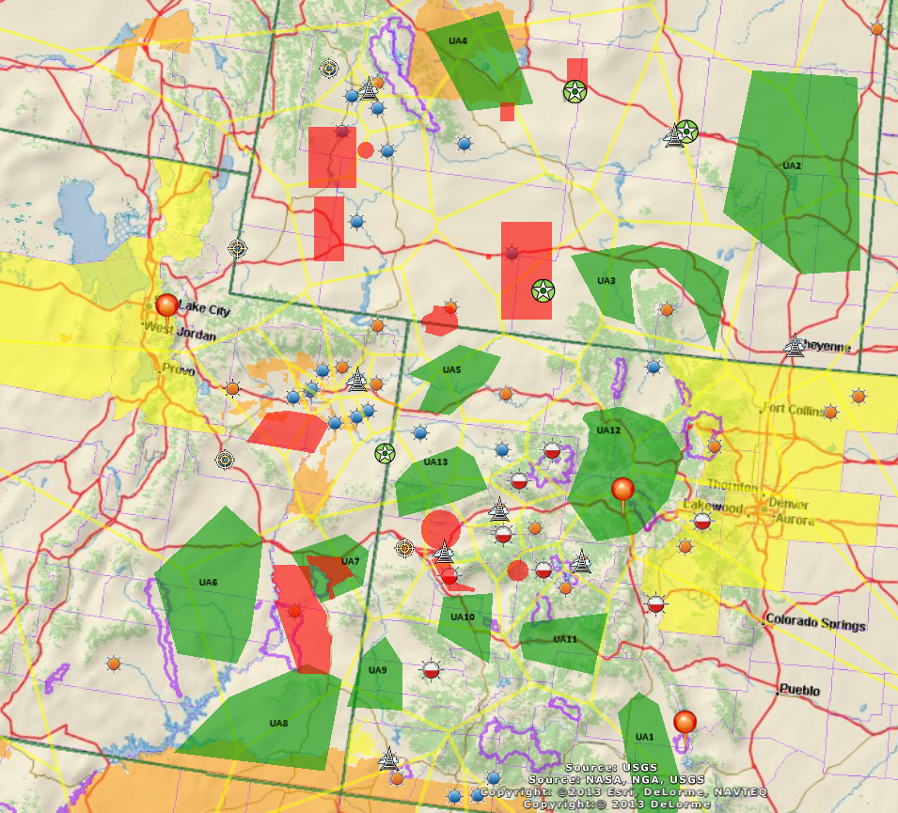
Evaluation of Potentially Underserved Areas (UAs)
13 UAs identified on map
List pros and cons for each UA
Rank order UAs

Slide 13
Next Steps – Jan. 10th through mid-Feb.
Step | Deadline
Obtain additional input :
Assessment WG review of site status / rankings | Comments by 17 January
Call for Assessment WG to reach consensus | Target of 23 January at 900 AM MST
Additional calls as needed for Assessment WG to reach consensus | 24 January Possible calls at 300 PM MST on 28 and/or 29 January, or morning of 31 January
Complete recommendations memo for distribution to Steering Committee | before or on 6 February
Review of recommendations memo by Steering Committee, including input on site operations commitments by each funding agency | by 14 February
Finalize memo including data files, map layers, data sources and processing procedures | 21 February

Slide 14
Formulating Recommendations
Input Requested
Information Resources
Complete By | Item
1/14 | Review lists of “permanent” and Class A sites: email any recommended changes to the WG
1/14 | ENVIRON provides rank-ordered UA list with pros & cons
1/17 | Funding estimates (how many sites?) Comments on UA rankings Recommend Class B site moves
1/17 | WG conference call: discuss network revisions
1/20 | ENVIRON provides revised network map
1/24 | WG conference call: consensus recommendations
Site database (.xls file)
Draft site classifications
Ranked UAs with pros & cons
Previously provided maps (see presentations and jpg files in 3SDW)

