Slide 1
3SAQS Network Assessment
Till Stoeckenius, ENVIRON
Three-State Air Quality Working Group
Conference Call
19 December 2013

Slide 2
Recent Work
Refinement of ozone site database
Additional state and FLM input
Identify sites currently expected to be operating 2014 – 2017
Identify reason for site closures (funding vs logistical or other siting concerns)
Identify seasonal Forest Service monitors
Identify sites with co-located NOx
Identify all sites which can be included in 3SAQS
Currently operating and expected to continue operating
Potentially being closed primarily due to funding issues

Slide 3
Recent Work (cont.)
Additional map layers
Ozone non-attainment areas
Oil & Gas basin boundaries and total emissions by basin
Producing wells 2008, 2011, 2011-2008
RFD areas
Correlation analysis
Potentially underserved areas analysis

Slide 4
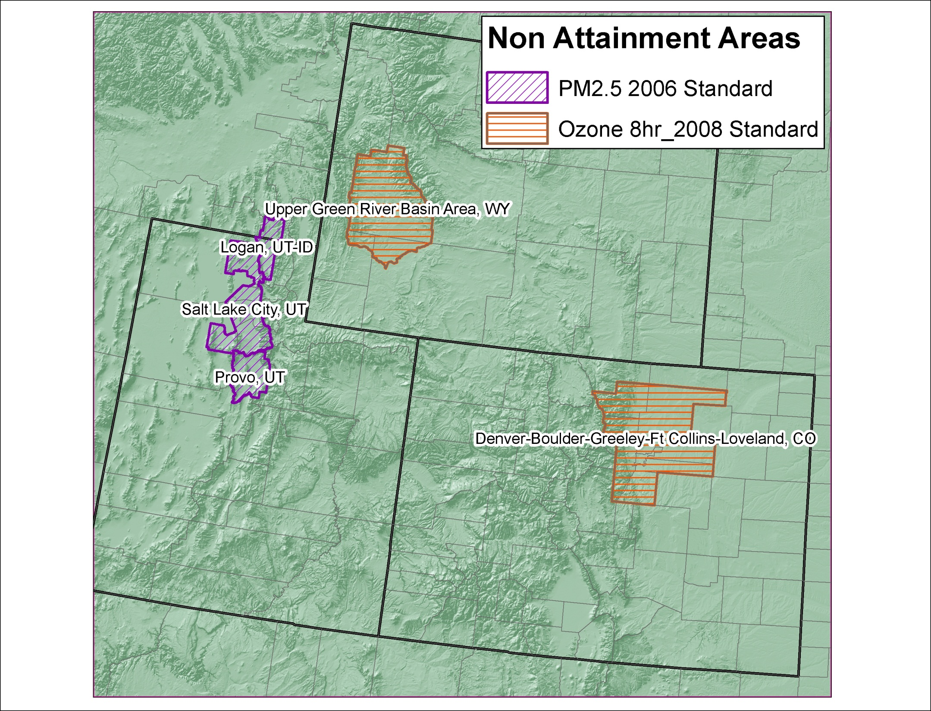

Slide 5
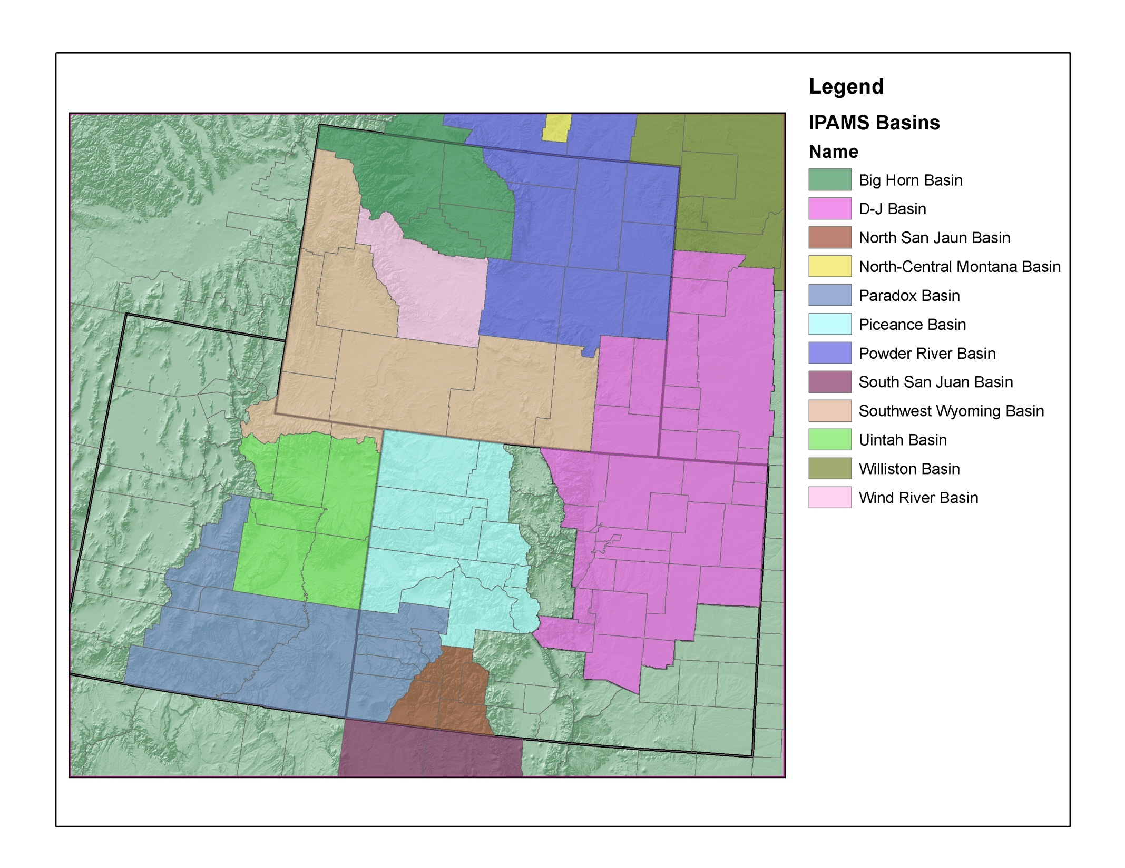
 | WestJump 2008 Emissions (tpy)
Basin | NOx | VOC | CO | SOx | PM
D-J | 22,165 | 100,622 | 14,367 | 115 | 717
Piceance | 20,113 | 45,714 | 11,520 | 519 | 1,812
N. San Juan | 5,917 | 2,187 | 6,456 | 30 | 72
Uintah | 15,508 | 97,303 | 11,569 | 431 | 716
Powder River | 20,980 | 14,787 | 15,445 | 596 | 666
Southwest WY | 23,824 | 87,374 | 16,024 | 6,030 | 679
Wind River | 1,335 | 10,993 | 2,062 | 1,276 | 31

Slide 6
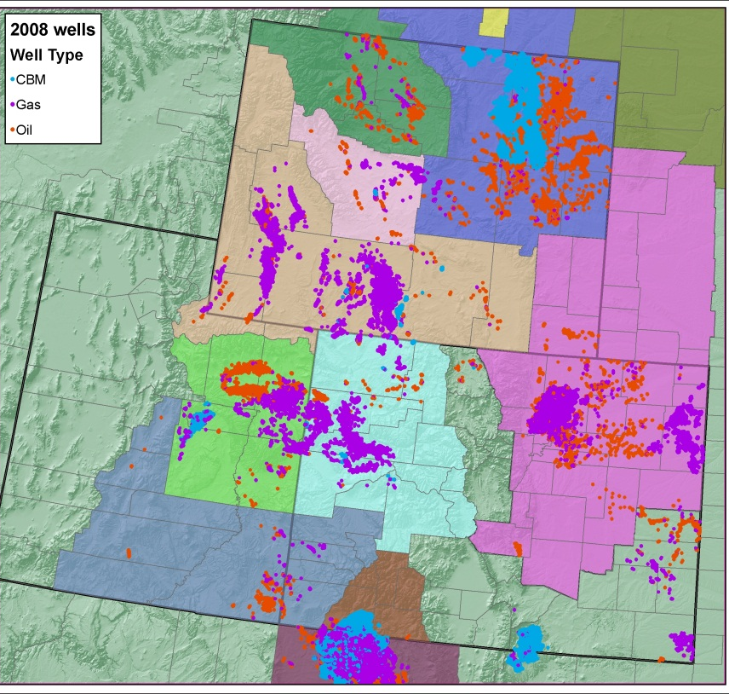
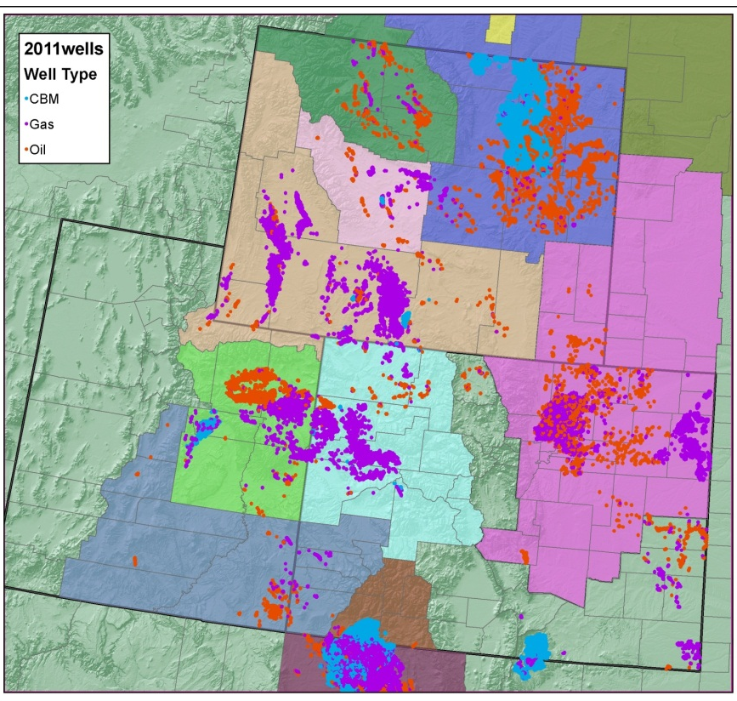
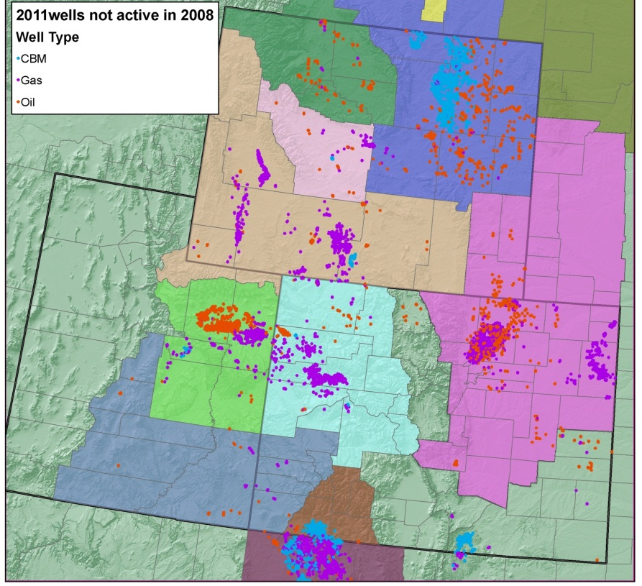

Slide 7
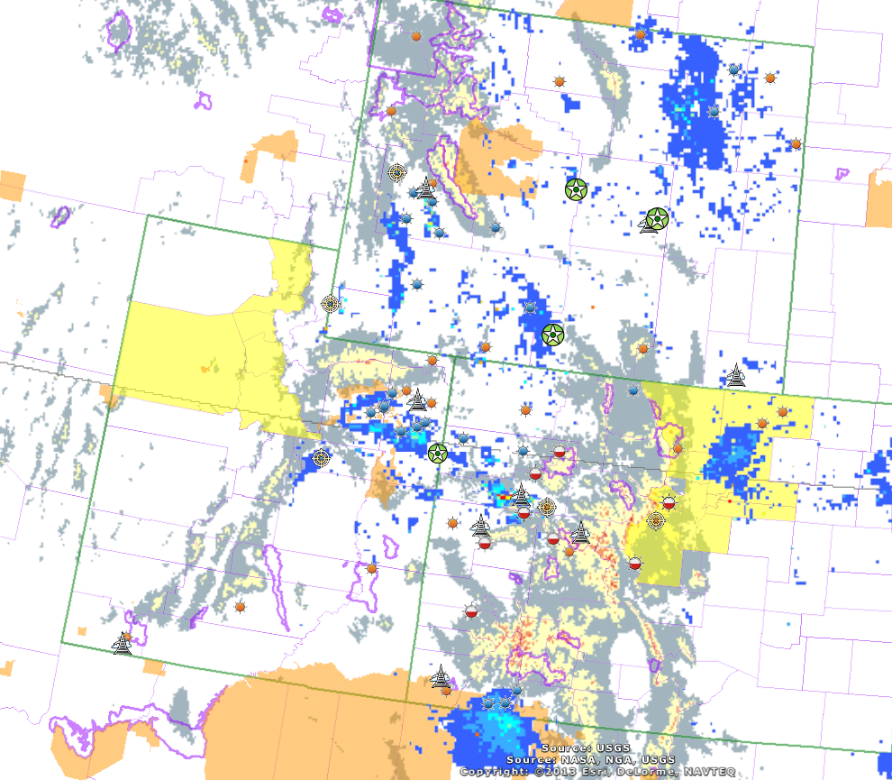
Class I Area
NOx (tpy)
Potential 3SAQS Ozone Monitoring Sites
Urban, Pop -Oriented
Industrial
Other
Co-Located NOx
Seasonal
Potential Closure
O&G NOx

Slide 8
Wyoming Range
Murphy Ridge
Potential or Confirmed Site Closure
Price
Sunlight Mountain
Kenosha Pass

Slide 9
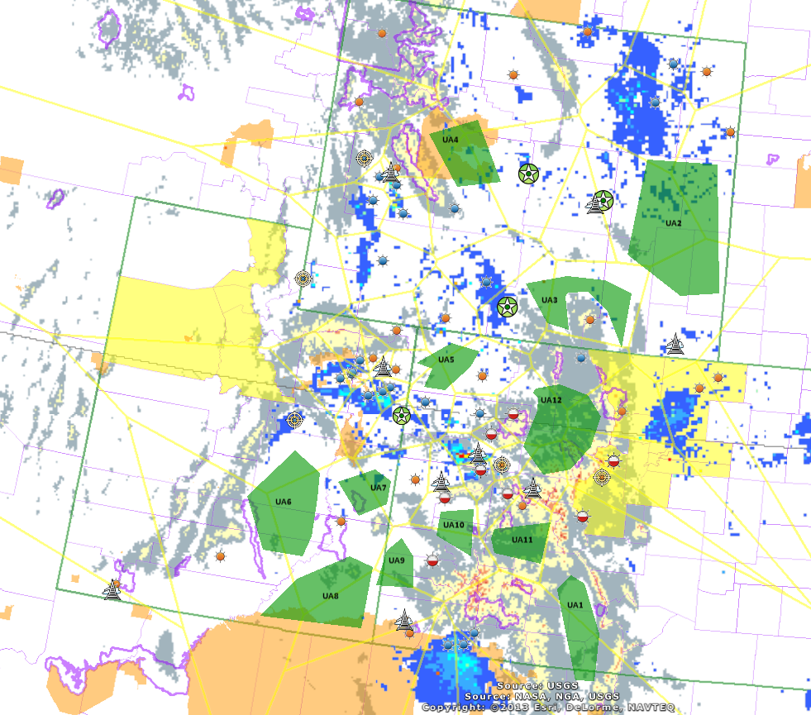
Potentially Underserved Area
Thiessen Polygons

Slide 10
Prevailing Summer Wind Direction

Slide 11
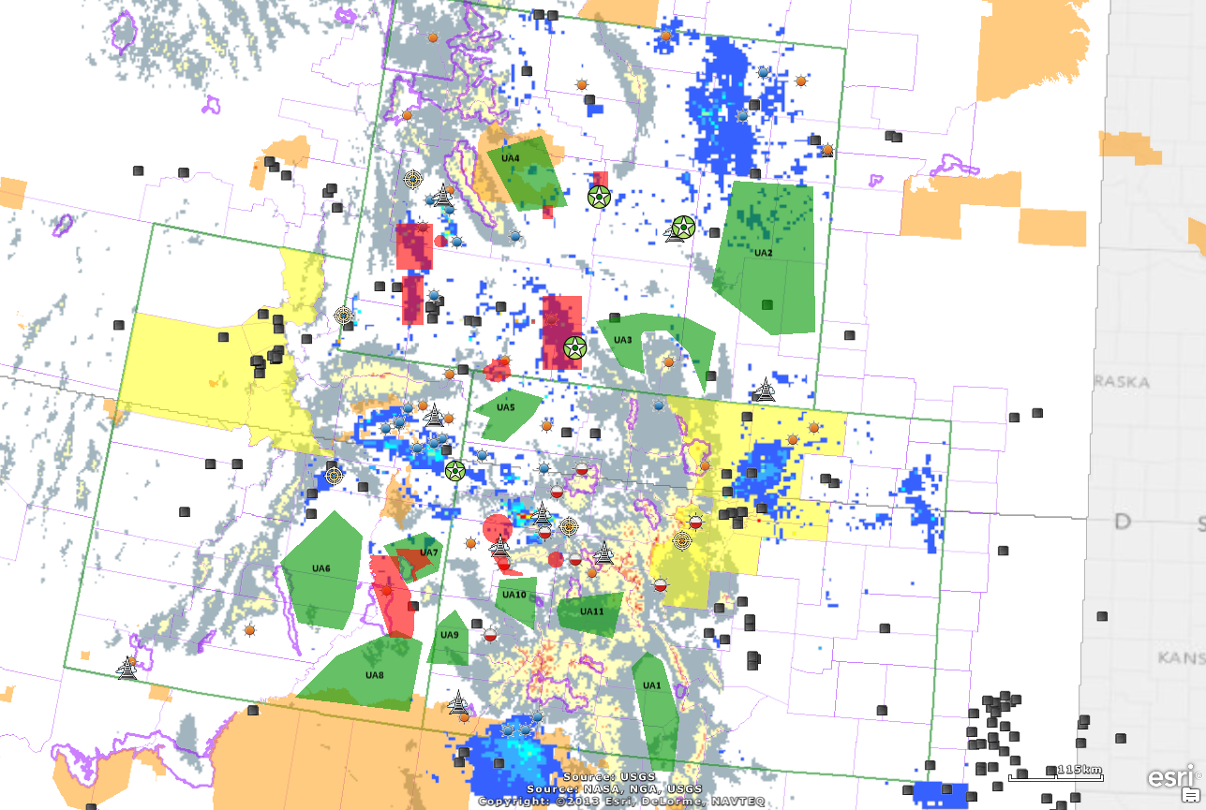
NOx Point Source > 250 tpy
RFD Area

Slide 12
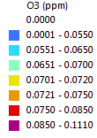
Predicted 4th Highest Daily Max 8-hr O3: Apr-Aug 2008 (no fires)
Predicted 4th Highest Daily Max 8-hr O3: Apr-Aug 2008 (no fires; 8,000’ Mask)

Slide 13
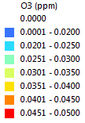
Predicted 4th Highest Daily Max 8-hr O3: Apr-Aug 2008 (no fires)
Predicted 4th Highest Daily Max 8-hr O3: Apr-Aug 2008 (no fires; no BC/IC)

Slide 14
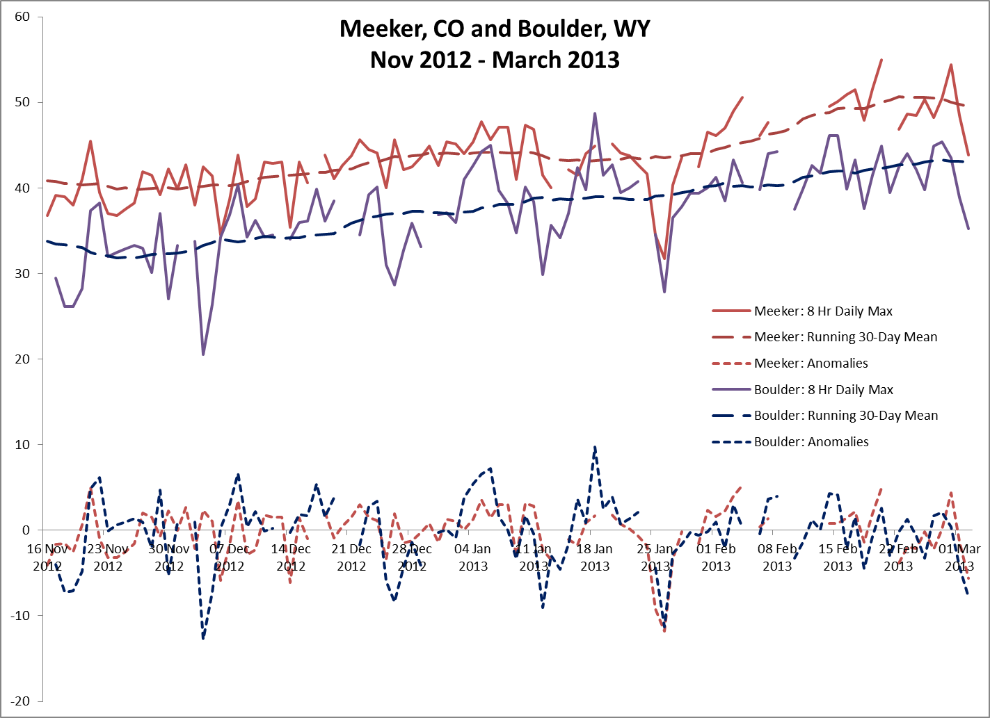
Inter-Site Correlations

Slide 15
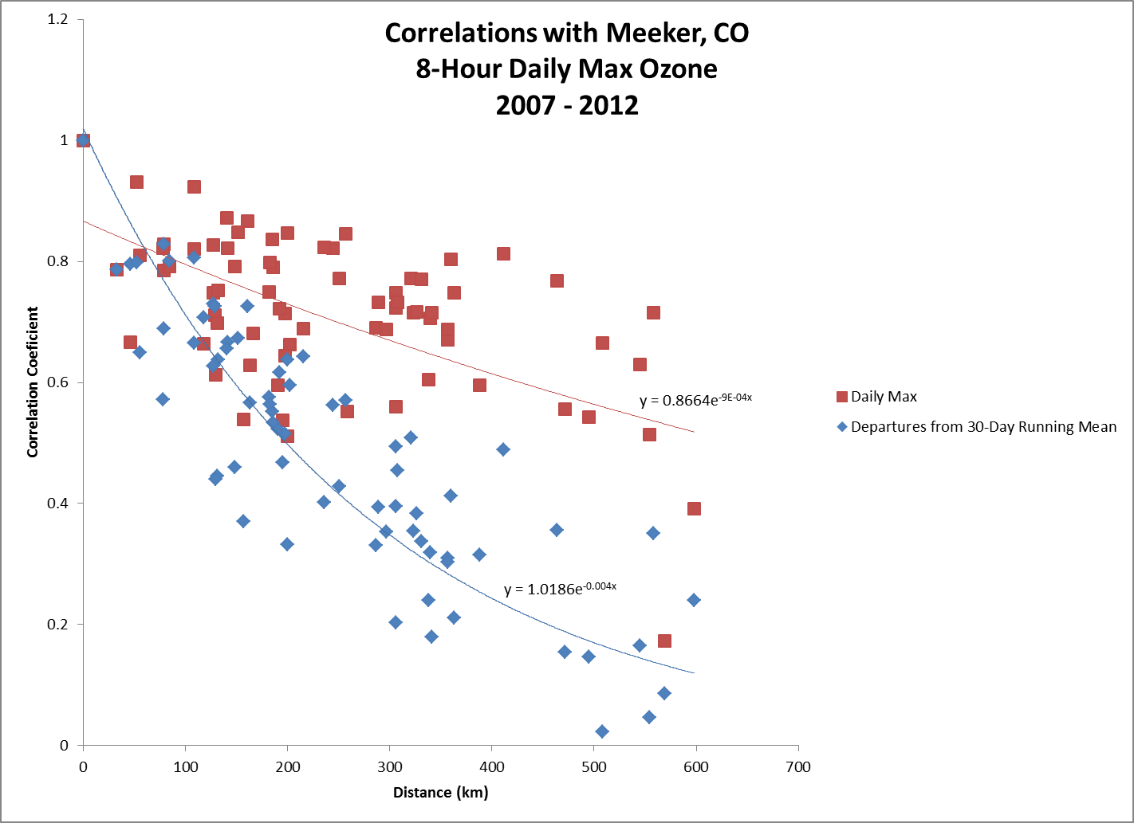

Slide 16
#4
Ozone Monitor Clusters
#3
#5
#2
#1

Slide 17
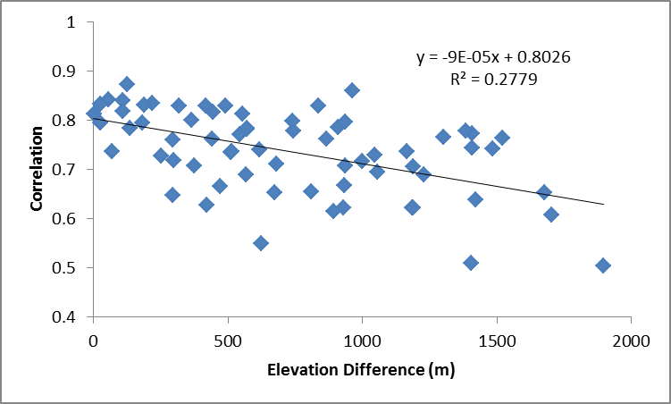
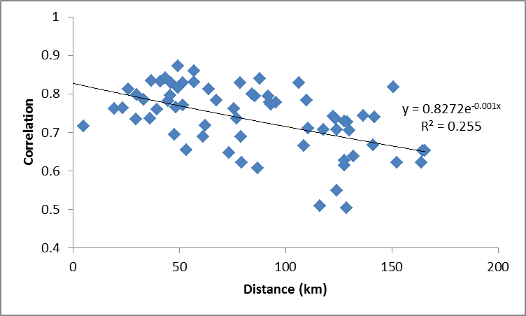
Pearson Correlations in Departures from Running 30-Day Mean
 |  | Colorado National Monument | Palisade Water Treatment | Grand Mesa | Gothic | McClure Pass | Ajax Mountain (will close 2014) | City of Aspen | Silt-Collbran | Sunlight Mountain | Wilson | Flattops #3 | Meeker, CO | Ripple Creek
Cluster | Site / Elev. (m): | 1740 | 1521 | 3040 | 2926 | 2930 | 3415 | 2415 | 2485 | 3224 | 2358 | 2904 | 1994 | 2930
5 | Colorado National Monument | 1 | 0.83346 | 0.76464 | 0.62127 | 0.70457 | 0.65241 | 0.65323 | 0.77756 | 0.74078 | 0.73898 | 0.73661 | 0.72618 | 0.6214
5 | Palisade Water Treatment | 0.83346 | 1 | 0.76271 | 0.51007 | 0.77206 | 0.50355 | 0.61503 | 0.86028 | 0.60676 | 0.82857 | 0.77697 | 0.66545 | 0.74361
5 | Grand Mesa | 0.76464 | 0.76271 | 1 | #N/A | 0.84036 | 0.70732 | 0.54945 | 0.81246 | 0.79435 | 0.7114 | 0.78264 | 0.72909 | 0.81772
2 | Gothic | 0.62127 | 0.51007 | #N/A | 1 | 0.8127 | #N/A | 0.73374 | 0.76168 | 0.71841 | 0.68856 | #N/A | 0.66662 | #N/A
2 | McClure Pass | 0.70457 | 0.77206 | 0.84036 | 0.8127 | 1 | #N/A | 0.73619 | 0.81675 | 0.75888 | 0.78094 | 0.79488 | 0.70792 | #N/A
1 | Ajax Mountain | 0.65241 | 0.50355 | 0.70732 | #N/A | #N/A | 1 | 0.71684 | 0.62201 | 0.83082 | 0.69496 | #N/A | 0.63737 | #N/A
1 | City of Aspen | 0.65323 | 0.61503 | 0.54945 | 0.73374 | 0.73619 | 0.71684 | 1 | 0.73628 | 0.65491 | 0.84122 | #N/A | 0.62741 | #N/A
3 | Silt-Collbran | 0.77756 | 0.86028 | 0.81246 | 0.76168 | 0.81675 | 0.62201 | 0.73628 | 1 | 0.79791 | 0.87304 | 0.82911 | 0.82836 | #N/A
3 | Sunlight Mountain | 0.74078 | 0.60676 | 0.79435 | 0.71841 | 0.75888 | 0.83082 | 0.65491 | 0.79791 | 1 | 0.76147 | 0.82942 | 0.68869 | 0.64728
3 | Wilson | 0.73898 | 0.82857 | 0.7114 | 0.68856 | 0.78094 | 0.69496 | 0.84122 | 0.87304 | 0.76147 | 1 | 0.77122 | 0.80027 | 0.78353
4 | Flattops #3 | 0.73661 | 0.77697 | 0.78264 | #N/A | 0.79488 | #N/A | #N/A | 0.82911 | 0.82942 | 0.77122 | 1 | 0.78576 | 0.83205
4 | Meeker, CO | 0.72618 | 0.66545 | 0.72909 | 0.66662 | 0.70792 | 0.63737 | 0.62741 | 0.82836 | 0.68869 | 0.80027 | 0.78576 | 1 | 0.7959
4 | Ripple Creek | 0.6214 | 0.74361 | 0.81772 | #N/A | #N/A | #N/A | #N/A | #N/A | 0.64728 | 0.78353 | 0.83205 | 0.7959 | 1

Slide 18
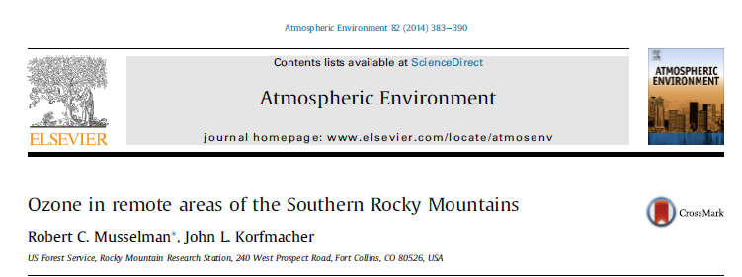
Relationships Between O3 and Altitude
Potential Altitude Effects on O3
Reduced upwind depositional losses
Increased potential for stratospheric intrusion impacts
Reduced impacts from upwind sources located at lower elevations
Others?
Recent Forest Service Study:
Highest nighttime O3 at highest elevations
No correlation of daytime O3 with elevation

Slide 19
Potentially Underserved Areas
 |  |  | Price | Escalante | Canyonlands
 |  | Site ID: | _490071003 | _490170004 | _490370101
 |  | Elevation (m asl): | 1722 | 1789 | 1814
Series | Cor Type | Ozone DV (ppm): | 0.07 | incomplete | 0.068
Anomaly | Pearson | Price | 1 | 0.598 | 0.633
Anomaly | Pearson | Escalante | 0.598 | 1 | 0.752
Anomaly | Pearson | Canyonlands | 0.633 | 0.752 | 1
Absolute | Pearson | Price | 1 | 0.853 | 0.883
Absolute | Pearson | Escalante | 0.853 | 1 | 0.905
Absolute | Pearson | Canyonlands | 0.883 | 0.905 | 1
UA6
Pros | Cons
Upwind boundary | No significant sources or population centers
Near Capitol Reef Class I area | High absolute correlations between surrounding sites

Slide 20
Potentially Underserved Areas
UA5
Pros | Cons
Downwind of Uintah Basin | No significant sources or population centers
Cross-border transport
Hiawatha RFD on northern edge
High values at Rangely and Dinosaur (Lay Peak at much higher elevation)

Slide 21
Potentially Underserved Areas
 |  |  | Colorad NM | Canyonlands
 |  | Site ID: | _080771001 | _490370101
 |  | Elevation (m asl): | 1740 | 1814
Time Series | Cor Type | Ozone DV (ppm): | 0.068 | 0.068
Anomaly | Pearson | Colorad NM | 1 | 0.73838
Anomaly | Pearson | Canyonlands | 0.73838 | 1
Absolute | Pearson | Colorad NM | 1 | 0.76543
Absolute | Pearson | Canyonlands | 0.76543 | 1
UA7
Pros | Cons
Near Arches Class I area and Moab | No significant existing sources or major population centers in immediate vicinity
Potential new O&G development (Moab Master Leasing Plan)
Only moderate correlations between nearby sites (Canyonlands and Colorado NM)

Slide 22
Potentially Underserved Areas
UA10
Pros | Cons
Near Black Canyon of the Gunnison NM Class I area | No significant existing sources or major population centers in immediate vicinity
Potential new O&G development (Moab Master Leasing Plan) | Not far from Grand Mesa USFS seasonal site but Grand Mesa is at higher elevation (3040 m)
Some areas of elevated ozone predicted, including areas below 8,000’ | Generally low O3 contribution from anthropogenic sources predicted (WestJump modeling)

Slide 23
Potentially Underserved Areas
UA1
Pros | Cons
Great Sand Dunes NM on eastern boundary (but at higher elevation) | Isolated; No significant existing sources or major population centers in immediate vicinity
Far from any existing monitoring sites | Far from any emissions sources
Some areas of elevated ozone predicted, including areas below 8,000’ | Generally low O3 contribution from anthropogenic sources predicted (WestJump modeling)

Slide 24
Next Steps
Step | Deadline
Obtain additional input :
NPS review of ozone site metadata | 6 January
RFD shapefiles | 6 January
Comments on potential underserved areas (locations, pros and cons) | 6 January
Prepare draft recommendations memo | 10 January
Discuss recommendations with funding agencies and revise as appropriate | Late January
Document data sources and processing procedures | 31 January

