Slide 1
3SAQS Network Assessment
Work Group Call
25 October 2013

Slide 2
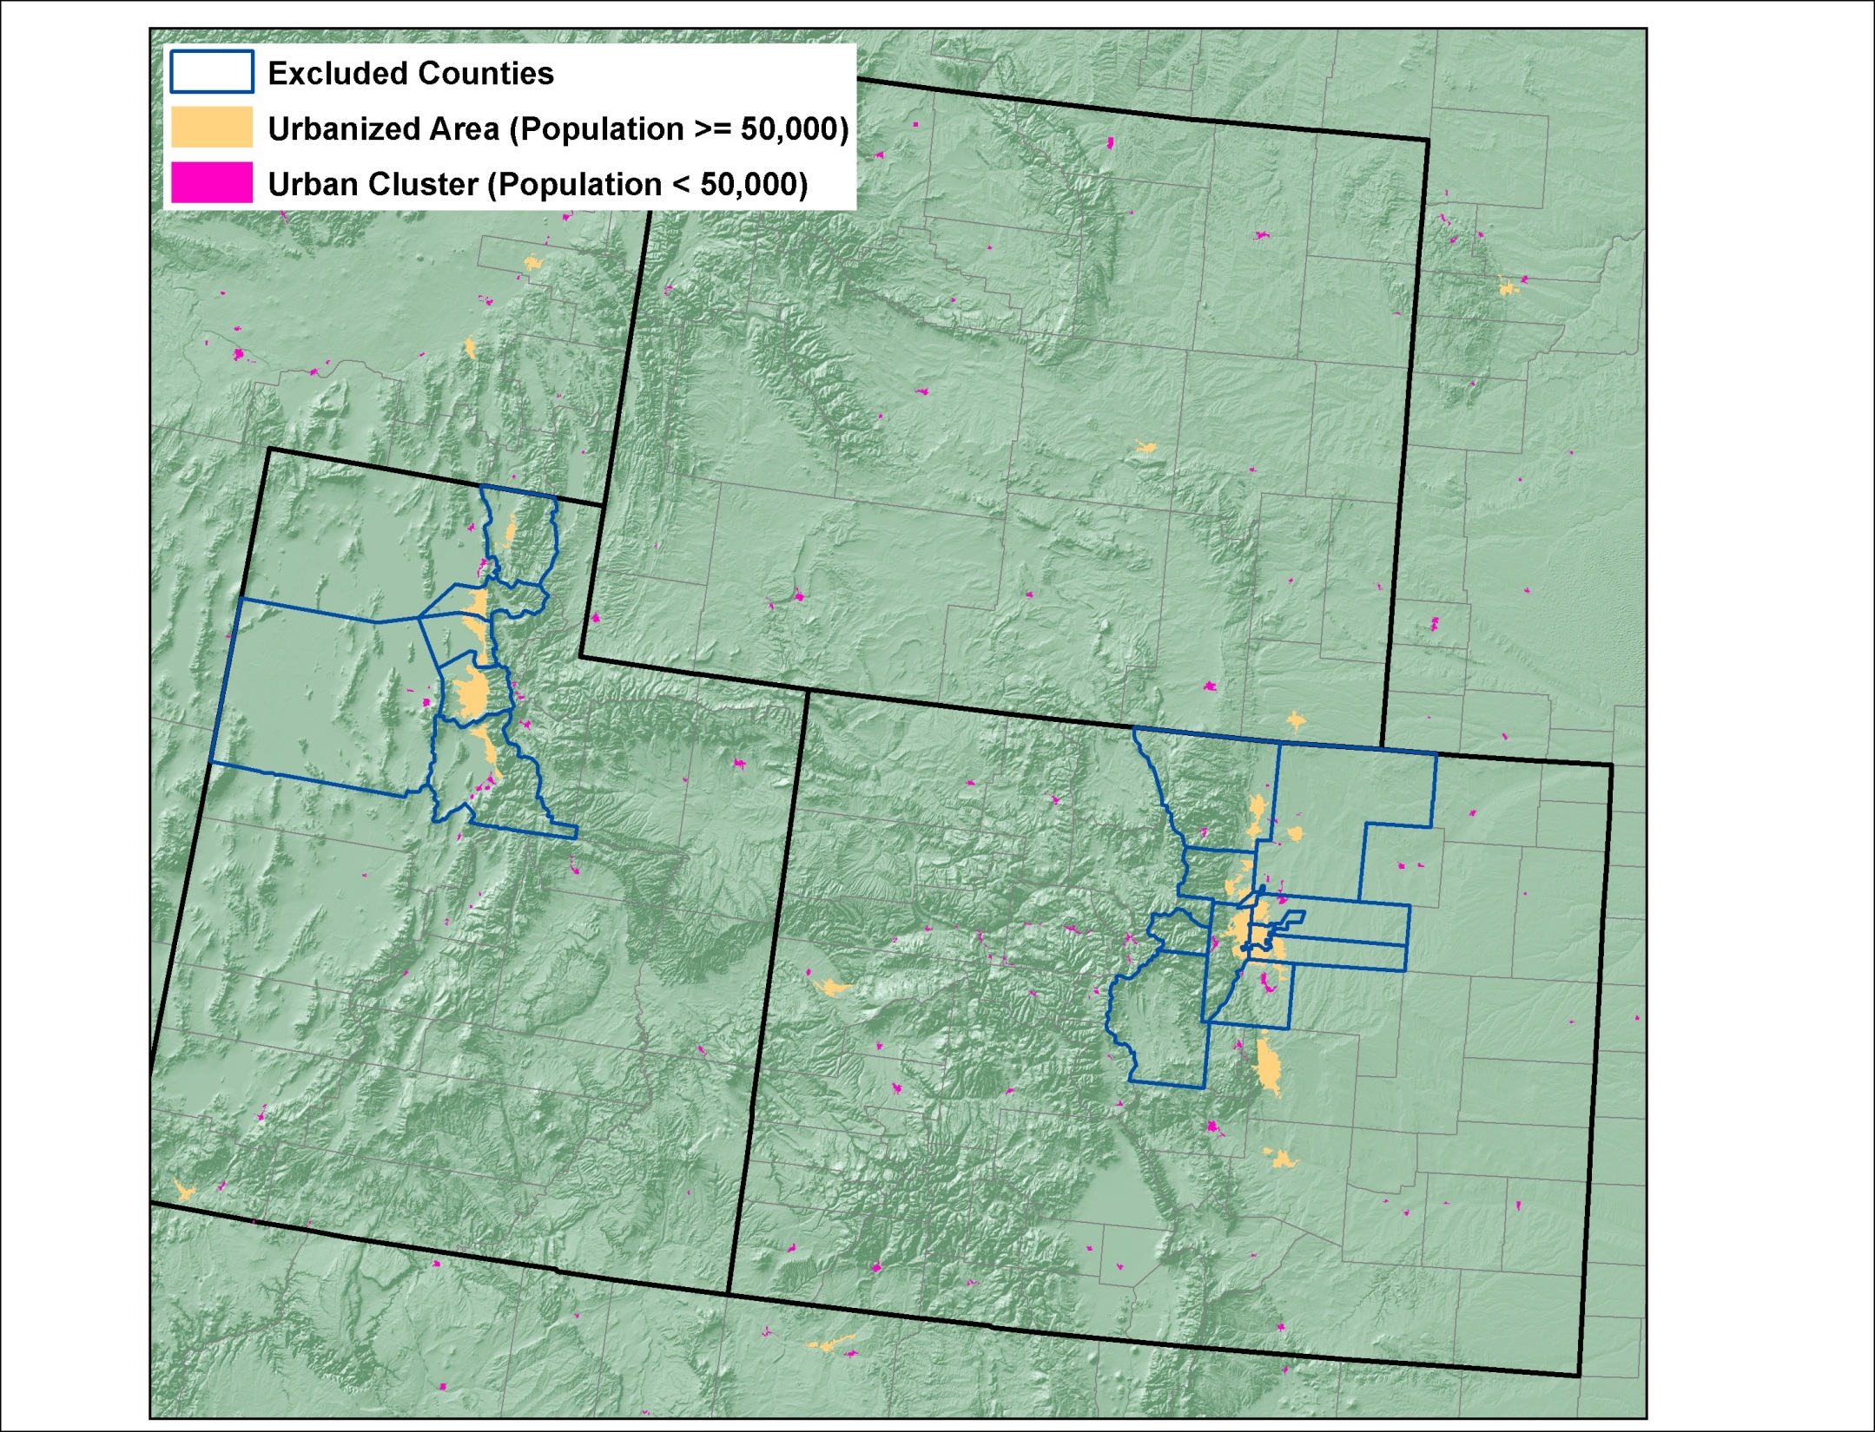
Urban Areas

Slide 3
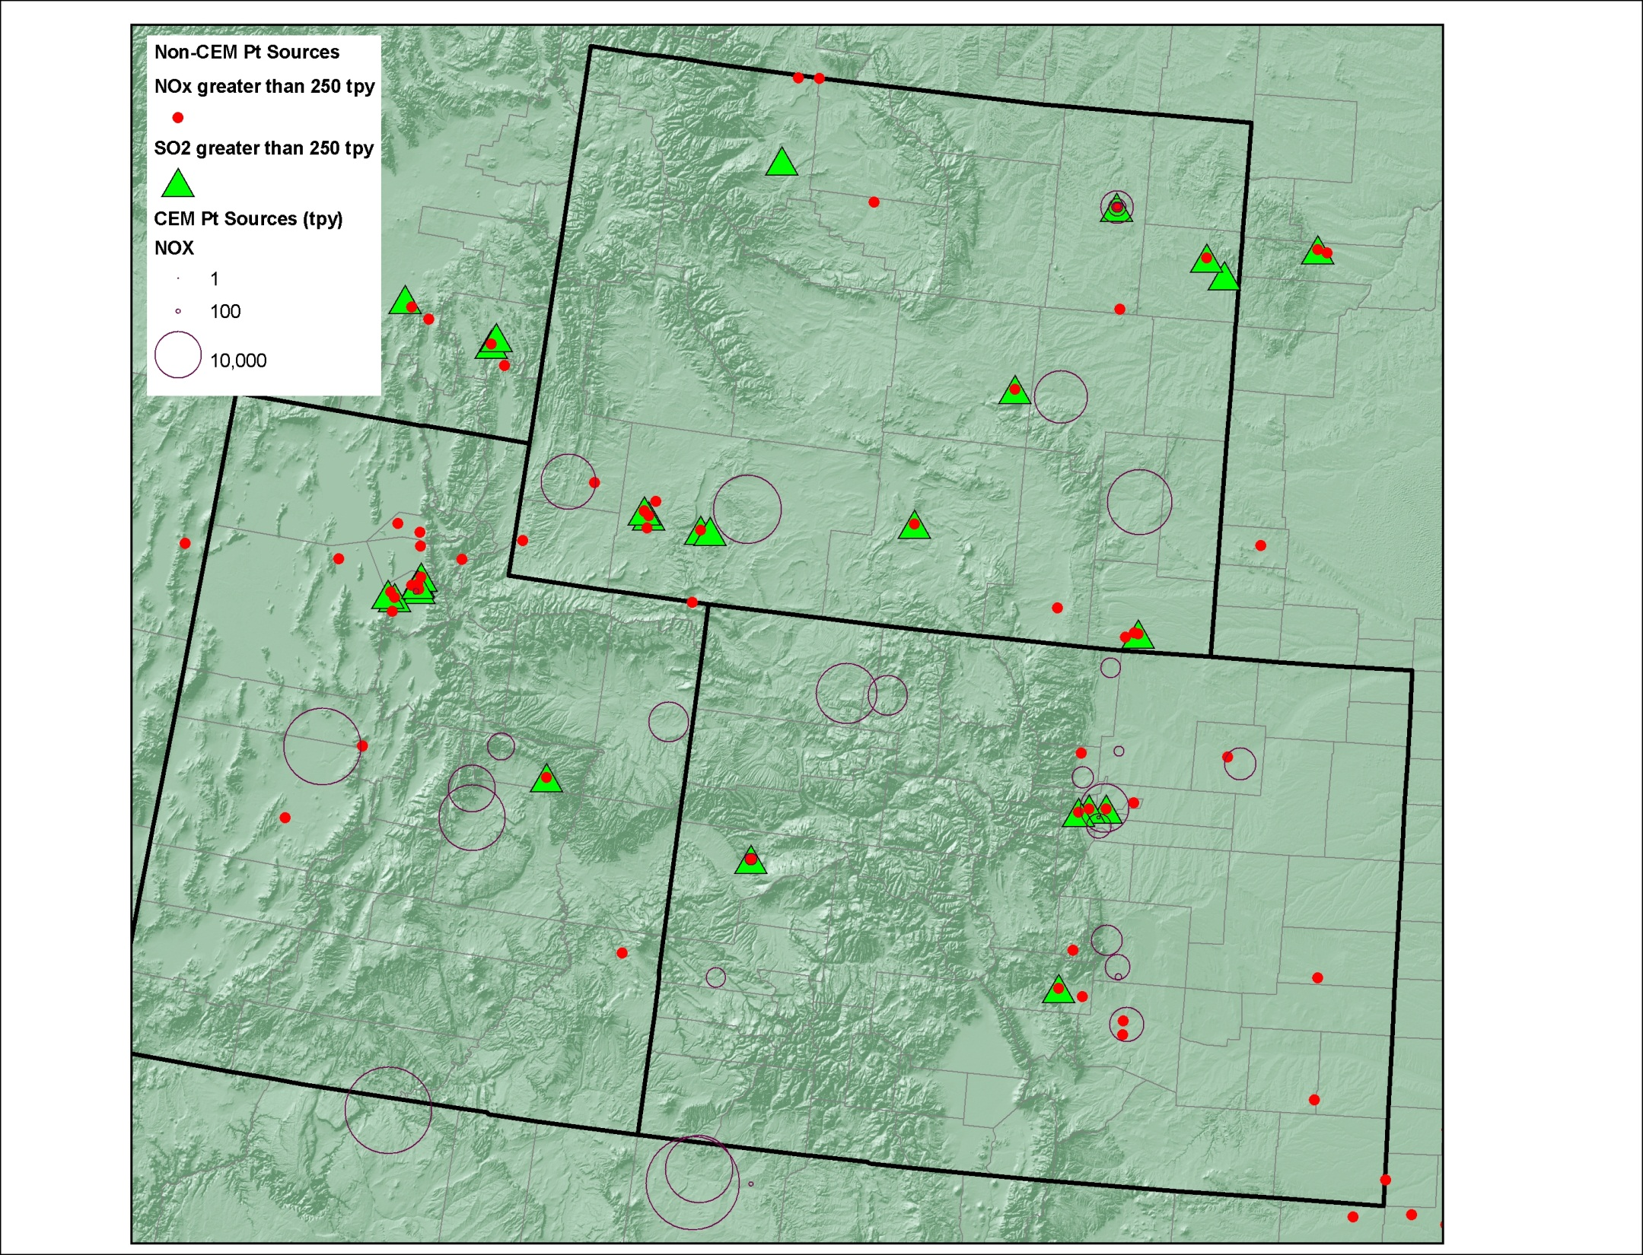
Major Point Sources

Slide 4
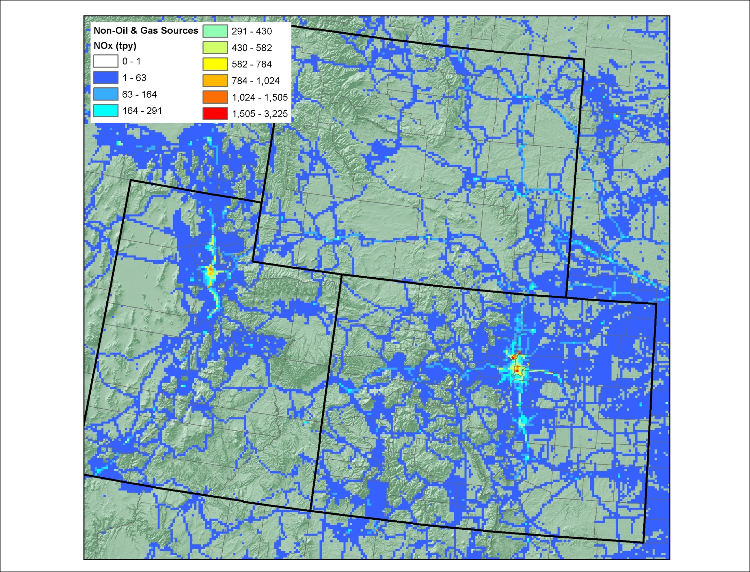
Area Source NOx (except O&G)

Slide 5
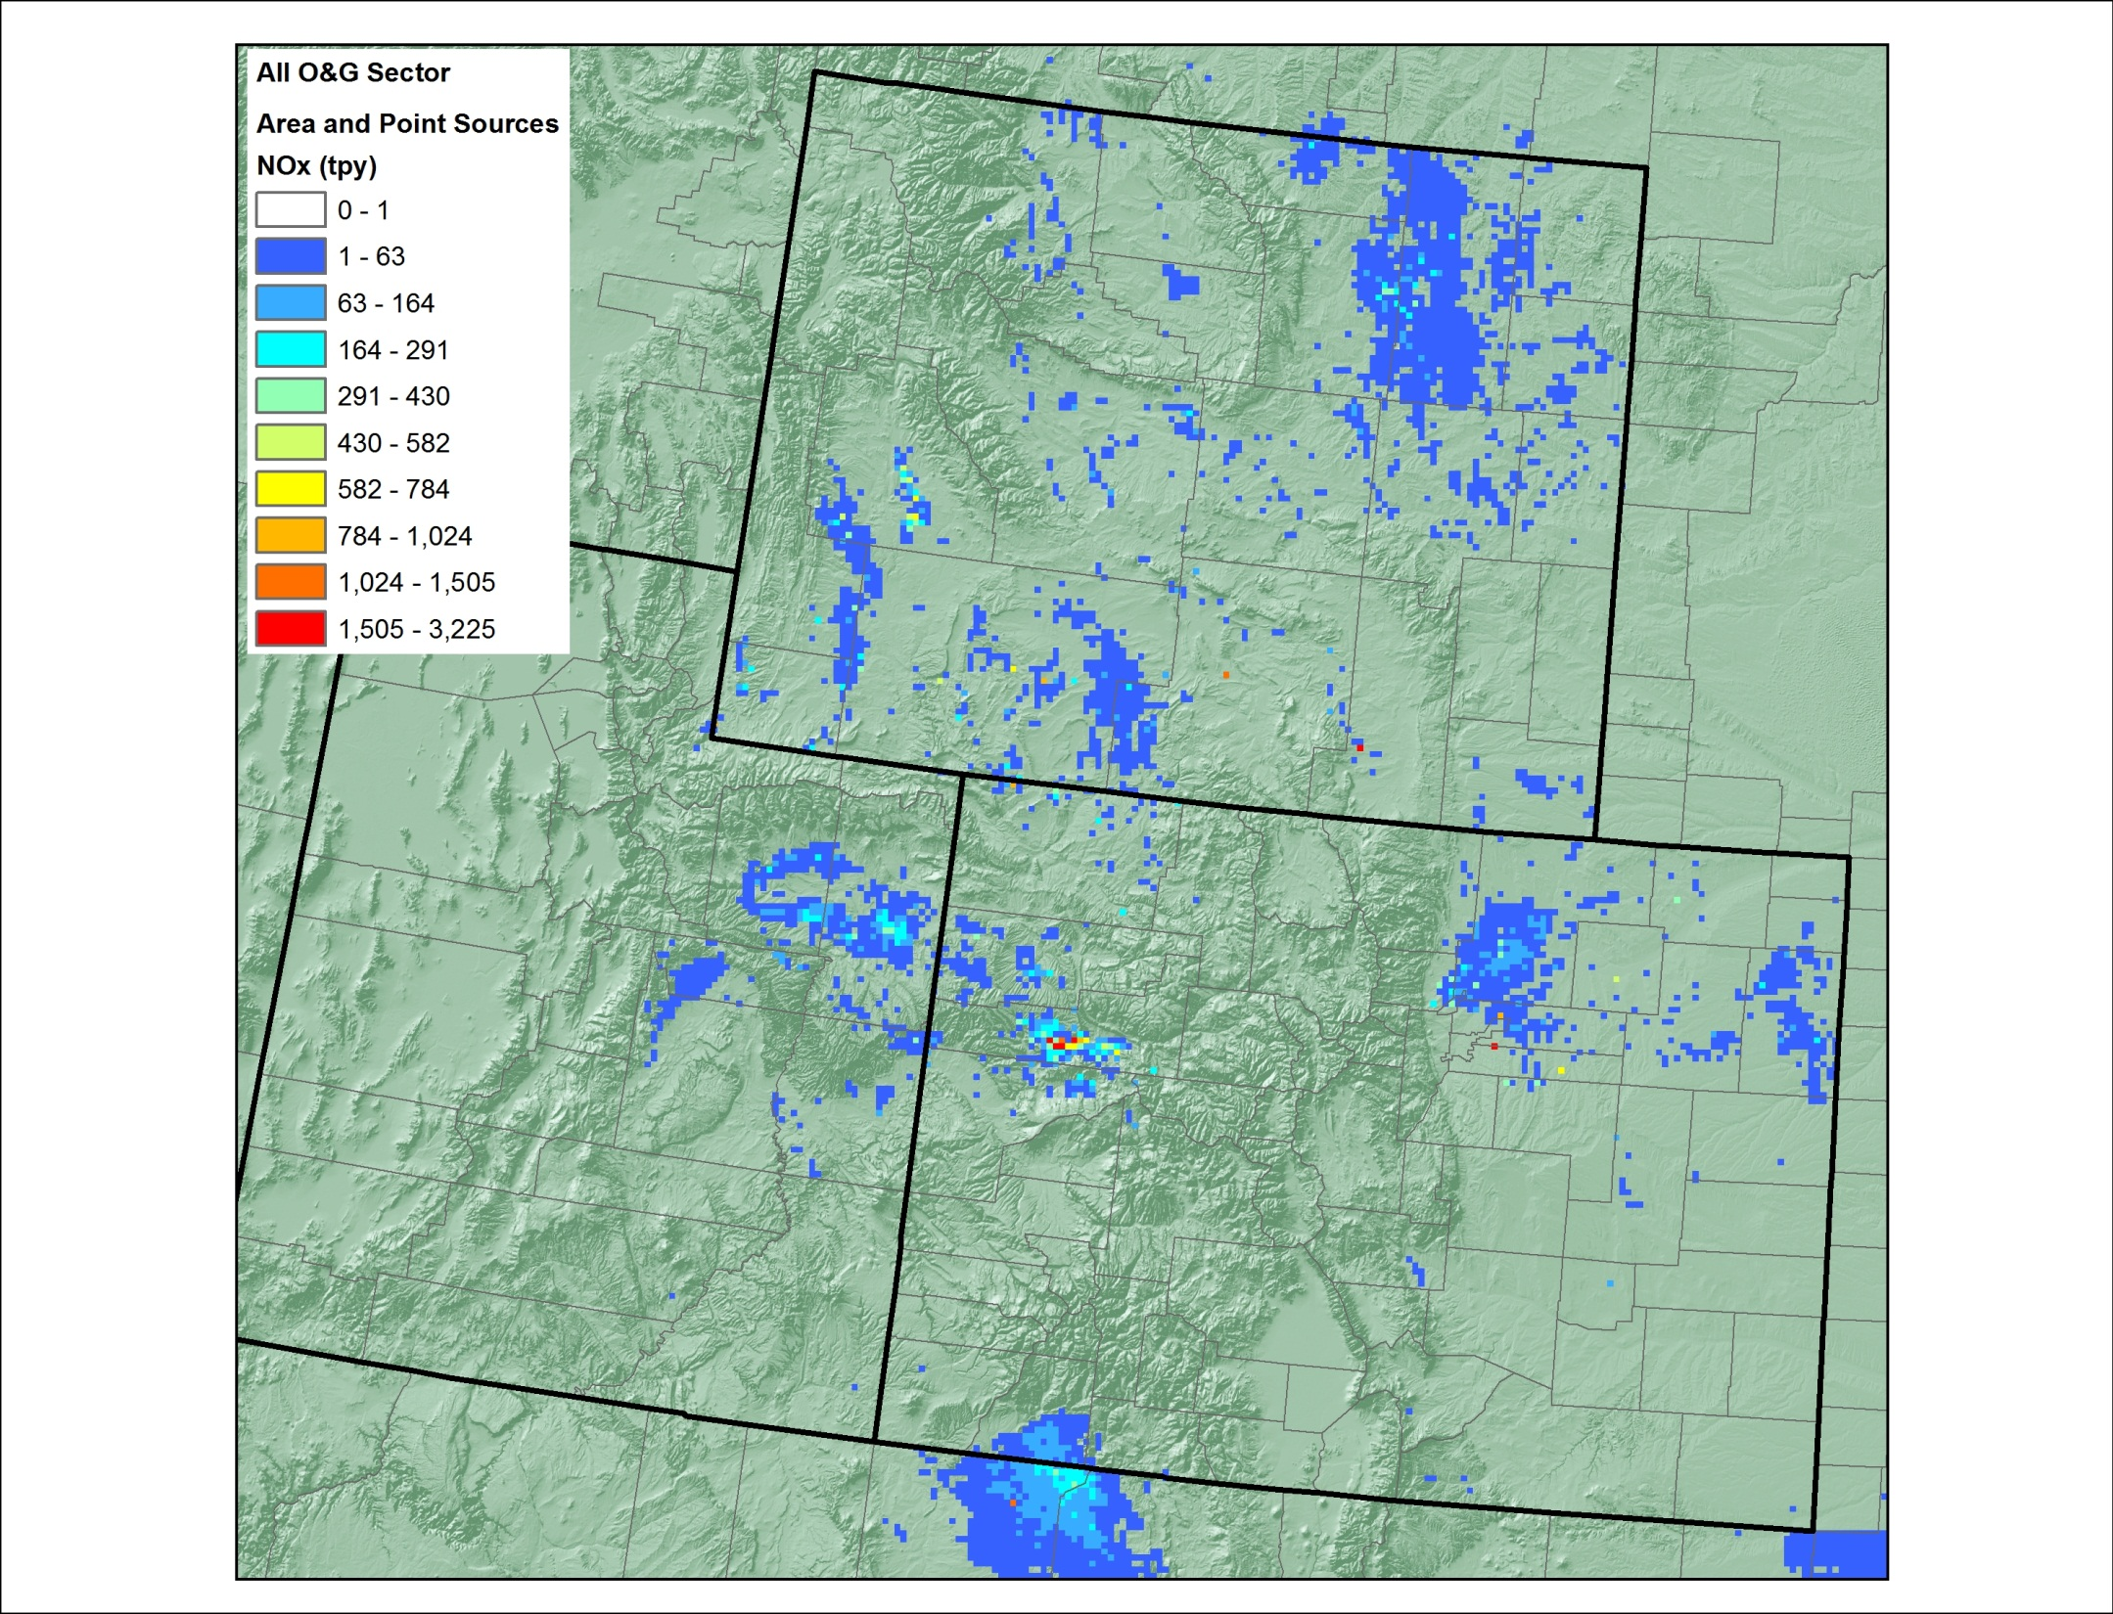
O&G NOx (point and area)

Slide 6
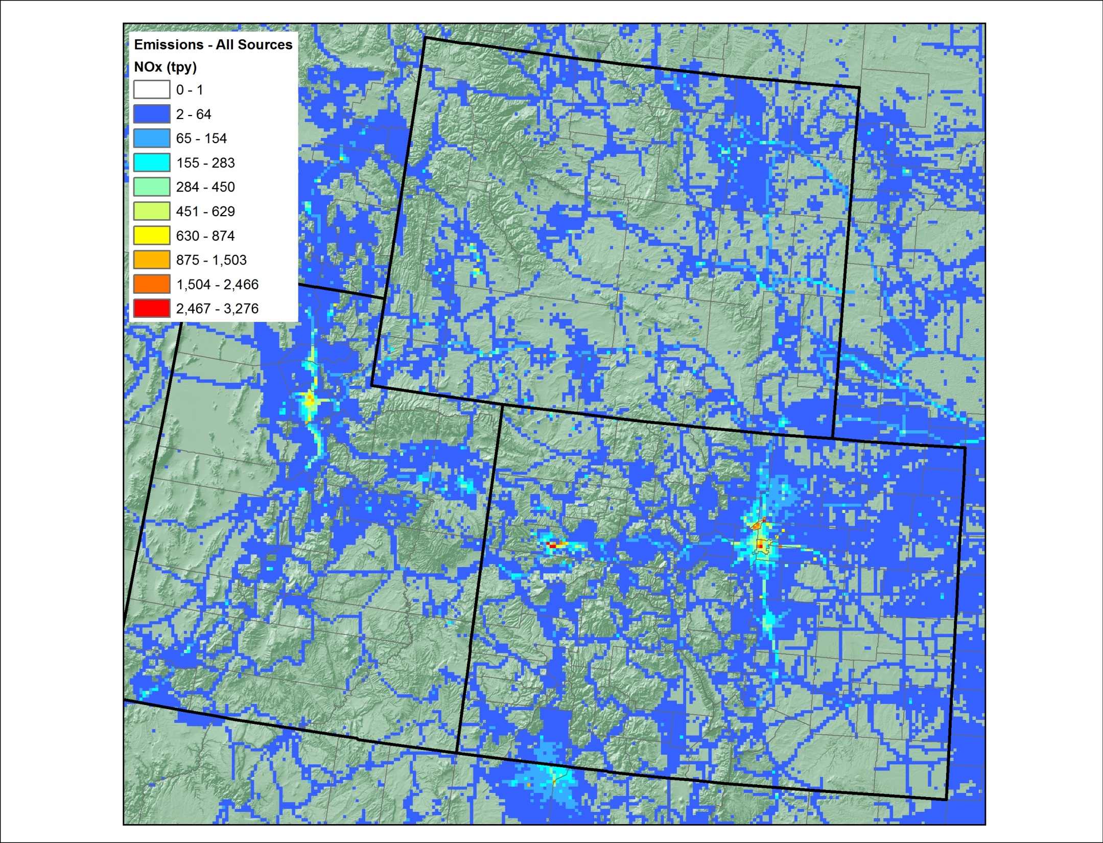
Area Source NOx (incl O&G pts)

Slide 7
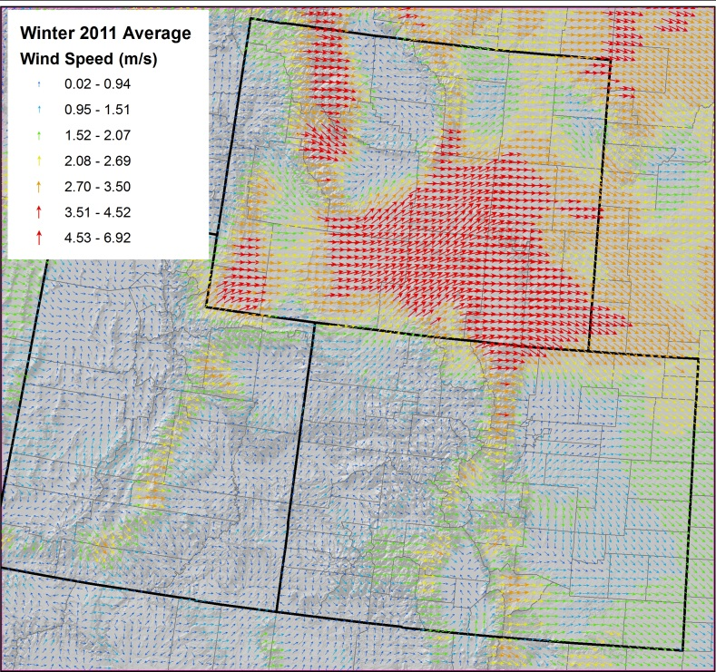
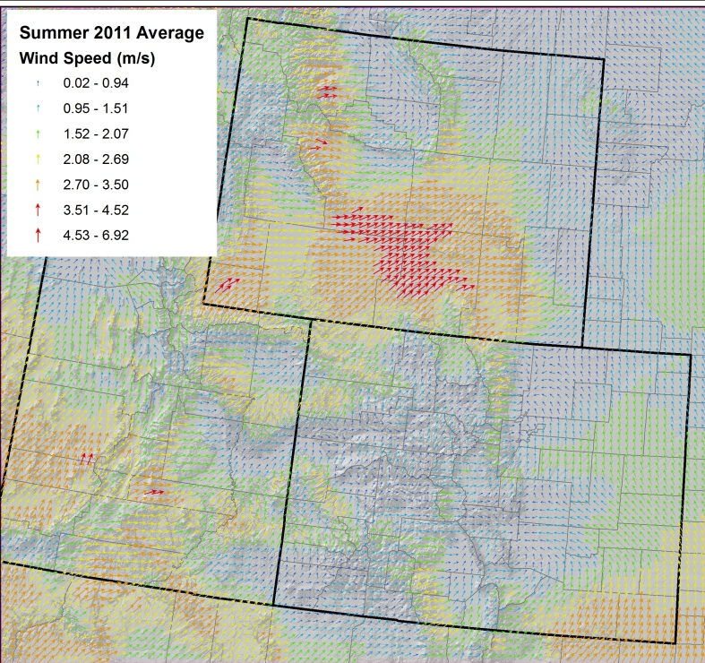
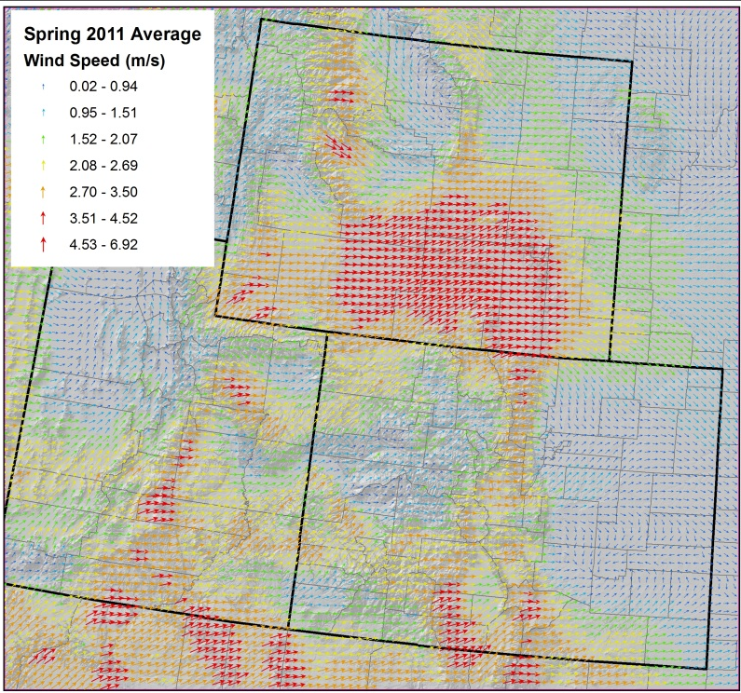
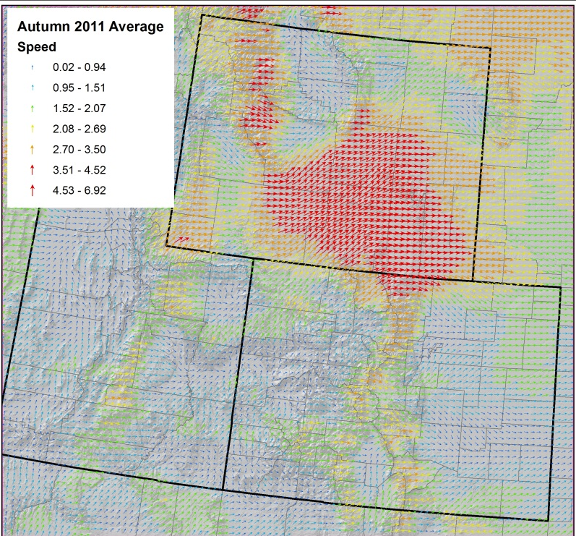
Mean Boundary Layer Winds (2011)
Winter (DJF)
Summer (JJA)
Spring (MAM)
Fall (SON)

Slide 8
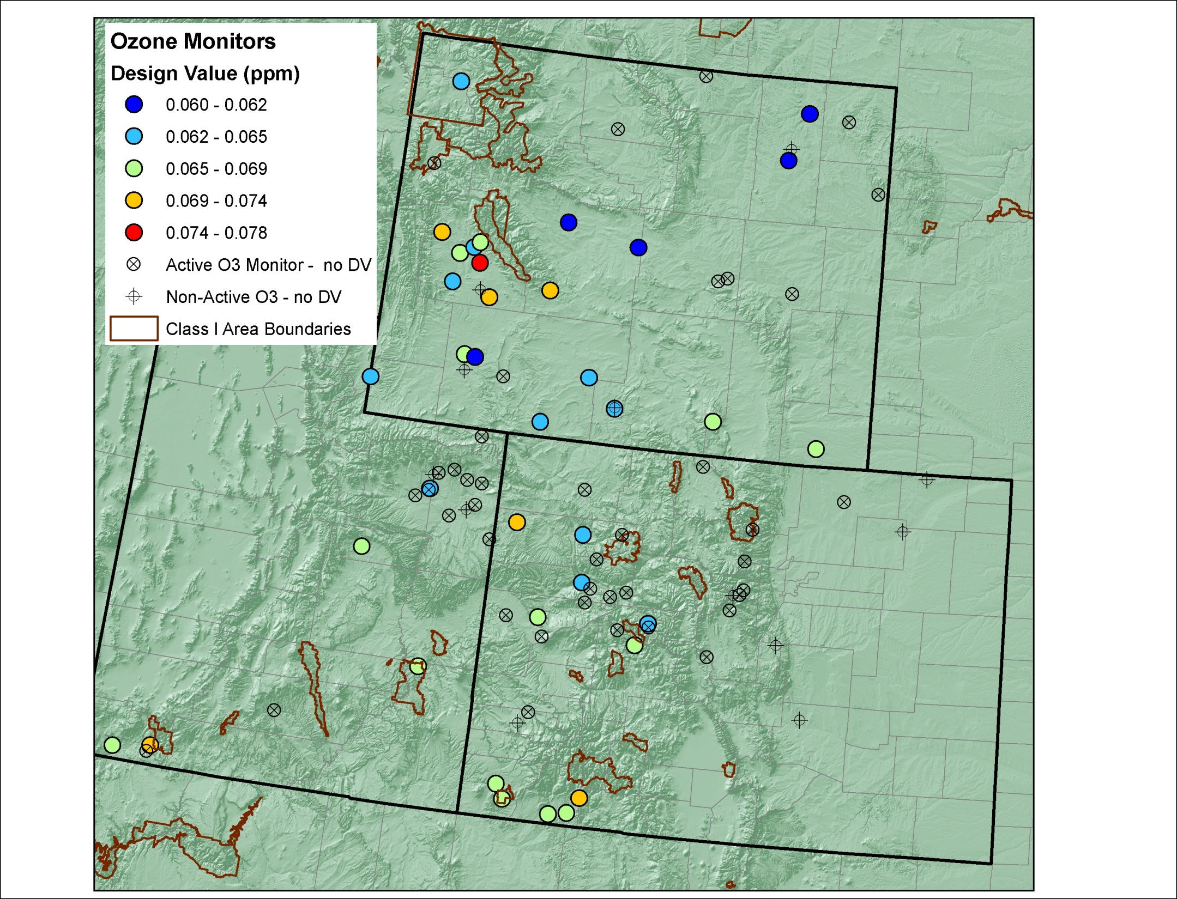
Monitored 8-hr O3 DV

Slide 9
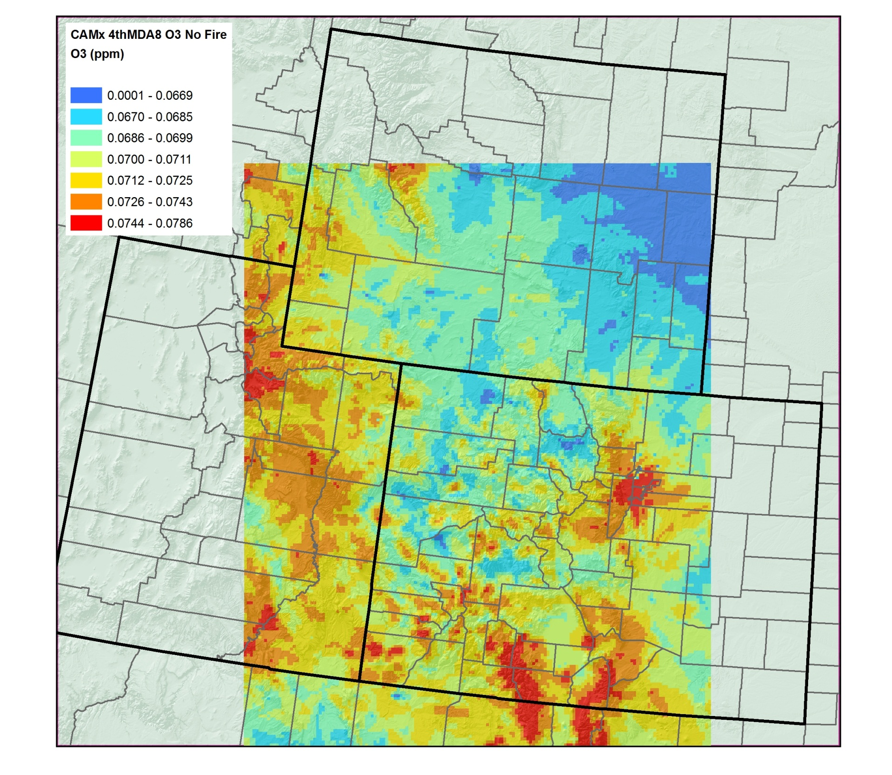
Predicted 8-hr O3 DV for 2008 (no fires)

Slide 10
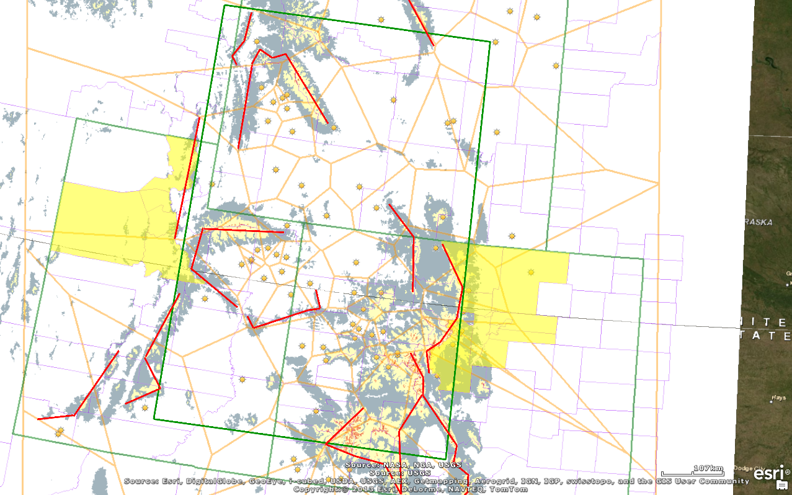
Active O3 Monitors Terrain above 8,000 ft
3SAQS Network Focus Area
O3 Monitor
Thiessen Polygons
Terrain Block
Urban Counties
Under Served Area

Slide 11
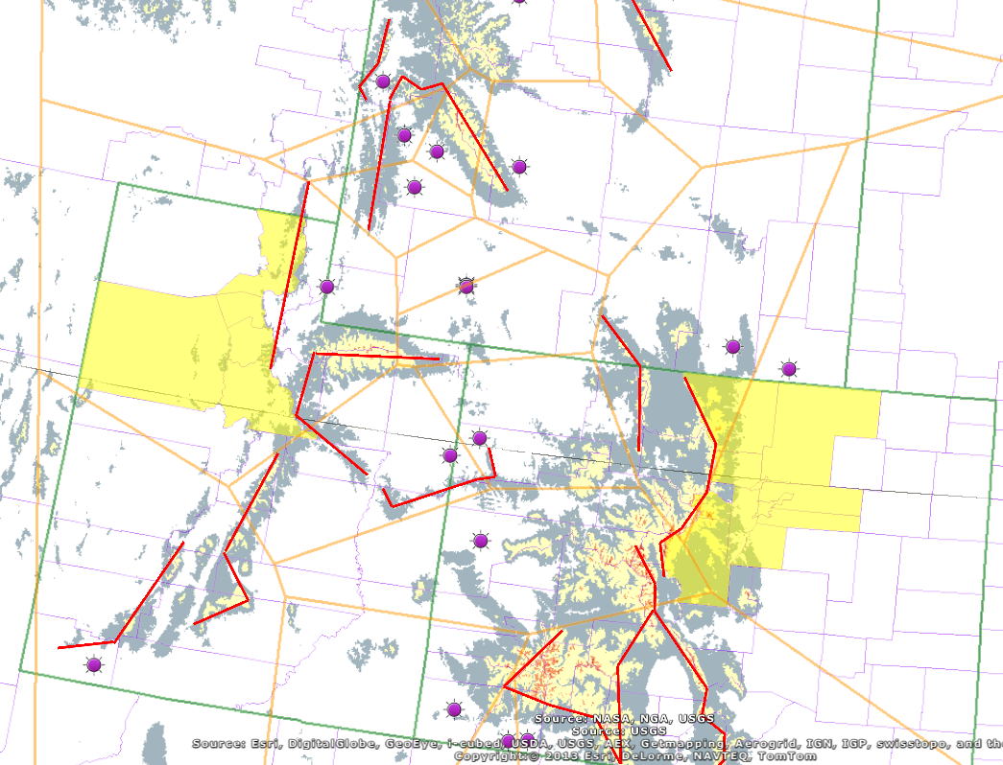
Active PM2.5 Monitors Terrain above 8,000 ft
PM2.5 Monitor
Thiessen Polygons
Terrain Block
Urban Counties

