Slide 1
Three State Air Quality Study (3SAQS) Benchmarking for 3SAQS base 2008 CAMx simulations

Slide 2
Overview
Modeling 5-day period from January 1-5, 2008
Instructions and input data provided for 36- and 12-km modeling grids from UNC
CAMx v5.41 with in-line plume rise for DEASCO3 fires (differs from public release of CAMx v5.41)
Perform simulation using provided inputs and then compare against UNC results generated using different compiler and hardware.
Maximum expected differences between simulations should be less than 1% for both gas and aerosol species

Slide 3
Configuration
ENVIRON
UNC
Operating System: 64-bit Fedora 14
Hardware: dual 6 core 3.06 GHz Intel, 12M cache (Model X5675)
Fortran Compiler: Portland Group Fortran version 8.02
MPI: MPICH3
CAMx: v5.41 hybrid MPI-OpenMP
Operating System: 64-bit RHEL
Hardware: 12 core 2.93 GHz Intel, 12M cache (Model X5670)
Fortran Compiler: Portland Group Fortran version 11.6-0
MPI: mvapich2-1.7
CAMx: v5.41 hybrid MPI-OpenMP

Slide 4
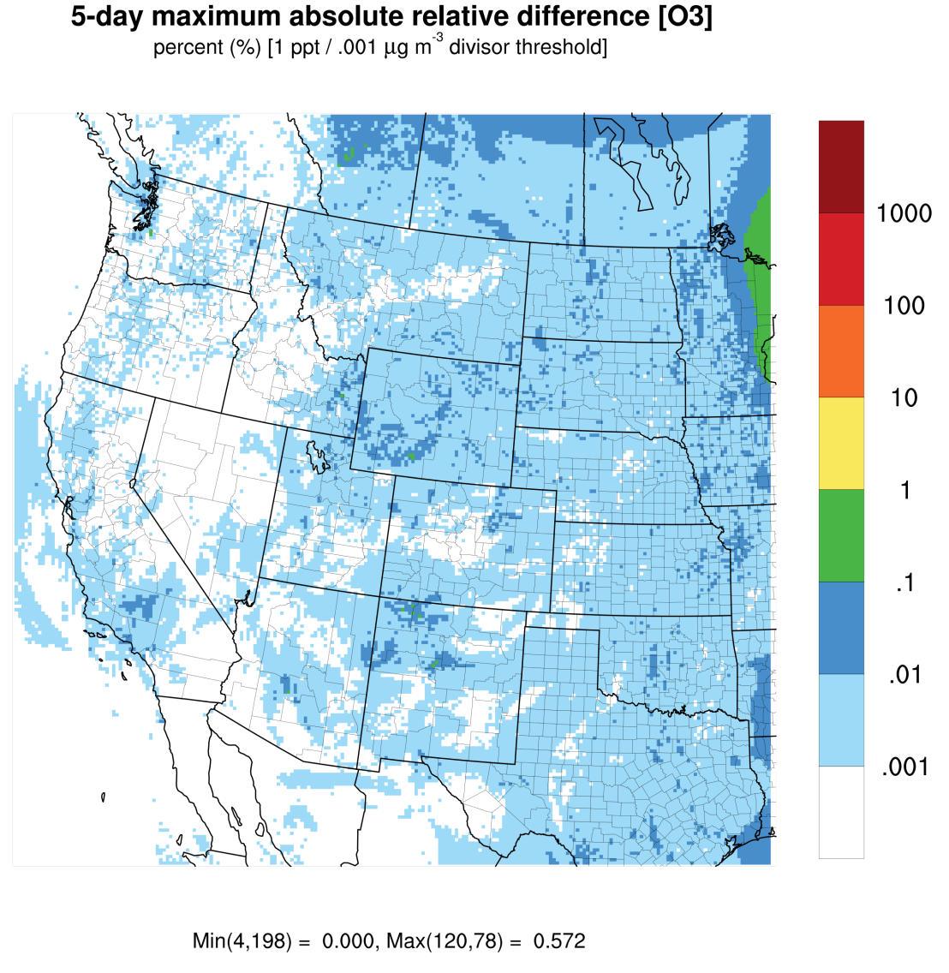
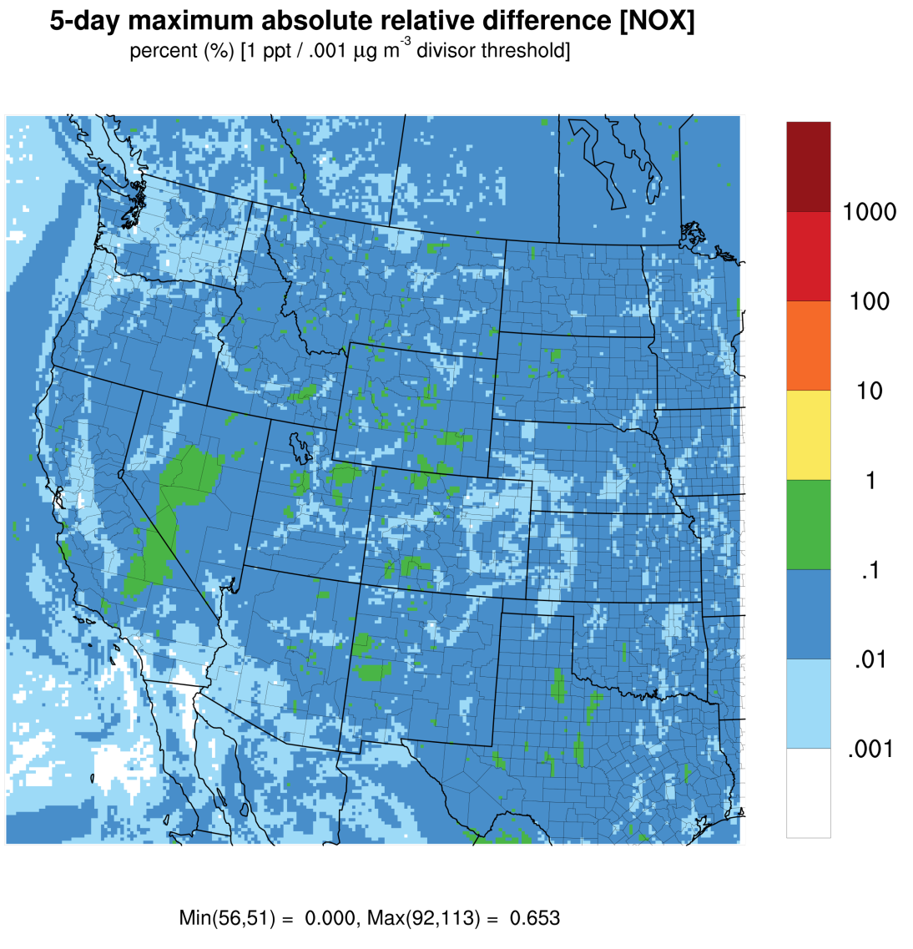
Concentrations [O₃ and NO_{x}]
Note: concentrations below 1 ppt/ .001 ug m⁻³ are not included in calculations as to prevent numerical “blow-up”

Slide 5
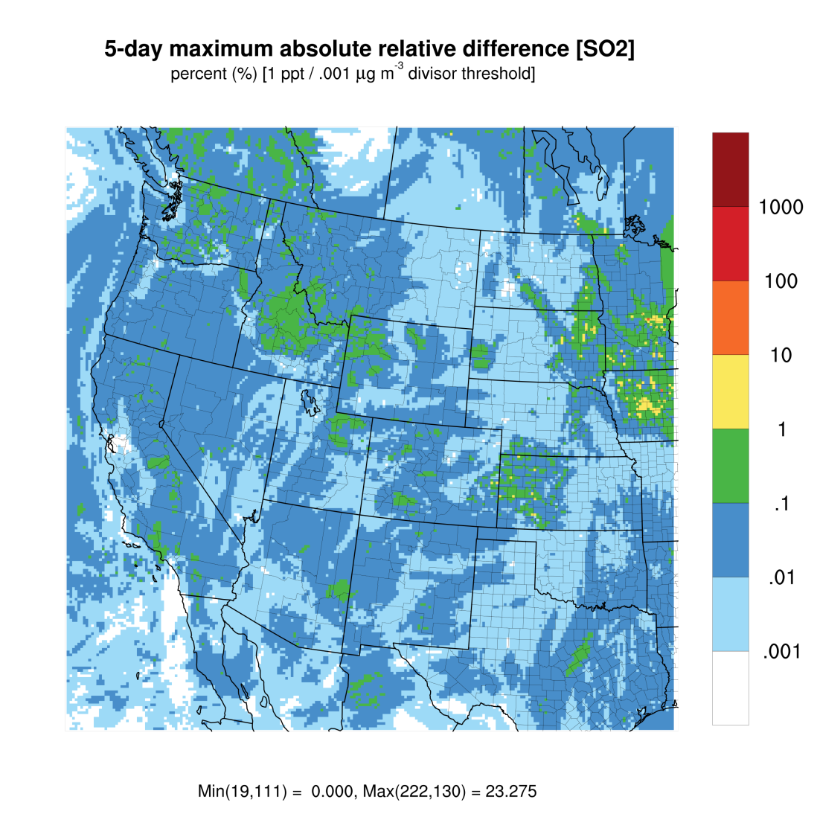
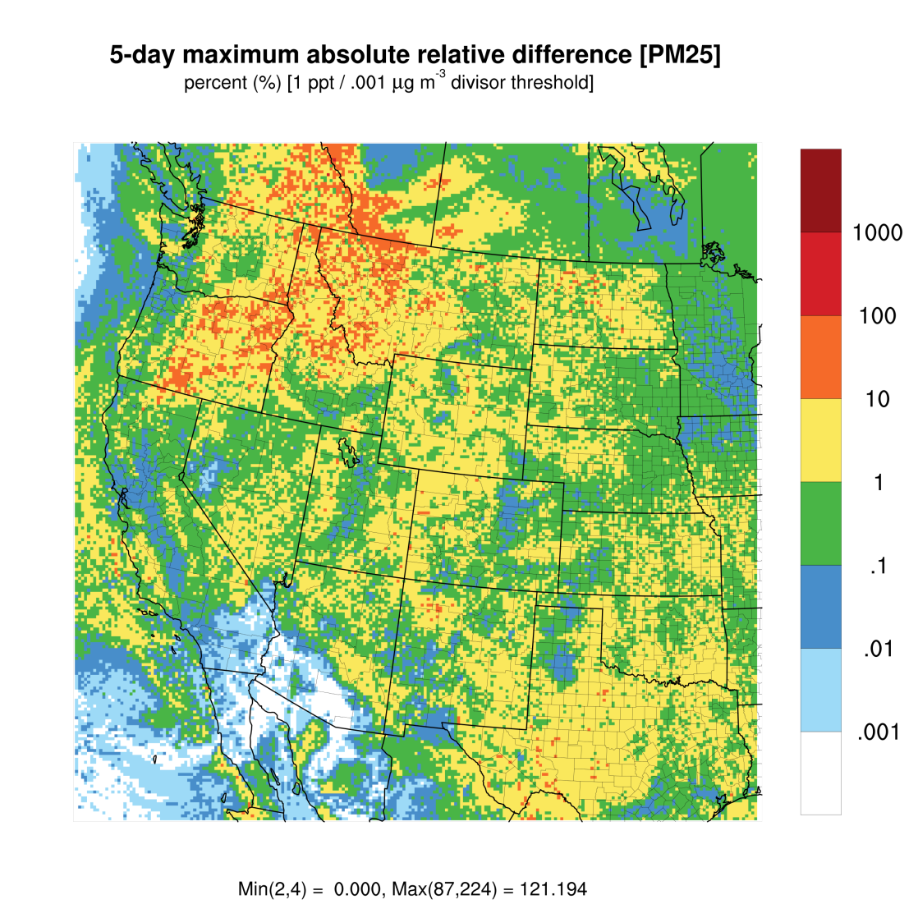
Concentrations [SO₂ and PM_{2.5}]

Slide 6
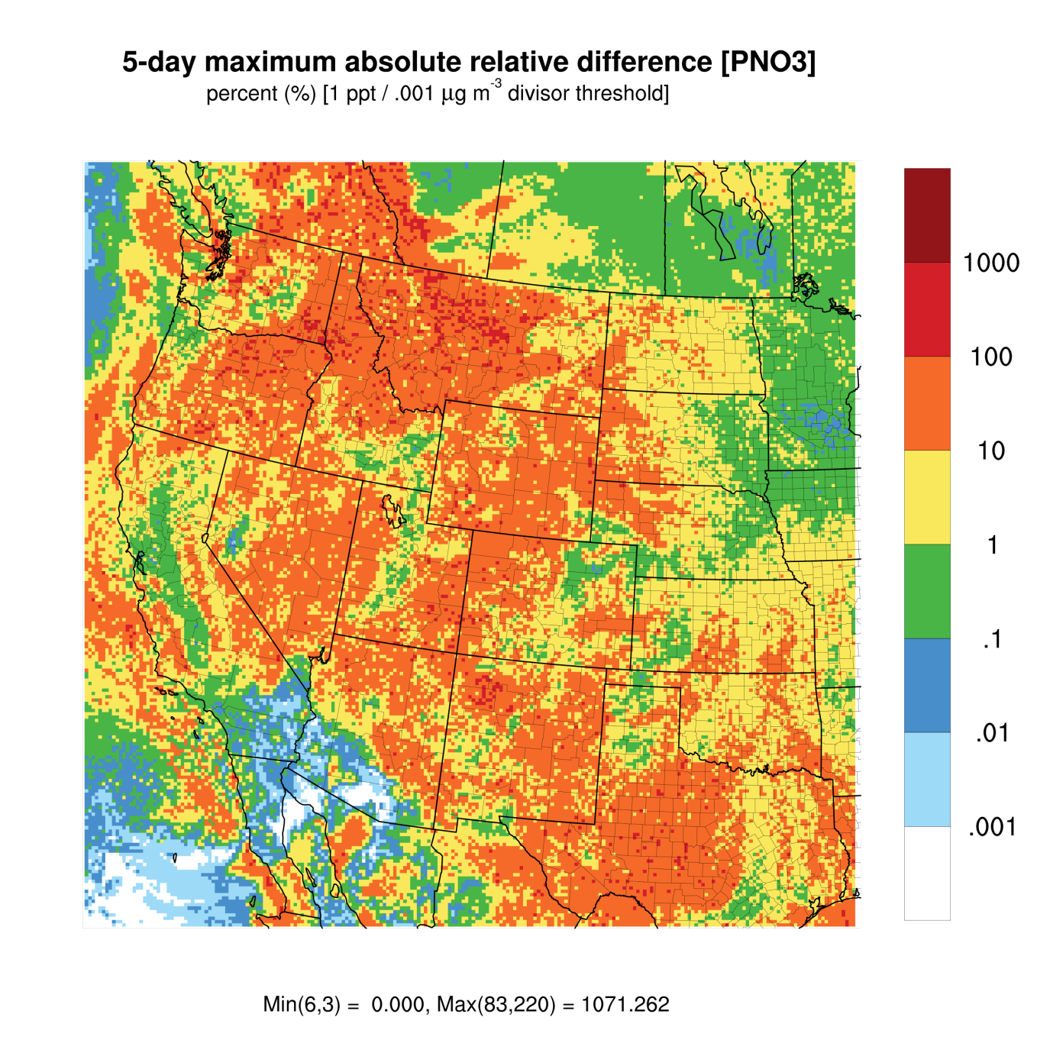
Concentrations [PNO₃]

Slide 7
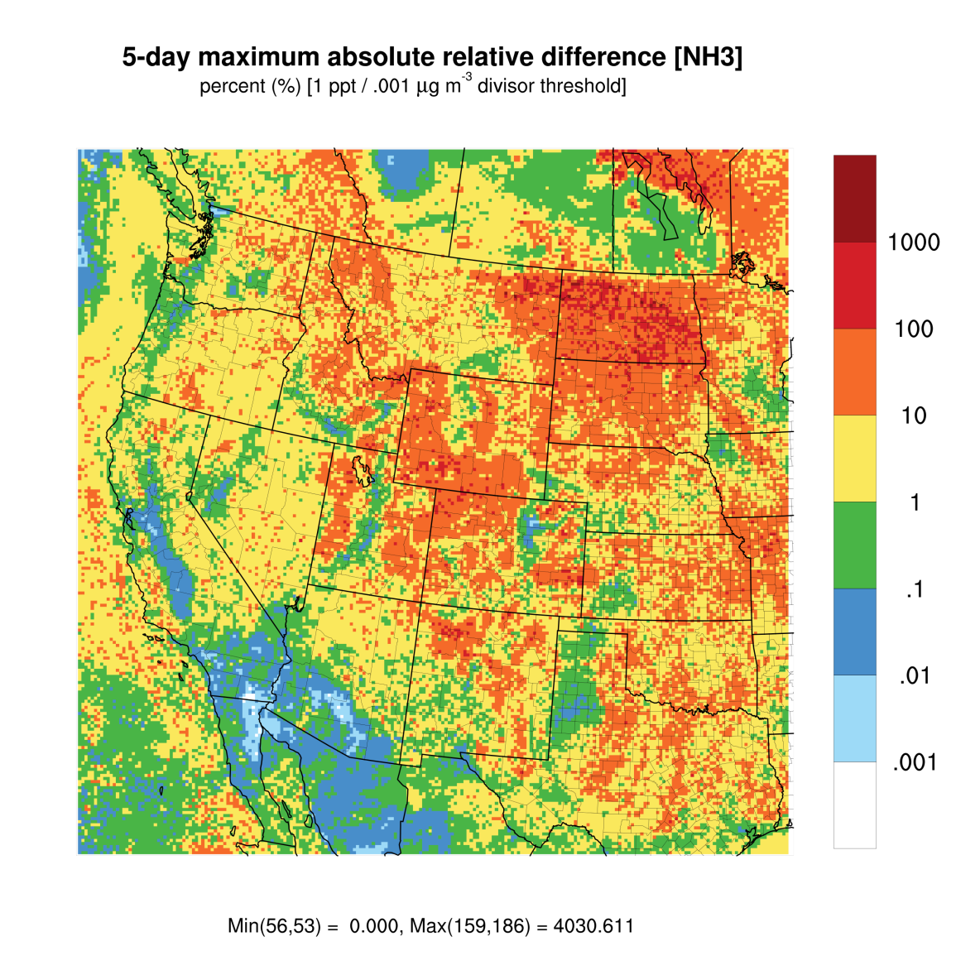
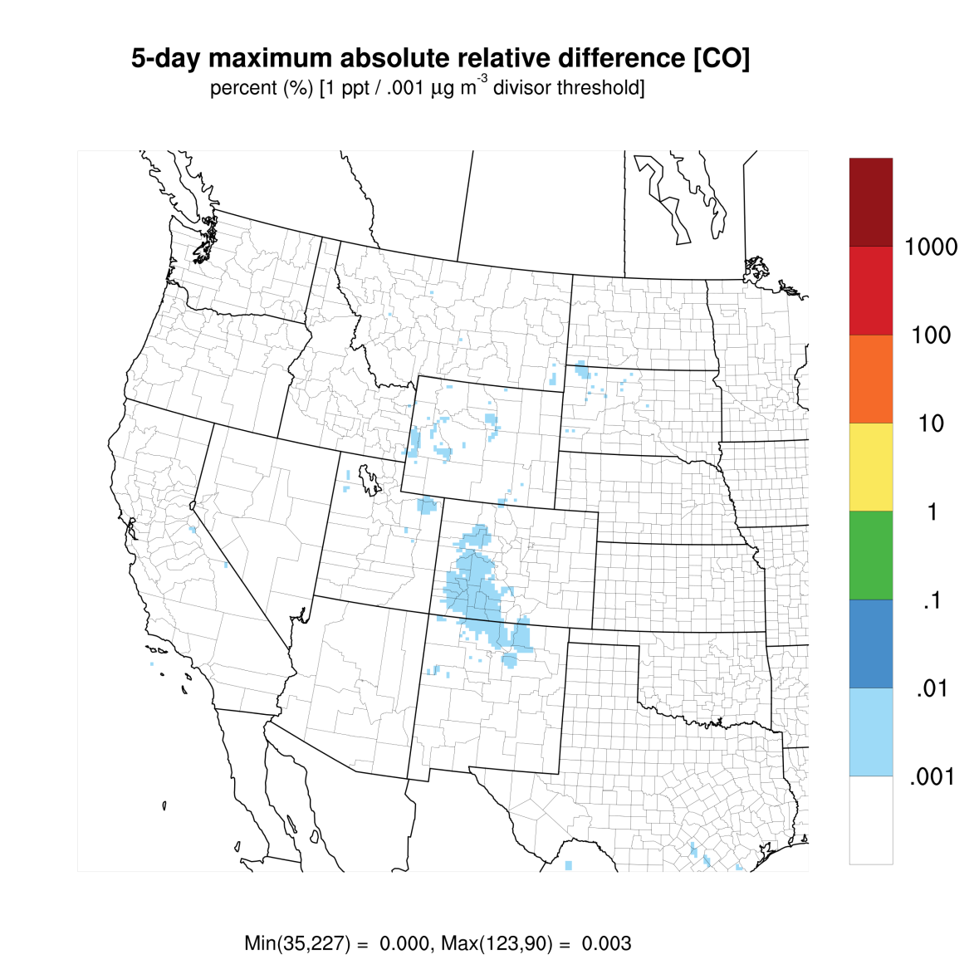
Concentrations [NH₃ and CO]

Slide 8
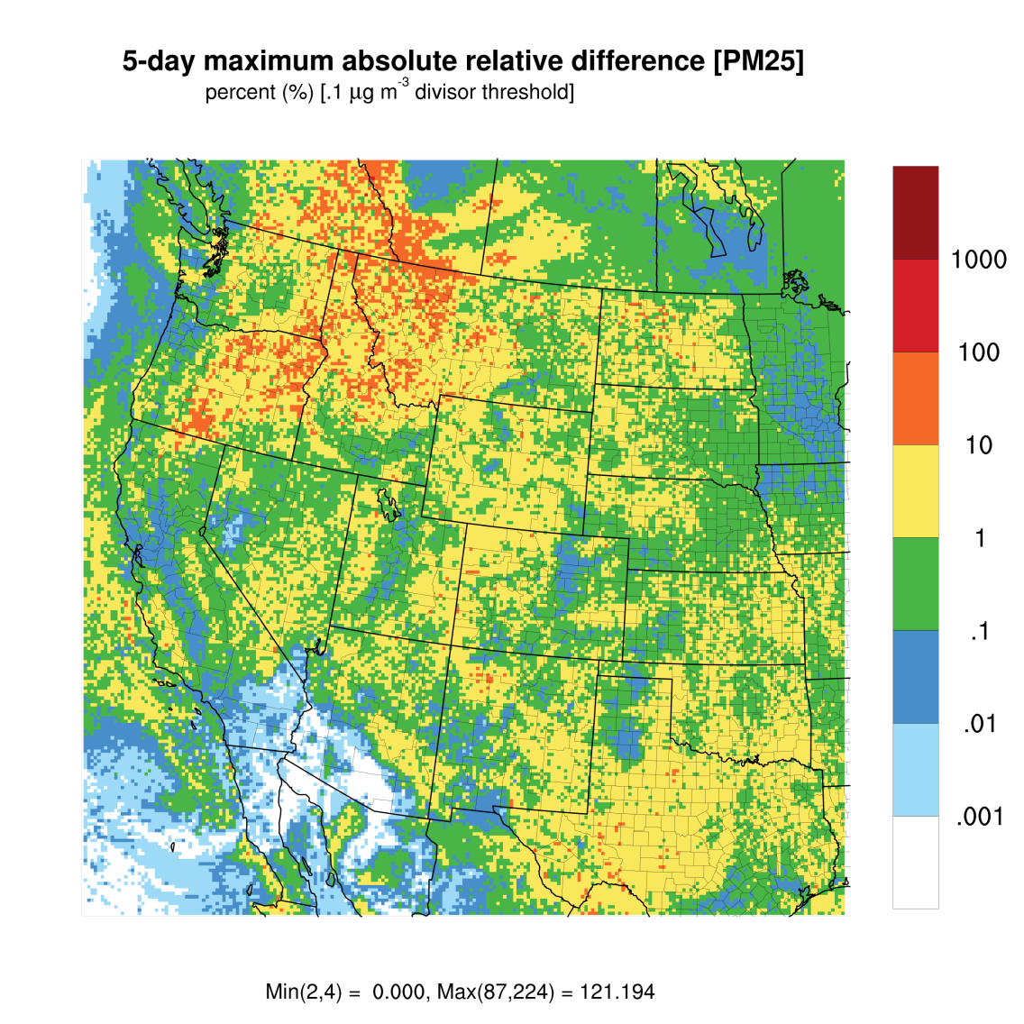
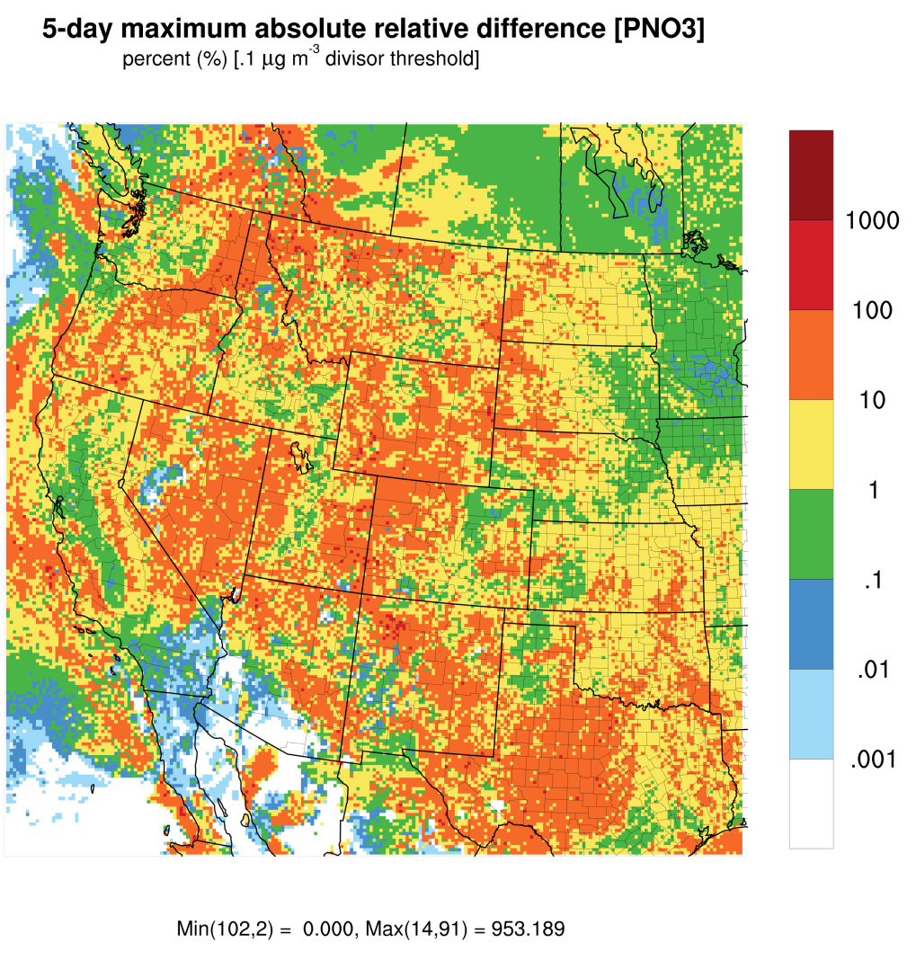
Concentrations [PM2.5 and PNO3]
Note: concentrations below .1 ug m⁻³ are not included in calculations

Slide 9
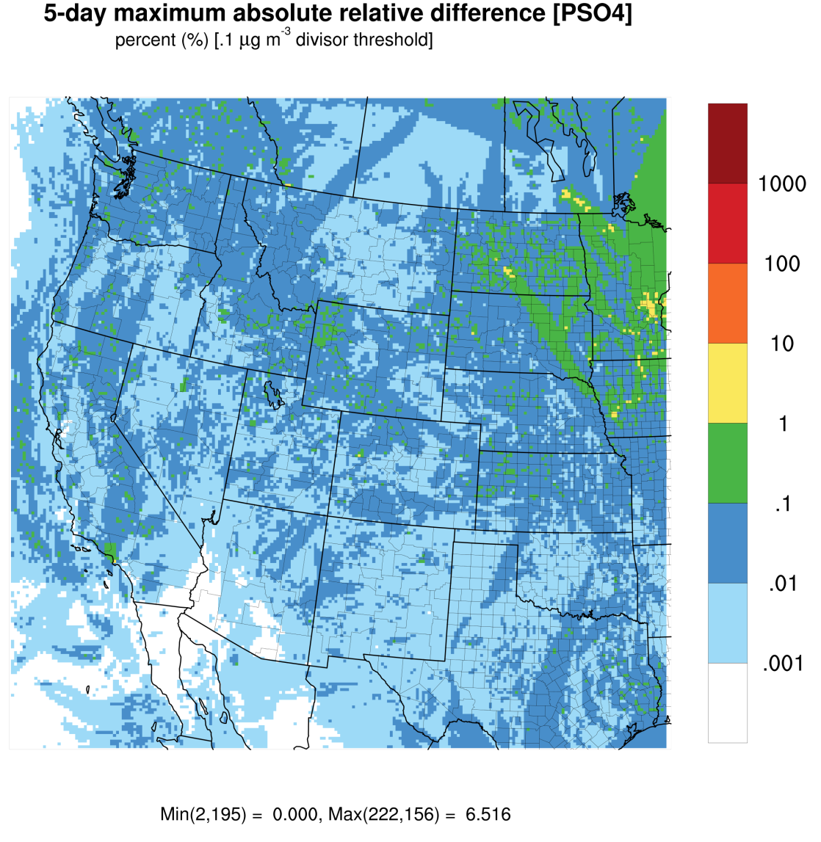
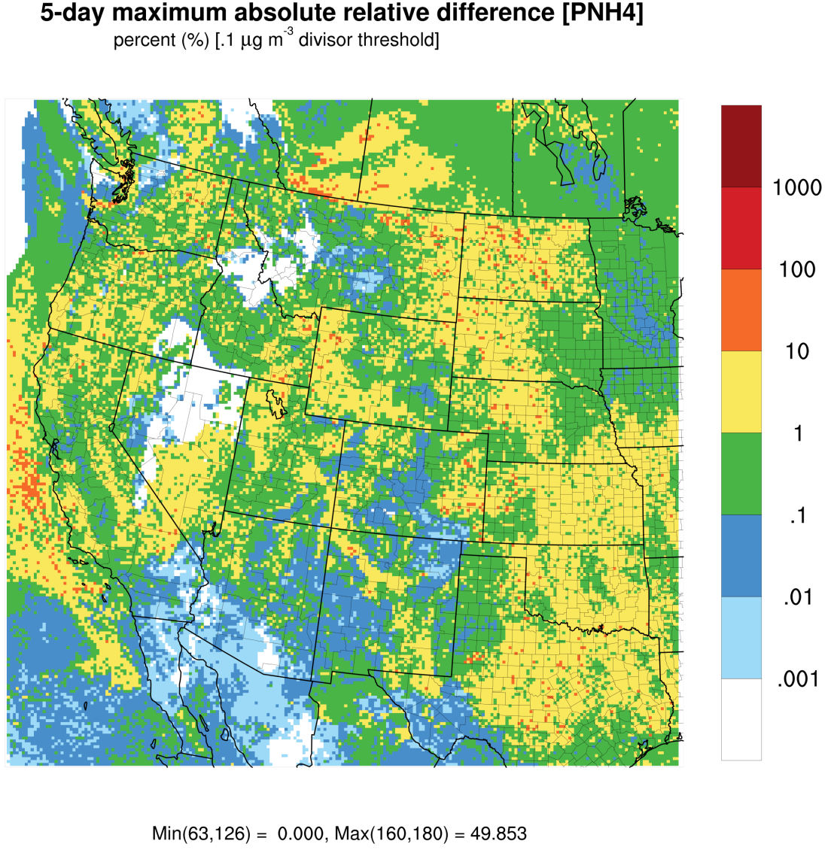
Concentrations [PSO4 and PNH4]

Slide 10
Conclusions
In some cases, maximum absolute relative differences between model runs over the 5-day period are much larger than the expected 1%. Largest errors are for SO₂, NH₃, and aerosol species.
O₃, NO_{X}, and CO differences are generally < 1%, as expected.

