Slide 1
Three-State Air Quality Study (3SAQS) Three-State Data Warehouse (3SDW)
3SAQS/3SDW Progress Review
to the 3SAQS Technical Committee
University of North Carolina (UNC-IE)
Cooperative Institute for Research in the Atmosphere (CIRA)
ENVIRON International Corporation (ENVIRON)
May 6, 2014

Slide 2
Outline
3SAQS 2008 Modeling Protocol
3SAQS 2011 Modeling Protocol
3SAQS Methane Inventory Memo
2008-2011-2020 Inventory Comparison
Status Reports
2008 3SAQS CAMx MPE (3SAQS_CAMx_Base08a)
2011 3SAQS WRF MPE (3SAQS_WRF_Base11a)
2011 3SAQS CAMx Base Simulation (3SAQS_CAMx_Base11a)
2020 3SAQS EI and Modeling

Slide 3
3SAQS 2008 Modeling Protocol
Release date: 1/21/2014
Comments received: 3/5/2014
Response to comments: 4/4/2014
Based on the WestJumpAQMS protocol
Highlights
Updates to onroad mobile emissions and other ancillary emissions data
CAMxv5.41 with CB05
No 4-km modeling domain
No CMAQ modeling
Model performance evaluation to focus on CO/UT/WY
2020 future year from NEI2008v2

Slide 4
3SAQS 2008 Modeling Protocol
Response to comments
3SAQS 2008 modeling short shelf-life
No 4-km domain
Optimizing model for wintertime ozone is not an emphasis of the 2008 base simulation
CMAQ not being run for 2008 because we’re trying to expedite the transition to 2011
Model performance evaluation will bring in Upper Green River Basin Ozone Study data

Slide 5
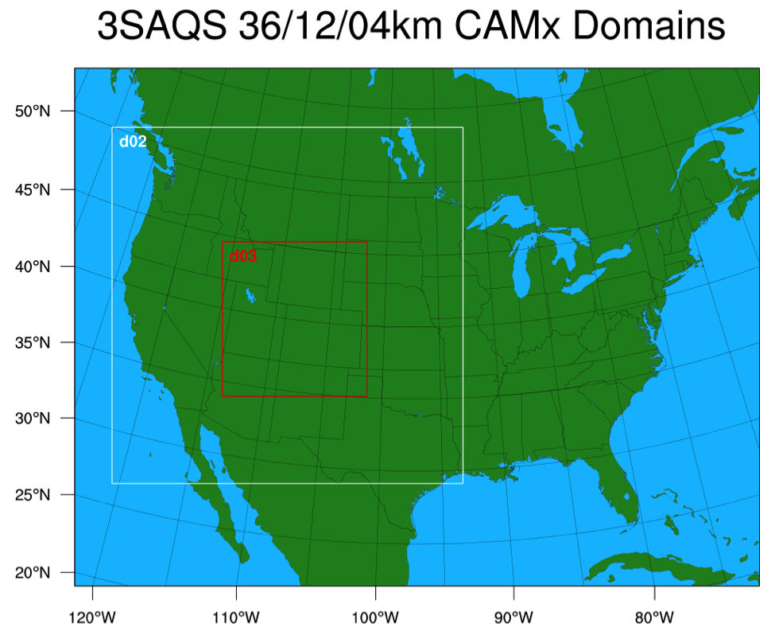
3SAQS 2011 Modeling Protocol
3SAQS_CAMx_Base11a
Release date: pending May 2014
Highlights and changes from 2008
36/12 & 4-km 3SAQS modeling domain
3SAQS 2011 WRF
NEI2011v1 (OAQPS 2011v6 Modeling Platform)
Same 2020 EI (NEI08v2-based) as 2008
CAMxv6.10 with CB6r2 (includes CH4)
Daily 6-hour MOZART BCs

Slide 6
3SAQS 2011 Modeling Protocol
Plans for version “B” (3SAQS_CTM_Base11b)
Targeted inventory and ancillary data improvements
Address performance issues found in 3SAQS_CAMx_Base11a
Include CMAQ
Source apportionment simulations
Possibly add a WRF/CTM configuration that optimizes winter ozone and ozone precursor performance

Slide 7
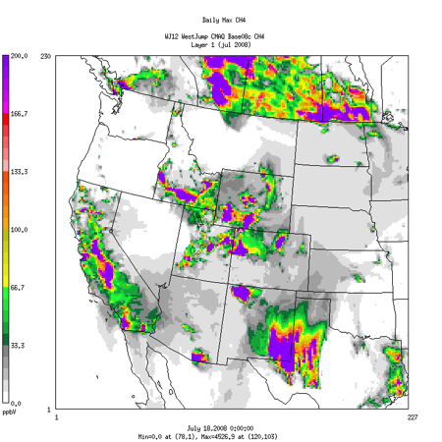
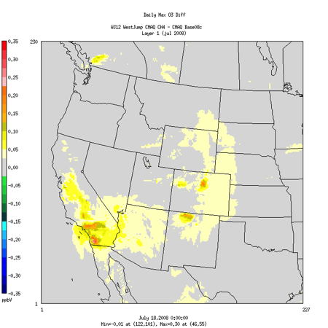
3SAQS Methane Inventory Memo
Why add methane emissions to the CTM?
Tracer for oil and gas sources (and livestock, municipal waste, waste water treatment, natural gas utility distribution systems…)
Ozone precursor
July 8, 2008 CMAQ
Daily Max CH4 (L)
Daily Max O3 Diff (R)
Max 0.3 ppb

Slide 8
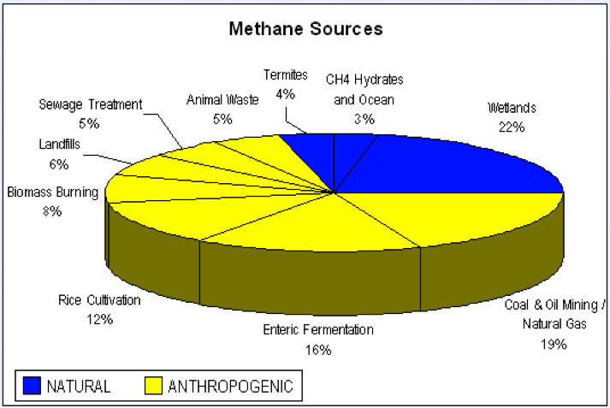
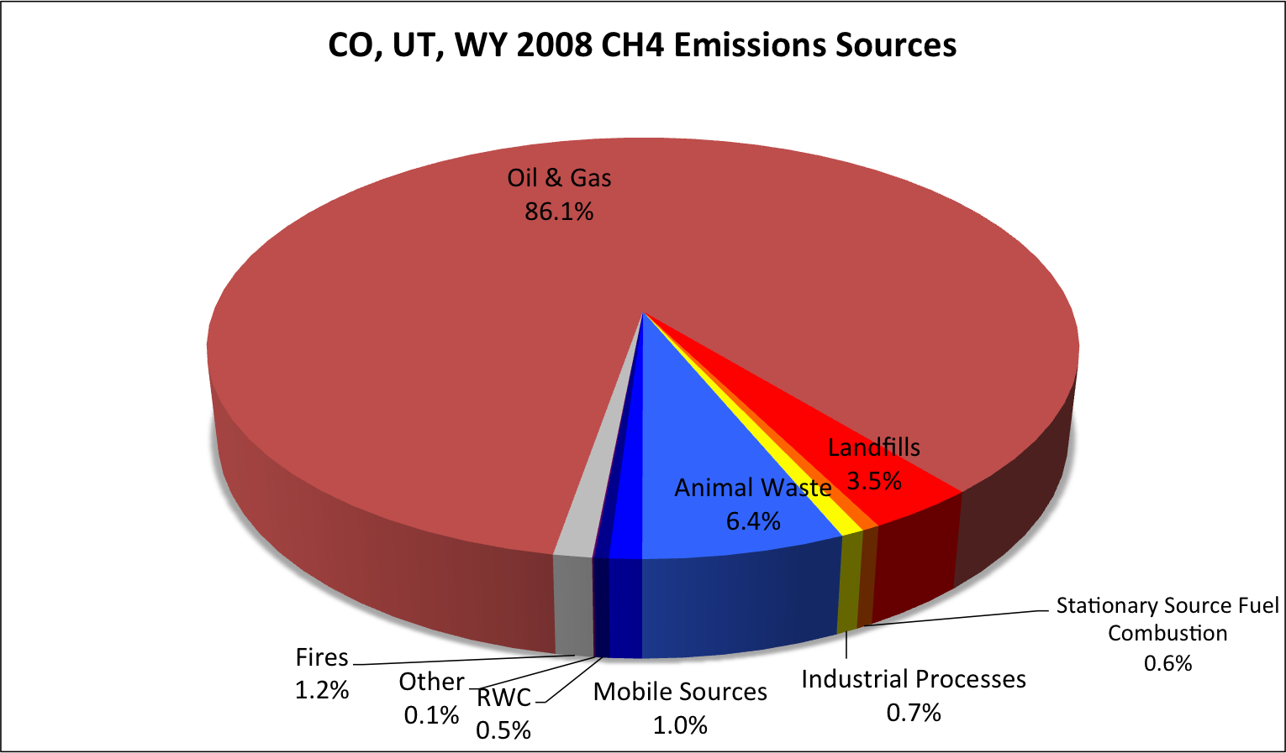
3SAQS Methane Inventory Memo
NASA GISS Global (L) vs 3-state (R) 2008 CH4 emissions sources
Key missing sources of CH4 in 3-state EI
Ag: Animal waste and enteric fermentation
Sewage treatment
Natural

Slide 9
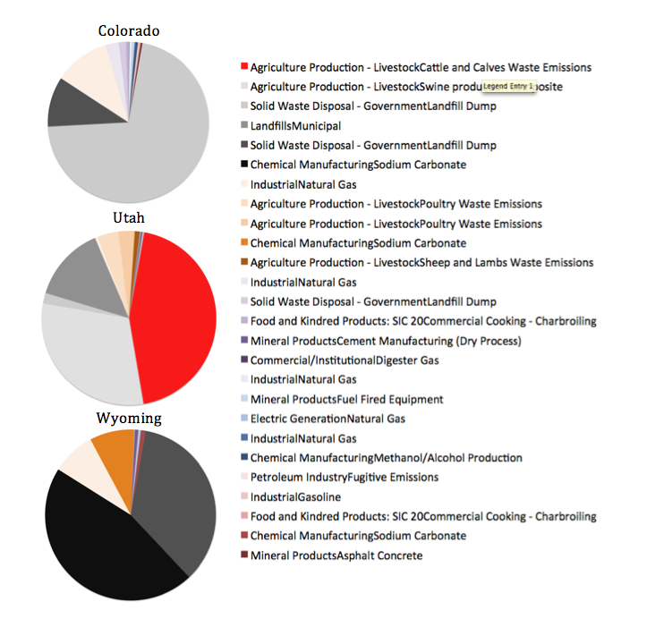
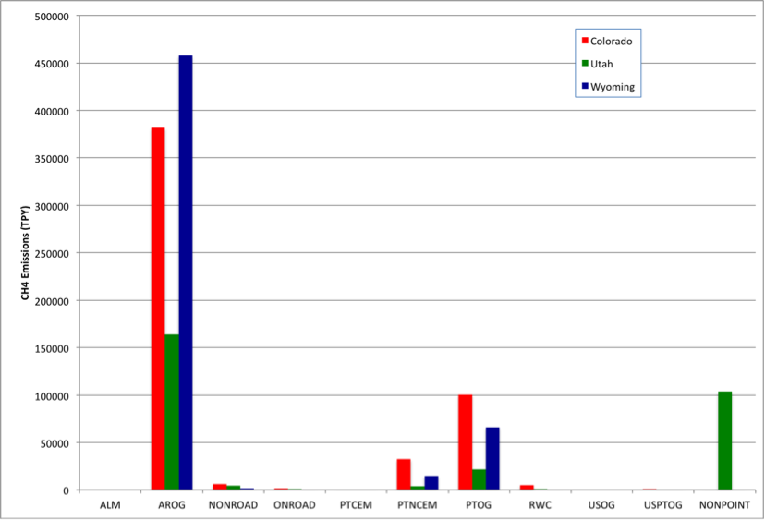
3SAQS Methane Inventory Memo

Slide 10
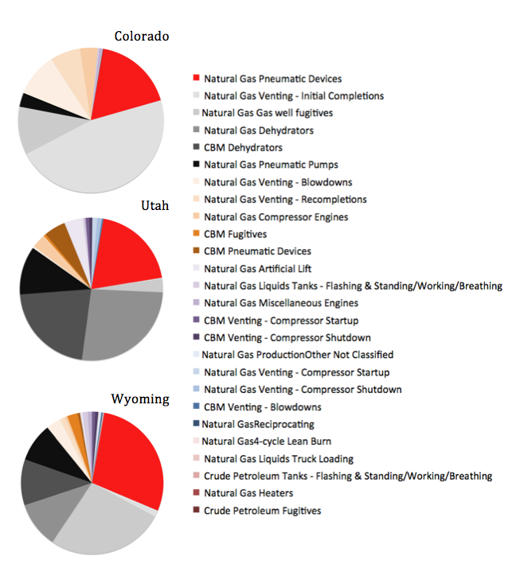
3SAQS Methane Inventory Memo

Slide 11
3SAQS Methane Inventory Memo
3-state CH4 Inventory Needs
Livestock waste: county-level TOG EI (could be scaled from NH3 EI)
Enteric fermentation: not waste-related, need to start from the bottom up
Wastewater treatment: speciation profile update → convert 70% unknown TOG mass to CH4
Oil and gas: review the current CH4 source distribution and flag/correct inconsistencies or omissions
Effort Should be Based on Intent: Why Model CH4?
If a tracer for oil and gas, shouldn’t we “turn-off” other sources?
If an ozone precursor, need a serious (and significant) effort at building a complete inventory for the 3-state (WRAP, US) region

Slide 12
3SAQS Methane Inventory Memo
Approach for 3SAQS 2011 version A modeling
Simulate all of the CH4 emissions sources that we have data for now: oil and gas, industrial sources, landfills, wastewater
No agricultural sources
Decision based on data availability
Looking for comments on this approach in the 2011 modeling protocol
Where to go from here…
Develop a comprehensive methane inventory?
Should be a national inventory, a three-state-only CH4 EI will miss the regional “background” ozone signal
Who can help with this/is already working on it? (EPA?)

Slide 13
2008-2011-2020 EI Comparison Memo
UNC is using the National Emission Inventory (NEI) to represent the non-oil & gas anthropogenic emissions for the 3SAQS
NEI release every 3-years based on state submitted data
EPA OAQPS compiles Emission Modeling Platforms (EMPs) to support rulemaking modeling; 3SAQS using 2008 and 2011-based EMPs
Changes made for 3SAQS to ancillary emissions data
Oil and gas inventories from West US modeling studies: WRAP, WestJumpAQMS, 3SAQS
Fires and natural emissions (biogenics, windblown dust, sea salt, and lightning) use data and methods developed or validated for the West U.S.

Slide 14
2008-2011-2020 EI Comparison Memo
Quantify and evaluate differences in the 3SAQS inventories
Inform CTM performance evaluation and comparisons
Validate/QA emissions
Memo Scope: Report what is changing, by how much, not why the changes
3SAQS Inventories
Sector | 2008 | 2011 | 2020
Non-oil & gas | NEI2007v5 & NEI2008v2 EMP | NEI2011v6 EMP | NEI2020re_v5_07c (2008-based) NEI2018ed_v6_11f (2011-base)
Oil & gas | WRAP P3 & NEI2008v2 | 3SAQS P1 | 3SAQS P1 projected to 2020
Fires | DEASCO3 | PMDETAIL | See base year
Biogenic | MEGANv2.10 | MEGANv2.10 | See base year

Slide 15
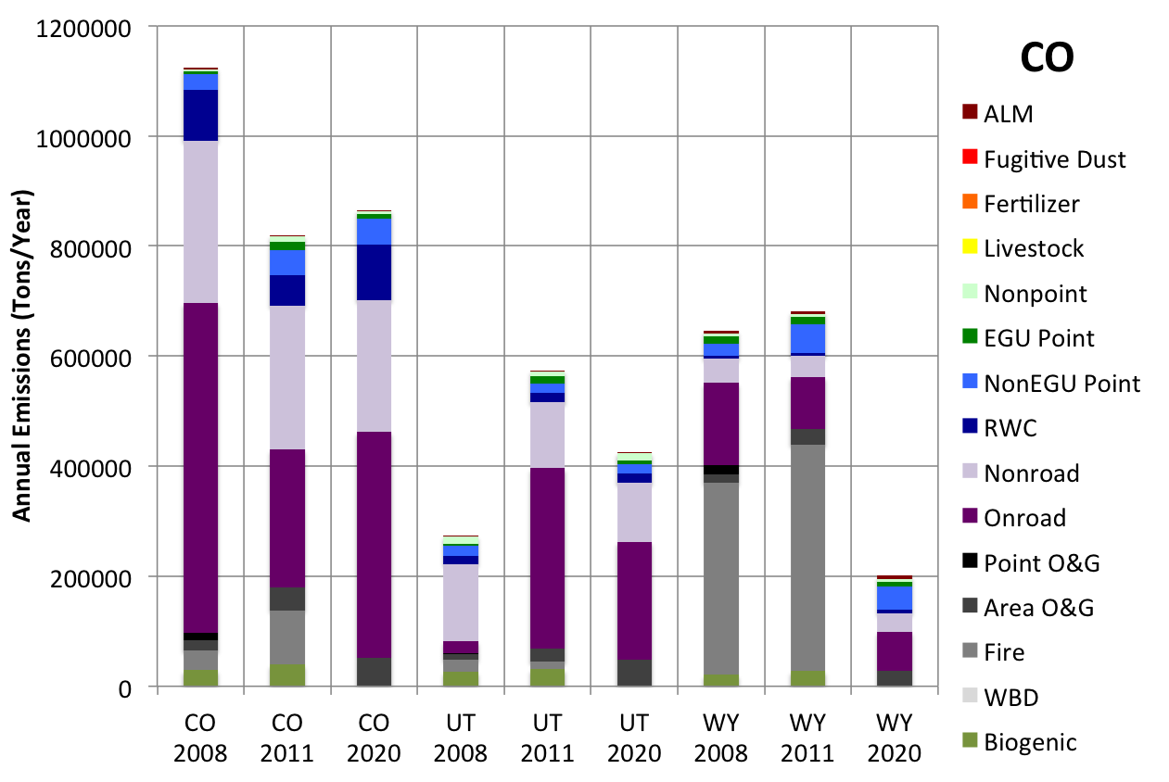
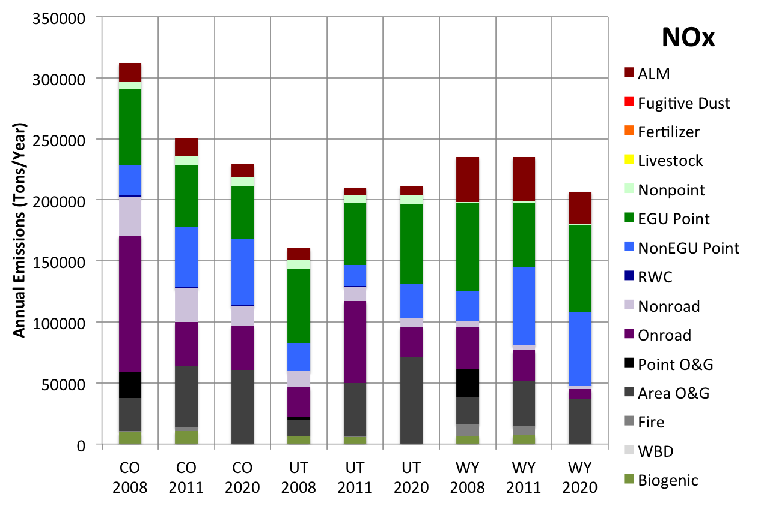
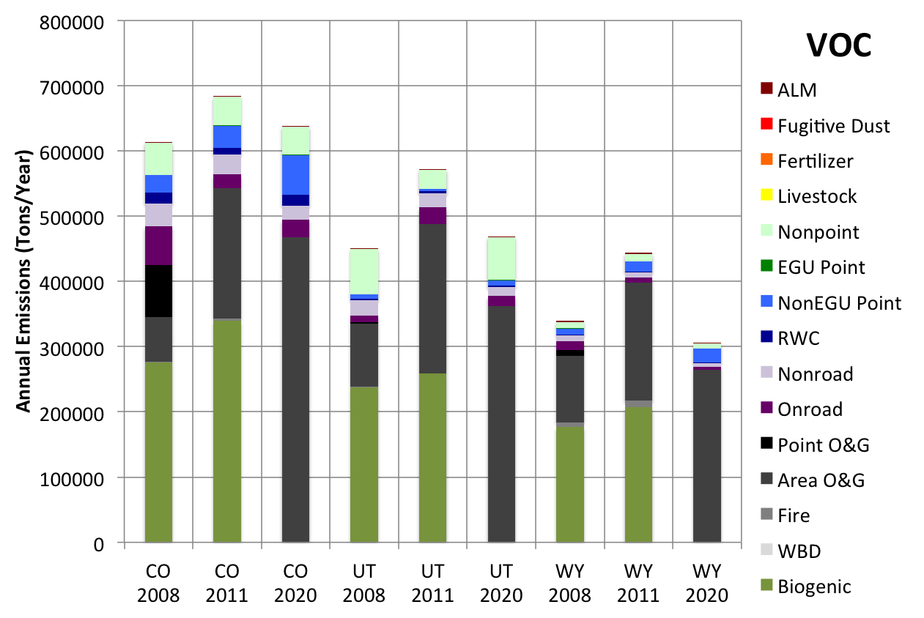
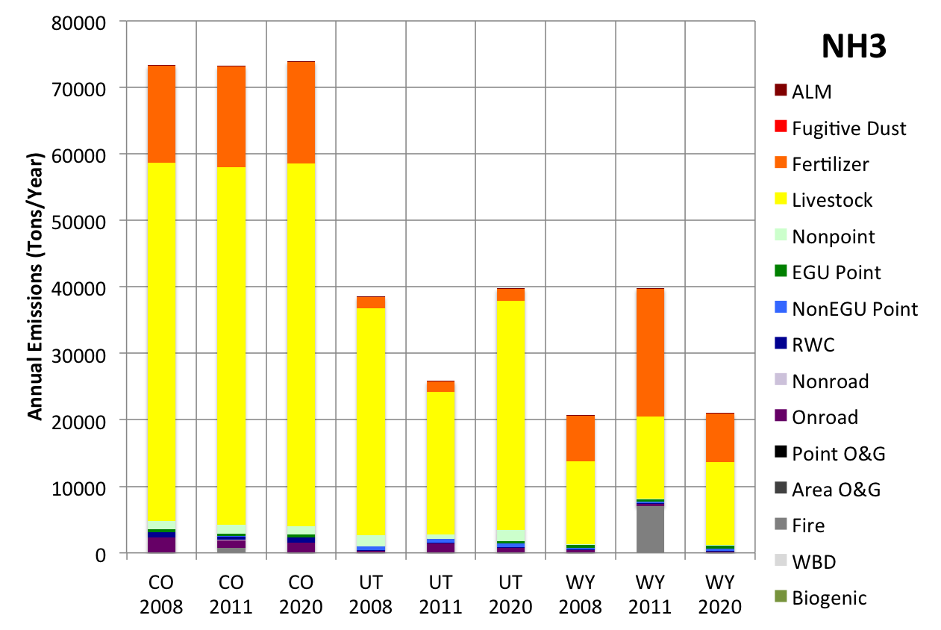
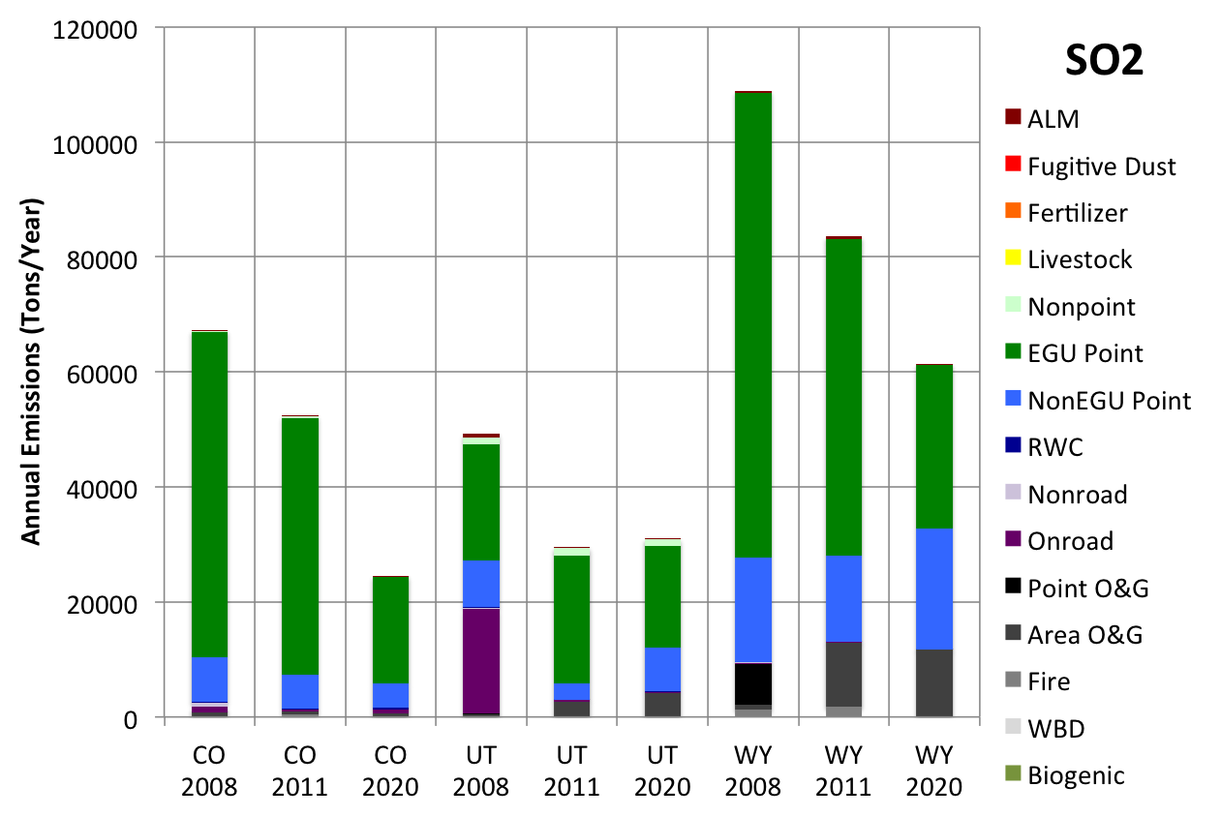
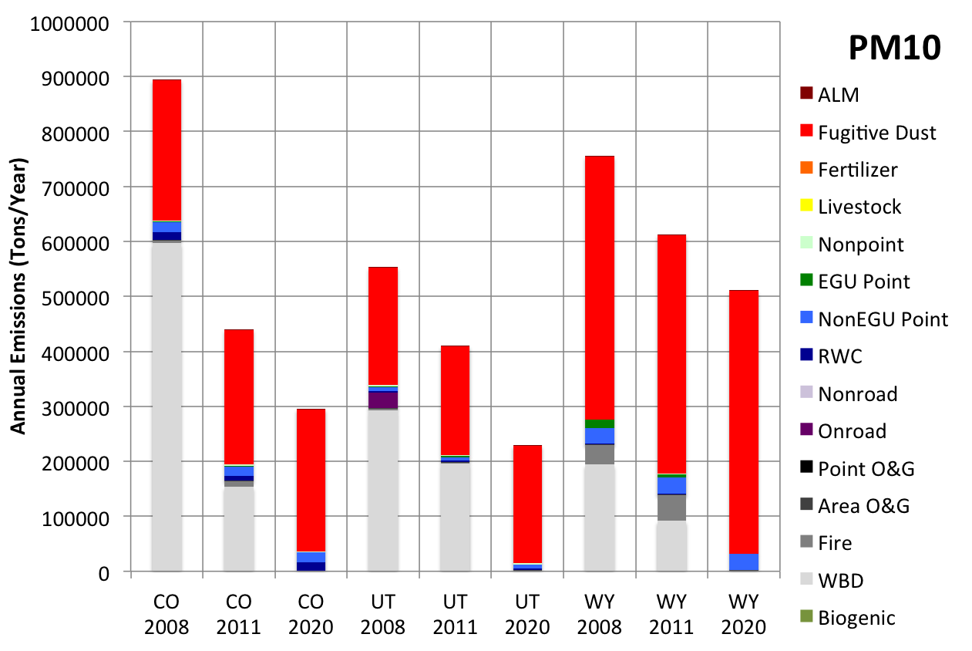
2008-2011-2020 EI Comparison Memo
Draft Results: DO NOT CITE

Slide 16
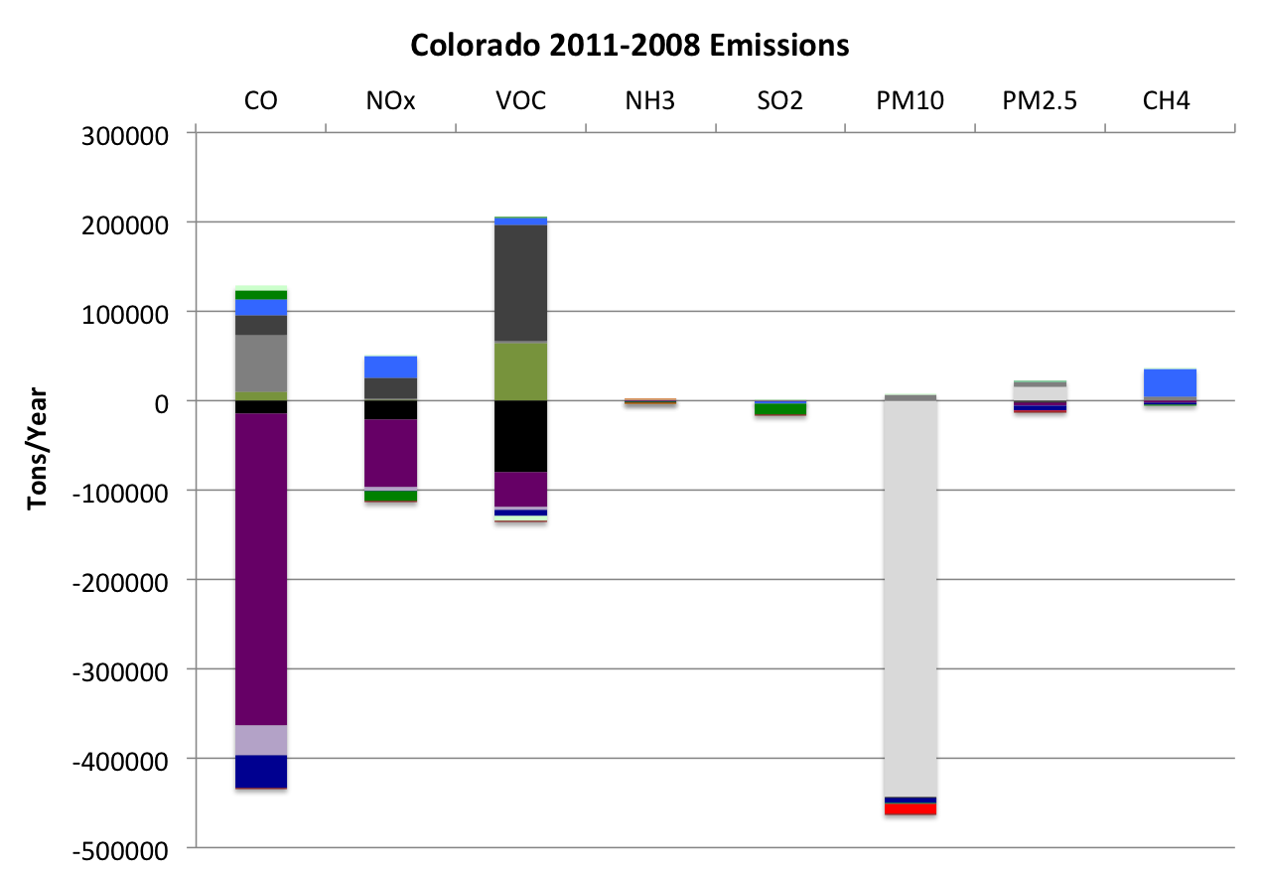
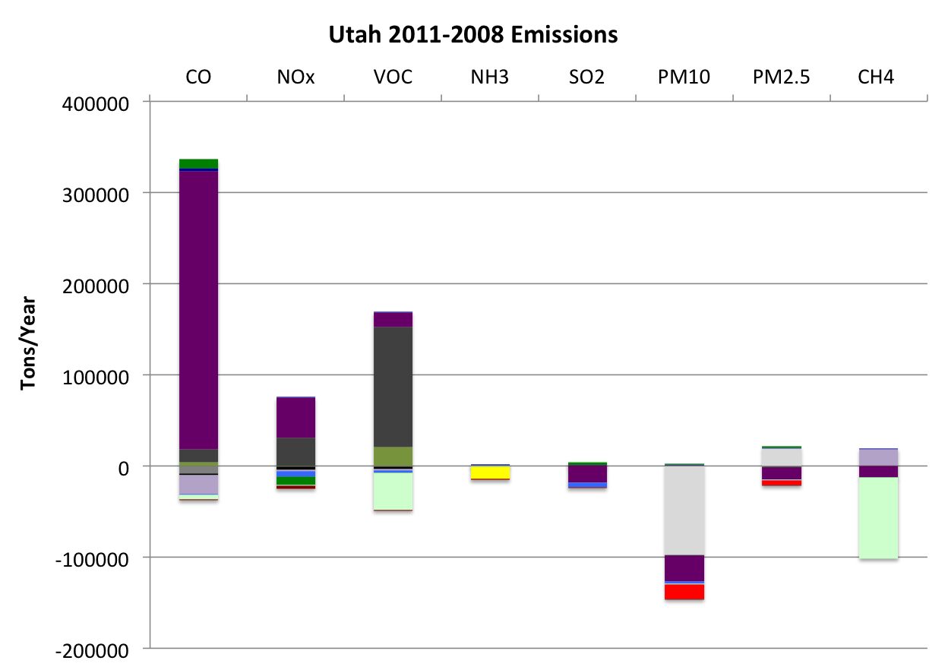
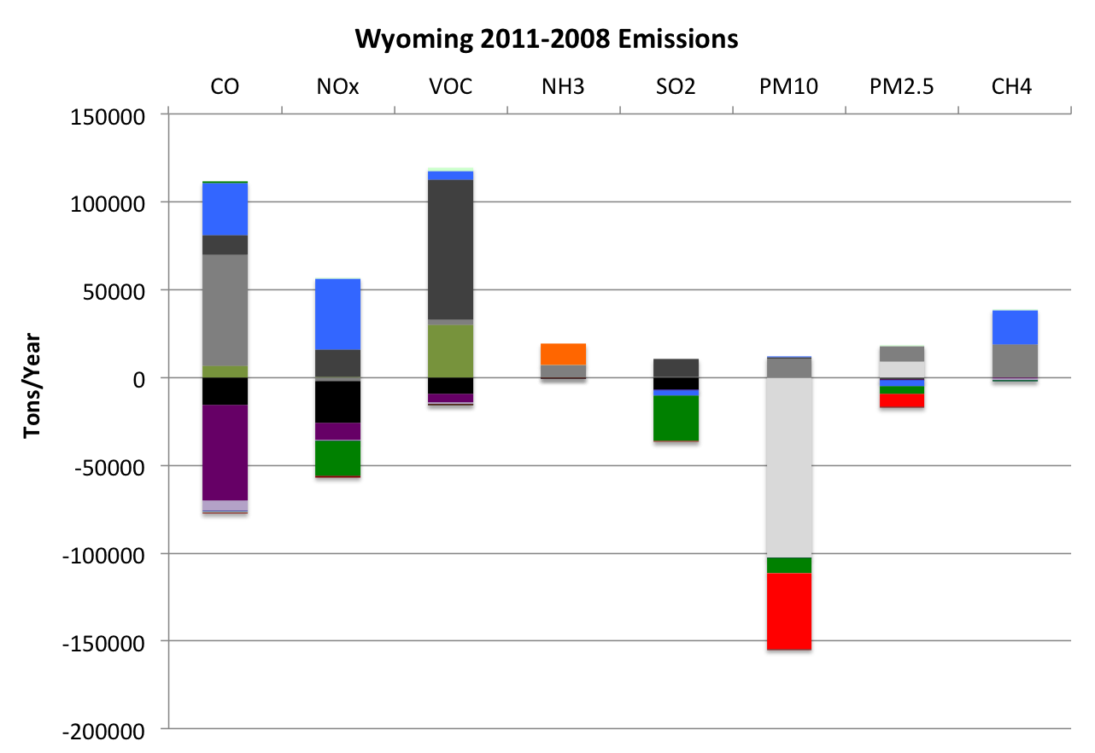
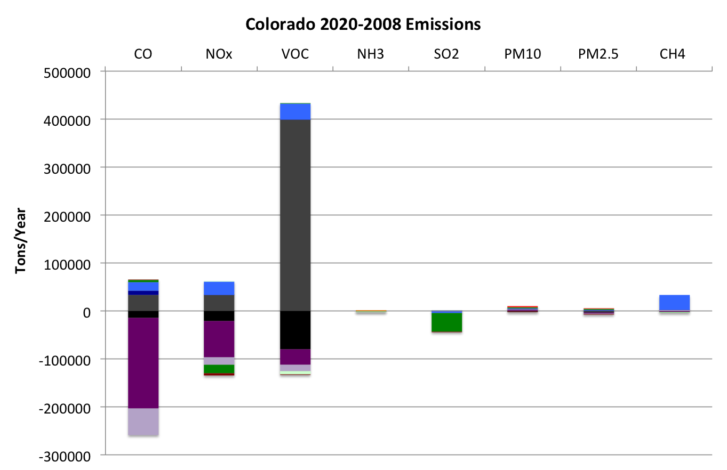
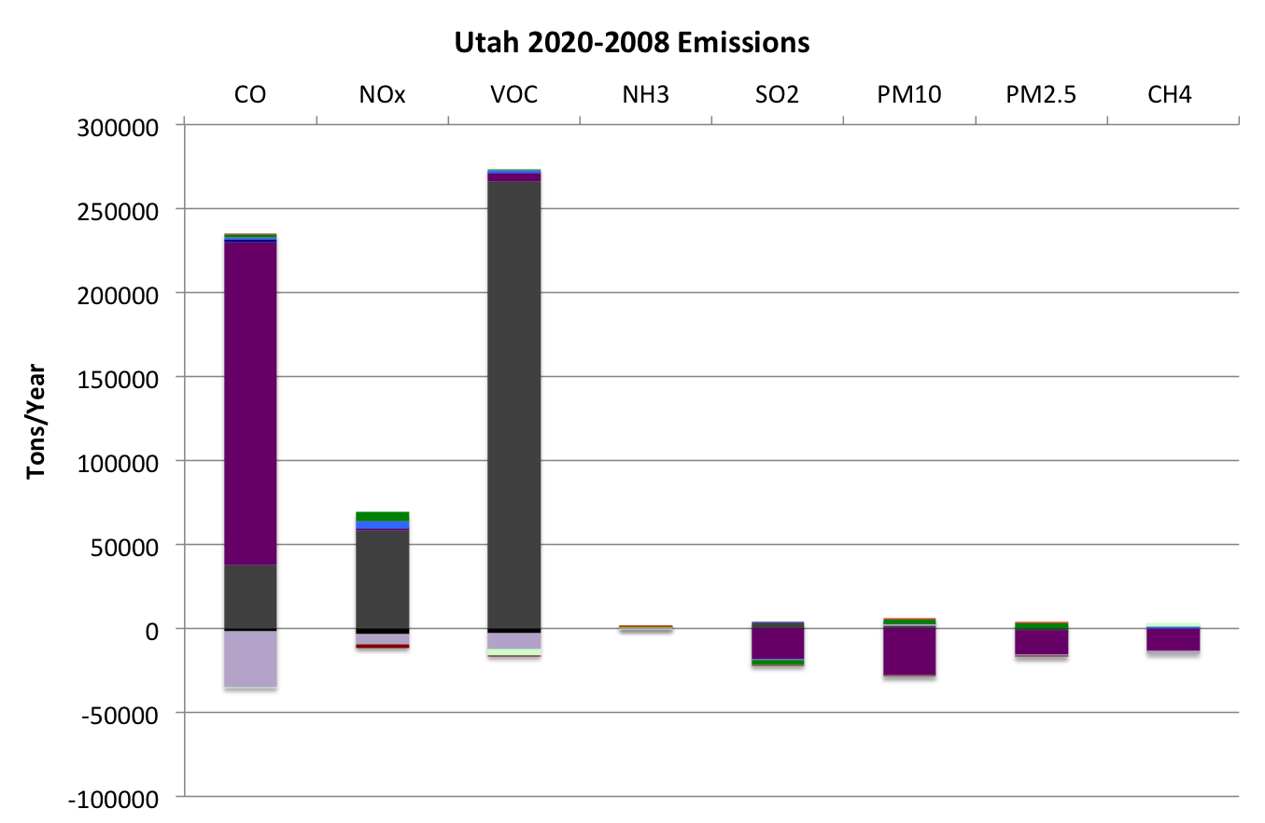
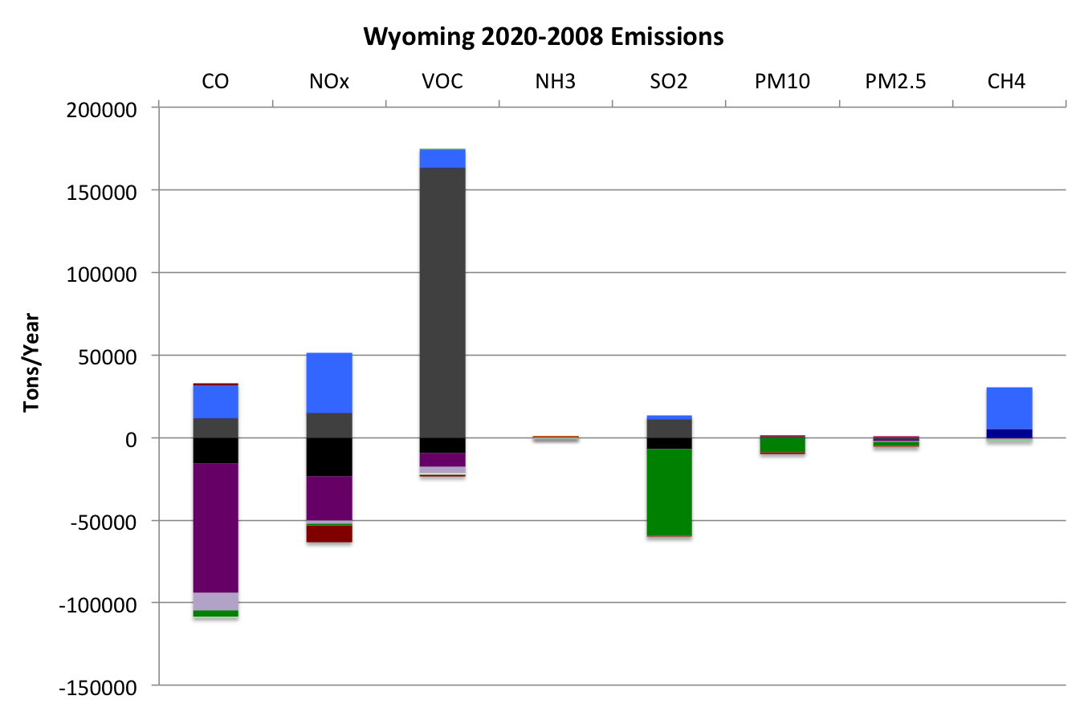
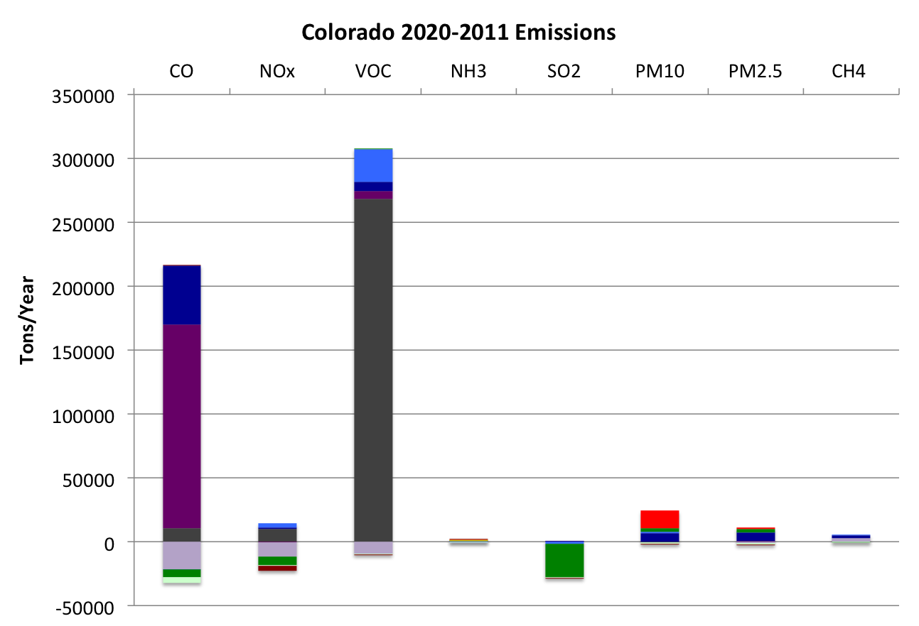
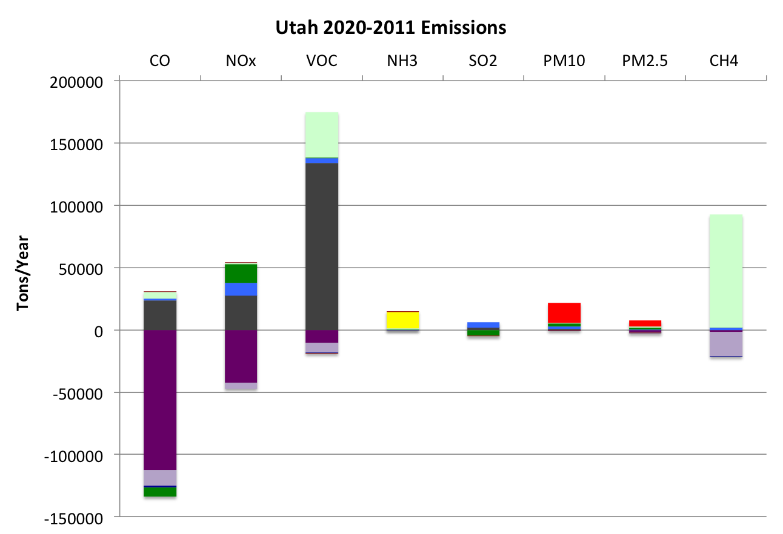
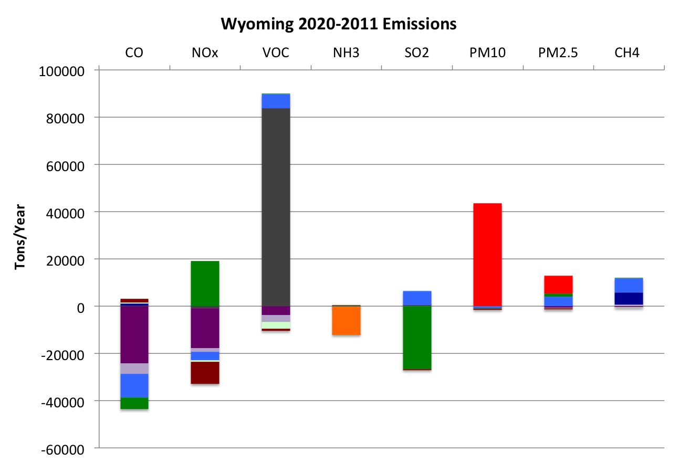
2008-2011-2020 EI Comparison Memo
CO UT WY
2011-2008
2020-2008
2020-2011
Draft Results: DO NOT CITE

Slide 17
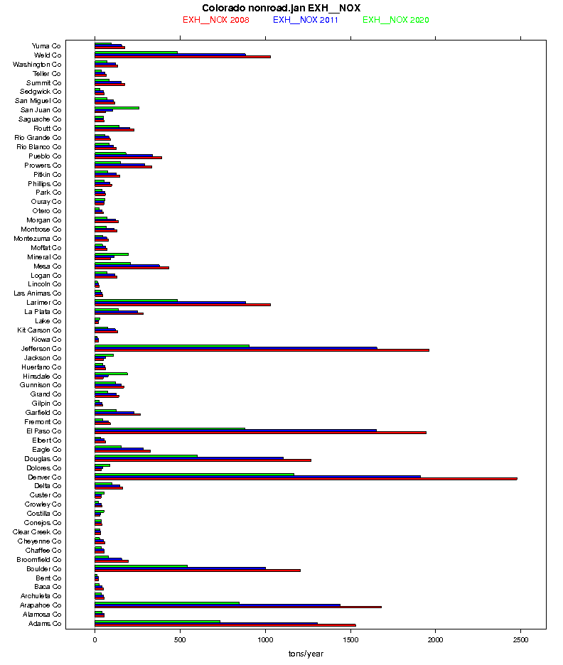
2008-2011-2020 EI Comparison Memo
Memo will show state, county, and some SCC-level comparisons
Accompanying spreadsheet and 3SDW Emission Review Tool will support targeted analysis of inventories
Separate O&G analysis spreadsheets will provide additional source and basin-level details
Draft memo available: mid-May

Slide 18
Status Report: 2008 3SAQS CAMx Final Report
Release Schedule: late May
Simulation 3SAQS_CAMx_Base08a
Includes Model Performance Evaluation
Evaluation focusing on performance in the 3-state region
MPE plots available now on the 3SDW
Amend report with 2020 results when available

Slide 19
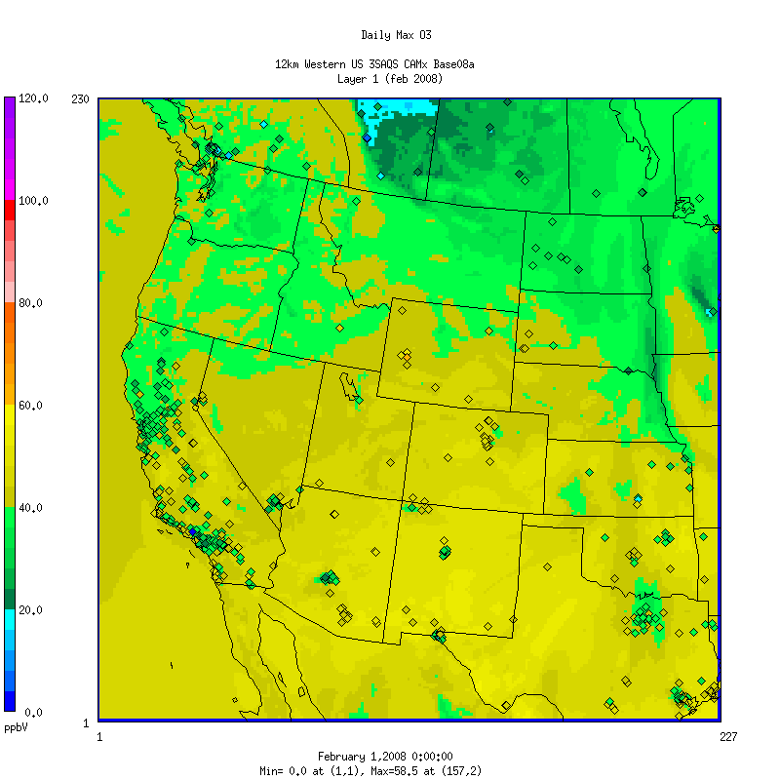
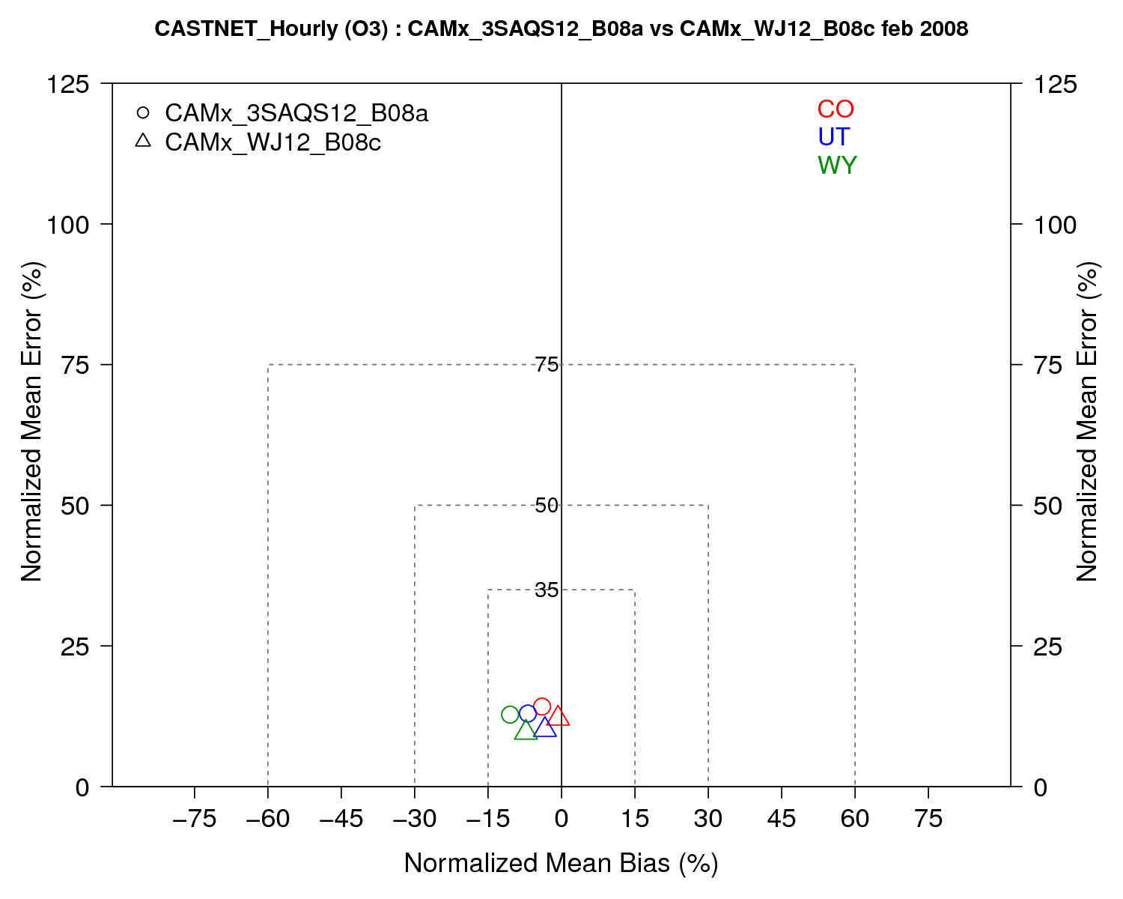
Status Report: 2008 3SAQS CAMx MPE

Slide 20
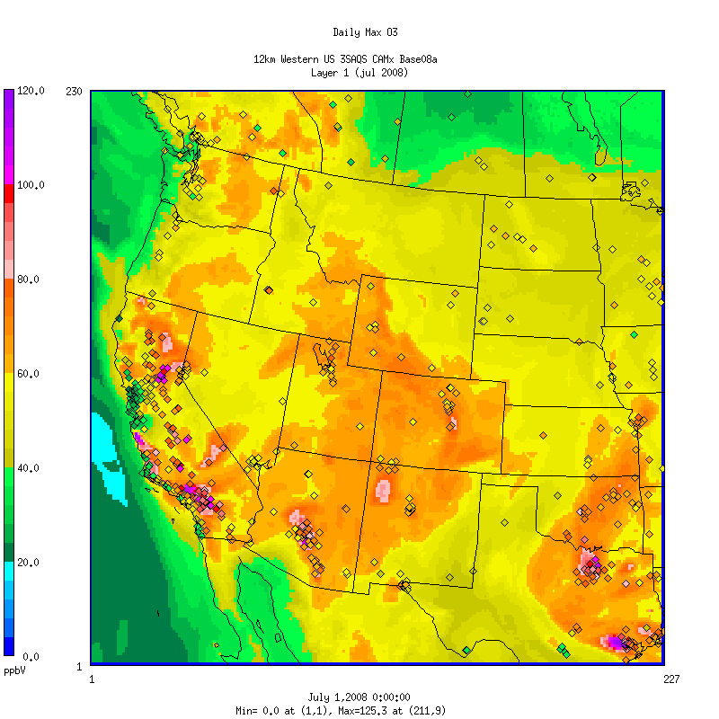
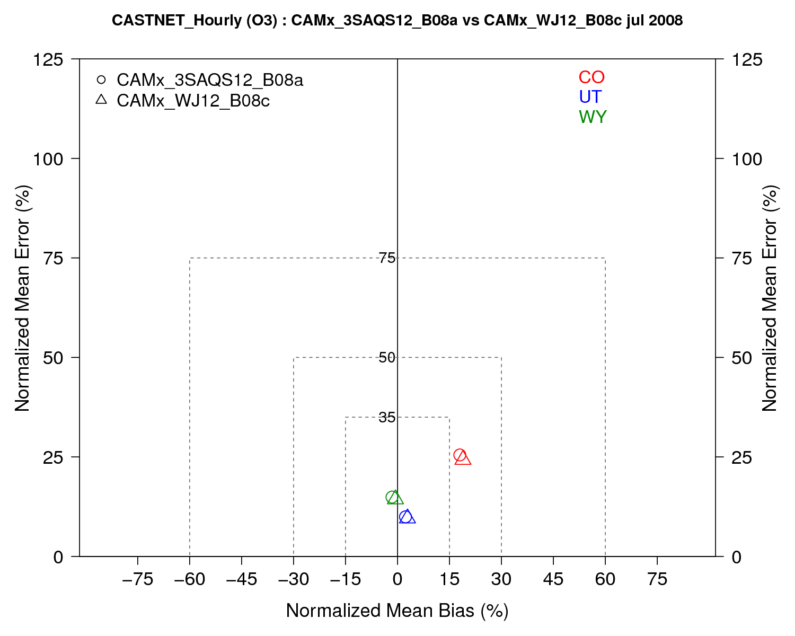
Status Report: 2008 3SAQS CAMx MPE

Slide 21
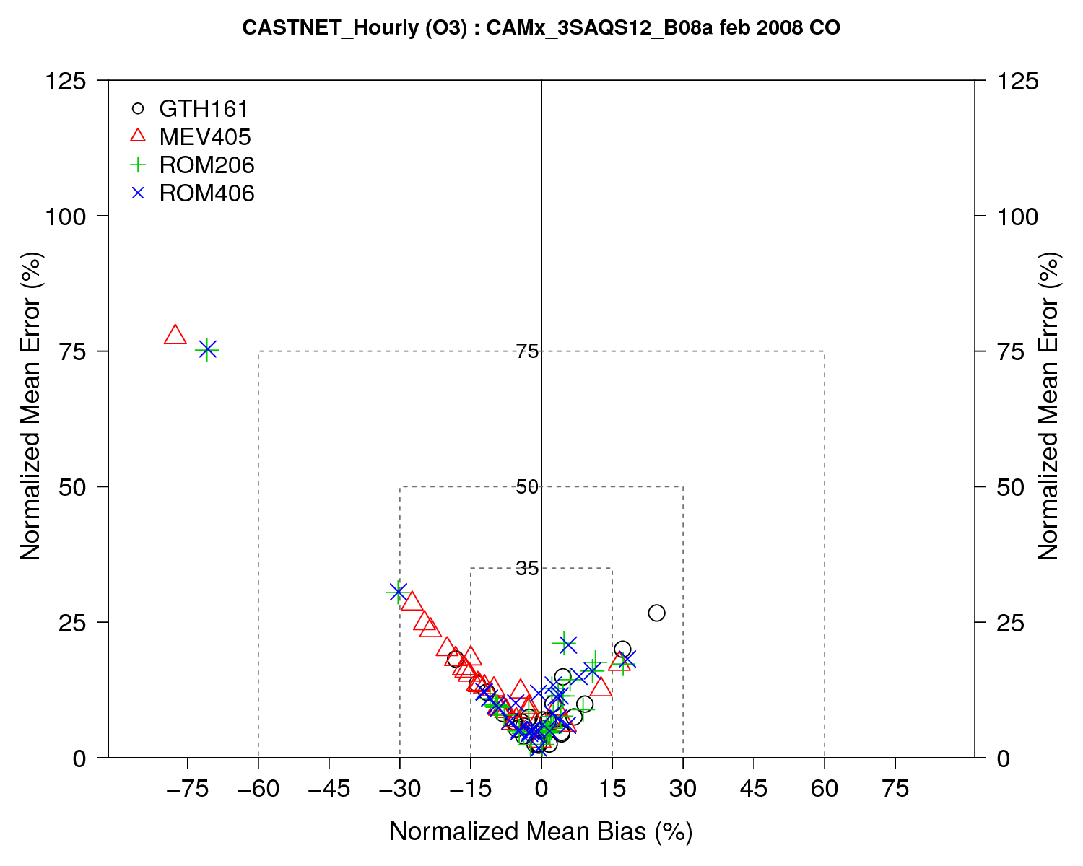
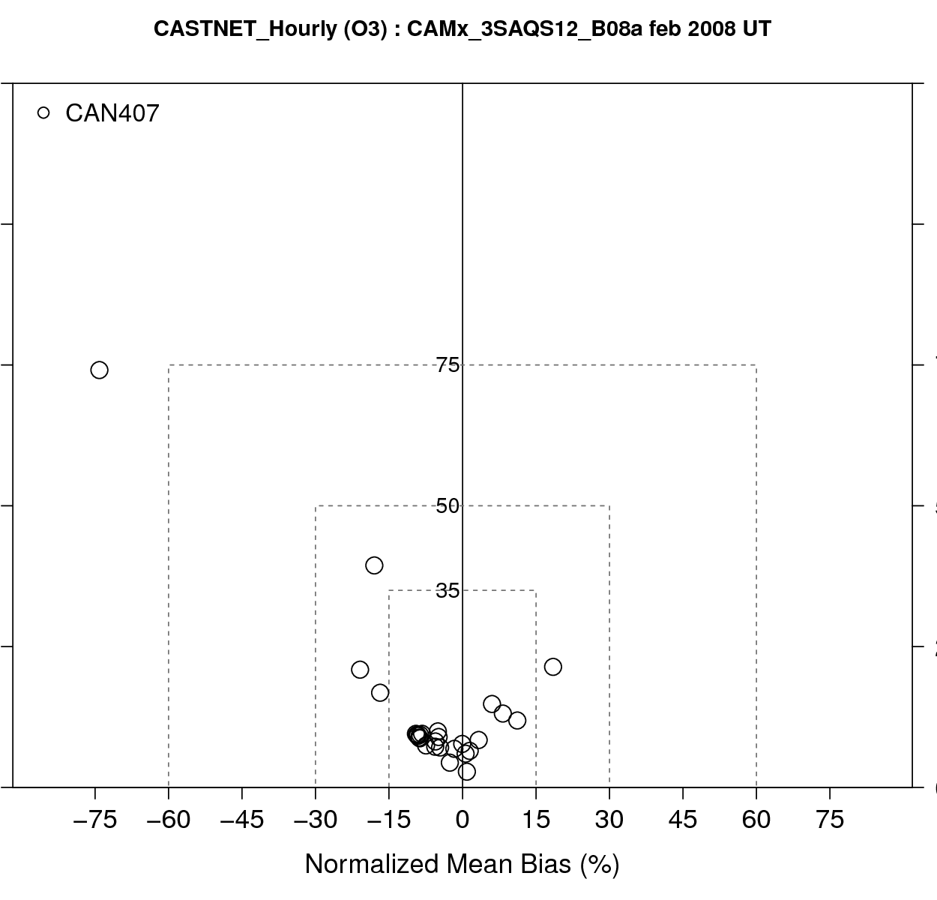
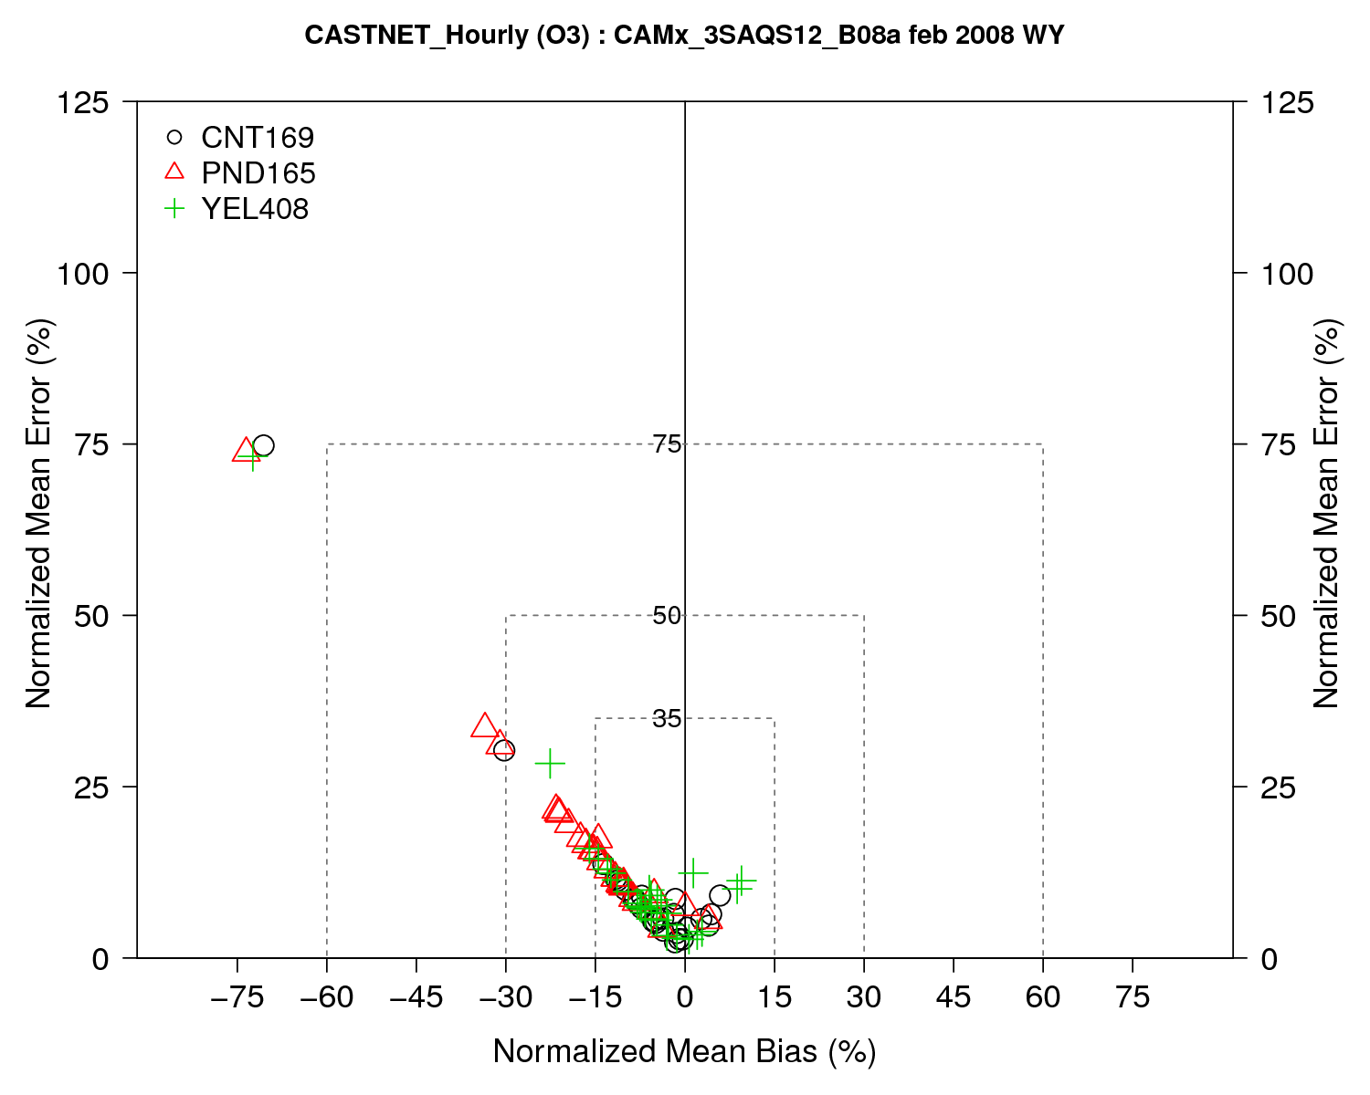
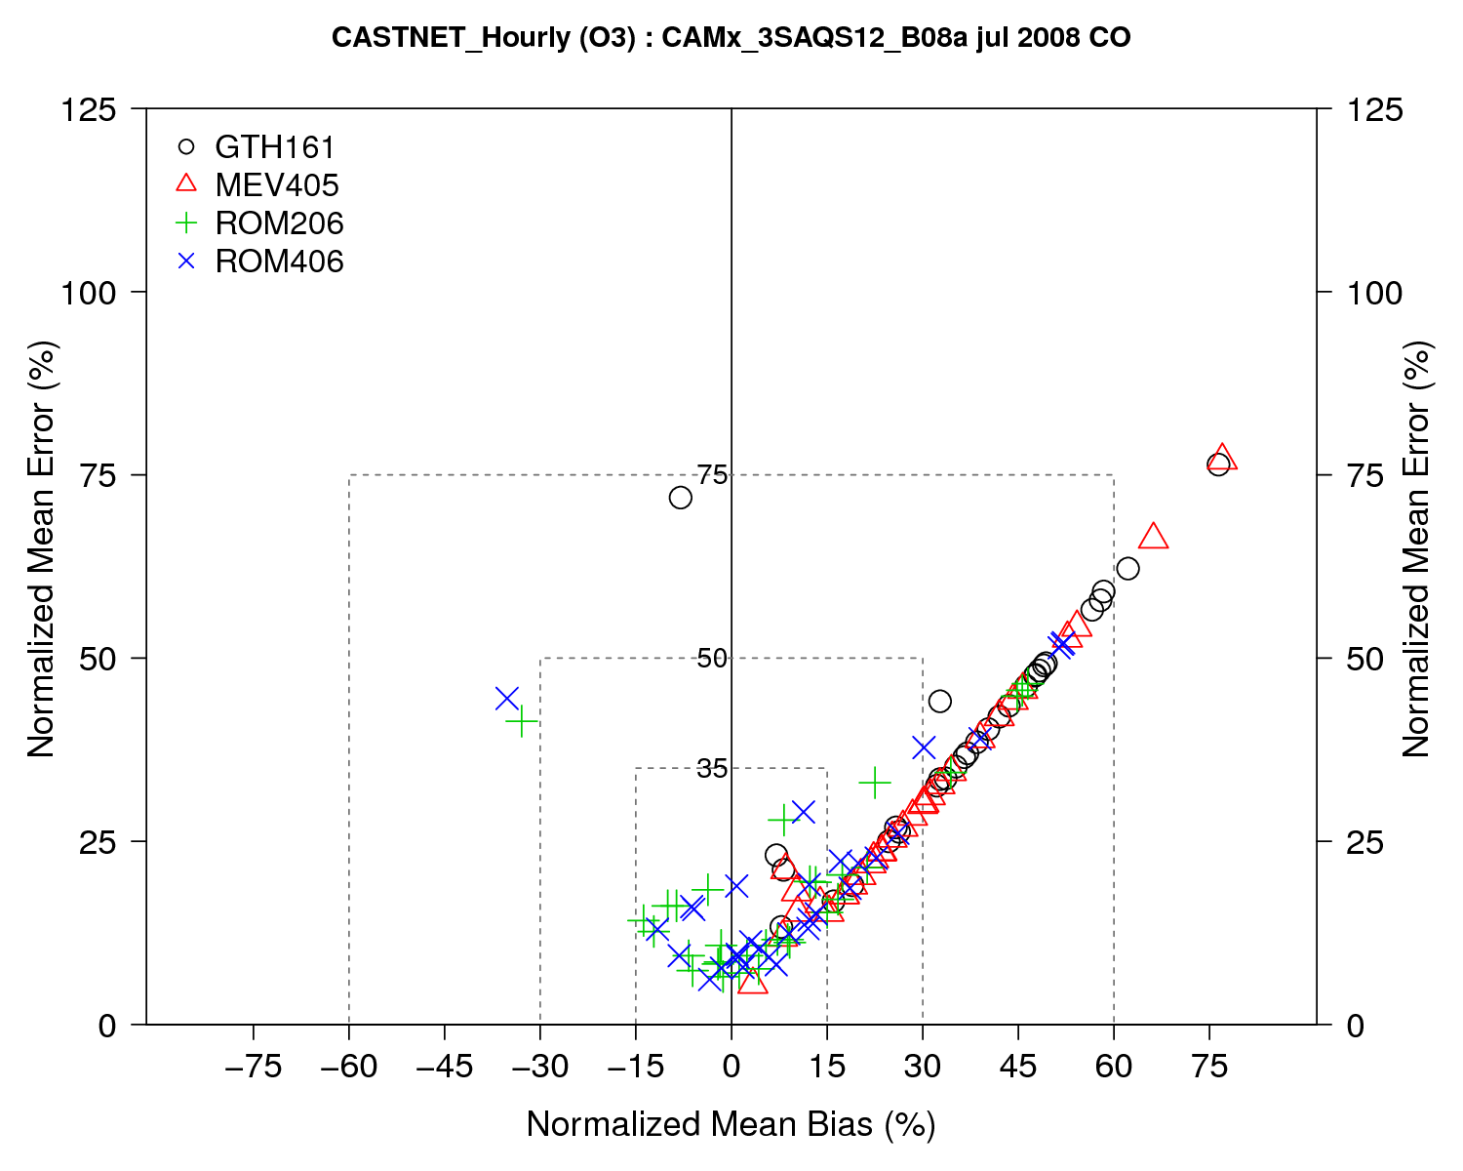
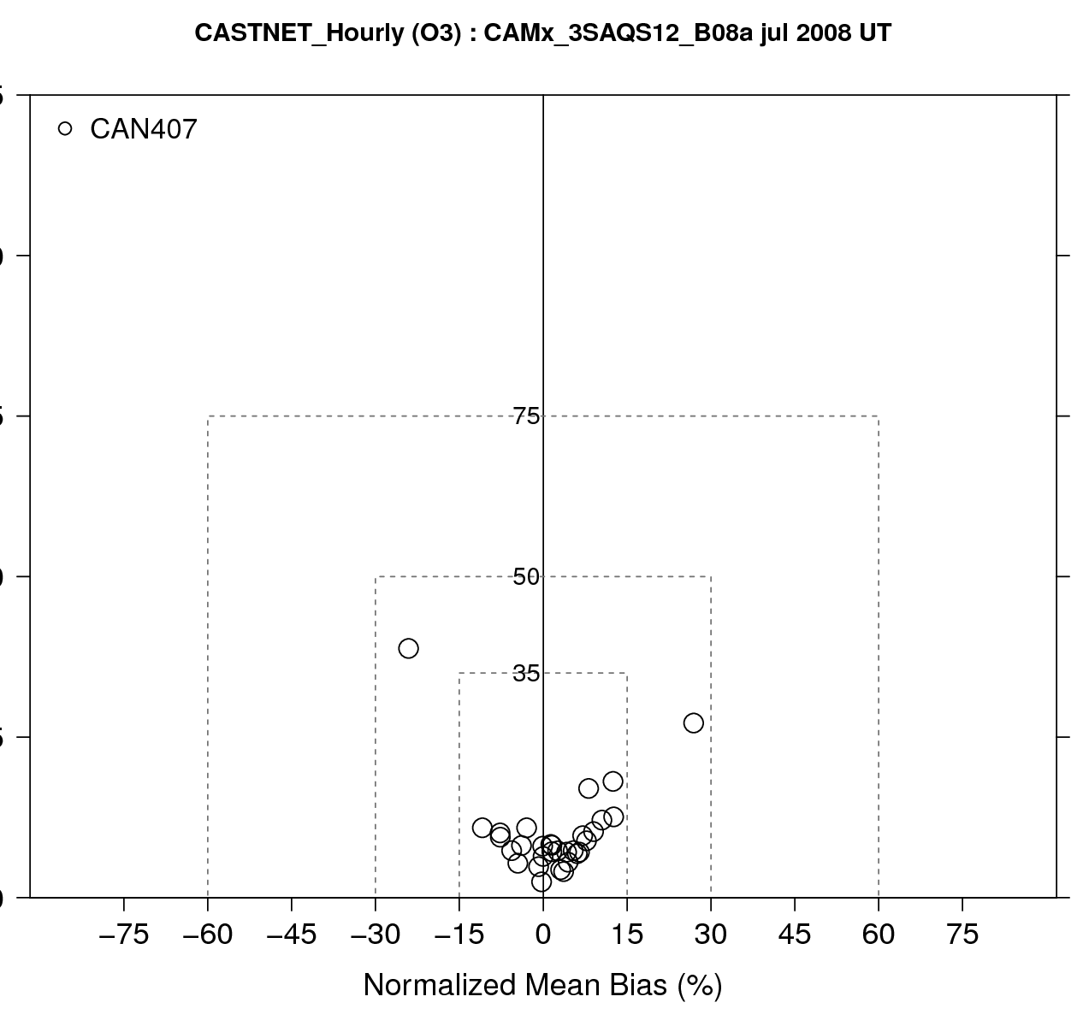
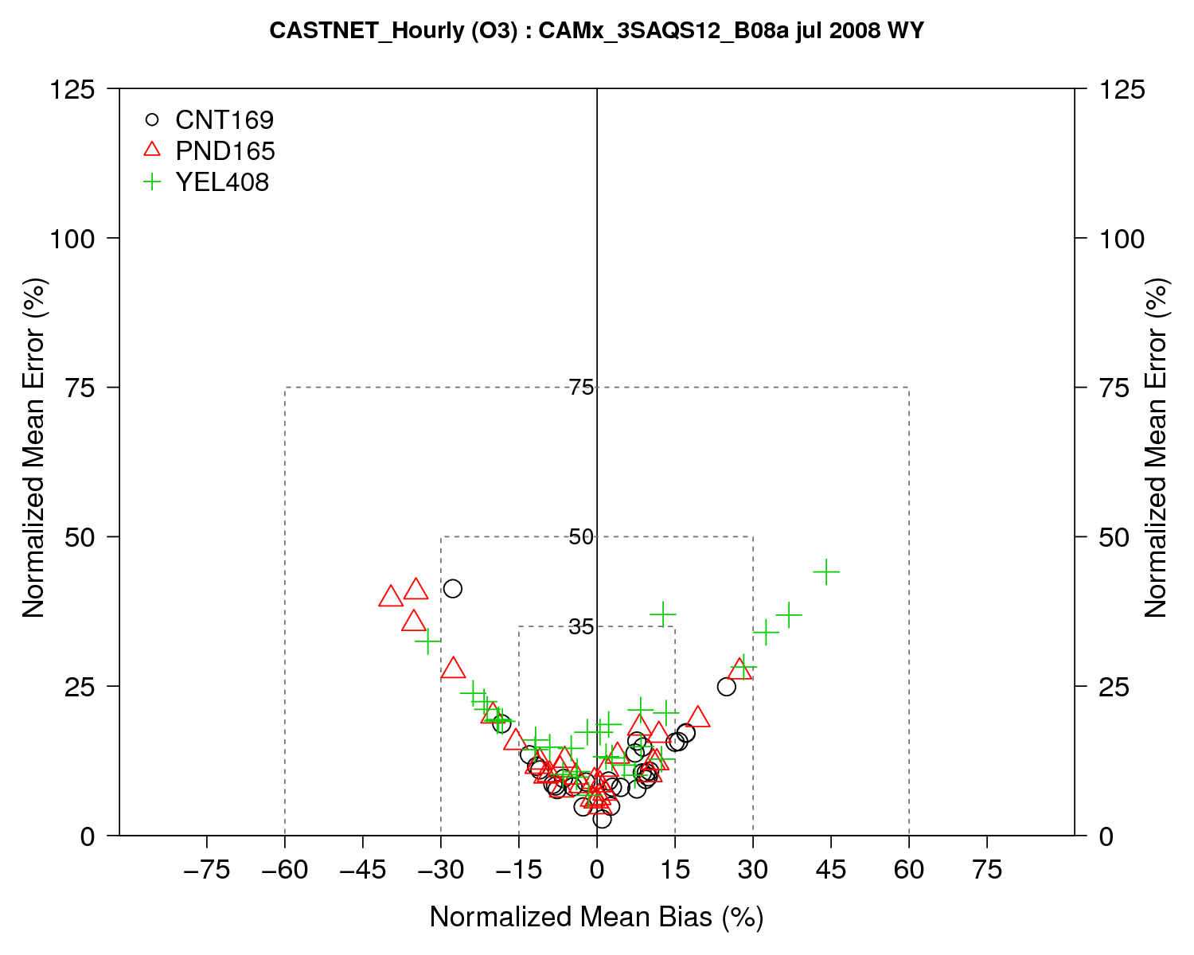
Status Report: 2008 3SAQS CAMx MPE

Slide 22
Status Report: 2011 3SAQS WRF Final Report
Release Schedule: early June
Simulation 3SAQS_WRF_Base11a
Evaluation focusing on performance in the 3-state region
Additional performance indicators for winter ozone, stratosphere-troposphere exchange, and precipitation
Performance reported by state and season

Slide 23
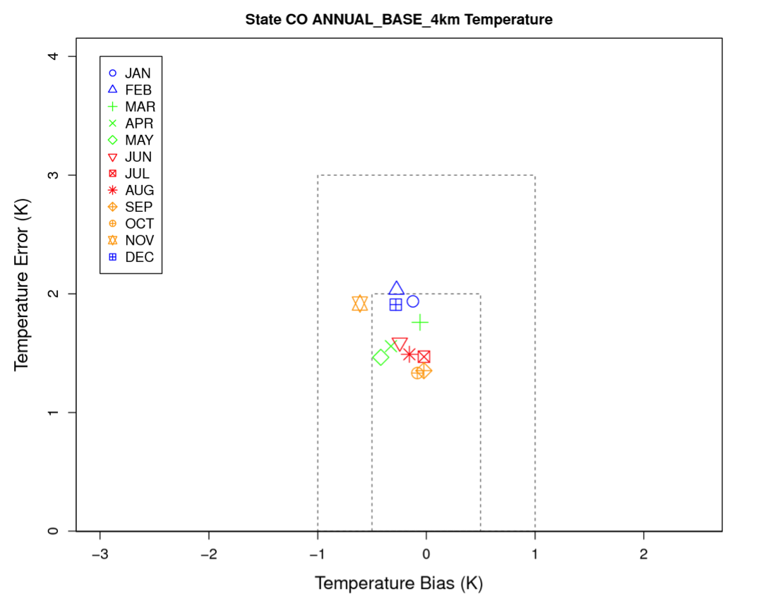
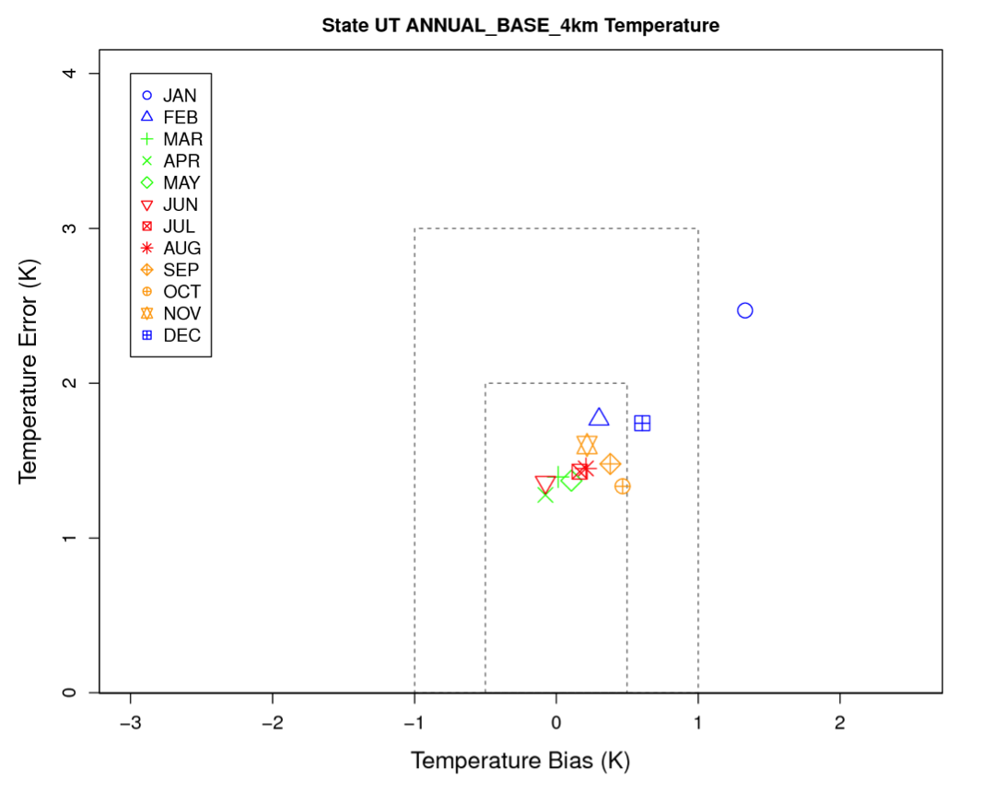
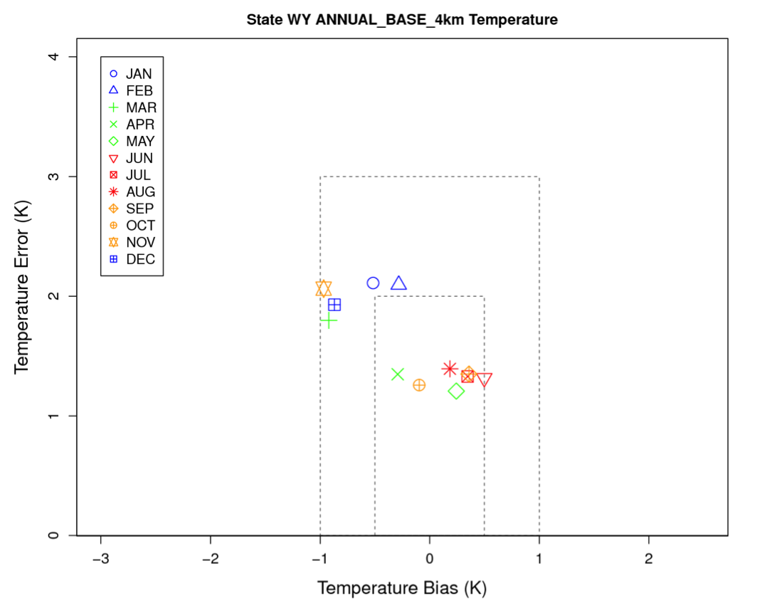
Status Report: 2011 3SAQS WRF MPE

Slide 24
Status Report: 2011 3SAQS CAMx Base
Release Schedule: start simulation after protocol comments addressed
Simulation 3SAQS_CAMx_Base11a
Address any major issues found in 3SAQS_CAMx_Base08a MPE
2011 WRF and NEI2011v6 EMP
Ancillary data updates (spatial surrogates and temporal profiles)
3SAQS Phase I O&G data

Slide 25
Status Report: 2020 Emissions and SMOKE
Release Schedule: Finish emissions processing and analysis in May
Non-O&G 2020 EI from the NEI2007v5 (2008v2) EMP
O&G EI from 3SAQS P1 projections
Two 2020 3SAQS emissions datasets
Different anthropogenic inventories
2008: NEI2020re_v5_07c
2011: NEI2018ed_v6_11f
3SAQS_SMOKE_Base2020_08a: 2008 meteorology, biogenics, etc.; CB05
3SAQS_SMOKE_Base2020_11a: 2011 meteorology, biogenics, etc.; CB6r2

Slide 26
3SAQS Modeling Flow Diagram
2008 MOZART
2008 WRF
2008 CAMx
2008 SMOKE
2008 EI
2008 Final Report
2020 EI
2020_08 SMOKE
2020_08 CAMx
2008 Platform
2011 Platform
2018 EI
2020_11 SMOKE
2020_11 CAMx
2011 WRF
2011 Final Report
2011 EI
2011 SMOKE
2011 CAMx
2011 MOZART

Slide 27
Schedule of 3SAQS and 3SDW Activities
3SAQS | 2011 SMOKE and MEGAN modeling; complete 3SAQS Phase I oil & gas inventory | 2011 Base CAMx simulation; 2020 SMOKE modeling complete | 2020_08 CAMx simulation | 2020_11 CAMx simulation | 2011 cumulative impacts CAMx simulation
 | April | May | June | July | August
3SDW | Populate 3SDW with 2008 modeling results |  | Populate 3SDW with 2011 modeling results

