Slide 1
Three-State Study First Use Test Case
Gail Tonnesen, EPA Region 8
Three-State Study Technical Workshop
Ft Collins, Colorado, May 29, 2013

Slide 2
Acknowledgments
3SDW, WRAP, CDPHE, RAQC,
ENVIRON, Alpine Geophysics

Slide 3
3-state study test case
Simulation performed on EPA cluster at RTP
Intel compiler, CAMx version 5.40
updated with patch for point source emissions
run time of 2 hours/day using 8 CPUs
initialized using IC file for June 21
Data Transfer
data provided by warehouse on 2 TB hard disk
model input files transferred to RTP using secure copy
transfer time of 1.3 MB/s from eSATA hard disk, or 9 MB/s when copied from workstation hard disk: 100 to 800 GB day.
Used previously obtained WestJump 36 km met files.
analysis performed on local workstation

Slide 4
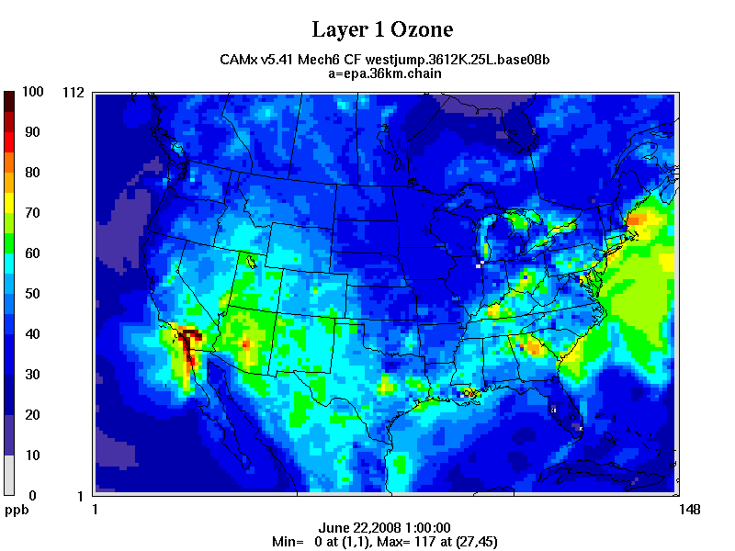
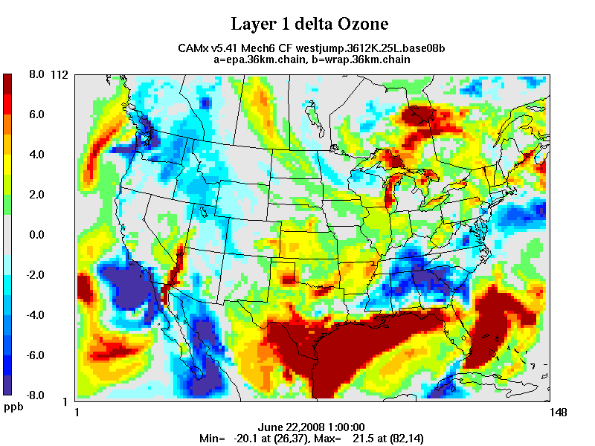
Comparison with reference case
Large differences from IC at beginning of simulation

Slide 5
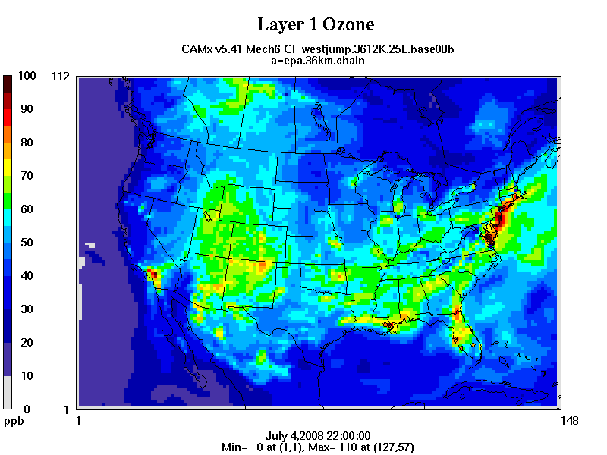
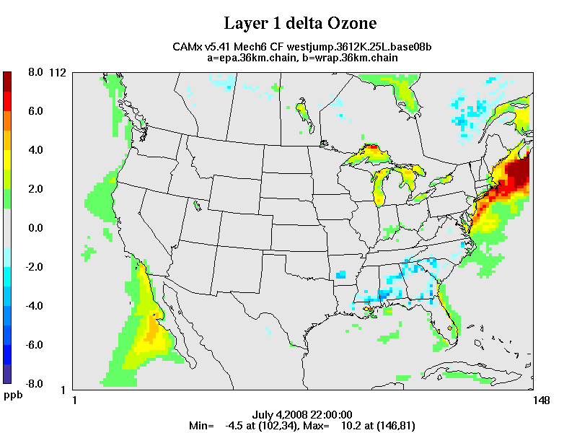
Comparison with reference case
Differences reduced but not eliminated after 13 day spinup

Slide 6
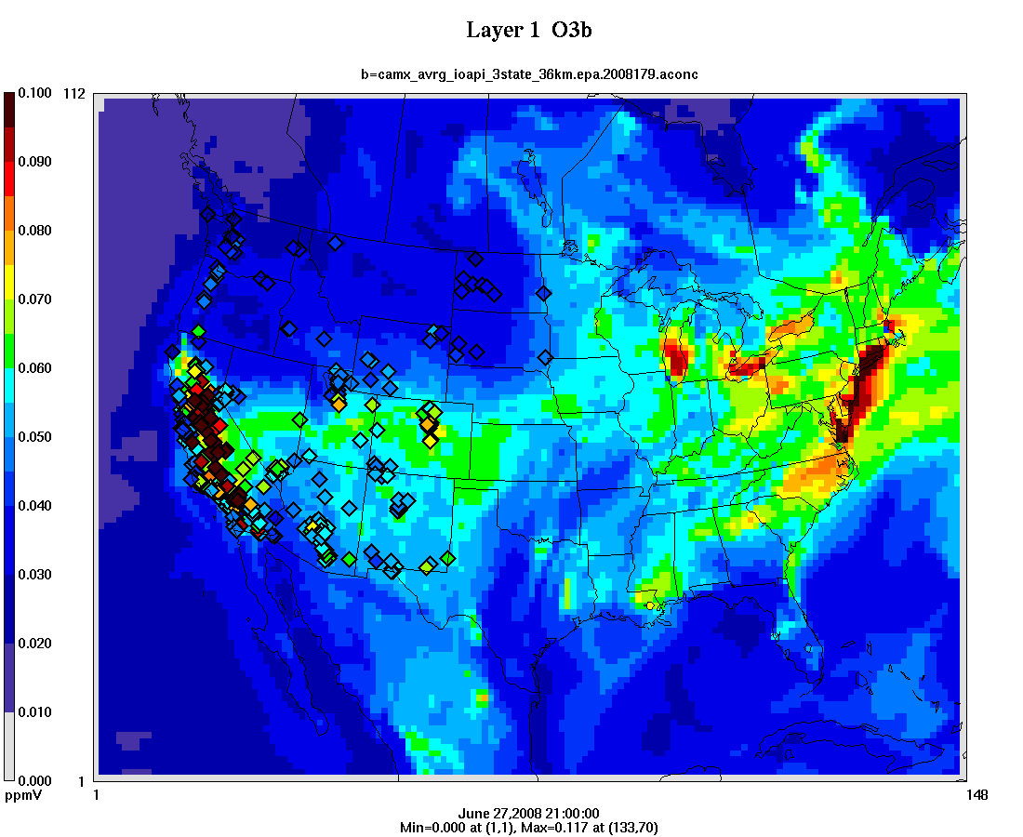
Comparison with Ozone monitors

Slide 7
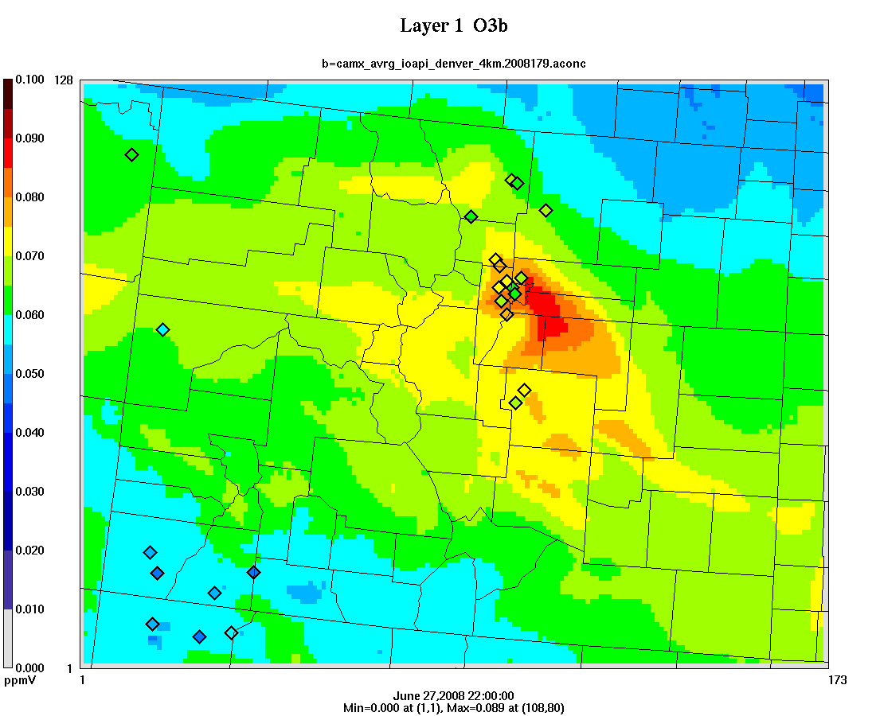
Comparison with Ozone monitors

Slide 8
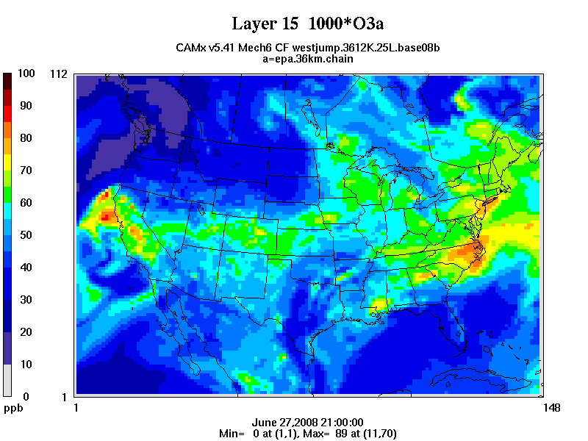
Layer 15 Ozone (2,100 to 2,500 m)

Slide 9
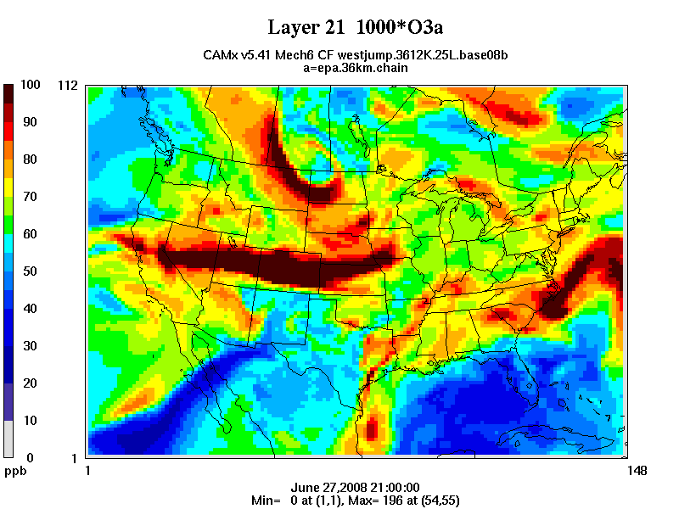
Layer 21 Ozone (5,800 to 7,400 m)

Slide 10
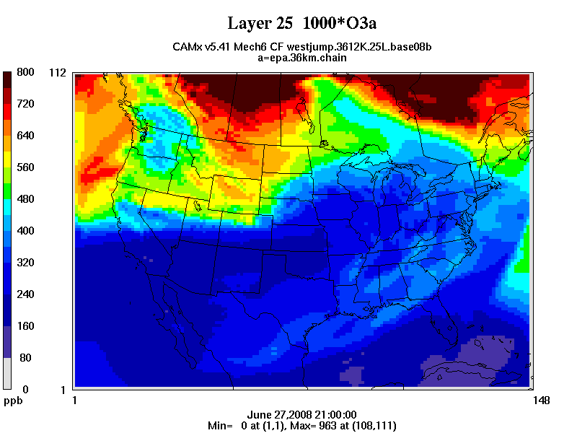
Ozone at Layer 25 (15,000 to 19,000 m)

Slide 11
Comparison with Ozone monitors

Slide 12
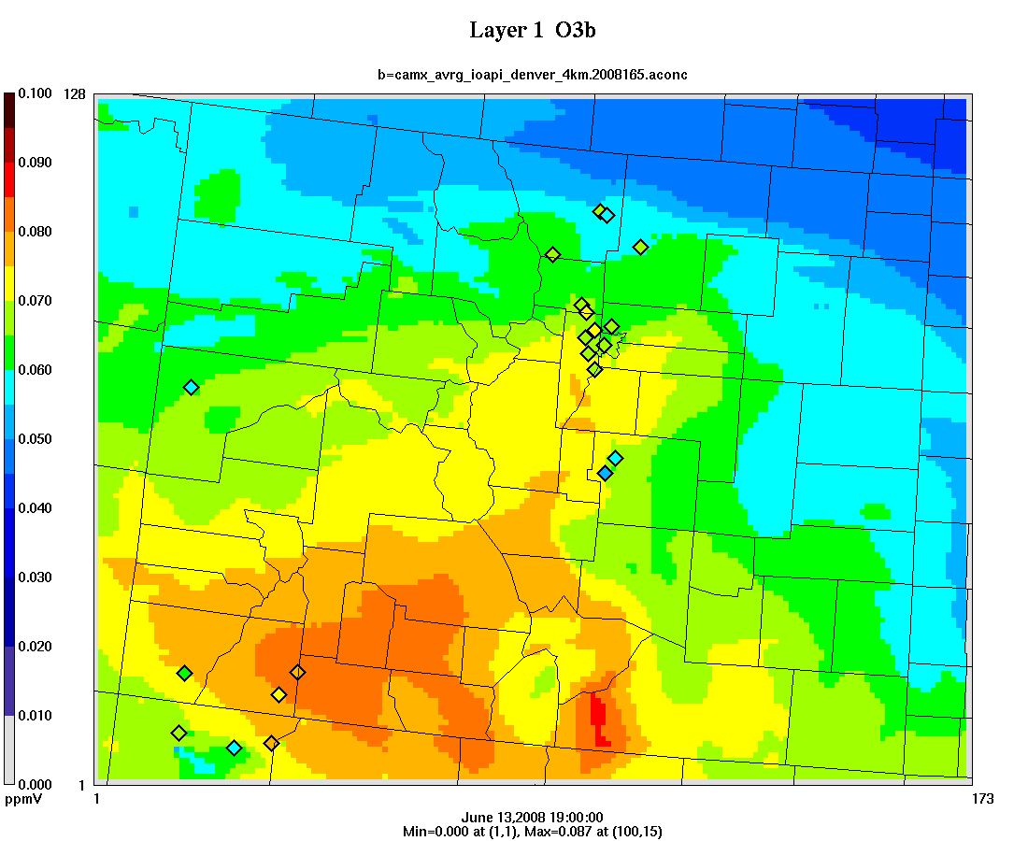
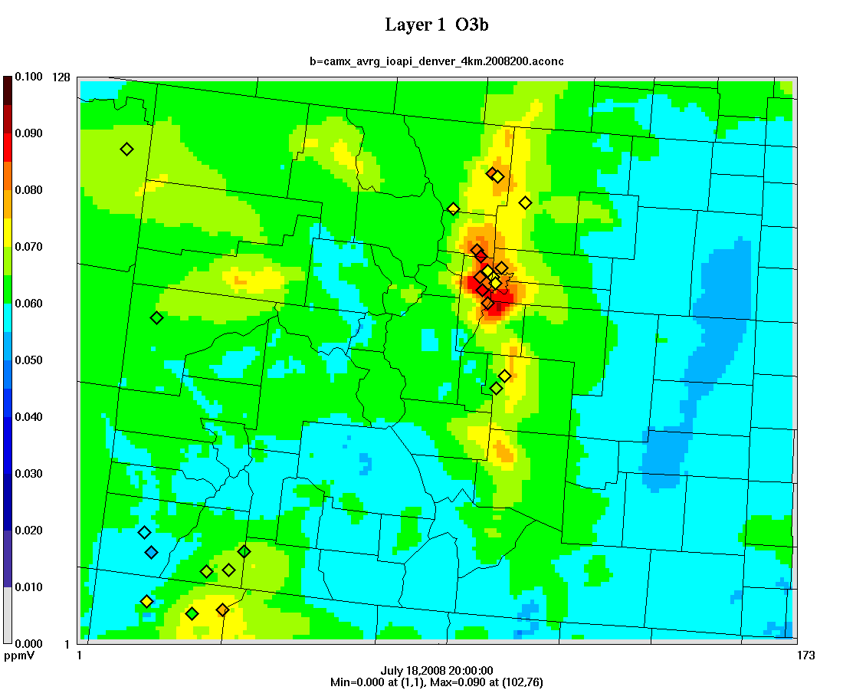
Ozone during SI and smog events
June 13: high ozone across large region including rural areas
July 18: high ozone in urban areas or areas with precursor emissions

Slide 13
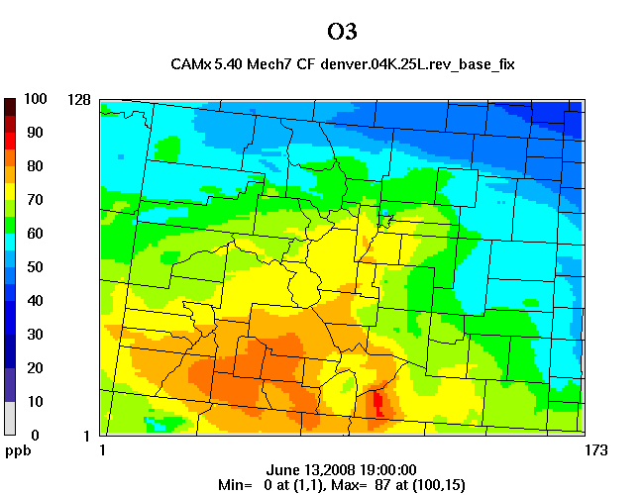
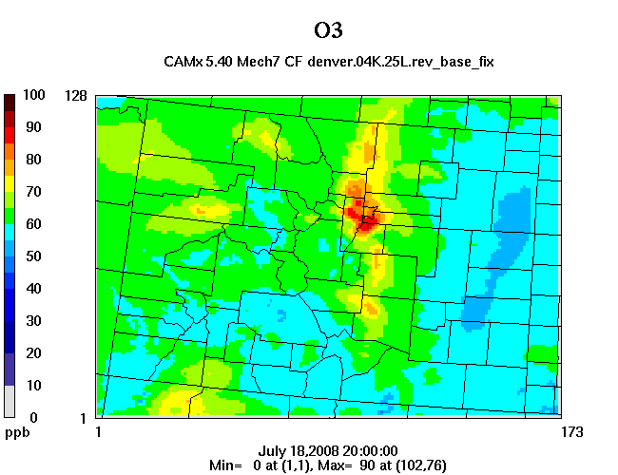
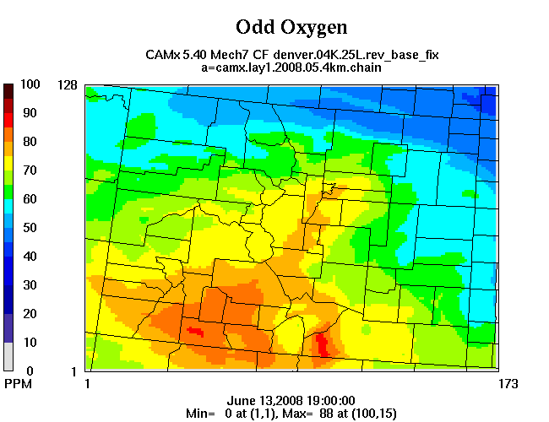
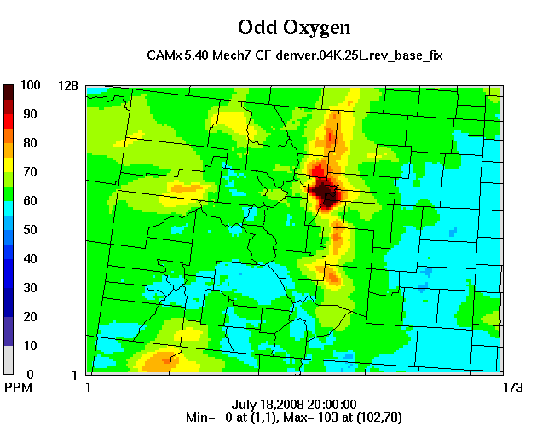
Total Oxidant
Total Oxidant

Slide 14
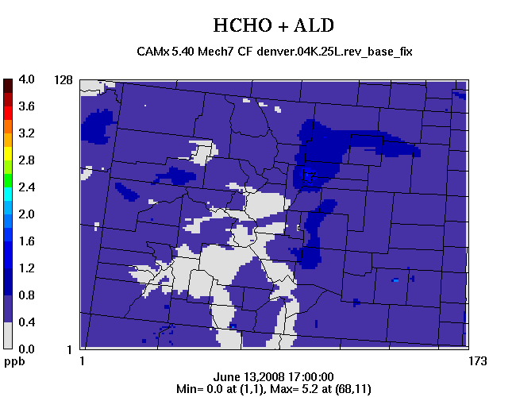
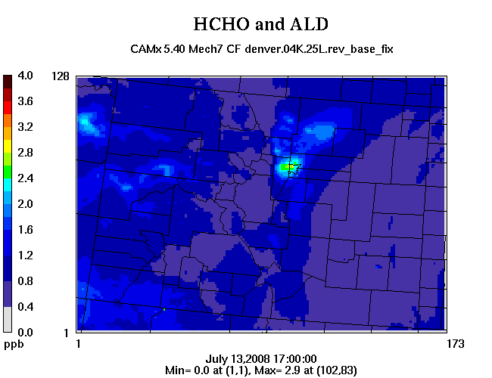
Aldehydes on June 13 and July 13
June 13: low aldehydes in high ozone region
July13: high aldehydes in areas with O3 precursor emissions

Slide 15
Comparison of aldehydes and O3 on June 13
Strong correlation of low aldehydes and high ozone region

Slide 16
Summary of First Use Test Case
Successful first test of data warehouse concept
data transfer by hard drive works well
option to download directly from the warehouse is desirable, if feasible
Suggestions for next test case:
Need datasets for the full year.
Ability to request premerged emissions files.
Separate emissions file for individual O&G projects.
Emissions projections for future years.
Distribution package should also include original modeling protocol, reports on base case MPE, emissions QA, etc.

Slide 17
Background O3 and Monitoring Needs
Background and transported ozone is highly variable in both space and time.
Important to accurately model background O3:
transported O3 can cause exceedances of the NAAQS.
background O3 level also affects the reactivity of a VOC-NOx mixture.
What type of monitoring network is needed to characterize background ozone?
surface monitors; lidar profiles; ozonesondes; satellite data.

Slide 18
Questions?

