Slide 1
3SDW Project Workflow and
Inventory Management

Slide 2
Overview
High Level Goals
Inventory Management
Project and Data Request Workflow
Project Pages
  Projects Overview
  Project Configuration
  Data Request
Future Work

Slide 3
High Level Goals
Manage Data Access
Provide Project Managers an overview of data transfer fulfillment
Provide Users a concise view of available data
Provide Data Requestors with a detailed manifest (receipt)
Detailed data accounting (Inventory Management)
  Meta data
  Who got what and when
  Change control
Track usage of supplied data
Capture communication threads (Future work)

Slide 4
Inventory Management
Data is placed within the warehouse
Warehouse file system is represented in database
  Facilitates change control
File system items are data
  Files
  Directories
Categories are groups of File System Items
  Files and Directories are grouped into Categories
  Meta data is attached to Category
  Categories may be hierarchically related
  Data may belong in multiple categories
Data Packages are groups of Categories
  Collection of categories for intended use (NEPA)

Slide 5
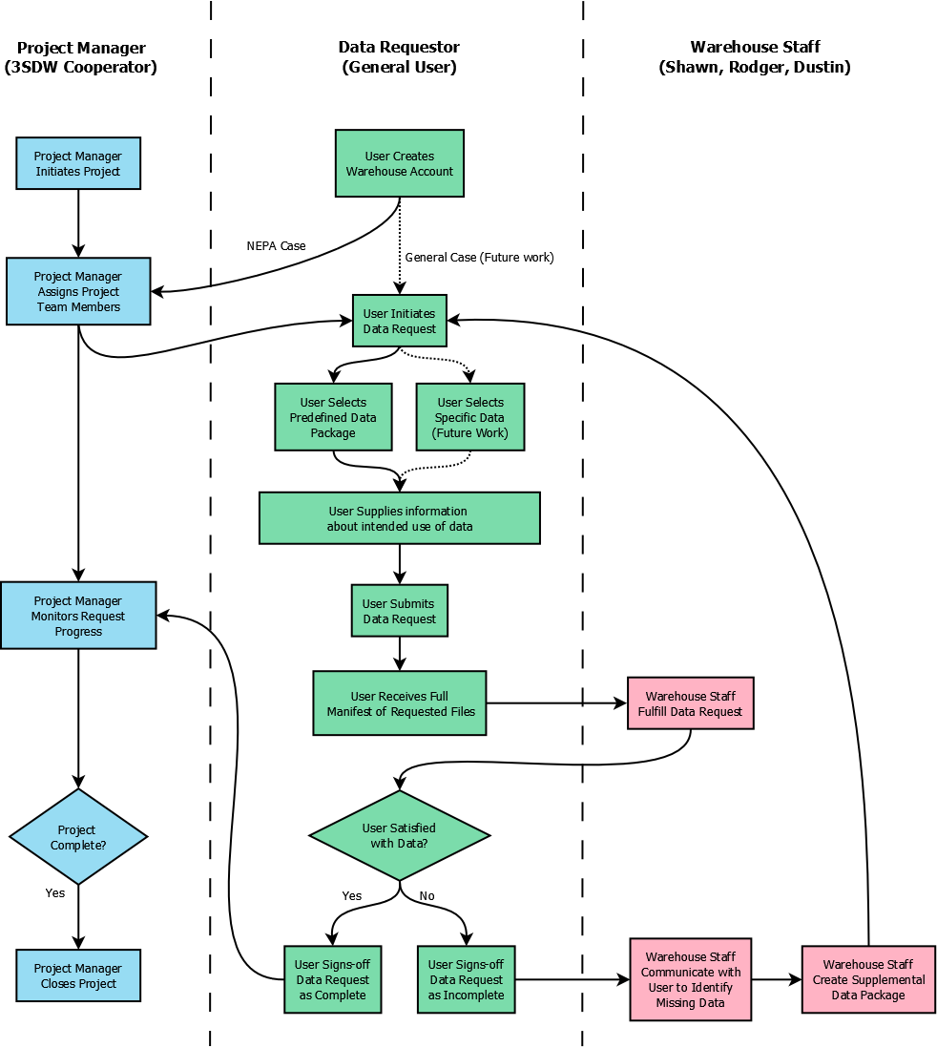
Project
Workflow

Slide 6
Projects Overview
Purpose
  Present an overview of Data Request status
  Entry point for Project process
  Create a new project

Slide 7
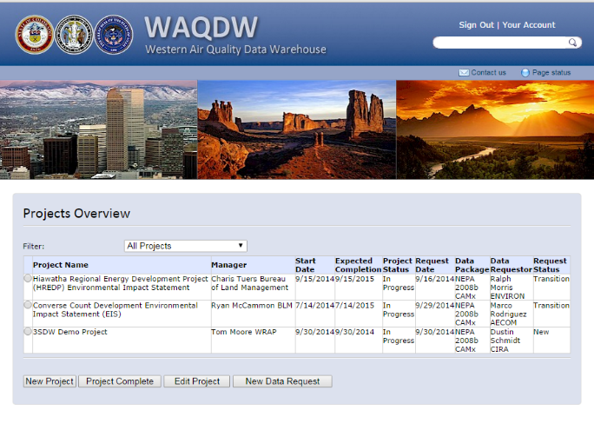
Projects Overview

Slide 8
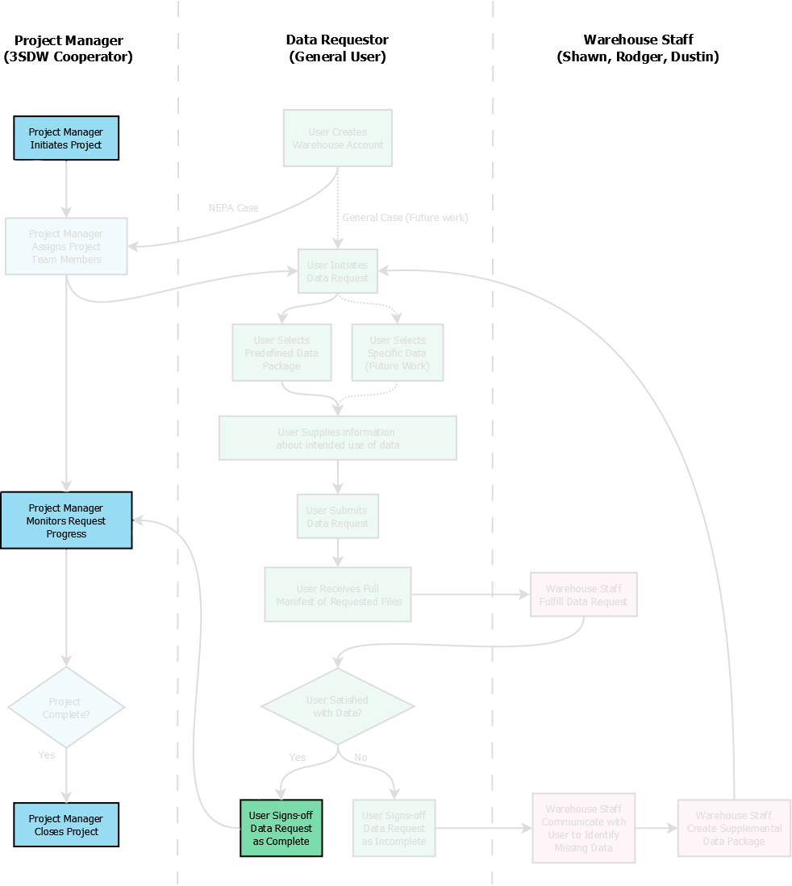
Projects
Overview

Slide 9
Project Configuration
Purpose
  Capture high level information about the project
    High level description (Details provided by data requestors)
    Location
    Timeframe
  Managing Data Access
    Selected pool of Project Managers (3SDW Cooperators)
    Project Managers assign 3SDW registered users to project

Slide 10
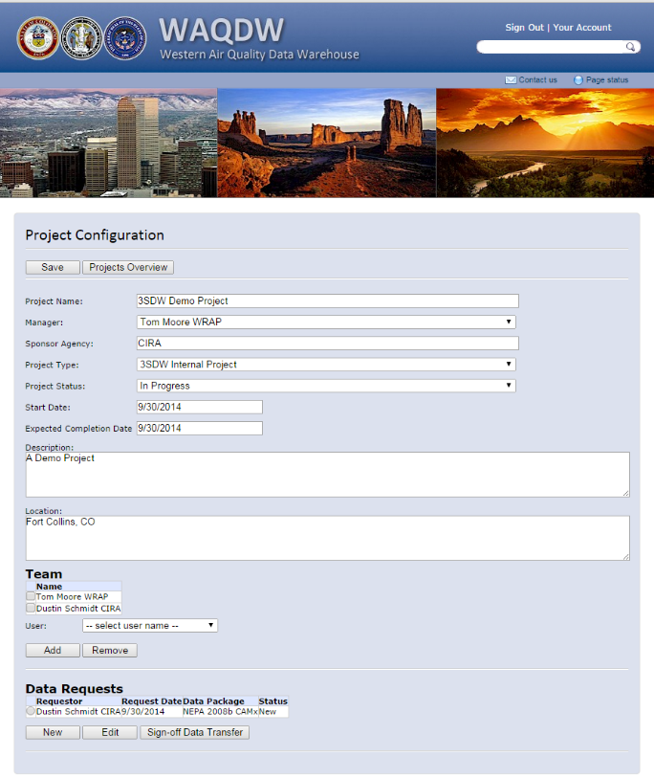
Project Configuration

Slide 11
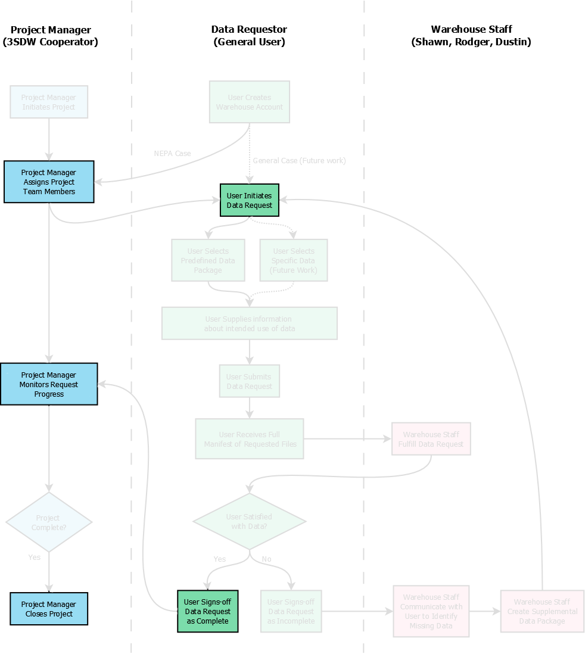
Project
Configuration

Slide 12
Data Request
Allow users to browse available data
Capture optional information about
  Intended use of data
  Results/Conclusions from data usage
Supply detailed manifest of requested data

Slide 13
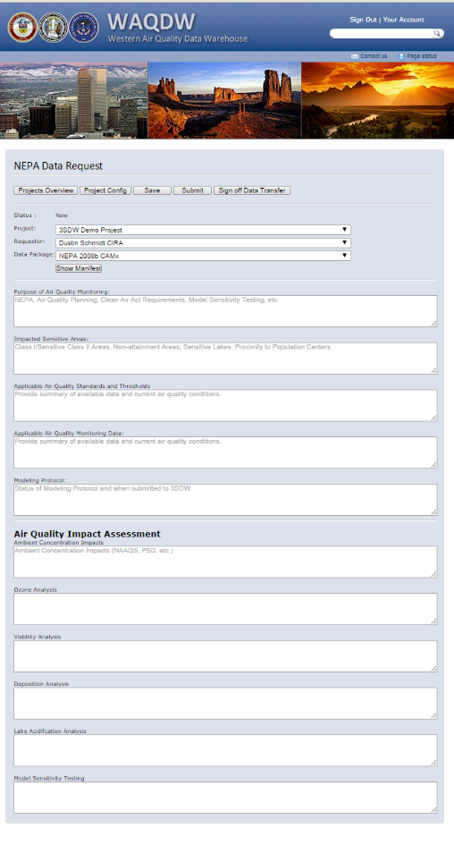
Data Request

Slide 14
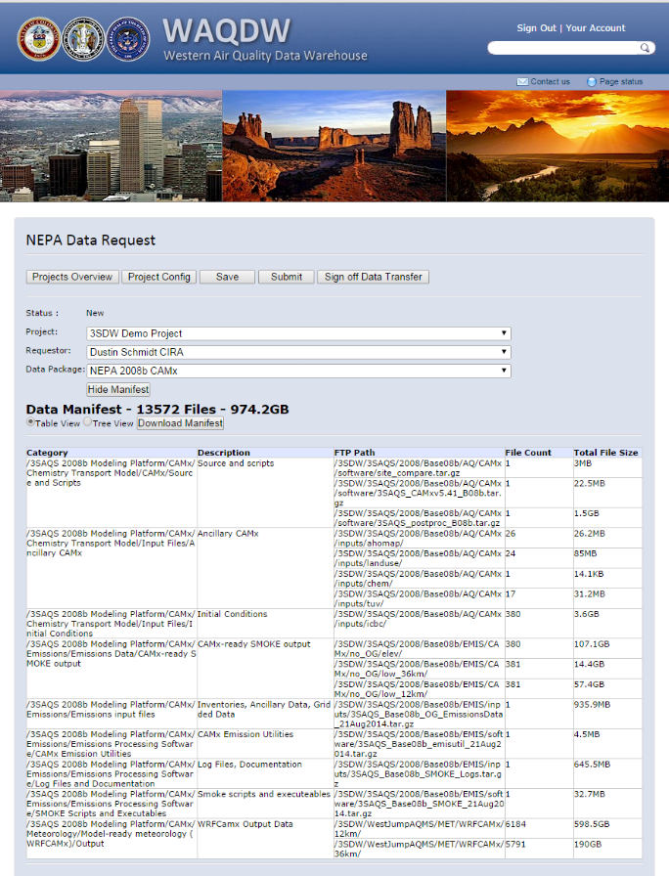
Data Request

Slide 15
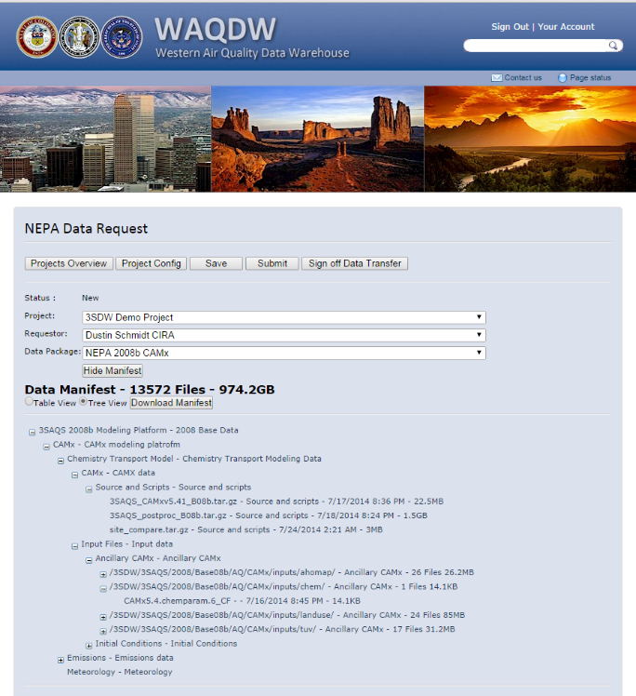
Data Request

Slide 16
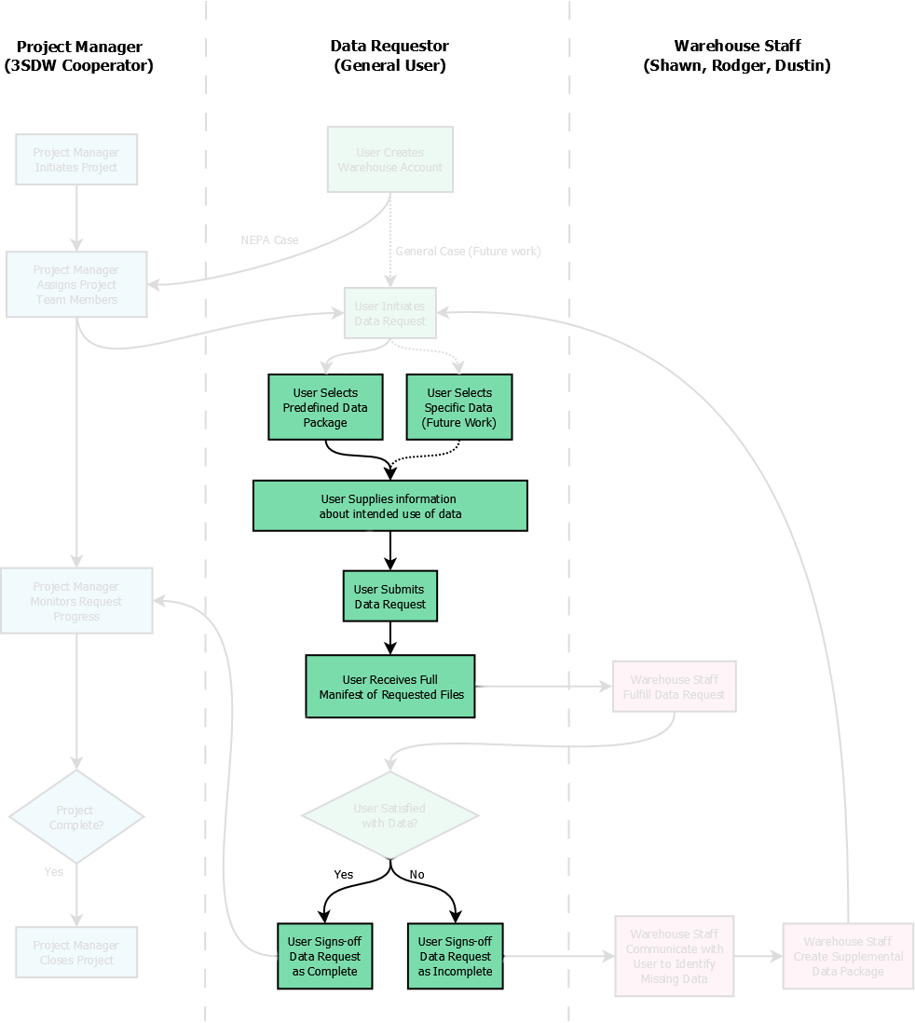
Data
Request

Slide 17
Future Work
Provide finer granularity in data selection
Tune process for supplying supplemental data
Enhance performance of online data transfer
Capture e-mail communication traffic for Project / Data Request
Data Submission Process (Return model results to warehouse)

