Slide 1



Three-State Air Quality Study (3SAQS)
Three-State Data Warehouse (3SDW)
3SAQS 2011 CAMx
Model Performance Evaluation
University of North Carolina (UNC-IE)
ENVIRON International Corporation (ENVIRON)
September 30, 2014

Slide 2
Objectives
Present initial CAMx Base 2011 version A (Base11a) performance results
Timeline for full MPE
Process for release of 3SAQS CAMx Base11a modeling platform

Slide 3
Initial Model Performance Evaluation
Ozone and PM species
Annual and monthly performance in the 12-km and 4-km domains
Annual and monthly performance in CO, UT, WY for the 4-km simulation
Comparison to WestJumpAQMS and 3SAQS Base08b model performance

Slide 4
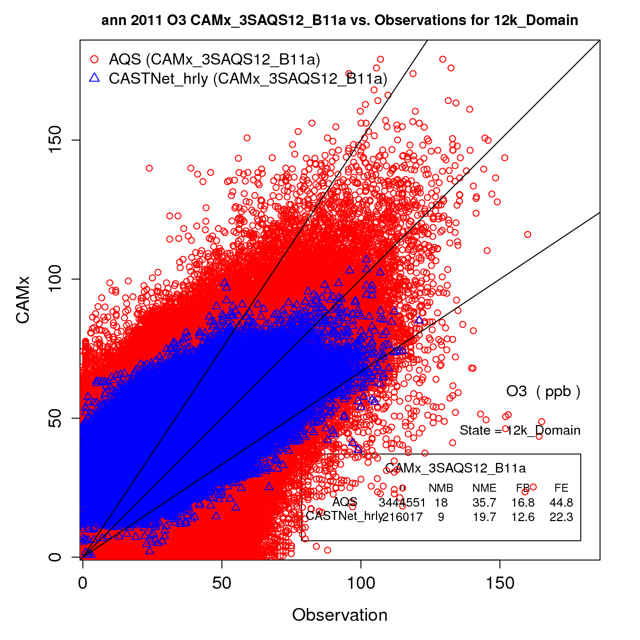
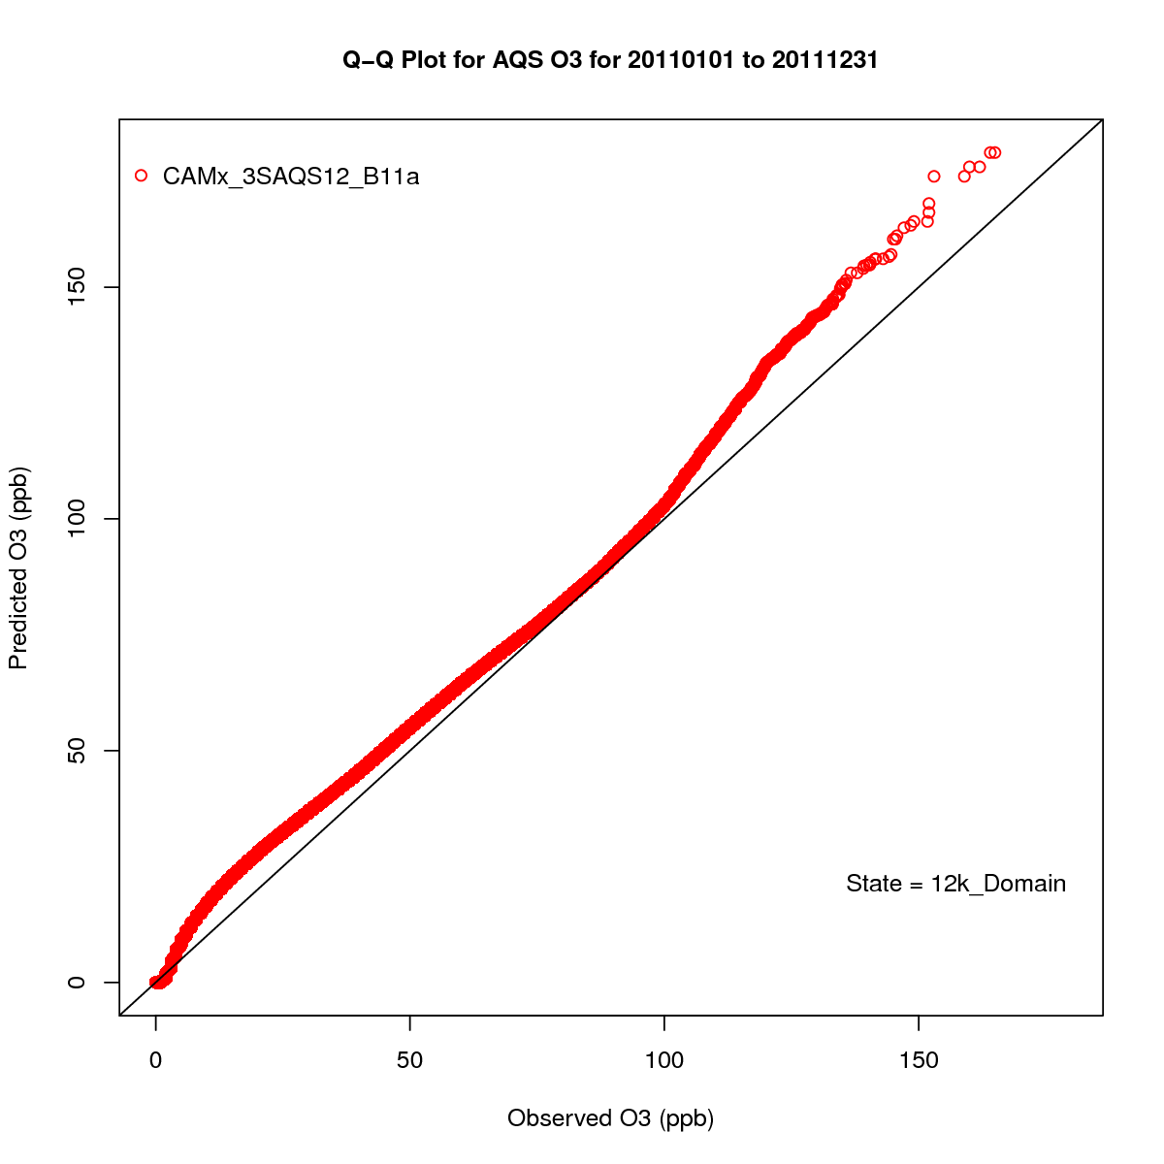
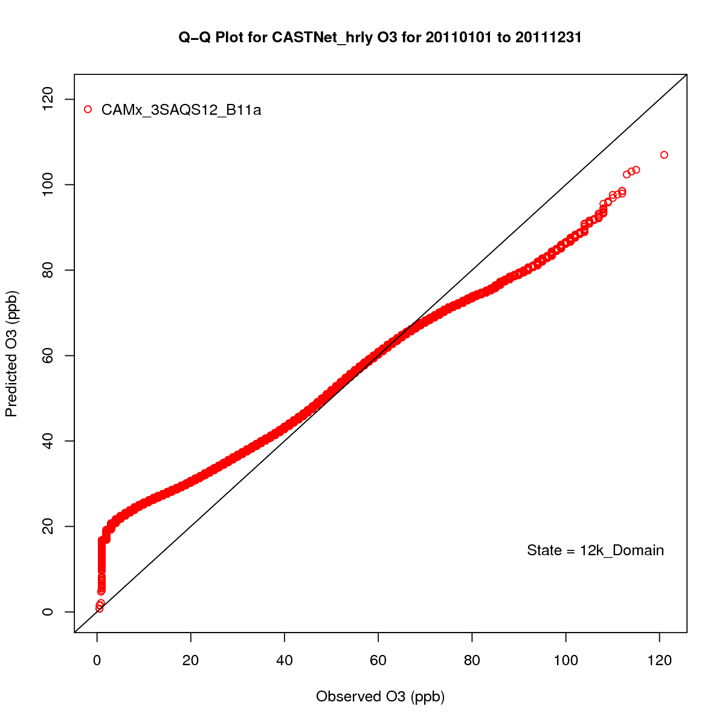
Hourly Ozone Performance
12-km Domain
AQS
CASTNet

Slide 5
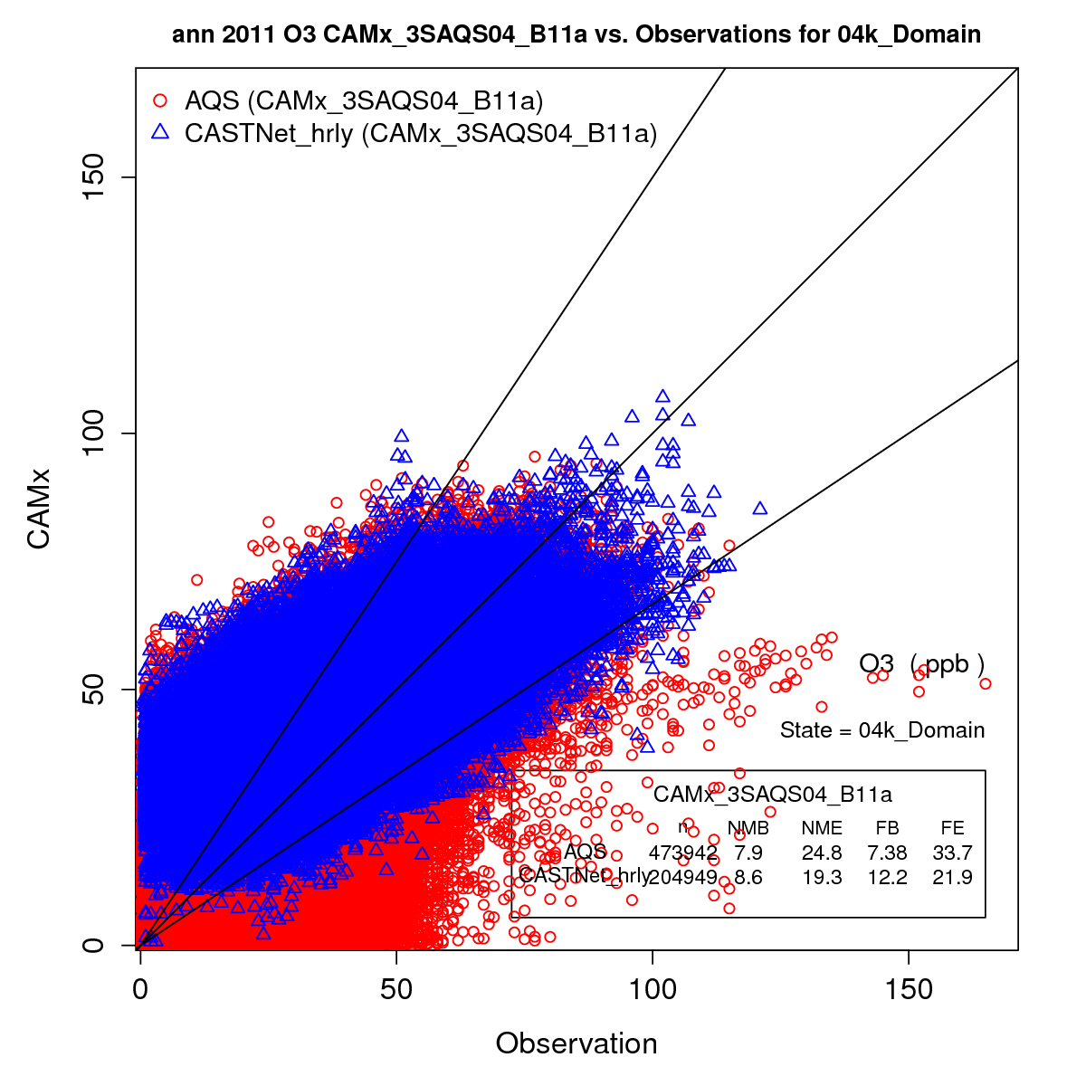
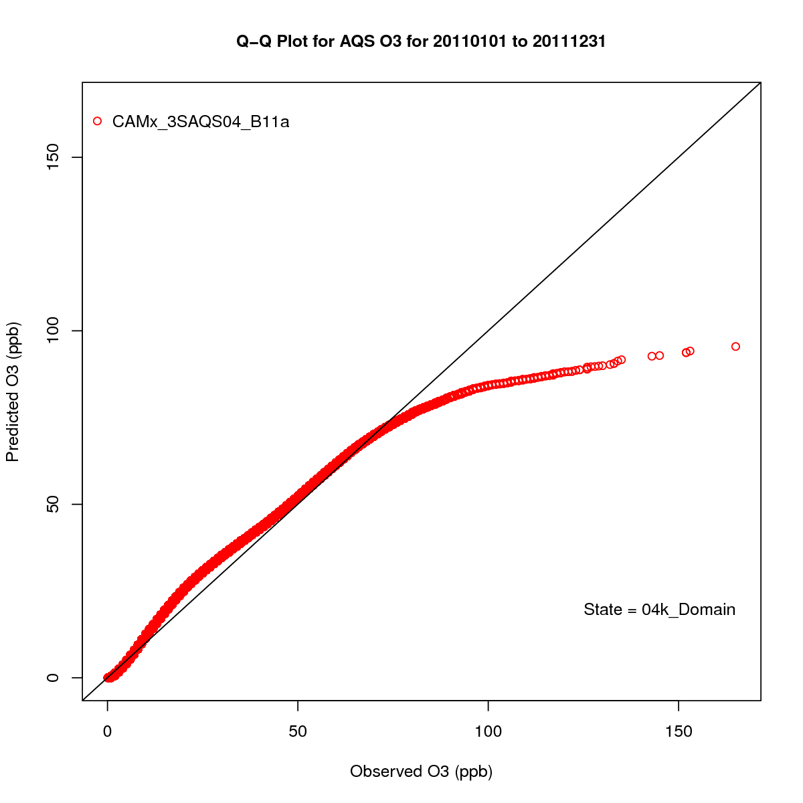
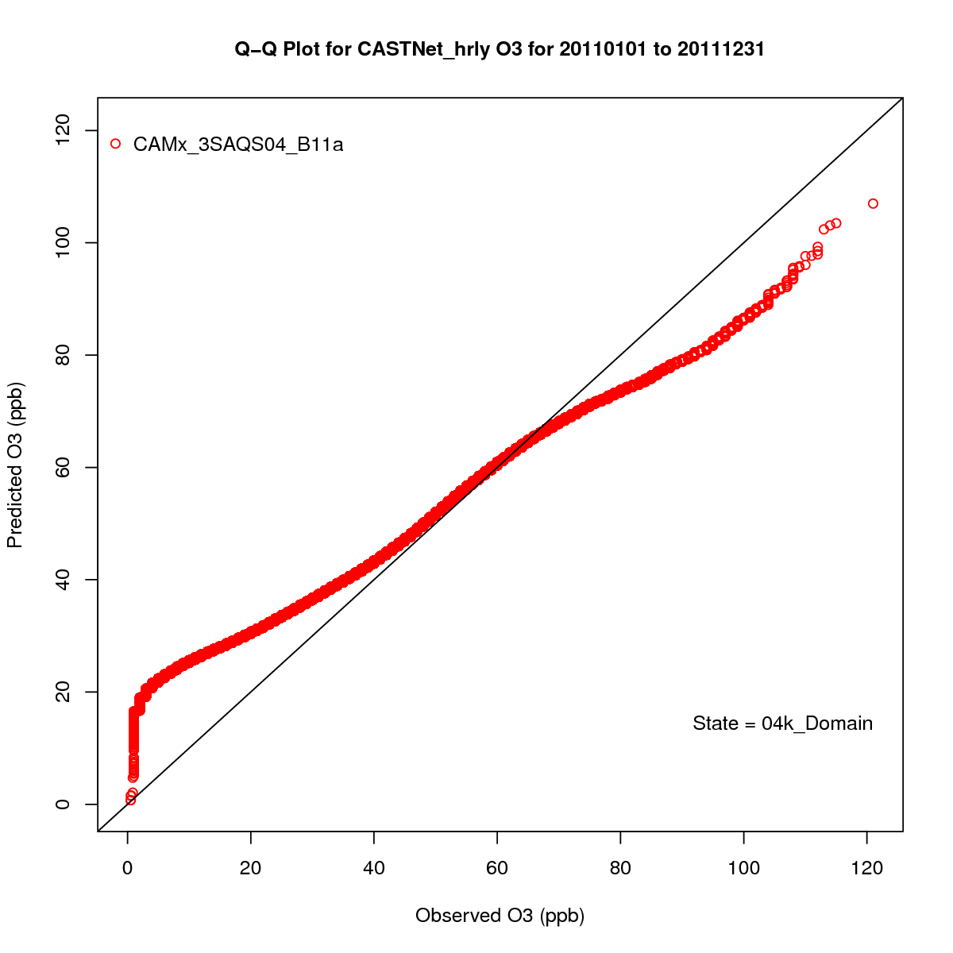
Hourly Ozone Performance
4-km Domain
AQS
CASTNet

Slide 6
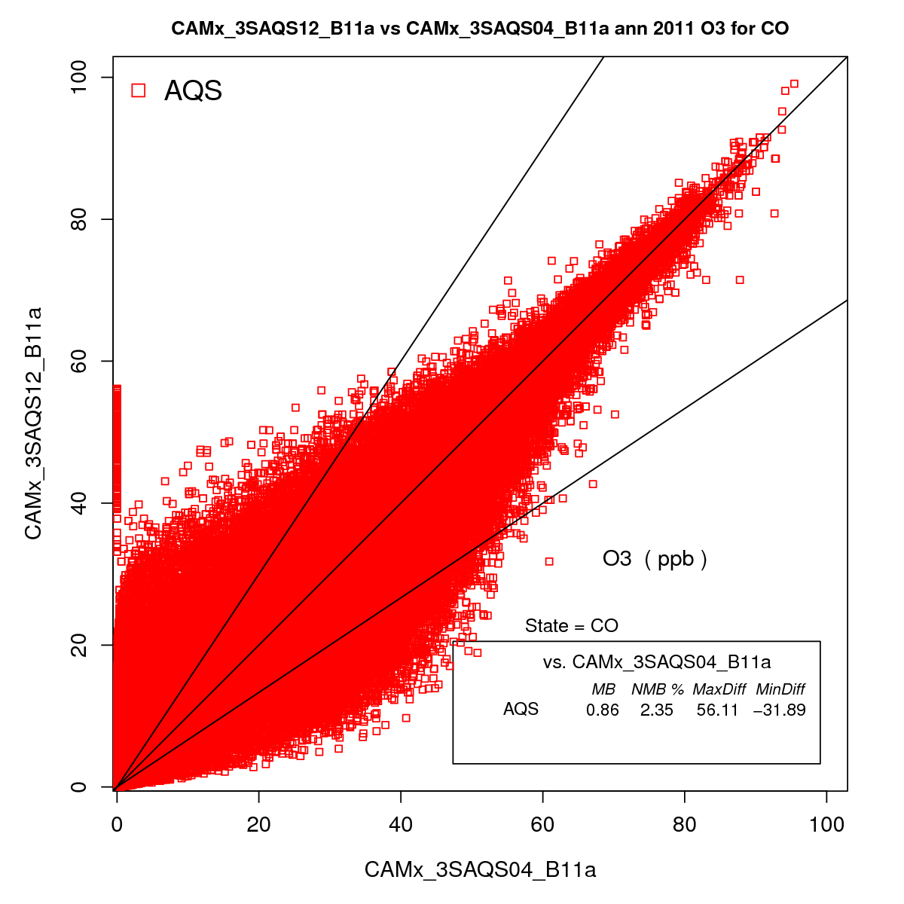
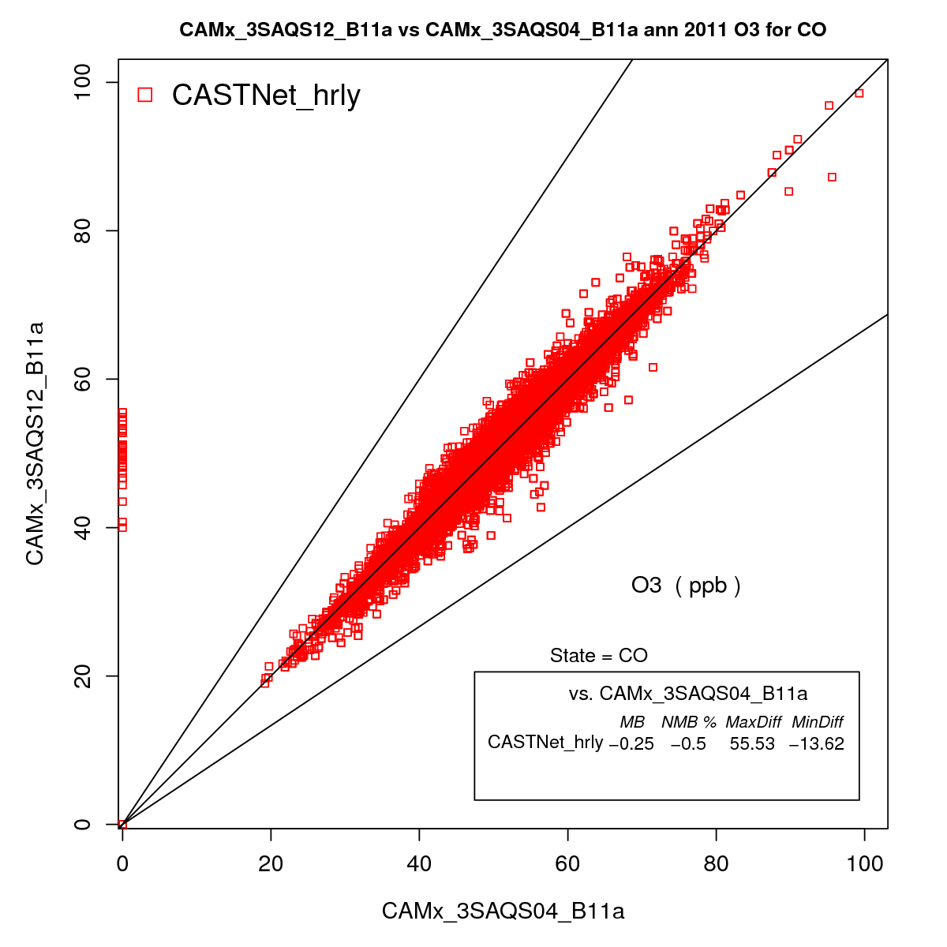
Grid Resolution Impacts on Predicted O3
Colorado 12-km vs 4-km Hourly O3

Slide 7
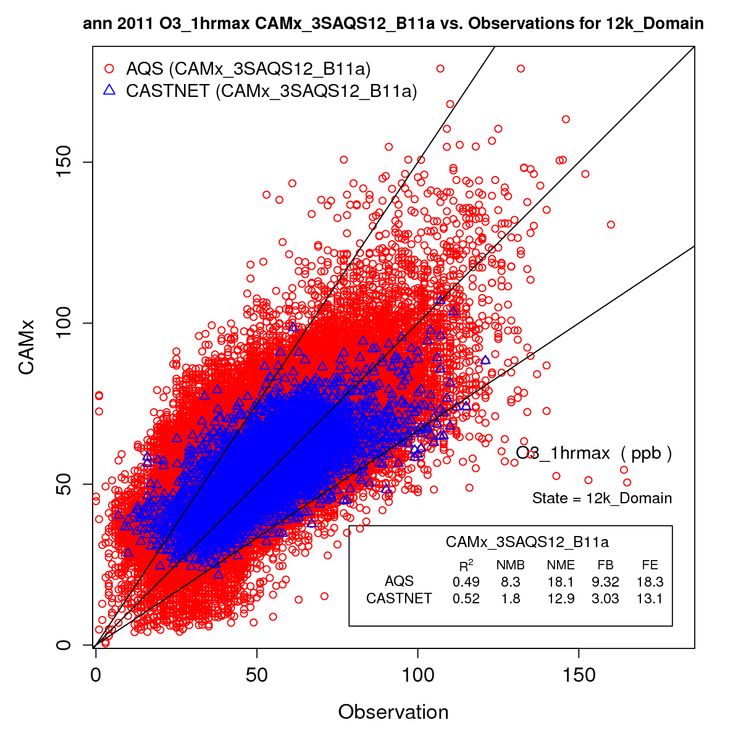
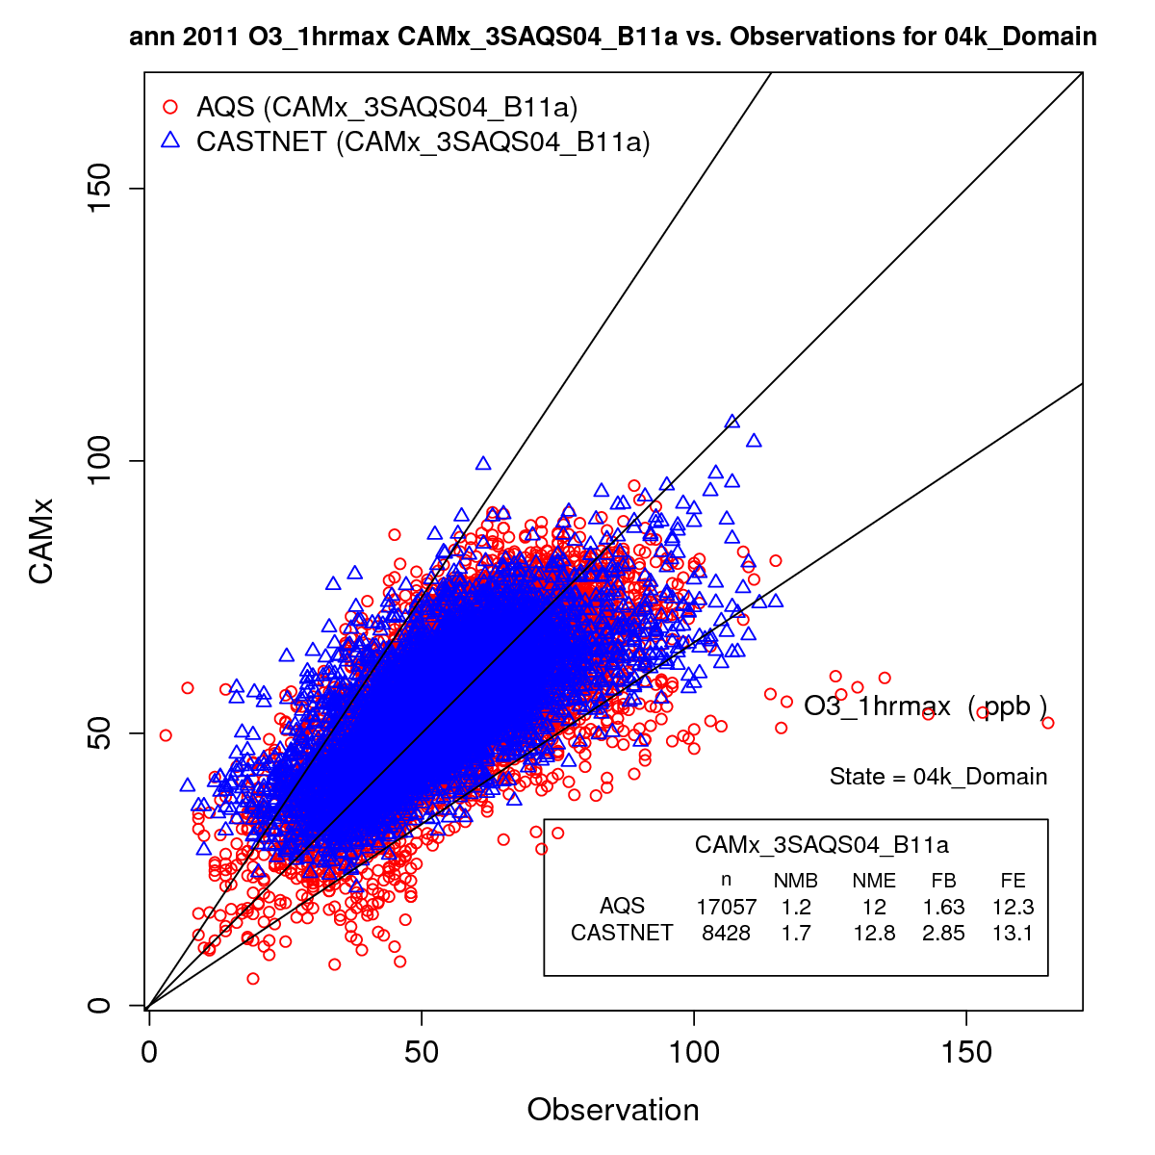
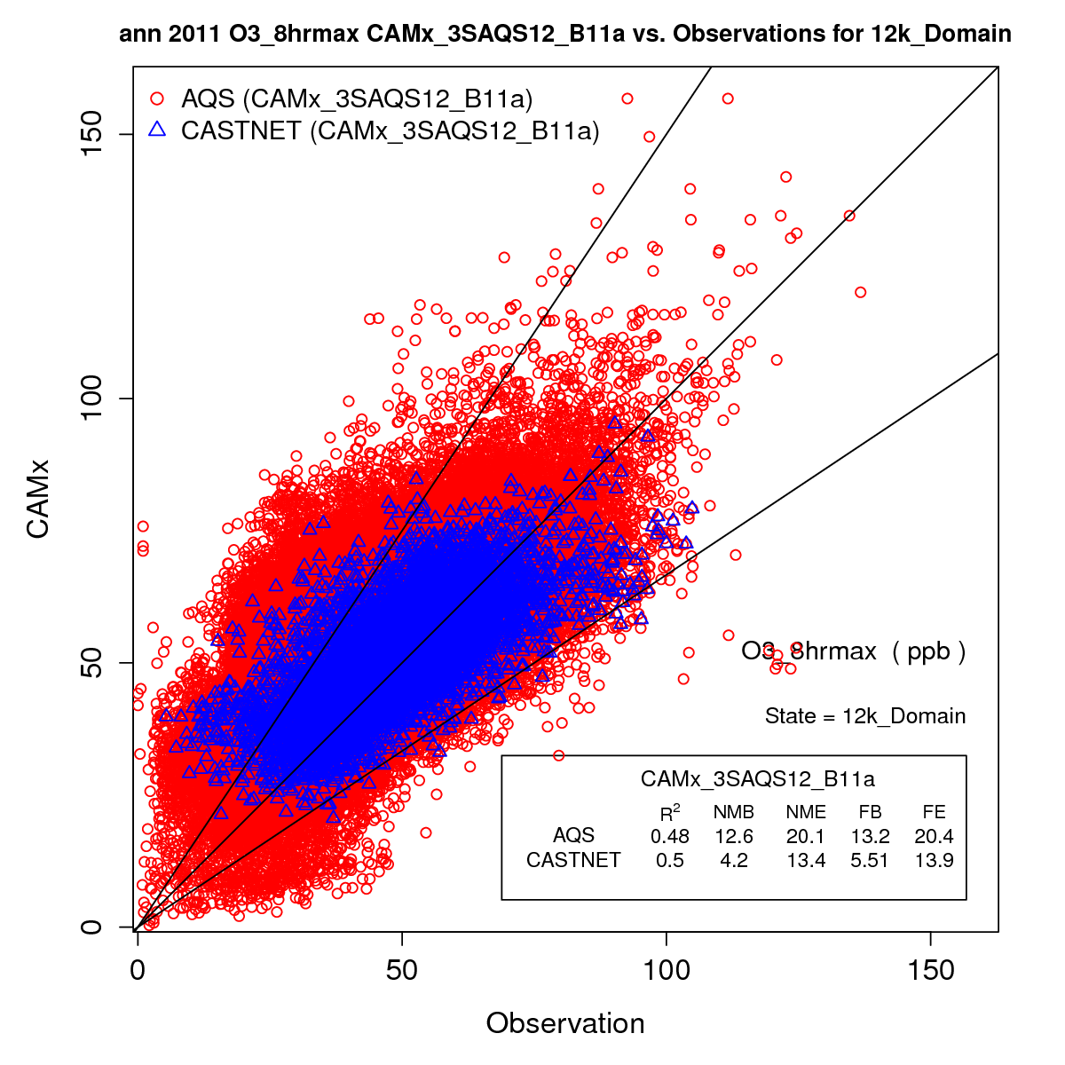
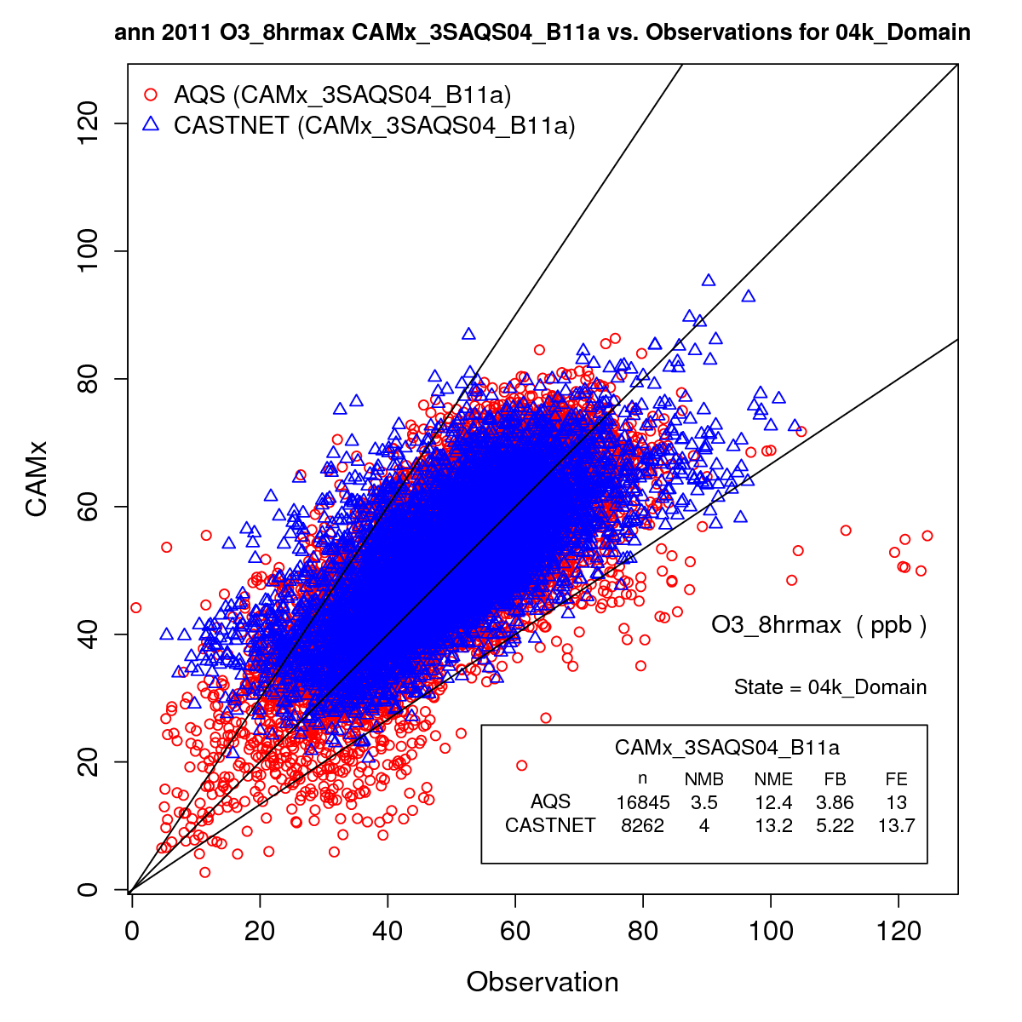
Daily Max Ozone Performance
Domain-wide AQS and CASTNet Sites
12-km
4-km
Metric | 1-hr | MDA8
FB | 9.3 | 13.2
 | 3.0 | 5.5
FE | 18.3 | 20.4
 | 13.1 | 13.9
NMB | 8.3 | 12.6
 | 1.8 | 4.2
NME | 18.1 | 20.1
 | 12.9 | 13.4
Daily Max O3
Metric | 1-hr | MDA8
FB | 1.6 | 3.9
 | 2.8 | 5.2
FE | 12.3 | 13.0
 | 13.1 | 13.7
NMB | 1.2 | 3.5
 | 1.7 | 4.0
NME | 12.0 | 12.4
 | 12.8 | 13.2
MDA8
Goals
Bias = 15%
Error = 35%
Criteria
Bias = 35%
Error = 50%

Slide 8
Daily Max Ozone Performance
Colorado AQS and CASTNet Sites (4-km CAMx)
Annual
All Values
June - August
O3 > 60 ppb
Metric | 1-hr | MDA8
FB | 2.7 | 5.0
 | 2.2 | 3.6
FE | 12.8 | 14.1
 | 10.0 | 9.8
NMB | 2.1 | 4.6
 | 2.0 | 3.5
NME | 12.3 | 13.1
 | 10.3 | 10.1
Daily Max O3
Metric | 1-hr | MDA8
FB | -4.6 | -4.2
 | -4.5 | -4.6
FE | 10.5 | 9.2
 | 10.4 | 8.9
NMB | -4.6 | -4.0
 | -4.5 | -4.3
NME | 10.3 | 9.1
 | 10.2 | 8.7
MDA8
Goals
Bias = 15%
Error = 35%
Criteria
Bias = 35%
Error = 50%

Slide 9
Daily Max Ozone Performance
Utah AQS and CASTNet Sites (4-km CAMx)
Annual
All Values
June - August
O3 > 60 ppb
Metric | 1-hr | MDA8
FB | -1.0 | 1.3
 | 1.7 | 2.5
FE | 13.0 | 13.3
 | 8.6 | 9.2
NMB | -2.0 | 0.4
 | 1.3 | 2.2
NME | 12.5 | 12.5
 | 8.7 | 9.2
Daily Max O3
Metric | 1-hr | MDA8
FB | -11.9 | -11.4
 | -4.8 | -3.7
FE | 14.4 | 13.8
 | 10.1 | 9.9
NMB | -11.2 | -10.4
 | -4.5 | -3.2
NME | 13.7 | 12.8
 | 9.9 | 9.7
MDA8
Goals
Bias = 15%
Error = 35%
Criteria
Bias = 35%
Error = 50%

Slide 10
Daily Max Ozone Performance
Wyoming AQS and CASTNet Sites (4-km CAMx)
Annual
All Values
June - August
O3 > 60 ppb
Metric | 1-hr | MDA8
FB | -0.3 | 1.8
 | -1.3 | -0.3
FE | 11.0 | 10.7
 | 9.0 | 8.4
NMB | -0.9 | 1.4
 | -1.5 | -0.6
NME | 11.2 | 10.8
 | 9.1 | 8.4
Daily Max O3
Metric | 1-hr | MDA8
FB | -5.7 | -5.8
 | -8.2 | -8.8
FE | 9.4 | 7.8
 | 10.8 | 10.6
NMB | -5.2 | -5.4
 | -7.6 | -8.2
NME | 9.1 | 7.4
 | 10.3 | 10.0
MDA8
Goals
Bias = 15%
Error = 35%
Criteria
Bias = 35%
Error = 50%

Slide 11
AQS Daily O3
Colorado 4-km CAMx
Daily Max O3 MDA8

Slide 12
CASTNet Daily O3
Colorado 4-km CAMx
Daily Max O3 MDA8

Slide 13
AQS Daily O3
Utah 4-km CAMx
Daily Max O3 MDA8

Slide 14
CASTNet Daily O3
Utah 4-km CAMx
Daily Max O3 MDA8

Slide 15
AQS Daily O3
Wyoming 4-km CAMx
Daily Max O3 MDA8

Slide 16
CASTNet Daily O3
Wyoming 4-km CAMx
Daily Max O3 MDA8

Slide 17
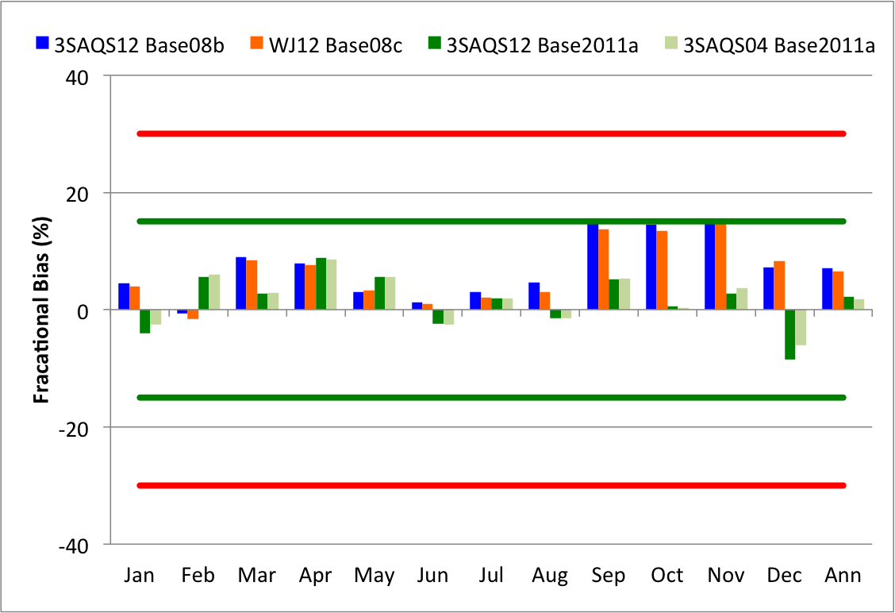
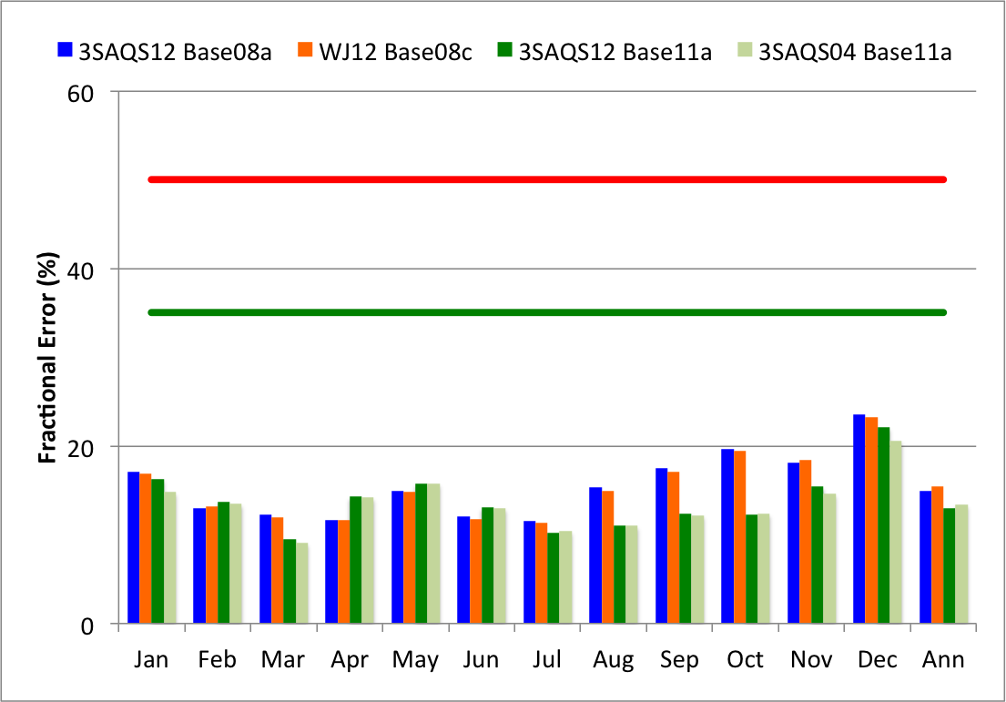
3SAQS Simulation Comparison
Colorado AQS Daily Max O3
Fractional Bias
Fractional Error

Slide 18
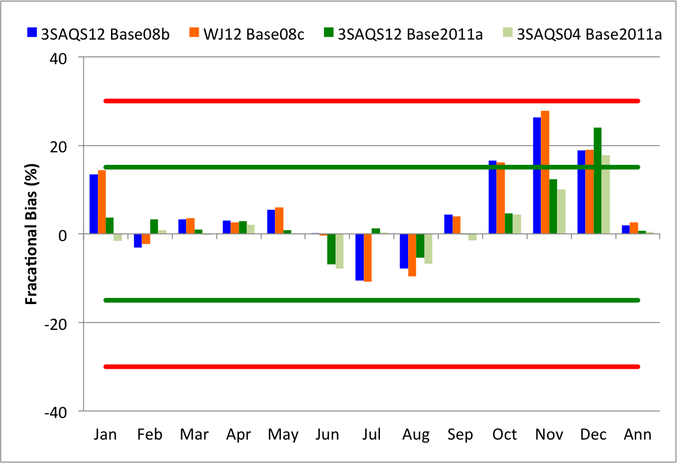
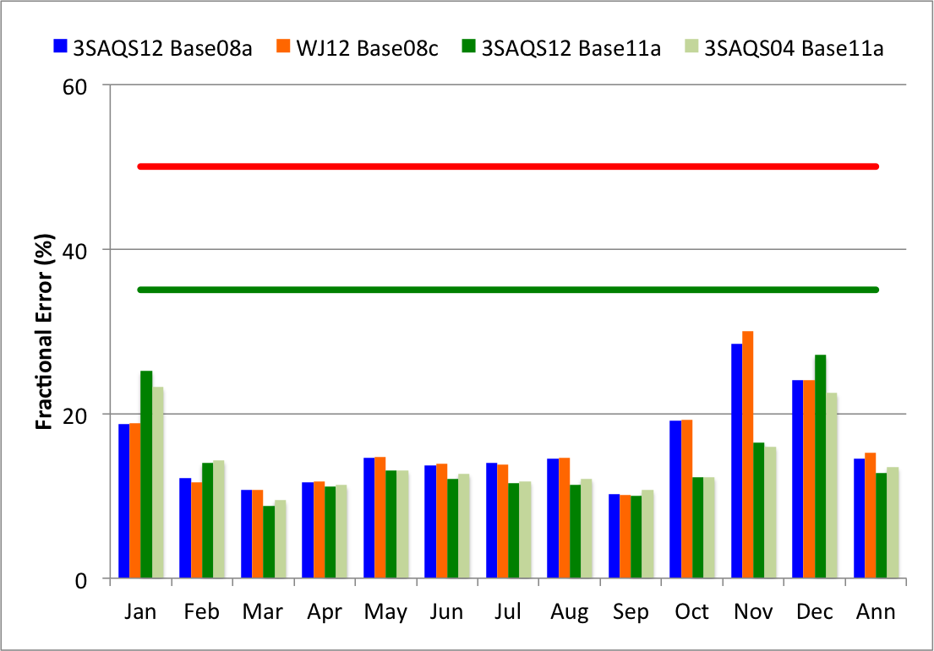
3SAQS Simulation Comparison
Utah AQS Daily Max O3
Fractional Bias
Fractional Error

Slide 19
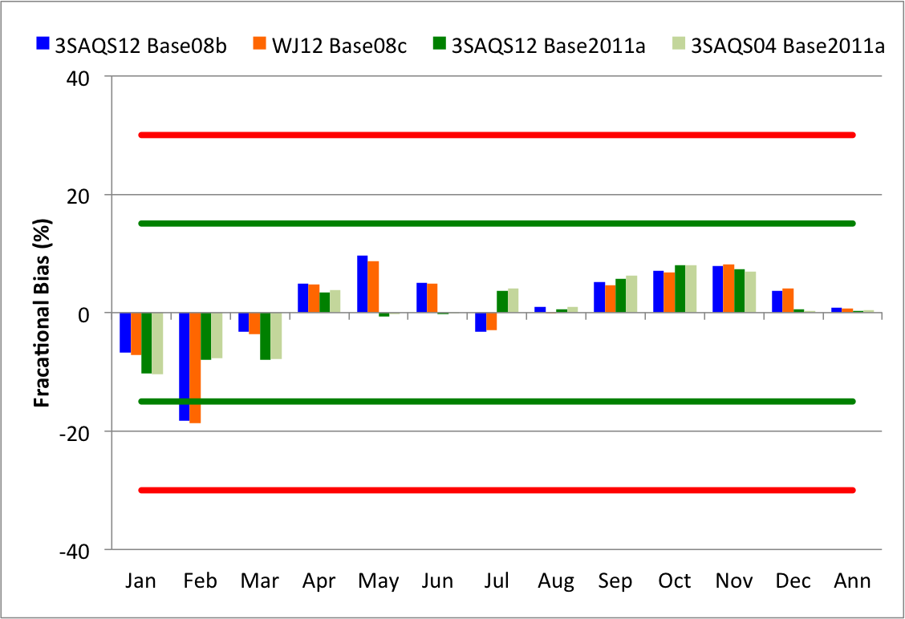
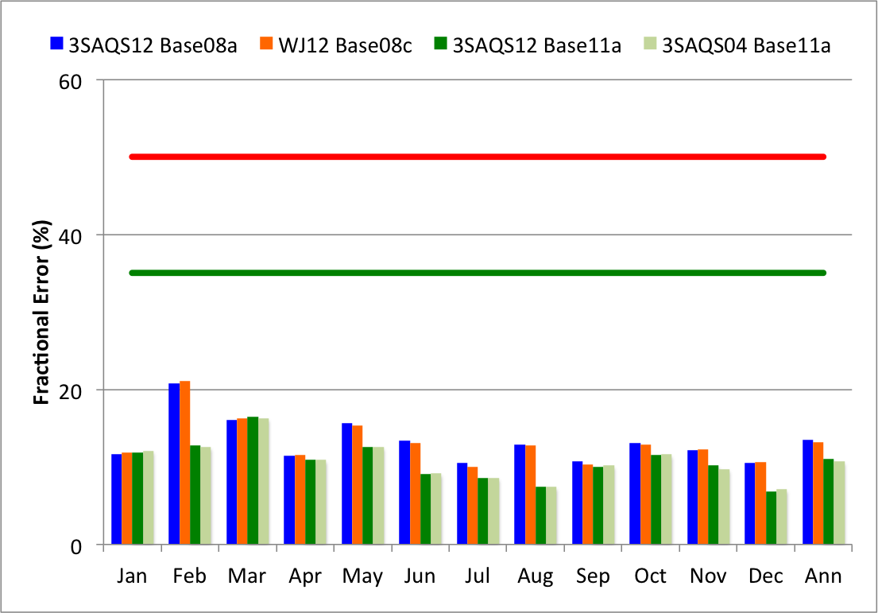
3SAQS Simulation Comparison
Wyoming AQS Daily Max O3
Fractional Bias
Fractional Error

Slide 20
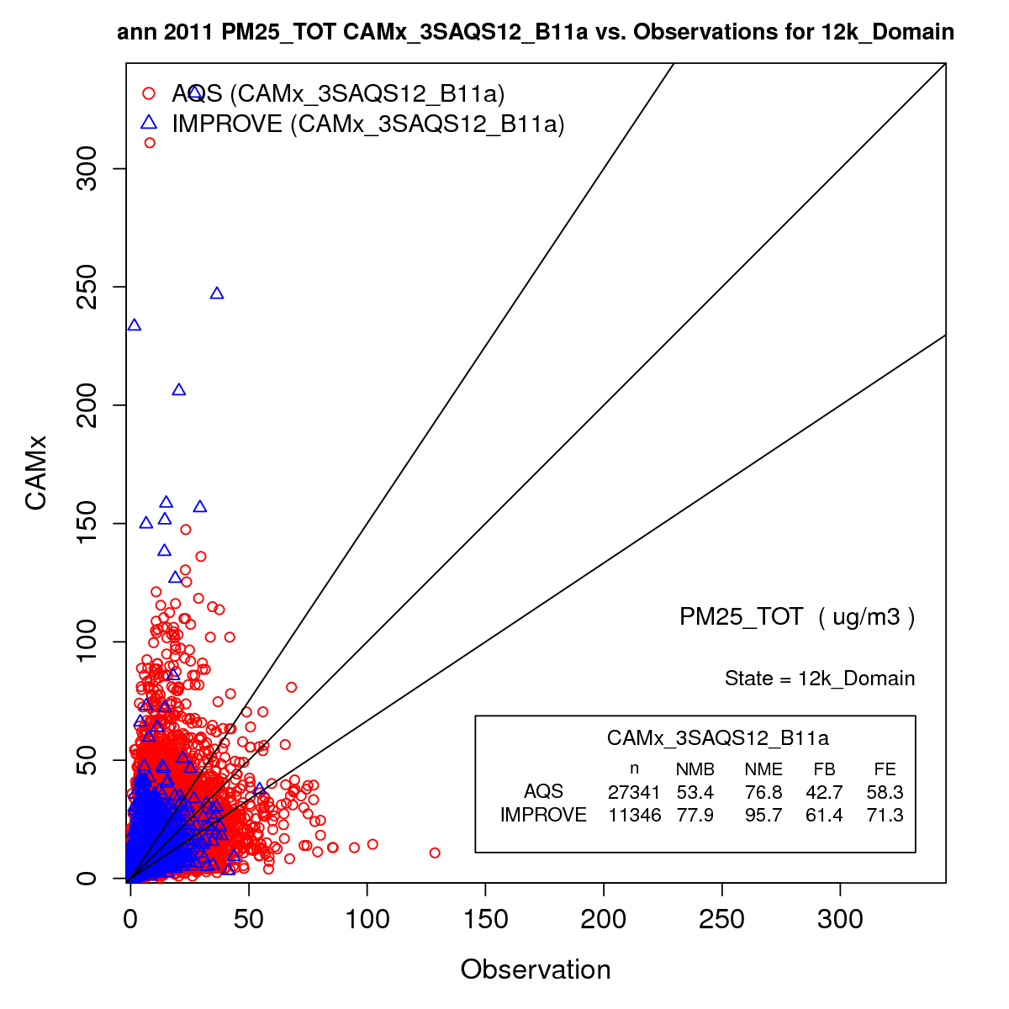

Daily PM2.5 Performance
Goals
Bias = 30%
Error = 50%
Criteria
Bias = 60%
Error = 75%

Slide 21
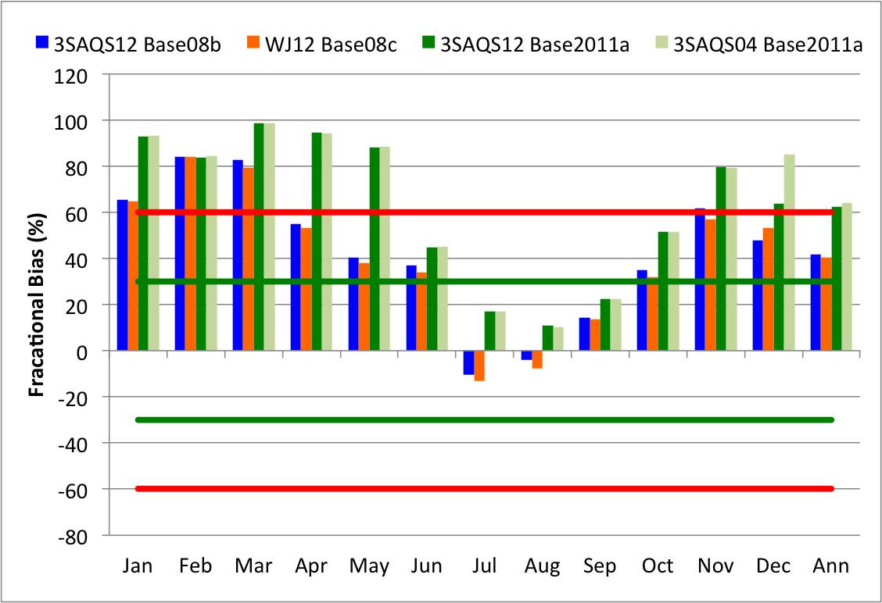
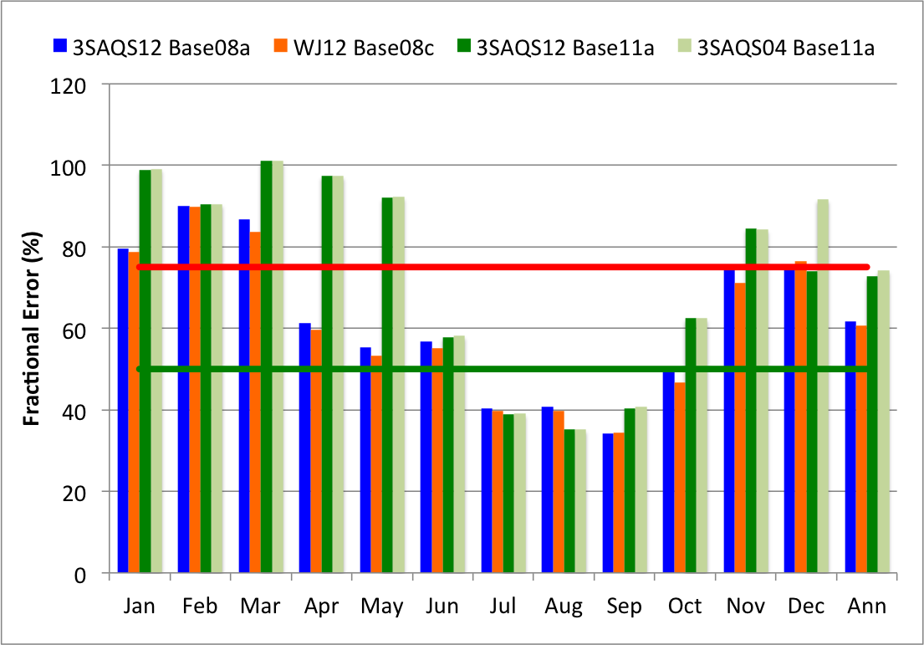
3SAQS Simulation Comparison
Domain Average IMPROVE Total PM2.5
Fractional Bias
Fractional Error

Slide 22
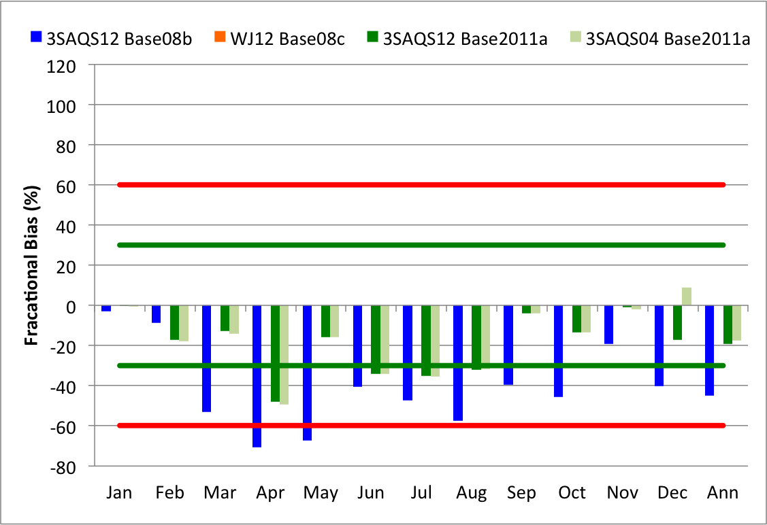
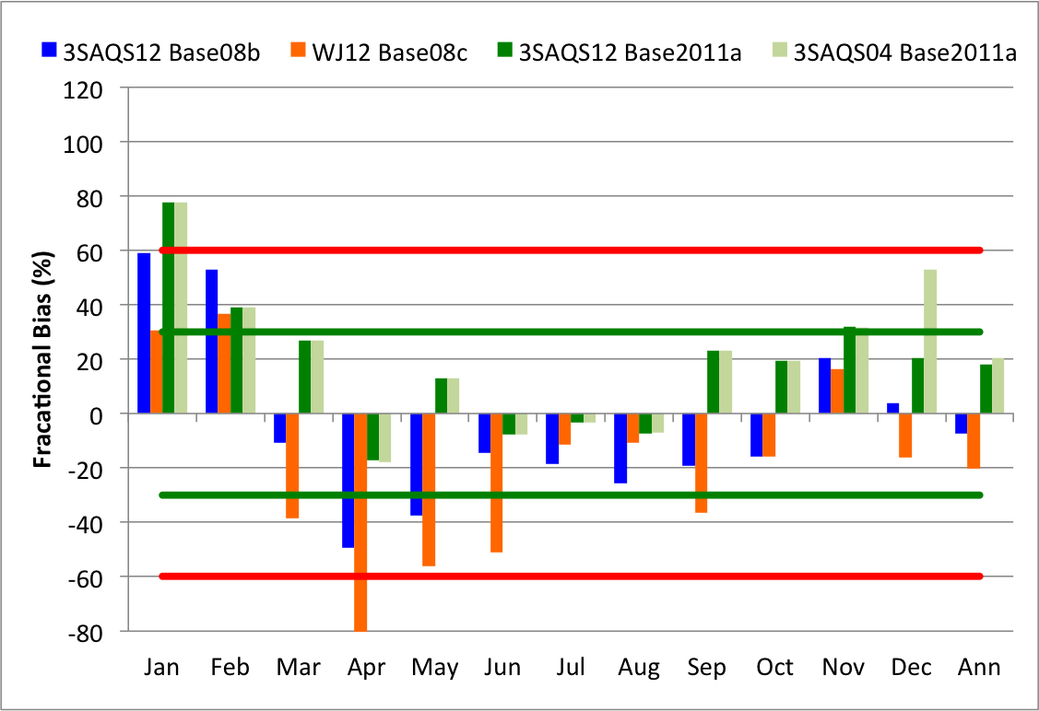
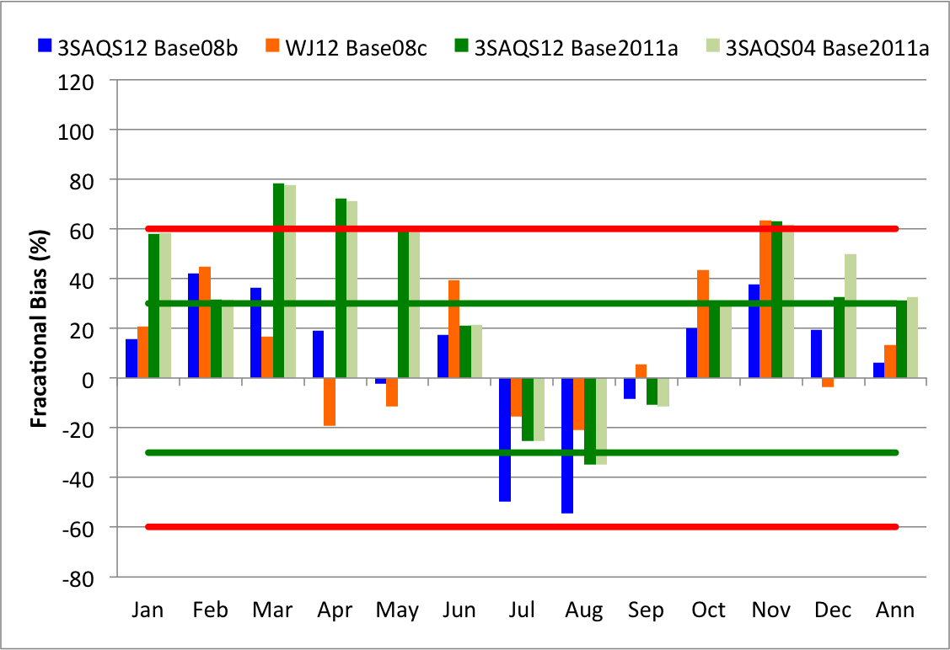
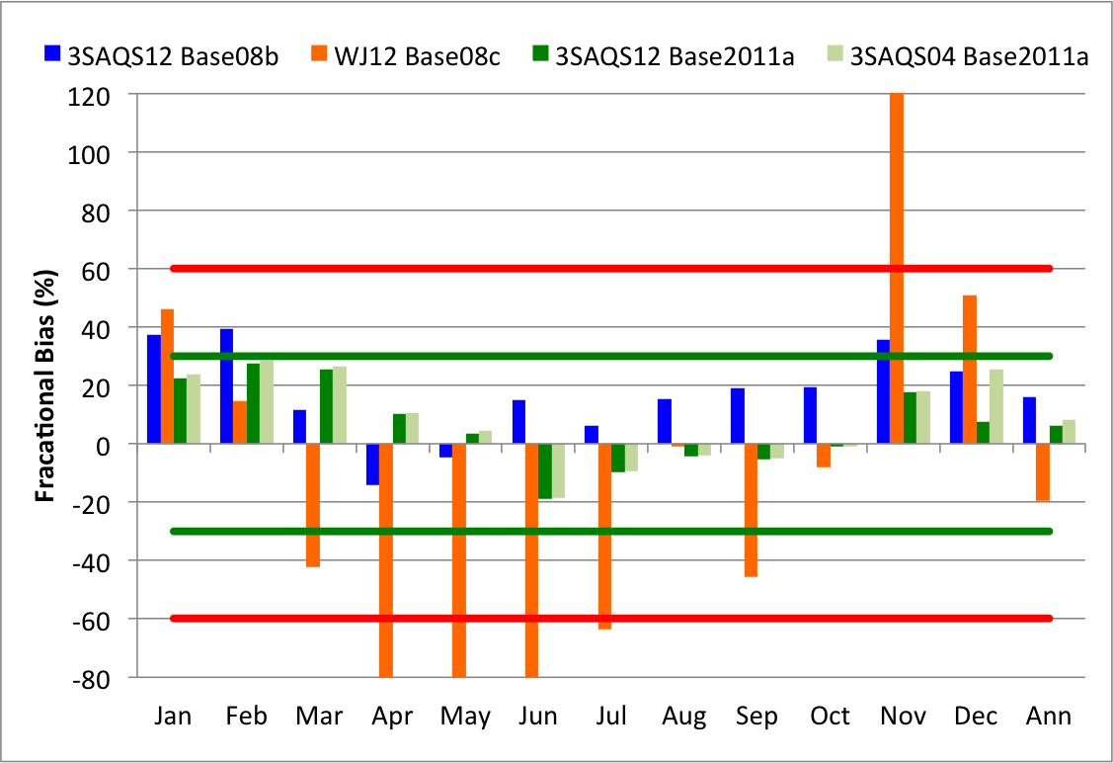
3SAQS Simulation Comparison
Domain-wide Average IMPROVE PM Fractional Bias
SO4 NO3
NH4 EC+OC

Slide 23
Colorado IMPROVE Speciated PM2.5 (CAMx Base11a 4-km)
Spring
Summer
Fall
Winter

Slide 24
Utah IMPROVE Speciated PM2.5 (CAMx Base11a 4-km)
Spring
Summer
Fall
Winter

Slide 25
Wyoming IMPROVE Speciated PM2.5 (CAMx Base11a 4-km)
Spring
Summer
Fall
Winter

Slide 26
3SAQS Base11a MPE
Preliminary O3 Results
Domain and state-wide ozone performance is within performance goals
  Some sites/months will miss the goals/criteria
AQS (urban?) sites are more sensitive to grid resolution than the CASTNet sites
General bias and error improvements at AQS monitors in each of the three states relative to 3SAQS 2008 and WJAQMS

Slide 27
3SAQS Base11a MPE
Preliminary PM Results
Missing (overbias) the criteria targets for total PM2.5 at IMPROVE and AQS sites outside of the summer months
Many of the IMPROVE PM species show performance gains relative the 3SAQS 2008 and WJAQMS
  Nitrate and winter sulfate performance appears to degrade
Seasonal speciated IMPROVE PM2.5 performance is acceptable

Slide 28
3SAQS Base11a MPE Next Steps
Draft Model Performance Evaluation (MPE) report (10/17)
  Ozone, PM, and deposition at standard surface networks
Draft Final MPE (11/4)
  Add UGWOS network
  Add vertical ozone profiles
  Add NH3
  Integrate comments on draft MPE

Slide 29
3SAQS Base11a Platform Schedule
Date | Item
10/17 | Draft MPE Report
11/3 | Comments due on MPE
11/4 | Draft Final MPE Report and Response-to-Comments
TBD | Meeting to review 3SAQS Base11a and discuss outstanding issues and data release
12/1 | 3SAQS Base11a available through 3SDW
1/1/2015 | 3SAQS Base2020a_11 available through 3SDW

