Slide 1
Three-State Air Quality Study (3SAQS) Three-State Data Warehouse (3SDW)
3SAQS 2015 Scope of Work
University of North Carolina (UNC-IE)
ENVIRON International Corporation (ENVIRON)
September 30, 2014

Slide 2
Three-State Air Quality Study (3SAQS) 2015 Scope of Work (SOW)
Covers period of October 1, 2014 through July 31, 2015
Contracted through WESTAR
Tom Moore, Technical Director
ENVIRON International Corporation – Prime
Ralph Morris, Project Manager
University of North Carolina, Institute for Environment -- Subcontractor
Zac Adelman, Project Manager

Slide 3
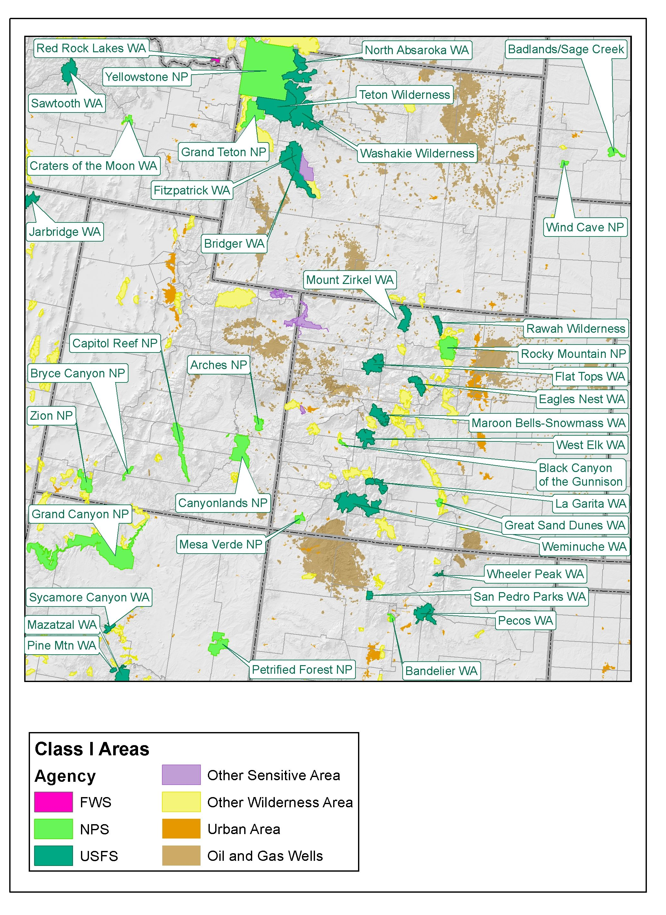
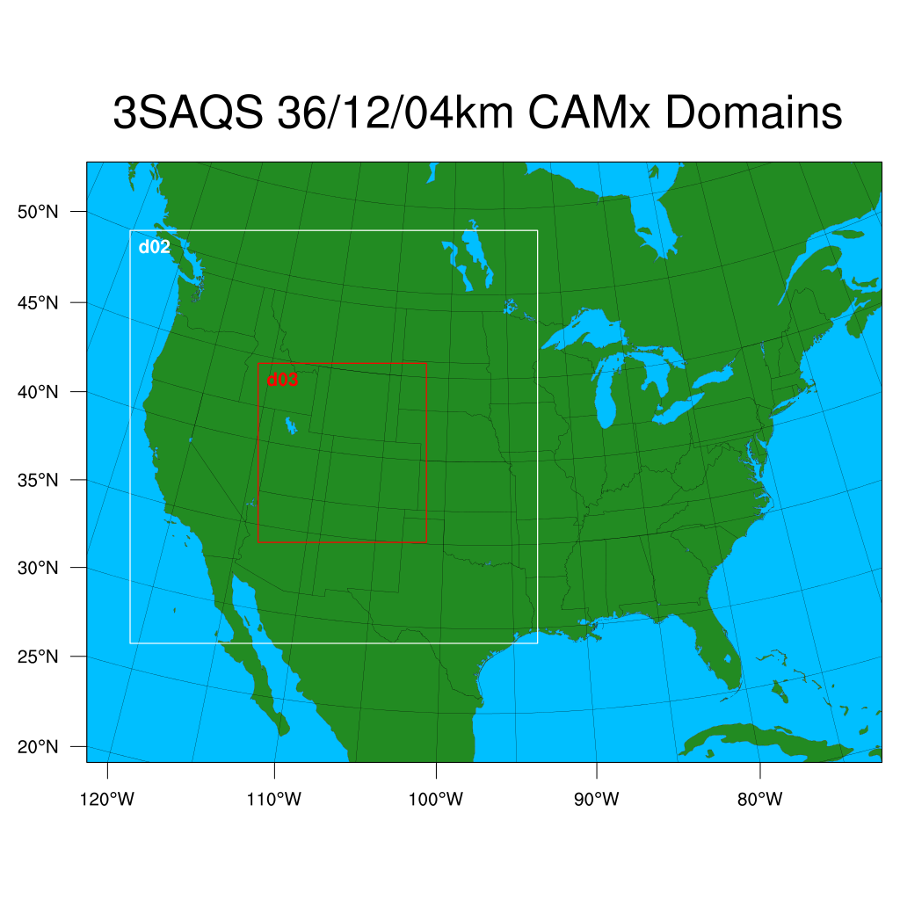
3SAQS Pilot Study 2011 CAMx Platform
36 km CONUS; 12 km WESTUS; 4 km 3SAQS

Slide 4
Task 1: 2011 CMAQ Modeling
CMAQ V5.0.2 2011a 36/12/4 km Base Case Modeling
Use “same” inputs as current CAMx 2011a Base Case
MOZART or GEOS-Chem BCs; WRF processed with MCIP meteorology; 2011a Base Case emissions
Annual 2011 CMAQ 36, 12 and 4 km one-way nesting
(CAMx used two-way nesting)
Model Performance Evaluation
Deliverables:
2011 CMAQ 36/12/4 km I/O loaded on 3SDW
CMAQ MPE report and comparison to CAMx MPE
3SAQS guidance document on how/when use CMAQ vs. CAMx
Schedule: Oct - Nov 2014

Slide 5
Task 2: 2011 Source Apportionment Modeling (1 of 2)
2a: Source Apportionment (SA) Design
Review and comment from 3SAQS TechComm
2b: CAMx 2011 36/12 km Geographic SA
State-specific, BCs, EUSA, Can, Mex, Off-shore
Post-process: CSAPR-type, on-line SA web tool, etc.
2c: CAMx 2011 36/12/4 km Emissions Sector SA
SA by major source categories
E.G., EGU, other Points, On-road, Non-road, O&G, etc.
Post-process model results

Slide 6
Task 2: 2011 Source Apportionment Modeling (2 of 2)
2d: CAMx detailed SA using 4 km 3SAQS Domain
Geographic (e.g., by Basins) and Source Sectors
2e: SA Web Tool on 3SDW
Functionality similar to WestJumpAQMS Spreadsheets only all days instead of just top 10 days
2f: CMAQ SA Modeling
Geographic like 2b only just using 36 km CONUS domain
For some days CAMx 36 km SA to help interpret differences
Detailed SA 4 using 4 km domain like 2d
Deliverables:
SA Design Document
SA Results loaded in web-based visualization tool
SA report on results and how to use/interpret SA results
Schedule: Oct 2014 – Apr 2015

Slide 7
Task 3: 2011 Model Improvements (1 of 6)
Perform CAMx and/or CMAQ sensitivity tests for all or part of 2011 to investigate model performance issues and/or alternative inputs/options
Model Performance Evaluation (MPE)
If improved performance is seen, may adopt as new 2011 base case
First set of sensitivity tests performed using 2013-2014 Pilot Study funding

Slide 8
Task 3: 2011 Model Improvements (2 of 6)
GEOS-Chem Boundary Condition (BC) [Pilot]
Compare with results using MOZART BCs
Dust and ozone BC tracers
CAMx 36/12/4 km 2011 annual run
MPE including ozonesonde, STE events and spring dust
Adopt as new 2011 Base Case if improved MPE
US Background AQ using MOZART BCs [Pilot]
CAMx 2011 36/12 km annual with zero US anthropogenic emissions
Calculate background ozone with no US anthro

Slide 9
Task 3: 2011 Model Improvements (3 of 6)
Oil and Gas VOC Sensitivity [Pilot]
Literature review to obtain top down VOC scaling factors for each O&G Basin
Adjust 2011 O&G VOC emission by Basin
CAMx 2011 with adjusted VOC O&G simulation
Conduct MPE and compare with 2011 Base Case
Preliminary Winter ozone sensitivity [Pilot]
May use new winter WRF simulations performed under Task 9
CAMx and/or CMAQ sensitivity to O&G VOC, snow cover, albedo, mixing, etc.

Slide 10
Task 3: 2011 Model Improvements (4 of 6)
Ammonia Emissions Sensitivity [Pilot]
Work with NPS/ARD to develop ammonia sens test
Use AMON observations, satellite data etc. to develop changes in temporal, spatial and magnitude of NH43 emissions
CAMx and/or CMAQ sensitivity for portion of 2011
Optional US Background using GEOS-Chem BCs [Pilot]
CAMx 2011 36/12 km annual with zero US anthropogenic emissions
Calculate background ozone with no US anthro
Compare with MOZART US Background run

Slide 11
Task 3: 2011 Model Improvements (5 of 6)
Oil and Gas Emissions [2015 SOW]
Design 2-3 emission sensitivity to adjust O&G emissions in specific Basins to improve MPE
Link to literature review of top down adjustments
Vertical Transport/Mixing [2015 SOW]
Explore alternative vertical transport and mixing approaches including no WRF layer collapsing using CAMx and/or CMAQ for portion of 2011
MOVES2014 on-road mobile sources [2015 SOW]
MOVES2014 released 7/31/14, SMOKE-MOVES2014 in Oct?
Use SMOKE-MOVES2014 to generate new on-road emissions for 36/12/4 km 3SAQS domains
Compare emissions w/ MOVES2010b for 3SAQS domains
CAMx 2011 MOVES2014 annual Base Case and MPE
Compare CAMx MPE using MOVES2014 vs. MOVES2010b

Slide 12
Task 3: 2011 Model Improvements (6 of 6)
CAMx 2011b Base Case modeling
Integrate model improvements in CAMx emissions and other inputs
Conduct CAMx 2011b 36/12/4 km base case and MPE
Deliverables:
Work Plan describing sensitivity tests to be performed
PowerPoint presentations on each sensitivity test
Memorandum on all sensitivity tests and 2011b updates
Updated CAMx 2011b base case I/O loaded on 3SDW
Schedule: Oct 2014 – Mar 2015

Slide 13
Task 4: Deposition and Visibility Analysis
Provide more detailed analysis of 2011 visibility and deposition MPE
Analyze CAMx/CMAQ visibility performance using direct measurements as well as reconstructed mass
Wet deposition MPE (NADP) and dry deposition “MPE” (CASTNet)
Deliverables: Document describing CMAQ and CAMx 2011 visibility and deposition analysis and how it will be used to improve the 2014 application
Schedule: Dec 2014 – Mar 2015

Slide 14
Task 5: 2014 Data Analysis/Modeling Plan
Develop a plan for how the preliminary 2014 modeling will be conducted
Deliverables:
2014 Modeling Plan overview
Document on Lessons Learned from 3SAQS 2008 and 2011 SMOKE/WRF/CAMx/CMAQ modeling
Schedule: Jan – Feb 2015

Slide 15
Task 6: 2014 WRF Modeling
Apply WRF for 2014 36/12/4 km
Use two WRF configurations
Standard configuration like 3SAQS with updates
Wintertime configuration based on Task 9
Model Performance Evaluation
Surface, Upper-Air, Mixing Heights, Precipitation
Deliverables:
WRF 2014 Modeling Protocol
2014 WRF I/O and displays loaded on 3SDW
WRF 2014 Model Application/Evaluation Report
Schedule: Mar – May 2015

Slide 16
Task 7: Preliminary 2014 Emissions (1 of 2)
Why not wait for 2014 NEI?
EPA getting better but still delays in releasing NEIs
2008 NEI V1 Apr 2012 – 40 months after year
2011 NEI V1 Sep 2013 – 21 months after year
Performing preliminary 2014 emissions and AQ modeling will allow an evaluation of other components of the modeling system and provide time for model improvements
Meteorology, boundary conditions, etc.
Also allow development of 2014 O&G emissions that can feed 2014 NEI
Preliminary 2014 emissions and SMOKE modeling
Keep simple, 2014prelim will have short shelf life
O&G from Task 10 preliminary 2014 O&G
SMOKE-MOVES2014 with 2014 VMT and WRF data

Slide 17
Task 7: Preliminary 2014 Emissions (2 of 2)
Preliminary 2014 emissions and SMOKE modeling
2014 CEMs data for large EGUs
2011 NEI projected to 2014
MEGAN biogenic emissions using 2014 WRF
Ammonia using 3014 CAFOs etc. and CMU model
Use best available source for fires (FINN?)
Deliverables:
2014prelim development plan
SMOKE 2014prelim I/O loaded on 3SDW
Emission trends report comparing 2008/2011/2014
Annual 2014prelim 36/12/4 km CMAQ/CAMx emission inputs
Memo on 2014prelim emissions and recommendations for improvements
Schedule: Mar – Jun 2015

Slide 18
Task 8: Preliminary 2014 AQ Modeling
Prepare CMAQ/CAMx 2014 Modeling Protocol
Conduct CMAQ/CAMx preliminary 2014 36/12 km modeling
Add in 4 km domain later with improved emissions
Model Performance Evaluation
Recommend model improvements
Deliverables:
CMAQ/CAMx 2014 Modeling Protocol
CMAQ/CAMx 2014 I/O and MPE displays loaded on 3SDW
Report on CMAQ/CAMx preliminary 2014 modeling and MPE
3SAQS air quality/deposition/visibility trends report comparing 2008, 2011 and 2014
Schedule: May – Jul 2015

Slide 19
Task 9: WRF Winter Ozone Modeling
9a: Winter Ozone Work Plan
Review winter ozone field and modeling studies
9b: Develop WRF winter ozone period configuration
9c: Evaluate 3SAQS WRF configuration for Feb 1-7, 2013 benchmark
Uinta Basin
9d: Simulate 2011 winter ozone periods with 3SAQS WRF configuration
Uinta Basin and JPAD area
CAMx/CMAQ sensitivity tests under Task 3
9e: Winter WRF Modeling Memo
9f: Additional WRF for other winter ozone events
Deliverables:
WRF Work Plan for winter ozone modeling
3SAQS WRF 2011 winter ozone modeling I/O and MPE results on 3SDW
Final WRF winter ozone modeling memorandum
Schedule: Oct 2014 – Feb 2015

Slide 20
Task 10: O&G Survey and Preliminary 2014 Emissions (1 of 2)
Survey O&G Operators in Piceance Basin and Unita Basin
WRAP Phase III survey for 2006 out-of-date
Significant changes in industry practices since then
WDEQ has O&G inventory for whole state
No survey needed as O&G inventory judged complete
Denver-Julesburg survey under separate study (RPSEA)
Perform outreach to Operators to make sure surveys are responded to (Airstar)
Acquire 2014 O&G “permitted” O&G data from states and EPA (tribes)
Colorado 2014 APEN data
Utah mainly tribal data obtained from EPA
Wyoming has complete O&G inventory

Slide 21
Task 10: O&G Survey and Preliminary 2014 Emissions (2 of 2)
Project “unpermitted” O&G emissions to 2014
For Colorado and Utah only
Start with 3SAQS 2011 O&G emissions
Assume new 2014 survey data will not be available
Format preliminary CO-UT-WY 2014 O&G for SMOKE
Deliverables:
Plan for developing preliminary 2014 O&G emissions for 3 States
Basin-aggregated survey data on activity, equipment, processes, gas composition, etc.
Preliminary 2014 O&G emissions for 3SAQS formatted for SMOKE
Memo on development of preliminary 2014 O&G emissions
Memo on how to implement new NEPA future year Project O&G emissions with 3SAQS O&G emission inventories
Also discusses design of on-line tool that compares Project O&G emissions with 3SAQS future year O&G emission inventories
Schedule: Oct 2014 – Jun 2015

Slide 22
Task 11: Project Management
Attend conference calls and project meetings
Interact with 3SDW contractors
Prepare contracts and monthly progress reports and invoices
Perform project management
Deliverables:
Signed Contracts and Subcontracts
Monthly progress reports and invoices
Attend conference calls and meetings
Schedule: Oct 2014 – Jul 2015

Slide 23
Questions?
3SAQS 2015 SOW
Oct 1, 2014 – Jul 31, 2015

