Slide 1
IWDW-WAQS Technical Committee Meeting
IWDW Update
Dec. 21, 2017

Slide 2
IWDW Activities – Outline
Wiki additions
Modeling platform data transfers
Modeling platform post-processing
Modeling platform documentation and updates
Future directions: visualization and MPE tools
Monitoring Network Assessment
Lessons learned
Next steps

Slide 3
IWDW Activities – wiki additions
Oversight Committee and Governing Board meetings link
2017 Monitoring Network Assessment meetings and resources wiki
  2017 Final Report & monitor list
  2014 3SAQS MNA Technical Memo and presentation
2014 WAQS O&G basins emissions inventories wiki
  WESTAR 2014 EI Project for 13 O&G basins
Inventory Collaborative wiki
  Multi-jurisdictional partnership (MJOs, FLMs, EPA and others) to develop 2016 base year emissions modeling platform

Slide 4
IWDW Modeling Platforms - data transfers
2017 - incoming
WAQS Derivative
2011b CAMx -Denver O₃ SIP for 2008 NAAQS (with 2017 attainment demonstration)
External
USEPA 2013-15 WRF/MMIF (AERMET output for AERMOD, 2015 MCIP)
USEPA O₃ Interstate Transport for 2015 NAAQS (2011 base, 2023 projections)
USEPA 2011v6 v3 platform (2011, 2017, 2023, 2028 emissions and documentation)

Slide 5
IWDW Modeling Platforms - data transfers
2017 - outgoing
WAQS
2011b CMAQ (ALA; CSU – Health impacts assessment in Southern Colorado)
2011b CAMx (UDAQ; AECOM/PacifiCorp - Utah’s 2012 RHR SIP)
2011b emissions inventories (CO River Indian Tribes - biogenics)
2011b CAMx (NPS; CIRA - BC sensitivity to nitrogen deposition in GYA)
2011a WRF (EPRI; Ramboll-Environ - CMAQ mercury modeling for Northern Colorado)
WAQS Derivative
2011b CAMx -Denver O₃ SIP (NCAR ASP; UNC – MCFs in Denver)

Slide 6
IWDW Modeling Platforms - data transfers
2017 - outgoing
External
EPA WRF/MMIF 2013-15
  6 Requests (EPA-R10, AZDEQ, UDAQ, ODEQ, City of Albuquerque, Trinity Consultants)
EPA Interstate Ozone Transport Modeling for 2015 NAAQS (2011 base and 2023 projections)
  5 Requests (CARB, DEC-NY, USFWS, LADCO, TCEQ)

Slide 7
IWDW Modeling Platforms - data transfers
Oversight - Stewards
Recent IWDW data requests
Follow up on current modeling studies
Level of support for external and derivative platforms
Delivery - external disks
Full EPA platforms are 14TB each
Disk management (EXT4, XFS, NTFS, HFS+)
Disk shipping
Delivery - FTP
Globus (Enabled on both IWDW data servers; test with Ramboll-Environ)
FileZilla (support for ftp & sftp)
Windows Explorer (WinSCP)
Command line client software
Notes:
Disk management: updated valkyr with latest CENTOS OS to allow Linux to “talk” to various disk formats. Required some IT effort but positions IWDW to serve users on different platforms.

Slide 8
IWDW Activities - modeling platform post-processing
Installed AMET v1.3
Ran AMET on Base11b CAMx and CMAQ outputs (12 & 4km)
Installed Verdi 1.5.0 and Pave v2.3
Using standard AMET package leverages external development efforts
Implemented various tools (Python, Fortran, IDL, ArcGIS) to visualize and process gridded emissions data as part of MNA
IWDW is positioned to take on more WAQS modeling post-processing
  Will work with 2014 modeling contractor to define scope of deliverables

Slide 9
IWDW Activities – modeling platform updates
WAQS 2011b
CAMx output using consistent (winter) meteorology CAMx configuration (Dennis McNally, Alpine Geophysics)
2011b_v2 emissions (WAQS O&G emissions inventories for Williston and Great Plains Basins, inventories->premerged CAMx. Not in Base case AQ modeling)
AHOMAP and TUV scripts for non-winter CAMx configuration (Jung Chien, AECOM)
2011b platform description link

Slide 10
IWDW Activities – modeling platform updates
External Platforms
Mapped file structure for USEPA platforms from delivery disks to IWDW file structure
Added modeling platform descriptions
  Backend for IWDW Data Request UI
Added TSD/MPE documents (where available)
USEPA 2011el platform description link
Notes:
For WRF/MMIF platform only MPE docs are for nested 4km modeling, but the IWDW only has the 12km modeling, for which there are apparently no TSDs.

Slide 11
IWDW Activities – future directions: tools
2011 Platform
Update data for current tools
  Model-to-Obs. tools currently include CAMx 2008b 12km; CAMx 2011b 12km & 4km
  Add 2011b CMAQ from IWDW AMET processing; add plots to Image Browser
2014 Platform
Assess model performance where there are known issues/uncertainties with 2011 modeling
  PM - GCM boundary conditions 2011a BC sensitivity wiki
  Winter O₃ - wintertime cold pools/snow cover 2011 winter O3 modeling wiki
  Background O₃ - SI events and long-range transport
  Negative winter VOC bias in some O&G development regions
  These and other issues outlined in 2011b release memo
Notes:
Other issues: negative model bias for VOCs in winter in areas of intense O&G dev. In Utah and Wyoming
Note that some issues (emisions_v2 and use of inconsistent meteorology) were identified in 2017 and are not included in July version of 2011b release memo. Need to append memo.

Slide 12
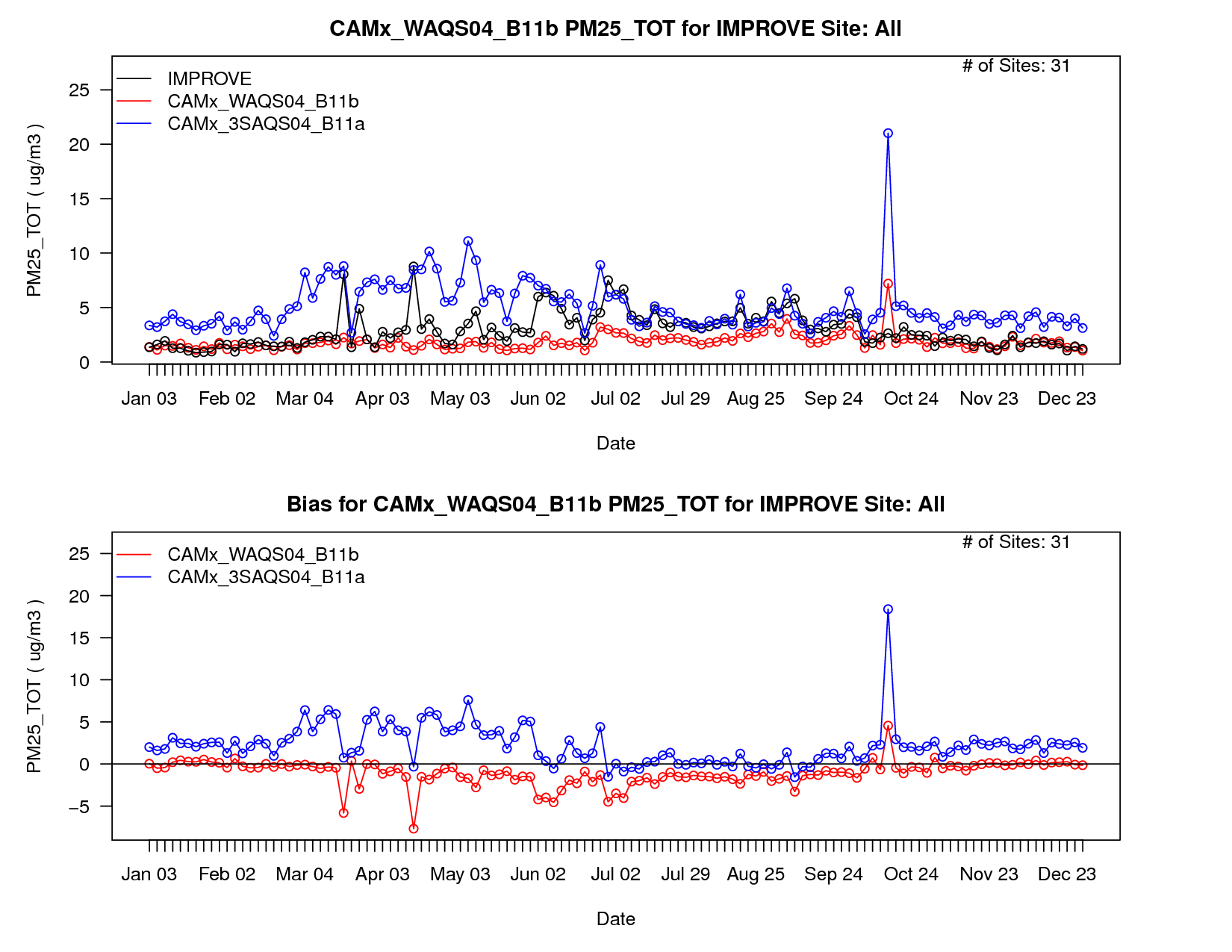
Plots:
2011a, 2011b CAMx 4km
PM2.5 from IMPROVE
2011b removed fine and coarse mode dust and sea salt from MOZART BCs
Plot from IWDW Image Browser

Slide 13
IWDW Activities – future directions: tools
Emissions Review Tool
  Functionality for emissions scenario intercomparisons (e.g., base vs. future; WAQS vs external and/or derivative platforms)
  Capability to display “user developed” emission projections for O&G projects – (Mike George)
Model-to-Obs Tool
  Model-to-model intercomparisons (e.g., 2011a, 2011b; CAMx vs. CMAQ)
  Additional plot types (current plots are time series for network average or single monitoring site)
  Formatting (labeling, etc.)
  Use obs. data from FED (perhaps non-trivial due to extent of AMET post-processing)
Image Browser
  Add 2011b CMAQ; custom AMET output; 2014 data (when available)

Slide 14
IWDW Activities – future directions: tools
New Tools/UI enhancements
  MPE stats (site level MPE statistics)
  Site selection by region and/or site characteristics
GIS tools for visualization of gridded data
  Implement prototype NetCDF visualization tool
  Met data (WRF output, model ready met)
  Emissions (e.g., premerged files)
  PGM results with observational data overlays
Recommendations from IWDW-WAQS Visualization Tools Workgroup
  Create IWDW MPE products aligned with EPA’s MPE Guidance Document
  Met: Site-specific analyses of wind fields, precipitation, cloud cover, and photolysis rates
  Emissions: Displays of speciated VOCs (daily, by county, state)
  PGM: Vertical ozone profiles at routine monitoring sites
  PGM: Additional MPE Plot types as requested by Cooperators

Slide 15
WAQS Monitoring Network Assessment
Process for 2017 assessment is complete
Capture status of current AQ monitoring network in seven WAQS states (focus on parameters and regions of interest to WAQS participants)
Identify monitoring gaps and potential redundancies
Inform WAQS MPE
Final report and supplemental information are available on the IWDW-WAQS MNA Wiki
Key recommendations from the 2017 Assessment
Address lack of NO₂ monitoring in areas potentially impacted by emissions from the D-J Basin
Add O₃ monitors to serve rural communities in Eastern Colorado*
Conduct O₃ monitoring to establish a baseline for Trinidad, Colorado
Redistribute O₃ monitors from overserved to underserved basins (e.g. Roaring Fork/Glenwood area to Grand Junction/Delta County)
Add O₃ & NO₂ monitoring to establish baseline levels along Montana-Canadian border
Potentially redundant PM2.5 AQI (non-FRM/FEM) monitors near Class I/II areas
Other recommendations in MNA Final Report
*CDPHE commented that previous monitoring demonstrates additional monitoring in this area is not necessary

Slide 16
WAQS Monitoring Network Assessment
Closer look at Shamrock Mine, Elk Springs and Paradox monitors to assess their value in current network (Nov. 6 OC meeting)
Maps of target sites and surrounding monitors
Spatial analyses/data from MNA (airsheds, monitor extents, O&G well locations)
Scatter and time series plots (O₃ MD8)
Look at long-term monitors to better understand local AQ characteristics
Consider multiple factors:
  Is the monitoring record sufficient to calculate 3-year design values?
  Sufficient data to capture interannual meteorological variability and/or make meaningful comparisons to surrounding sites?
  Outlook for future O&G development in the region
  Design value trends at surrounding monitors

Slide 17
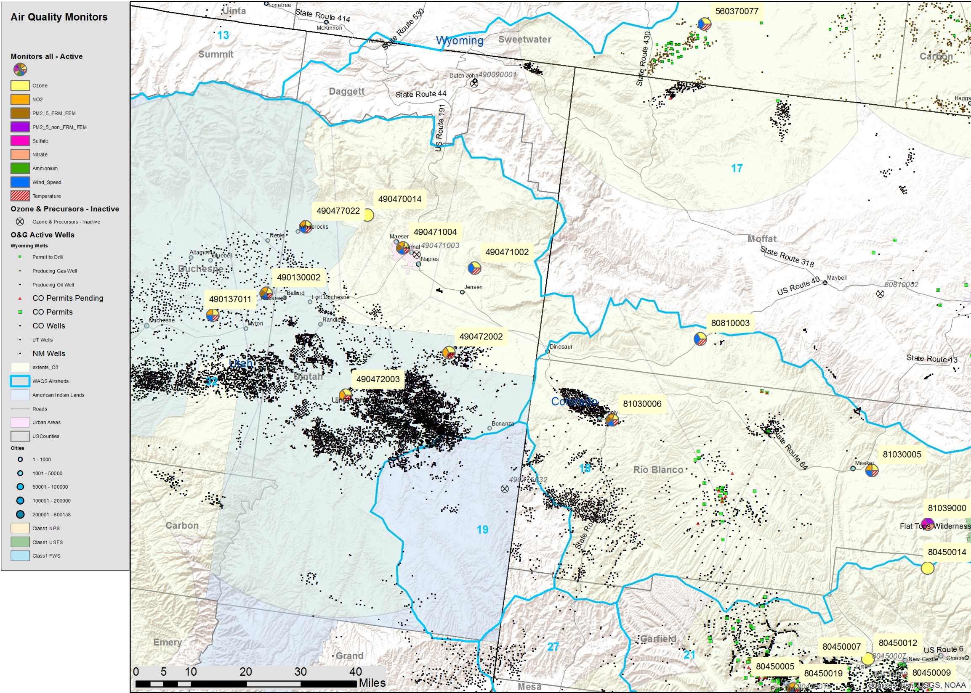
Elk Springs
Moffat County, Colo.
Operated by CDPHE
Replaces Lay Peak monitor
Start Date 8/1/2015
AKA Dinosaur East
Compare to
Rangely (CO-BLM/NPS)
Meeker, (CO-BLM/NPS)
Dinosaur, UT (NPS)
Redwash/Deadman’s Bench, UT (Ute)
Elk Springs
Comparison sites
Notes:
Add map with scale bar

Slide 18
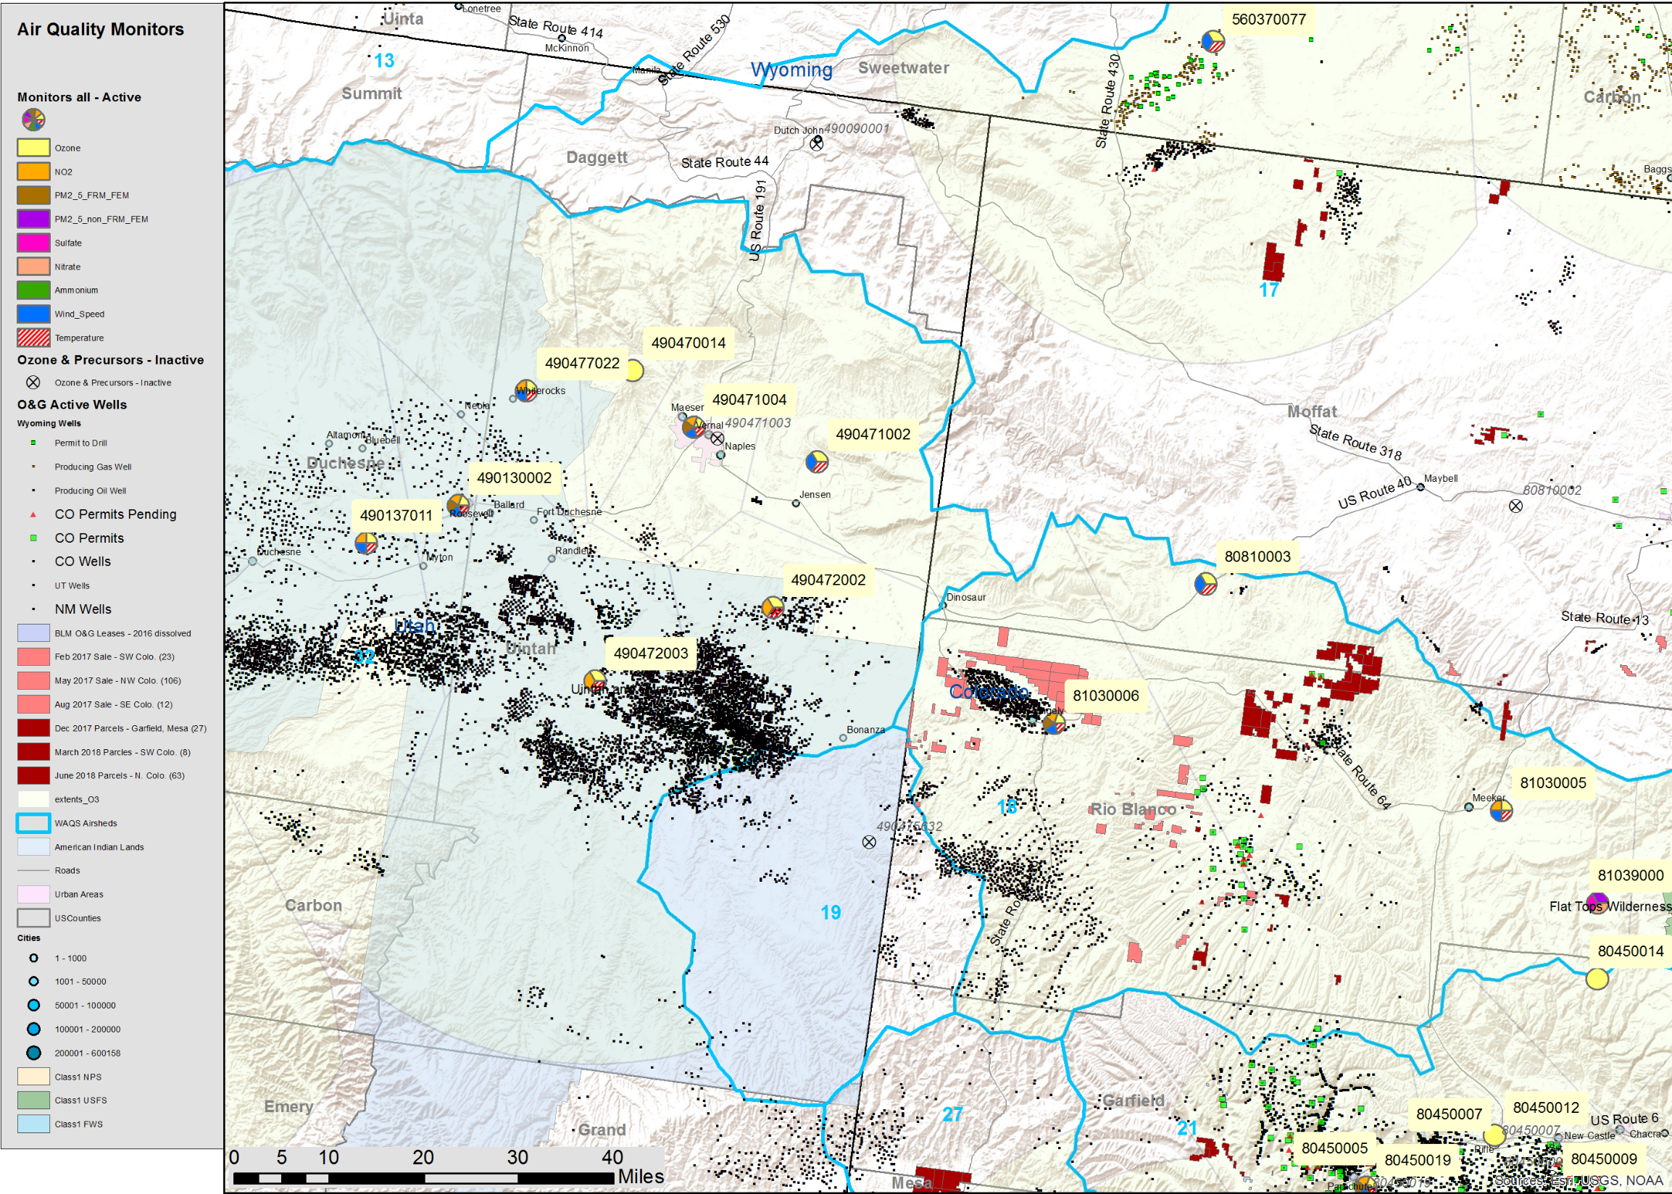
Elk Springs
Moffat County, Colo.
Operated by CDPHE
Replaces Lay Peak monitor
Start Date 8/1/2015
AKA Dinosaur East
Compare to
Rangely (CO-BLM/NPS)
Meeker, (CO-BLM/NPS)
Dinosaur, UT (NPS)
Redwash/Deadman’s Bench, UT (Ute)
CO BLM O&G Leases
Elk Springs
Comparison sites
Notes:
Add map with scale bar

Slide 19
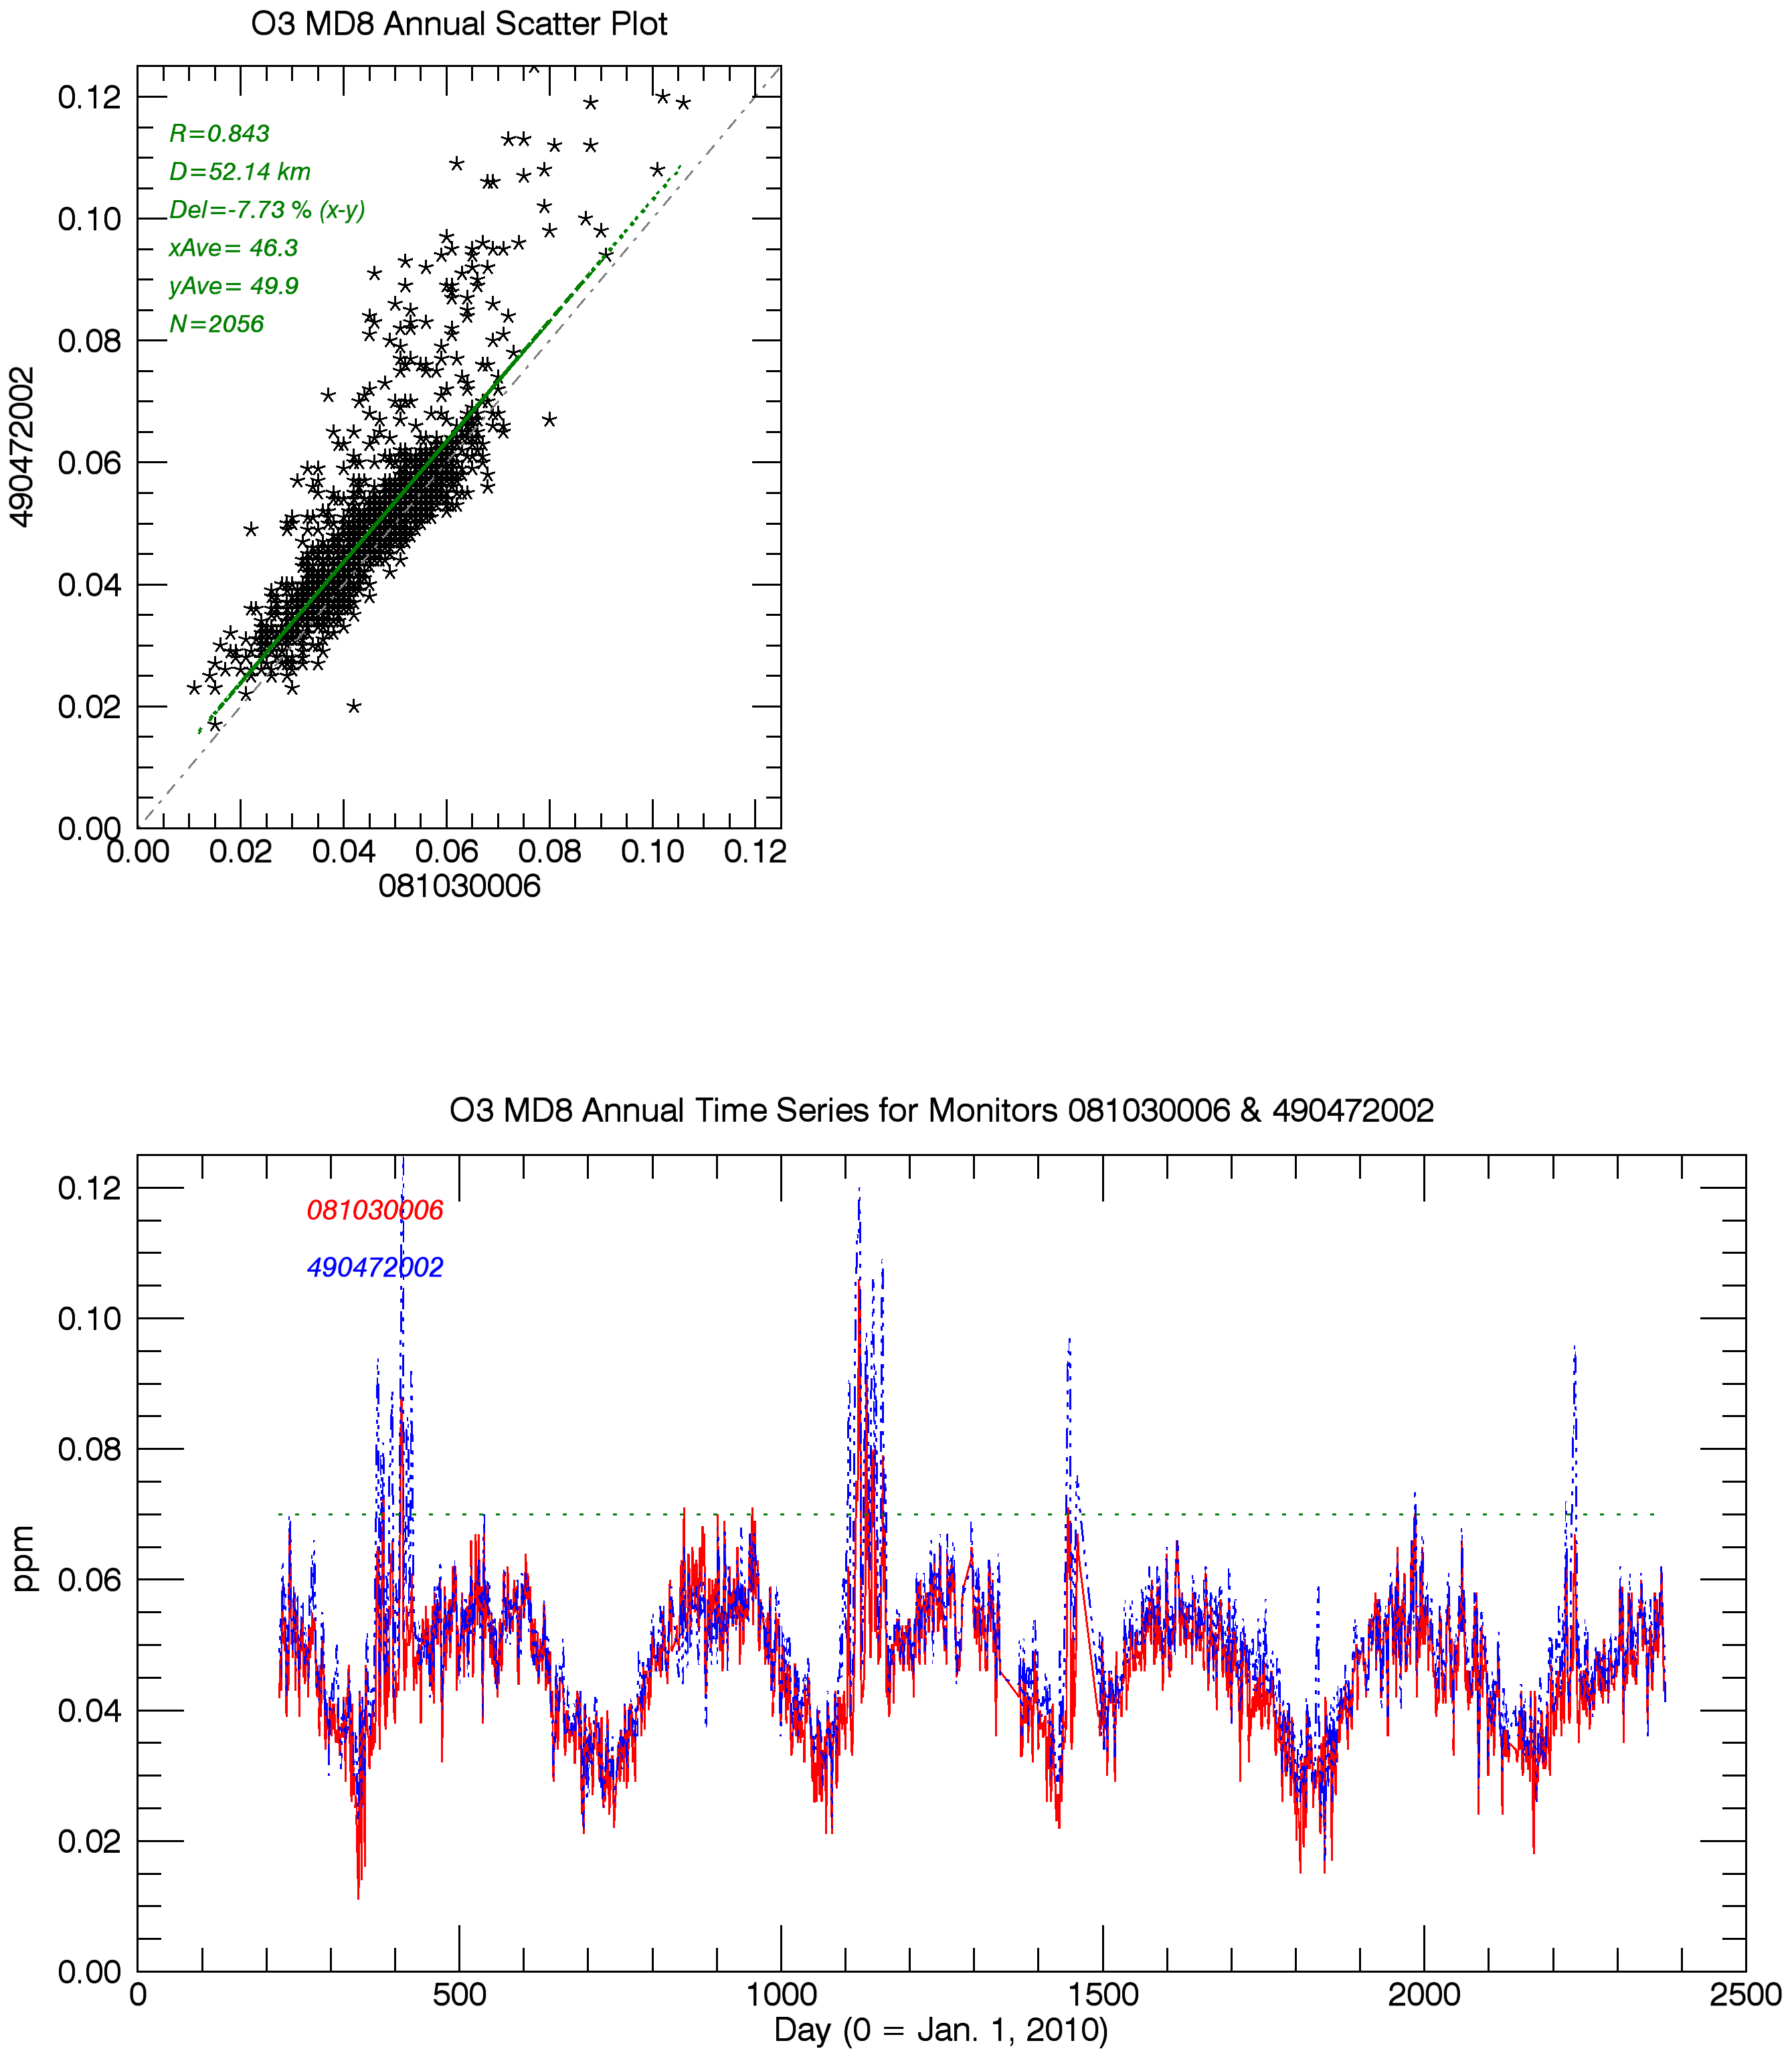
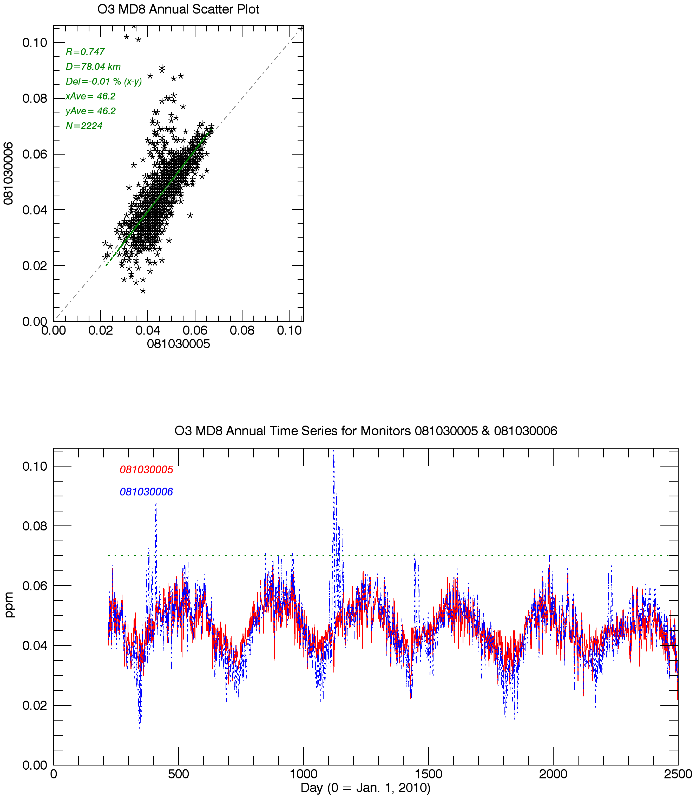
O₃ MD8
2010-2016
Redwash/Deadman’s Bench, UT vs. Rangely, CO
O₃ MD8
2010-2016
Rangely CO vs. Meeker, CO
High wintertime O₃ is not observed at Meeker, 78km west of Rangely
Winter O₃ spikes at both monitors
1. Deadman’s Bench
2. Rangely
3. Meeker
Rangely
2011
2012
2013
2014
Notes:
Winter O3 spikes: transport from O3 produced due to met and precursors in Uinta Basin or local conditions in Piceance Basin?
Note lower winter O3 at Rangely than Meeker
UBOS 2011-2014
UT legislature funding for Uintah Basin Air Quality Research Project, SB118

Slide 20
2014-2016 O₃ 8-hr County level Design Values for the 2015 NAAQS (based on monitor with the highest value in each county)
Utah:
Duchesne & Uintah Counties above NAAQS for last three 3-yr DV periods; monitoring in the Uinta Basin was sparse before then.
Colorado:
Rio Blanco County (Rangely) above NAAQS for three of last four 3-yr DV periods.

Slide 21
Uinta & Piceance Basins O₃ Design Values
State | County | AQS Site ID | Site Name | 2010-2012 Design Value | 2011-2013 Design Value | 2012-2014 Design Value | 2013-2015 Design Value | 2014-2016 Design Value
Colorado | Rio Blanco | 081030005 | Meeker | 0.063 | 0.063 | 0.063 | 0.063 | 0.061
Colorado | Rio Blanco | 081030006 | Rangely |  | 0.077 | 0.074 | 0.073 | 0.063
Utah | Duchesne | 490130002 | Roosevelt |  |  | 0.078 | 0.075
Utah | Duchesne | 490137011 | Myton |  |  |  | 0.073 | 0.072
Utah | Uintah | 490471001 | Fruitland |  | 0.068
Utah | Uintah | 490471002 | Dinosaur |  |  |  |  | 0.068
Utah | Uintah | 490471003 | Vernal |  |  | 0.076
Utah | Uintah | 490471004 | Vernal
Utah | Uintah | 490472002 | Redwash |  |  |  |  | 0.070¹
Utah | Uintah | 490472003 | Ouray |  |  |  | 0.079 | 0.080
Utah | Uintah | 490477022 | Whiterocks |  |  |  |  | 0.071
State | County | AQS Site ID | Site Name | 2014 4th Highest Daily Max Value | 2015 4th Highest Daily Max Value | 2016 4th Highest Daily Max Value
Colorado | Rio Blanco | 081030005 | Meeker | 0.062 | 0.064 | 0.059
Colorado | Rio Blanco | 081030006 | Rangely | 0.062 | 0.066 | 0.061
Utah | Duchesne | 490130002 | Roosevelt | 0.062 | 0.060 | 0.081
Utah | Duchesne | 490137011 | Myton | 0.067 | 0.065 | 0.085
Utah | Uintah | 490471002 | Dinosaur | 0.064 | 0.067 | 0.075
Utah | Uintah | 490471003 | Vernal | 0.062
Utah | Uintah | 490471004 | Vernal |  | 0.064 | 0.073
Utah | Uintah | 490472002 | Redwash | 0.061 | 0.066 | 0.083
Utah | Uintah | 490472003 | Ouray | 0.079 | 0.067 | 0.096
Utah | Uintah | 490477022 | Whiterocks | 0.064 | 0.068 | 0.081
Interannual variability influences 3-year DV
Notes:
1. Deadman’s Bench had invalid 2014-16 DV due to incomplete data in 2014. Not sure why based on available data. Monitor had 7 exceedances in 2106.

Slide 22
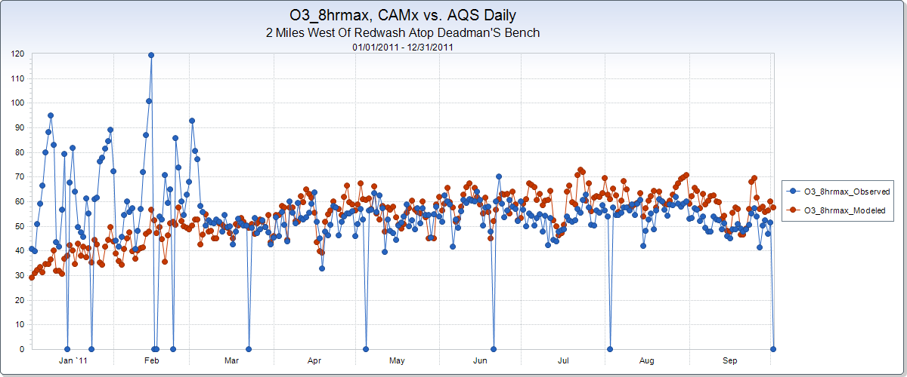
IWDW Model-to-Obs. Tool
IWDW has data from standard networks and special studies, including 2011 UBOS
2011b CAMx 4km and
AQS monitor at Redwash/Deadman’s Bench, UT
O₃ MD8
2011 Obs.:
22 days > 70ppb
4th highest = 93ppb
Notes:
O3 spikes corresponded to time period of 2011 UBOS. High O3 ( > 120ppb) was observed at a number of monitors in the Basin (e.g. Pariet, Redwash, Ouray, Horse Pool)

Slide 23
Lessons Learned – WAQS emissions and AQ modeling
Completeness
  2011b_v2 emissions
  2011b nonpoint refueling emissions
  Weld County O&G VOC speciation corrections
Version control
  CAMx output with consistent meteorology
  Source apportionment modeling vs. two-way nested grid WAQS CAMx configuration
User expectations
  Complete set of pre-processing scripts
Notes:
Issues are documented on 2011b emissions and AQ modeling errata and on platform description

Slide 24
Next Steps
WAQS Modeling
Platform deliverables: completeness; version control; user expectations
Monitoring Network Assessment
Engage Tribal Data Workgroup
Obtain O&G lease information where available
“Clean” and “anthropogenic only” AQ simulations would allow for monitor rankings with and w/o anthropogenic emissions
Identify priority sites that align with WAQS network assessment objectives and WAQS MPE
Tool Development
Update current tools with available data
Refine and release prototype tools (e.g., NetCDF browser w/ monitoring data overlays)
Create data products that support evaluations outlined in EPA’s MPE Guidance Document
Ad hoc, user defined, output (e.g., AMET scripts for site/episode specific MPE products)
Focus on regions of poor model performance/uncertainty (e.g., background O₃; winter O_{3,} PM, emissions)
Notes:
Tribal Data Workgroup – use Tribal emissions inventories in regional AQ modeling

Slide 25
Model-to-Obs Tool - examples
Hourly O₃ time series for four monitors across Uinta/Piceance Basins
  Jan. 1 to March 7, 2011
Monitors (west to east, separated by ~100miles)
  Ouray
  Readwash/Deadman’s
  Rangely
  Meeker
Parameters
  O₃ hourly
  NO_{x} hourly

Slide 26
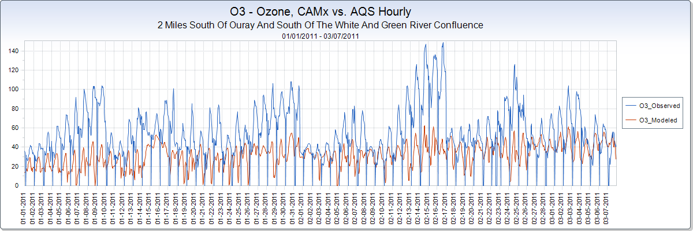
2011b CAMx 4km

Slide 27
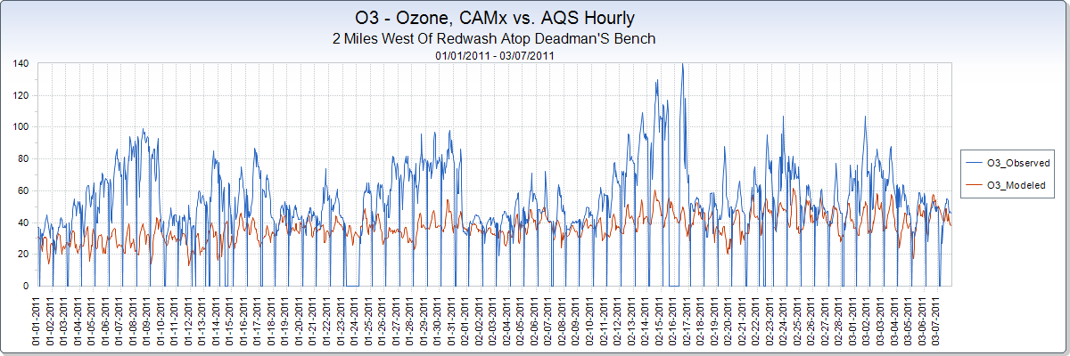
2011b CAMx 4km

Slide 28
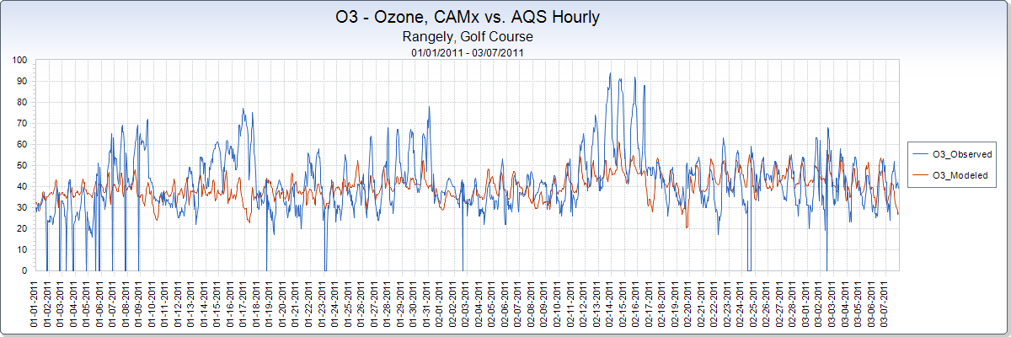
2011b CAMx 4km

Slide 29
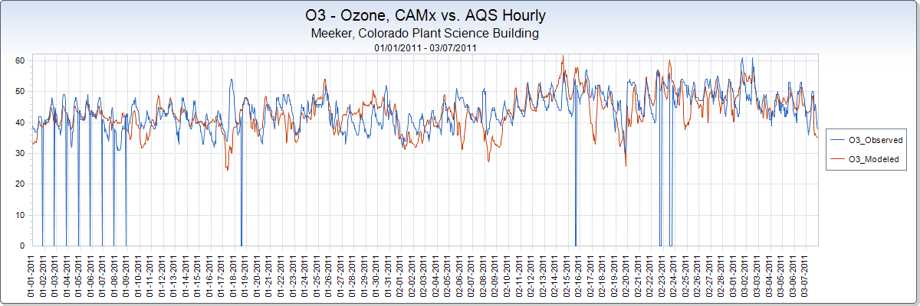
2011b CAMx 4km

Slide 30
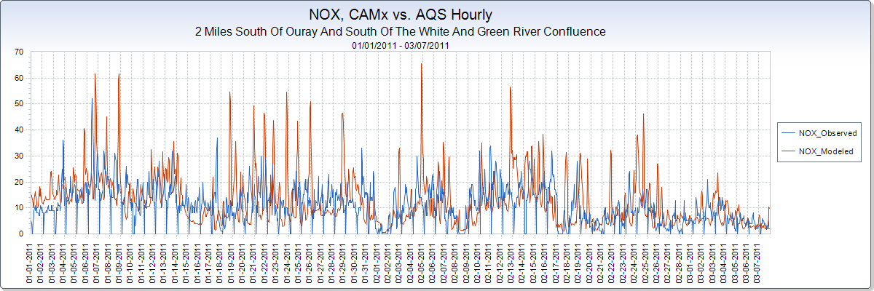
2011b CAMx 4km

Slide 31
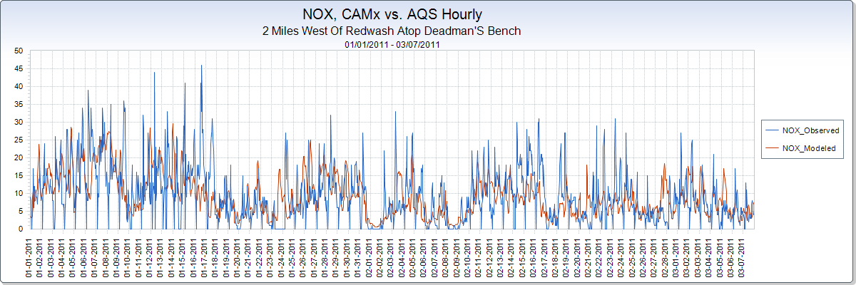
2011b CAMx 4km

Slide 32
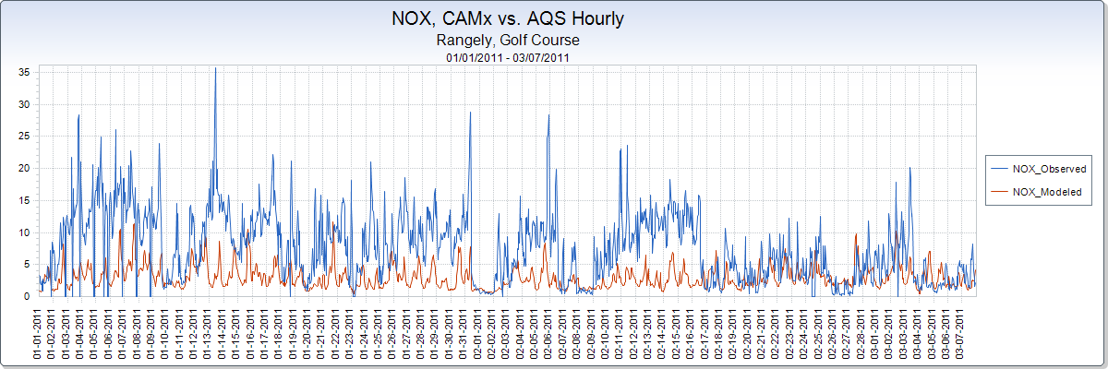
2011b CAMx 4km

Slide 33
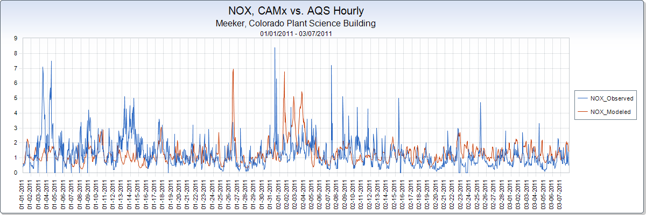
2011b CAMx 4km

