Slide 1

Western Air Quality Study (WAQS)
Intermountain Data Warehouse (IWDW)
WAQS 2011b Emissions Projections
University of North Carolina (UNC-IE)
Ramboll-Environ (Environ)
September 23, 2015
WAQS/IWDW Technical Committee Meeting

Slide 2
Summary
Emissions Processing Categories
  Options from EPA 2011v2 Platform
  WAQS Categories
Recommendations for 2011b Projections

Slide 3
Emissions Inventories
Emissions are what is regulated, not ambient air quality - through:
  Limits on permitted sources and tracking of actual emissions
    Strategies that address group or types of sources by specifying technology for operations (fuels, turnover of technology) or controls (specified emissions limits)
    Fees for permitted sources allow regulators to recover costs to issue, inspect, and monitor impacts
  Reporting and analysis of inventory data allows trend and compliance tracking
    A heightened effort is required to build and understand a baseline historical period inventory for a modeling study
    Modeling studies also require projections of future emissions to assess control programs to efficient emissions reduction strategies

Slide 4
Projections of Future Emissions – Background
Need
  Air quality planning to correct violations of health and welfare standards
  To prevent violations of standards and to reduce exposure
  Account for state and federal regulations “on the books and on the way”
  Effectively consider “known future” to estimate additional costs and benefits of additional control options
Scope
  Change across all source categories from baseline actual emissions into the future
  Anthropogenic sources affected by
    Economic factors
    Changes in technology
    Emerging standards
4

Slide 5
Emissions Projection Conventions
Base Year → Future Year
Projections = growth + controls
Do not decouple a base and future year inventory pair
Natural emissions categories are held constant
Anthropogenic emissions categories may be projected
Typically no changes to spatial allocation, temporal patterns, or speciation

Slide 6
Available Projection Inventories for Base11b Platform
Non-O&G
  EPA 2011NEIv2 Platform
  2017 and 2025 projection years
    2017 available now, includes documentation; part of recent NODA
    2025 to be released in October, with documentation
  Same categories as 2011 base (including O&G)
O&G
  2020 projections off of 2011 Phase 2

Slide 7
WRAP Phase III O&G EI Methodology Diagram
“Unpermitted” sources surveys to O&G producers
Permit data from State databases and EPA permit data (Title V) or other permit data
Combined survey responses for all participating companies
IHS database (oil and gas production and well and spud counts)
Scaled-up “unpermitted” sources emissions for entire basin
Complete oil and gas emissions inventory for entire basin
7

Slide 8
WRAP Phase III – Source Categories
Large Point Sources
(Gas plants, compressor stations)
Drill Rigs
Wellhead Compressor Engines
CBM Pump Engines
Heaters
Pneumatic Devices
Condensate and Oil Tanks
Dehydrators
Completion Venting
Fracing Engines
Lateral compressor engines
Workover Rigs
Salt-Water Disposal Engines
Artificial Lift Engines (Pumpjacks)
Vapor Recovery Units (VRU’s)
Miscellaneous or Exempt Engines
Flaring
Fugitive Emissions
Well Blowdowns
Truck Loading
Amine Units (acid gas removal)
Water Tanks

Slide 10
O&G Projections - Methodology
No standardized methodology for conducting projections – each inventory study has used different approaches (RMPs, NEPA projects, regional inventories)
WRAP Phase III inventories use a three-step approach:
  Activity scaling factors
  “Uncontrolled” projections
  State and federal regulatory control requirements
Activity scaling requires input from operators on planned activities and/or analyzes trends and/or relies on industry studies
State and federal regulatory control requirements complex
10

Slide 11
Projections - Methodology
Operators queried for planned drilling activities
Well decline data gathered to generate basin-average curves
Production projections constructed from operator data/historic trends
11

Slide 12
NOx Projections - Results
Emissions projections are complex mix of growth or decline factors and controls from natural equipment turnover and state/federal regulations
12

Slide 13
VOC Projections - Results
State regulations vary widely from state to state in emission source categories regulated and levels of control required
13

Slide 14
Emission Inventories – Issues and New Concepts
Point vs. area sources
Missing source categories
Skewness
Gas composition data
New factor data
Uncertainties
14

Slide 15
Issues and New Concepts – Point vs. Area
Point vs. Area Sources
Pros | Cons
Better spatial resolution | Resource intensive (to states and industry)
Gather actual emissions/actual usage | Resource intensive to process
Improved accuracy of emissions | Factor approach still used for minor sources
Expect improvement in spatial resolution and accuracy of emissions data from point sources but significant effort to process and track
Colorado (APENs) and Wyoming (site surveys) already doing this
15

Slide 16
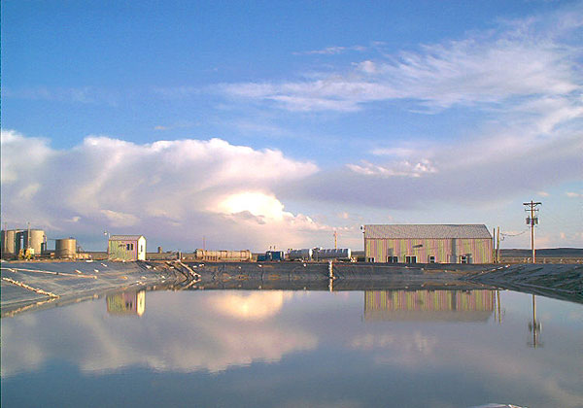
Issues and New Concepts – Missing Categories
Produced water (evaporation) ponds
Emission factors uncertain and highly dependent on composition, production type
Seasonal/diurnal variations
See for example Utah State University work to characterize emissions in Uinta Basin
16

Slide 17
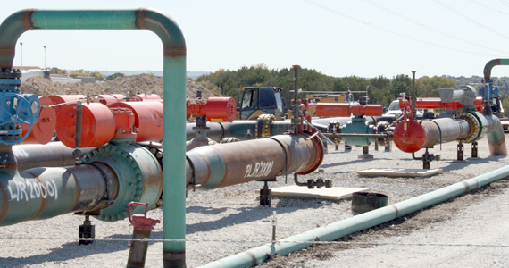
Issues and New Concepts – Missing Categories
Field gathering pipelines
Lack of data on extent of pipeline infrastructure within fields
Pipeline companies historically not part of the inventory process
17

Slide 18
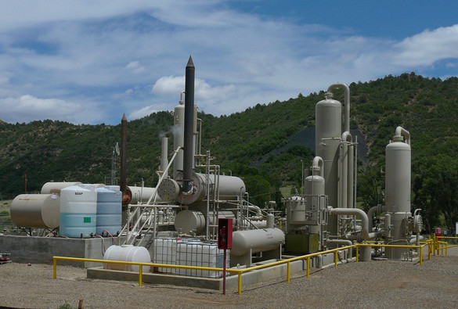
Issues and New Concepts – Missing Categories
Midstream sources
Midstream sources not always captured in inventories – state reporting thresholds
Midstream sources on tribal lands
Midstream companies historically not part of the inventory process
18

Slide 19
Issues and New Concepts – Missing Categories
Mobile sources
Trucking and off-road equipment likely underestimated in existing mobile inventories
Activities dispersed throughout basins and among basins
See for example P3 study in Piceance Basin
As operators and regulators move to other systems to produce and move products and by-products (train, pipelines and electrification) and away from trucks and diesel/field gas combustion, new data is needed
19

Slide 20
Issues and New Concepts – Missing Categories
Non-routine events
Pipeline blowdowns
Spills/upsets
Maintenance activities
20

Slide 21
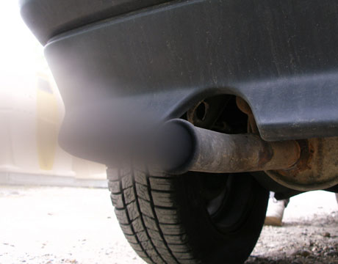
Issues and New Concepts – Skewness
Poorly performing and “non-average” sources could have significantly higher emissions than estimated in inventories
Analogous to “smoking vehicles” in mobile source inventories
Statistical sampling/monitoring of sources needed to develop methods to represent this in inventories
See for example NOAA monitoring in Uinta Basin and CDPHE capture efficiency adjustments
21

Slide 22
Issues and New Concepts – Gas Compositions
Gas compositions in Phase III use a basin-average approach
Variability within a basin by production type (field to field)
Variability within the production/gathering system
More data needed – field or formation level approach for basins?
Conventional Gas
(Vented/Fugitive Sources)
Flash Gas
(Condensate and Oil Tanks)
22

Slide 23
Issues and New Concepts – Factors and Uncertainty
New factor data
  Fugitive emissions
  Venting from well completions
  Water tanks / evap ponds
  Applying EDF studies’ results in specific Basins
  More complete/representative speciation data across various processes
Uncertainty
  Uncertainties not quantitatively estimated in most inventories
  Large data sets needed to estimate uncertainty
  Helpful in identifying poorly-characterized sources, and estimating uncertainty in AQ modeling
23

