Slide 1
WAQS Monitoring Network Assessment
Nov. 21, 2016
Update for IWDW-WAQS Technical Committee

Slide 2
WAQS Monitoring Network Assessment
Activities
Oct. - Nov. 2016
11 Oct. Technical Committee Meeting
  initial presentation
  solicit participants for Working Group
27 Oct. WG call #1
  21 participants from state and federal agencies (CDPHE, WYDEQ, UTDEQ, NMED, NDDH, MTDEQ, BLM CO, FS, NPS)
  expand assessment to seven states (add MT, ND, SD)
  reviewed objectives of 3SAQS assessment
  Working Group task: feedback from states on current network configuration
21 Nov. Technical Committee Meeting Call
  status update
30 Nov. WG call #2
  finalize current network configuration
  outline chemical parameters and analyses for WAQS assessment

Slide 3
WAQS Monitoring Network Assessment
Activities
Nov. 2016
Summary of states’ 5-year monitoring network assessments
  monitoring sites used in state assessments (~2010-2014) – generally only state run sites are considered or at least explicitly analyzed
  compare to current monitoring sites from AQS (2015-2016)
  states’ plans for site/monitor changes
  summary of analyses
  recommendations
Monitoring site spreadsheet (from AQS monitors list)
  monitors by state; includes all parameters
Items 1 & 2 sent to WG on 15 Nov. for comments and discussion on 30 Nov. call Wiki

Slide 5
WAQS Monitoring Network Assessment
Activities
Nov.- Dec. 2016
Finalize monitoring sites
Determine analysis parameters (O3, NO2, VOCs, PM2.5, Met.)
Data collection
Outline analyses for WAQS assessment
  area served (polygons)
  concentration (DVs, difference from NAAQS)
  site-to-site (correlation)
  site rankings based on WAQS emissions (opportunities for source based site rankings, e.g. mobile vs. O&G)
  site rankings using WAQS AQ modeling results
  others….
Begin analysis

Slide 6
WAQS Monitoring Network Assessment
Activities
Nov. 2016
Data collection (AQS 2014-2016)
Dataset |  |  |  |  | Notes
 | Daily |  | Hourly
 | Sites | Parameters | Sites | Parameters
O3 | 161 | 1 | 161 | 1
NO2 | 90 | 1 | 90 | 1
NONOxNOy | 90 | 3 | 88 | 3
VOCs | 13 | 105 | 2 | 1 a
PM2.5 | 154 | 72 | 89 | 4 b | FRM, non-FRM, SPEC c
HAPS | 63 | 31 | 0 | 0
MET
Two NMHC monitors (Colorado)
Three urban carbon PM monitors (Colorado, Utah)
Includes T,P at 60 sites

Slide 7
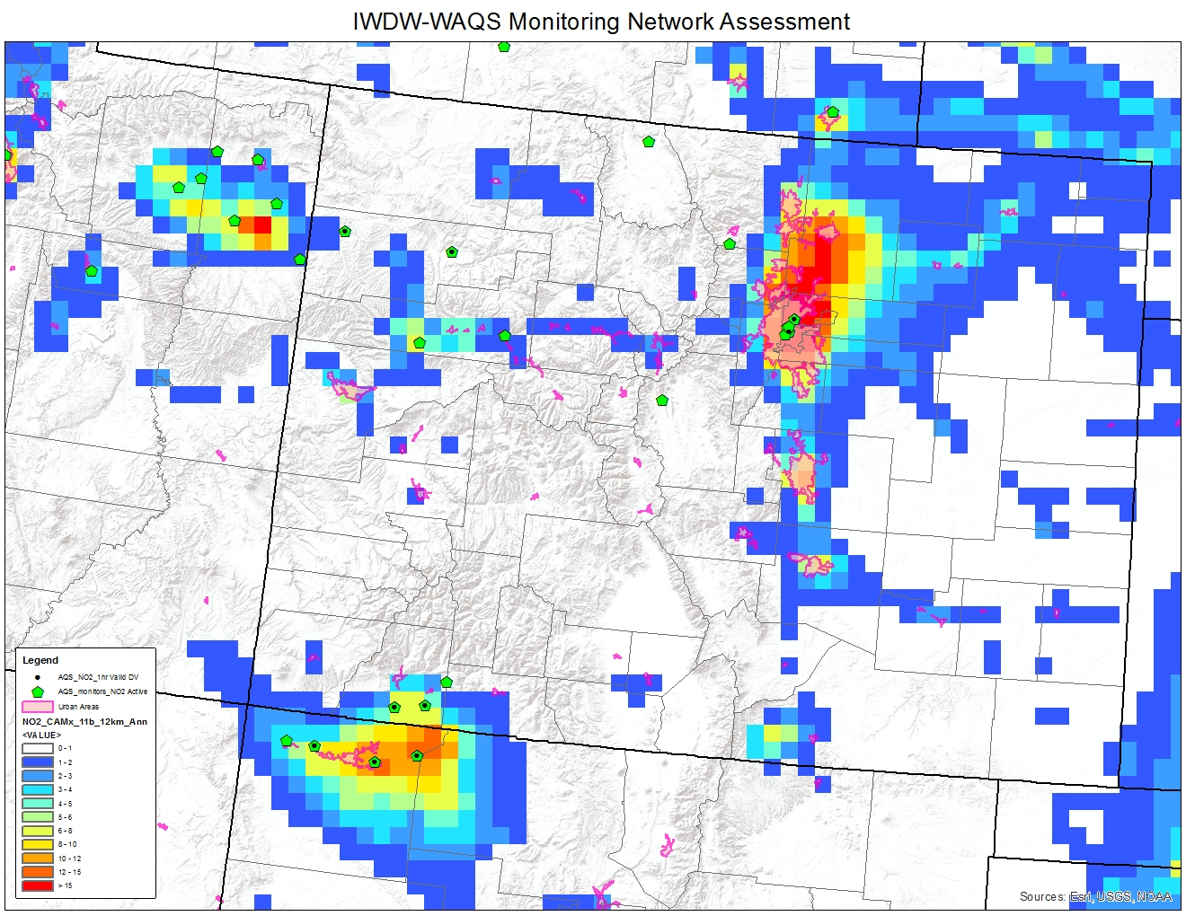
Map Features
Colorado
Urban Areas
Active NO2 monitors
Sites reporting valid 2013-15 NO2 DVs
WAQS 2011b annual average NO2

Slide 8
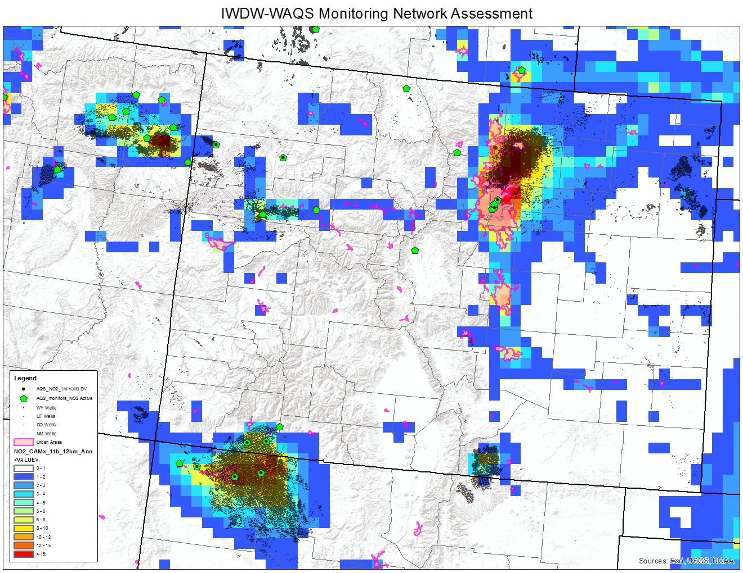
Potential regions for new monitors
Map Features
Colorado
Urban Areas
Active NO2 monitors
Sites reporting valid 2013-15 NO2 DVs
WAQS 2011b annual average NO2
Active O&G wells

Slide 9
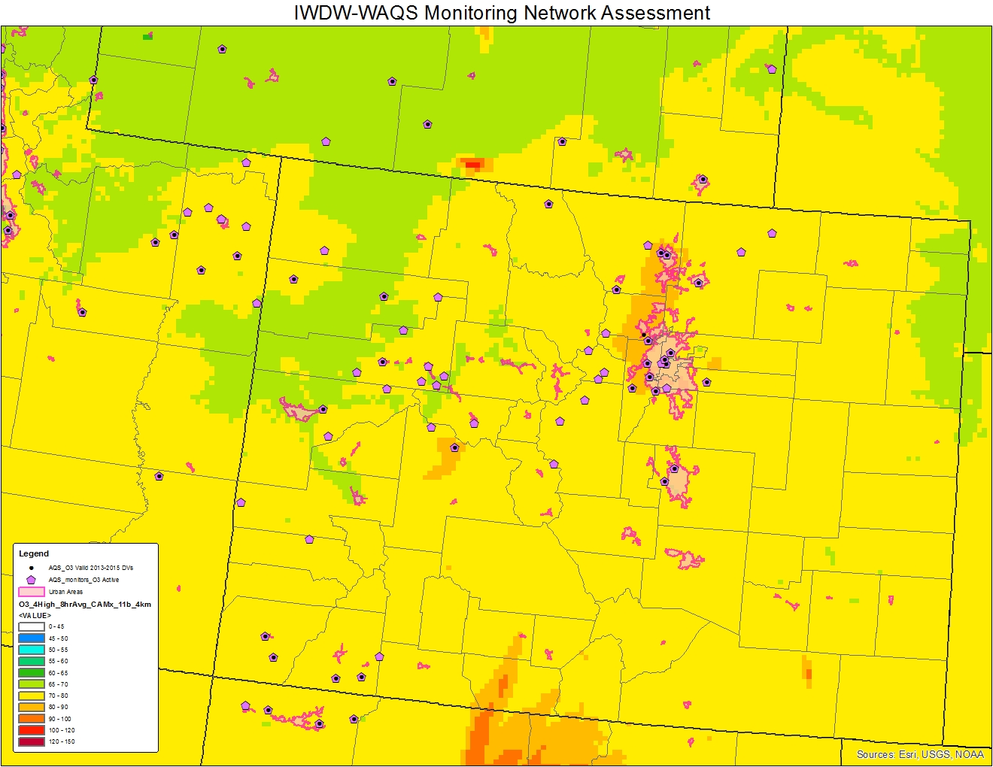
Map Features
Colorado
Urban Areas
Active ozone monitors
Sites reporting valid 2013-15 ozone DVs
WAQS 2011b 4th highest 8-hr ozone

Slide 10
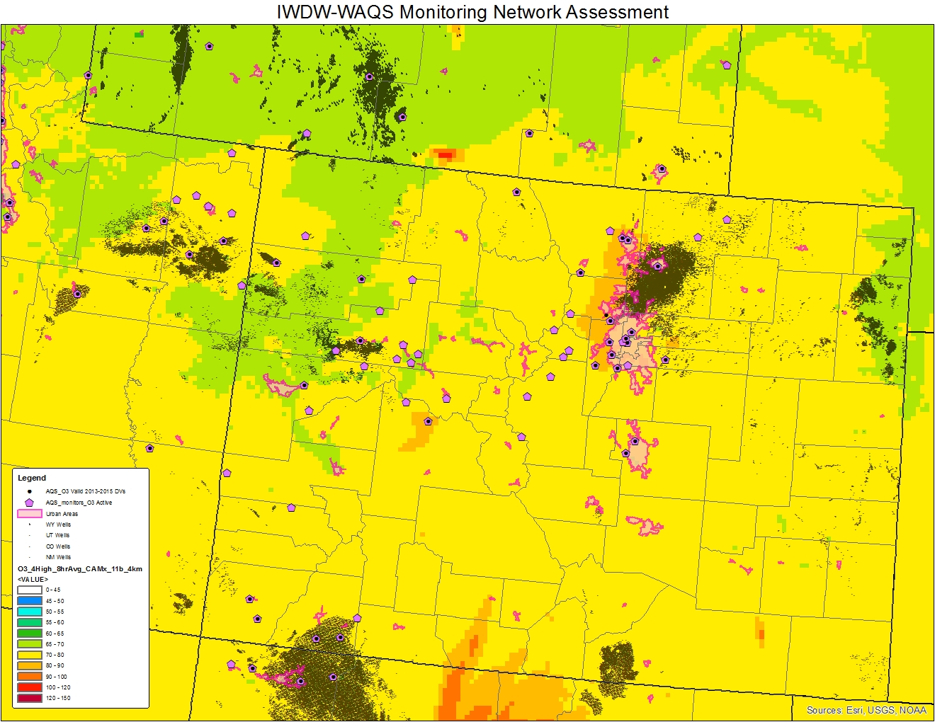
Map Features
Colorado
Urban Areas
Active ozone monitors
Sites reporting valid 2013-15 ozone DVs
WAQS 2011b 4th highest 8-hr ozone
Active O&G wells
Potential monitors for shut-down or relocation?
Potential regions for new monitors

Slide 11
WAQS Network Assessment
Timeline
Oct. 2016
  initial Working Group meeting
  outreach to expansion states
  outline WAQS monitoring objectives
Nov 2016
  define expanded WAQS region
  identify monitoring sites and their funding/reporting agencies
  data collection
Dec 2016
  analysis
  cost sharing estimates for WAQS Cooperator funded monitoring sites
  draft report to Working Group
Jan 2017
  analysis review
  draft report to WAQS Oversight Committee

