Slide 1
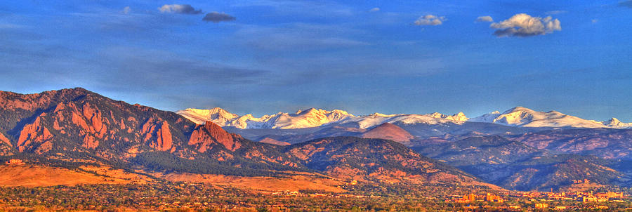
Western Air Quality Study (WAQS)
Intermountain Data Warehouse (IWDW)
2025 Modeling and Ozone and PM_{2.5}
Design Value Projections
University of North Carolina (UNC-IE)
Ramboll Environ
May 6, 2016
IWDW-WAQS Technical Committee Call

Slide 2
2025 Modeling Outline
2011 to 2025 Emissions and Air Quality
2025 Design Value Projection
Projected 2025 Design Values
  CAMx and CMAQ
  4 km Three-State and 12 km WESTUS domains
  Comparison with EPA NODA (Jul 2015) 2017 ozone DVF Projections
Next Steps

Slide 3
2025 Emissions
EPA’s 2025 emission projections for most sources
  Based on 2011 NEI v6.2 modeling platform (Jul 2015)
2020 WAQS projections for oil and gas sources
  Use WRAP Phase III methodology
  Made in fall 2014
  Adjustments for Denver-Julesburg Basin O&G following RAQC/CDPHE 2017 O&G projection methodology
Constant at 2011b levels
  MEGAN biogenic, lightning NO_{X}, sea salt, windblown dust

Slide 4
WAQS Emissions Results
Base and future year emissions documentation and results on the IWDW:
http://vibe.cira.colostate.edu/wiki/wiki/7112/waqs-2011b-platform-future-year-emissions
Descriptions of the data sources with links to TSDs and documentation
Plots
  Base11b vs Base11a
  Base25a_11b vs Base11b

Slide 5
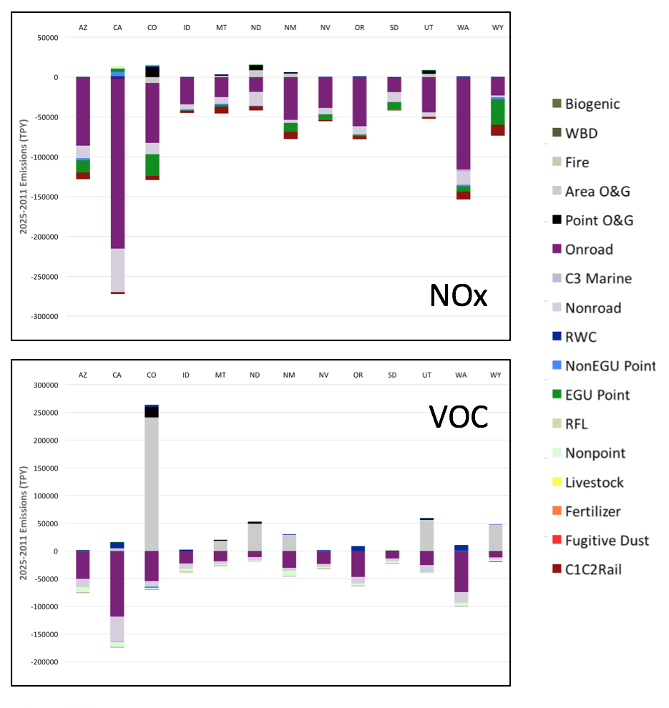
WAQS Emissions Results
Base25a_11b Summary of Significant Trends
2011 → 2025
Sector/Poll | CO | UT | WY | NM
Oil and Gas/VOC | ++ | + | + | +
Oil and Gas/CH4 | + | -- | + | +
Oil and Gas/NOx | + | + | + | +
Onroad/All | -- | -- | -- | --
Livestock/NH3 | + | + | - | -
EGU Point/NOx | -- | + | -- | -
EGU Point/NH3 | + | + | + | +
EGU Point/SO2 | -- | - | -- | -
Fug. Dust/PM2.5 | + | + | ++ | ++

Slide 6
WAQS Emissions Results
2025-2011 Diff: July Carbon Monoxide
Onroad Mobile All Sectors Nonpt/Surveyed O&G
Onroad contributes most of the change in CO across the region
Surveyed O&G changes are significant in Uintah, D-J, and S. San Juan Basins

Slide 7
WAQS Emissions Results
2025-2011 Diff: July NOx
Onroad Mobile All Sectors Nonpt/Surveyed O&G
Onroad contributes most of the change in NOx across the region
Surveyed O&G changes are significant in Uintah, D-J, and S. San Juan Basins

Slide 8
WAQS Emissions Results
2025-2011 Diff: July TOG
Onroad Mobile All Sectors Nonpt/Surveyed O&G
Offroad Mobile
Nonpoint
TOG/VOC changes are localized with many sectors contributing; O&G changes are large and spatially diffuse in each O&G basin.

Slide 9
WAQS Emissions Results
2025-2011 Diff: July PM2.5
Onroad Mobile All Sectors Fugitive Dust
Offroad Mobile
Fugitive dust contributes most of the PM changes, primarily increases
Localized PM decreases from mobile

Slide 10
WAQS Air Quality Modeling Results
CAMx and CMAQ Base2011b Modeling Platforms available on the IWDW
http://vibe.cira.colostate.edu/wiki/SiteSettings/Wiki/Index/2077?title=WAQS-2011b-Modeling-Platform
Platform description
Emissions documentation
Base year model description
Source apportionment modeling results
Results available on the IWDW MPE Tool

Slide 11
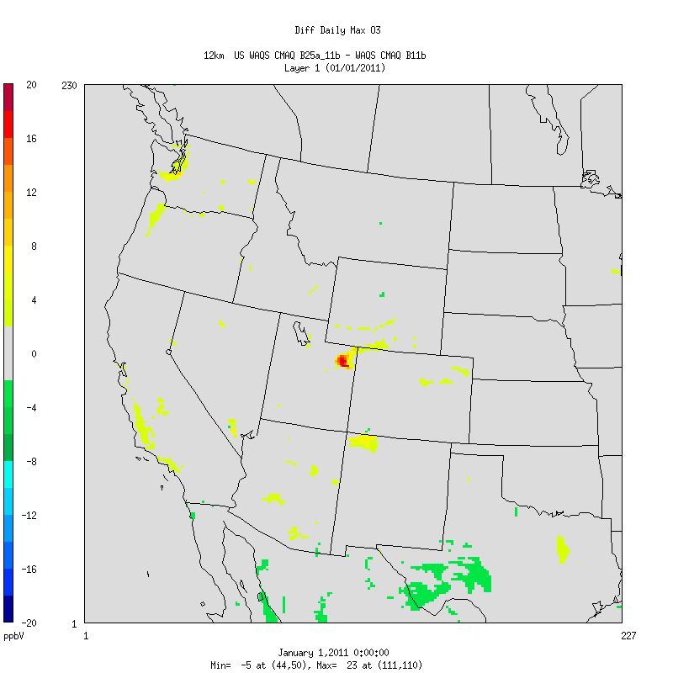
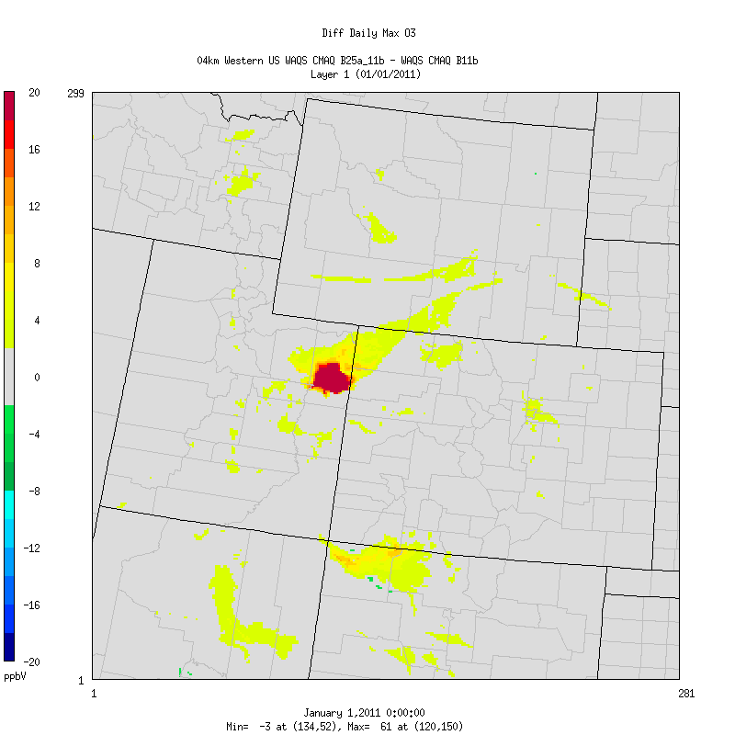
WAQS Air Quality Modeling Results
2025-2011: January CMAQ O3 and Emissions Differences
Jan TOG Emis Diff
Diff Daily Max O3
Jan NOx Emis Diff

Slide 12
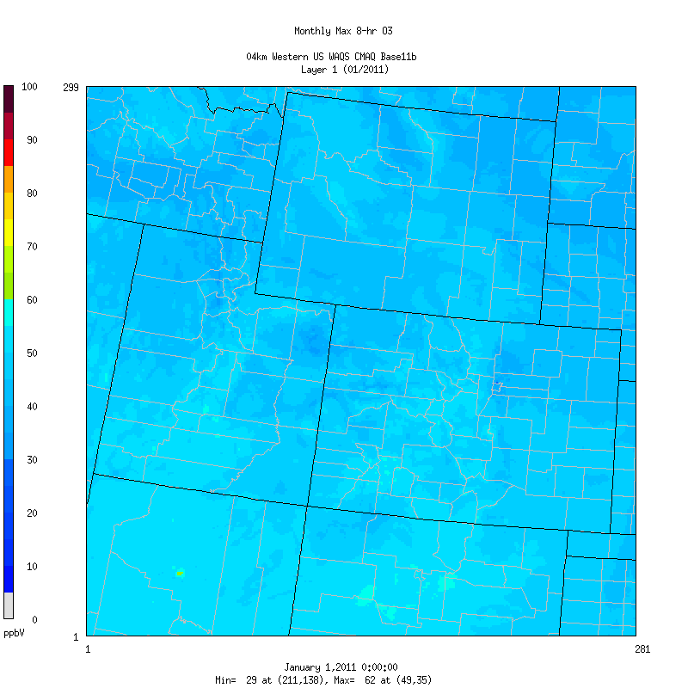
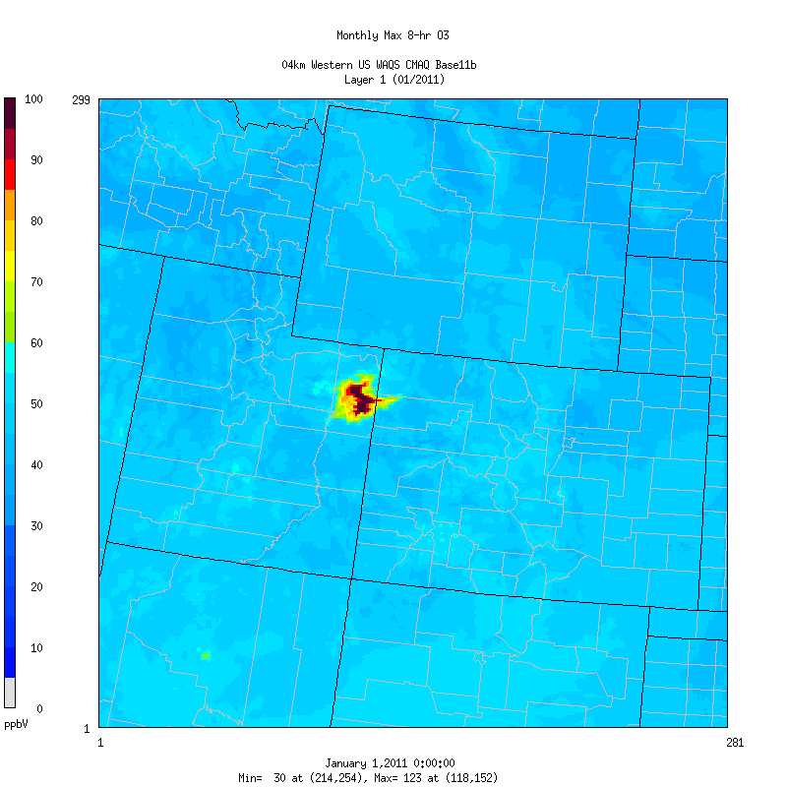
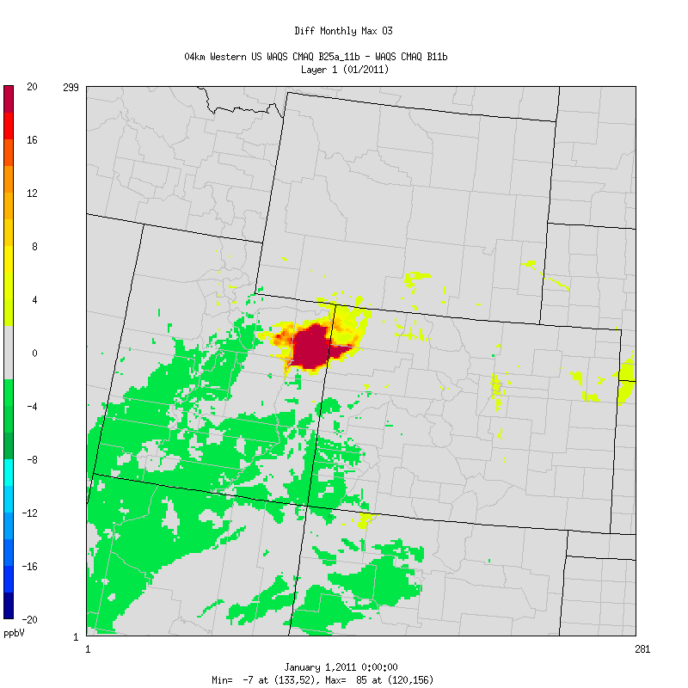
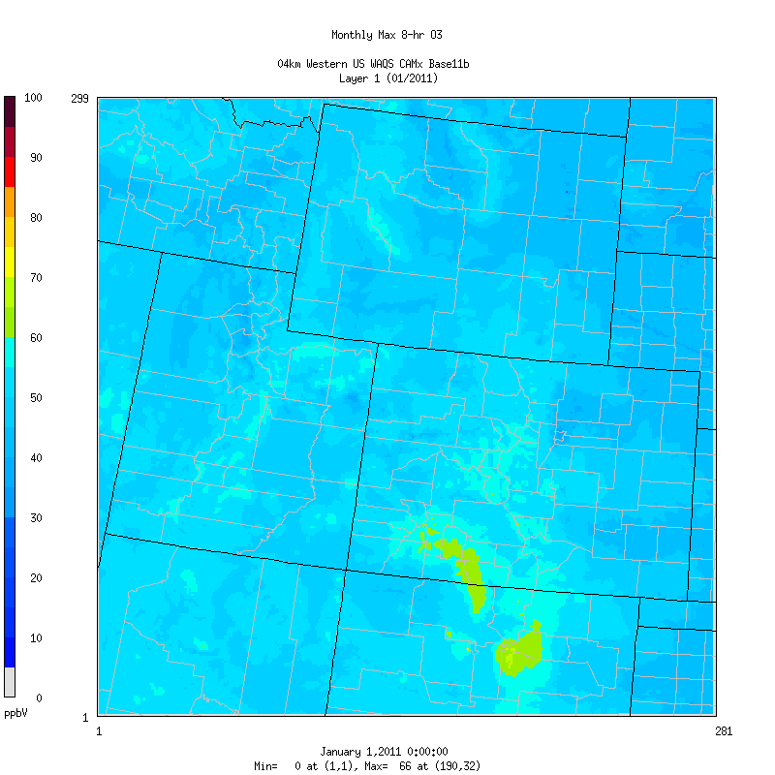
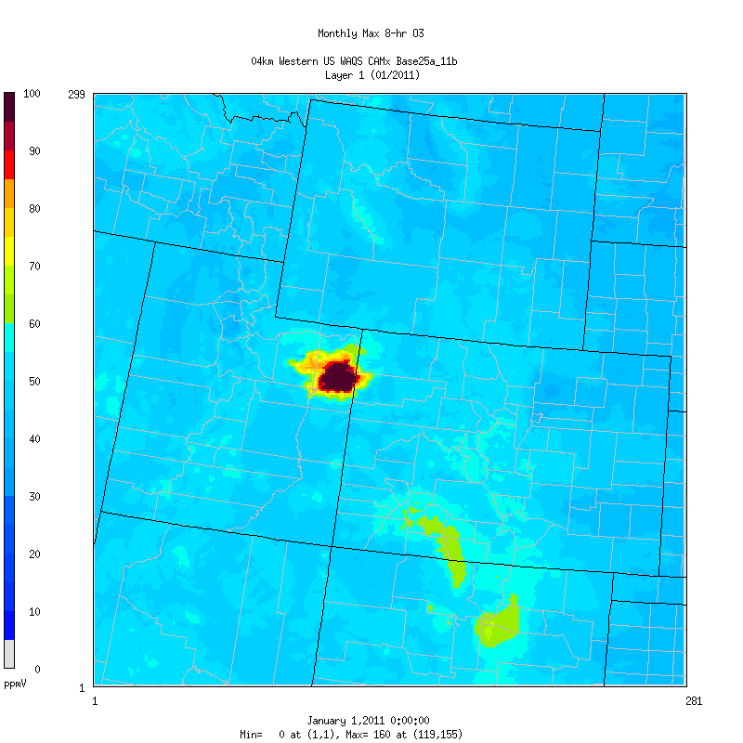
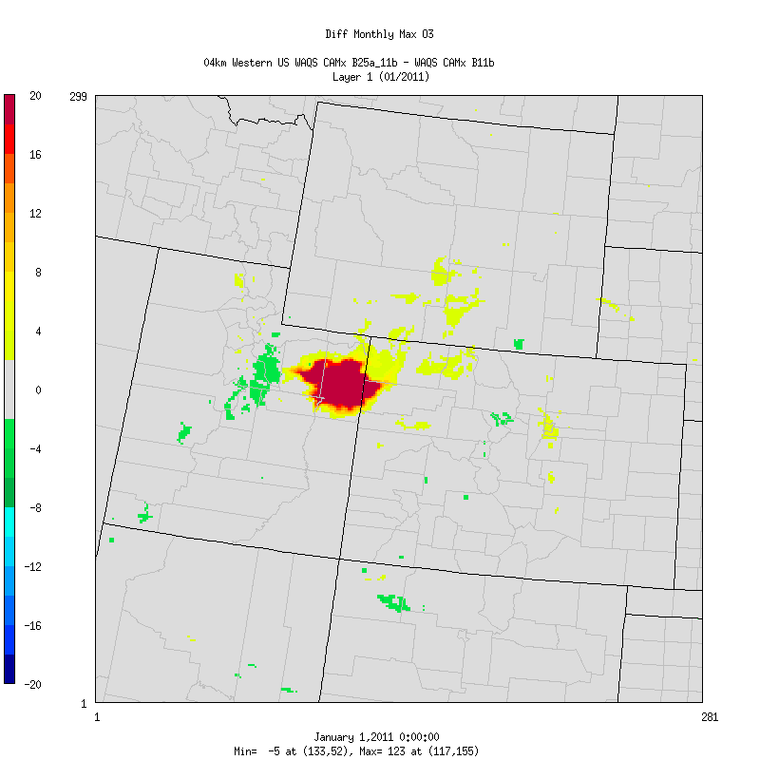
January CAMx vs CMAQ Monthly Max MDA8 O3
2011
2025
2025-2011
CMAQ
CAMx
CAMx

Slide 13
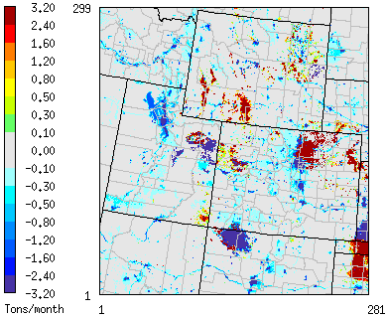
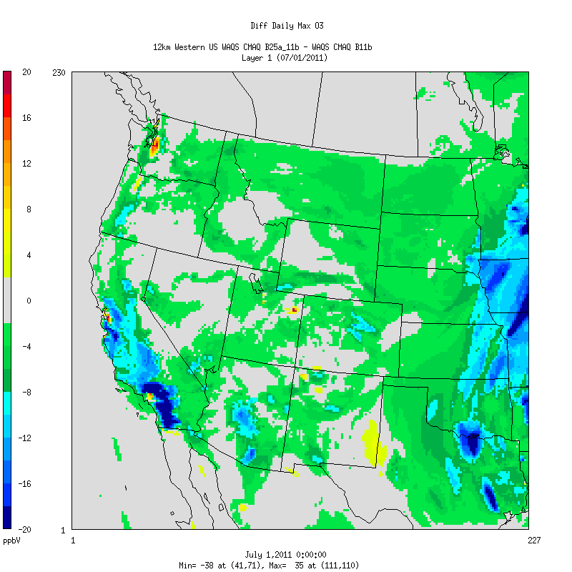
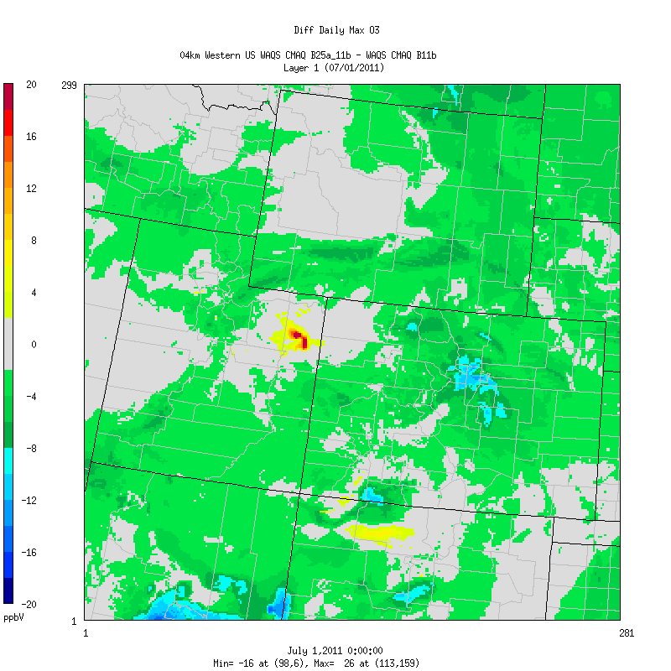
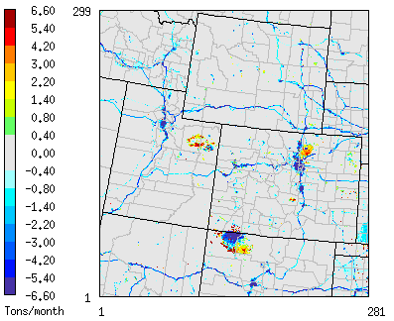
WAQS Air Quality Modeling Results
2025-2011: July CMAQ O3 and Emissions Differences
July TOG Emis Diff
Diff Daily Max O3
July NOx Emis Diff

Slide 14
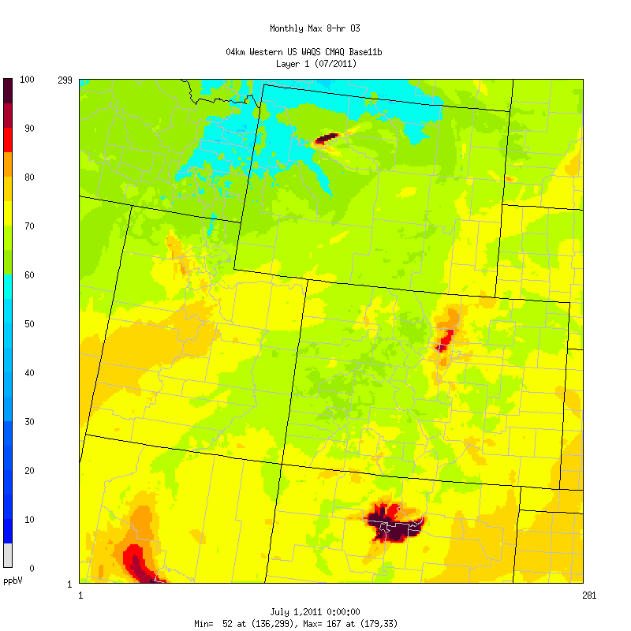
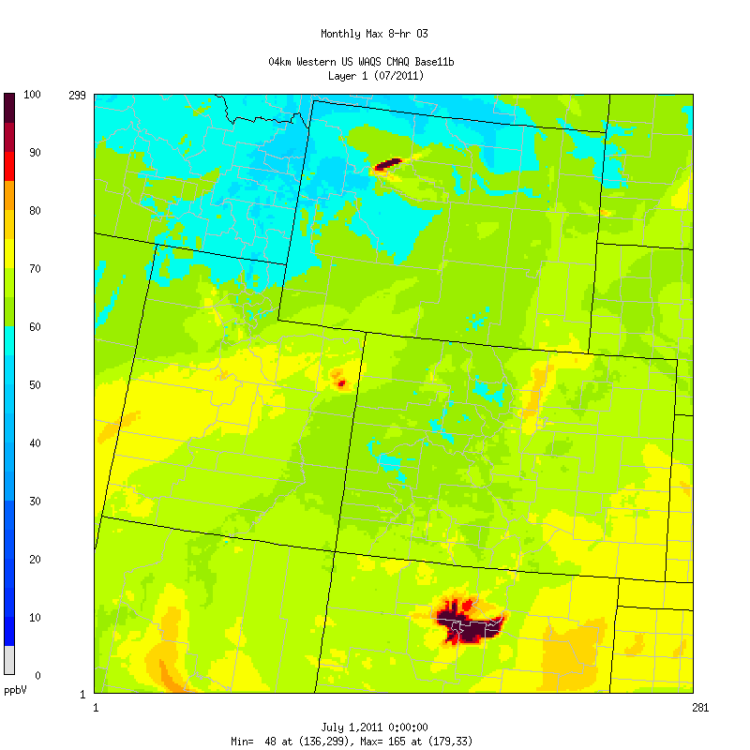
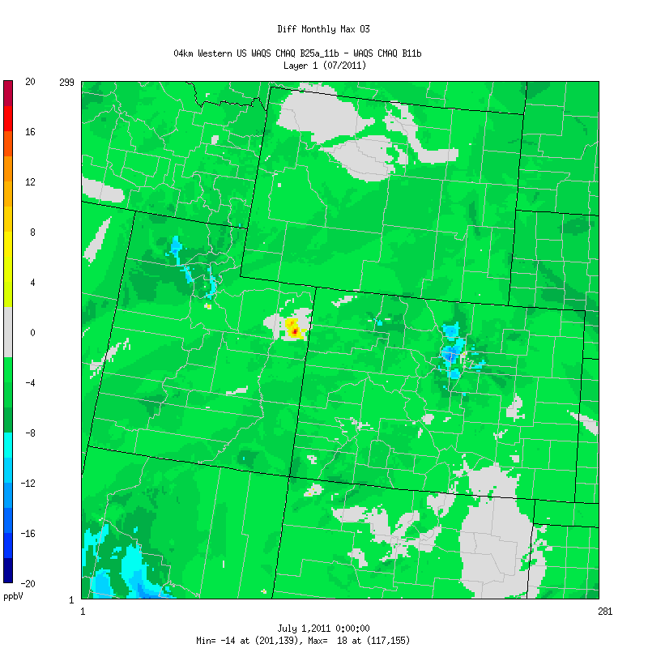
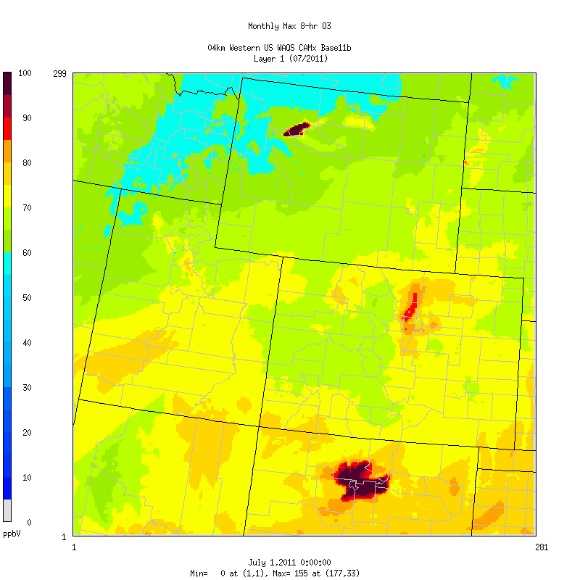
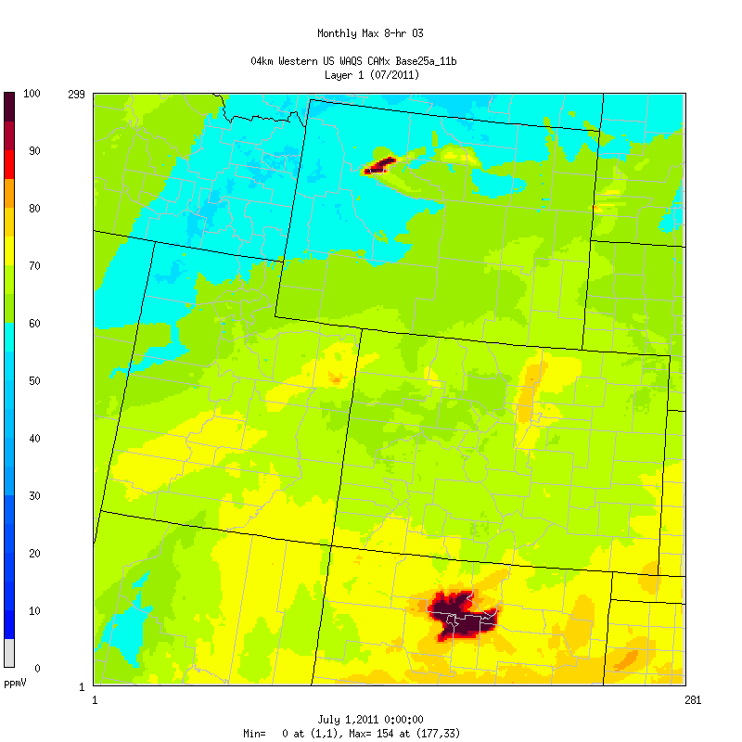
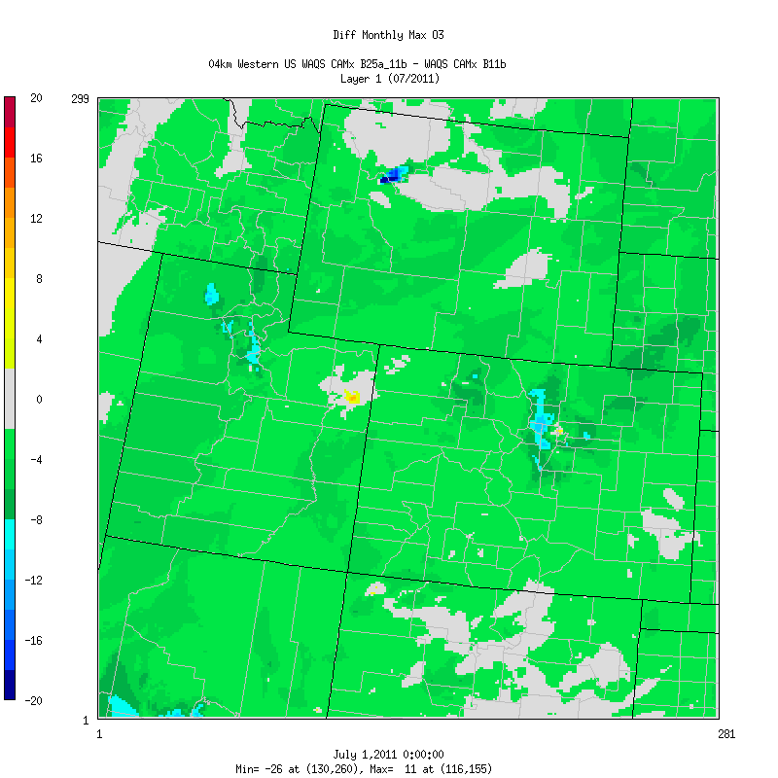
July CAMx vs CMAQ Monthly Max MDA8 O3
2011
2025
2025-2011
CMAQ
CAMx

Slide 15
2025 DV Projection Procedures
Follow EPA Dec 2014 Guidance
  Modeled Attainment Test Software (MATS)
Use relative change in PGM modeling results between 2011 and 2025
  Relative Response Factor (RRF)
  RRF = ∑ PGM₂₀₂₅ / ∑ PGM₂₀₁₁
Projected 2025 future year Design Value (DVF) by scaling observed current year DV (DVC)
  DVF = DVC x RRF

Slide 16
2025 DV Projection Procedures
DVC based on average of 3-years of DVs centered on base modeling year
  DVC = (1/3) x (DV₂₀₀₉₋₂₀₁₁ + DV₂₀₁₀₋₂₀₁₂ + DV₂₀₁₁₋₂₀₁₃)
RRFs based on 10 highest 2011 modeled days
  Maximum modeled 2011 MDA8 ozone in 3x3 array of 4 km grid cells centered on monitor
  Use modeled 2025 MDA8 ozone in same grid cell
PM_{2.5} RRFs made for each PM component
  Seasonal RRFs for annual and 24-hour PM_{2.5} projections
  For 24-hour PM_{2.5} DV re-rank projected daily PM_{2.5} concentrations to find 98th percentile

Slide 17
Comparisons of WAQS 2025 and EPA 2017 NODA Ozone DVFs at Monitors
In general 2025 CAMx DVFs > 2025 CMAQ DVFs: Max +4.1; Min -2.3; Avg 0.6 ppb

Slide 18
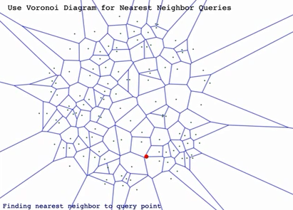
Unmonitored Area Analysis (UAA)
Interpolate DVCs to each grid cell in the 4 km and 12 km domains
Use modeled RRFs in each grid cell to develop spatial distribution of 2025 DVFs
  UAA future year projections have more uncertainties than monitor-based projections
  Use Voronoi Nearest Neighbor
  Uses modeled 2011 concentration gradients in the interpolation

Slide 19
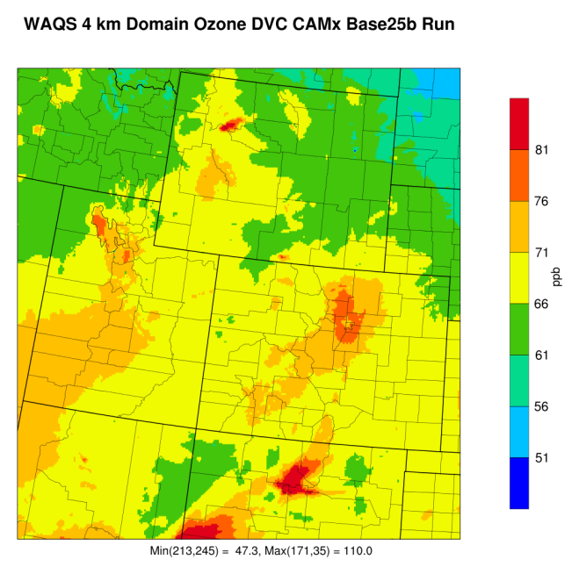
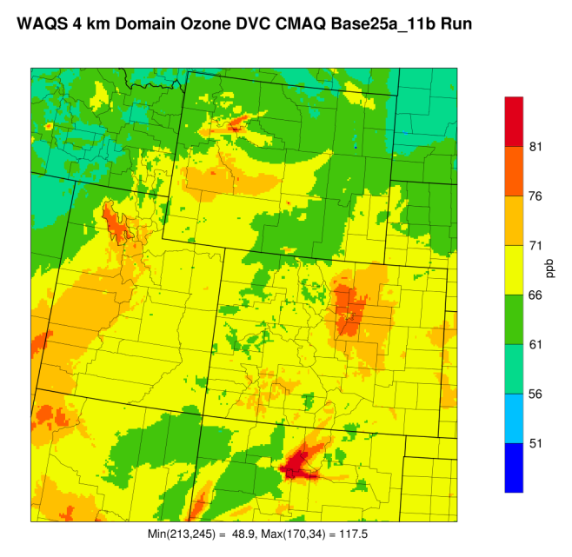
2011 Ozone DVC 4 km Domain
Exceeds Oct 2015 ozone NAAQS ≥ 71.0 ppb
Also Exceeds Mar 2008 ozone NAAQS ≥ 76.0 ppb
CAMx CMAQ

Slide 20
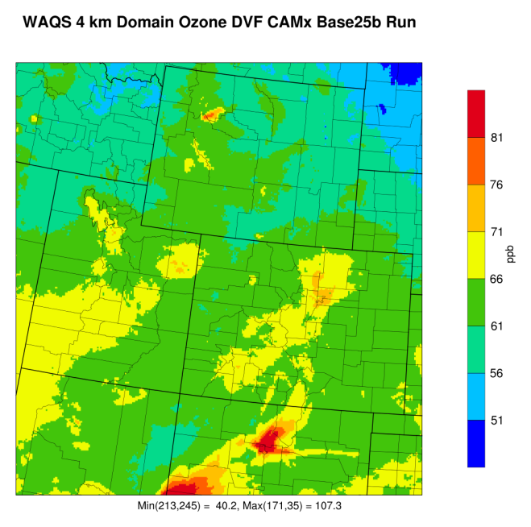
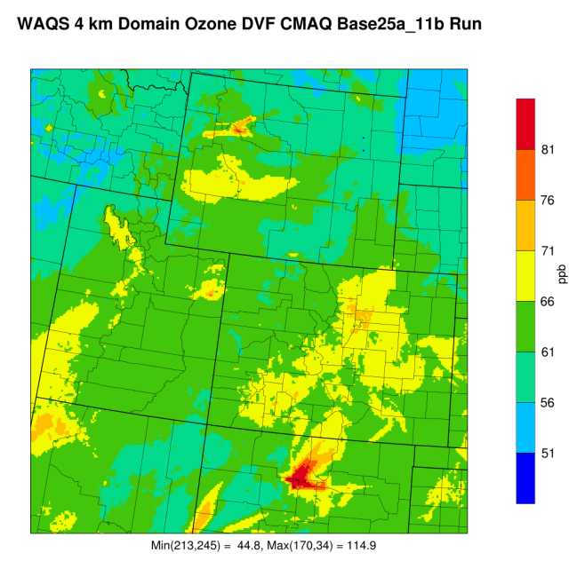
2025 Ozone DVF 4 km Domain
Exceeds Oct 2015 ozone NAAQS ≥ 71.0 ppb
Also Exceeds Mar 2008 ozone NAAQS ≥ 76.0 ppb
CAMx CMAQ

Slide 21
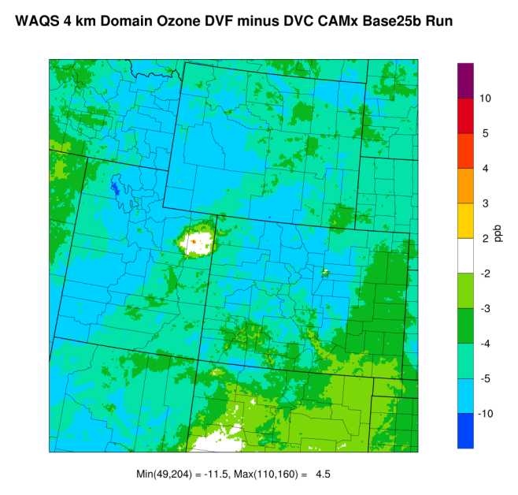
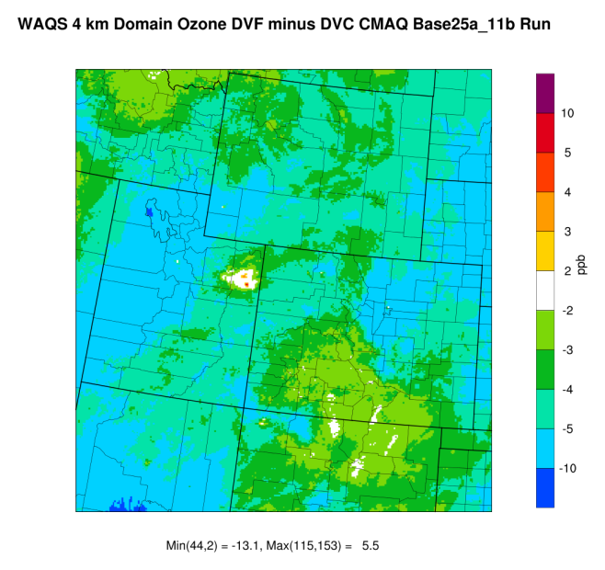
Ozone DVF – DVC 4 km Domain
CAMx CMAQ

Slide 22
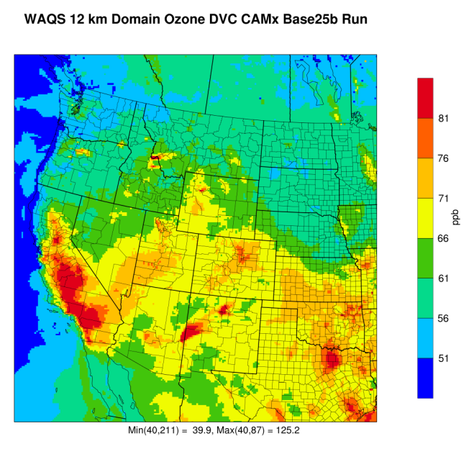
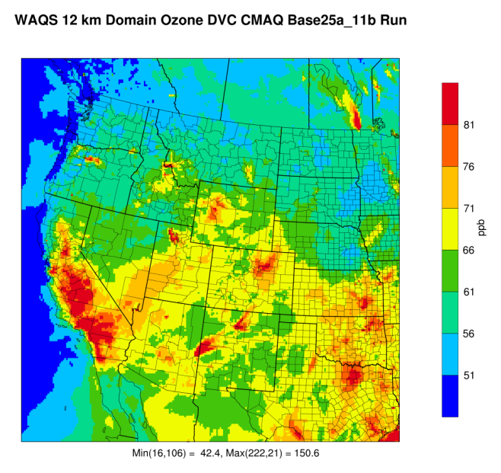
2011 Ozone DVC 12 km Domain
Exceeds Oct 2015 ozone NAAQS ≥ 71.0 ppb
Also Exceeds Mar 2008 ozone NAAQS ≥ 76.0 ppb
CAMx CMAQ

Slide 23
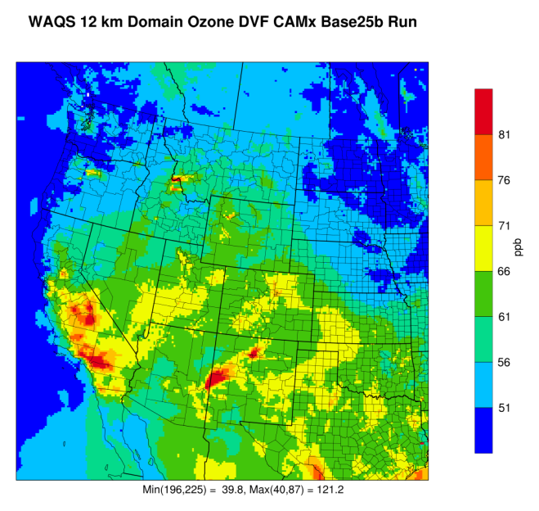
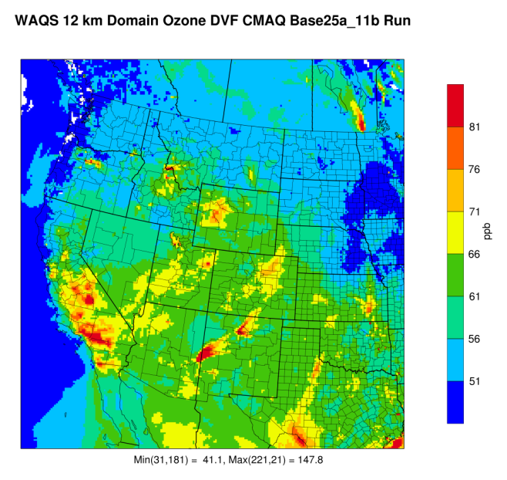
2025 Ozone DVF 12 km Domain
Exceeds Oct 2015 ozone NAAQS ≥ 71.0 ppb
Also Exceeds Mar 2008 ozone NAAQS ≥ 76.0 ppb
CAMx CMAQ

Slide 24
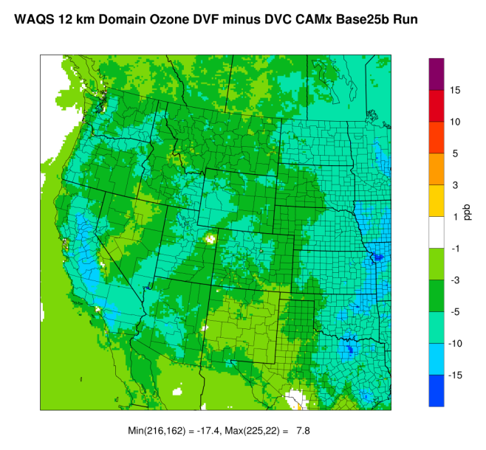
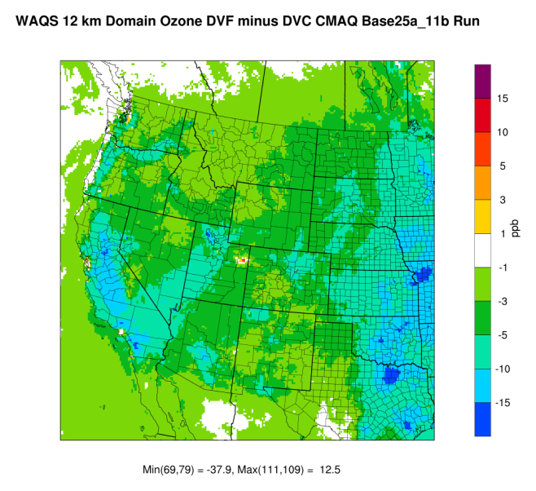
Ozone DVF – DVC 12 km Domain
CAMx CMAQ

Slide 25
Annual PM_{2.5}

Slide 26
24-hour PM_{2.5}

Slide 27
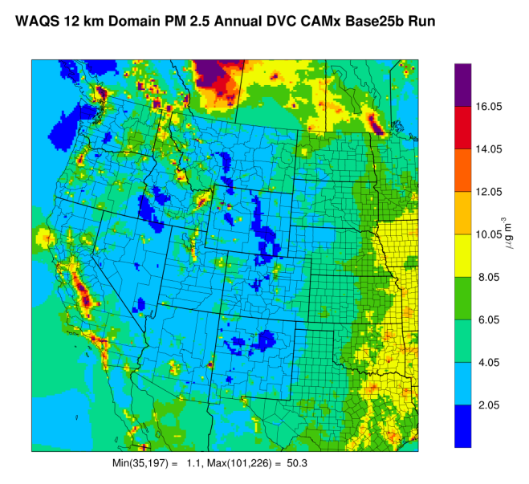
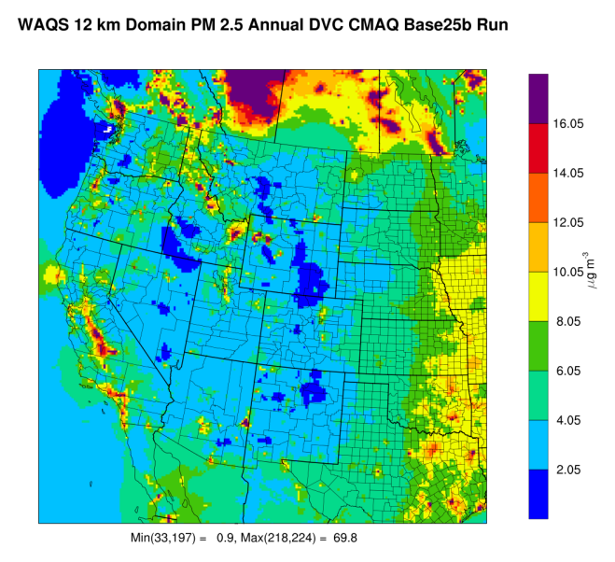
2011 Annual PM_{2.5} DVC

Slide 28
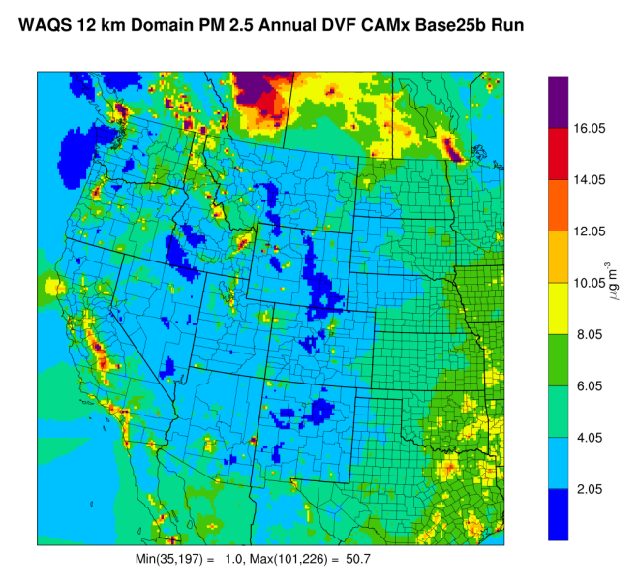
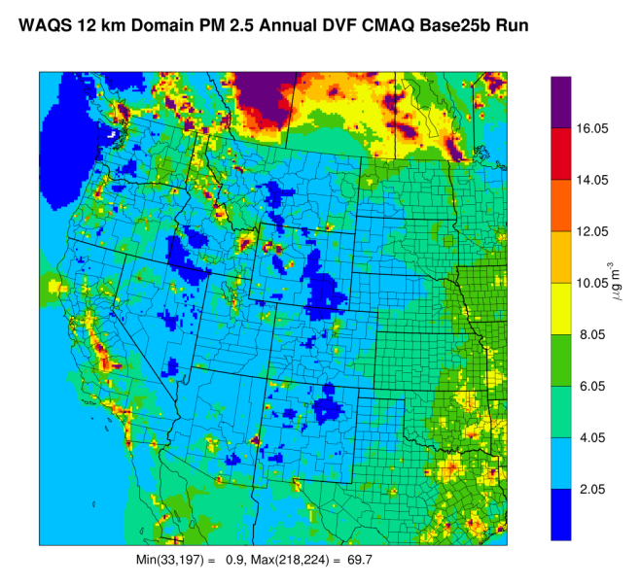
2025 Annual PM_{2.5} DVF

Slide 29
2025 CAMX and CMAQ Modeling– Next Steps
Transfer of modeling inputs and outputs to IWDW
Set up 2025 Modeling wiki for accessing data
  Spreadsheets of 2025 DVF projections
  Spatial Maps
  2025 emissions displays
  Supporting information
Load 2025 emissions into Emissions Review Tool
Notes:
Additional plots

