Slide 1
IWDW-WAQS Technical Committee Status Call
IWDW Update

Slide 2
Outline
Overview of IWDW development - Rodger
Tools Workgroup recap
Visualization products
ERT corrections and addition of 2011b (demo) - Zac
Source apportionment tool progress – Ralph
Updated Image browser release (demo) – Shawn
Data transfer status – Rodger
Overview of data requests, new since Sept. – Rodger
Notes:
Overview – some slides are pulled from Sept 23 Tech. Comm. meeting presentation to show website revisions and tool organization on IWDW website

Slide 3
IWDW development
Tools Workgroup recap
Purpose
v1 tool enhancements
v2 tool development
MPE x IWDW
Timeline
Notes:
Purpose: Interact with Tech. Comm. to guide IWDW tool development
V1 enhancements: 2011b to ERT, Updated UI and 2011b plots added to MPE tool
V2 enhancements: 2011a SA; filtering for diurnal trends on model-to-obs, Model-On-Model; emissions GIS w/. Pie chart overlays, dynamic spatial maps, custom reports, e.g. 70ppb O3 standard, and additional chart types in ERT and other tools as recommended by MPE x IWDW.

Slide 4
IWDW development
SEPT
Data: request UI, emissions & modeling tools, obs data reports
Resources: documents, support, project management
JAN-MAR
GIS integration; updates to SA, model-to-obs, reports
NOV-DEC Updates: MPE Plot Browser;
2011b ERT
Query Wizard
Adapted from FED
MAR
Data Request UI
MAY
Image Browser, ERT
APR-MAY
v2 Tool Release
2015
2016
FEB 25
Tech Comm.
APR 29-30
Tech Comm.
JUL 23
Tech Comm.
SEP 23
Tech Comm.
DEC 15
Tech Comm.
JAN 12
Tech Comm.
SEP 2
Tool WG
OCT 20
Tool WG
DEC 2
Tool WG
Notes:
Data:
Bulk data: direct data request UI; monitoring data via query wizard
Emissions: ERT
Modeling: SA, model-to-obs, MPE plots
Monitoring data tools (reports): RHR trends, O3 trends, Wet dep summary, dry dep summary
Resources:
Documents: Docs, literature
Community & Support: Forums, wiki
DW operations and Management: data request overview, studies, project overview

Slide 5
Website Revisions
Overview
Data landing page
Resources landing page
About page
Data selection interface
Data request overview/details
Notification system

Slide 6
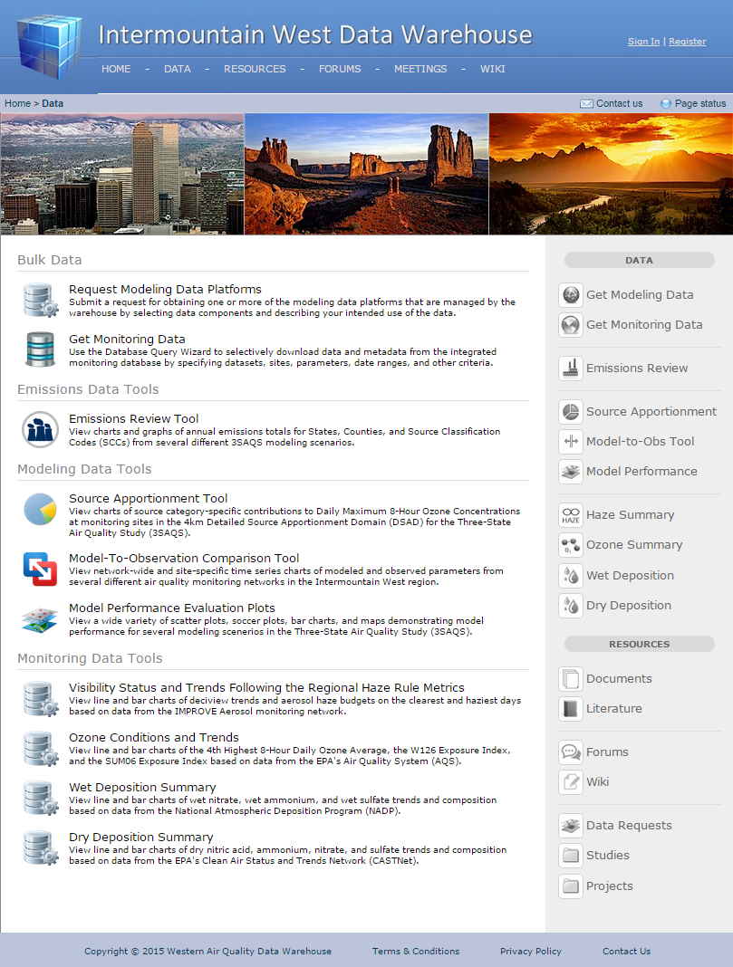
Website Revisions
Data Landing Page
Accessible from “Data” link on navigation bar
Previously linked to modeling data request form
Bulk Data
Request modeling platform data
Query for monitoring network data
Emissions Data Tools
Review modeled / inventory emissions(?)
Modeling Data Tools
Model Performance and Diagnostics
Monitoring Data Tools
Trend and summary data from air quality monitoring

Slide 7
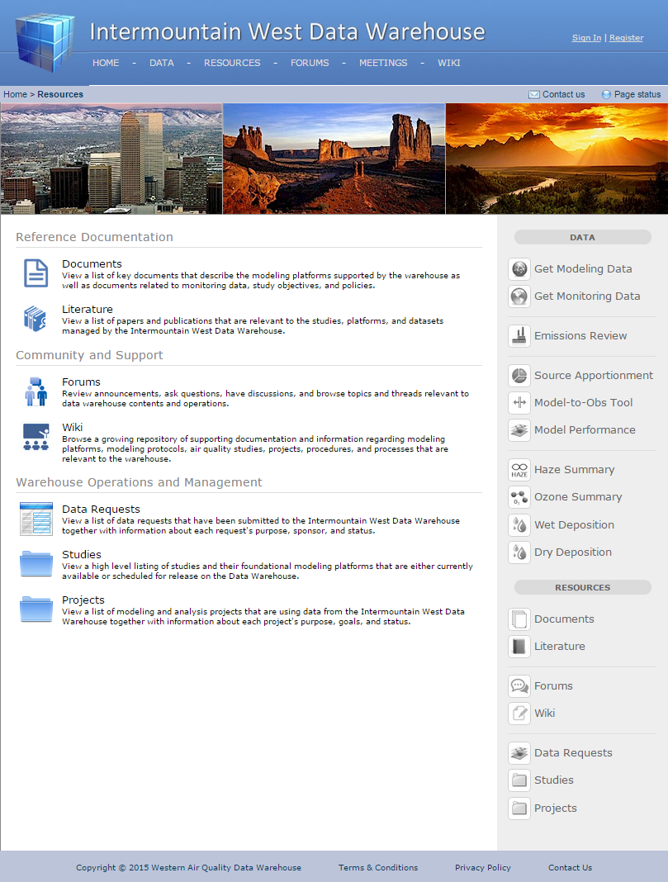
Website Revisions
Resources Landing Page
Accessible from “Resources” link on navigation bar
Secondary data-related content
Replaces Projects, Studies, and Documents links

Slide 8
IWDW development
Visualization products
ERT (Zac)
SA Tool (Ralph)
MPE Image Browser (Shawn)

Slide 9
IWDW development
Visualization products
Emissions Review Tool (ERT)
Corrections and addition of 2011b emissions
demo

Slide 10
IWDW development
Visualization products
Source Apportionment (SA) Tool
link to current tool
Progress version for 2011a

Slide 11
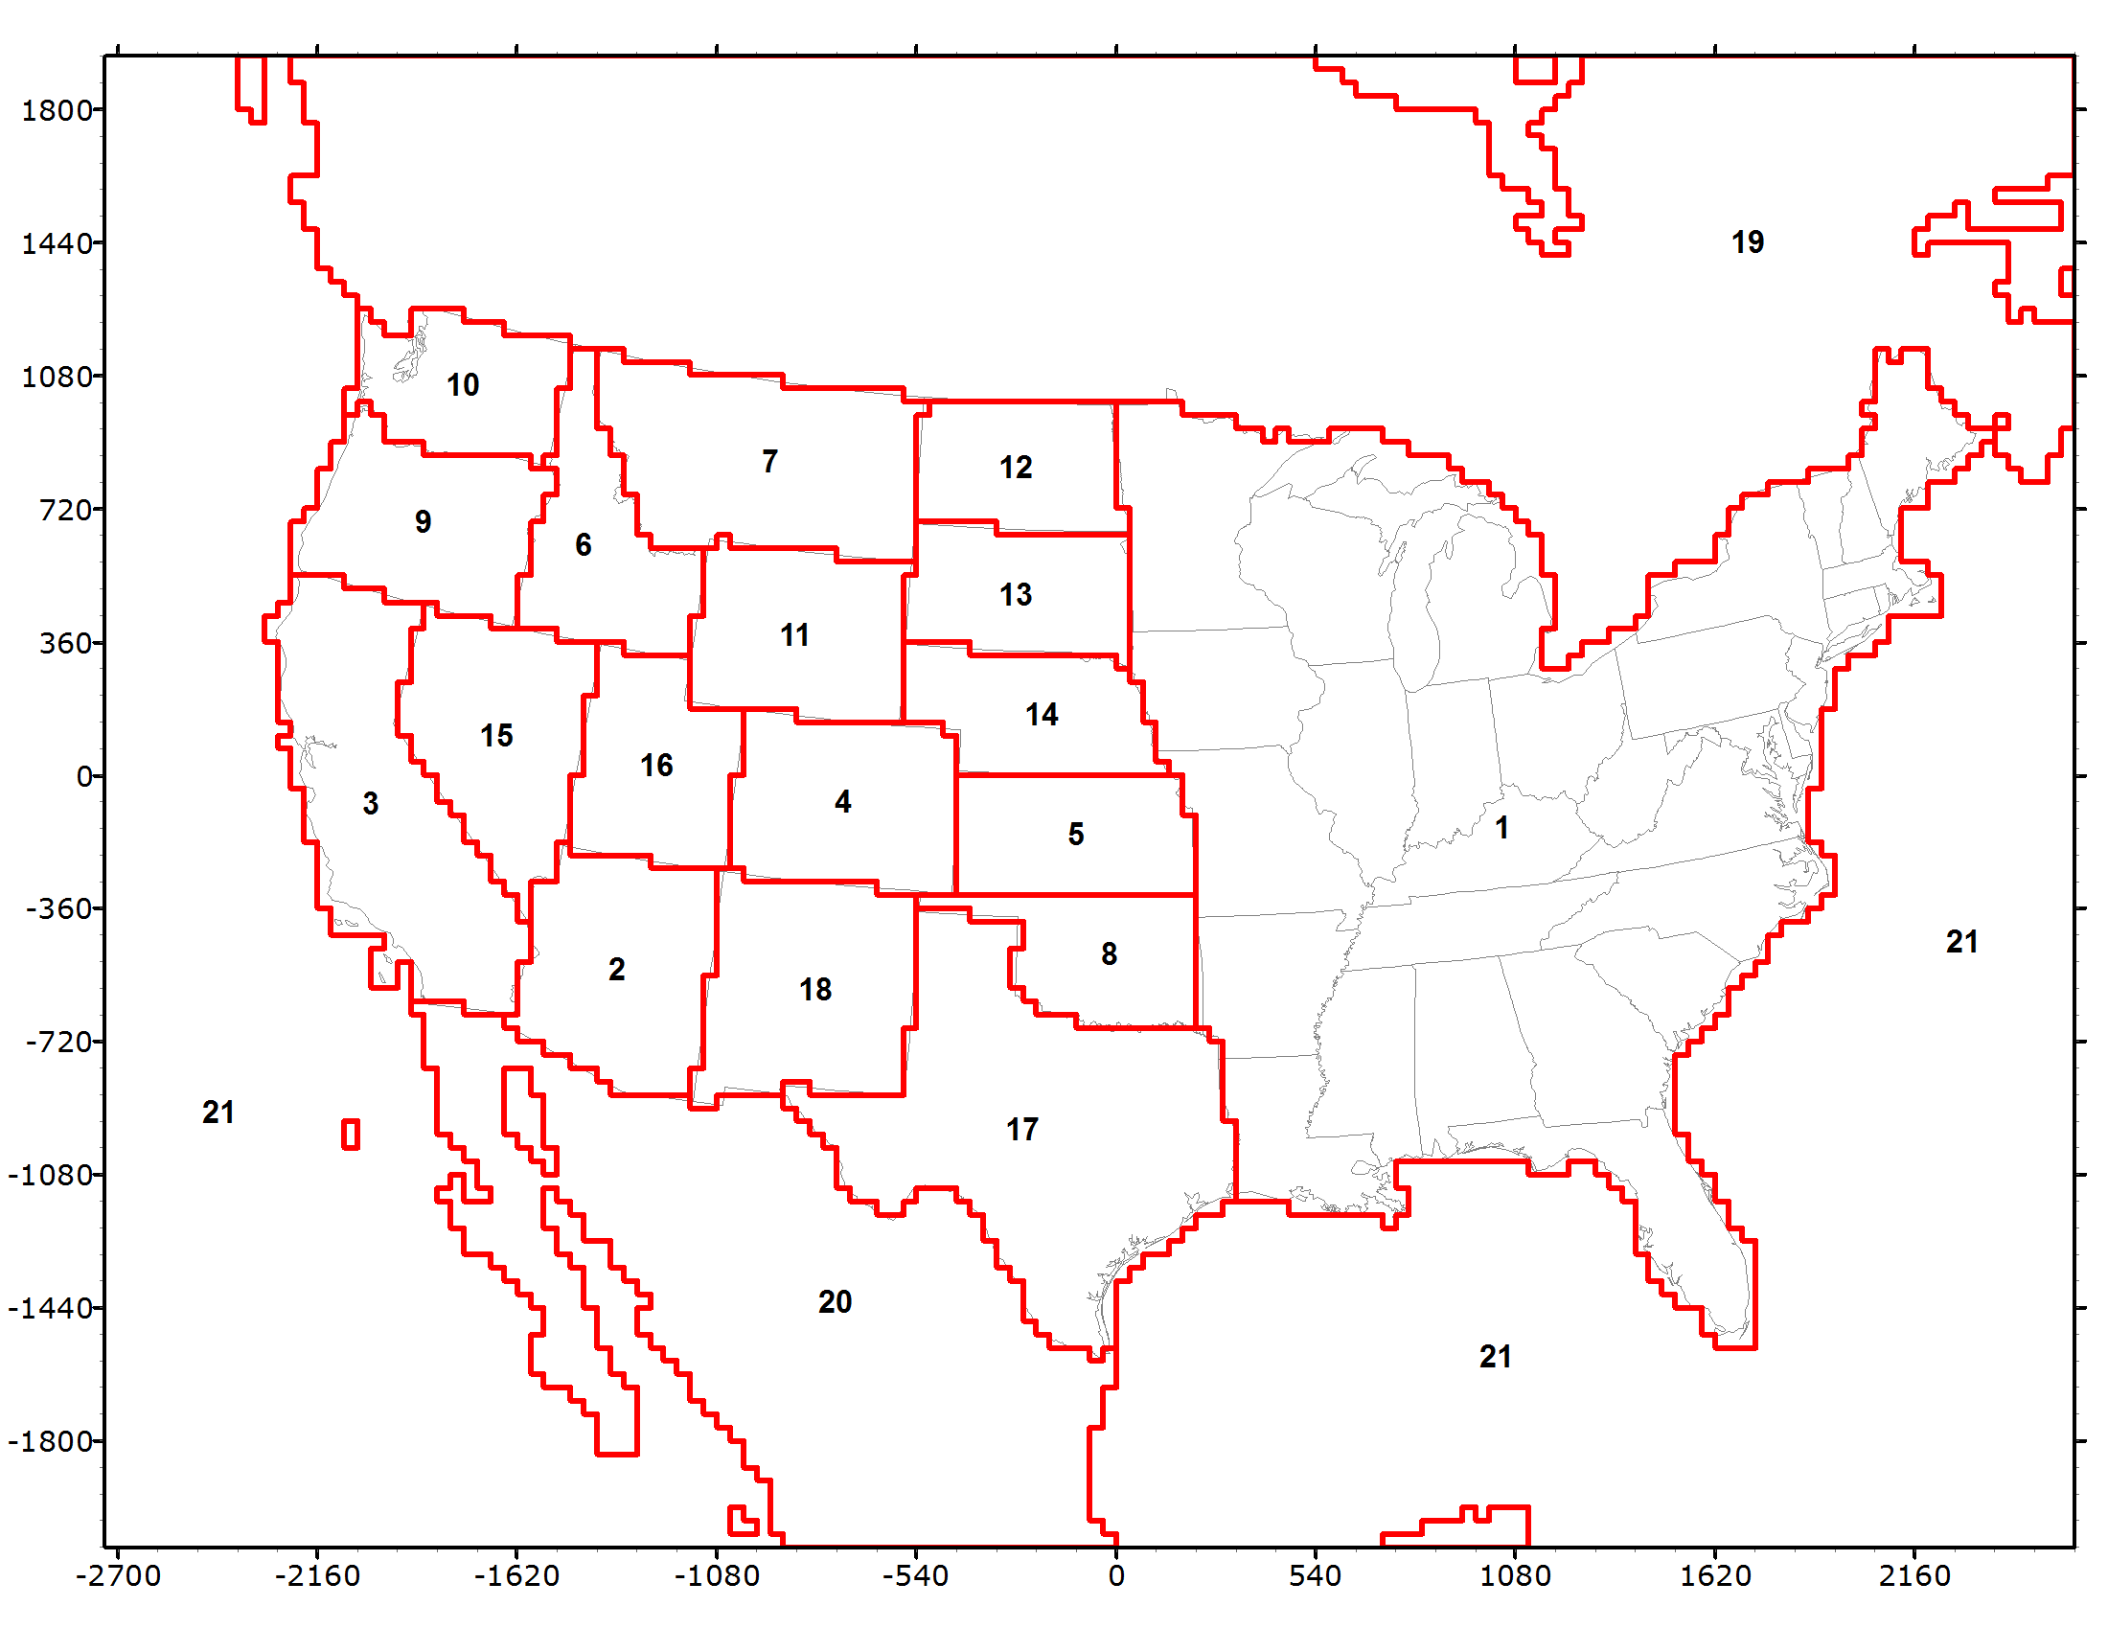
2011 Geographic Source Apportionment
2011a Emissions
21 Source Regions
5 Source Categories
Natural (Bio, Lx, SS, WBD)
3 Fires (WF, Rx, Ag)
Remainder Anthropogenic
Ozone/APCA 36/12 km
PSAT/PM 36 km
O3, PM, Vis and Dep Contribution
CSAPR-type Analysis
RHR Impaired vs. W20% Days

Slide 12
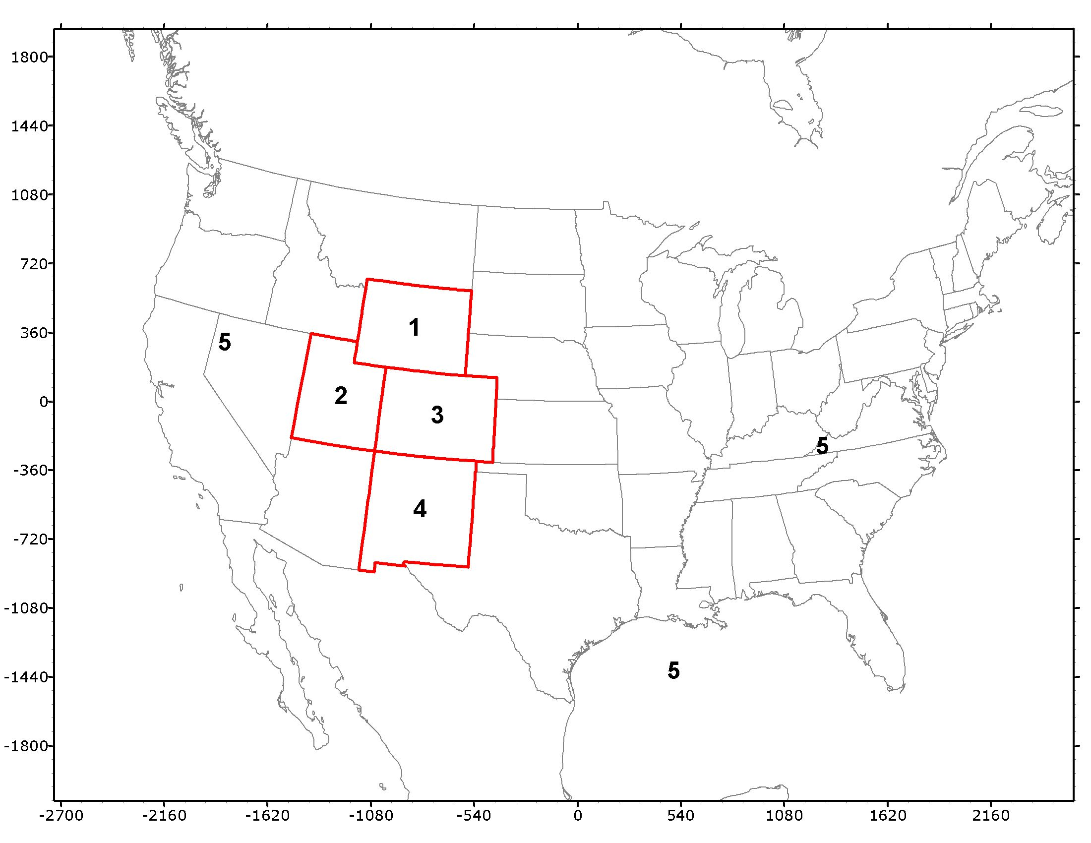
2011 Source Sector Apportionment
Source Categories:
Natural (Bio, Lx, SS, WBD)
Wildfires (WF)
Rx+Ag Fires
O&G
EGU Point
Other Point
On-Road
Non-Road
Remainder Anthro
Five Source Regions
CO, UT, WY and NM
Remainder

Slide 13
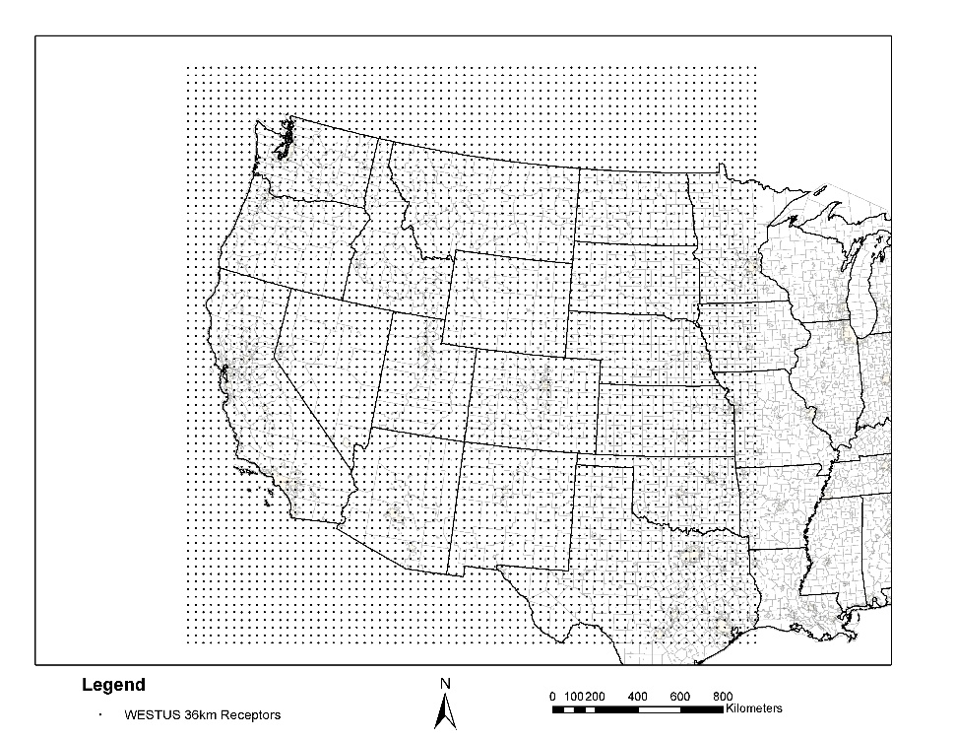
Web-Based SA Visualization Tool
Prototype developed and Comments Received
Biggest comment is need to include more receptors than monitoring network
Added 36 km virtual receptor network

Slide 14
Web-Based SA Visualization Tool
With many receptors and need to display all days in year for DMAX8 ozone and 24-hour PM_{2.5}, need better method to access data than drop down menus
Adding graphical spatial map for receptor data (especially important for 36 km virtual receptor grid) and calendar access to day of year (as well as ranked highest day list)

Slide 15
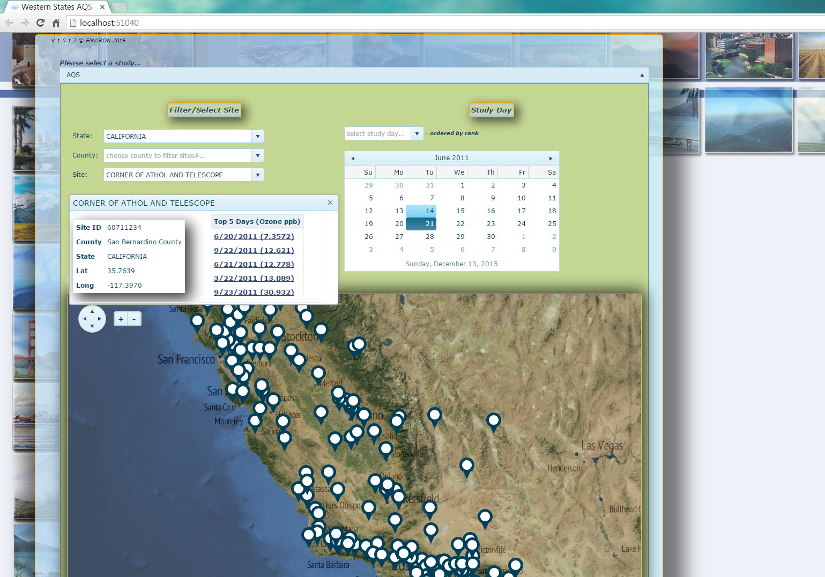
Web-Based SA Visualization Tool

Slide 16
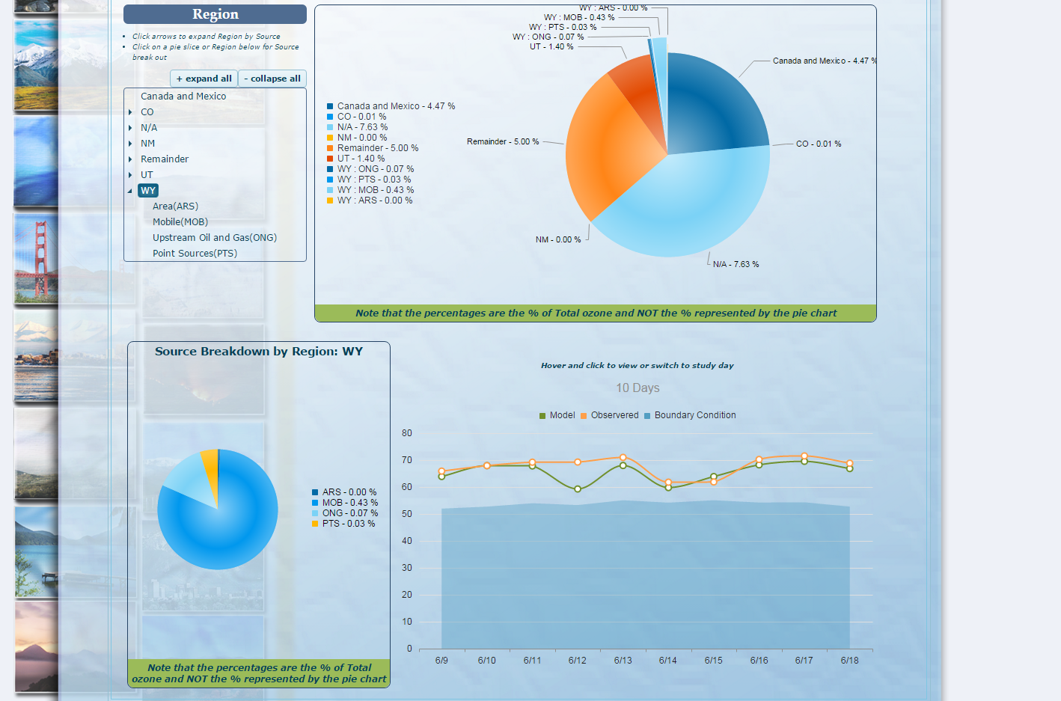
Web-Based SA Visualization Tool

Slide 17
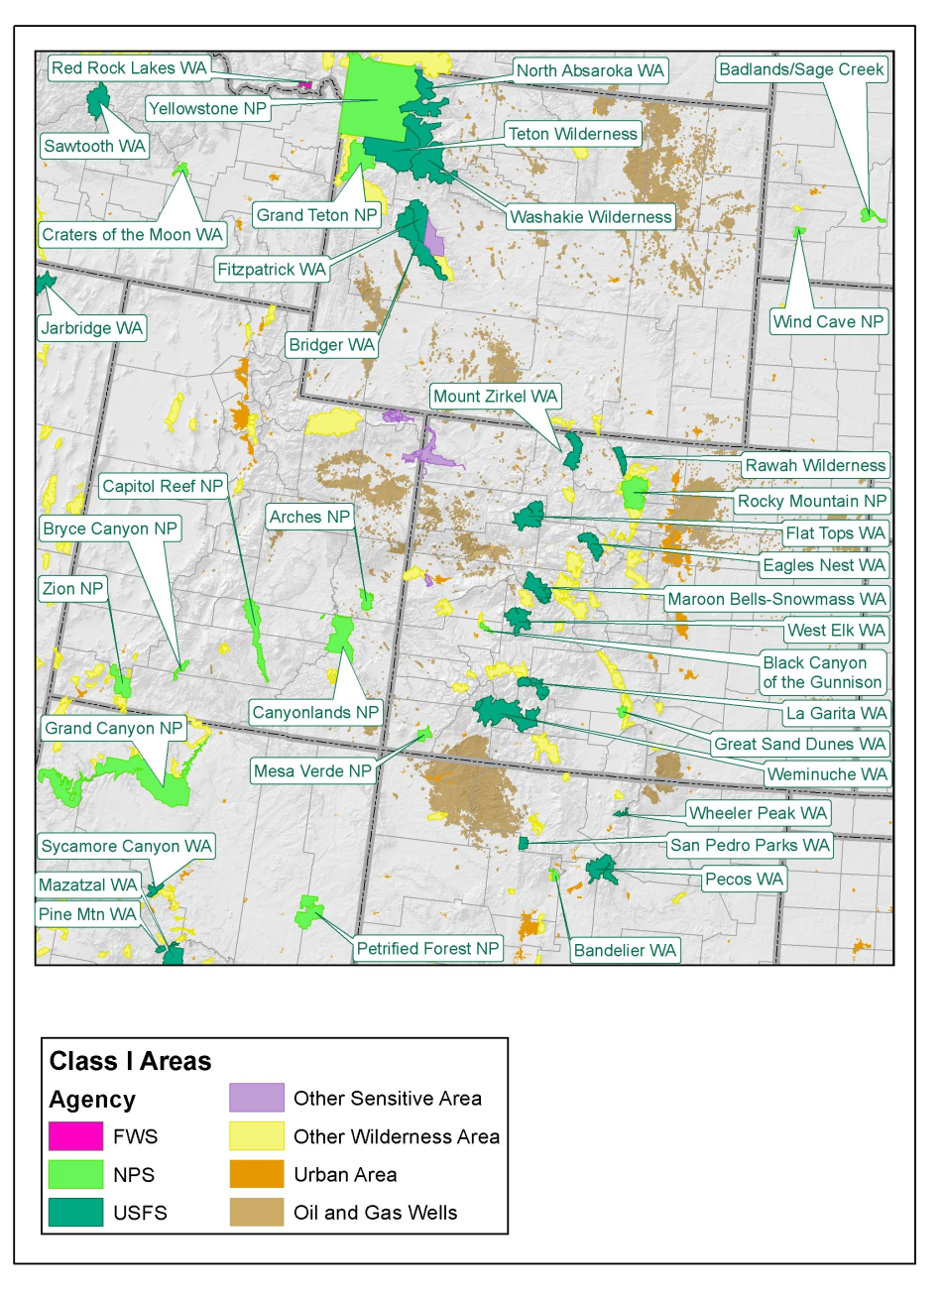
2011 Detailed 4 km Apportionment
Geographic Regions:
By O&G Basins?
Source Sectors?:
Natural
O&G Drilling
O&G Production
O&G Midstream
On-Road
Non-Road
Point
Fires
Remainder
Potentially limited duration periods
Limited by available resources

Slide 18
IWDW development
Visualization products
Model Performance (a.k.a image browser)
Updated version
demo

Slide 19
IWDW update
Data transfer status
Modeling platform descriptions
IWDW supported platforms - link

Slide 20
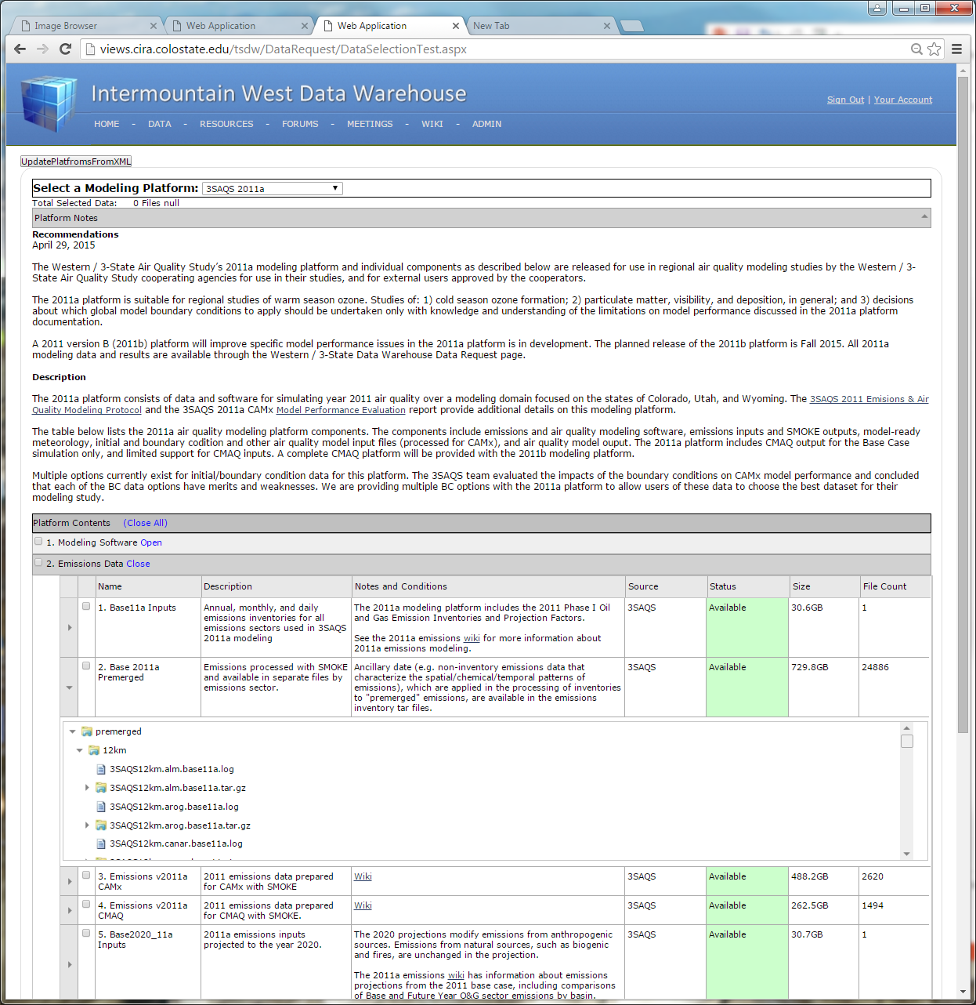
Website Revisions
Modeling Platform Descriptions
Describes modeling platform and components
Used by data request page for user file selection
Shows availability, file size, directory & compress file content

Slide 21
IWDW update
Data Transfer Status Summary
2008b
WestJump Met
3SAQS 2008b emissions - Base and Future
3SAQS 2008b CAMx - Base and Future
2011a
3SAQS Met
3SAQS 2011a emissions (Phase I O&G) - Base and Future
3SAQS 2011a CAMx - Base and Future
3SAQS 2011a CMAQ output - Base
2011b
3SAQS Met
WAQS Winter O3 Met
WAQS 2011b emissions (Phase II O&G) Base and Future
WAQS 2011b CAMx - Base and Future
WAQS 2011b CMAQ - Base and Future
Inbound
CARMMS/Mancos Shale – emissions, CAMx, SA
ARMS - pending
Notes:
Met - refers to WRF and WRF CAMx (MCIP for CMAQ) met files
Emissions - refers to SMOKE software and ancillary data, emissions inventories, premerged SMOKE output, and model-ready smoke output
CAMx and CMAQ - refer boundary condition files and other AQ model inputs and model output (CAMx ICBCs have been transferred)
Inbound datasets – have worked out gist of file transfer details with NM and CO BLM and E-R. ARMS transfer is still being worked out.
Orange text indicates data transfer is pending

Slide 22
IWDW update
Overview of data requests
Modeling platform descriptions
IWDW data request overview - link

Slide 23
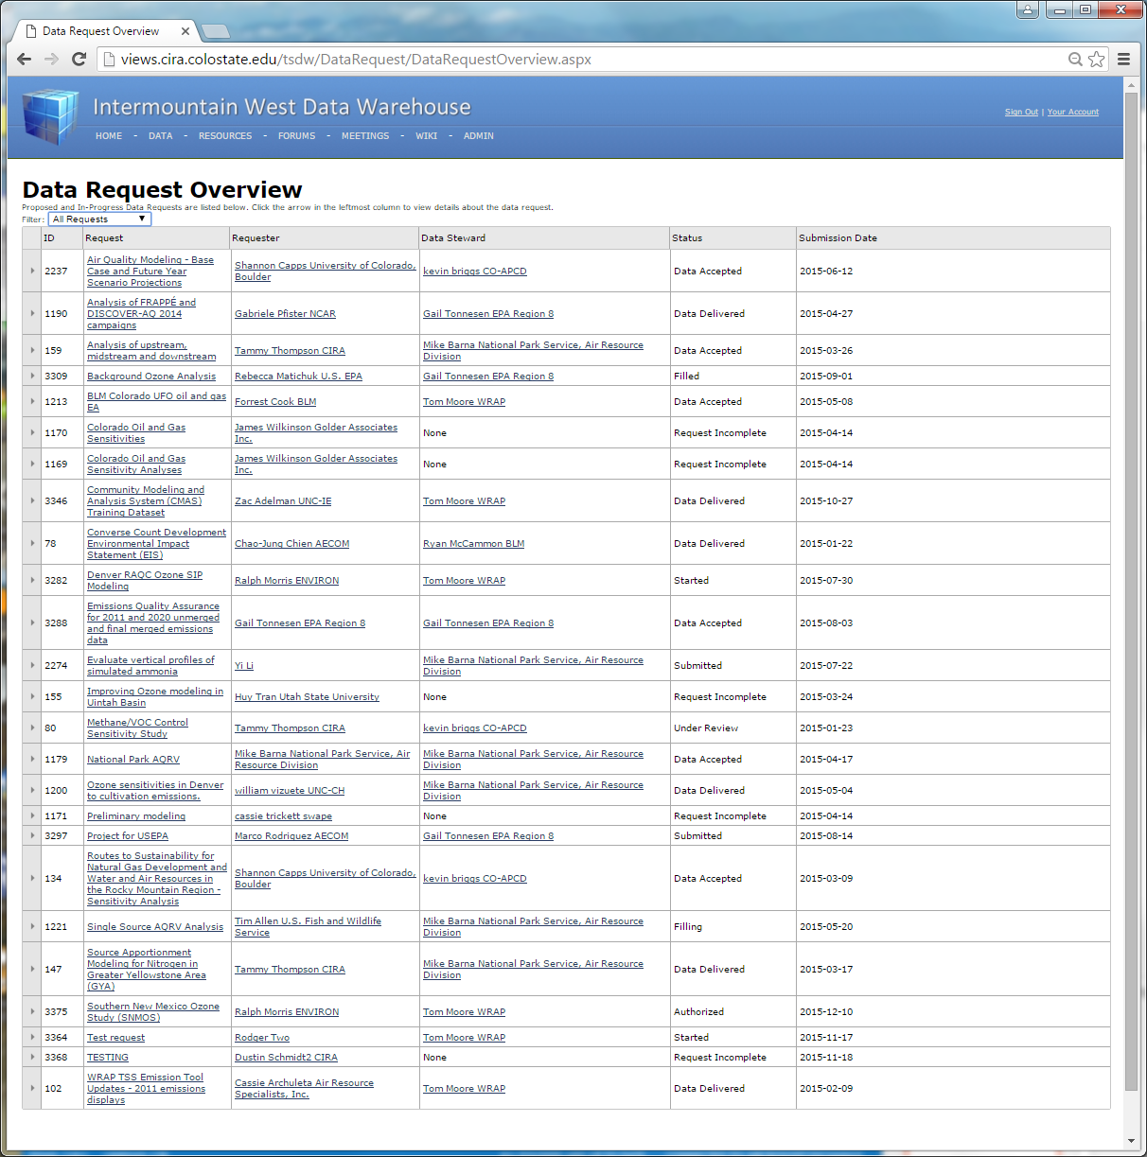
Website Revisions
Data Request Overview
Overview of Request traffic
Used by admins for request processing
Used by Project Stewards for review / authorization

Slide 24
IWDW update
Data Request Summary
New (Since Sept., 2015)
SNMOS (E-R) – 2011b CAMx
CMAS Training (UNC-IE) – 2011b CMAQ inputs
Project for USEPA (AECOM) – 2008b
Background Ozone Analysis (EPA R8) – 2011 WRF
Earlier (May-Aug., 2015)
Denver RAQC Ozone SIP (E-R) – 2011a
Ozone sensitivities in Denver to cultivation emissions (UNC) – 2008b
BLM CO UFO oil and gas EA (BLM CO) - 2011 WRF
Single Source AQRV Analysis (NPS) – 2008b
Analysis of FRAPPE and DISCOVER-AQ (CU) – 2011a
Methane VOC Control Sensitivity Study (CATF) – 2008b Future
SA Modeling for Nitrogen in GYA (CIRA) – 2011a
Earlier (Jan. – April, 2015)
6 projects
Earlier (July – Dec., 2014)
10 projects

