Slide 1



Three-State Air Quality Study (3SAQS)
Three-State Data Warehouse (3SDW)
3SAQS Pilot Project Modeling Overview
University of North Carolina (UNC-IE)
ENVIRON International Corporation (ENVIRON)
October 10, 2014

Slide 2
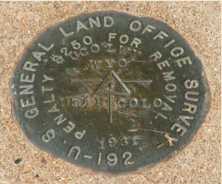
Summary
3SAQS Pilot Project Timeline and Deliverables
Emissions Inventory Improvements
Key Collaborations and Interactions
Modeling Highlights
  WRF Meteorology
  SMOKE Emissions
  CAMx Air Quality
Oil and Gas Inventories
Monitoring Network Analysis
3SDW Support and Tool Development
Status and Next Steps

Slide 3
3SAQS Pilot Project Timeline
JAN 2013
EI Improvement
Meetings With
CO, UT, WY
AUG 2012
CAMx 2008a
SEP 2014
SMOKE 2011a
OCT 2012
Pilot Project Start
FEB 2014
3SAQS Monitoring Network Report
NOV 2014-APR 2015
CAMx 2011 Sensitivities
FEB-MAY 2012
2008 EI Modeling
JUL 2014
Final 2008 Emissions
2012
2013
2014
OCT 2013
WRF 2011 Sensitivities
AUG 2014
CAMx 2008b, WRF 2011, 2011 Oil & Gas EI,
2011a Emissions
NOV-DEC 2012
CO, UT, WY
2008 EI Analysis and Evaluation
JUN 2012
Emissions VOC Reactivity Analysis
MAR-JUN 2014
2011 EI Modeling
OCT 2014
CAMx 2011a MPE

Slide 4
3SAQS Pilot Project Major Deliverables
Modeling Platforms
  Modeling input/output data, software, and scripts
  2008 version A and B
    SMOKE and CAMx
    Base and Future Year (2020)
  2011 version A
    WRF, SMOKE, and CAMx
    Base and Future Year (2020)
Emissions
  2011 O&G inventory
  Data updates for 3-state sources
  2008, 2011, 2020 inventories
    Fusion of NEI and 3-state inventories
Monitoring Network Assessment

Slide 5
3SAQS Pilot Project Major Deliverables
Key Analysis Products
  Inventory comparisons
  VOC reactivity analysis
  Model performance evaluations
    CAMx 2008
    WRF 2011
    CAMx 2011
  Methane inventory analysis
Modeling Sensitivities
  Boundary conditions
  US background air quality
  Ammonia emissions
  Oil and gas emissions
  Winter ozone

Slide 6
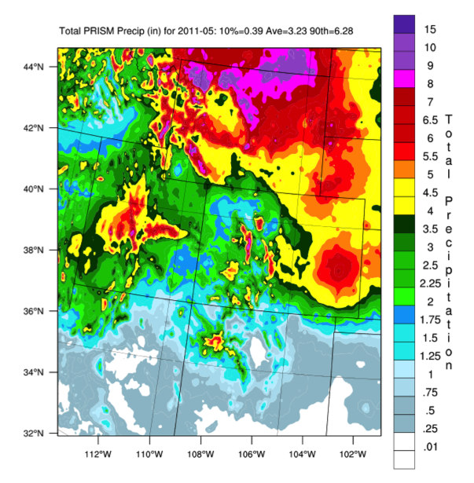
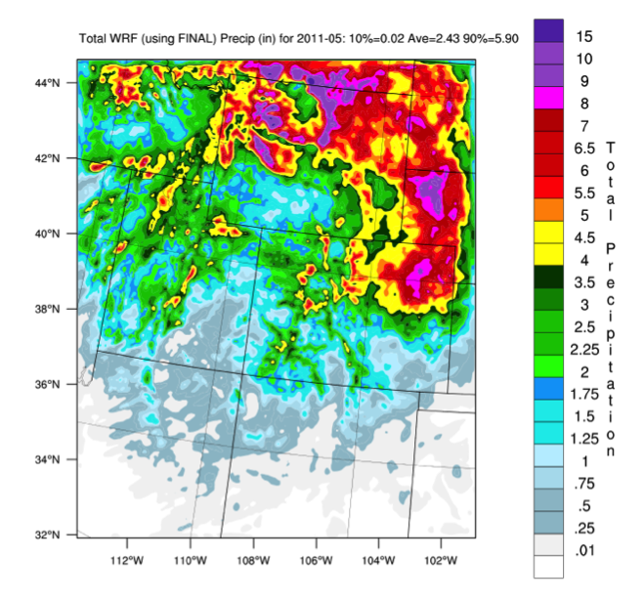
Key Findings: Meteorology
Completed 2011 WRF modeling and evaluation
2008 and 2011 WRF performance acceptable and comparable
WRF configuration based on systematic configuration testing
Episodic performance issues, particularly for winter inversions
Observed
May 2011
Total Precip (in.)
WRF
May 2011
Total Precip (in.)

Slide 7
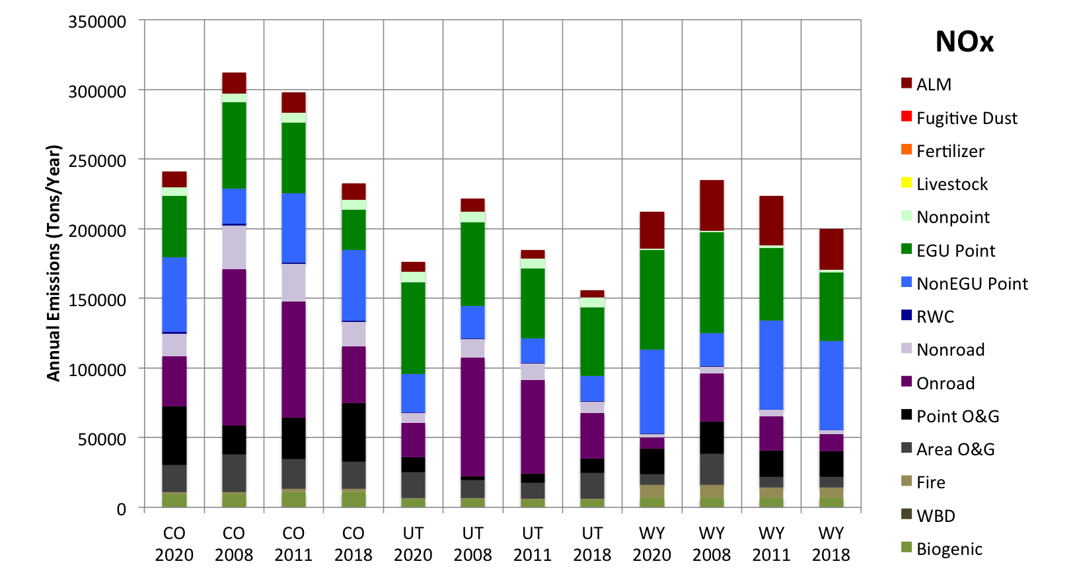
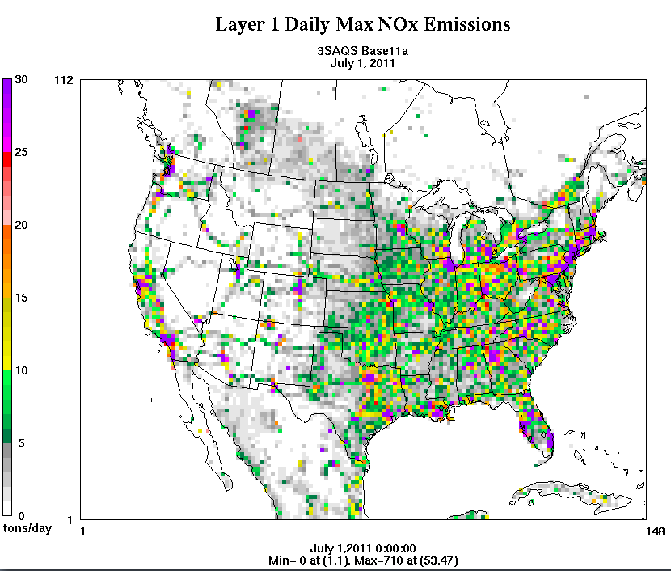
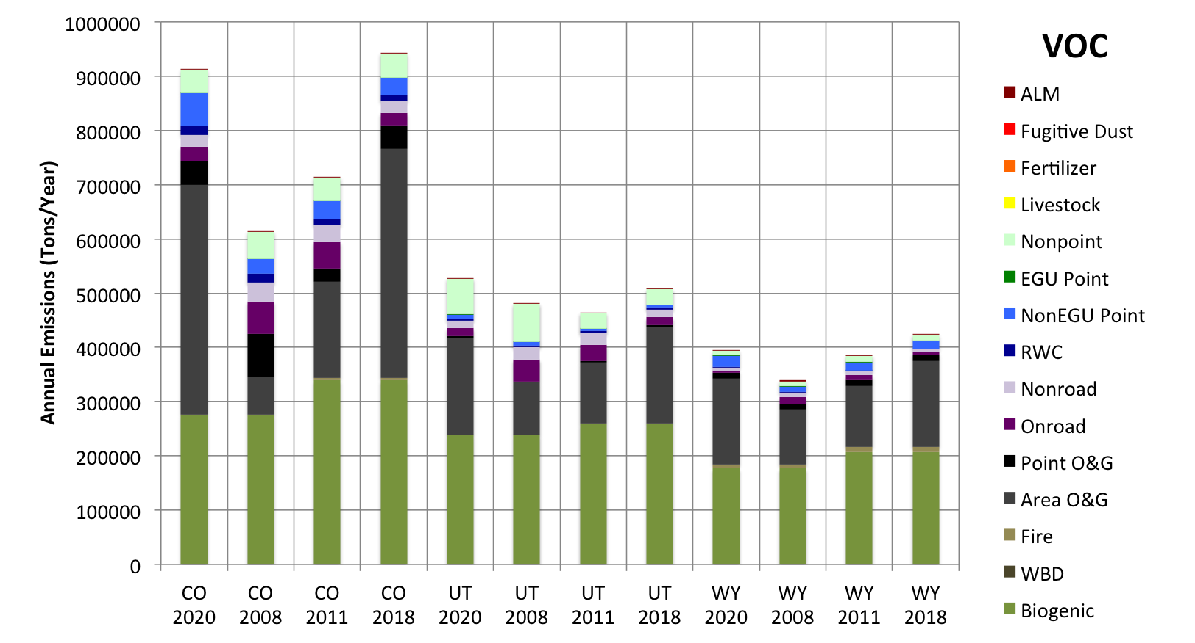
Key Findings: Emissions
New 2011 O&G EI
2008 > 2011 > 2020
  Trends vary by state/sector/pollutant
  General decrease in emissions through time
  Exception is VOC from O&G sources

Slide 8
Key Findings: Emissions
Collaboration with CO, UT, WY state DAQs to obtain data, review emissions, and get feedback on protocols/evaluations
Updates to key sectors/pollutants
  Agricultural NH3 – point CAFO locations used to improve the spatial allocation of livestock emissions
  On-road mobile – link-based VMT from CO used to improve spatial allocation of on-road mobile sources in CO
  Review of 3SAQS updates to temporal and chemical speciation profiles for nonroad and nonpoint sources

Slide 9
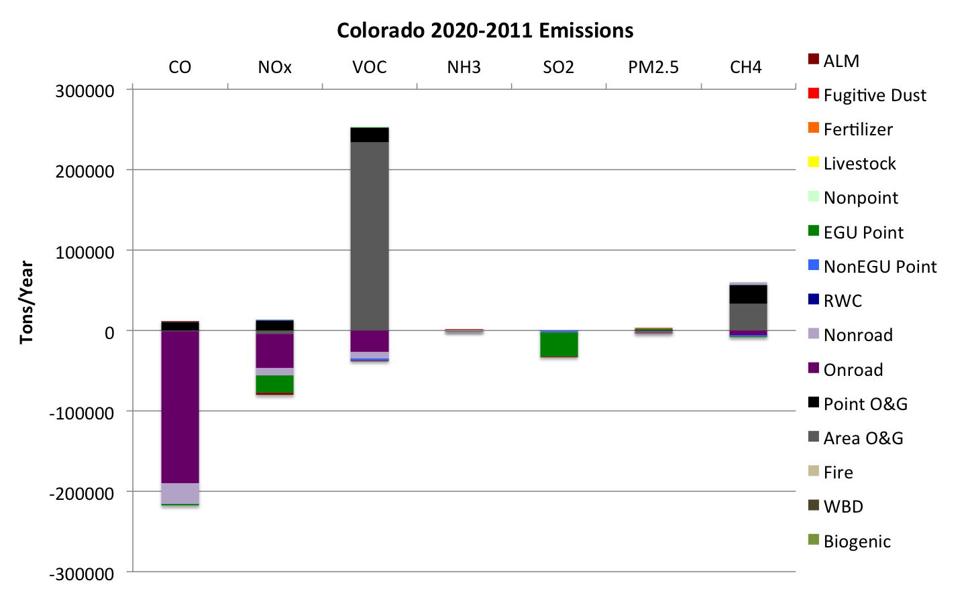
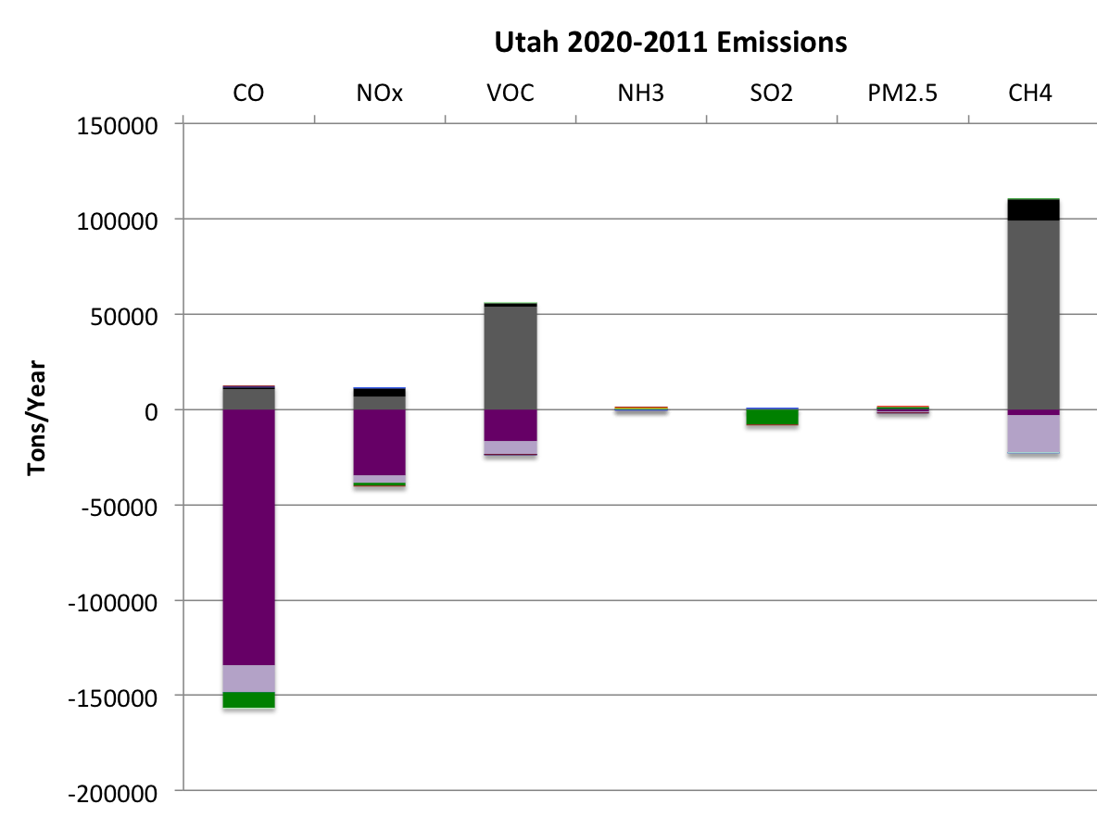
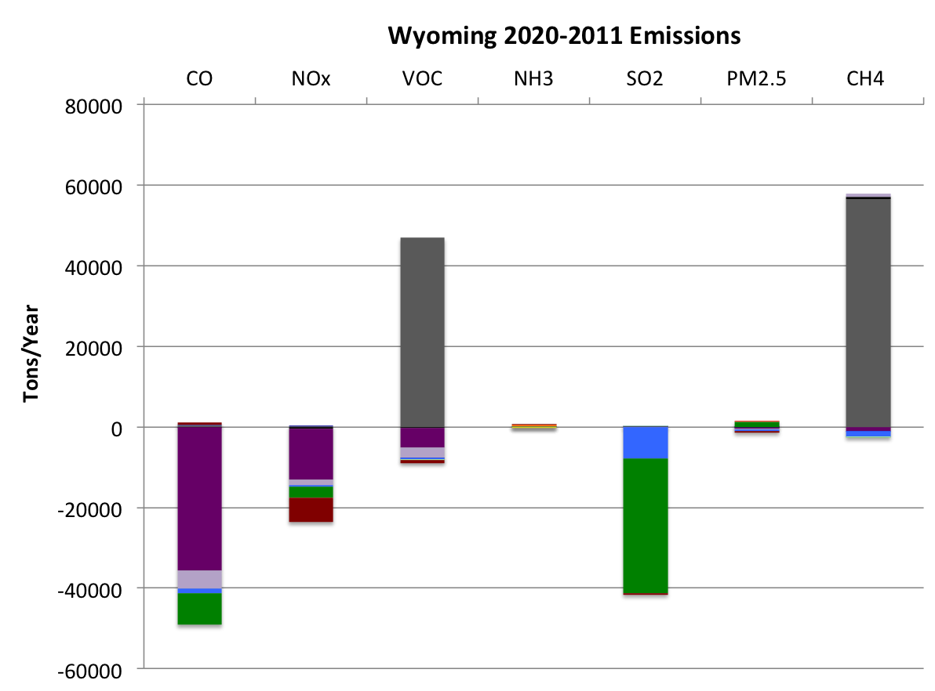
Key Findings: Emissions
2020 – 2011 Emissions
  Mostly decreases for all sectors/pollutants/states except O&G VOC/TOG
  Plots show differences by state (CO, UT, WY)

Slide 10
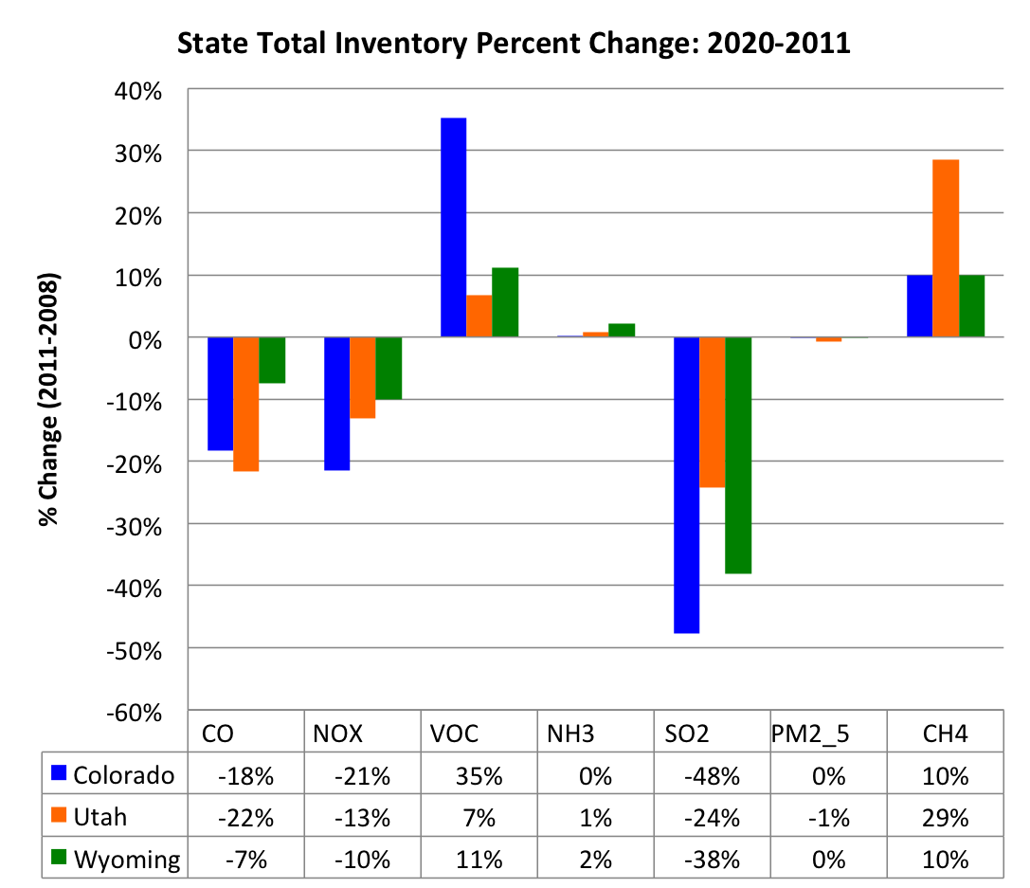
Key Findings: Emissions

Slide 11
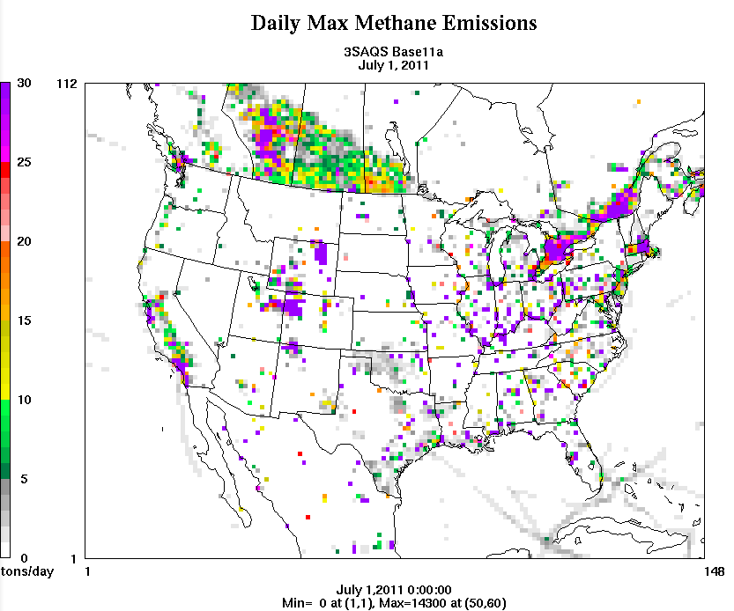
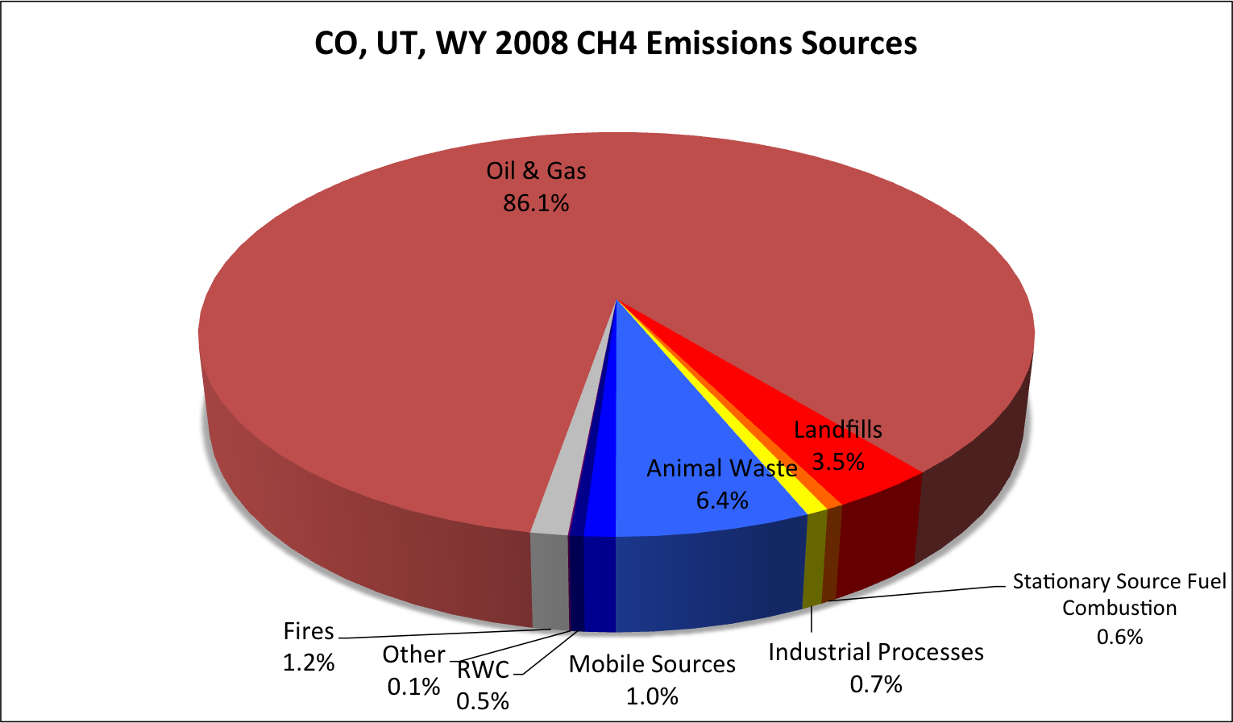
Key Findings: Emissions
Methane
  3SAQS one of the first U.S. regional CTM studies to look at active methane emissions
  Tracer for important regional emissions sectors (O&G and ag)
  O&G is the largest source in the current inventory
  Missing significant agricultural sources: enteric fermentation and livestock waste

Slide 12
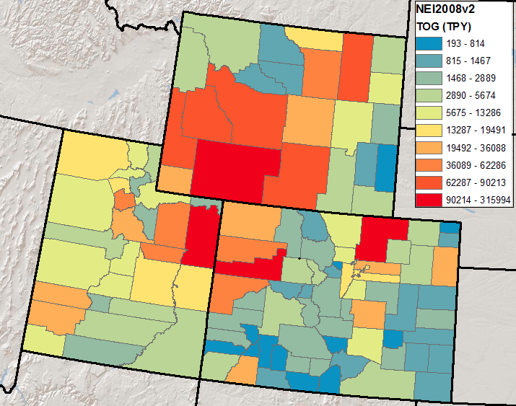
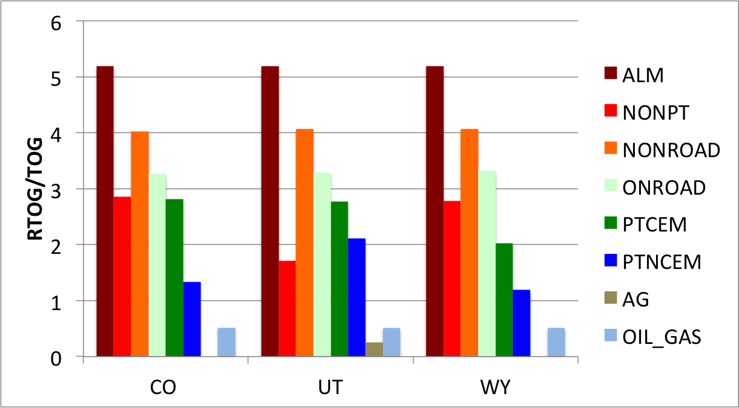
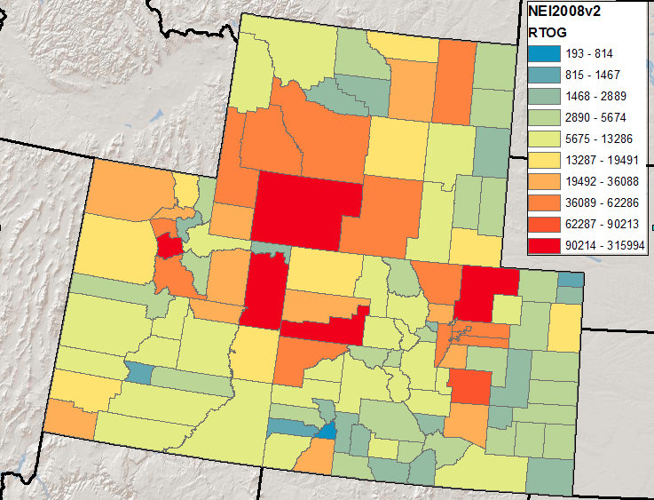
Key Findings: Emissions
Emissions Reactivity
RTOG = TOG * Profile Total MIR
RTOG/TOG = Relative emission reactivity

Slide 13
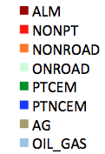
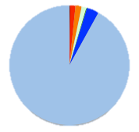
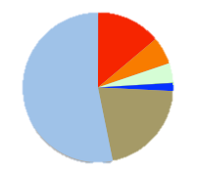
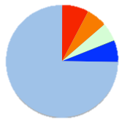
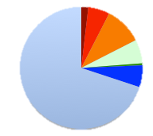
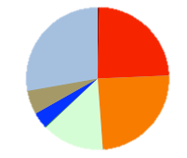

Key Findings: Emissions
Emissions Reactivity
  Reactivity-based analysis of inventories focuses on sources with greatest ozone formation potential
  Different sources are dominant using reactivity weighting vs. mass-based analysis
  Reactivity analysis is dependent on validity of inventory and chemical speciation

Slide 14
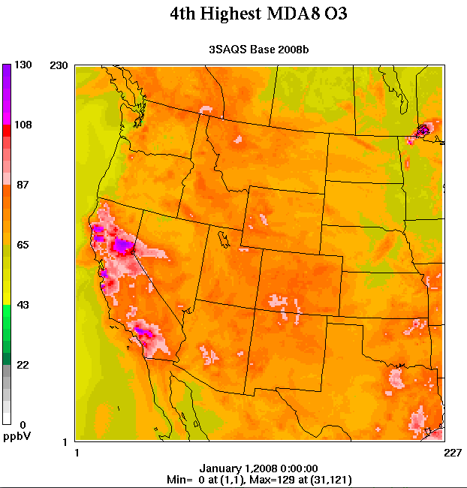
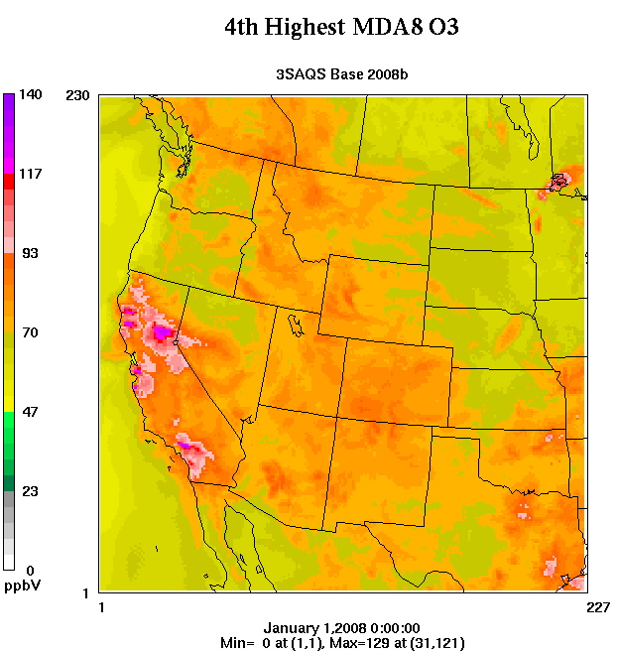
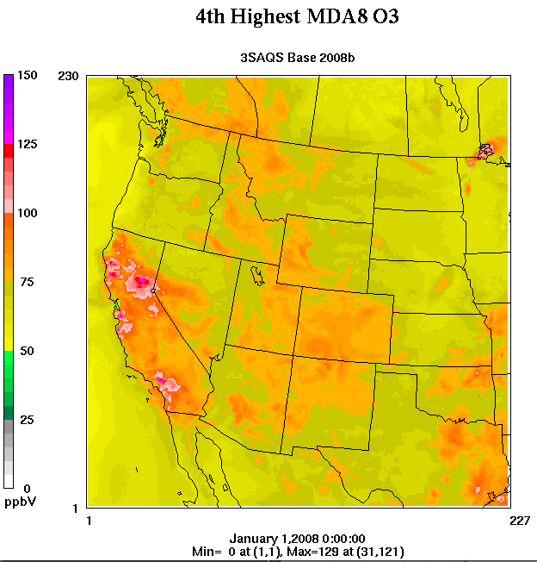
Key Findings: Air Quality
2008 Annual 4th Highest Daily Max 8-hour Average O3
65 ppb 70 ppb 75 ppb
Orange is the cutoff for different O3 standards

Slide 15
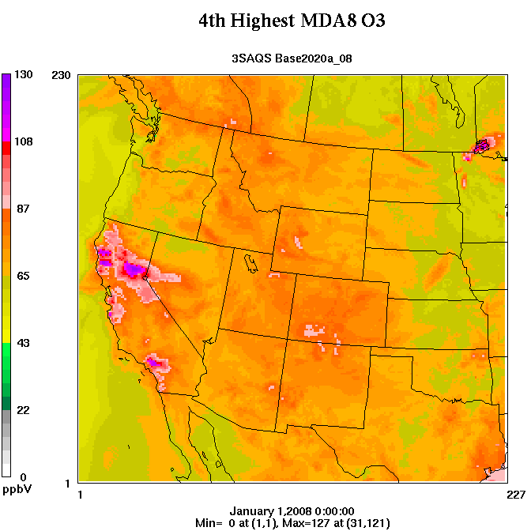
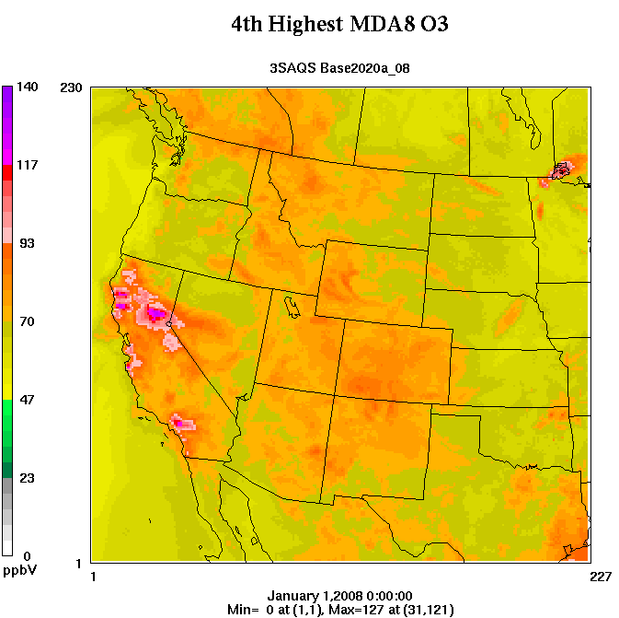
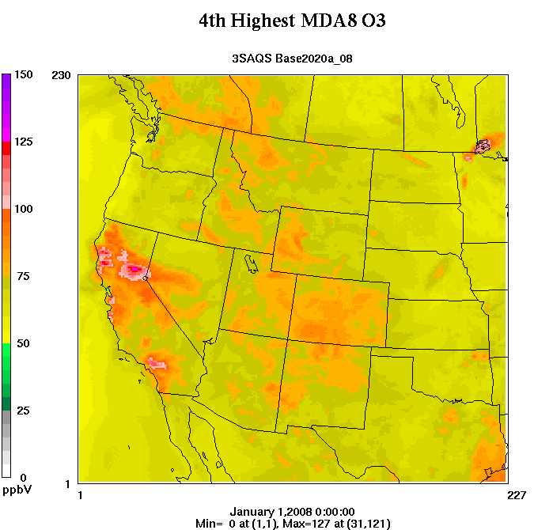
Key Findings: Air Quality
2020 Annual 4th Highest Daily Max 8-hour Average O3
65 ppb 70 ppb 75 ppb
Orange is the cutoff for different O3 standards

Slide 16
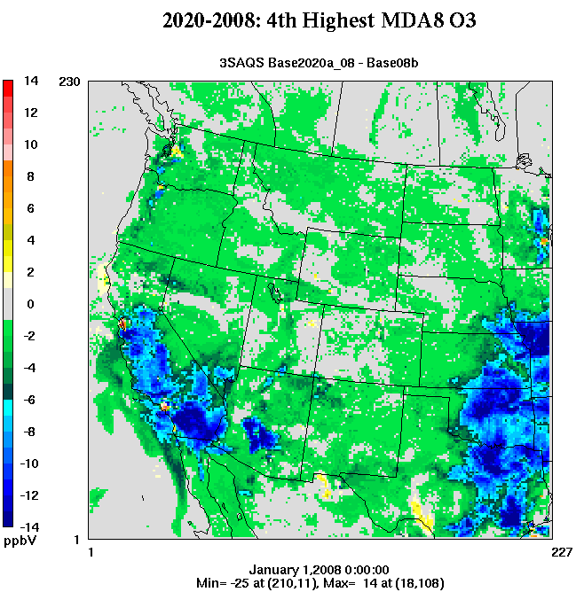
Key Findings: Air Quality
2020 - 2008
4th highest MDA8 O3 decreases up to 25 ppb
Widespread decreases of 1-3 ppb for most of the 3-state region
1-3 ppb increases in O&G development areas

Slide 17
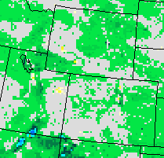
Key Findings: Air Quality
2020 - 2008
4th highest MDA8 O3 decreases up to 25 ppb
Widespread decreases of 1-3 ppb for most of the 3-state region
1-3 ppb increases in O&G development areas

Slide 18
Key Findings: Air Quality
2008 Annual 4th Highest Daily Max 8-hour Average O3
65 ppb 70 ppb 75 ppb
Orange is the cutoff for different O3 standards

Slide 19
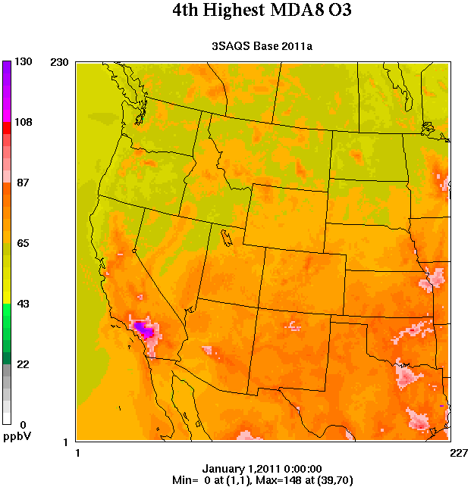
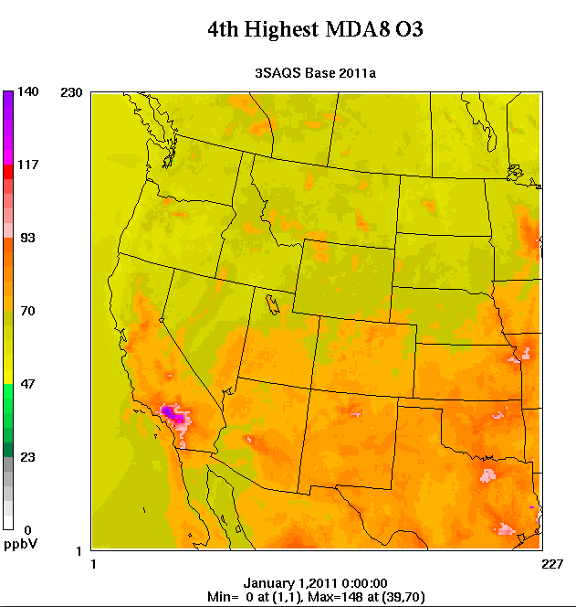
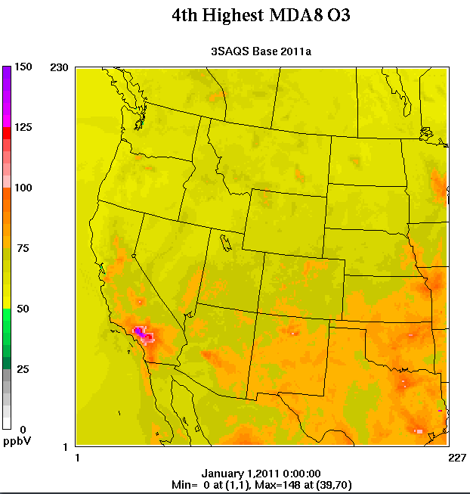
Key Findings: Air Quality
2011 Annual 4th Highest Daily Max 8-hour Average O3
65 ppb 70 ppb 75 ppb
Orange is the cutoff for different O3 standards

Slide 20
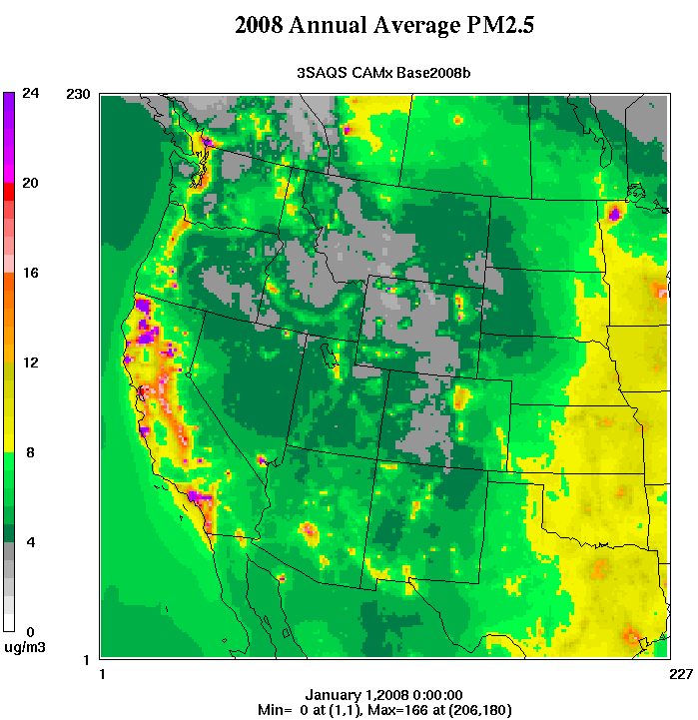
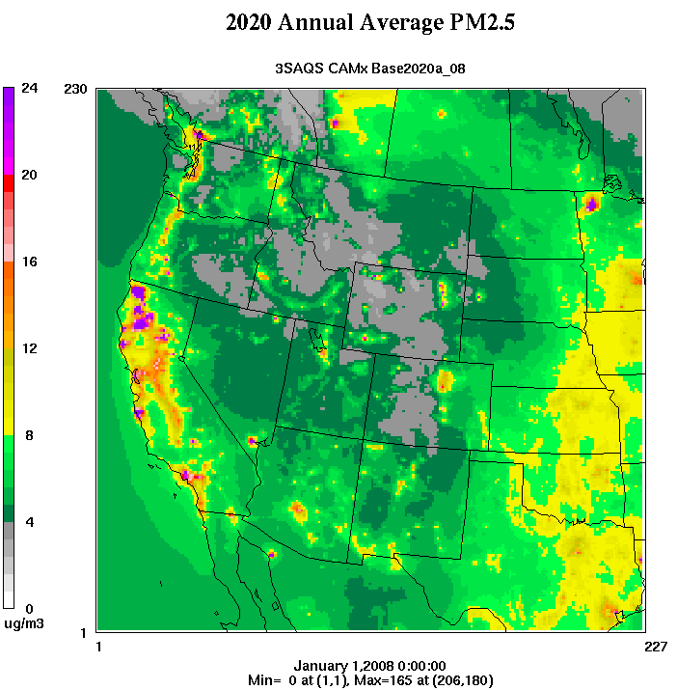
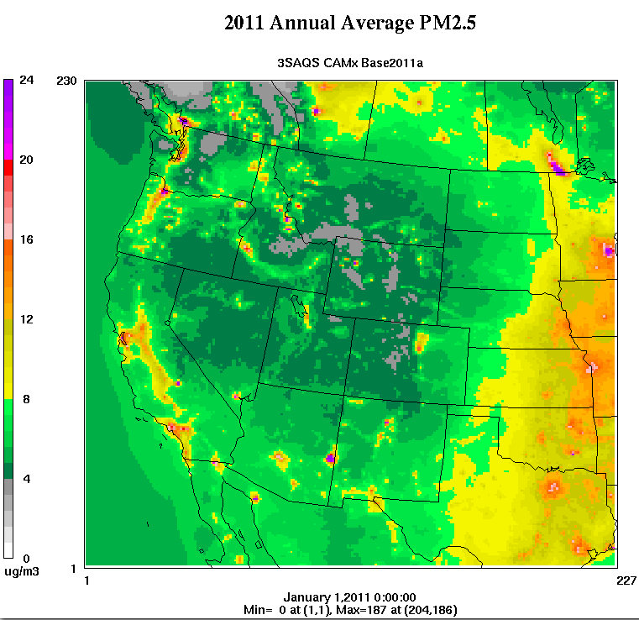
Key Findings: Air Quality
Annual Average PM2.5
2008 2020 (2008-based) 2011
Orange is the cutoff for 12 ug/m3

Slide 21
Oil and Gas Emissions Development Activities
2011 base year inventories developed for all major basins in the 3 states
  Uinta (UT)
  Piceance (CO)
  D-J (CO)
  All Wyoming Basins (WY)
  Raton Basin (CO/NM)
  Paradox Basin (UT)
  South San Juan Basin (NM)
2020 projections developed for all basins
2011/2020 emissions processed through SMOKE and model-ready

Slide 22
Oil and Gas Emissions Development Activities
2011 base year inventories provide updated county-level and by-source category NOx and VOC emissions
Developed by projecting older inventories forward to 2011 considering changes in production and activity, as well as regulatory effects on emission sources
Further projections conducted out to 2020 using historic development trends and forecasts, regulatory effects on inventories
Emissions processed and gridded using SMOKE including industry-specific speciation profiles and detailed spatial allocation of wells and production

Slide 23
Forecasting Activity to 2020
2020 gas production forecast in the Uinta Basin

Slide 24
Example Controls Analysis
Federal regulatory controls in the Piceance Basin in 2020

Slide 25
Oil and Gas Inventory Results for 2011/2020
* Permitted emissions only
Notes:
Will update in next base year and future year to reflect new rules that hit the books since the development of this inventory

Slide 26
Example Emissions by Source Category
2011 NOx emissions by source category in the D-J Basin

Slide 27
Example Emissions by Source Category
2011 VOC emissions by source category in the D-J Basin

Slide 28
Example Emissions by County
2011 NOx emissions by county in the Uinta Basin

Slide 29
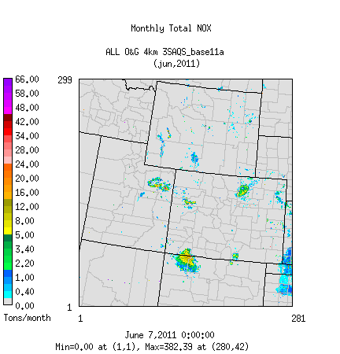
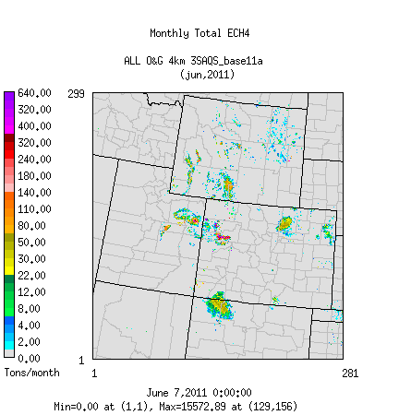
Example Processed and Gridded O&G Emissions
June 2011 gridded oil and gas emissions in 4-km modeling domain

Slide 30
Ongoing Oil and Gas Tasks and Next Steps
Ongoing work
  Data mining of US EPA Tribal Minor New Source Review (MNSR) data on tribal land to improve emissions sources
  Guidance document on incorporation of 3SAQS regional emissions into project analyses
Potential future work
  Improved projection methodologies for midstream and other permitted sources or sources provided by state agencies
  Additional survey efforts to update key source category data in key basins

Slide 31
Monitoring Network Assessment Recommendations
Operations Through 2017
Assessment of ozone monitoring data, meteorology, and unmonitored areas, as well as expected changes in emissions indicate that the existing 3SAQS cooperator group-funded site locations/areas should continue operating through 2017.
Recommending slight changes to some existing site locations, as well as adding new sites.
There are two sets of recommendations, for calendar 2014 and for 2015 to 2017.
Assessment was reviewed and approved by the Steering Committee in May 2014.
  Final assessment materials available on the 3-State Data Warehouse website (http://views.cira.colostate.edu/documents/Projects/TSDW/Projects/MonitoringNetworkAssessment/)
Notes:
Steering Committee formed Network Assessment WG for this effort.
Met 10 times October 2013 through Feb. 2014 by phone and at Technical Workshop to conduct Assessment.
Many calls with sub-groups of cooperating agencies.
Note that this was reviewed and approved by the steering committee

Slide 32
Prototype Web-Based Source Apportionment Visualization Tool
Develop on-line tool for the 3SDW that can visualize ozone and PM source apportionment modeling results
Use WestJumpAQMS state-specific and source category-specific ozone source apportionment results to test the tool
  Daily maximum 8-hour ozone for Geographic (state-specific) and Source Category SA runs
In 3SAQS will expand from 10 highest ozone days to all days and monitors in domain

Slide 33
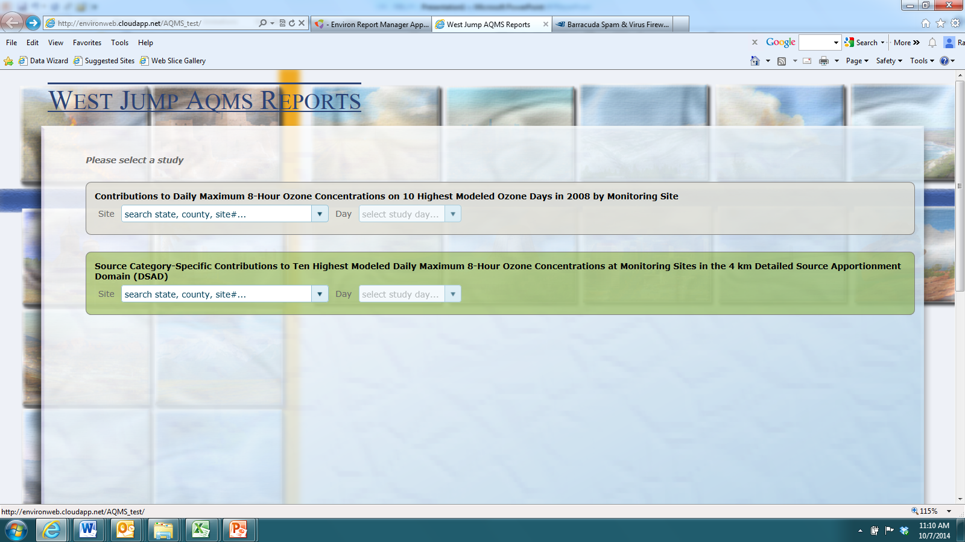
SrcApp Visualization Selection
Currently two options

Slide 34
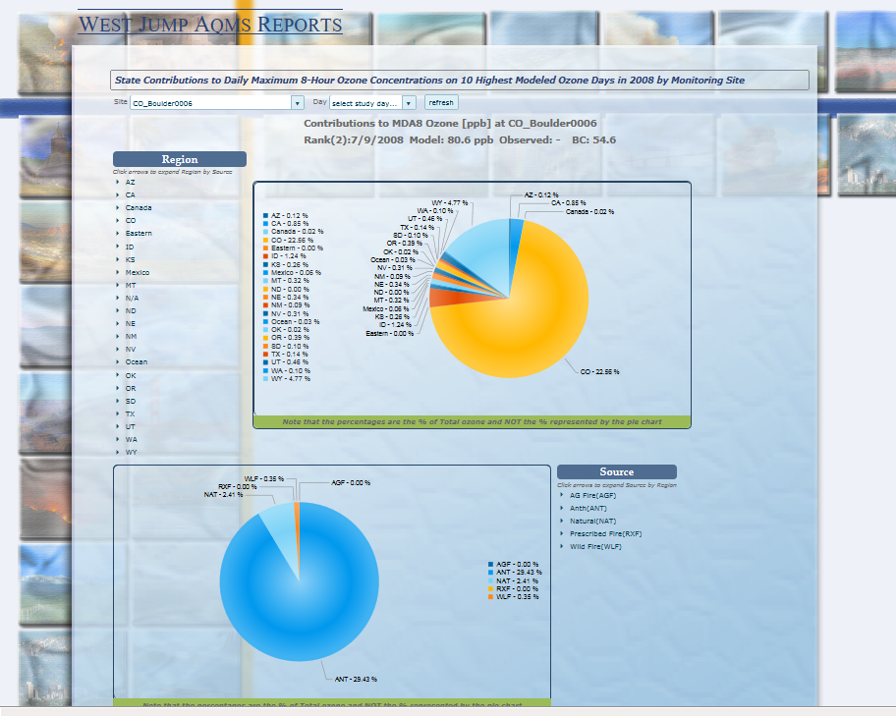
Select Rocky Flats North, CO on July 9, 2008
← Geographic
← Source Category

Slide 35
Web-Based SA Visualization Tool
Refine prototype SA visualization tool
Populate with 3SAQS CAMx and CMAQ SA runs when available
  Daily maximum 8-hour ozone and 24-hour PM2.5 concentrations at all monitors in domain
  Annual deposition and daily visibility impairment at IMPROVE monitors
Implement on 3SDW

Slide 36
Status and Next Steps
Pilot study modeling work status
Plans for October 2014 – April 2015
  2011 CMAQ modeling
  2011 AQ sensitivity modeling
    Boundary Conditions
    Background Air Quality
    Oil & Gas
    Winter Ozone
    Ammonia
    Vertical Transport
    MOVES2014
Reference 9/30 presentation

Slide 37
3SAQS Pilot Study Modeling Status
Deliverable | Status
2008 Modeling Platform
2008 Modeling Protocol | Completed (4/2014)
SMOKE 36/12-km 2008a | Completed (5/2014)
SMOKE 36/12-km 2008b | Completed (7/2014)
CAMx 36/12-km 2008b | Completed (8/2014)
CAMx 2008a MPE Report | Ready for Review (9/2014)
SMOKE 36/12-km 2020a_08 | Completed (7/2014)
CAMx 36/12-km 2020a_08 | Completed (8/2014)
2011 Modeling Platform
2011 Modeling Protocol | Completed (7/2014)
WRF 36/12/4-km 2011a | Completed (5/2014)
WRF 2011 MPE Report | Ready for Review (8/2014)
SMOKE 36/12/4-km 2011a | Completed (8/2014)
CAMx 36/12/4-km 2011a | Completed (9/2014)
CAMx 36/12/4-km 2020a_11 | Running (11/2014)

Slide 38
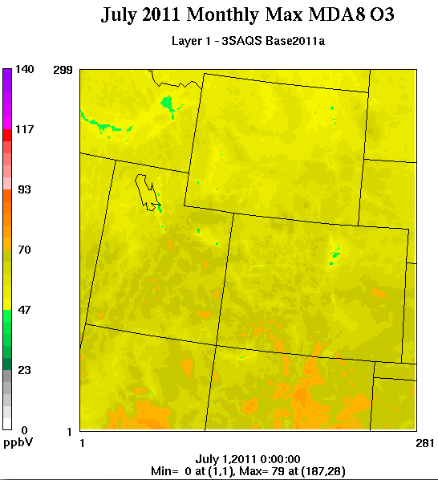
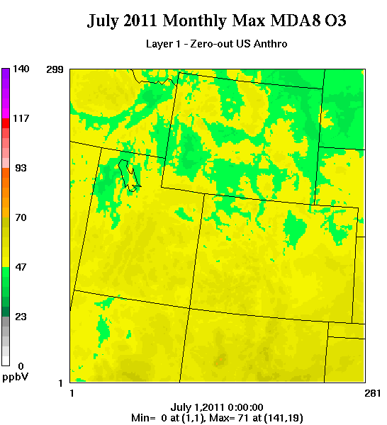
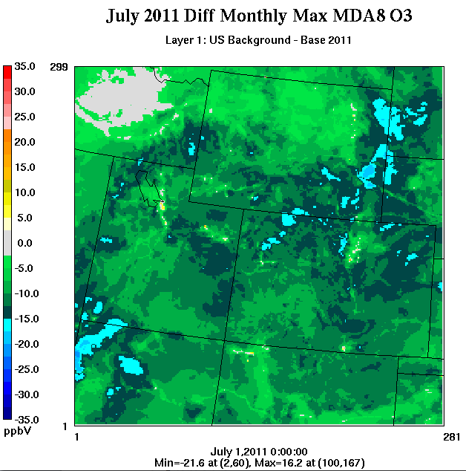
2011 US Background Air Quality
July 2011 US Background

